Slide 1
Lecture 6: Divide and Conquer
Nathan Brunelle

Slide 2
Homeworks
HW 1 feedback expected Thursday
HW 2 out, due Friday 11:59pm.

Slide 3
Motivating Example

Slide 4
Trominos Tiling
Given an 8x8 grid with 1 cell missing, can we exactly cover it with “trominoes”?
Can you cover this?
With these?

Slide 5

Trominoes Puzzle - Generalizing
$$2^{n}$$
$$2^{n}$$
What about larger boards?

Slide 6
Trominoes Puzzle Solution – Step 1
Divide the board into quadrants

Slide 7
Trominoes Puzzle Solution – Step 2
Place a tromino to occupy the three quadrants without the missing piece

Slide 8
Trominoes Puzzle Solution – Step 3
Each quadrant is now a smaller subproblem

Slide 9
Trominoes Puzzle Solution – Step 4
Solve Recursively

Slide 10
Divide and Conquer

Slide 11
Trominoes Puzzle Solution

Slide 12
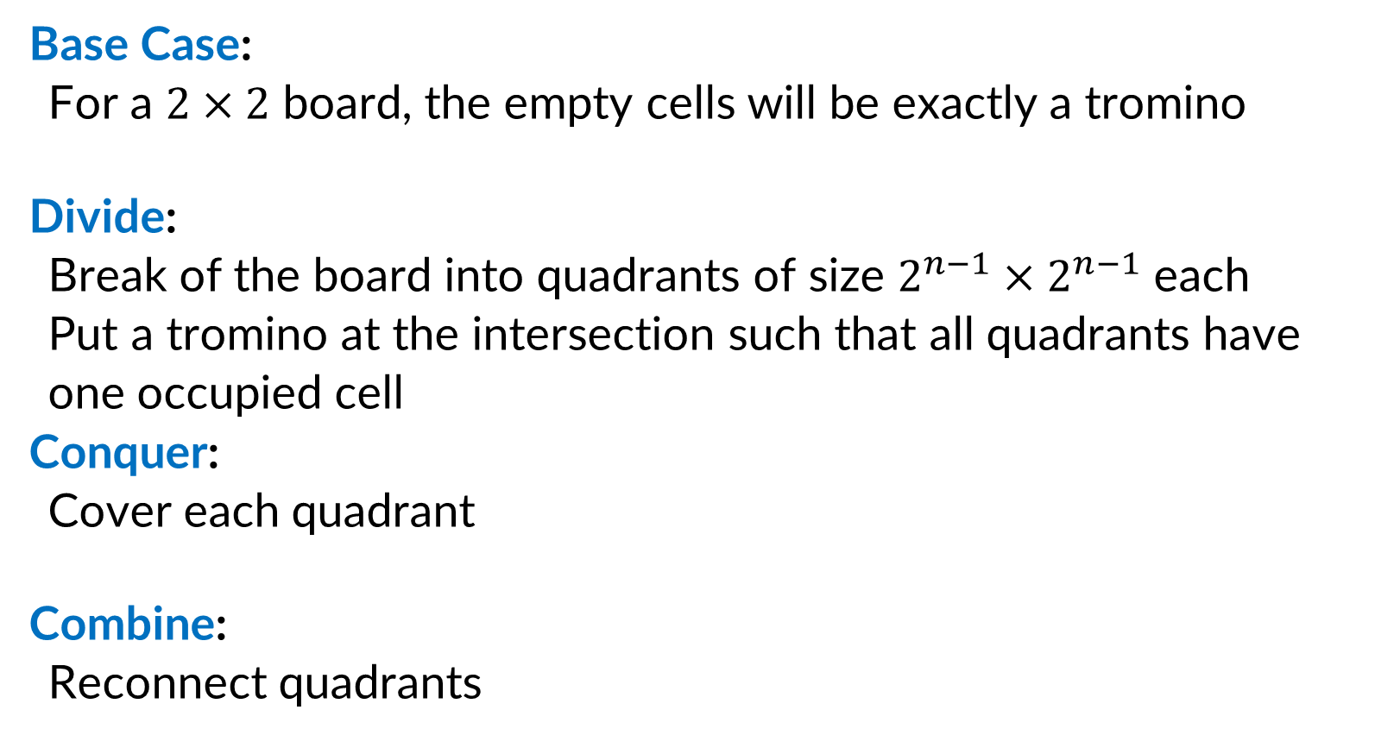
Divide and Conquer (Trominoes)
Base Case:
For a $2×2$ board, the empty cells will be exactly a tromino
Divide:
Break of the board into quadrants of size $2^{n−1}×2^{n−1}$ each
Put a tromino at the intersection such that all quadrants have one occupied cell
Conquer:
Cover each quadrant
Combine:
Reconnect quadrants

Slide 13
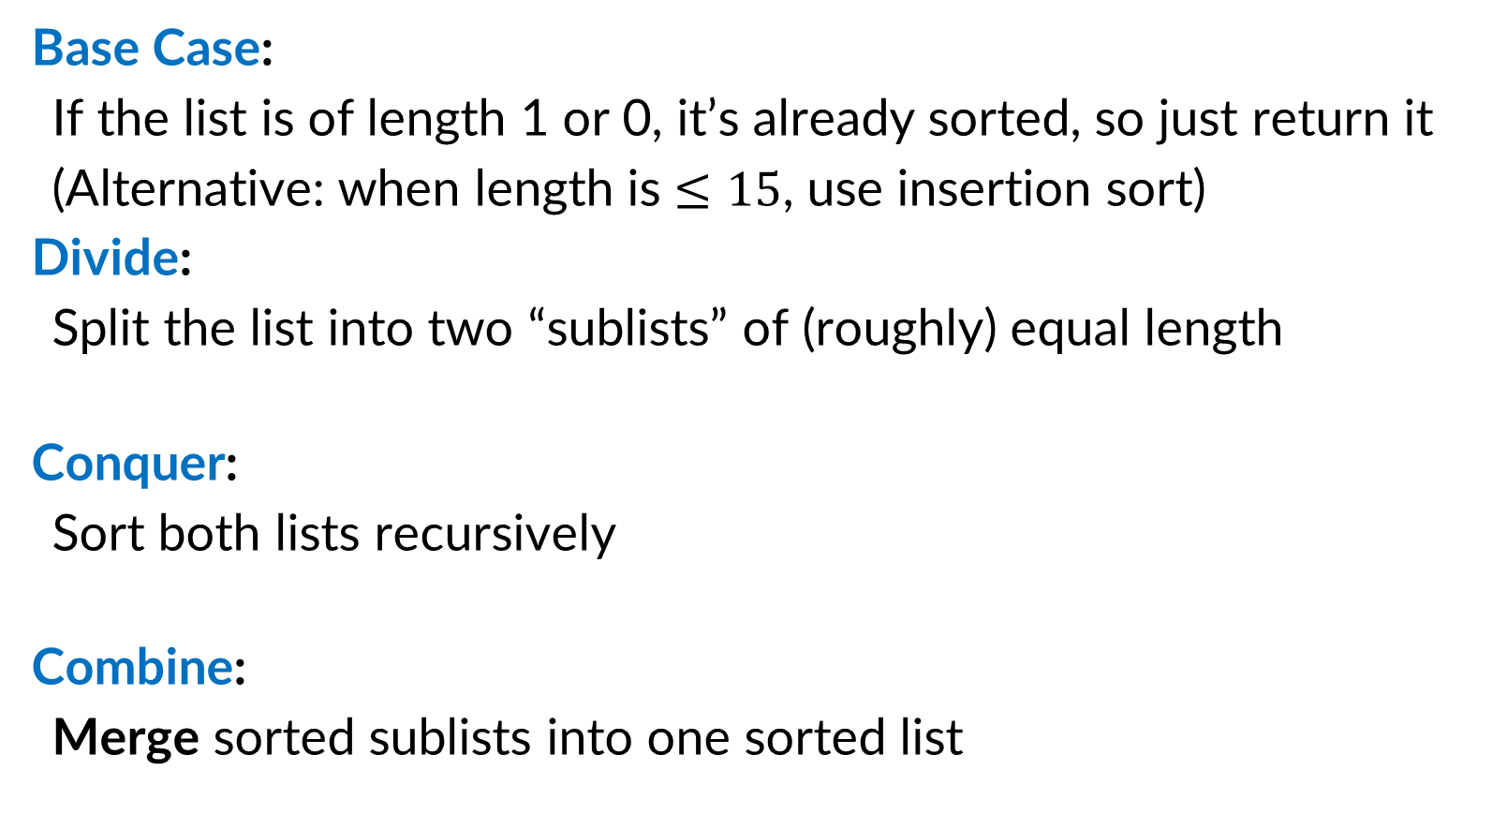
Divide and Conquer (Merge Sort)
Base Case:
If the list is of length 1 or 0, it’s already sorted, so just return it
(Alternative: when length is $≤15$, use insertion sort)
Divide:
Split the list into two “sublists” of (roughly) equal length
Conquer:
Sort both lists recursively
Combine:
Merge sorted sublists into one sorted list
5
5
8
2
9
4
1
2
5
8
1
4
9
2
5
8
1
4
9
1
2
4
5
8
9

Slide 14

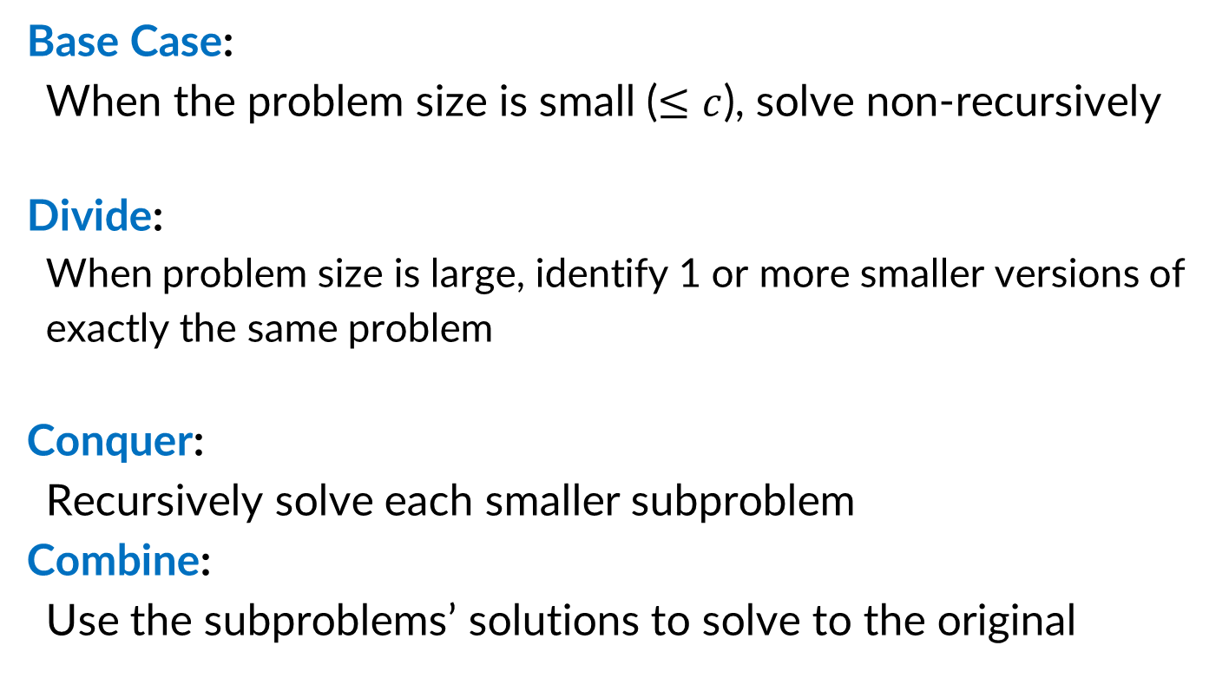
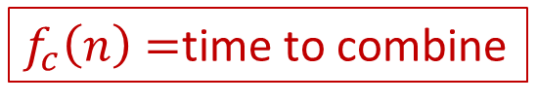

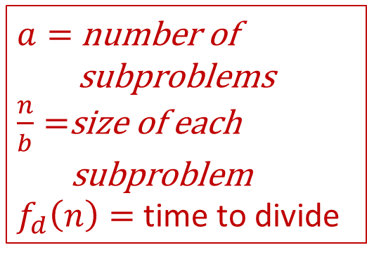
Divide and Conquer (Running Time)
$$T\left(c\right)=k$$
Base Case:
When the problem size is small ($≤c$), solve non-recursively
Divide:
When problem size is large, identify 1 or more smaller versions of exactly the same problem
Conquer:
Recursively solve each smaller subproblem
Combine:
Use the subproblems’ solutions to solve to the original
$a=$ number of
subproblems
$\frac{n}{b}=$size of each
subproblem
$f_{d}\left(n\right)=$ time to divide
$$a⋅T\left(\frac{n}{b}\right)$$
$f_{c}\left(n\right)=$time to combine
Overall: $T\left(n\right)=aT\left(\frac{n}{b}\right)+f\left(n\right)$ where $f\left(n\right)=f_{d}\left(n\right)+f_{c}(n)$

Slide 15

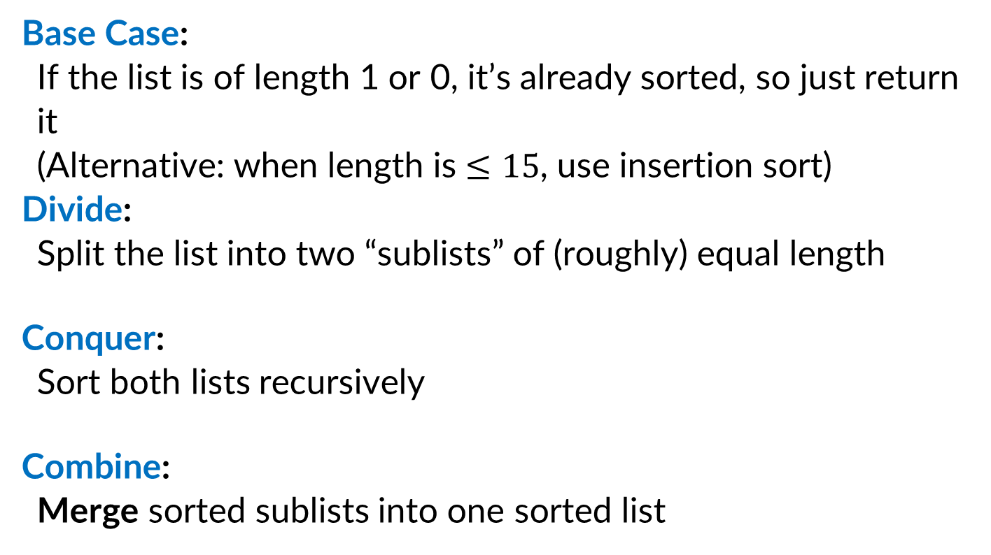
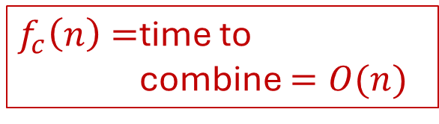

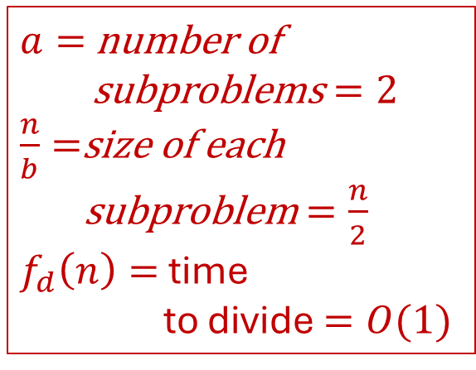
Merge Sort Running Time
$$T\left(c\right)=k$$
Base Case:
If the list is of length 1 or 0, it’s already sorted, so just return it
(Alternative: when length is $≤15$, use insertion sort)
Divide:
Split the list into two “sublists” of (roughly) equal length
Conquer:
Sort both lists recursively
Combine:
Merge sorted sublists into one sorted list
$a=$ number of
subproblems $=2$
$\frac{n}{b}=$size of each
subproblem $=\frac{n}{2}$
$f_{d}\left(n\right)=$ time
to divide $=O(1)$
$$2T\left(\frac{n}{2}\right)$$
$f_{c}\left(n\right)=$time to
combine $=O(n)$
Overall: $T\left(n\right)=aT\left(\frac{n}{b}\right)+f\left(n\right)$ where $f\left(n\right)=f_{d}\left(n\right)+f_{c}(n)$

Slide 16
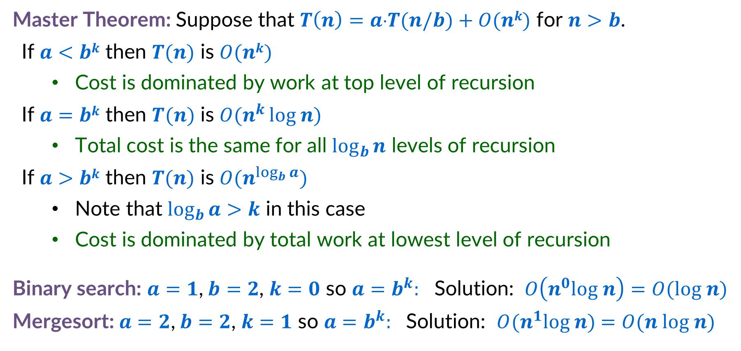
Master Theorem
Master Theorem: Suppose that $T\left(n\right)=a⋅T(n/b)+O(nk)$ for $n>b$.
If $a<bk$ then $T(n)$ is $O(nk)$
Cost is dominated by work at top level of recursion
If $a=bk$ then $T(n)$ is $O(n^{k }log n)$
Total cost is the same for all $\log_{b}{n}$ levels of recursion
If $a>bk$ then $T(n)$ is $O(n^{\log_{b}{a}})$
Note that $\log_{b}{a>k}$ in this case
Cost is dominated by total work at lowest level of recursion
Binary search: $a=1$,$b=2$, $k=0$ so $a=b^{k}:$ Solution: $O\left(n^{0}log n\right)=O(log n)$
Mergesort: $a=2$,$b=2$, $k=1$ so $a=b^{k}:$ Solution: $O(n^{1}log n)$ $=O(n log n)$

Slide 17
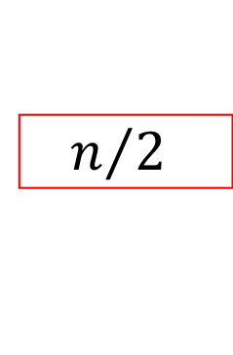


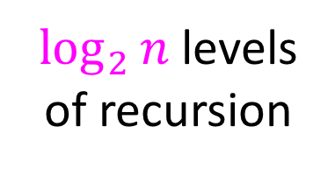




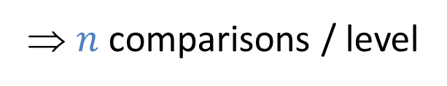



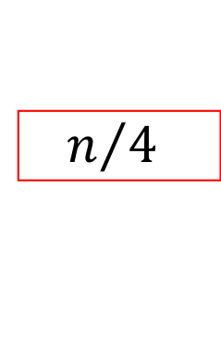
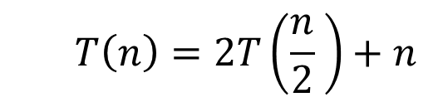








Visualizing the Merge Sort Recurrence
$$T\left(n\right)=2T\left(\frac{n}{2} \right)+n$$
Red box represents a problem instance
Blue value represents time spent at that level of recursion
$$n$$
⇒ $n$ comparisons / level
$$n$$
$$n/2$$
$$\frac{n}{2}$$
$$n/2$$
$$\frac{n}{2}$$
$$\frac{n}{4}$$
$$\frac{n}{4}$$
$$\frac{n}{4}$$
$$\frac{n}{4}$$
$\log_{2}⁡n$ levels
of recursion
$$n/4$$
$$n/4$$
$$n/4$$
$$n/4$$
…
…
…
…
…
$$1$$
$$1$$
$$1$$
$$1$$
$$1$$
$$1$$
$$1$$
$$1$$
$$1$$
$$1$$
$$1$$
$$1$$
$$T\left(n\right)=Θ\left(n\log{n}\right)$$

Slide 18


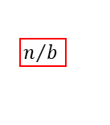
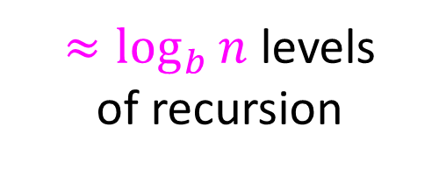

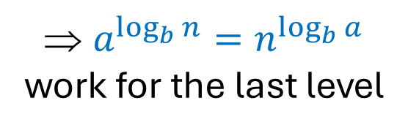



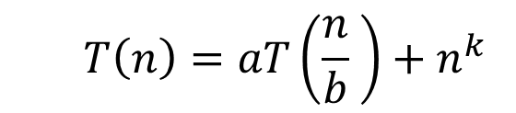
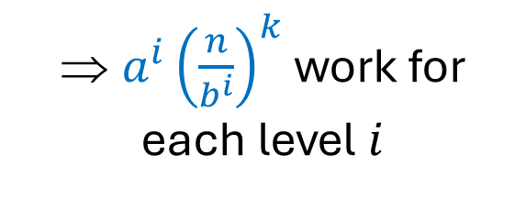

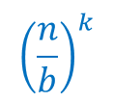









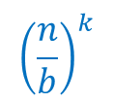








Visualizing Generic Recurrence
$$T\left(n\right)=aT\left(\frac{n}{b} \right)+n^{k}$$
Red box represents a problem instance
$$n^{k}$$
$$n$$
Blue value represents time spent at that level of recursion
⇒ $a^{i}{\left(\frac{n}{b^{i}}\right)}^{k}$ work for each level $i$
…
$a$ children
$${\left(\frac{n}{b}\right)}^{k}$$
$$n/b$$
$$n/b$$
$${\left(\frac{n}{b}\right)}^{k}$$
$$n/b$$
$$n/b$$
…
…
$${\left(\frac{n}{b^{2}}\right)}^{k}$$
$${\left(\frac{n}{b^{2}}\right)}^{k}$$
$${\left(\frac{n}{b^{2}}\right)}^{k}$$
$≈\log_{b}⁡n$ levels
of recursion
$$n/{b^{2}}$$
$${\left(\frac{n}{b^{2}}\right)}^{k}$$
$$n/{b^{2}}$$
$$n/{b^{2}}$$
$$n/{b^{2}}$$
…
…
…
…
…
$$x$$
$$c$$
$$x$$
$$c$$
$$x$$
c
$$x$$
$$c$$
$$x$$
$$c$$
$$x$$
$$c$$
⇒ $a^{\log_{b}{n}}=n^{\log_{b}{a}}$ work for the last level
$T\left(n\right)=???$ Depends on how quickly the number of boxes increases vs. how quickly the running time of each decreases

Slide 19
In comes the Master Theorem!
Master Theorem: Suppose that $T\left(n\right)=a⋅T(n/b)+O(nk)$ for $n>b$.
If $a<bk$ then $T(n)$ is $O(nk)$
Cost is dominated by work at top level of recursion
If $a=bk$ then $T(n)$ is $O(n^{k }log n)$
Total cost is the same for all $\log_{b}{n}$ levels of recursion
If $a>bk$ then $T(n)$ is $O(n^{\log_{b}{a}})$
Note that $\log_{b}{a>k}$ in this case
Cost is dominated by total work at lowest level of recursion
Binary search: $a=1$,$b=2$, $k=0$ so $a=b^{k}:$ Solution: $O\left(n^{0}log n\right)=O(log n)$
Mergesort: $a=2$,$b=2$, $k=1$ so $a=b^{k}:$ Solution: $O(n^{1}log n)$ $=O(n log n)$

Slide 20
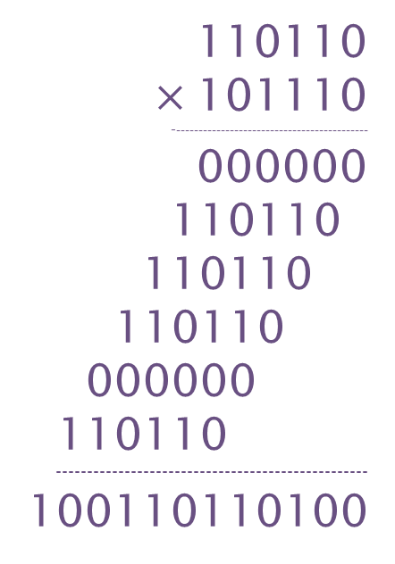
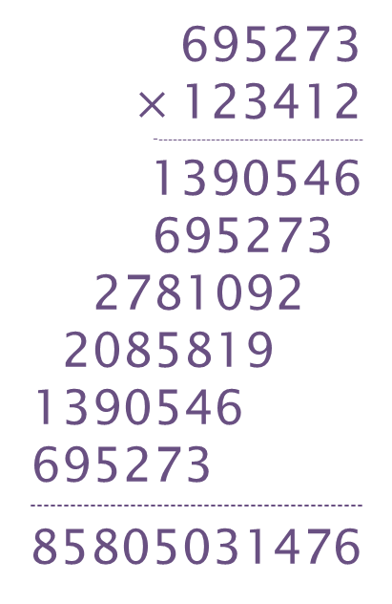
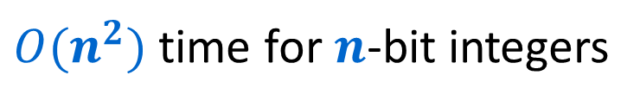
Integer Multiplication
695273
$×$123412
--------------------------------------------
1390546
695273
2781092
2085819
1390546
695273
--------------------------------------------------
85805031476
110110
$×$101110
--------------------------------------------
000000
110110
110110
110110
000000
110110
--------------------------------------------------
100110110100
Elementary school algorithm
$O(n^{2})$ time for $n$-bit integers
Decimal
Binary

Slide 21






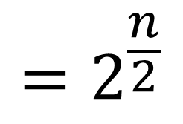


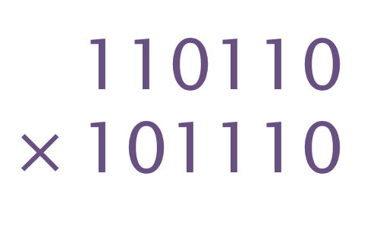
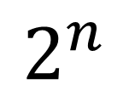





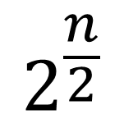

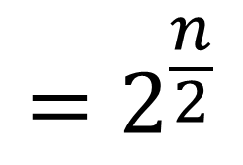


Divide and Conquer method
$$=2^{\frac{n}{2}}$$
110110
$×$101110
$$x_{1}$$
+
$$x_{2}$$
$$x_{1}$$
$$x_{2}$$
$$=2^{\frac{n}{2}}$$
$$y_{1}$$
$$y_{2}$$
$$y_{1}$$
+
$$y_{2}$$
$$2^{n}$$
( )
+
$$x_{1}$$
$$×$$
$$y_{1}$$
$$2^{\frac{n}{2}}$$
( )
+
$$x_{1}$$
$$×$$
$$y_{2}$$
+
$$x_{2}$$
$$×$$
$$y_{1}$$
( )
$$x_{2}$$
$$×$$
$$y_{2}$$

Slide 22







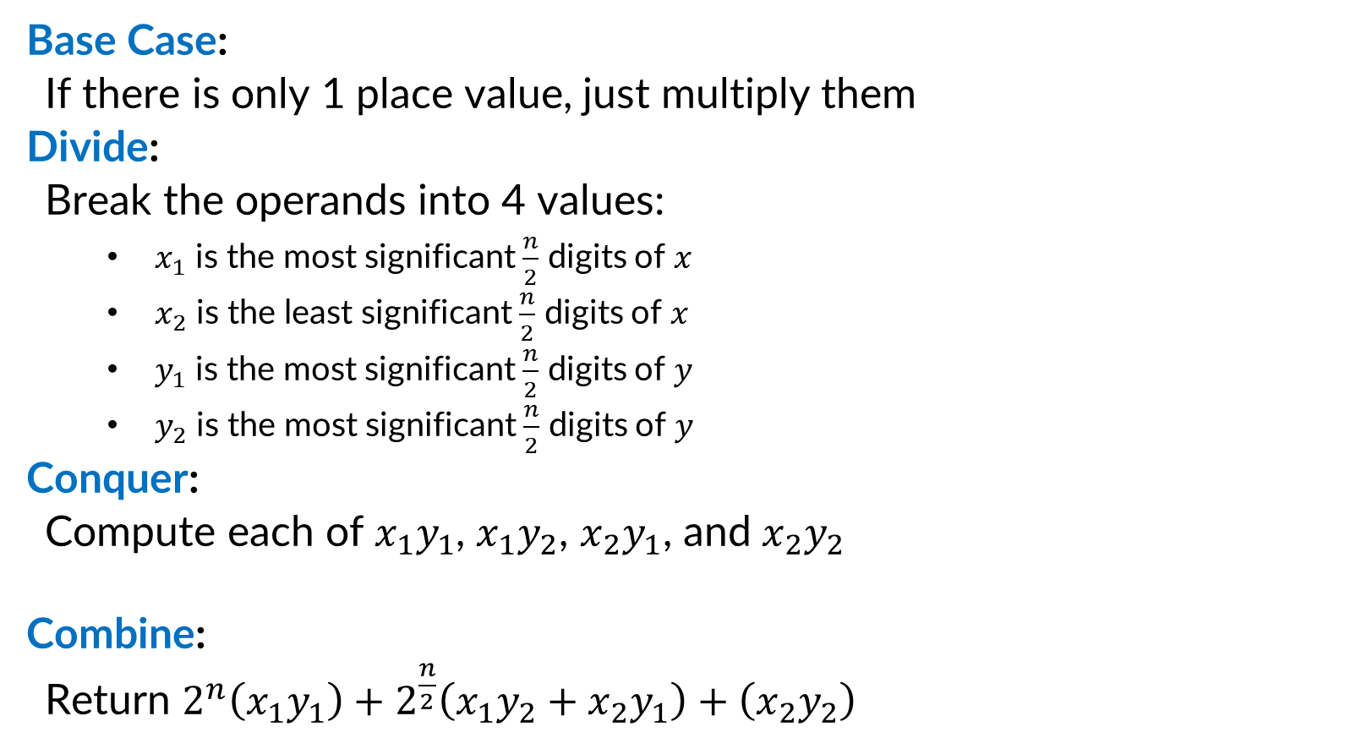









Divide and Conquer (Integer Multiplication)
Base Case:
If there is only 1 place value, just multiply them
Divide:
Break the operands into 4 values:
$x_{1}$ is the most significant $\frac{n}{2}$ digits of $x$
$x_{2}$ is the least significant $\frac{n}{2}$ digits of $x$
$y_{1}$ is the most significant $\frac{n}{2}$ digits of $y$
$y_{2}$ is the most significant $\frac{n}{2}$ digits of $y$
Conquer:
Compute each of $x_{1}y_{1}$, $x_{1}y_{2}$, $x_{2}y_{1}$, and $x_{2}y_{2}$
Combine:
Return $2^{n}\left(x_{1}y_{1}\right)+2^{\frac{n}{2}}\left(x_{1}y_{2}+x_{2}y_{1}\right)+\left(x_{2}y_{2}\right)$
$$x_{1}$$
$$x_{2}$$
$$×$$
$$y_{1}$$
$$y_{2}$$
$$x_{1}y_{1}$$
$$x_{1}y_{2}$$
$$x_{2}y_{1}$$
$$x_{2}y_{2}$$
$$x_{1}y_{1}$$
$$+$$
$$x_{1}y_{2}$$
$$+$$
$$x_{2}y_{1}$$
$$+$$
$$x_{2}y_{2}$$

Slide 23
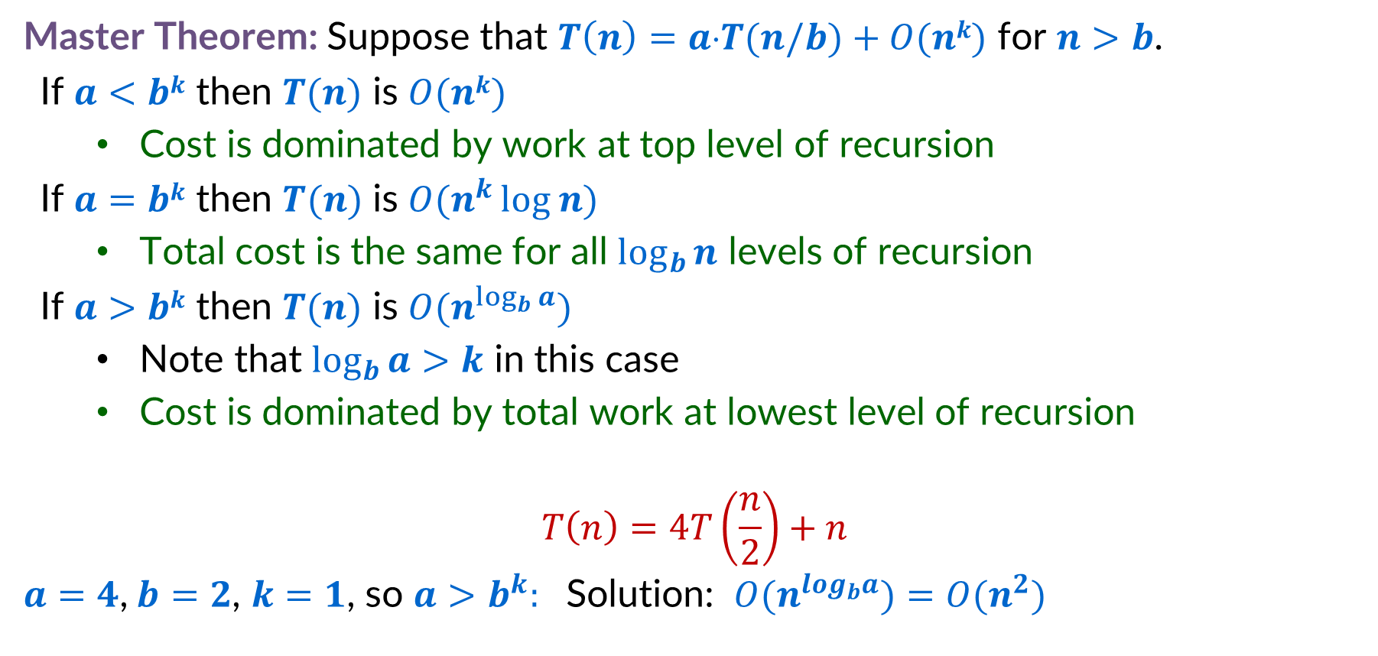
Integer Multiplication Recurrence Solution
Master Theorem: Suppose that $T\left(n\right)=a⋅T(n/b)+O(nk)$ for $n>b$.
If $a<bk$ then $T(n)$ is $O(nk)$
Cost is dominated by work at top level of recursion
If $a=bk$ then $T(n)$ is $O(n^{k }log n)$
Total cost is the same for all $\log_{b}{n}$ levels of recursion
If $a>bk$ then $T(n)$ is $O(n^{\log_{b}{a}})$
Note that $\log_{b}{a>k}$ in this case
Cost is dominated by total work at lowest level of recursion
$$T\left(n\right)=4T\left(\frac{n}{2}\right)+n$$
$a=4$,$b=2$, $k=1$, so $a>b^{k}:$ Solution: $O(n^{log_{b}a})$ $=O(n^{2})$

Slide 24
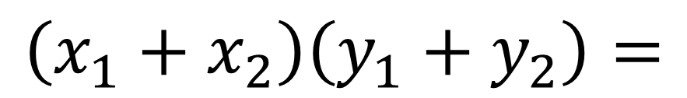
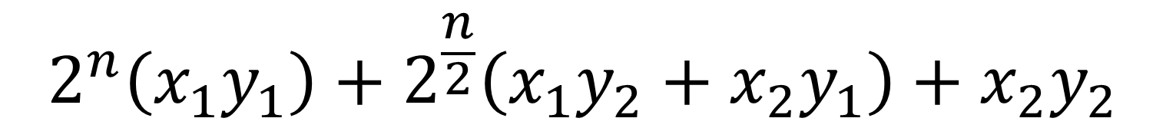
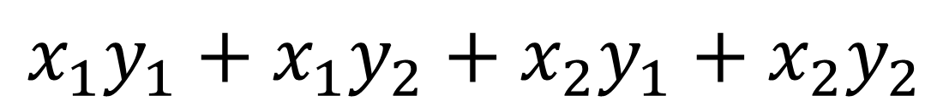
Karatsuba Method
Can’t avoid these
$$2^{n}\left(x_{1}y_{1}\right)+2^{\frac{n}{2}}\left(x_{1}y_{2}+x_{2}y_{1}\right)+x_{2}y_{2}$$
Can we do this with one multiplication?
$$\left(x_{1}+x_{2}\right)\left(y_{1}+y_{2}\right)=$$
$$x_{1}y_{1}+x_{1}y_{2}+x_{2}y_{1}+x_{2}y_{2}$$
$$x_{1}y_{2}+x_{2}y_{1}=\left(x_{1}+x_{2}\right)\left(y_{1}+y_{2}\right)−x_{1}y_{1}−x_{2}y_{2}$$
Two multiplications
One multiplication

Slide 25





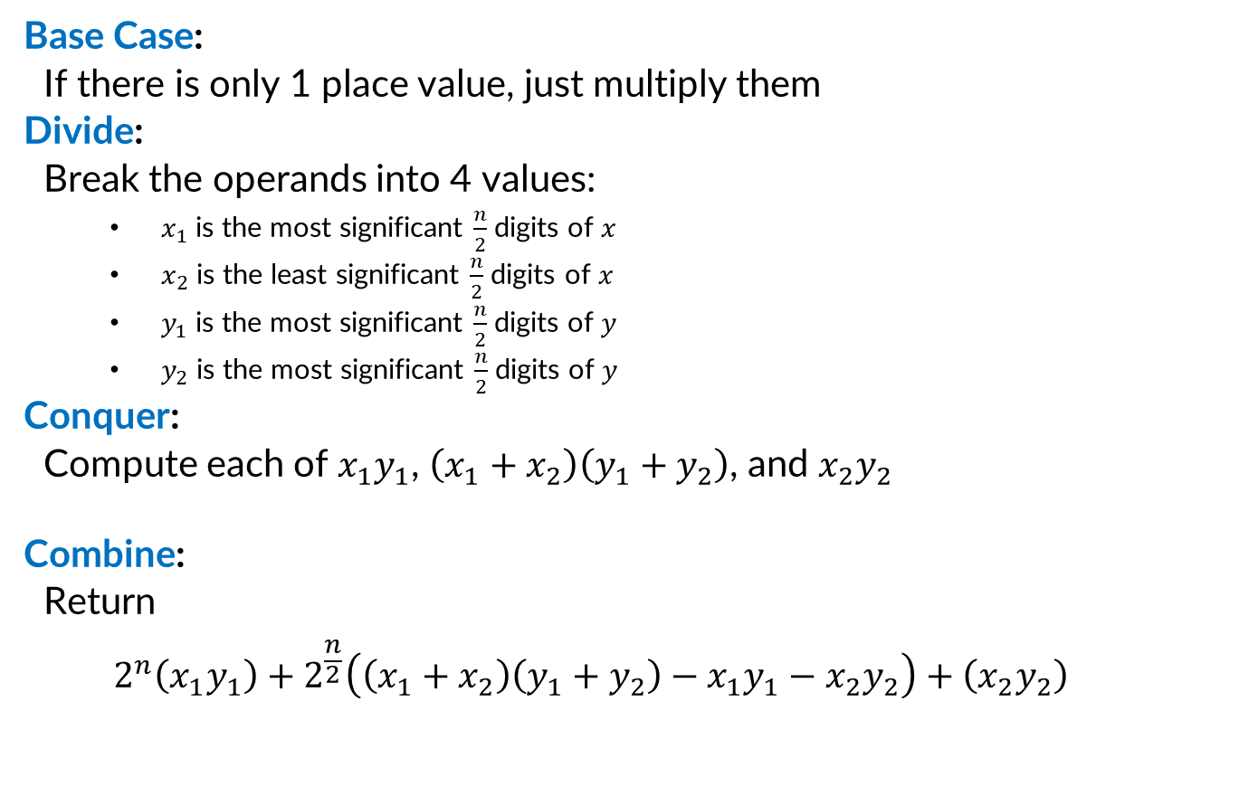








Divide and Conquer (Karatsuba Method)
Base Case:
If there is only 1 place value, just multiply them
Divide:
Break the operands into 4 values:
$x_{1}$ is the most significant $\frac{n}{2}$ digits of $x$
$x_{2}$ is the least significant $\frac{n}{2}$ digits of $x$
$y_{1}$ is the most significant $\frac{n}{2}$ digits of $y$
$y_{2}$ is the most significant $\frac{n}{2}$ digits of $y$
Conquer:
Compute each of $x_{1}y_{1}$, $\left(x_{1}+x_{2}\right)\left(y_{1}+y_{2}\right)$, and $x_{2}y_{2}$
Combine:
Return
$$2^{n}\left(x_{1}y_{1}\right)+2^{\frac{n}{2}}\left(\left(x_{1}+x_{2}\right)\left(y_{1}+y_{2}\right)−x_{1}y_{1}−x_{2}y_{2}\right)+\left(x_{2}y_{2}\right)$$
$$x_{1}$$
$$x_{2}$$
$$×$$
$$y_{1}$$
$$y_{2}$$
$$x_{1}y_{1}$$
$$x_{1}y_{2}$$
$$\left(x_{1}+x_{2}\right)$$
$$\left(y_{1}+y_{2}\right)$$
$$x_{2}y_{2}$$
$$x_{1}y_{1}$$
$$+$$
$$\left(x_{1}+x_{2}\right)$$
$$\left(y_{1}+y_{2}\right)$$
$$−$$
$$x_{1}y_{1}$$
$$−$$
$$x_{2}y_{2}$$
$$+$$
$$x_{2}y_{2}$$

Slide 26
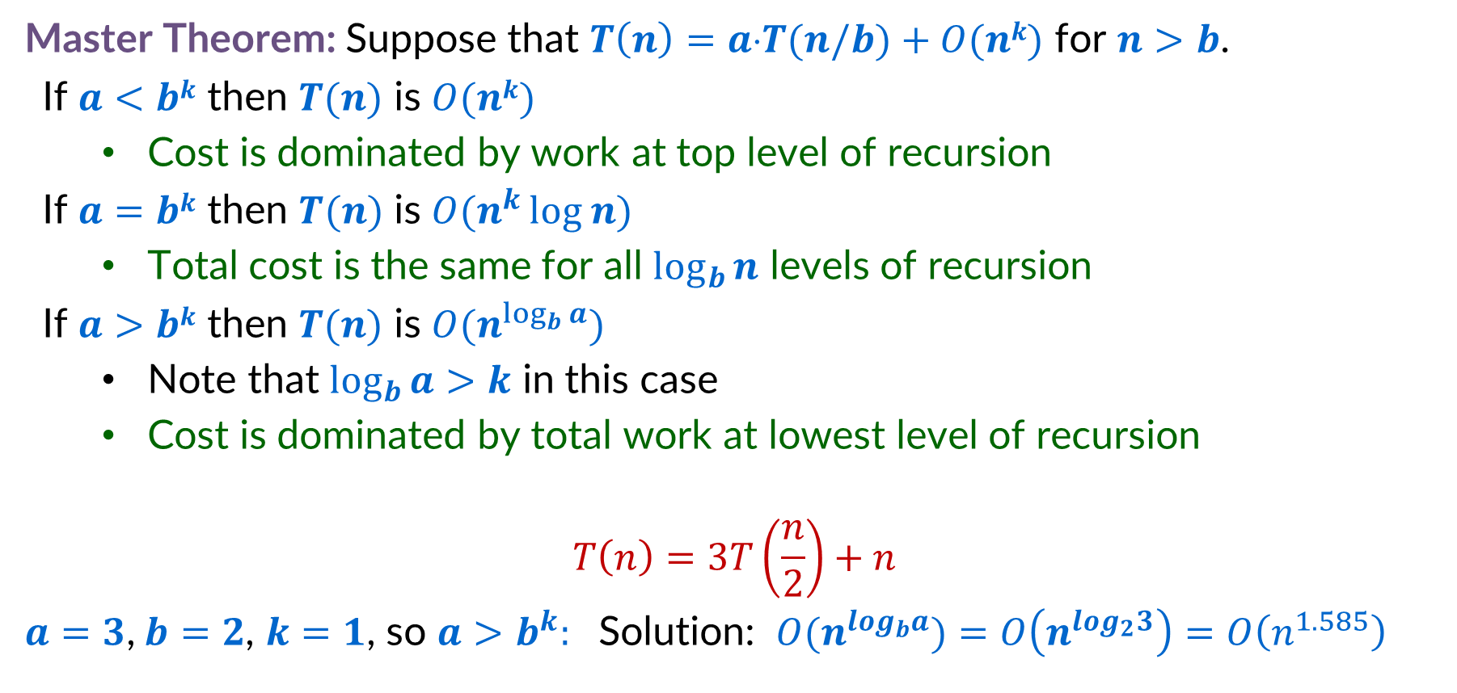
Karatsuba Method Recurrence Solution
Master Theorem: Suppose that $T\left(n\right)=a⋅T(n/b)+O(nk)$ for $n>b$.
If $a<bk$ then $T(n)$ is $O(nk)$
Cost is dominated by work at top level of recursion
If $a=bk$ then $T(n)$ is $O(n^{k }log n)$
Total cost is the same for all $\log_{b}{n}$ levels of recursion
If $a>bk$ then $T(n)$ is $O(n^{\log_{b}{a}})$
Note that $\log_{b}{a>k}$ in this case
Cost is dominated by total work at lowest level of recursion
$$T\left(n\right)=3T\left(\frac{n}{2}\right)+n$$
$a=3$,$b=2$, $k=1$, so $a>b^{k}:$ Solution: $O(n^{log_{b}a})$ $=O\left(n^{log_{2}3}\right)=O\left(n^{1.585}\right)$

Slide 27
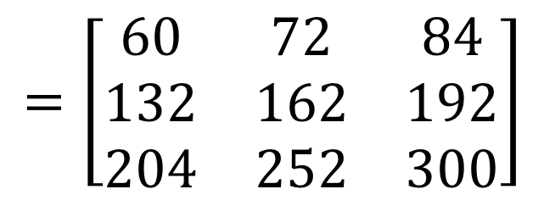

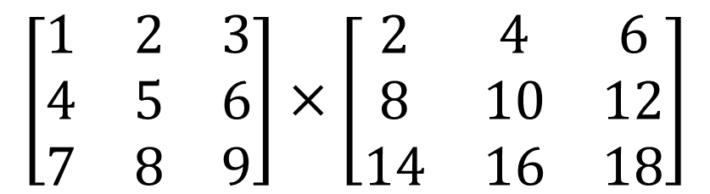

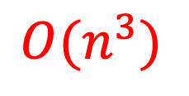
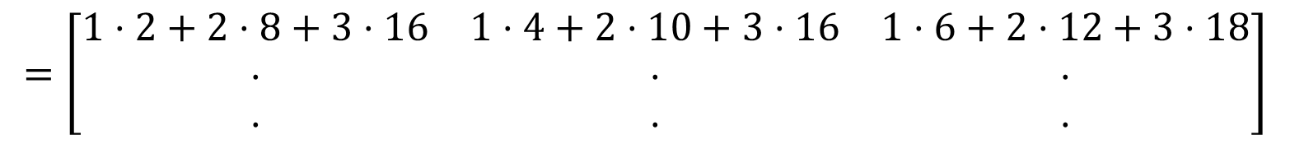
Matrix Multiplication
$$n$$
$$\left[\begin{matrix}1 & 2 & 3 \\ 4 & 5 & 6 \\ 7 & 8 & 9\end{matrix}\right]×\left[\begin{matrix}2 & 4 & 6 \\ 8 & 10 & 12 \\ 14 & 16 & 18\end{matrix}\right]$$
$$n$$
$$=\left[\begin{matrix}1⋅2+2⋅8+3⋅16 & 1⋅4+2⋅10+3⋅16 & 1⋅6+2⋅12+3⋅18 \\ ⋅ & ⋅ & ⋅ \\ ⋅ & ⋅ & ⋅\end{matrix}\right]$$
$$=\left[\begin{matrix}60 & 72 & 84 \\ 132 & 162 & 192 \\ 204 & 252 & 300\end{matrix}\right]$$
Run time?
$$O(n^{3})$$

Slide 28

Multiplying Matrices
for $i$ ← $1$ to $n$
for $j$← $1$ to $n$
$C[i,j]$ ← $0$
for $k$ ← $1$ to $n$
$C[i,j]$ ← $C[i,j]+A[i,k]B[k,j]$
endfor
endfor
endfor
Can we improve this with divide and conquer?

Slide 29

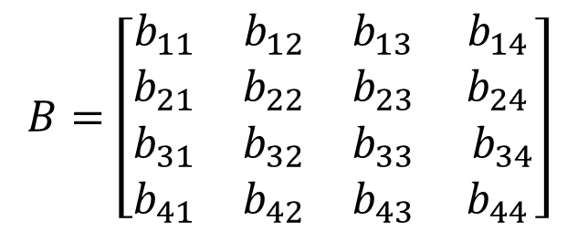

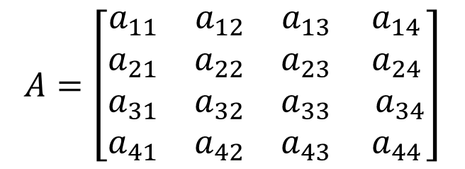


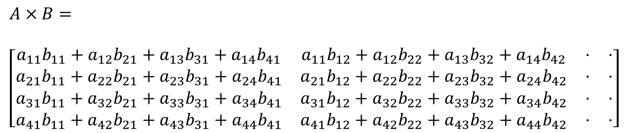
We can see subproblems!
$$A_{11}$$
$$B_{11}$$
$$A=\left[\begin{matrix}a_{11} & a_{12} & a_{13} & a_{14} \\ a_{21} & a_{22} & a_{23} & a_{24} \\ a_{31} & a_{32} & a_{33} & a_{34} \\ a_{41} & a_{42} & a_{43} & a_{44}\end{matrix}\right]$$
$$B=\left[\begin{matrix}b_{11} & b_{12} & b_{13} & b_{14} \\ b_{21} & b_{22} & b_{23} & b_{24} \\ b_{31} & b_{32} & b_{33} & b_{34} \\ b_{41} & b_{42} & b_{43} & b_{44}\end{matrix}\right]$$
$A×B=$
$\left[\begin{matrix}a_{11}b_{11}+a_{12}b_{21}+a_{13}b_{31}+a_{14}b_{41} & a_{11}b_{12}+a_{12}b_{22}+a_{13}b_{32}+a_{14}b_{42} & ⋅ & ⋅ \\ a_{21}b_{11}+a_{22}b_{21}+a_{23}b_{31}+a_{24}b_{41} & a_{21}b_{12}+a_{22}b_{22}+a_{23}b_{32}+a_{24}b_{42} & ⋅ & ⋅ \\ a_{31}b_{11}+a_{32}b_{21}+a_{33}b_{31}+a_{34}b_{41} & a_{31}b_{12}+a_{32}b_{22}+a_{33}b_{32}+a_{34}b_{42} & ⋅ & ⋅ \\ a_{41}b_{11}+a_{42}b_{21}+a_{43}b_{31}+a_{44}b_{41} & a_{41}b_{12}+a_{42}b_{22}+a_{43}b_{32}+a_{44}b_{42} & ⋅ & ⋅\end{matrix}\right]$
$$A_{11}×B_{11}$$
$$A_{11}×B_{11}$$

Slide 30




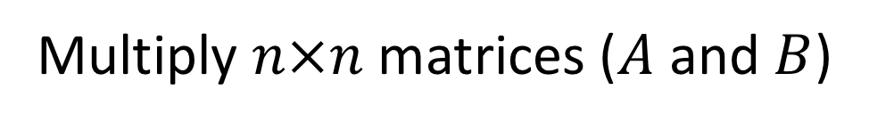






Matrix Multiplication D&C
Multiply $n×n$ matrices ($A$ and $B$)
$$B=\left[\begin{matrix}b_{11} & b_{12} & b_{13} & b_{14} \\ b_{21} & b_{22} & b_{23} & b_{24} \\ b_{31} & b_{32} & b_{33} & b_{34} \\ b_{41} & b_{42} & b_{43} & b_{44}\end{matrix}\right]$$
$$A=\left[\begin{matrix}a_{11} & a_{12} & a_{13} & a_{14} \\ a_{21} & a_{22} & a_{23} & a_{24} \\ a_{31} & a_{32} & a_{33} & a_{34} \\ a_{41} & a_{42} & a_{43} & a_{44}\end{matrix}\right]$$
$$B_{11}$$
$$B_{12}$$
$$A_{11}$$
$$A_{12}$$
$$A_{21}$$
$$A_{22}$$
$$B_{21}$$
$$B_{22}$$
$$A×B=\left[\begin{matrix}A_{11}×B_{11}+A_{12}×B_{21} & A_{11}×B_{12}+A_{12}×B_{22} \\ A_{21}×B_{11}+A_{22}×B_{21} & A_{21}×B_{12}+A_{22}×B_{22}\end{matrix}\right]$$

Slide 31























Divide and Conquer Matrix Multiplication
Base Case:
For a $1×1$ matrices, return the product in a $1×1$ matrix
Divide:
Use each quadrant of the input $n×n$ matrices as it’s own $\frac{n}{2}×\frac{n}{2}$matrix
Conquer:
Compute each of:
Combine:
Compute the value of each quadrant by summing $P_{1}…P_{8}$ as shown
$$A_{11}$$
$$A_{12}$$
$$B_{11}$$
$$B_{12}$$
$$A_{21}$$
$$A_{22}$$
$$B_{21}$$
$$B_{22}$$
$$P_{1}$$
$$P_{2}$$
$$P_{3}$$
$$P_{4}$$
$$P_{1}=A_{11}×B_{11}$$
$$P_{2}=A_{12}×B_{21}$$
$$P_{3}=A_{11}×B_{12}$$
$$P_{4}=A_{12}×B_{22}$$
$$P_{5}=A_{21}×B_{11}$$
$$P_{6}=A_{22}×B_{21}$$
$$P_{7}=A_{21}×B_{12}$$
$$P_{8}=A_{22}×B_{22}$$
$$P_{5}$$
$$P_{6}$$
$$P_{7}$$
$$P_{8}$$
$$P_{1}+P_{2}$$
$$P_{3}+P_{4}$$
$$P_{5}+P_{6}$$
$$P_{7}+P_{8}$$

Slide 32

Matrix Multiplication Recurrence Solution
Master Theorem: Suppose that $T\left(n\right)=a⋅T(n/b)+O(nk)$ for $n>b$.
If $a<bk$ then $T(n)$ is $O(nk)$
Cost is dominated by work at top level of recursion
If $a=bk$ then $T(n)$ is $O(n^{k }log n)$
Total cost is the same for all $\log_{b}{n}$ levels of recursion
If $a>bk$ then $T(n)$ is $O(n^{\log_{b}{a}})$
Note that $\log_{b}{a>k}$ in this case
Cost is dominated by total work at lowest level of recursion
$$T\left(n\right)=8T\left(\frac{n}{2}\right)+n^{2}$$
$a=8$,$b=2$, $k=2$, so $a>b^{k}:$ Solution: $O(n^{log_{b}a})$ $=O\left(n^{log_{2}8}\right)=O\left(n^{3}\right)$

Slide 33
How to Improve?
Multiply $n×n$ matrices ($A$ and $B$)
$$B=\left[\begin{matrix}b_{11} & b_{12} & b_{13} & b_{14} \\ b_{21} & b_{22} & b_{23} & b_{24} \\ b_{31} & b_{32} & b_{33} & b_{34} \\ b_{41} & b_{42} & b_{43} & b_{44}\end{matrix}\right]$$
$$A=\left[\begin{matrix}a_{11} & a_{12} & a_{13} & a_{14} \\ a_{21} & a_{22} & a_{23} & a_{24} \\ a_{31} & a_{32} & a_{33} & a_{34} \\ a_{41} & a_{42} & a_{43} & a_{44}\end{matrix}\right]$$
$$B_{11}$$
$$B_{12}$$
$$A_{11}$$
$$A_{12}$$
$$A_{21}$$
$$A_{22}$$
$$B_{21}$$
$$B_{22}$$
$$A×B=\left[\begin{matrix}A_{11}×B_{11}+A_{12}×B_{21} & A_{11}×B_{12}+A_{12}×B_{22} \\ A_{21}×B_{11}+A_{22}×B_{21} & A_{21}×B_{12}+A_{22}×B_{22}\end{matrix}\right]$$
Idea: Use an idea like Karatsuba! Can we derive these products using addition/subtraction?

Slide 34




















Strassen’s Algorithm
$$B=\left[\begin{matrix}b_{11} & b_{12} & b_{13} & b_{14} \\ b_{21} & b_{22} & b_{23} & b_{24} \\ b_{31} & b_{32} & b_{33} & b_{34} \\ b_{41} & b_{42} & b_{43} & b_{44}\end{matrix}\right]$$
$$A=\left[\begin{matrix}a_{11} & a_{12} & a_{13} & a_{14} \\ a_{21} & a_{22} & a_{23} & a_{24} \\ a_{31} & a_{32} & a_{33} & a_{34} \\ a_{41} & a_{42} & a_{43} & a_{44}\end{matrix}\right]$$
$$B_{11}$$
$$B_{12}$$
$$A_{11}$$
$$A_{12}$$
$$A_{21}$$
$$A_{22}$$
$$B_{21}$$
$$B_{22}$$
Calculate:
Find $A×B$:
$$Q_{1}=\left(A_{11}+A_{22}\right)×(B_{11}+B_{22})$$
$$\left[\begin{matrix}A_{1,1}B_{1,1}+A_{1,2}B_{2,1} & A_{1,1}B_{1,2}+A_{1,2}B_{2,2} \\ A_{2,1}B_{1,1}+A_{2,2}B_{2,1} & A_{2,1}B_{1,2}+A_{2,2}B_{2,2}\end{matrix}\right]=$$
$$Q_{2}=\left(A_{21}+A_{22}\right)×B_{11}$$
$$Q_{3}=A_{11}×(B_{12} −B_{22})$$
$$Q_{4}=A_{22}×(B_{21}−B_{11})$$
$$\left[\begin{matrix}Q_{1}+Q_{4}−Q_{5}+Q_{7} & Q_{3}+Q_{5} \\ Q_{2}+Q_{4} & Q_{1}−Q_{2}+Q_{3}+Q_{6}\end{matrix}\right]$$
$$Q_{5}=\left(A_{11}+A_{12}\right)×B_{22}$$
$$Q_{6}=\left(A_{21}−A_{11}\right)×(B_{11}+B_{12})$$
$$Q_{7}=\left(A_{12}−A_{22}\right)×(B_{21}+B_{22})$$

Slide 35













Divide and Conquer – Strassen’s Algorithm
Base Case:
For a $32×32$ matrices, use the textbook algorithm
Divide:
Use each quadrant of the input $n×n$ matrices as it’s own $\frac{n}{2}×\frac{n}{2}$matrix
Conquer:
Compute each of:
Combine:
Compute the value of each quadrant by summing $Q_{1}…Q_{8}$ as shown
$$A_{11}$$
$$A_{12}$$
$$B_{11}$$
$$B_{12}$$
$$A_{21}$$
$$A_{22}$$
$$B_{21}$$
$$B_{22}$$
$Q_{1}=\left(A_{11}+A_{22}\right)×(B_{11}+B_{22})$
$Q_{2}=\left(A_{21}+A_{22}\right)×B_{11}$
$Q_{3}=A_{11}×(B_{12} −B_{22})$
$Q_{4}=A_{22}×(B_{21}−B_{11})$
$Q_{5}=\left(A_{11}+A_{12}\right)×B_{22}$
$Q_{6}=\left(A_{21}−A_{11}\right)×(B_{11}+B_{12})$
$Q_{7}=\left(A_{12}−A_{22}\right)×(B_{21}+B_{22})$
$$Q_{1}$$
$$Q_{2}$$
$$Q_{3}$$
$$Q_{4}$$
$$Q_{5}$$
$$Q_{6}$$
$$Q_{7}$$
$$Q_{1}+Q_{4}−Q_{5}+Q_{7}$$
$$Q_{3}+Q_{5}$$
$$Q_{2}+Q_{4}$$
$$Q_{1}−Q_{2}+Q_{3}+Q_{6}$$

Slide 36

Strassen’s Recurrence Solution
Master Theorem: Suppose that $T\left(n\right)=a⋅T(n/b)+O(nk)$ for $n>b$.
If $a<bk$ then $T(n)$ is $O(nk)$
Cost is dominated by work at top level of recursion
If $a=bk$ then $T(n)$ is $O(n^{k }log n)$
Total cost is the same for all $\log_{b}{n}$ levels of recursion
If $a>bk$ then $T(n)$ is $O(n^{\log_{b}{a}})$
Note that $\log_{b}{a>k}$ in this case
Cost is dominated by total work at lowest level of recursion
$$T\left(n\right)=7T\left(\frac{n}{2}\right)+n^{2}$$
$a=7$,$b=2$, $k=2$, so $a>b^{k}:$ Solution: $O(n^{log_{b}a})$ $=O\left(n^{log_{2}7}\right)=O\left(n^{2.807}\right)$

Slide 37



Strassen’s Algorithm vs. Naïve Running Time
$$n^{3}$$
$$n^{\log_{2}{7}}$$

Slide 38


Is this the fastest?
Every few years someone comes up with an asymptotically faster algorithm
Current best is $O\left(n^{2.3728596}\right)$, but it requires input sizes in the millions to actually be faster
We know there is no algorithm with running time $o\left(n^{2}\right)$
The best possible running time is unknown!
(and weirdly, may not exist!)

