Slide 1
Lecture 2: Algorithm Correctness
Glenn Sun

Slide 2
Concept check quizzes
Many students haven’t done it yet 🙁
Remember: unlimited submissions, and are marked “incomplete” until you get every question right.
One-time extension for everyone until 11:59pm tonight!
Be sure to get those in on time going forward.

Slide 3
Homework 1
HW 1 out right after class, due next Friday at 11:59pm.
Problem 1 (Grading ChatGPT): Read ChatGPT’s response to a question about stable matchings, and explain where the LLM made mistakes.
Problem 2 (Business profit): Write a super simple algorithm for a basic task, and prove its correctness (today’s lecture!)

Slide 4
Video submission option
Optional! Written solutions are always accepted.
Use a whiteboard, paper, or tablet + stylus to sketch key points while speaking, as if you were teaching a colleague.
Please do not use slides, read a script, or edit your video.
You may have some key points written before starting the video (e.g. problem statement, pseudocode, etc.)
Watch the example video on Canvas/course website!

Slide 5
Extension options
Problem 1X.1 (Stable matching verifier): Correctly solve the question from Problem 1 by writing (part of) a Java program that performs a brute-force verification.
Problem 1X.2 (Using LLMs): Reflect on your experience answering Problem 1 and share your thoughts on when it is appropriate to use LLMs.
Pick one to do!

Slide 6
Homework 0: Sample
HW 0 has been out on Canvas/course website since last night
Includes:
One sample problem
One sample written solution
LaTeX source for the written solution
One sample video solution

Slide 7
What is correctness?

Slide 8
Correctness defined
Algorithm: A list of unambiguous instructions to solve a class of computational problems
An algorithm is correct for a given problem if it has:
​Soundness: Running it never raises exceptions/errors
​Termination: All loops terminate
​Validity: The output meets the problem specification

Slide 9
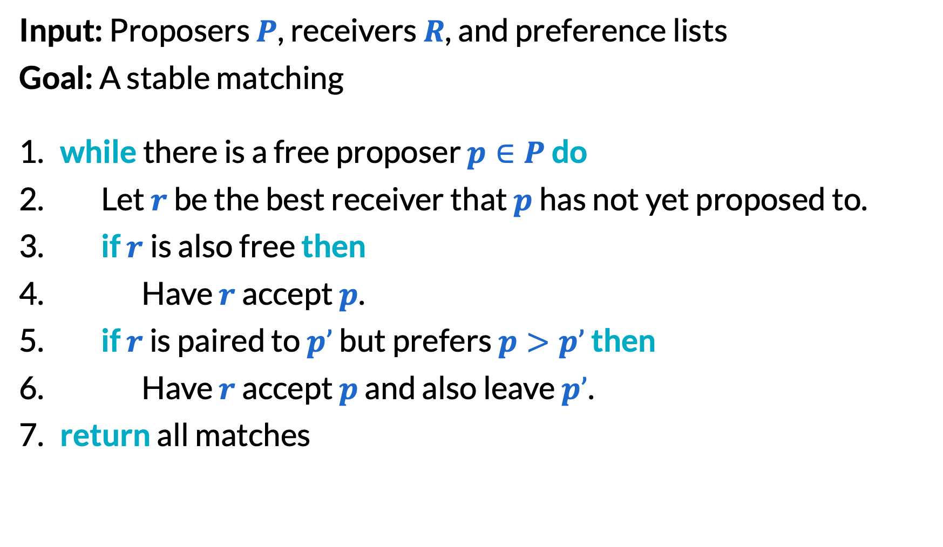
Gale–Shapley revisited (1/2)
Input: Proposers $P$, receivers $R$, and preference lists
Goal: A stable matching
​while there is a free proposer $p∈P$ do
Let $r$ be the best receiver that $p$ has not yet proposed to.
​if $r$is also free then
Have $r$ accept $p$.
​if $r$ is paired to $p’$ but prefers $p>p’$ then
Have $r$ accept $p$ and also leave $p’$.
​return all matches

Slide 10
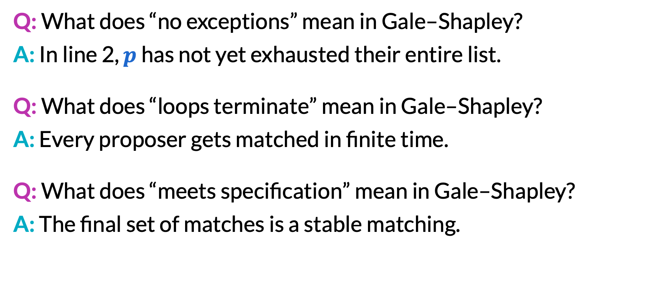
Gale–Shapley revisited (2/2)
Q: What does “no exceptions” mean in Gale–Shapley?
A: In line 2, $p$ has not yet exhausted their entire list.
Q: What does “loops terminate” mean in Gale–Shapley?
A: Every proposer gets matched in finite time.
Q: What does “meets specification” mean in Gale–Shapley?
A: The final set of matches is a stable matching.

Slide 11
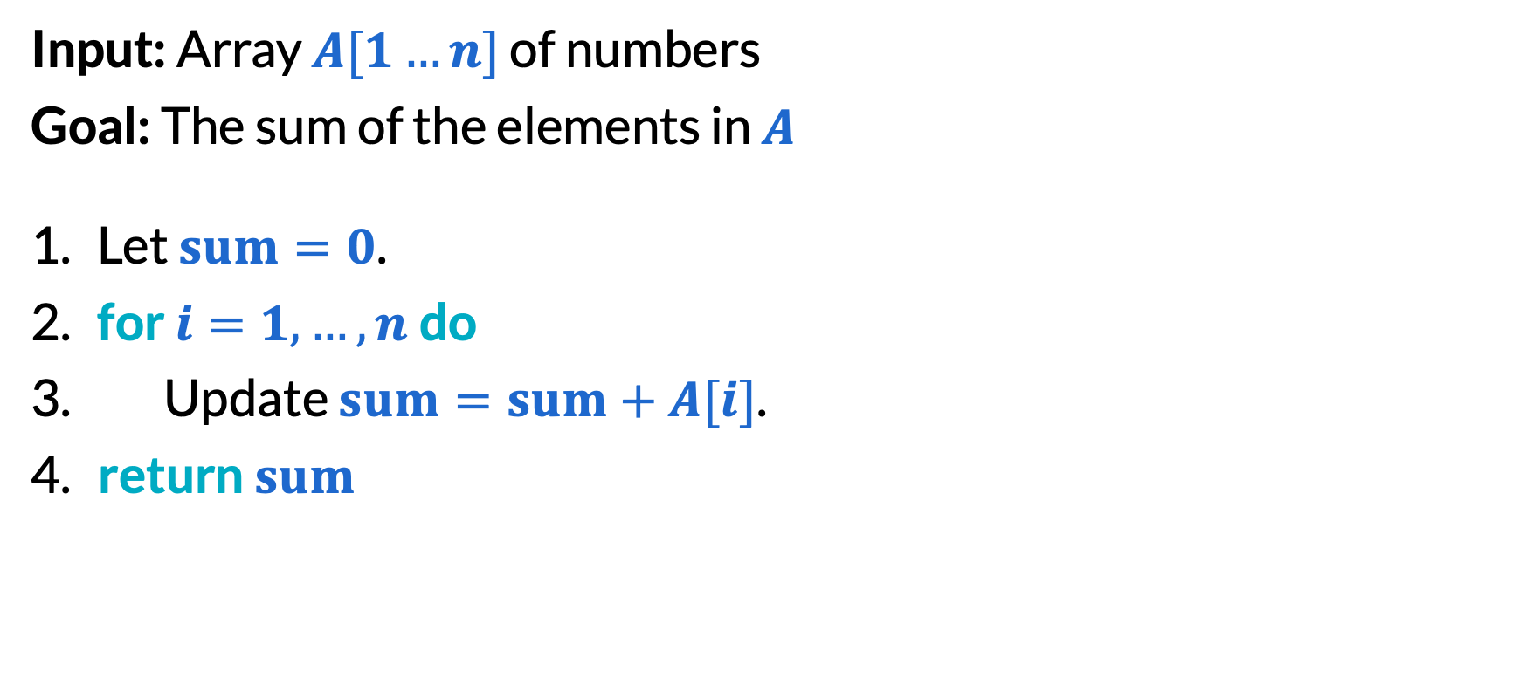
Sum of an array (1/2)
Input: Array $A[1…n]$ of numbers
Goal: The sum of the elements in $A$
Let $sum=0$.
​for $i=1,…,n$do
​Update $sum=sum+A[i]$.
​return $sum$

Slide 12
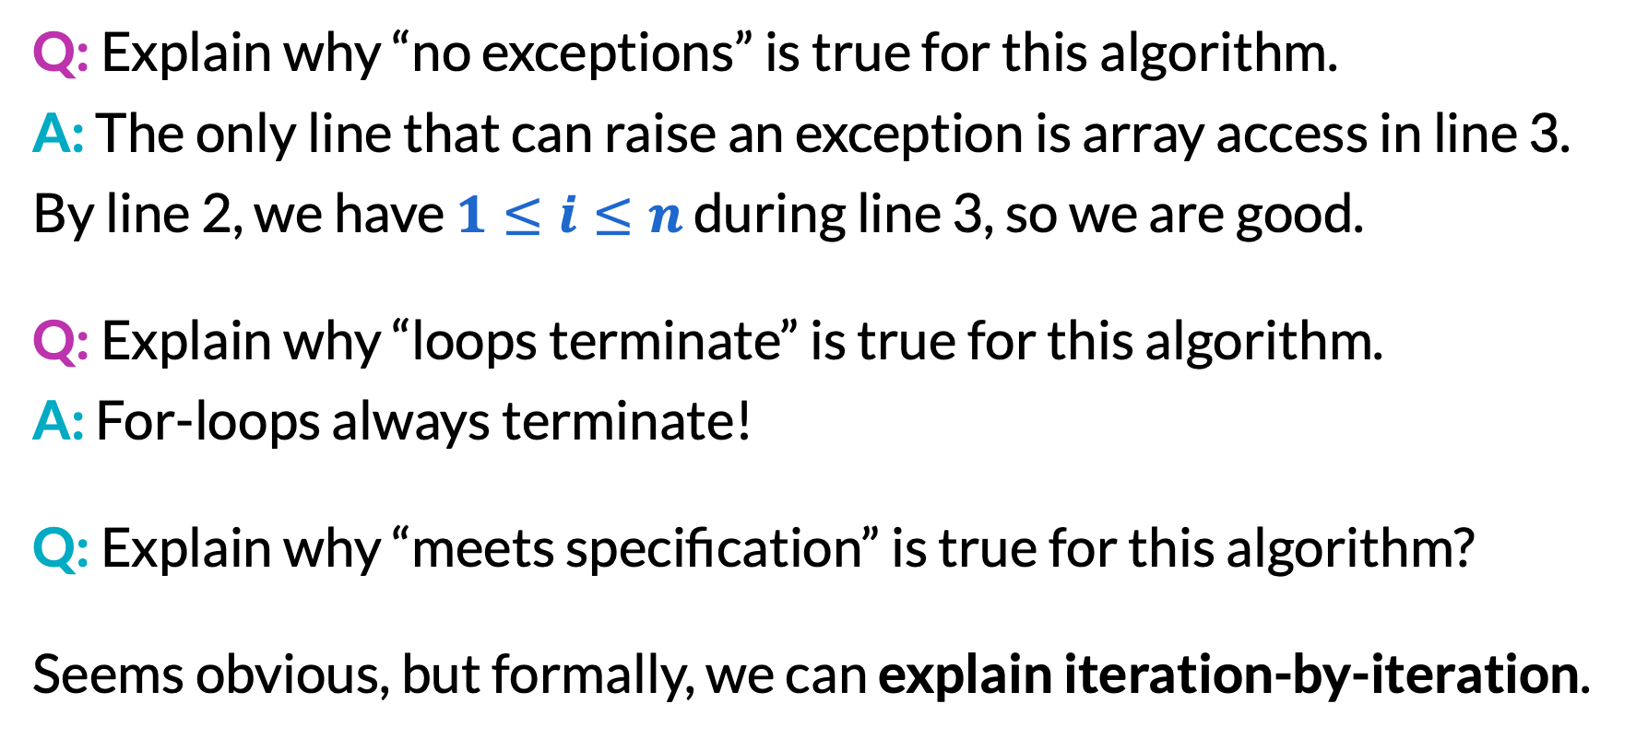
Sum of an array (2/2)
Q: Explain why “no exceptions” is true for this algorithm.
A: The only line that can raise an exception is array access in line 3. By line 2, we have $1≤i≤n$ during line 3, so we are good.
Q: Explain why “loops terminate” is true for this algorithm.
A: For-loops always terminate!
Q: Explain why “meets specification” is true for this algorithm?
Seems obvious, but formally, we can explain iteration-by-iteration.

Slide 13
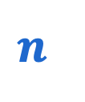

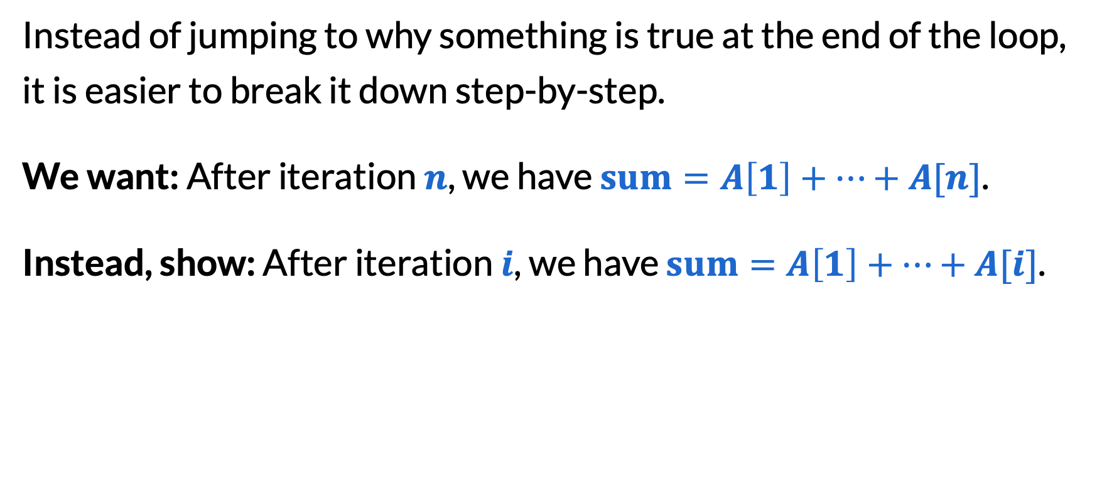
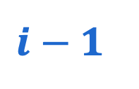
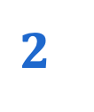

Loop invariants (1/3)
Instead of jumping to why something is true at the end of the loop, it is easier to break it down step-by-step.
We want: After iteration $n$, we have $sum=A\left[1\right]+…+A[n]$.
Instead, show: After iteration $i$, we have $sum=A\left[1\right]+…+A[i]$.
after iteration #:
before
$$1$$
$$2$$
$$i−1$$
$$i$$
$$n$$
🏁

Slide 14
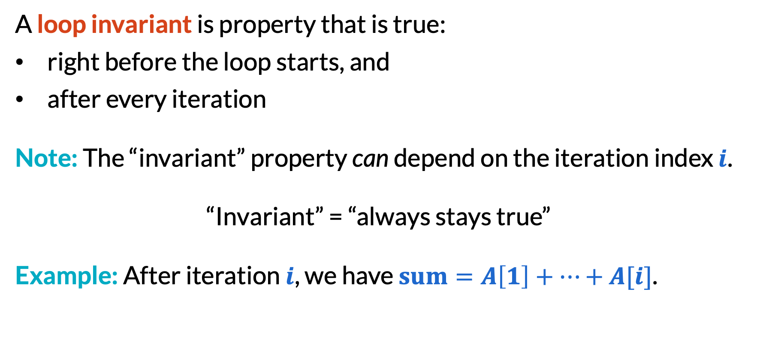
Loop invariants (2/3)
A loop invariant is property that is true:
right before the loop starts, and
after every iteration
Note: The “invariant” property can depend on the iteration index $i$.
“Invariant” = “always stays true”
Example: After iteration $i$, we have $sum=A\left[1\right]+…+A[i]$.

Slide 15
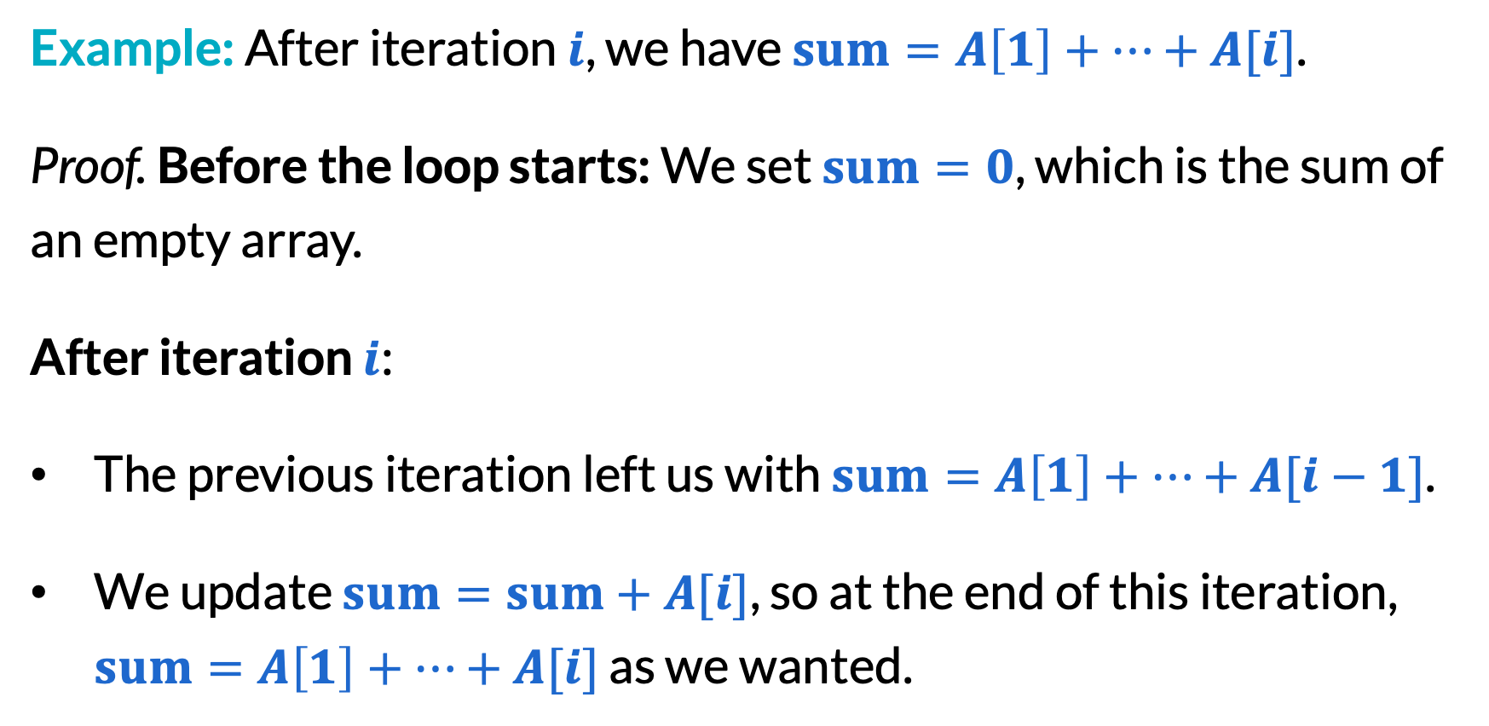
Loop invariants (3/3)
Example: After iteration $i$, we have $sum=A\left[1\right]+…+A[i]$.
Proof. Before the loop starts: We set $sum=0$, which is the sum of an empty array.
After iteration $i$:
The previous iteration left us with $sum=A\left[1\right]+…+A[i−1]$.
We update $sum=sum+A[i]$, so at the end of this iteration, $sum=A\left[1\right]+…+A[i]$ as we wanted.

Slide 16
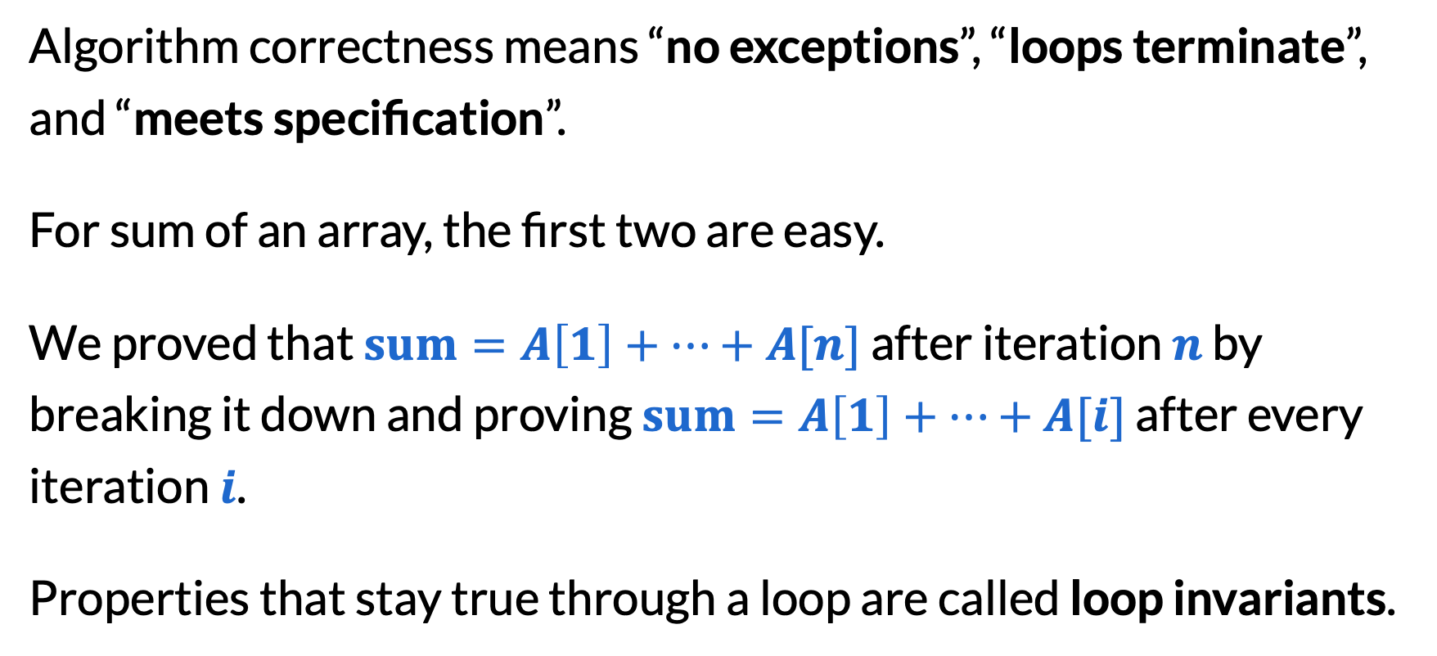
Summary so far
Algorithm correctness means “no exceptions”, “loops terminate”, and “meets specification”.
For sum of an array, the first two are easy.
We proved that $sum=A\left[1\right]+…+A[n]$ after iteration $n$ by breaking it down and proving $sum=A\left[1\right]+…+A[i]$ after every iteration $i$.
Properties that stay true through a loop are called loop invariants.

Slide 17
Practice with more loop invariants

Slide 18
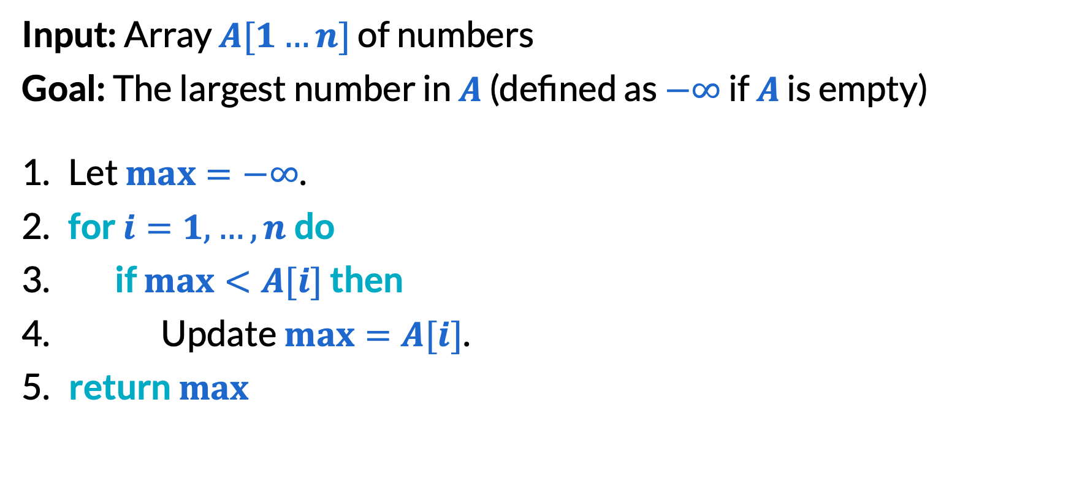
Max element in array (1/4)
Input: Array $A[1…n]$ of numbers
Goal: The largest number in $A$ (defined as $−∞$ if $A$ is empty)
Let $max=−∞$.
​for $i=1,…,n$do
​if $max<A[i]$ then
Update $max=A[i]$.
​return $max$

Slide 19
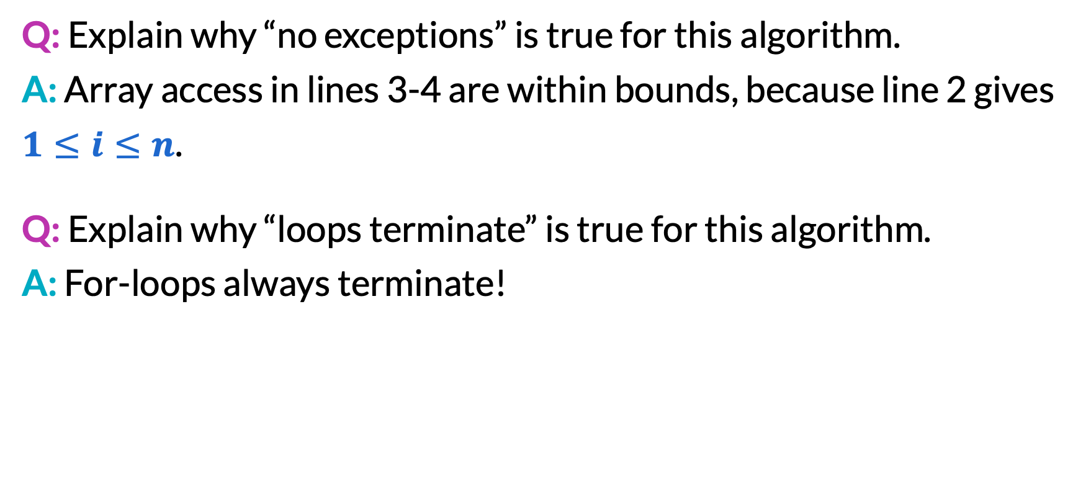
Max element in array (2/4)
Q: Explain why “no exceptions” is true for this algorithm.
A: Array access in lines 3-4 are within bounds, because line 2 gives $1≤i≤n$.
Q: Explain why “loops terminate” is true for this algorithm.
A: For-loops always terminate!

Slide 20
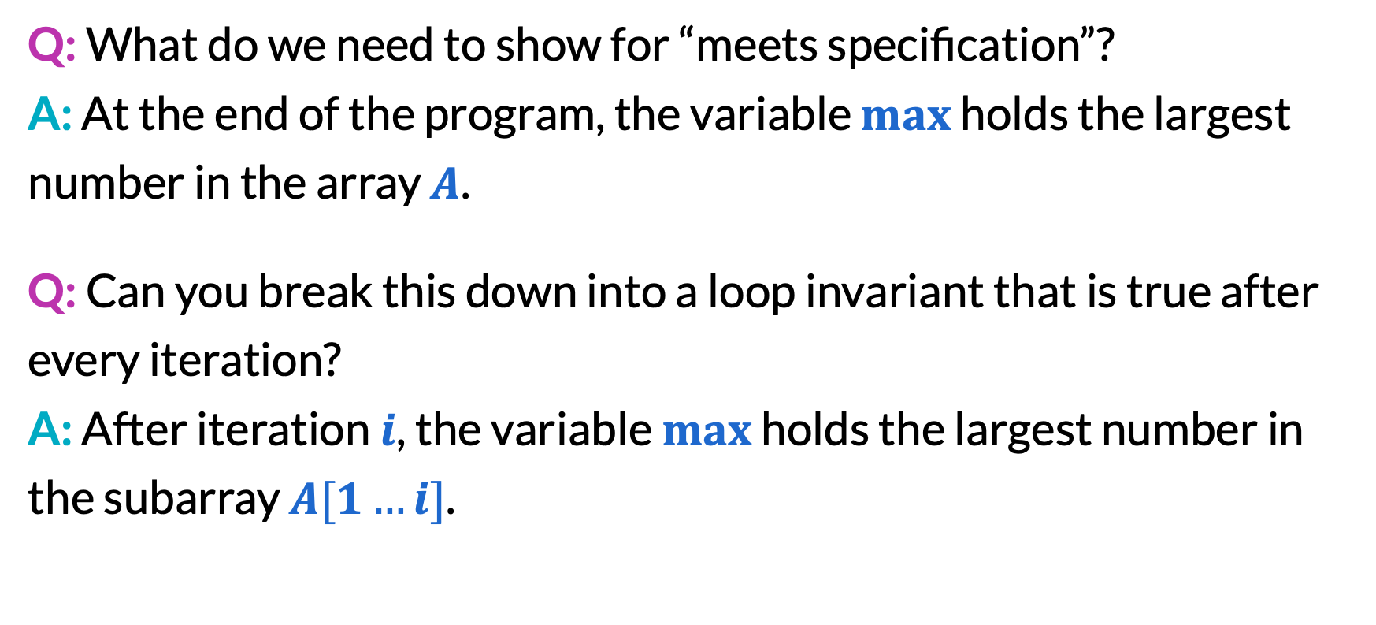
Max element in array (3/4)
Q: What do we need to show for “meets specification”?
A: At the end of the program, the variable $max$ holds the largest number in the array $A$.
Q: Can you break this down into a loop invariant that is true after every iteration?
A: After iteration $i$, the variable $max$ holds the largest number in the subarray $A[1…i]$.

Slide 21
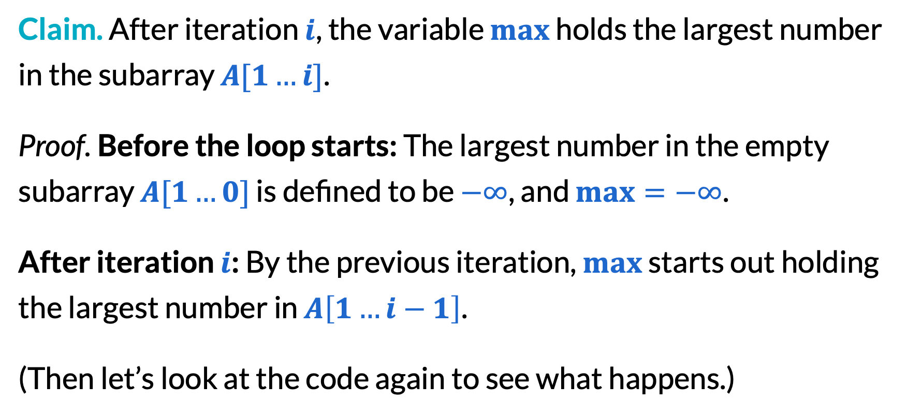
Max element in array (4/4)
Claim. After iteration $i$, the variable $max$ holds the largest number in the subarray $A[1…i]$.
Proof. Before the loop starts: The largest number in the empty subarray $A[1…0]$ is defined to be $−∞$, and $max=−∞$.
After iteration $i$: By the previous iteration, $max$ starts out holding the largest number in $A\left[1…i−1\right]$.
(Then let’s look at the code again to see what happens.)

Slide 22
Proving code with if-statements (1/3)
Input: Array $A[1…n]$ of numbers
Goal: The largest number in $A$ (defined as $−∞$ if $A$ is empty)
Let $max=−∞$.
​for $i=1,…,n$do
​if $max<A[i]$ then
Update $max=A[i]$.
​return $max$
What kinds of inputs trigger the if statement?
Break into cases based on this!

Slide 23
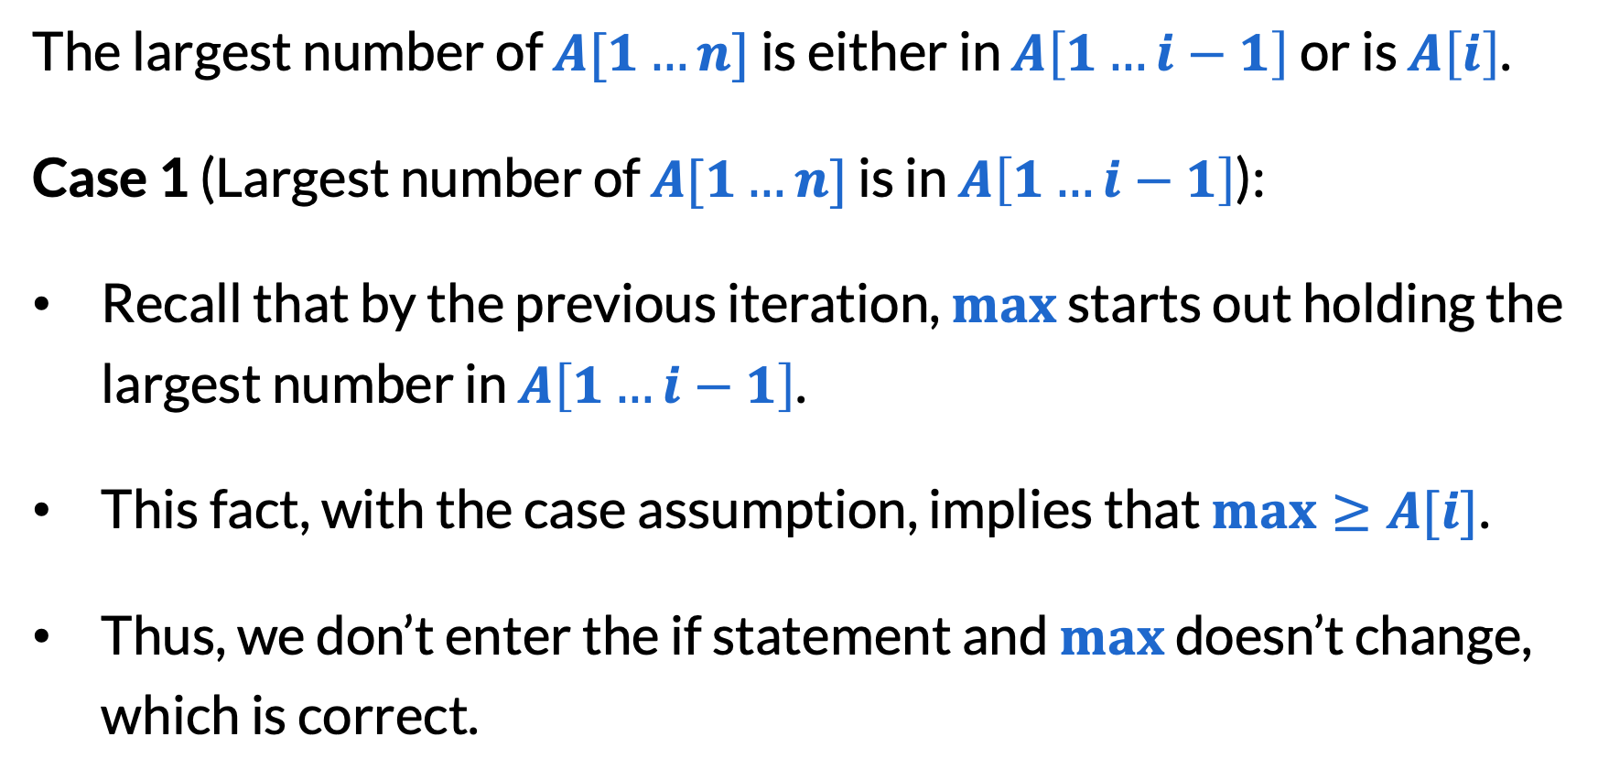
Proving code with if-statements (2/3)
The largest number of $A[1…n]$ is either in $A\left[1…i−1\right]$ or is $A\left[i\right]$.
Case 1 (Largest number of $A[1…n]$ is in $A\left[1…i−1\right]$):
Recall that by the previous iteration, $max$ starts out holding the largest number in $A\left[1…i−1\right]$.
This fact, with the case assumption, implies that $max≥A[i]$.
Thus, we don’t enter the if statement and $max$ doesn’t change, which is correct.

Slide 24
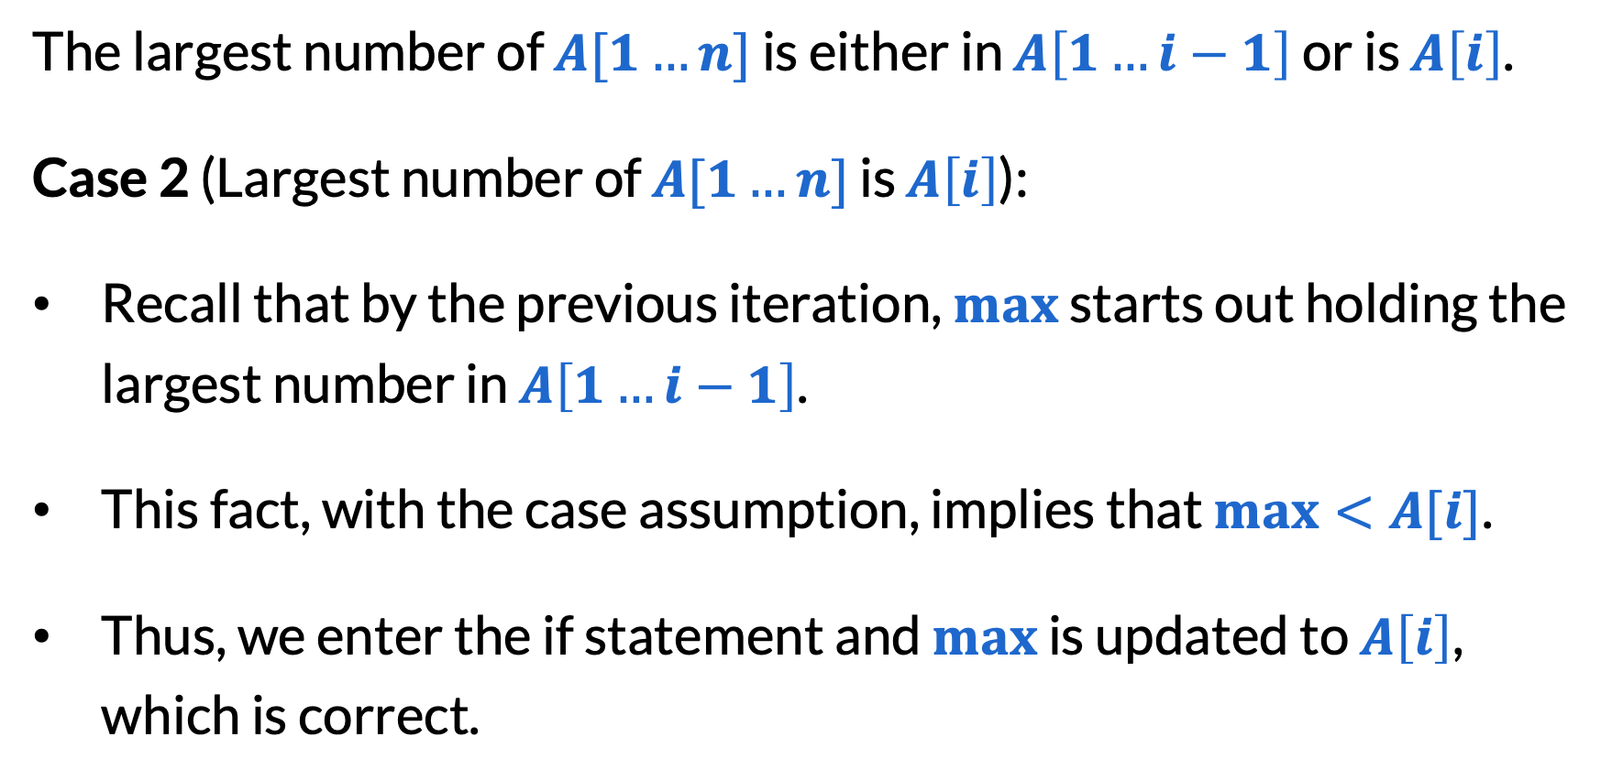
Proving code with if-statements (3/3)
The largest number of $A[1…n]$ is either in $A\left[1…i−1\right]$ or is $A\left[i\right]$.
Case 2 (Largest number of $A[1…n]$ is $A\left[i\right]$):
Recall that by the previous iteration, $max$ starts out holding the largest number in $A\left[1…i−1\right]$.
This fact, with the case assumption, implies that $max<A[i]$.
Thus, we enter the if statement and $max$ is updated to $A\left[i\right]$, which is correct.

Slide 25
Small tangent on pseudocode
Pseudocode: Description of code intended for human reading.
Why write pseudocode over code?
Easier to read and think about
Communicate with people who don’t know Java
Why write pseudocode over English?
Precise communication with no ambiguity

Slide 26
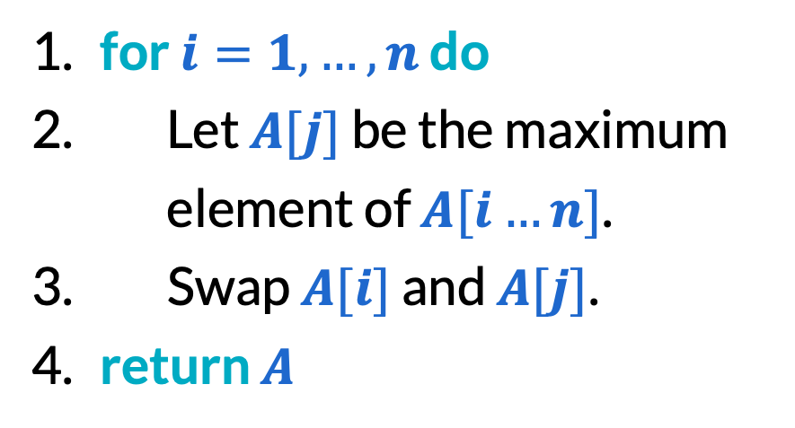


Pseudocode detail depends on context (1/2)
Input: Array $A[1…n]$ of numbers
​for $i=1,…,n$ do
Let $maxIndex=i$.
​for $j=i,…,n$ do
​if $A[j]>A[maxIndex]$then
Update $maxIndex=j$.
Let $temp=A[i]$.
Replace $A[i]=A[maxIndex]$.
Replace $A[maxIndex]=temp$.
​return $A$
​for $i=1,…,n$ do
Let $A[j]$ be the maximum element of $A[i…n]$.
Swap $A[i]$ and $A[j]$.
​return $A$
✅
⚠️

Slide 27

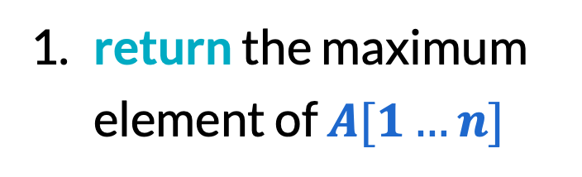
Pseudocode detail depends on context (2/2)
Input: Array $A[1…n]$ of numbers
Let $max=−∞$.
​for $i=1,…,n$do
​if $max<A[i]$ then
Update $max=A[i]$.
​return $max$
​return the maximum element of $A[1…n]$
✅
❌

Slide 28
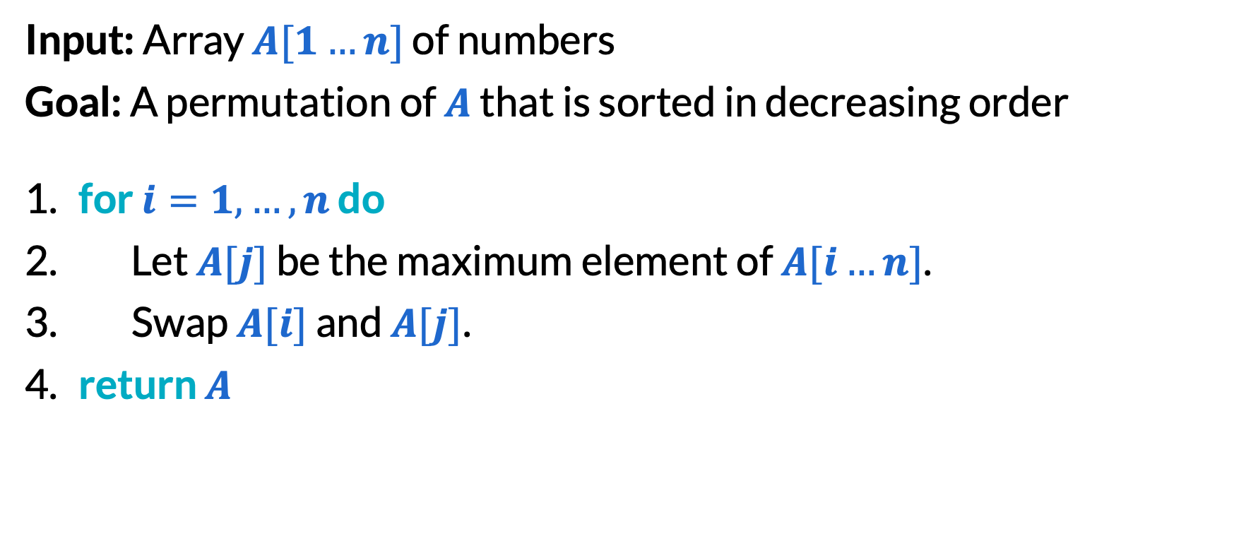
Selection sort (1/6)
Input: Array $A[1…n]$ of numbers
Goal: A permutation of $A$ that is sorted in decreasing order
​for $i=1,…,n$ do
Let $A[j]$ be the maximum element of $A[i…n]$.
Swap $A[i]$ and $A[j]$.
​return $A$

Slide 29
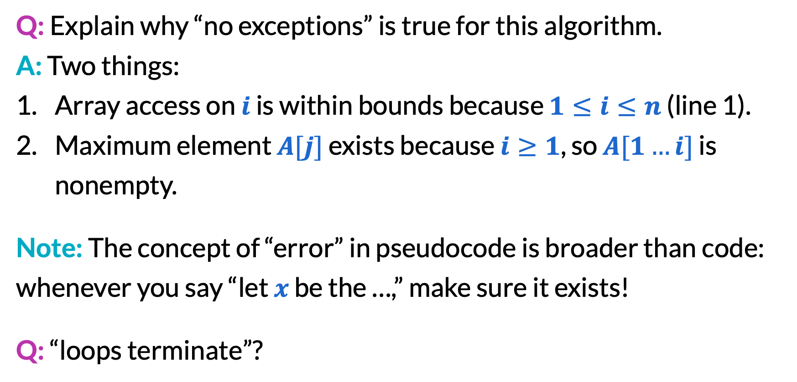
Selection sort (2/6)
Q: Explain why “no exceptions” is true for this algorithm.
A: Two things:
Array access on $i$ is within bounds because $1≤i≤n$ (line 1).
Maximum element $A[j]$ exists because $i≥1$, so $A[1…i]$ is nonempty.
Note: The concept of “error” in pseudocode is broader than code: whenever you say “let $x$ be the …,” make sure it exists!
Q: “loops terminate”?
A: For-loops always terminate!

Slide 30
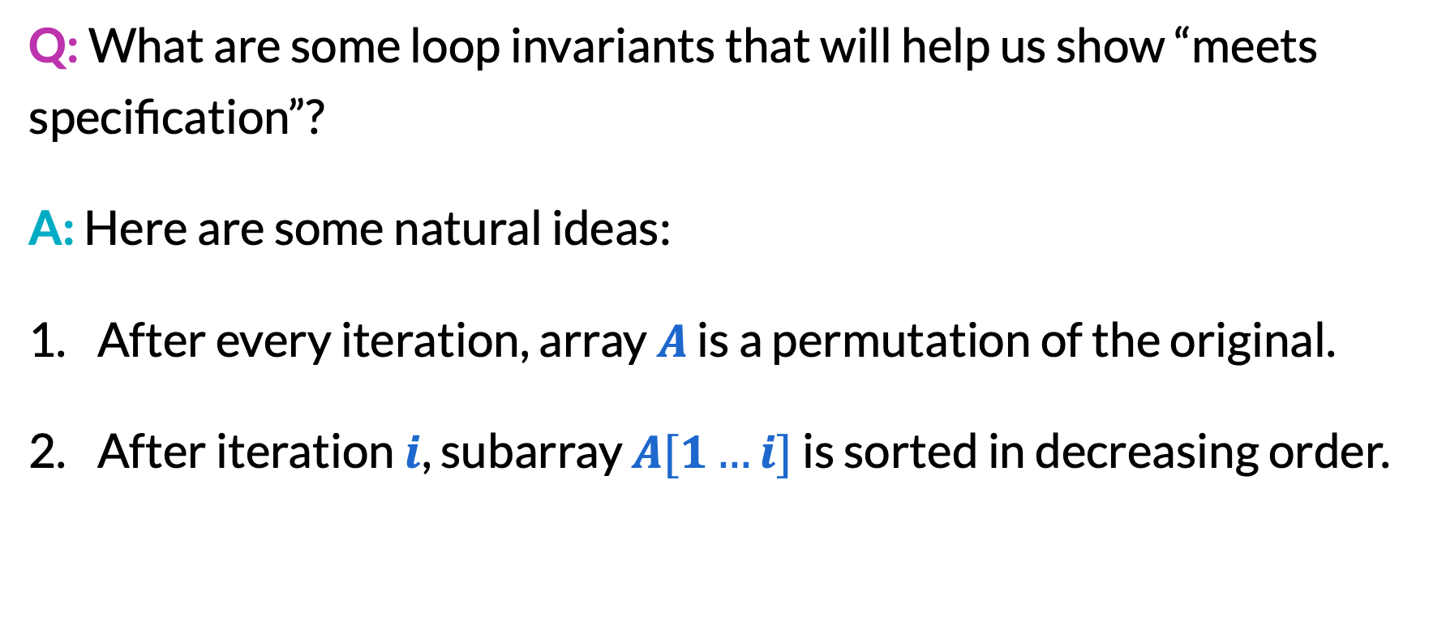
Selection sort (3/6)
Q: What are some loop invariants that will help us show “meets specification”?
A: Here are some natural ideas:
After every iteration, array $A$ is a permutation of the original.
After iteration $i$, subarray $A[1…i]$ is sorted in decreasing order.

Slide 31
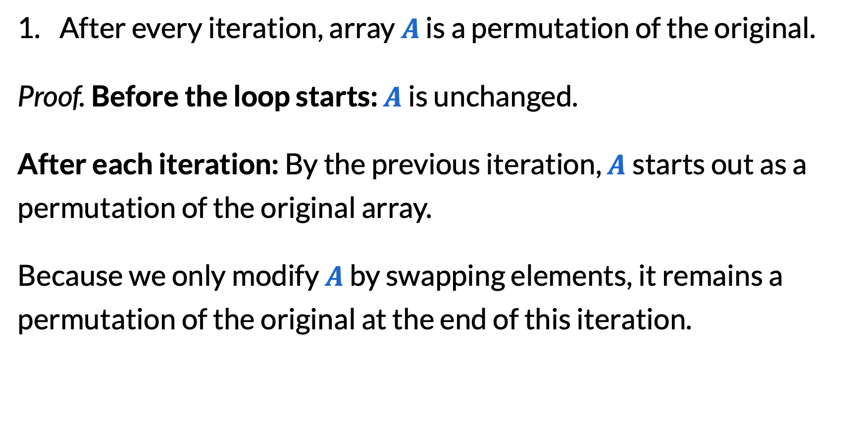
Selection sort (4/6)
After every iteration, array $A$ is a permutation of the original.
Proof. Before the loop starts: $A$ is unchanged.
After each iteration: By the previous iteration, $A$starts out as a permutation of the original array.
Because we only modify $A$ by swapping elements, it remains a permutation of the original at the end of this iteration.

Slide 32
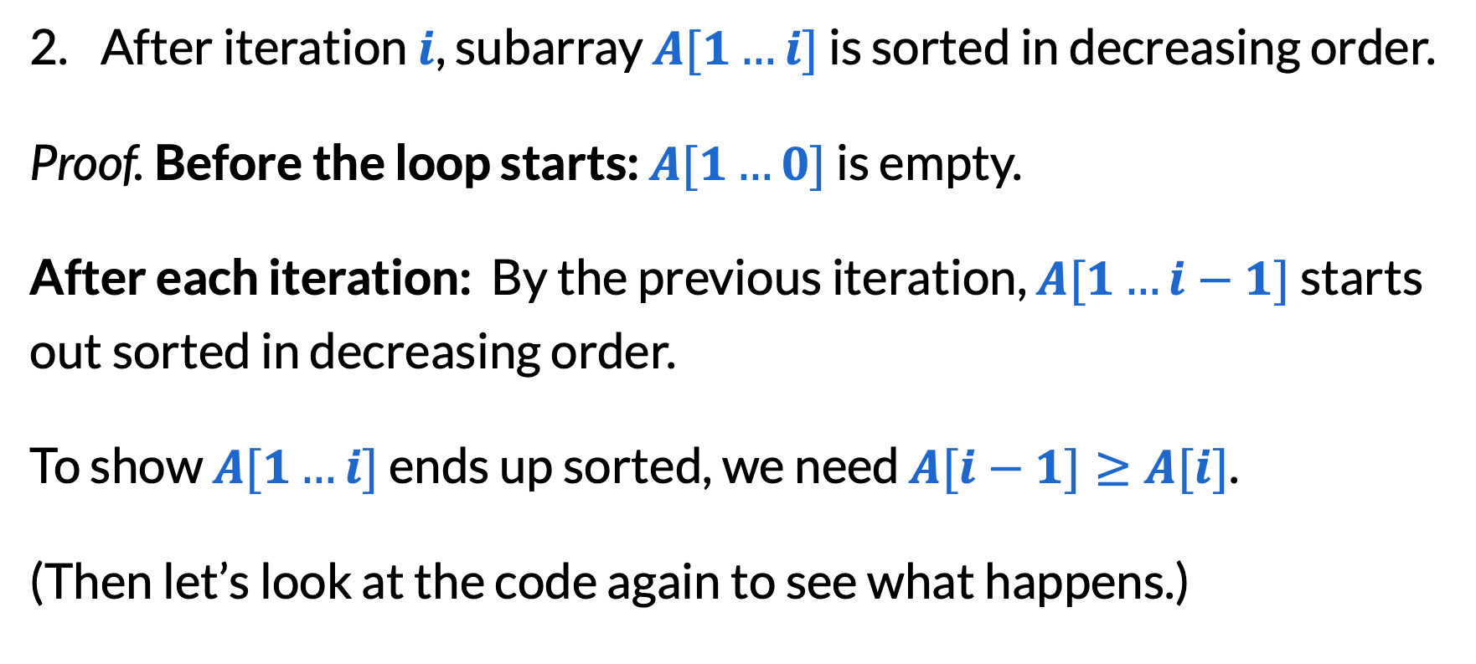
Selection sort (5/6)
After iteration $i$, subarray $A[1…i]$ is sorted in decreasing order.
Proof. Before the loop starts: $A[1…0]$ is empty.
After each iteration: By the previous iteration, $A[1…i−1]$ starts out sorted in decreasing order.
To show $A[1…i]$ ends up sorted, we need $A[i−1]≥A[i]$.
(Then let’s look at the code again to see what happens.)

Slide 33
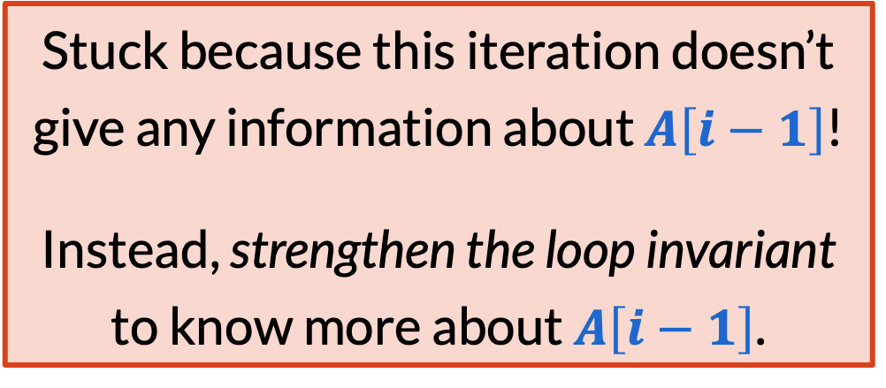
Selection sort (6/6)
Input: Array $A[1…n]$ of numbers
Goal: A permutation of $A$ that is sorted in decreasing order
​for $i=1,…,n$ do
Let $A[j]$ be the maximum element of $A[i…n]$.
Swap $A[i]$ and $A[j]$.
​return $A$
Stuck because this iteration doesn’t give any information about $A\left[i−1\right]$!
Instead, strengthen the loop invariant to know more about $A\left[i−1\right]$.

Slide 34
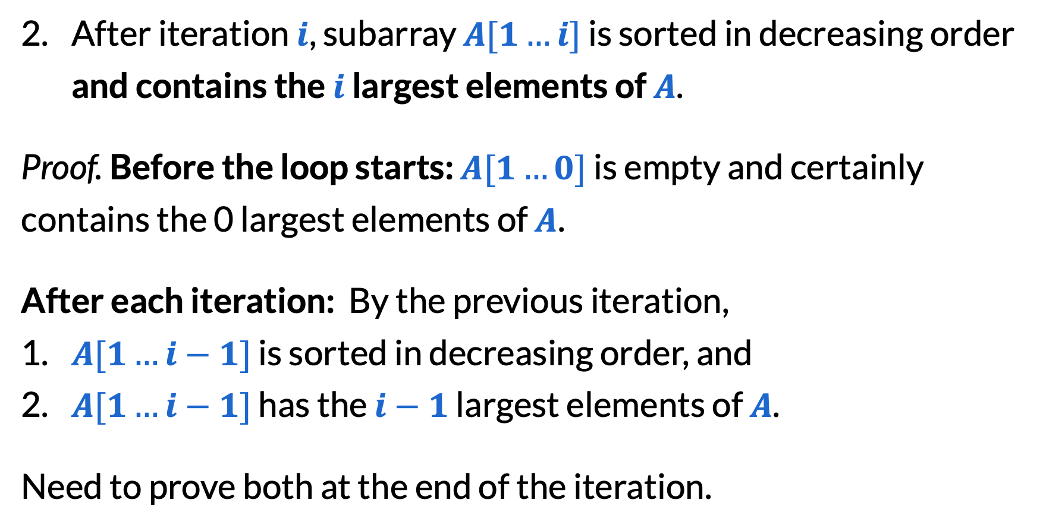
Strengthening the invariant (1/3)
After iteration $i$, subarray $A[1…i]$ is sorted in decreasing order and contains the $i$ largest elements of $A$.
Proof. Before the loop starts: $A[1…0]$ is empty and certainly contains the 0 largest elements of $A$.
After each iteration: By the previous iteration,
​$A[1…i−1]$ is sorted in decreasing order, and
​$A[1…i−1]$ has the $i−1$ largest elements of $A$.
Need to prove both at the end of the iteration.

Slide 35
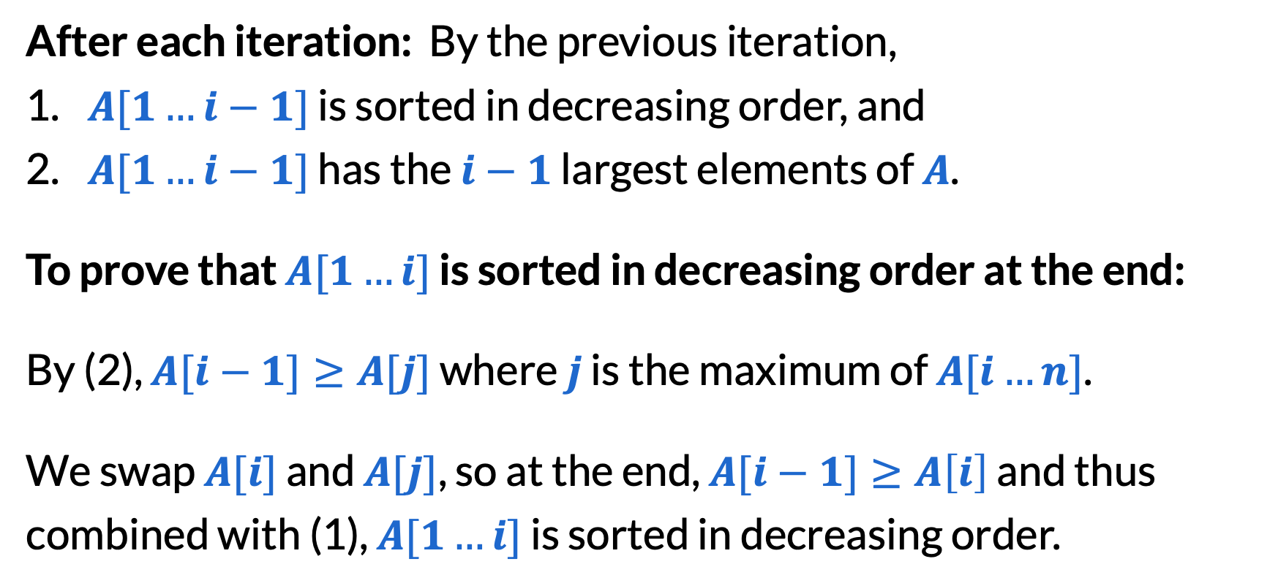
Strengthening the invariant (2/3)
After each iteration: By the previous iteration,
​$A[1…i−1]$ is sorted in decreasing order, and
​$A[1…i−1]$ has the $i−1$ largest elements of $A$.
To prove that $A[1…i]$ is sorted in decreasing order at the end:
By (2), $A[i−1]≥A[j]$ where $j$ is the maximum of $A[i…n]$.
We swap $A[i]$ and $A[j]$, so at the end, $A[i−1]≥A\left[i\right]$ and thus combined with (1), $A[1…i]$ is sorted in decreasing order.

Slide 36
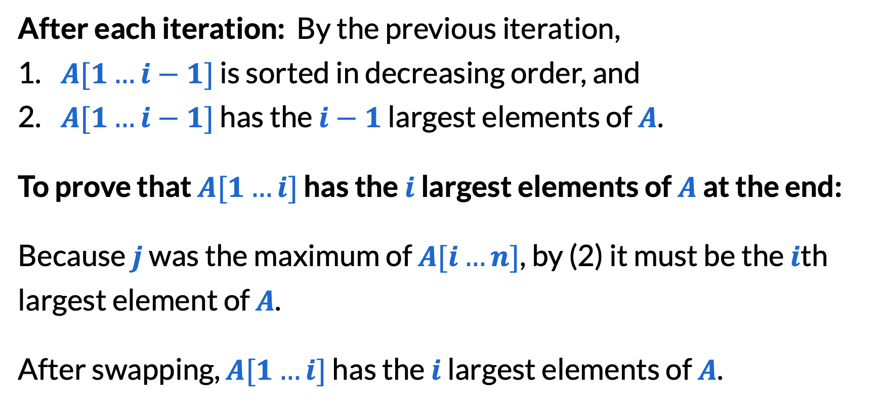
Strengthening the invariant (3/3)
After each iteration: By the previous iteration,
​$A[1…i−1]$ is sorted in decreasing order, and
​$A[1…i−1]$ has the $i−1$ largest elements of $A$.
To prove that $A[1…i]$ has the $i$ largest elements of $A$ at the end:
Because $j$ was the maximum of $A[i…n]$, by (2) it must be the $i$th largest element of $A$.
After swapping, $A[1…i]$ has the $i$ largest elements of $A$.

Slide 37
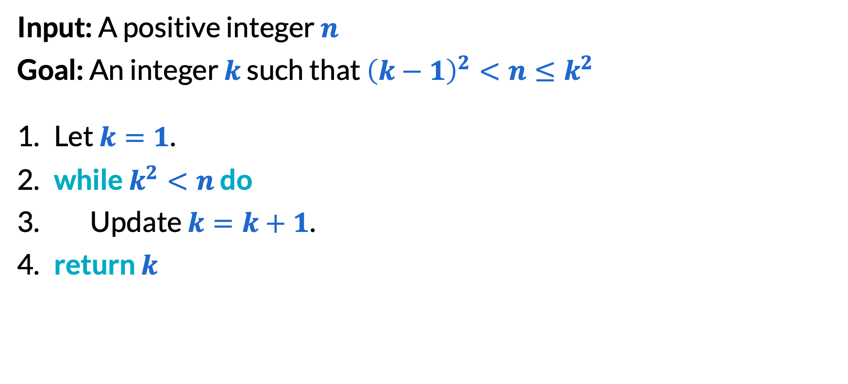
Integer square root (1/2)
Input: A positive integer $n$
Goal: An integer $k$ such that ${\left(k−1\right)}^{2}<n≤k^{2}$
Let $k=1$.
​while $k^{2}<n$ do
Update $k=k+1$.
​return $k$

Slide 38
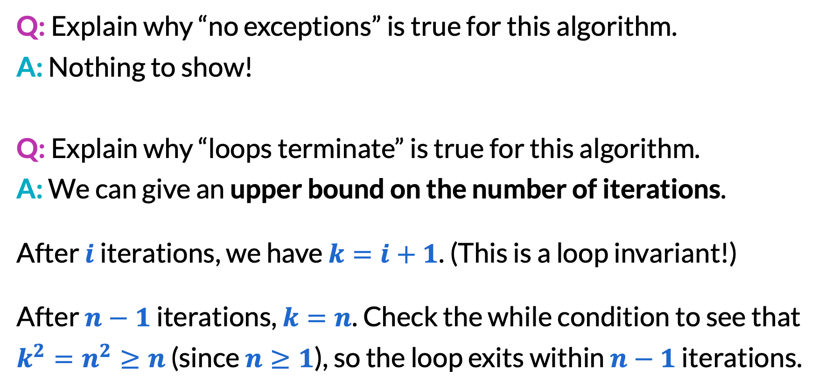
Integer square root (2/2)
Q: Explain why “no exceptions” is true for this algorithm.
A: Nothing to show!
Q: Explain why “loops terminate” is true for this algorithm.
A: We can give an upper bound on the number of iterations.
After $i$ iterations, we have $k=i+1$. (This is a loop invariant!)
After $n−1$ iterations, $k=n$. Check the while condition to see that $k^{2}=n^{2}≥n$ (since $n≥1$), so the loop exits within $n−1$ iterations.

Slide 39
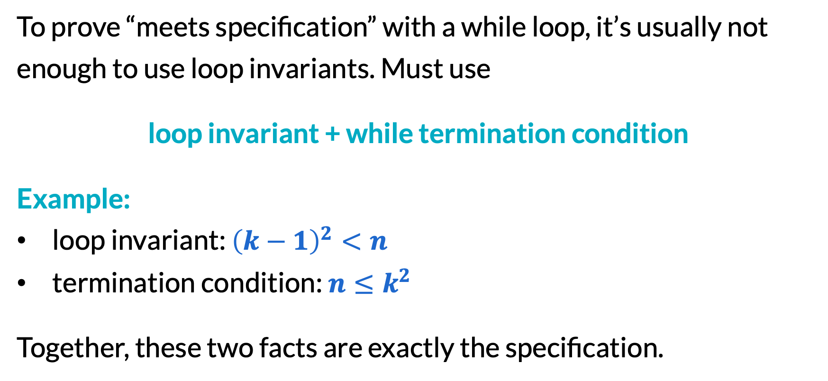
Proving code with while loops (1/3)
To prove “meets specification” with a while loop, it’s usually not enough to use loop invariants. Must use
loop invariant + while termination condition
Example:
loop invariant: ${\left(k−1\right)}^{2}<n$
termination condition: $n≤k^{2}$
Together, these two facts are exactly the specification.

Slide 40
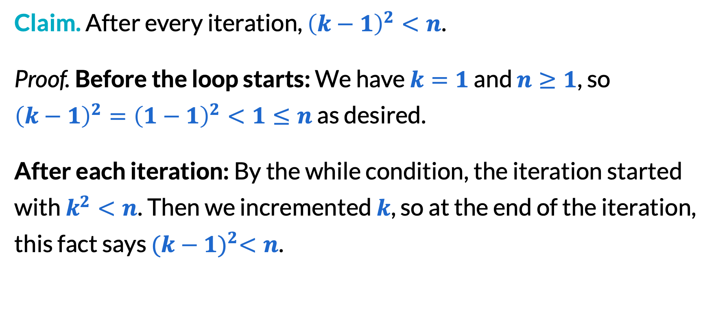
Proving code with while loops (2/3)
Claim. After every iteration, ${\left(k−1\right)}^{2}<n$.
Proof. Before the loop starts: We have $k=1$ and $n≥1$, so ${\left(k−1\right)}^{2}={\left(1−1\right)}^{2}<1≤n$ as desired.
After each iteration: By the while condition, the iteration started with $k^{2}<n$. Then we incremented $k$, so at the end of the iteration, this fact says ${(k−1)}^{2}<n$.
Didn’t use previous iteration!
Can jump to loop end instead of arguing iteration-by-iteration.

Slide 41
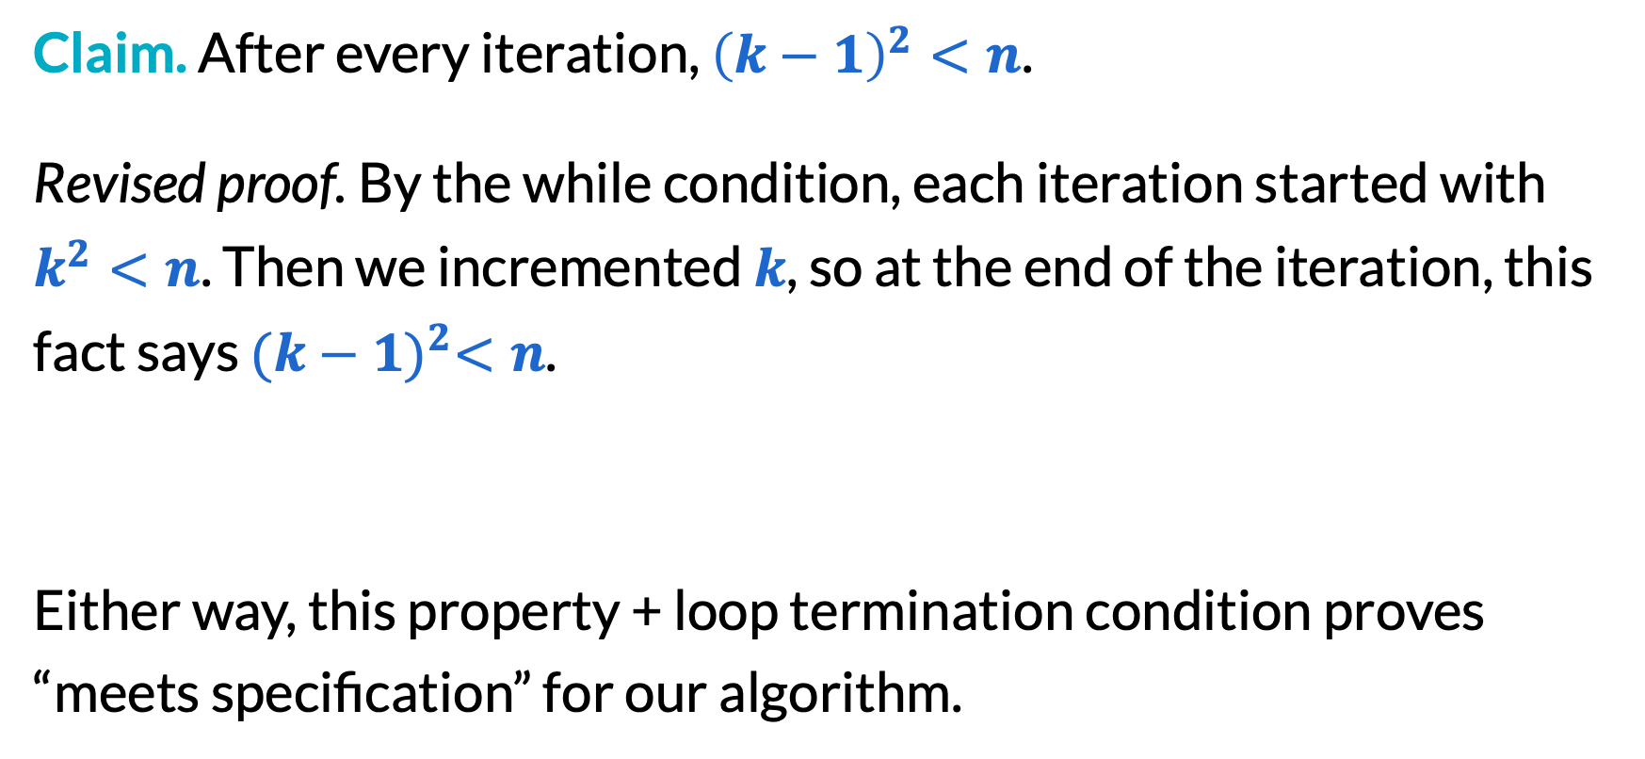
Proving code with while loops (3/3)
Claim. After every iteration, ${\left(k−1\right)}^{2}<n$.
Revised proof. By the while condition, each iteration started with $k^{2}<n$. Then we incremented $k$, so at the end of the iteration, this fact says ${(k−1)}^{2}<n$.
Either way, this property + loop termination condition proves “meets specification” for our algorithm.

Slide 42
Looking forward
In HW1 and HW2, we may ask you to state and proof loop invariants.
In homeworks after that, we recognize that this is very tedious, so feel free to just state the key loop invariants without proof (as long as you can prove them in your head).

Slide 43
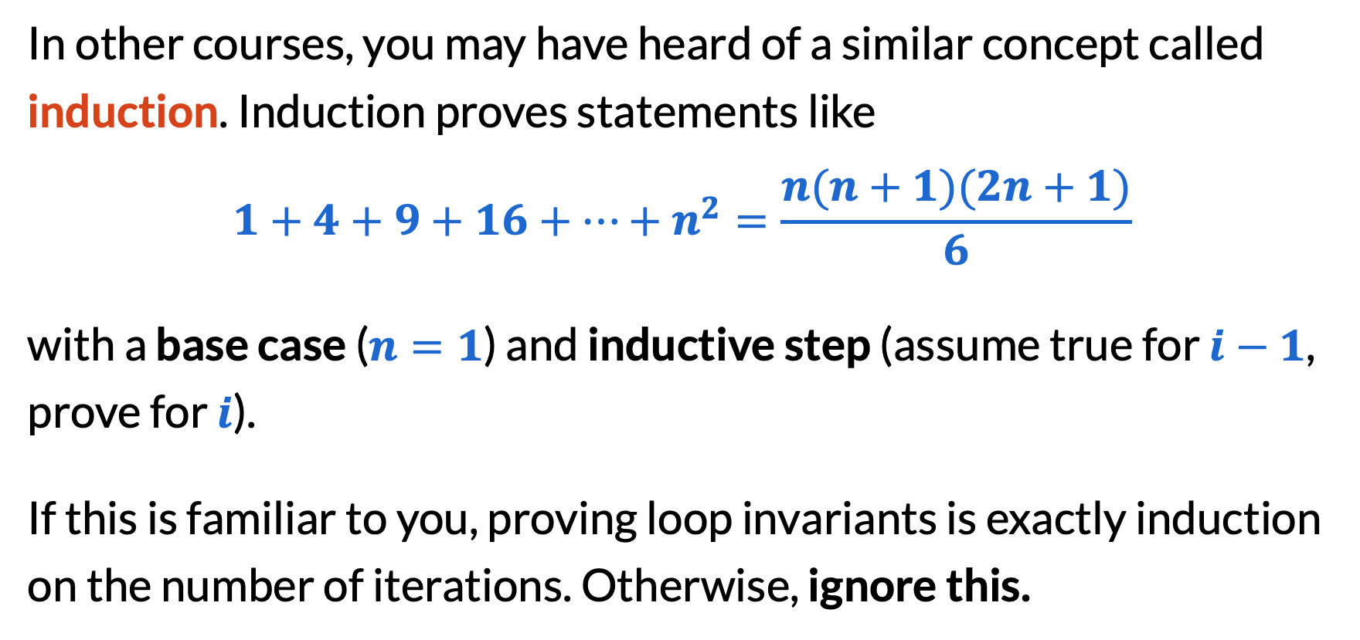
Induction
In other courses, you may have heard of a similar concept called induction. Induction proves statements like
$$1+4+9+16+…+n^{2}=\frac{n(n+1)(2n+1)}{6}$$
with a base case ($n=1$) and inductive step (assume true for $i−1$, prove for $i$).
If this is familiar to you, proving loop invariants is exactly induction on the number of iterations. Otherwise, ignore this.

Slide 44
Final reminders
HW1 released at 11:30am!
I have OH now-12:30pm:
Meet at front of classroom, we’ll walk over together
CSE (Allen) 214 if you’re coming later
Nathan has online OH 12–1pm:
Link on Canvas/course website
https://washington.zoom.us/my/nathanbrunelle

