Slide 1
Lecture 16: Dynamic Programming – Sequences
Nathan Brunelle

Slide 2
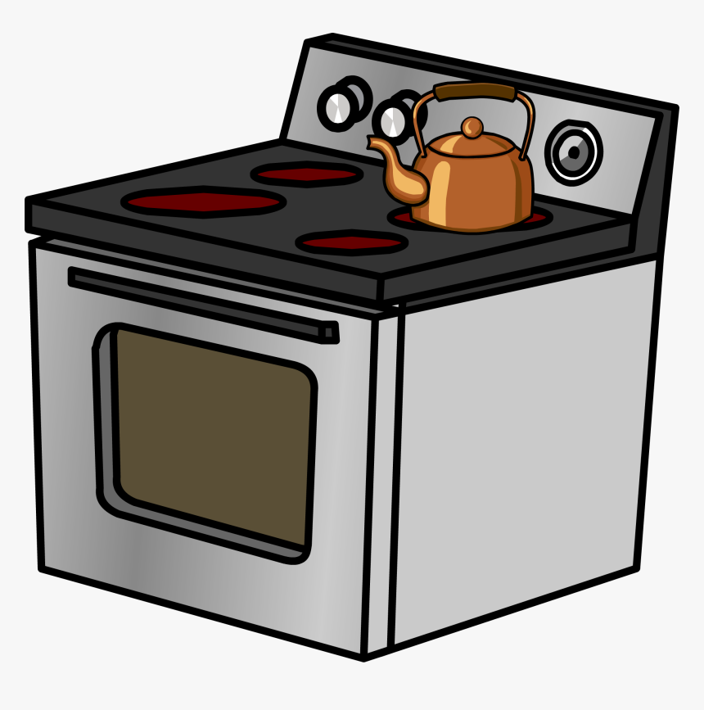
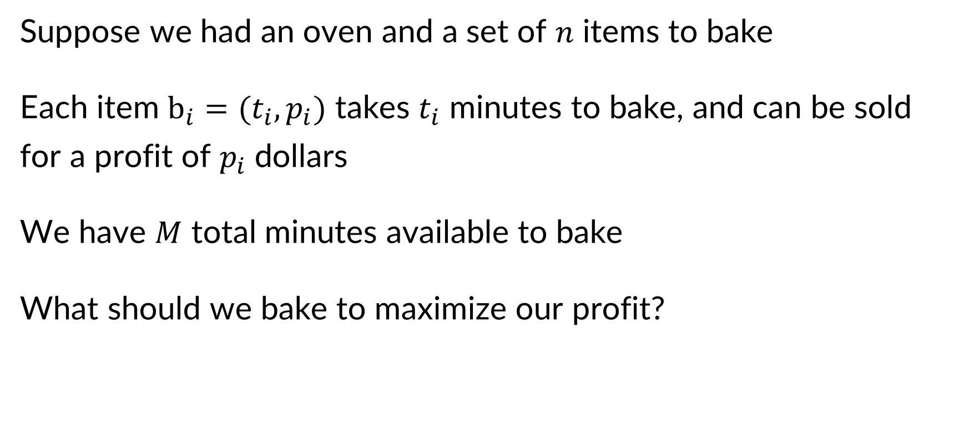

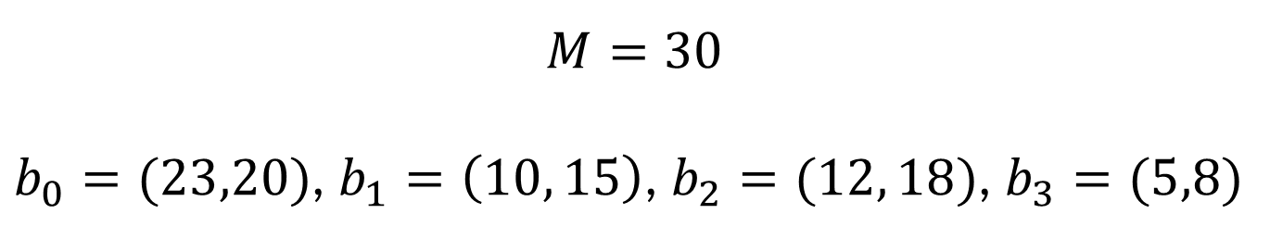
Oven Allocation (aka subset sum)
Suppose we had an oven and a set of $n$ items to bake
Each item $b_{i}=(t_{i},p_{i})$ takes $t_{i}$ minutes to bake, and can be sold for a profit of $p_{i}$ dollars
We have $M$ total minutes available to bake
What should we bake to maximize our profit?
Best solution: $b_{1},b_{2},b_{3}$
Uses 27 minutes
Earns $41
$$M=30$$
$b_{0}=(23,20)$, $b_{1}=\left(10, 15\right)$, $b_{2}=(12, 18)$, $b_{3}=(5,8)$

Slide 3
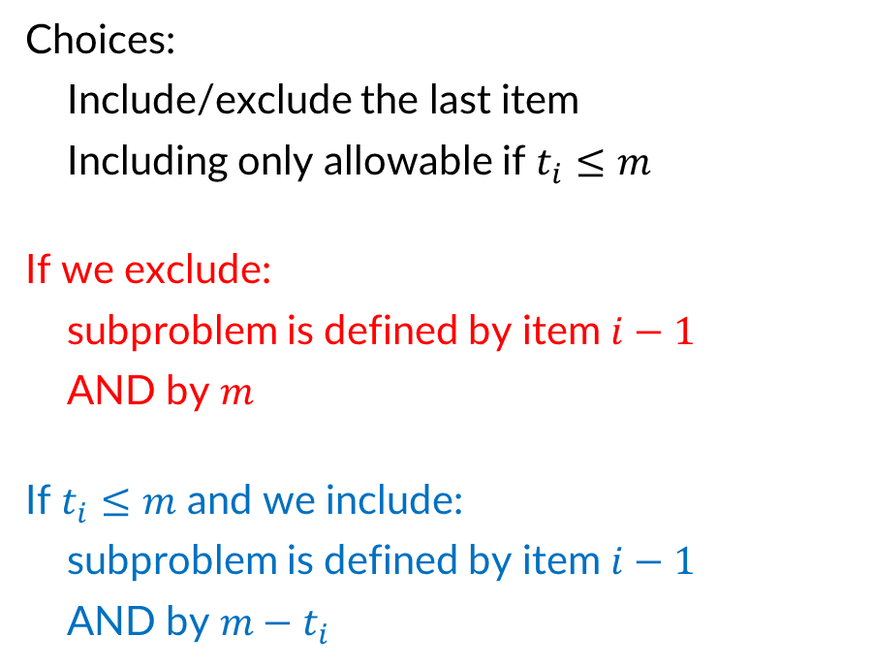





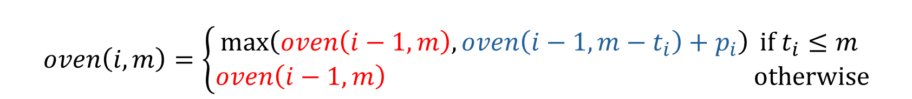
Oven Allocation – Full Recursive Structure
$$oven\left(i,m\right)=\left\{\begin{aligned}\max\left(oven\left(i−1,m\right),oven\left(i−1,m−t_{i}\right)+p_{i}\right) if t_{i}≤m \\ oven\left(i−1,m\right) otherwise\end{aligned}\right.$$
Choices:
Include/exclude the last item
Including only allowable if $t_{i}≤m$
If we exclude:
subproblem is defined by item $i−1$
AND by $m$
If $t_{i}≤m$ and we include:
subproblem is defined by item $i−1$
AND by $m−t_{i}$
$$v_{0}=3$$
$$v_{1}=4$$
$$v_{2}=4$$
$$v_{3}=7$$
$$v_{4}=2$$
$$v_{5}=1$$
Time
0
1
2
3
4
5
6
7
8
9
10

Slide 4
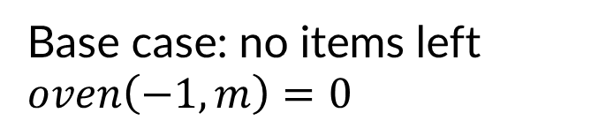
Oven Allocation – Base Case
$$oven\left(i,m\right)=\left\{\begin{aligned}\max\left(oven\left(i−1,m\right),oven\left(i−1,m−t_{i}\right)+p_{i}\right) if t_{i}≤m \\ oven\left(i−1,m\right) otherwise\end{aligned}\right.$$
Base case: no items left
$oven\left(−1,m\right)=0$
Time
0
1
2
3
4
5
6
7
8
9
10

Slide 5
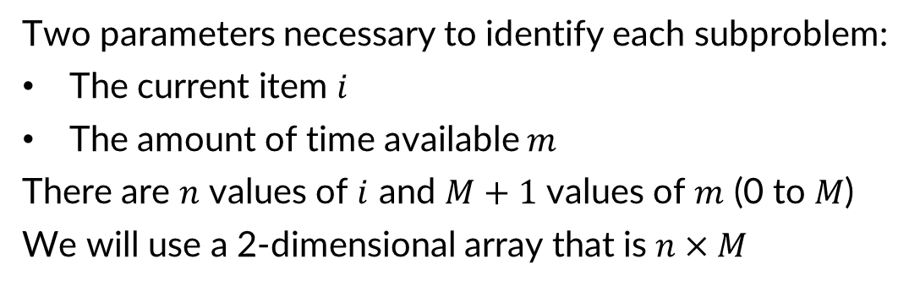


Oven Allocation – Memory Structure
$$oven\left(i,m\right)=\left\{\begin{aligned}\max\left(oven\left(i−1,m\right),oven\left(i−1,m−t_{i}\right)+p_{i}\right) if t_{i}≤m \\ oven\left(i−1,m\right) otherwise\end{aligned}\right.$$
Two parameters necessary to identify each subproblem:
The current item $i$
The amount of time available $m$
There are $n$ values of $i$ and $M+1$ values of $m$ (0 to $M$)
We will use a 2-dimensional array that is $n×M$
$$v_{0}=3$$
$M+1$ columns
$$v_{1}=4$$
$$v_{2}=4$$
$$v_{3}=7$$
$$v_{4}=2$$
$n$ rows
$$v_{5}=1$$
Time
0
1
2
3
4
5
6
7
8
9
10

Slide 6
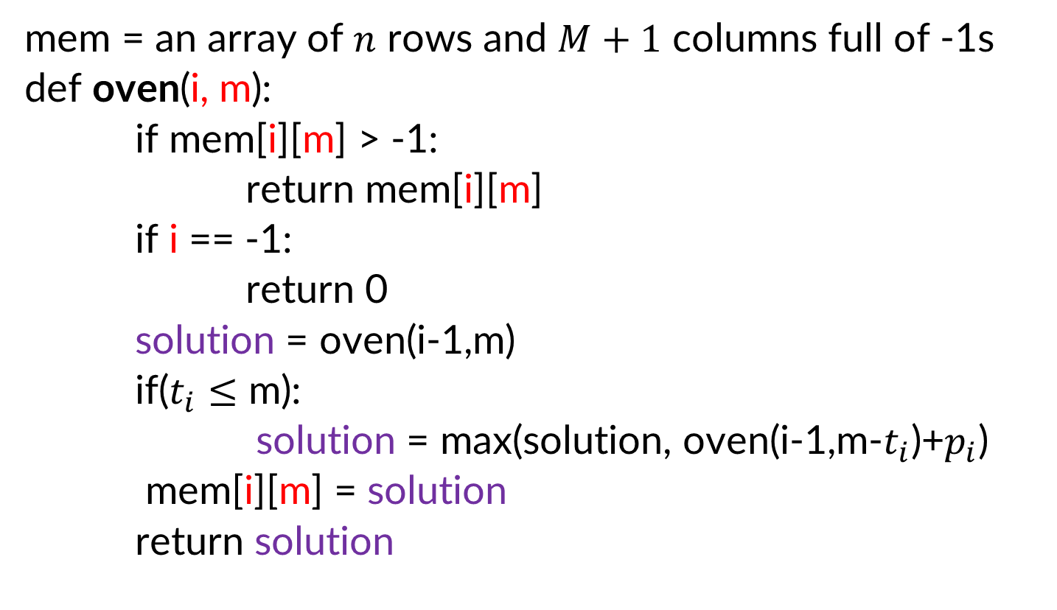
Oven Allocation Top-Down
mem = an array of $n$ rows and $M+1$ columns full of -1s
def oven(i, m):
if mem[i][m] > -1:
return mem[i][m]
if i == -1:
return 0
solution = oven(i-1,m)
if($t_{i}≤$ m):
solution = max(solution, oven(i-1,m-$t_{i}$)+$p_{i}$)
mem[i][m] = solution
return solution

Slide 7
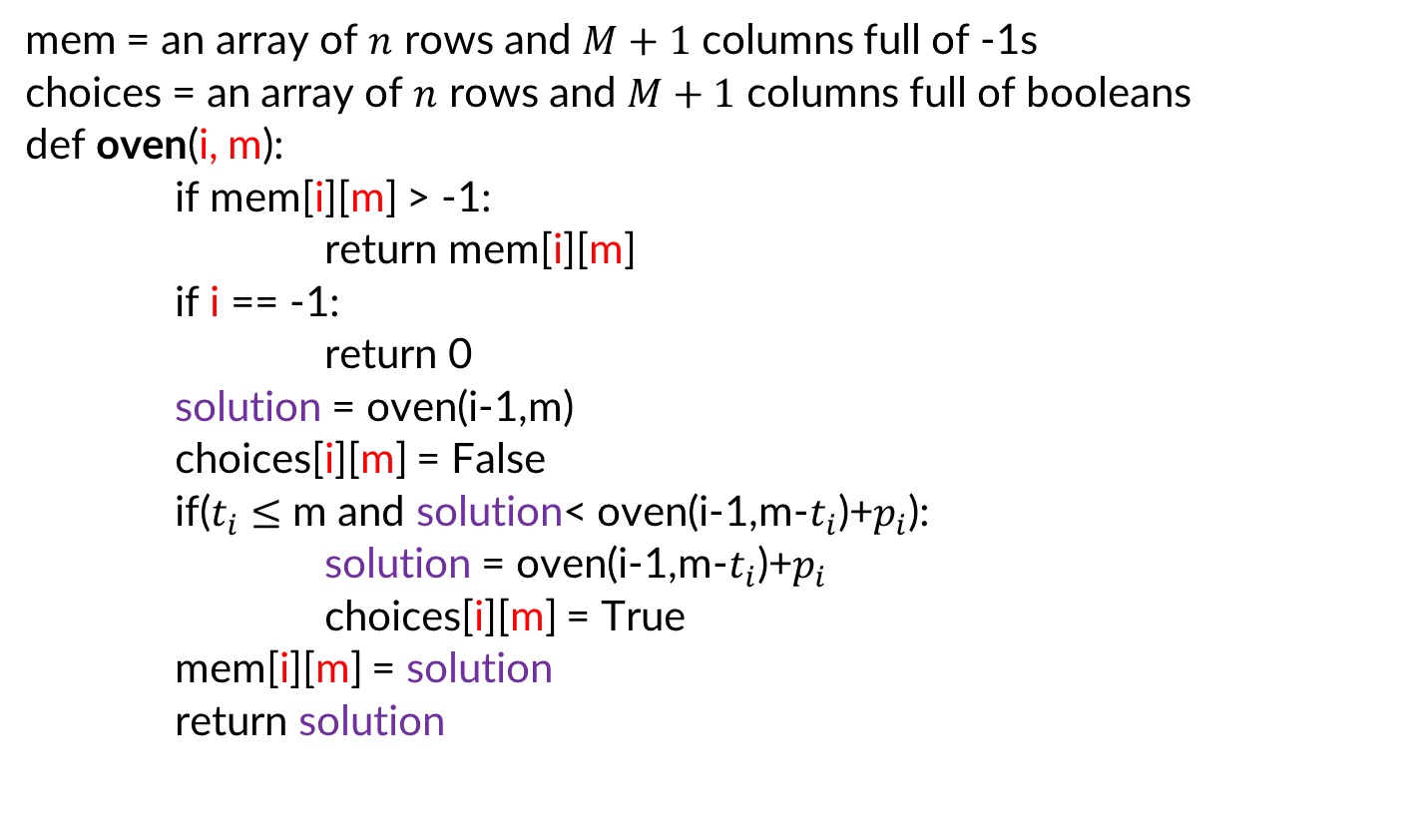
Oven Allocation Top-Down with choices
mem = an array of $n$ rows and $M+1$ columns full of -1s
choices = an array of $n$ rows and $M+1$ columns full of booleans
def oven(i, m):
if mem[i][m] > -1:
return mem[i][m]
if i == -1:
return 0
solution = oven(i-1,m)
choices[i][m] = False
if($t_{i}≤$ m and solution< oven(i-1,m-$t_{i}$)+$p_{i}$):
solution = oven(i-1,m-$t_{i}$)+$p_{i}$
choices[i][m] = True
mem[i][m] = solution
return solution

Slide 8




Oven Allocation Example
0
$$oven\left(i,m\right)=\left\{\begin{aligned}\max\left(oven\left(i−1,m\right),oven\left(i−1,m−t_{i}\right)+p_{i}\right) if t_{i}≤m \\ oven\left(i−1,m\right) otherwise\end{aligned}\right.$$
1
2
mem
$$+v_{3}$$
3
4
$$+v_{4}$$
$$+v_{4}$$
5
+$v_{5}$
$$v_{0}=3$$
0
1
2
3
4
5
6
7
8
9
10
$$v_{1}=4$$
0
$$v_{2}=4$$
$$v_{3}=7$$
1
choices
$$v_{4}=2$$
2
$$v_{5}=1$$
3
Time
4
0
1
2
3
4
5
6
7
8
9
10
5
0
1
2
3
4
5
6
7
8
9
10

Slide 9
Oven Allocation Example - complete
0
0
0
0
3
3
3
3
3
3
3
0
0
0
3
4
4
7
7
7
$$oven\left(i,m\right)=\left\{\begin{aligned}\max\left(oven\left(i−1,m\right),oven\left(i−1,m−t_{i}\right)+p_{i}\right) if t_{i}≤m \\ oven\left(i−1,m\right) otherwise\end{aligned}\right.$$
1
2
0
4
4
8
11
mem
$$+v_{3}$$
3
4
8
11
4
$$+v_{4}$$
8
$$+v_{4}$$
11
5
+$v_{5}$
11
$$v_{0}=3$$
0
1
2
3
4
5
6
7
8
9
10
$$v_{1}=4$$
0
F
F
F
T
T
T
T
T
T
T
$$v_{2}=4$$
1
F
F
F
F
T
T
T
T
T
$$v_{3}=7$$
choices
$$v_{4}=2$$
2
F
T
F
T
T
$$v_{5}=1$$
3
F
F
F
Time
4
F
F
0
1
2
3
4
5
6
7
8
9
10
5
F
0
1
2
3
4
5
6
7
8
9
10

Slide 10
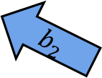
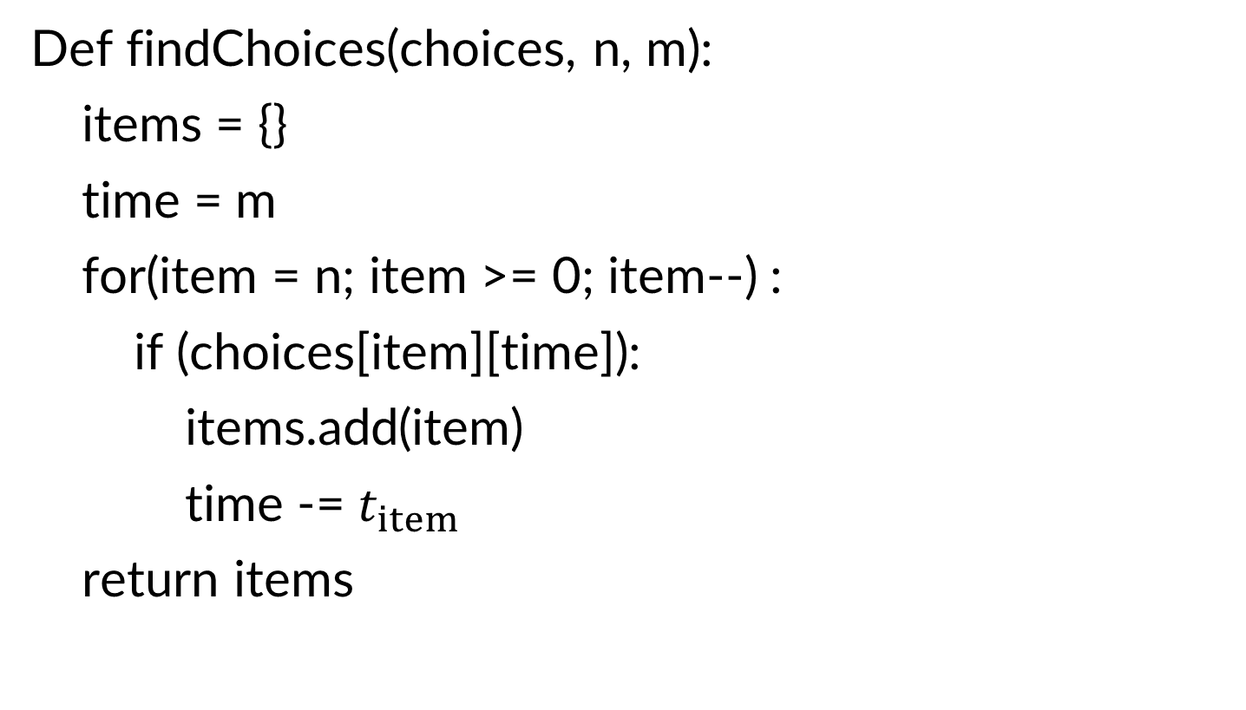
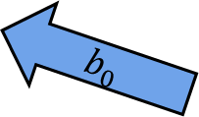
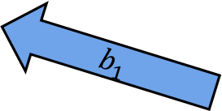
Using Choices
Def findChoices(choices, n, m):
items = {}
time = m
for(item = n; item >= 0; item--) :
if (choices[item][time]):
items.add(item)
time -= $t_{item}$
return items
$$b_{0}$$
0
F
F
F
T
T
T
T
T
T
T
$$b_{1}$$
1
F
F
F
F
T
T
T
T
T
$$b_{2}$$
2
F
T
F
T
T
3
F
F
F
4
F
F
5
F
0
1
2
3
4
5
6
7
8
9
10

Slide 11
Selecting an order
0
$$oven\left(i,m\right)=\left\{\begin{aligned}\max\left(oven\left(i−1,m\right),oven\left(i−1,m−t_{i}\right)+p_{i}\right) if t_{i}≤m \\ oven\left(i−1,m\right) otherwise\end{aligned}\right.$$
1
2
mem
$$+v_{3}$$
3
4
$$+v_{4}$$
$$+v_{4}$$
5
+$v_{5}$
0
1
2
3
4
5
6
7
8
9
10
Each subproblem needs only cells in the row above it, and to its left.
Sufficient to fill in top to bottom, left to right

Slide 12
Four Steps – Oven Allocation Step 4
Formulate the answer with a recursive structure
  What are the options for the last choice?
  For each such option, what does the subproblem look like? How do we use it?
Choose a memory structure.
  Figure out the possible values of all parameters in the recursive calls.
  How many subproblems (options for last choice) are there?
  What are the parameters needed to identify each?
  How many different values could there be per parameter?
Specify an order of evaluation. (Optional)
  Want to guarantee that the necessary subproblem solutions are in memory when you need them.
  With this step: a “Bottom-up” (iterative) algorithm
  Without this step: a “Top-down” (recursive) algorithm
See if there’s a way to save space (Optional)
  Is it possible to reuse some memory locations?

Slide 13
Can we save space?
0
$$oven\left(i,m\right)=\left\{\begin{aligned}\max\left(oven\left(i−1,m\right),oven\left(i−1,m−t_{i}\right)+p_{i}\right) if t_{i}≤m \\ oven\left(i−1,m\right) otherwise\end{aligned}\right.$$
1
2
mem
$$+v_{3}$$
3
4
$$+v_{4}$$
$$+v_{4}$$
5
+$v_{5}$
0
1
2
3
4
5
6
7
8
9
10
Each subproblem needs only cells in the row above it
Two rows are enough: the current one, and the one with subproblem solutions

Slide 14
String Similarity
o
c
u
r
r
a
n
c
e
-
How similar are two strings?
  ocurrance
  occurrence
o
c
c
u
r
r
e
n
c
e
6 mismatches, 1 gap
Clearly a better matching
o
c
-
u
r
r
a
n
c
e
o
c
c
u
r
r
e
n
c
e
1 mismatch, 1 gap
Maybe a better matching
depends on cost of gaps vs mismatches
o
c
-
u
r
r
-
a
n
c
e
o
c
c
u
r
r
e
-
n
c
e
0 mismatches, 3 gaps

Slide 15
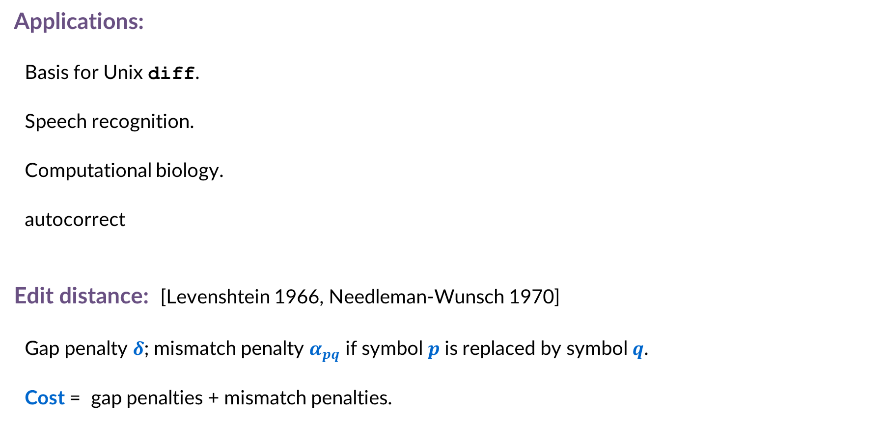


Edit Distance
Applications:
  Basis for Unix diff.
  Speech recognition.
  Computational biology.
  autocorrect
Edit distance: [Levenshtein 1966, Needleman-Wunsch 1970]
  Gap penalty $δ$; mismatch penalty $α_{pq}$ if symbol $p$ is replaced by symbol $q$.
  Cost = gap penalties + mismatch penalties.
C
T
G
A
C
C
T
A
C
C
T
-
C
T
G
A
C
C
T
A
C
C
T
C
C
T
G
A
C
T
A
C
A
T
C
C
T
G
A
C
-
T
A
C
A
T
$$α_{\text{TC}}+α_{\text{GT}}+α_{\text{AG}}+2α_{\text{CA}}$$
$$2δ+α_{\text{CA}}$$
Notes:
Levenshtein introduced concept of edit-distance; Needleman-Wunsch first applied it to aligning biological sequences; our algorithm is closest in spirit to Smith-Waterman (but their algorithm is for local alignment)
Presumably alpha_pp = 0, but assumption not needed (could be a profit instead of penalty)
bonus application: spam filter - compare message with known spam messages

Slide 16



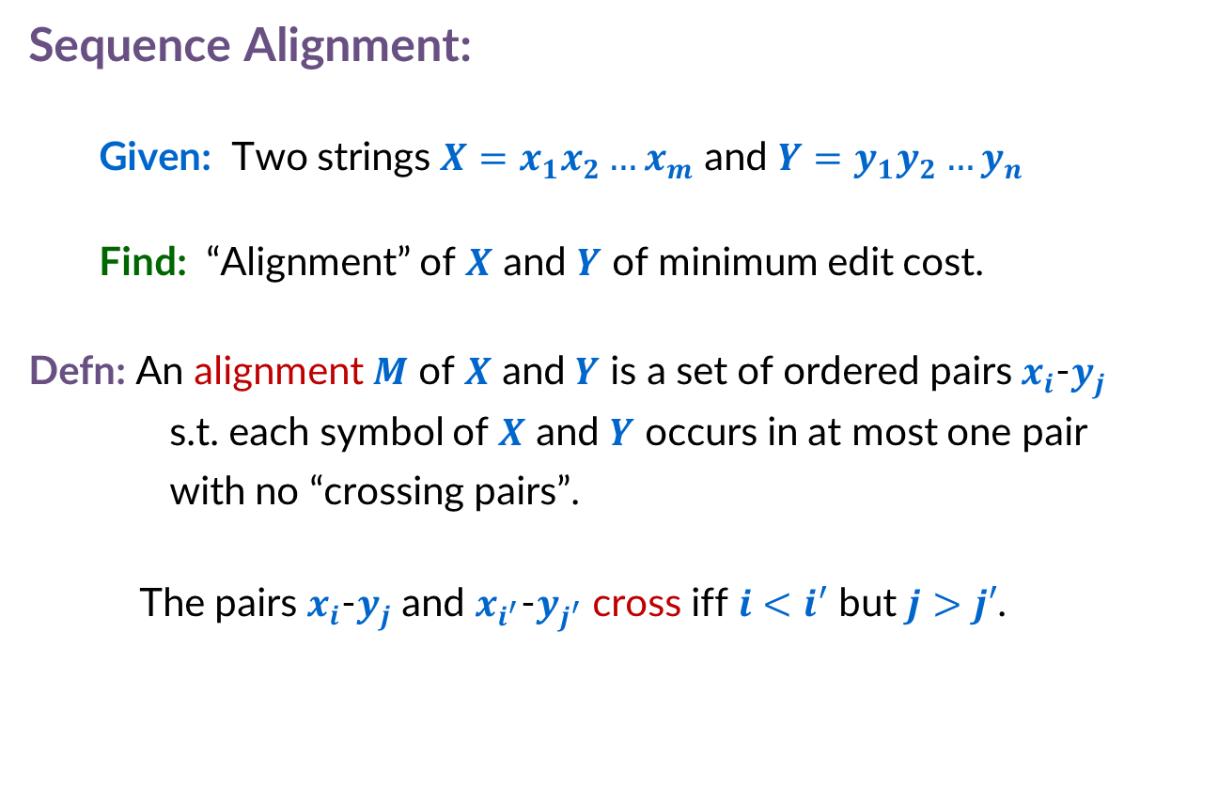



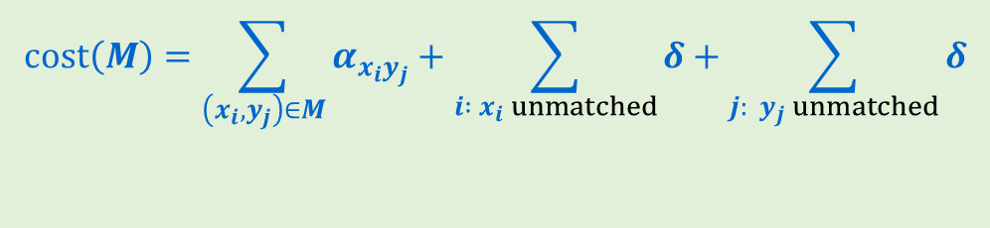








Sequence Alignment
Example:
CTACCG vs TACATG
Sequence Alignment:
  Given: Two strings $X=x_{1}x_{2}…x_{m}$ and $Y=y_{1}y_{2}…y_{n}$
  Find: “Alignment” of $X$ and $Y$ of minimum edit cost.
Defn: An alignment $M$ of $X$ and $Y$ is a set of ordered pairs $x_{i}$-$y_{j}$ s.t. each symbol of $X$ and $Y$ occurs in at most one pair with no “crossing pairs”.
  The pairs $x_{i}$-$y_{j}$ and $x_{i^{′}}$-$y_{j^{′}}$ cross iff $i<i′$ but $j>j′$.
$$x_{1}$$
$$x_{2}$$
$$x_{3}$$
$$x_{4}$$
$$x_{5}$$
$$x_{6}$$
C
T
A
C
C
-
G
-
T
A
C
A
T
G
$$y_{1}$$
$$y_{2}$$
$$y_{3}$$
$$y_{4}$$
$$y_{5}$$
$$y_{6}$$
$M=\{x_{2}\text{−}y_{1}$, $x_{3}$-$y_{2}$, $x_{4}$-$y_{3}$, $x_{5}$-$y_{4}$, $x_{6}$-$y_{6}$}
$$cost\left(M\right)=\sum_{\left(x_{i},y_{j}\right)∈M}{α_{x_{i}y_{j}}}+\sum_{i :{ x}_{i} unmatched}{δ}+\sum_{j:{ y}_{j} unmatched}{δ}$$
mismatch
gap
Note: if $x_{i}=y_{j}$ then $α_{x_{i}y_{j}}=0$

Slide 17
Edit Distance – Four Steps, Step 1
Formulate the answer with a recursive structure
  What are the options for the last choice?
  For each such option, what does the subproblem look like? How do we use it?
Choose a memory structure.
  Figure out the possible values of all parameters in the recursive calls.
  How many subproblems (options for last choice) are there?
  What are the parameters needed to identify each?
  How many different values could there be per parameter?
Specify an order of evaluation. (Optional)
  Want to guarantee that the necessary subproblem solutions are in memory when you need them.
  With this step: a “Bottom-up” (iterative) algorithm
  Without this step: a “Top-down” (recursive) algorithm
See if there’s a way to save space (Optional)
  Is it possible to reuse some memory locations?

Slide 18



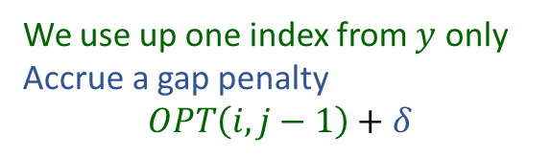




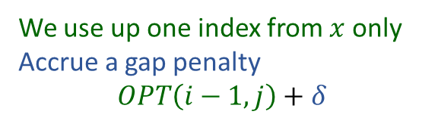


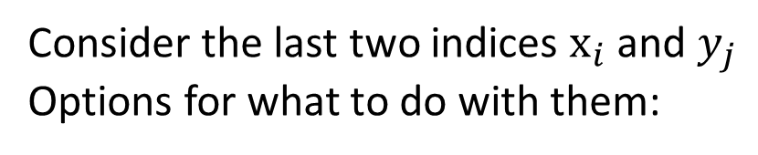



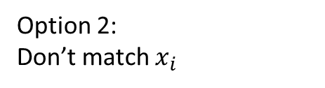
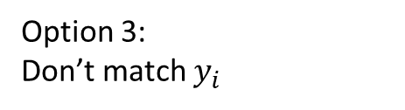

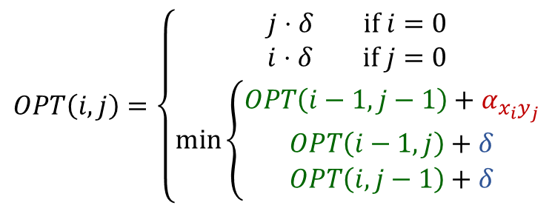

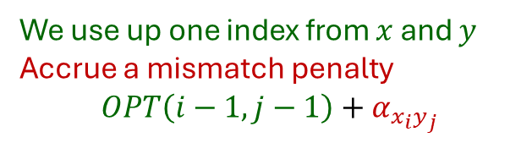










Step 1: Identify Recursive Structure
$$x_{1}$$
$$x_{2}$$
$$x_{3}$$
$$x_{4}$$
$$x_{5}$$
$$x_{6}$$
C
T
A
C
C
G
Consider the last two indices $x_{i}$ and $y_{j}$
Options for what to do with them:
T
A
C
A
T
G
$$y_{1}$$
$$y_{2}$$
$$y_{3}$$
$$y_{4}$$
$$y_{5}$$
$$y_{6}$$
$$x_{1}$$
$$x_{2}$$
$$x_{3}$$
$$x_{4}$$
$$x_{5}$$
$$x_{6}$$
C
T
A
C
C
G
We use up one index from $x$ and $y$
Accrue a mismatch penalty
$$OPT\left(i−1,j−1\right)+α_{x_{i}y_{j}}$$
Option 1:
Match them
T
A
C
A
T
G
$$OPT\left(i,j\right)=\left\{\begin{aligned}j⋅δ if i=0 \\ i⋅δ if j=0 \\ \min\left\{\begin{aligned}OPT\left(i−1,j−1\right)+α_{x_{i}y_{j}} \\ OPT\left(i−1,j\right)+δ \\ OPT\left(i,j−1\right)+δ\end{aligned}\right.\end{aligned}\right.$$
$$y_{1}$$
$$y_{2}$$
$$y_{3}$$
$$y_{4}$$
$$y_{5}$$
$$y_{6}$$
$$x_{1}$$
$$x_{2}$$
$$x_{3}$$
$$x_{4}$$
$$x_{5}$$
$$x_{6}$$
C
T
A
C
C
G
We use up one index from $x$ only
Accrue a gap penalty
$$OPT\left(i−1,j\right)+δ$$
Option 2:
Don’t match $x_{i}$
T
A
C
A
T
G
-
$$y_{1}$$
$$y_{2}$$
$$y_{3}$$
$$y_{4}$$
$$y_{5}$$
$$y_{6}$$
$$x_{1}$$
$$x_{2}$$
$$x_{3}$$
$$x_{4}$$
$$x_{5}$$
$$x_{6}$$
Option 3:
Don’t match $y_{i}$
-
We use up one index from $y$ only
Accrue a gap penalty
$$OPT\left(i,j−1\right)+δ$$
C
T
A
C
C
G
T
A
C
A
T
G
$$y_{1}$$
$$y_{2}$$
$$y_{3}$$
$$y_{4}$$
$$y_{5}$$
$$y_{6}$$

Slide 19
Edit Distance – Four Steps, Step 2
C
T
A
C
C
G
Formulate the answer with a recursive structure
  What are the options for the last choice?
  For each such option, what does the subproblem look like? How do we use it?
Choose a memory structure.
  Figure out the possible values of all parameters in the recursive calls.
  How many subproblems (options for last choice) are there?
  What are the parameters needed to identify each?
  How many different values could there be per parameter?
Specify an order of evaluation. (Optional)
  Want to guarantee that the necessary subproblem solutions are in memory when you need them.
  With this step: a “Bottom-up” (iterative) algorithm
  Without this step: a “Top-down” (recursive) algorithm
See if there’s a way to save space (Optional)
  Is it possible to reuse some memory locations?
T
A
C
A
T
G
-
C
T
A
C
C
G
C
T
A
C
C
G
-
T
A
C
A
T
G
T
A
C
A
T
G

Slide 20



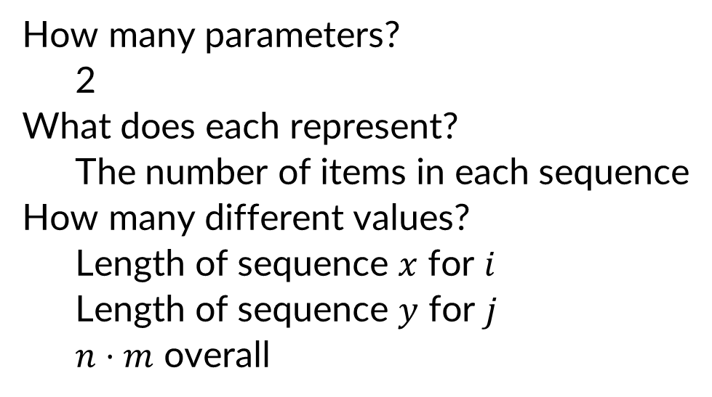

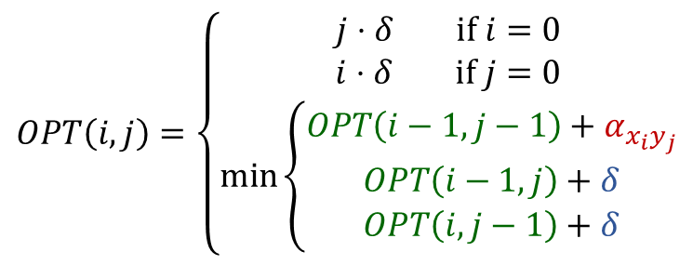










Step 2: Identify Memory Structure
$$x_{1}$$
$$x_{2}$$
$$x_{3}$$
$$x_{4}$$
$$x_{5}$$
$$x_{6}$$
C
T
A
C
C
G
T
A
C
A
T
G
$$OPT\left(i,j\right)=\left\{\begin{aligned}j⋅δ if i=0 \\ i⋅δ if j=0 \\ \min\left\{\begin{aligned}OPT\left(i−1,j−1\right)+α_{x_{i}y_{j}} \\ OPT\left(i−1,j\right)+δ \\ OPT\left(i,j−1\right)+δ\end{aligned}\right.\end{aligned}\right.$$
$$y_{1}$$
$$y_{2}$$
$$y_{3}$$
$$y_{4}$$
$$y_{5}$$
$$y_{6}$$
How many parameters?
  2
What does each represent?
  The number of items in each sequence
How many different values?
  Length of sequence $x$ for $i$
  Length of sequence $y$ for $j$
  $n⋅m$ overall
$$y_{1}$$
$$y_{2}$$
$$y_{3}$$
$$y_{4}$$
$$y_{5}$$
$$y_{6}$$
$$y_{7}$$
$$y_{8}$$
$$x_{1}$$
$$x_{2}$$
$$x_{3}$$
$$x_{4}$$
$$x_{5}$$
$$x_{6}$$

Slide 21
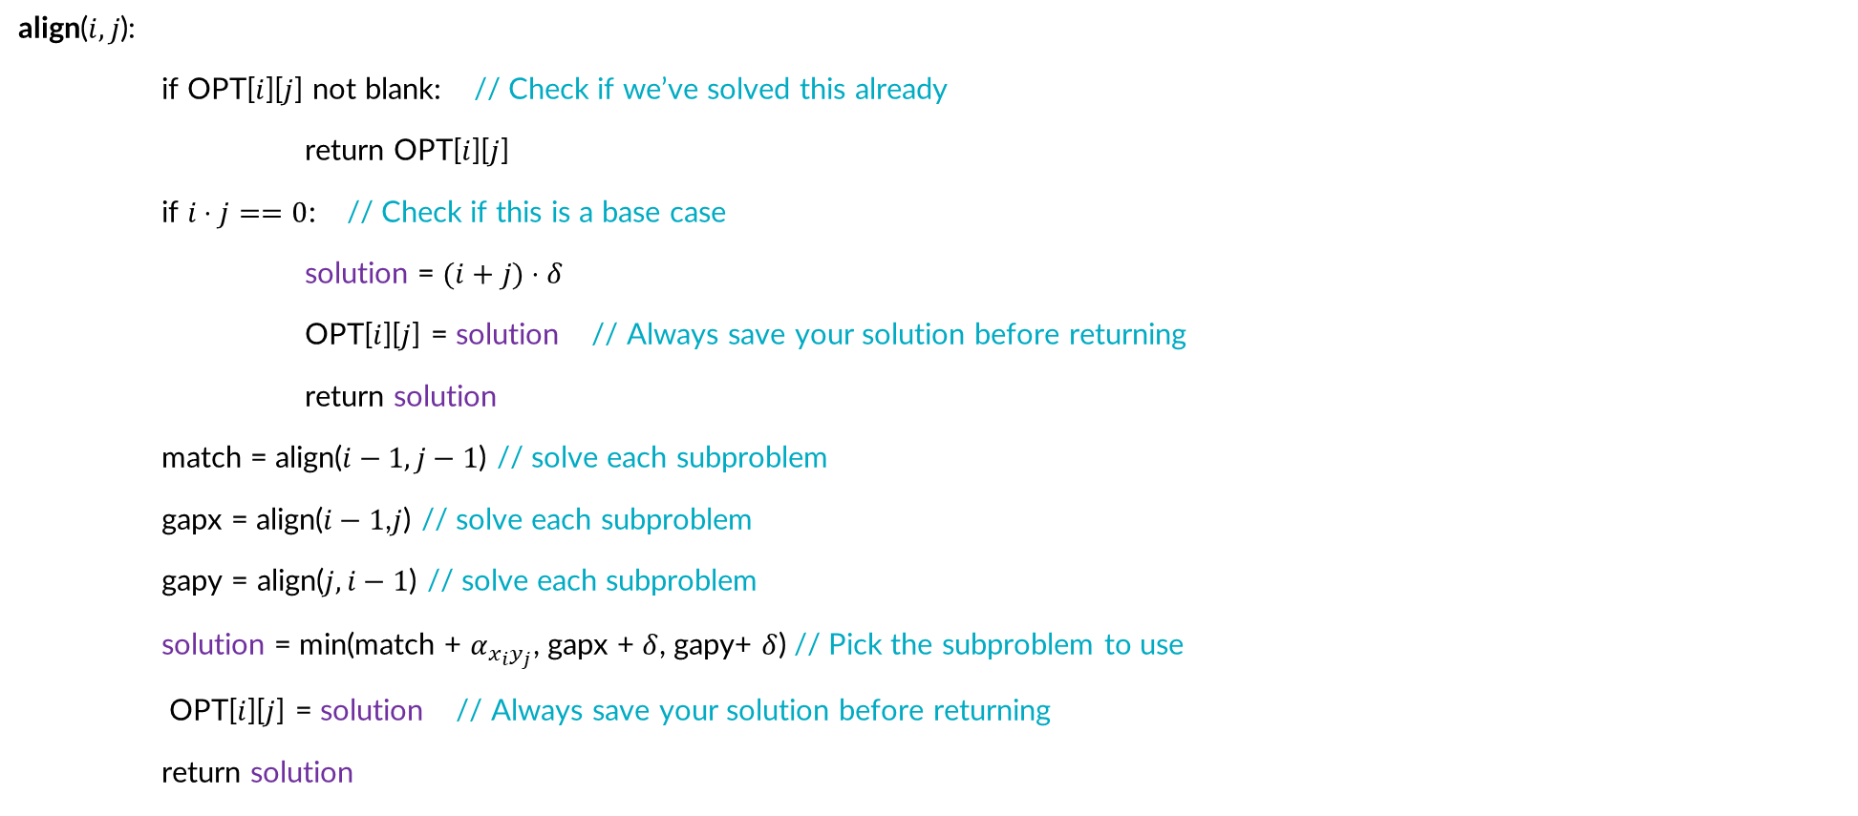
Top-Down Sequence Alignment
align($i,j$):
if OPT[$i$][$j$] not blank: // Check if we’ve solved this already
return OPT[$i$][$j$]
if $i⋅j==0$: // Check if this is a base case
solution = $(i+j)⋅δ$
OPT[$i$][$j$] = solution // Always save your solution before returning
return solution
match = align($i−1,j−1$) // solve each subproblem
gapx = align($i−1$,$j$) // solve each subproblem
gapy = align($j,i−1$) // solve each subproblem
solution = min(match + $α_{x_{i}y_{j}}$, gapx + $δ$, gapy+ $δ$) // Pick the subproblem to use
OPT[$i$][$j$] = solution // Always save your solution before returning
return solution

Slide 22
Edit Distance – Four Steps, Step 3
C
T
A
C
C
G
Formulate the answer with a recursive structure
  What are the options for the last choice?
  For each such option, what does the subproblem look like? How do we use it?
Choose a memory structure.
  Figure out the possible values of all parameters in the recursive calls.
  How many subproblems (options for last choice) are there?
  What are the parameters needed to identify each?
  How many different values could there be per parameter?
Specify an order of evaluation. (Optional)
  Want to guarantee that the necessary subproblem solutions are in memory when you need them.
  With this step: a “Bottom-up” (iterative) algorithm
  Without this step: a “Top-down” (recursive) algorithm
See if there’s a way to save space (Optional)
  Is it possible to reuse some memory locations?
T
A
C
A
T
G
-
C
T
A
C
C
G
C
T
A
C
C
G
-
T
A
C
A
T
G
T
A
C
A
T
G

Slide 23


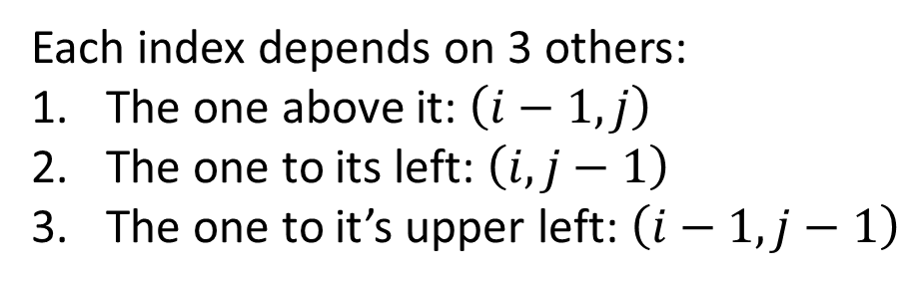
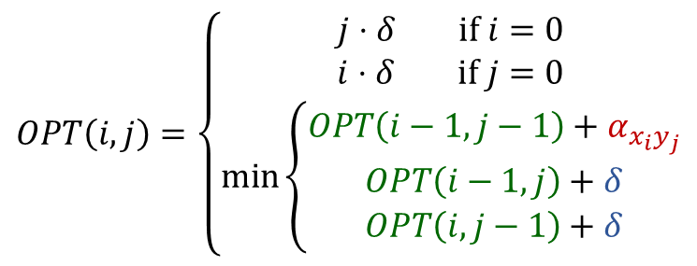












Step 3: Identify Order of Evaluation
$$y_{1}$$
$$y_{2}$$
$$y_{3}$$
$$y_{4}$$
$$y_{5}$$
$$y_{6}$$
$$y_{7}$$
$$y_{8}$$
$$OPT\left(i,j\right)=\left\{\begin{aligned}j⋅δ if i=0 \\ i⋅δ if j=0 \\ \min\left\{\begin{aligned}OPT\left(i−1,j−1\right)+α_{x_{i}y_{j}} \\ OPT\left(i−1,j\right)+δ \\ OPT\left(i,j−1\right)+δ\end{aligned}\right.\end{aligned}\right.$$
$$x_{1}$$
$$x_{2}$$
$$x_{3}$$
$$x_{4}$$
4,6
$$x_{5}$$
$$x_{6}$$
Any of these orders will work:
Top-to-bottom, then left-to-right
Left-to-right, then top-to-bottom
Diagonally
Each index depends on 3 others:
The one above it: $\left(i−1,j\right)$
The one to its left: $\left(i,j−1\right)$
The one to it’s upper left: $\left(i−1,j−1\right)$

Slide 24
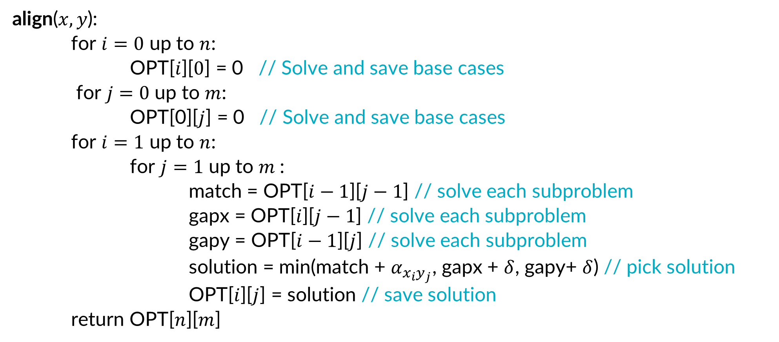
Bottom-Up Sequence Alignment
align($x,y$):
for $i=0$ up to $n$:
OPT[$i$][$0$] = 0 // Solve and save base cases
for $j=0$ up to $m$:
OPT[0][$j$] = 0 // Solve and save base cases
for $i=1$ up to $n$:
for $j=1$ up to $m$:
match = OPT[$i−1$][$j−1$] // solve each subproblem
gapx = OPT[$i$][$j−1$] // solve each subproblem
gapy = OPT[$i−1$][$j$] // solve each subproblem
solution = min(match + $α_{x_{i}y_{j}}$, gapx + $δ$, gapy+ $δ$) // pick solution
OPT[$i$][$j$] = solution // save solution
return OPT[$n$][$m$]

Slide 25
Edit Distance – Four Steps, Step 4
C
T
A
C
C
G
Formulate the answer with a recursive structure
  What are the options for the last choice?
  For each such option, what does the subproblem look like? How do we use it?
Choose a memory structure.
  Figure out the possible values of all parameters in the recursive calls.
  How many subproblems (options for last choice) are there?
  What are the parameters needed to identify each?
  How many different values could there be per parameter?
Specify an order of evaluation. (Optional)
  Want to guarantee that the necessary subproblem solutions are in memory when you need them.
  With this step: a “Bottom-up” (iterative) algorithm
  Without this step: a “Top-down” (recursive) algorithm
See if there’s a way to save space (Optional)
  Is it possible to reuse some memory locations?
T
A
C
A
T
G
-
C
T
A
C
C
G
C
T
A
C
C
G
-
T
A
C
A
T
G
T
A
C
A
T
G

Slide 26
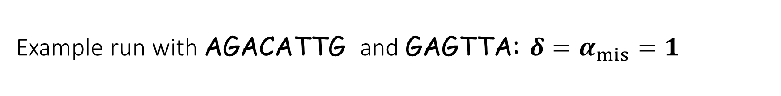
Example run with AGACATTG and GAGTTA: $δ=α_{mis}=1$
A
G
A
C
A
T
T
G
0
1
2
3
4
5
6
7
8
G
1
A
2
G
3
T
4
T
5
A
6

Slide 27
Example run with AGACATTG and GAGTTA: $δ=α_{mis}=1$
A
G
A
C
A
T
T
G
0
1
2
3
4
5
6
7
8
G
1
1
1
2
3
4
5
6
7
A
2
G
3
T
4
T
5
A
6

Slide 28
Example run with AGACATTG and GAGTTA: $δ=α_{mis}=1$
A
G
A
C
A
T
T
G
0
1
2
3
4
5
6
7
8
G
1
1
1
2
3
4
5
6
7
A
2
1
2
1
G
3
T
4
T
5
A
6

Slide 29
Example run with AGACATTG and GAGTTA: $δ=α_{mis}=1$
A
G
A
C
A
T
T
G
0
1
2
3
4
5
6
7
8
G
1
1
1
2
3
4
5
6
7
A
2
1
2
1
2
3
4
5
6
G
3
2
1
2
2
3
4
5
5
T
4
T
5
A
6

Slide 30
Example run with AGACATTG and GAGTTA: $δ=α_{mis}=1$
A
G
A
C
A
T
T
G
0
1
2
3
4
5
6
7
8
G
1
1
1
2
3
4
5
6
7
A
2
1
2
1
2
3
4
5
6
G
3
2
1
2
2
3
4
5
5
T
4
3
2
2
3
3
3
4
5
T
5
4
3
3
3
4
3
3
4
A
6
5
4
3
4
3
4
4
4

Slide 31
Example run with AGACATTG and GAGTTA: $δ=α_{mis}=1$
A
G
A
C
A
T
T
G
0
1
2
3
4
5
6
7
8
G
1
1
1
2
3
4
5
6
7
A
2
1
2
1
2
3
4
5
6
G
3
2
1
2
2
3
4
5
5
T
4
3
2
2
3
3
3
4
5
T
5
4
3
3
3
4
3
3
4
A
6
5
4
3
4
3
4
4
4

Slide 32
Example run with AGACATTG and GAGTTA: $δ=α_{mis}=1$
A
G
A
C
A
T
T
G
0
1
2
3
4
5
6
7
8
G
1
1
1
2
3
4
5
6
7
A
2
1
2
1
2
3
4
5
6
Optimal Alignment
A G A C A T T G
_ G A G _ T T A
G
3
2
1
2
2
3
4
5
5
T
4
3
2
2
3
3
3
4
5
T
5
4
3
3
3
4
3
3
4
A
6
5
4
3
4
3
4
4
4

Slide 33
Final reminders
HW5 released today @ 11:30am.
I have OH now-12:30pm:
Meet at front of classroom, we’ll walk over together
CSE (Allen) 434 if you’re coming later
Glenn has online OH 12–1pm

