Slide 1
Lecture 5: Running Time
Nathan Brunelle

Slide 2
Homeworks
HW 1 due today at 11:59pm.
HW 2 out today at 11:30am.

Slide 3
Motivating Example

Slide 4

Let’s design an algorithm
I have a pile of string
I have one end of the string in-hand
I need to find the other end in the pile
How can I do this efficiently?

Slide 5
Algorithm Ideas
Whatcha got?

Slide 6
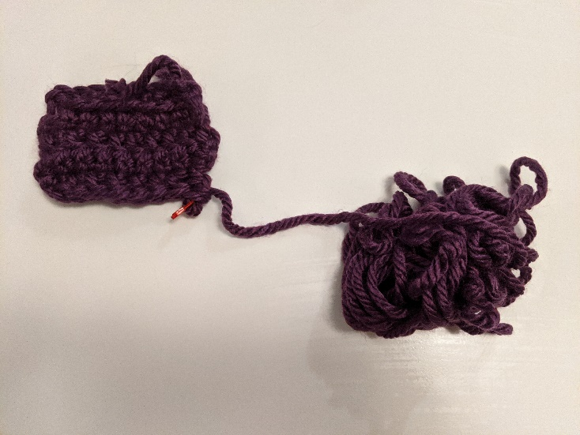
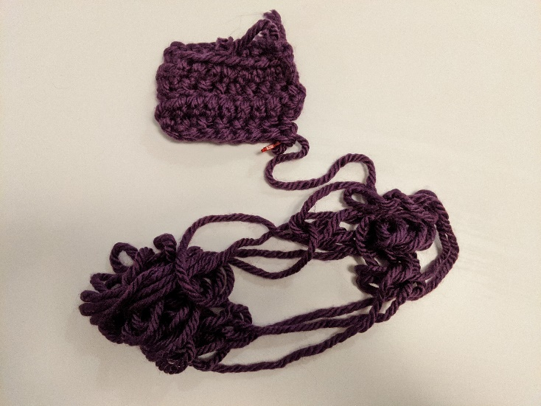
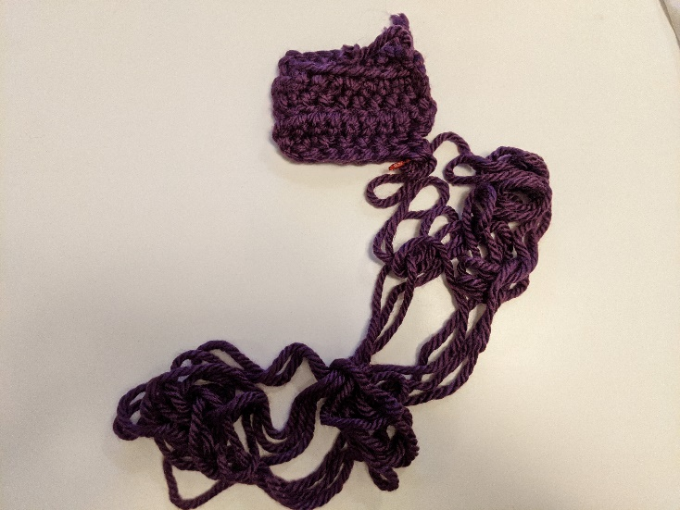
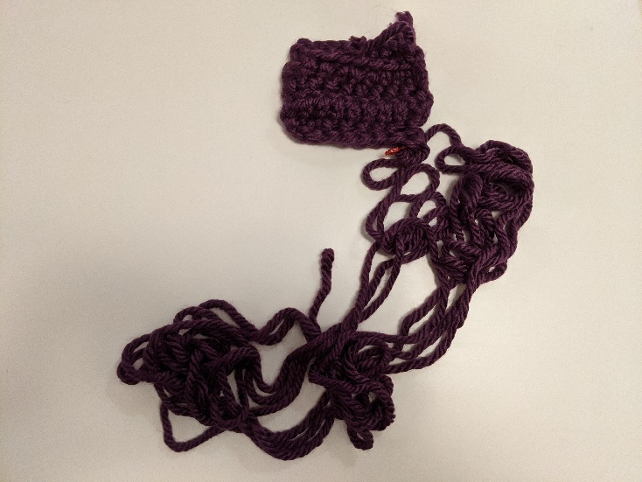
My Approach

Slide 7
End-of-Yarn Finding Algorithm
Set aside the already-obtained beginning Do the following until you find the end: Separate the pile of yarn into 2 piles Label A to be the pile that the beginning enters Label B to be the other pile Count the number of strands crossing the piles If count is even, set the pile to be A Otherwise set the pile to be B.
A
B

Slide 8
Resource Analysis

Slide 9
Why do resource analysis?
Allows us to compare algorithms, not implementations
Using observations necessarily couples the algorithm with its implementation
If my implementation on my computer takes more time than your implementation on your computer, we cannot conclude your algorithm is better
We can predict an algorithm’s running time before implementing
Understand where the bottlenecks are in our algorithm

Slide 10
Process for resource Analysis
End Result: A function which maps the algorithm’s input size to count of resources used Input of the function: sizes of the input
Number of characters in a string, number of items in a list, number of pixels in an image
Output of the function: counts of resources used
Number of times the algorithm adds two numbers together, number times the algorithm does a > or < comparison, maximum number of bytes of memory the algorithm uses at any time
Important note: Make sure you know the “units” of your input and output!

Slide 11
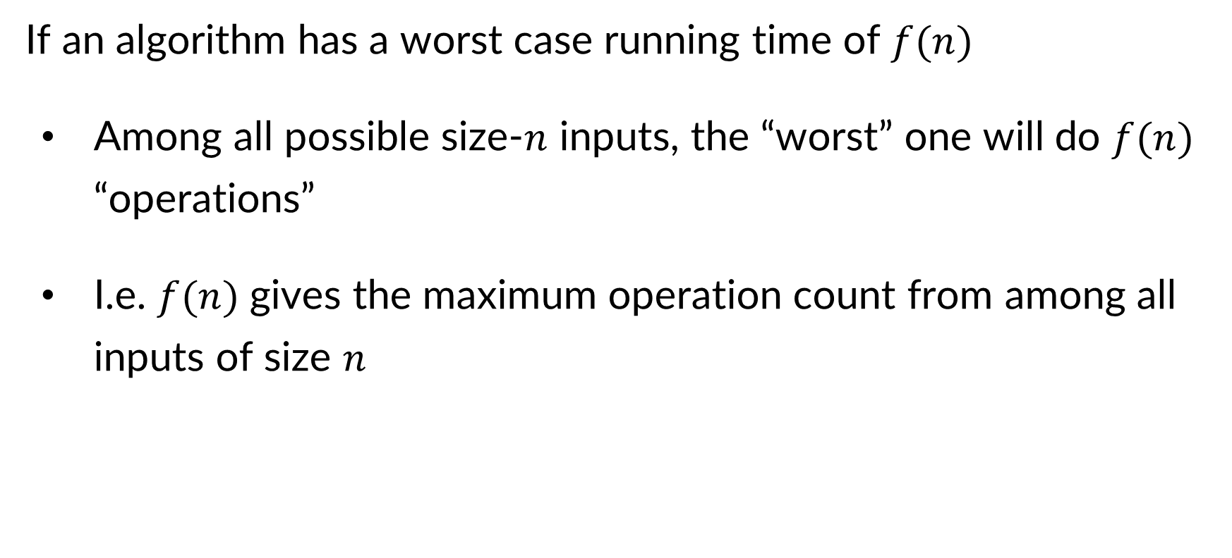
Resource Analysis – Worst Case Running Time
If an algorithm has a worst case running time of $f(n)$
Among all possible size-$n$ inputs, the “worst” one will do $f(n)$ “operations”
I.e. $f(n)$ gives the maximum operation count from among all inputs of size $n$

Slide 12
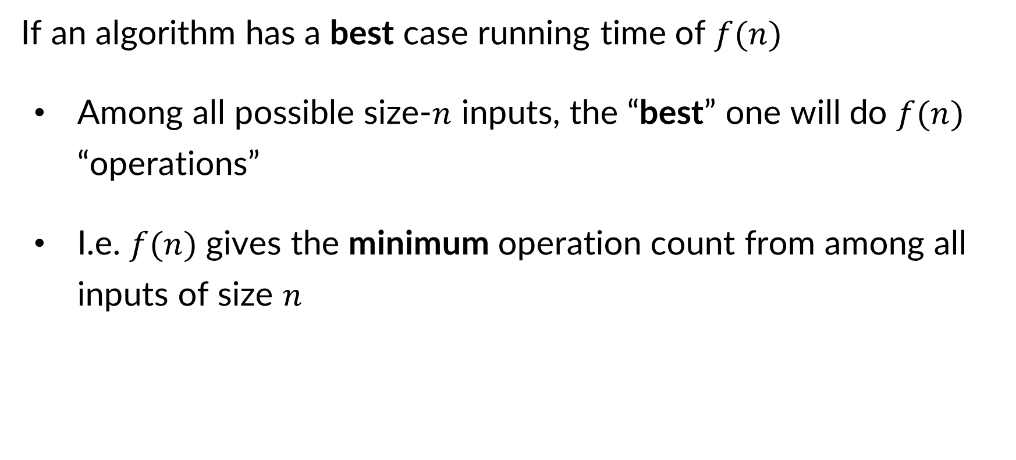
Resource Analysis – Best Case Running Time
If an algorithm has a best case running time of $f(n)$
Among all possible size-$n$ inputs, the “best” one will do $f(n)$ “operations”
I.e. $f(n)$ gives the minimum operation count from among all inputs of size $n$

Slide 13
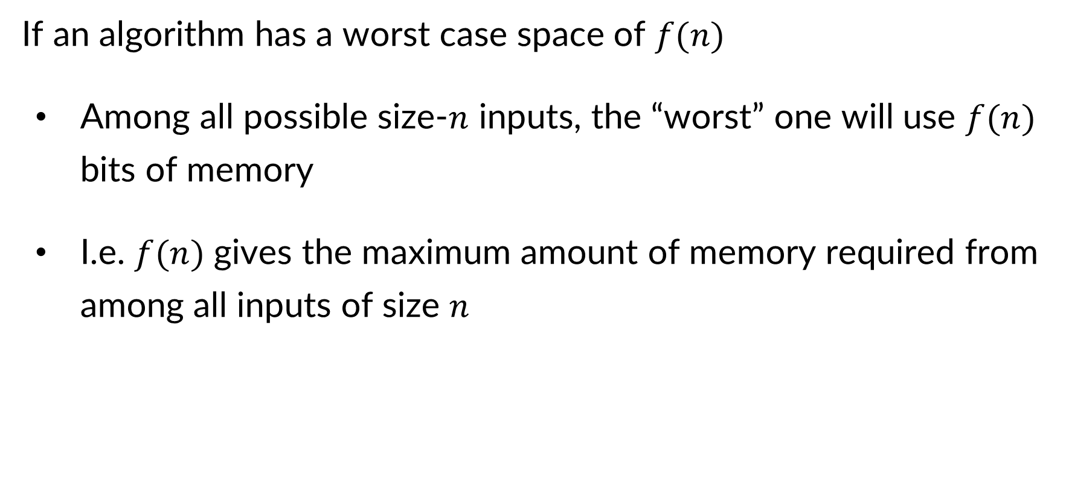
Resource Analysis – Worst Case Space
If an algorithm has a worst case space of $f(n)$
Among all possible size-$n$ inputs, the “worst” one will use $f(n)$ bits of memory
I.e. $f(n)$ gives the maximum amount of memory required from among all inputs of size $n$

Slide 14
Asymptotic Notation

Slide 15
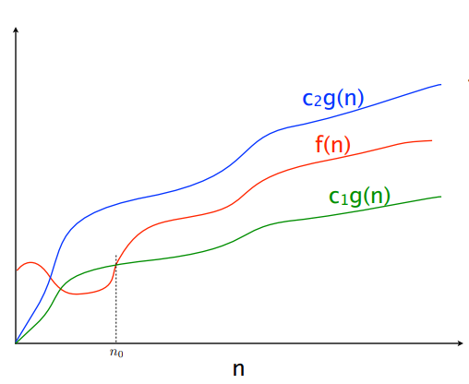

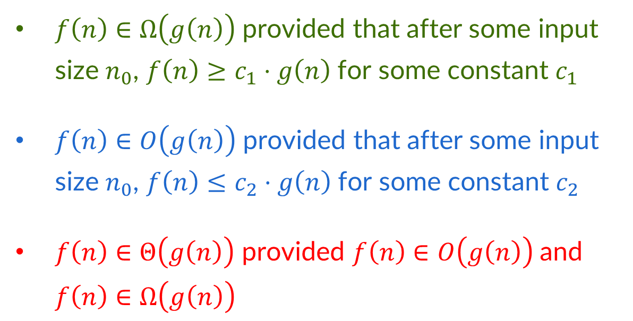


Asymptotic Notation – Comparing Functions
$$f\left(n\right)∈O(g\left(n\right))$$
$$f\left(n\right)∈Θ(g\left(n\right))$$
$$f\left(n\right)∈Ω(g\left(n\right))$$
$f\left(n\right)∈Ω\left(g\left(n\right)\right)$ provided that after some input size $n_{0}$, $f\left(n\right)≥c_{1}⋅g\left(n\right)$ for some constant $c_{1}$
$f\left(n\right)∈O\left(g\left(n\right)\right)$ provided that after some input size $n_{0}$, $f\left(n\right)≤c_{2}⋅g\left(n\right)$ for some constant $c_{2}$
$f\left(n\right)∈Θ\left(g\left(n\right)\right)$ provided $f\left(n\right)∈O\left(g\left(n\right)\right)$ and $f\left(n\right)∈Ω\left(g\left(n\right)\right)$

Slide 16

Asymptotic Notation Examples
$10n+100∈O\left(n^{2}\right)$
After $n_{0}=??$ with $c=??$ we have $10n+100≤cn^{2}$
$13n^{2}−50n∈Ω\left(n^{2}\right)$
After $n_{0}=??$ with $c=??$ we have $13n^{2}−50n≥cn^{2}$
$n^{2}+3n∈O\left(4n^{3}\right)$
After $n_{0}=??$ with $c=??$ we have $n^{2}+3n≤c4n^{3}$

Slide 17

Asymptotic Notation Examples
$10n+100∈O\left(n^{2}\right)$
After $n_{0}=101$ with $c=1$ we have $10n+100≤cn^{2}$
$13n^{2}−50n∈Ω\left(n^{2}\right)$
After $n_{0}=100$ with $c=\frac{1}{2}$ we have $13n^{2}−50n≥cn^{2}$
$n^{2}+3n∈O\left(4n^{3}\right)$
After $n_{0}=1$ with $c=1$ we have $n^{2}+3n≤c4n^{3}$

Slide 18
Running Time Example: Selection Sort

Slide 19
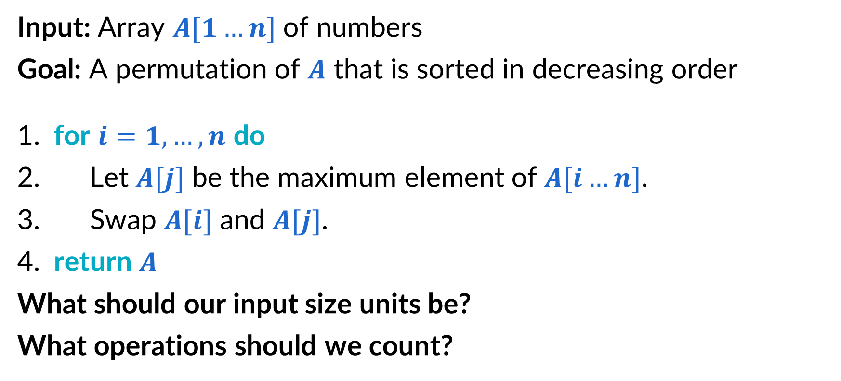
Reminder: Selection sort
Input: Array $A[1…n]$ of numbers
Goal: A permutation of $A$ that is sorted in decreasing order
​for $i=1,…,n$ do
Let $A[j]$ be the maximum element of $A[i…n]$.
Swap $A[i]$ and $A[j]$.
​return $A$
What should our input size units be? What operations should we count?

Slide 20
Selecting Running Time Units
Input size units:
Represents the size of the input
You typically want this to in discrete intervals (i.e. the size should always be an integer)
E.g. Number of elements in a data structure, number of indices in an array, number of characters in a string, bit in a number
Running time operations:
Count these to express running time
Ideally these will have the properties of:
Necessity – All algorithms solving this type of problem will do this operation
Frequency – This operation is not at least as often as any other operation we might want
Magnitude – This operation is expensive to perform

Slide 21
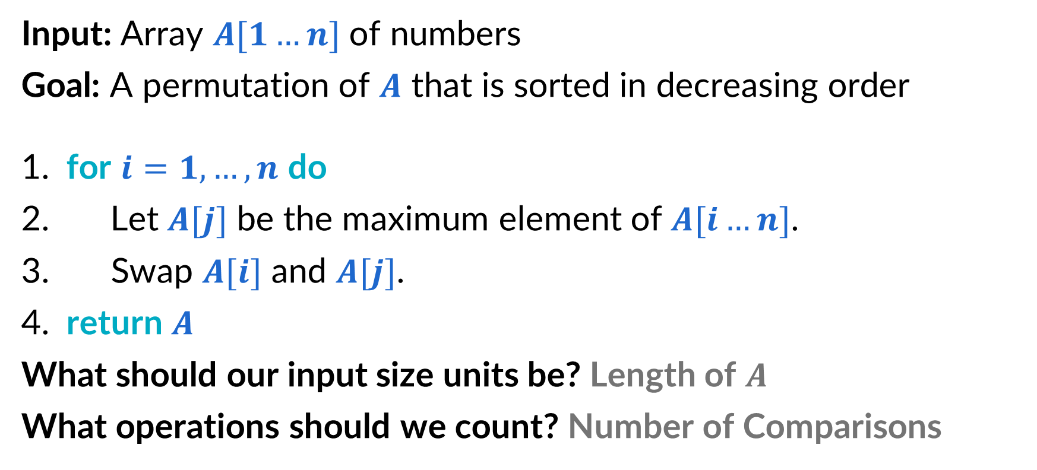
Selection sort Units
Input: Array $A[1…n]$ of numbers
Goal: A permutation of $A$ that is sorted in decreasing order
​for $i=1,…,n$ do
Let $A[j]$ be the maximum element of $A[i…n]$.
Swap $A[i]$ and $A[j]$.
​return $A$
What should our input size units be? Length of $A$ What operations should we count? Number of Comparisons

Slide 22
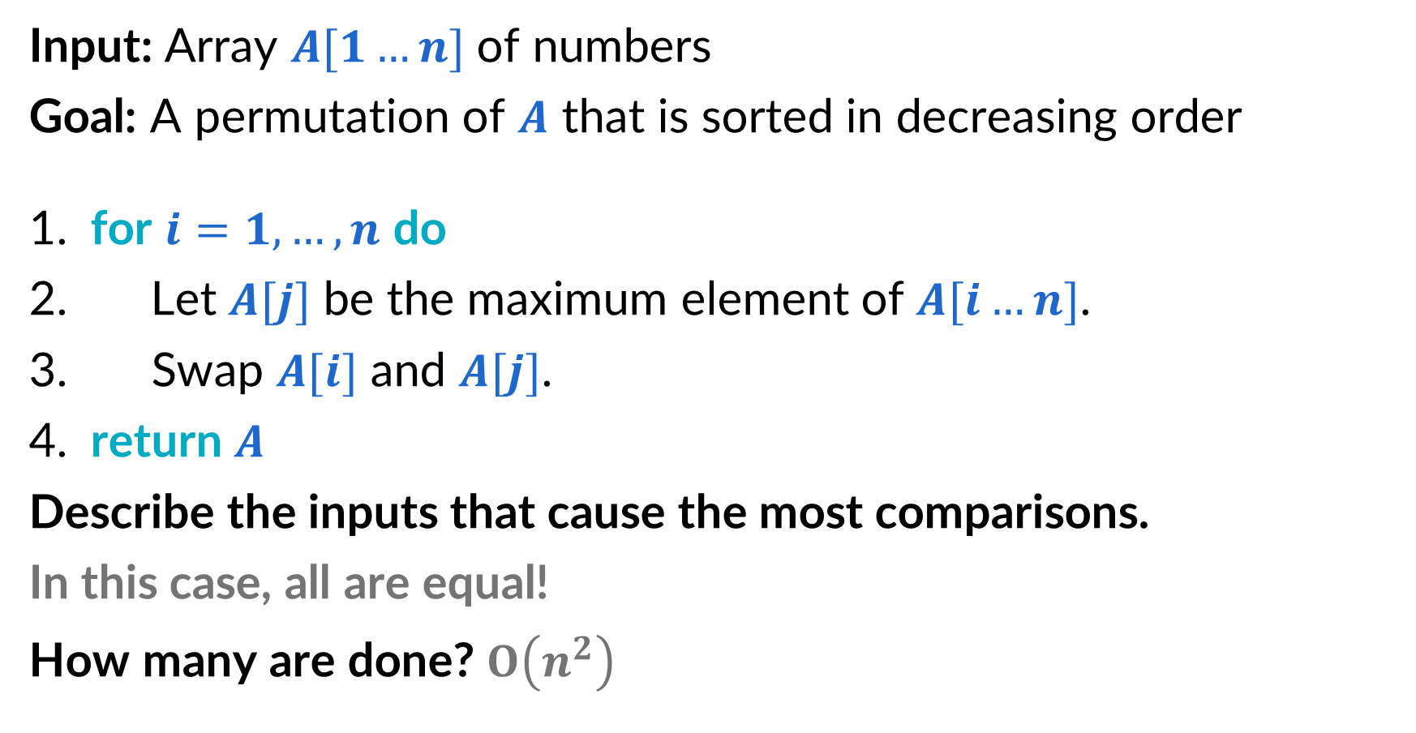
Selection sort – Worst Case Running Time
Input: Array $A[1…n]$ of numbers
Goal: A permutation of $A$ that is sorted in decreasing order
​for $i=1,…,n$ do
Let $A[j]$ be the maximum element of $A[i…n]$.
Swap $A[i]$ and $A[j]$.
​return $A$
Describe the inputs that cause the most comparisons.
In this case, all are equal!
How many are done? $O\left(n^{2}\right)$

Slide 23
Running Time Example: Gale-Shapley

Slide 24
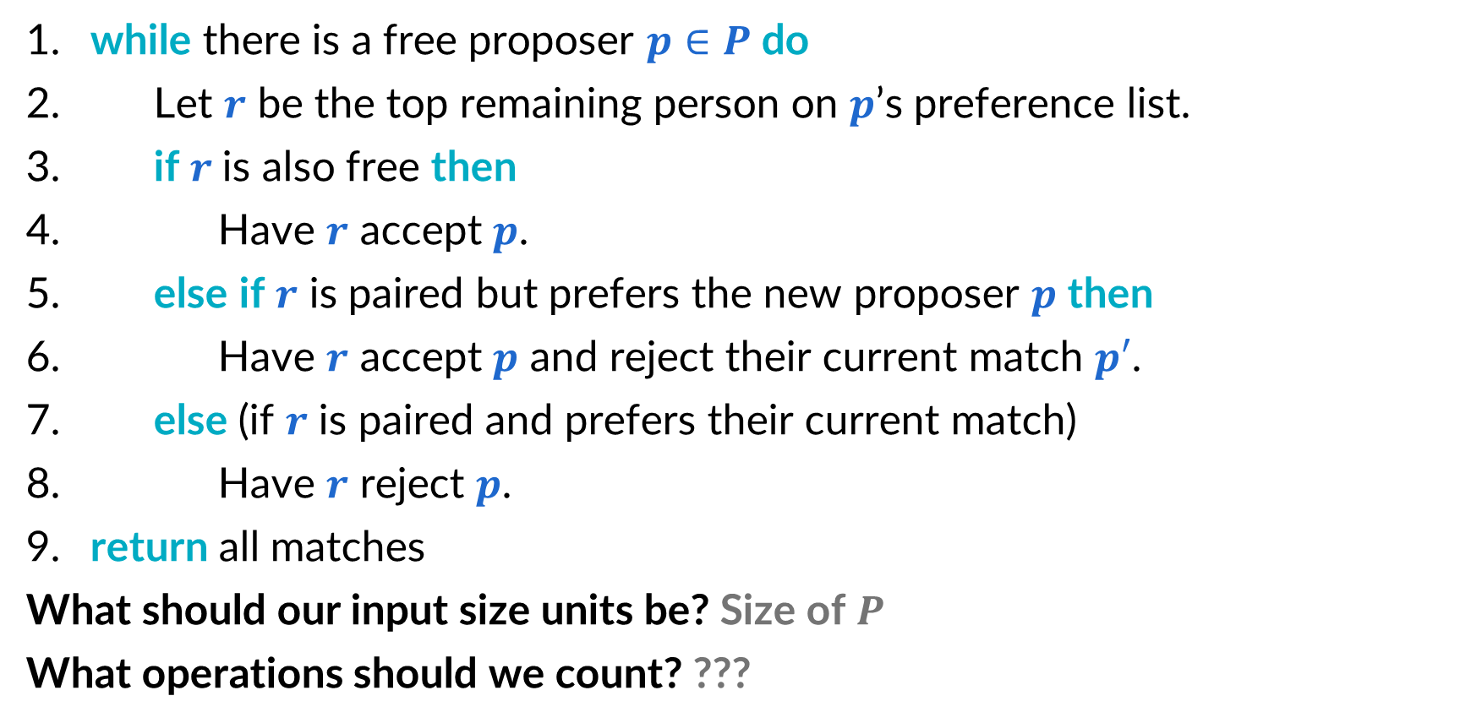
Reminder: Gale–Shapley algorithm
​while there is a free proposer $p∈P$ do
Let $r$ be the top remaining person on $p$’s preference list.
​if $r$is also free then
Have $r$ accept $p$.
​else if $r$ is paired but prefers the new proposer $p$ then
Have $r$ accept $p$ and reject their current match $p′$.
​else (if $r$ is paired and prefers their current match)
Have $r$ reject $p$.
​return all matches
What should our input size units be? Size of $P$ What operations should we count? ???

Slide 25
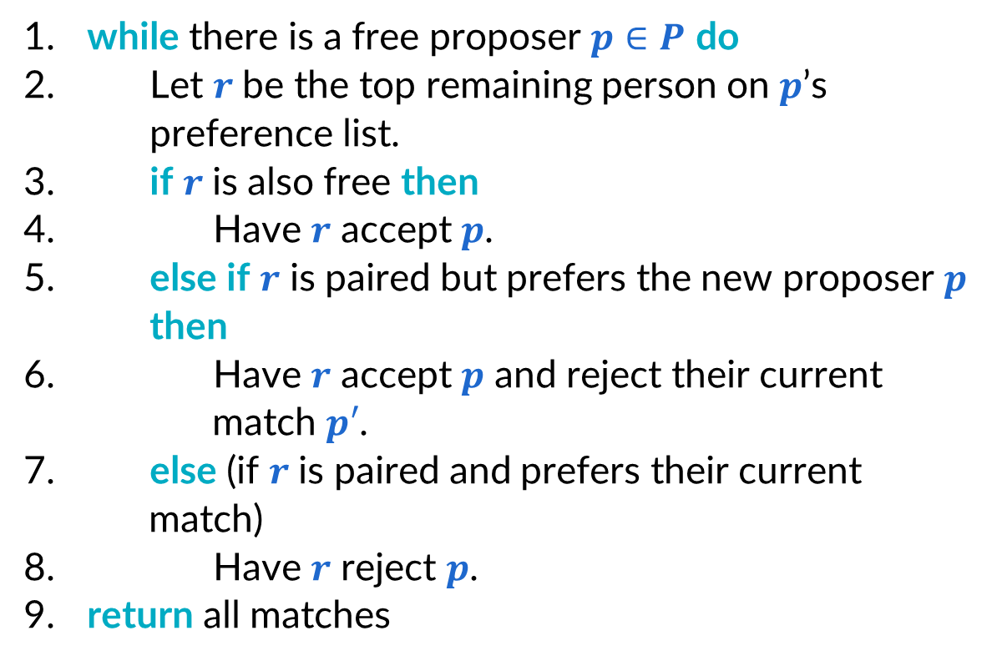
What operations do we need?
​while there is a free proposer $p∈P$ do
Let $r$ be the top remaining person on $p$’s preference list.
​if $r$is also free then
Have $r$ accept $p$.
​else if $r$ is paired but prefers the new proposer $p$ then
Have $r$ accept $p$ and reject their current match $p′$.
​else (if $r$ is paired and prefers their current match)
Have $r$ reject $p$.
​return all matches
Things we need to do:
Iterate over free proposers
Check if someone is matched
Look up someone’s current match
Compare preferences
Make/unmake a match

Slide 26
Operations to count
Comparing “agents” (proposers with receivers, proposers with proposers, receivers with receivers)
This includes:
Equality checks (e.g. is this the receiver we’re looking for?)
Matched queries (e.g. is this receiver matched, if so then to whom?)
Preference checks (e.g. does this receiver prefer proposer 1 or 2?)

Slide 27
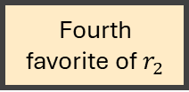

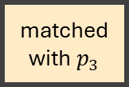
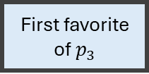
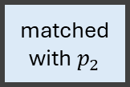
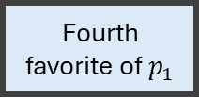
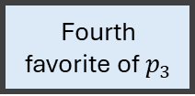

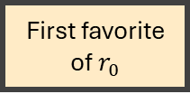
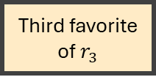
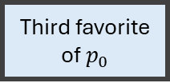
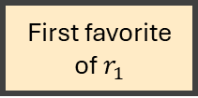
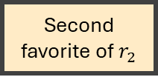
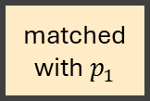
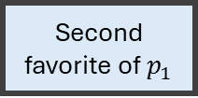
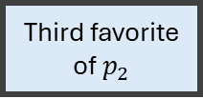
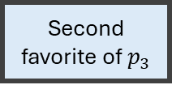
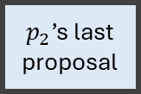


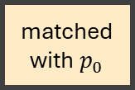
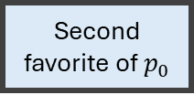

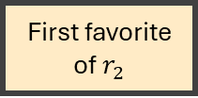
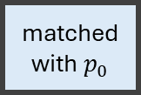
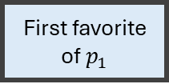
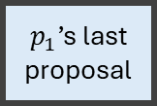
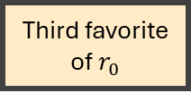

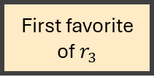
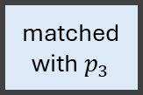
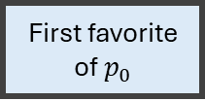
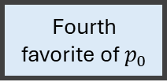
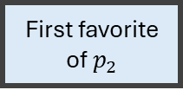
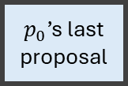


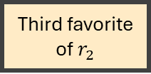

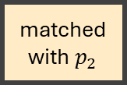
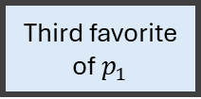
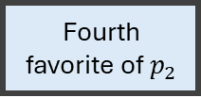



Data Structures – first attempt
Linked list for free proposers
Originally contains all proposers
Match the first on in the list, then remove
Re-add to the end if unmatched
Two 1d arrays for matches
One where index $i$ has the proposer matched with receiver $i$, $−1$ if unmatched
One where index $i$ has the receiver matched with proposer $i$, $−1$ if unmatched
Two 2d arrays for preferences
One where index $i,j$ has the $j$th favorite proposer for receiver $i$
One where index $i,j$ has the $j$th favorite receiver for proposer $i$
One 1d array for proposals
Index $i$ has the last receiver that proposer $i$ has proposed to.
Proposer
Proposer
Proposer
matched with $p_{0}$
matched with $p_{1}$
matched with $p_{2}$
matched with $p_{3}$
matched with $p_{0}$
matched with $p_{1}$
matched with $p_{2}$
matched with $p_{3}$
First favorite of $p_{0}$
Second favorite of $p_{0}$
Third favorite of $p_{0}$
Fourth favorite of $p_{0}$
First favorite of $r_{0}$
Second favorite of $r_{0}$
Third favorite of $r_{0}$
Fourth favorite of $r_{0}$
First favorite of $p_{1}$
Second favorite of $p_{1}$
Third favorite of $p_{1}$
Fourth favorite of $p_{1}$
First favorite of $r_{1}$
Second favorite of $r_{1}$
Third favorite of $r_{1}$
Fourth favorite of $r_{1}$
First favorite of $p_{2}$
Second favorite of $p_{2}$
Third favorite of $p_{2}$
Fourth favorite of $p_{2}$
First favorite of $r_{2}$
Second favorite of $r_{2}$
Third favorite of $r_{2}$
Fourth favorite of $r_{2}$
First favorite of $p_{3}$
Second favorite of $p_{3}$
Third favorite of $p_{3}$
Fourth favorite of $p_{3}$
First favorite of $r_{3}$
Second favorite of $r_{3}$
Third favorite of $r_{3}$
Fourth favorite of $r_{3}$
$p_{0}$’s last proposal
$p_{1}$’s last proposal
$p_{2}$’s last proposal
$p_{3}$’s last proposal

Slide 28










Running time of each step
​while there is a free proposer $p∈P$ do
Let $r$ be the top remaining person on $p$’s preference list.
​if $r$is also free then
Have $r$ accept $p$.
​else if $r$ is paired but prefers the new proposer $p$ then
Have $r$ accept $p$ and reject their current match $p′$.
​else (if $r$ is paired and prefers their current match)
Have $r$ reject $p$.
​return all matches
$$O\left(1\right)$$
$$O\left(1\right)$$
$$O\left(1\right)$$
$$O\left(n\right)$$
$$O\left(n^{2}\right)$$
$$O\left(1\right)$$
$$O\left(n\right)$$
$$O\left(1\right)$$
Overall: $O\left(n^{3}\right)$
What is the bottleneck? Where should we focus if we want to make it faster?

Slide 29

















Data Structures – Better
$p_{0}$’s preference for $r_{0}$
$p_{0}$’s preference for $r_{1}$
$p_{0}$’s preference for $r_{2}$
$p_{0}$’s preference for $r_{3}$
$p_{1}$’s preference for $r_{0}$
$p_{1}$’s preference for $r_{1}$
$p_{1}$’s preference for $r_{2}$
$p_{1}$’s preference for $r_{3}$
Linked list for free proposers
Originally contains all proposers
Match the first on in the list, then remove
Re-add to the end if unmatched
Two 1d arrays for matches
One where index $i$ has the proposer matched with receiver $i$, $−1$ if unmatched
One where index $i$ has the receiver matched with proposer $i$, $−1$ if unmatched
Two 2d arrays for preferences
One where index $i,j$ has the $j$th favorite proposer for receiver $i$
One where index $i,j$ has the $j$th favorite receiver for proposer $i$
One where index $i,j$ has the index of receiver $j$ in proposer $i$’s preference list
One where index $i,j$ has the index of proposer $j$ in receiver $i$’s preference list
One 1d array for proposals
Index $i$ has the last receiver that proposer $i$ has proposed to.
$p_{2}$’s preference for $r_{0}$
$p_{2}$’s preference for $r_{1}$
$p_{2}$’s preference for $r_{2}$
$p_{2}$’s preference for $r_{3}$
$p_{3}$’s preference for $r_{0}$
$p_{3}$’s preference for $r_{1}$
$p_{3}$’s preference for $r_{2}$
$p_{3}$’s preference for $r_{3}$

Slide 30



Improved running time of each step
​while there is a free proposer $p∈P$ do
Let $r$ be the top remaining person on $p$’s preference list.
​if $r$is also free then
Have $r$ accept $p$.
​else if $r$ is paired but prefers the new proposer $p$ then
Have $r$ accept $p$ and reject their current match $p′$.
​else (if $r$ is paired and prefers their current match)
Have $r$ reject $p$.
​return all matches
$$O\left(1\right)$$
$$O\left(1\right)$$
$$O\left(1\right)$$
$$O\left(1\right)$$
$$O\left(n^{2}\right)$$
$$O\left(1\right)$$
$$O\left(1\right)$$
$$O\left(1\right)$$
Overall: $O\left(n^{2}\right)$

