Slide 1
Lecture 11: Minimum spanning trees
Glenn Sun

Slide 2
Logistics
HW 4 on graphs out after class:
Problem 7, 7X.1/2: Using MSTs (today’s topic) for clustering
Problem 8: A graph modeling problem
HW 1 solutions are out on Canvas!
Practice quiz out on Canvas/website tonight.

Slide 3
More graph review

Slide 4
Trees
In a rooted tree:
Each vertex has one parent above it (except the root, which has none)
Each vertex can have zero or more children below it
One way to reach each vertex from root
Examples: file tree, binary search tree, etc.

Slide 5
Trees
In an (unrooted) tree:
No concept of parents, children, root, etc.
A connected graph with no cycles
In other words, take a rooted tree and “forget” what the root is.
Resulting connectivity structure is a tree!

Slide 6

Number of edges
Claim. A tree with $n$ vertices has $n−1$ edges.

Slide 7

Number of edges
Claim. A tree with $n$ vertices has $n−1$ edges.
Proof. (Handwaving a bit) If you keep removing leaves, you remove 1 vertex and 1 edge at a time, until you just have one node.

Slide 8
Adding edges to trees
Claim. Adding any edge to a tree creates a cycle.

Slide 9
Adding edges to trees
Claim. Adding any edge to a tree creates a cycle.
Proof. The graph is already connected, so this edge turns the original path into a cycle.

Slide 10
Minimal connectedness
Claim. If a connected graph is not a tree, you can remove an edge and still be connected.

Slide 11
Minimal connectedness
Claim. If a connected graph is not a tree, you can remove an edge and still be connected.
Proof. Take any cycle and delete any edge in it.

Slide 12
Forests
Multiple trees in a single graph form a forest.
(0 trees and 1 tree are also technically forests.)
Equivalently, any undirected graph with no cycles is a forest.

Slide 13
Weighted graphs
Sometimes, we put “weights” on edges. They can represent:
Distance
Cost
Capacity
Etc.
3
-1.3
20

Slide 14
Minimum spanning trees

Slide 15
Emergency snow network
A city has a network of roads of various lengths. (diagram not to scale)
4
8
2
🏘️
🏢
🏥
🏠
5
6
1
7
3
3
2
📚
5
🏡
🚒
🛒
9
🏚️

Slide 16
Emergency snow network
Goal: Find a minimum length network to plow that connects everyone during a snowstorm.
(Tree, by minimal connectedness!)
4
8
2
🏘️
🏢
🏥
🏠
5
6
1
7
3
3
2
📚
❄️
5
🏡
🚒
🛒
9
🏚️

Slide 17
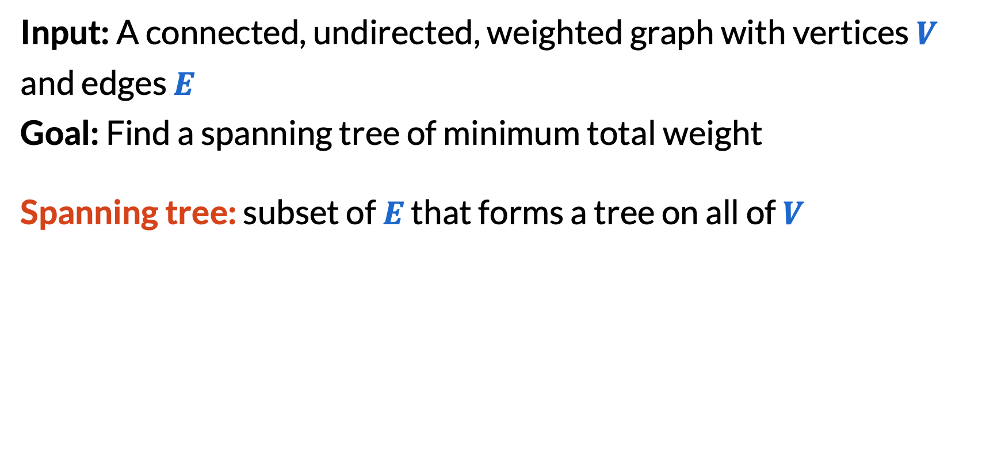
Minimum spanning tree
Input: A connected, undirected, weighted graph with vertices $V$ and edges $E$
Goal: Find a spanning tree of minimum total weight
Spanning tree: subset of $E$ that forms a tree on all of $V$
✅
❌

Slide 18
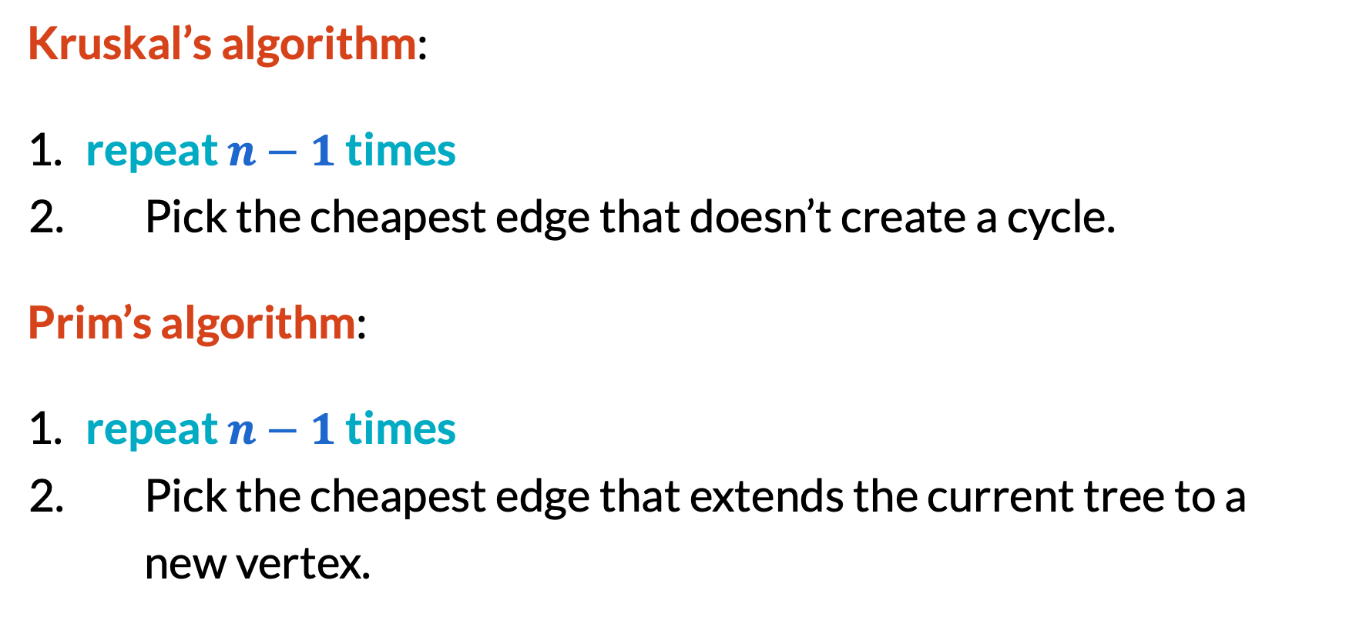
MST algorithms
Kruskal’s algorithm:
​repeat $n−1$ times
Pick the cheapest edge that doesn’t create a cycle.
Prim’s algorithm:
​repeat $n−1$ times
Pick the cheapest edge that extends the current tree to a new vertex.

Slide 19
Kruskal’s algorithm demonstration
4
8
2
5
6
1
7
3
3
2
5
9

Slide 20
Prim’s algorithm demonstration
4
8
2
5
6
1
7
3
3
2
5
9

Slide 21
Cut property of MSTs
A cut splits the vertices of a graph into two parts.
An edge crosses the cut if it has one endpoint in each part.
4
8
2
5
6
1
7
3
3
2
5
9

Slide 22
Cut property of MSTs
Theorem. If an edge is the minimum cost edge across some cut, then it must be in every MST.
Proof. By contradiction.
If an MST doesn’t have the edge, we can make a smaller spanning tree by swapping it in!
$$$
$$$
$

Slide 23
Cut property of MSTs
Theorem. If an edge is the minimum cost edge across some cut, then it must be in every MST.
Proof. By contradiction.
If an MST doesn’t have the edge, we can make a smaller spanning tree by swapping it in!
$$$
$$$
$

Slide 24
Cut property of MSTs
Theorem. If an edge is the minimum cost edge across some cut, then it must be in every MST.
Proof. By contradiction.
If an MST doesn’t have the edge, we can make a smaller spanning tree by swapping it in!
$$$
$$$
$

Slide 25
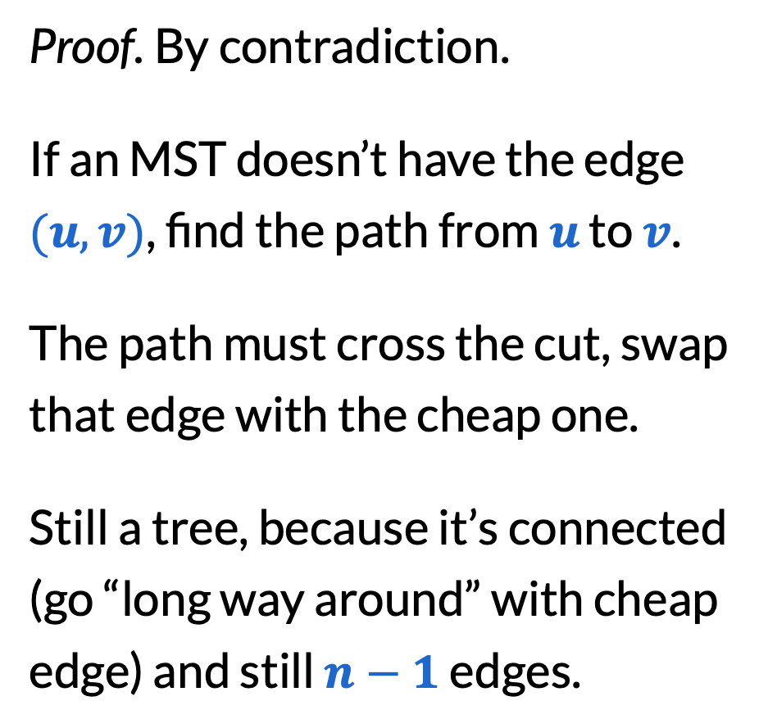
Cut property of MSTs
Proof. By contradiction.
If an MST doesn’t have the edge $(u,v)$, find the path from $u$ to $v$.
The path must cross the cut, swap that edge with the cheap one.
Still a tree, because it’s connected (go “long way around” with cheap edge) and still $n−1$ edges.
$$$
$$$
$

Slide 26
Cut property of MSTs
Warning:
Must swap with an edge in a cycle!
Otherwise, cost will go down but you don’t get a tree.
$$$
$$$
$

Slide 27
Correctness of Kruskal’s algorithm
The edge we picked is the cheapest edge across any cut that puts connected components of endpoints on separate sides.
4
8
2
5
6
1
7
3
3
2
5
9

Slide 28
Correctness of Prim’s algorithm
The edge we picked is the cheapest edge across the cut that puts our working tree all on one side.
4
8
2
5
6
1
7
3
3
2
5
9

Slide 29
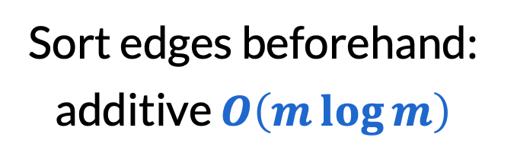

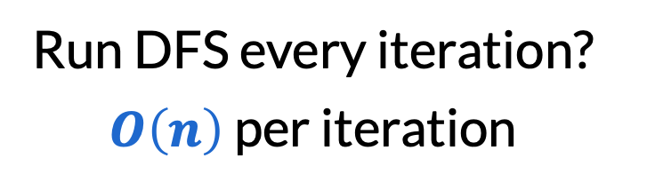
Running time of Kruskal’s algorithm
​repeat $n−1$ times
Pick the cheapest edge that doesn’t create a cycle.
Sort edges beforehand: additive $O\left(m\log{m}\right)$
Run DFS every iteration? $O\left(n\right)$ per iteration
Idea: Just check that endpoints are in two different connected components!

Slide 30
Union-Find data structure
4
8
2
5
6
1
7
3
3
2
5
9

Slide 31
Union-Find data structure
Need the following operations:
​Union two connected components
​Find if two vertices belong to the same CC
Idea:
For each vertex, store the name of its CC (e.g. the alphabetically smallest vertex in the CC)
Also store the reverse lists (list of vertices in each CC)
​Union: Overwrite the names of the smaller CC and merge lists
​Find: Query if the CC names are the same

Slide 32
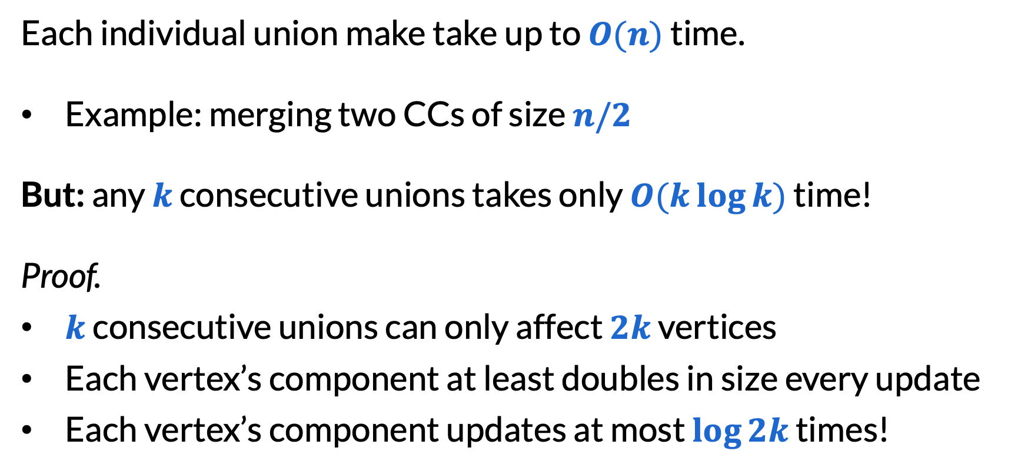
Union-Find data structure
Each individual union make take up to $O(n)$ time.
Example: merging two CCs of size $n/2$
But: any $k$ consecutive unions takes only $O(k\log{k})$ time!
Proof.
​$k$ consecutive unions can only affect $2k$ vertices
Each vertex’s component at least doubles in size every update
Each vertex’s component updates at most $\log{2k}$ times!

Slide 33
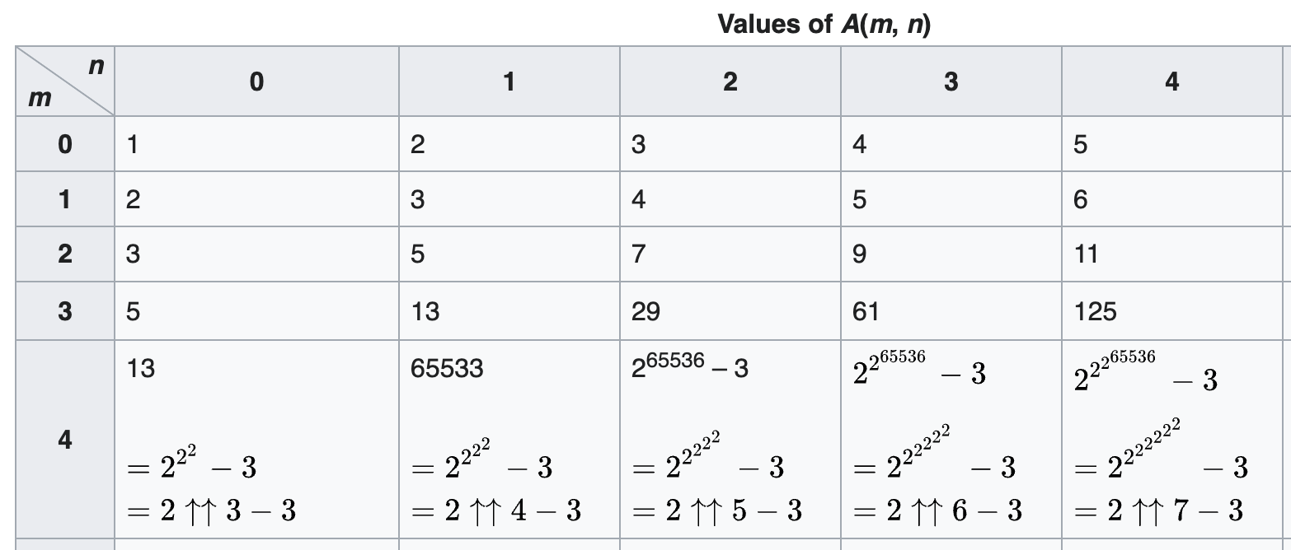

Union-Find data structure
With more optimizations, $k$ consecutive unions can take just $O(kα (k))≈O(k)$ time! (Practically, $α\left(k\right)≤4$ for all $k$.)
This is the “inverse Ackermann function”.

Slide 34
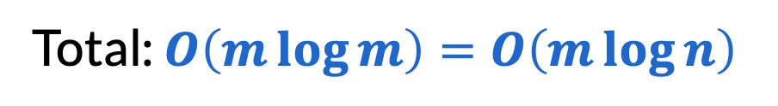
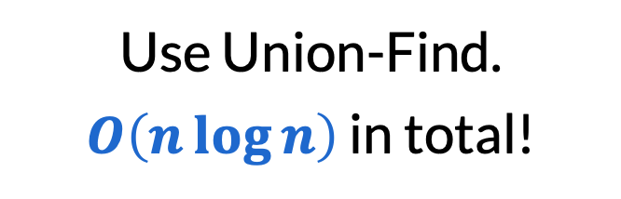
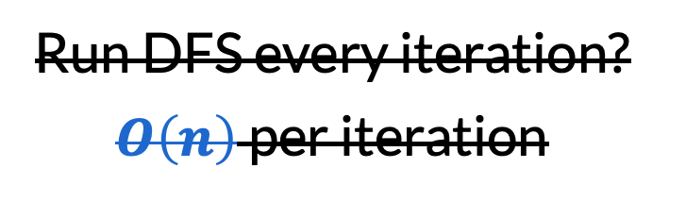
Running time of Kruskal’s algorithm
​repeat $n−1$ times
Pick the cheapest edge that doesn’t create a cycle.
Sort edges beforehand: additive $O\left(m\log{m}\right)$
Run DFS every iteration? $O\left(n\right)$ per iteration
Use Union-Find. $O\left(n\log{n}\right)$ in total!
Total: $O\left(m\log{m}\right)=O\left(m\log{n}\right)$

Slide 35


Running time of Prim’s algorithm
​repeat $n−1$ times
Pick the cheapest edge that extends the current tree to a new vertex.
Key optimization: remember only cheapest edge for every discovered vertex
List of possible vertices: up to $O(n)$
Pick cheapest edge: $O(n)$ per iteration
Traversing edges: additive $O(m)$
Total: $O(n^{2})$ – better than Kruskal for graphs where $m≈n^{2}$

Slide 36
Running time of Prim’s algorithm
​repeat $n−1$ times
Pick the cheapest edge that extends the current tree to a new vertex.
Key optimization: remember only cheapest edge for every discovered vertex
Can also do with a priority queue: will discuss more Monday!

Slide 37








2
$$a$$
$$a$$
$$s$$
$$s$$
3
1
4
1
$$t$$
$$t$$
$$b$$
$$b$$

Slide 38
Final reminders
HW4 out, HW3 due tonight @ 11:59pm.
Practice quiz will posted tonight!
I have OH now-12:30pm:
Meet at front of classroom, we’ll walk over together
CSE (Allen) 214 if you’re coming later
Nathan has online OH 12–1pm:
https://washington.zoom.us/my/nathanbrunelle

