Slide 1
Lecture 3: Proof Techniques
Nathan Brunelle

Slide 2
Concept check quizzes
Remember: unlimited submissions, and are marked “incomplete” until you get every question right.
One-time extension for everyone until 12:30pm today!
Be sure to get those in on time going forward.

Slide 3
Homework 1
HW 1 due this Friday at 11:59pm.
Problem 1 (Grading ChatGPT): Read ChatGPT’s response to a question about stable matchings, and explain where the LLM made mistakes.
Problem 2 (Business profit): Write a super simple algorithm for a basic task, and prove its correctness (today’s lecture!)

Slide 4
Todo
Homework 1 due this Friday at 11:59pm
Reading + Concept checks for each lecture!

Slide 5
Proof writing practice

Slide 6
Proof Techniques
Claim: If property P is true, then property Q is true.
Direct proof: Start with statement “P is true”, then write down a sequence of consequences until reaching “Q is true”.
Indirect Proof (by contrapositive): Start with statement “Q is false”, then write down a sequence of consequences until reaching “P is false”.
Contradiction: Start with the statement “P is true and Q is false”, then write a sequence of consequences until reaching a statement that is obvious impossible.
Counterexample (for proving false): Give one thing that has property P but not Q.
Cases: If there are multiple ways for property P to be true, you can consider each different way separately.

Slide 7
Let’s Practice! (Example 1)

Slide 8
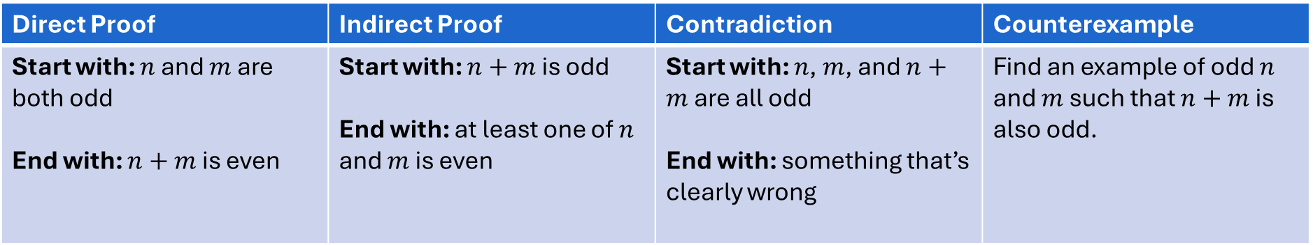

Example 1
Claim: If $n$ and $m$ are both odd, then $n+m$ is even.
Do you think the statement is true or false? TRUE
Which strategy seems easiest to you? DIRECT
Direct Proof | Indirect Proof | Contradiction | Counterexample
Start with: $n$ and $m$ are both odd End with: $n+m$ is even | Start with: $n+m$ is odd End with: at least one of $n$ and $m$ is even | Start with: $n$, $m$, and $n+m$ are all odd End with: something that’s clearly wrong | Find an example of odd $n$ and $m$ such that $n+m$ is also odd.

Slide 9
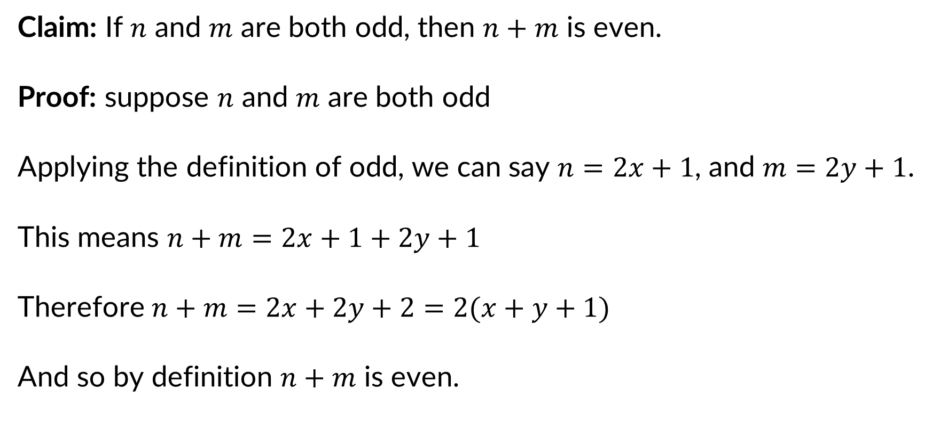
Example 1: Direct proof
Claim: If $n$ and $m$ are both odd, then $n+m$ is even.
Proof: suppose $n$ and $m$ are both odd
Applying the definition of odd, we can say $n=2x+1$, and $m=2y+1$.
This means $n+m=2x+1+2y+1$
Therefore $n+m=2x+2y+2=2(x+y+1)$
And so by definition $n+m$ is even.

Slide 10

Example 1: Indirect proof
Claim: If $n$ and $m$ are both odd, then $n+m$ is even.
Proof: Suppose $n+m$ is odd

Slide 11

Example 1: Proof by Contradiction
Claim: If $n$ and $m$ are both odd, then $n+m$ is even.
Proof: suppose, towards reaching a contradiction, that $n$, $m$, and $n+m$ are all odd

Slide 12
Let’s Practice! (Example 2)

Slide 13
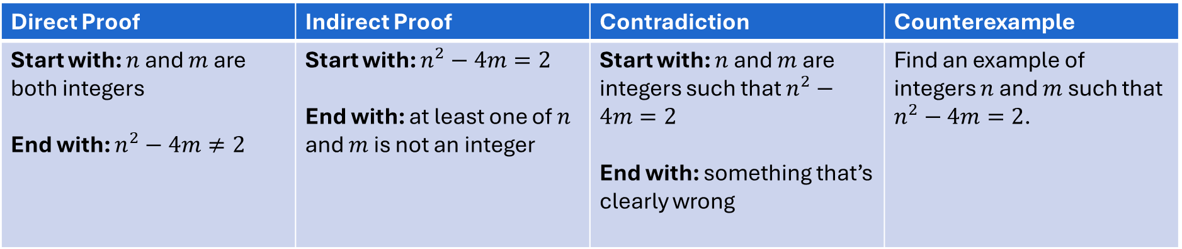

Example 2
Claim: If $n$ and $m$ are both integers, then $n^{2}−4m≠2$
Do you think the statement is true or false? TRUE
Which strategy seems easiest to you? CONTRADICTION
Direct Proof | Indirect Proof | Contradiction | Counterexample
Start with: $n$ and $m$ are both integers End with: $n^{2}−4m≠2$ | Start with: $n^{2}−4m=2$ End with: at least one of $n$ and $m$ is not an integer | Start with: $n$ and $m$ are integers such that $n^{2}−4m=2$ End with: something that’s clearly wrong | Find an example of integers $n$ and $m$ such that $n^{2}−4m=2$.

Slide 14

Example 2: Direct proof
Claim: If $n$ and $m$ are both integers, then $n^{2}−4m≠2$
Proof: suppose $n$ and $m$ are both integers

Slide 15

Example 2: Indirect proof
Claim: If $n$ and $m$ are both integers, then $n^{2}−4m≠2$
Proof: Suppose $n^{2}−4m=2$
$$n⋅n−4m=2$$
Case 1: both of $n$ and $m$ are odd

Slide 16
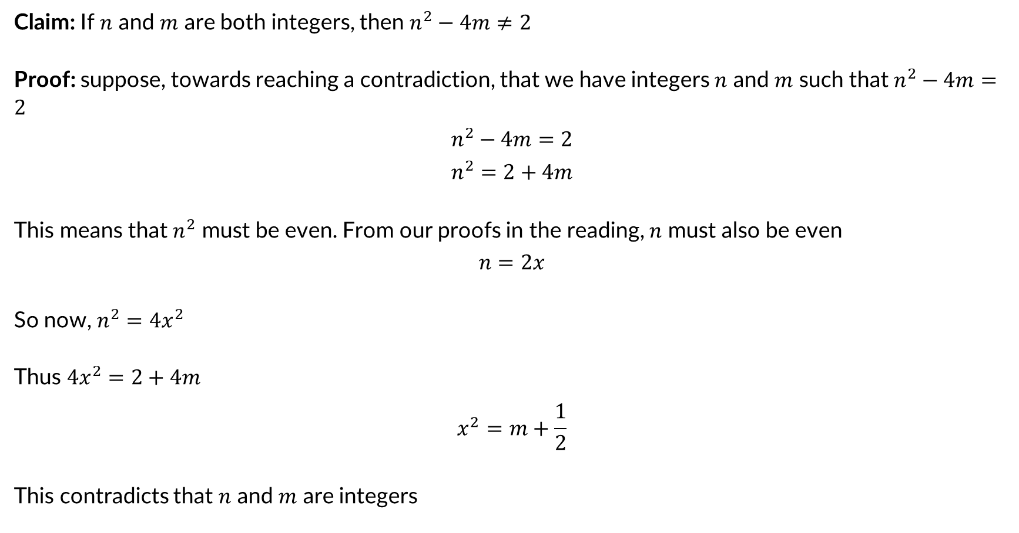
Example 2: Proof by Contradiction
Claim: If $n$ and $m$ are both integers, then $n^{2}−4m≠2$
Proof: suppose, towards reaching a contradiction, that we have integers $n$ and $m$ such that $n^{2}−4m=2$
$$n^{2}−4m=2$$
$$n^{2}=2+4m$$
This means that $n^{2}$ must be even. From our proofs in the reading, $n$ must also be even
$$n=2x$$
So now, $n^{2}=4x^{2}$
Thus $4x^{2}=2+4m$
$$x^{2}=m+\frac{1}{2}$$
This contradicts that $n$ and $m$ are integers

Slide 17
Let’s Practice! (Example 3)

Slide 18
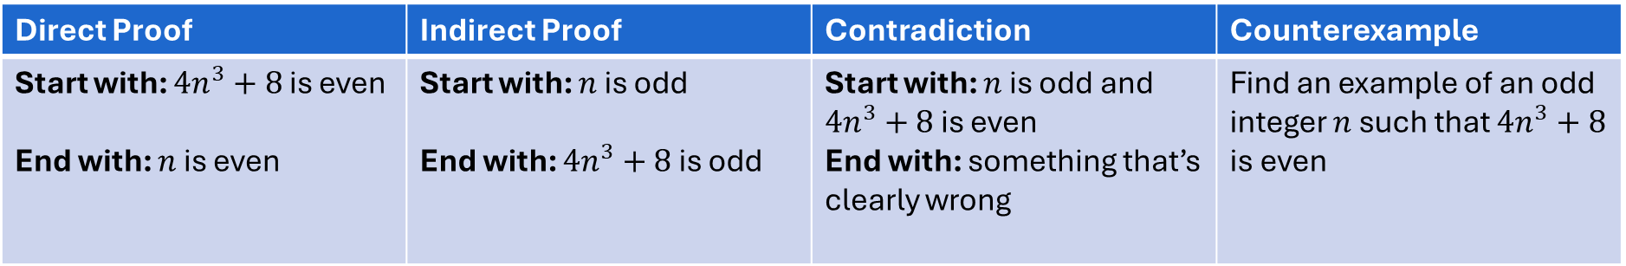

Example 3
Claim: If $4n^{3}+8$ is even then $n$ is even
Do you think the statement is true or false? FALSE
Which strategy seems easiest to you? COUNTEREXAMPLE
Direct Proof | Indirect Proof | Contradiction | Counterexample
Start with: ${4n}^{3}+8$ is even End with: $n$ is even | Start with: $n$ is odd End with: ${4n}^{3}+8$ is odd | Start with: $n$ is odd and $4n^{3}+8$ is even End with: something that’s clearly wrong | Find an example of an odd integer $n$ such that ${4n}^{3}+8$ is even

Slide 19

Example 3: Indirect proof - BAD
Claim: If $4n^{3}+8$ is even then $n$ is even
Proof: Suppose $n$ is even. So $n=2x$. Then we can see that $4n^{3}+8=4{\left(2x\right)}^{3}+8=4⋅8x^{3}+8$ which is even.

Slide 20

Example 3: Counterexample
Claim: If $4n^{3}+8$ is even then $n$ is even
Proof: let $n=1$. Note that $4{\left(1\right)}^{3}+8=12$ which is even.

Slide 21
Let’s Practice! (Example 4)

Slide 22
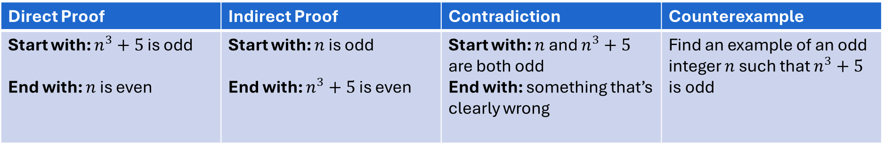

Example 4
Claim: If $n^{3}+5$ is odd then $n$ is even
Do you think the statement is true or false? TRUE
Which strategy seems easiest to you? CONTRADICTION
Direct Proof | Indirect Proof | Contradiction | Counterexample
Start with: $n^{3}+5$ is odd End with: $n$ is even | Start with: $n$ is odd End with: $n^{3}+5$ is even | Start with: $n$ and $n^{3}+5$ are both odd End with: something that’s clearly wrong | Find an example of an odd integer $n$ such that $n^{3}+5$ is odd

Slide 23

Example 4: Direct proof
Claim: If $n^{3}+5$ is odd then $n$ is even
Proof: suppose $n^{3}+5$ is odd

Slide 24

Example 4: Indirect proof
Claim: If $n^{3}+5$ is odd then $n$ is even
Proof: Suppose $n$ is odd

Slide 25
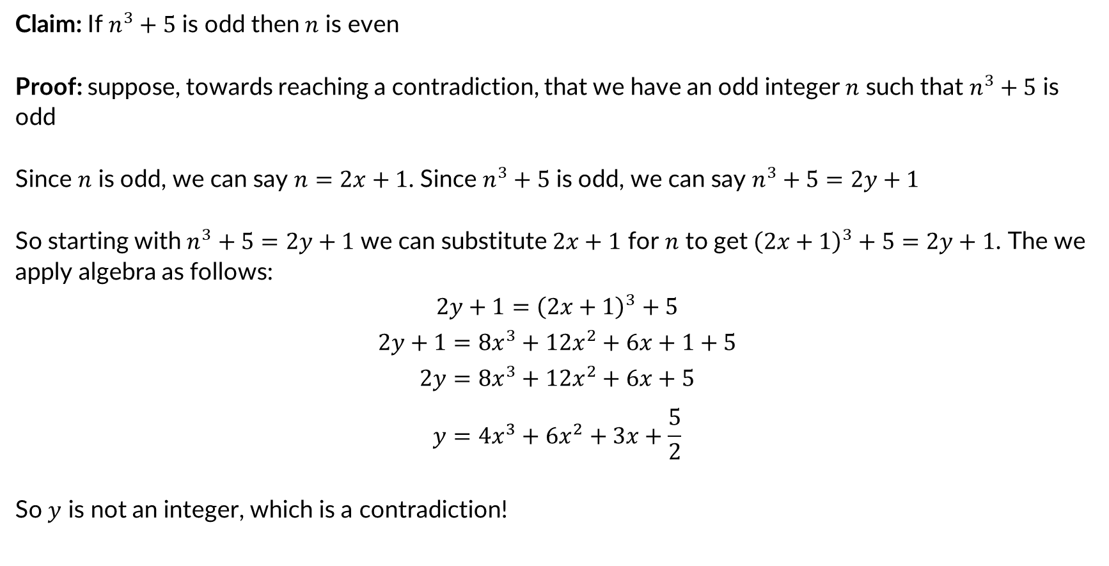
Example 4: Proof by Contradiction
Claim: If $n^{3}+5$ is odd then $n$ is even
Proof: suppose, towards reaching a contradiction, that we have an odd integer $n$ such that $n^{3}+5$ is odd
Since $n$ is odd, we can say $n=2x+1$. Since $n^{3}+5$ is odd, we can say $n^{3}+5=2y+1$
So starting with $n^{3}+5=2y+1$ we can substitute $2x+1$ for $n$ to get ${\left(2x+1\right)}^{3}+5=2y+1$. The we apply algebra as follows:
$$2y+1={\left(2x+1\right)}^{3}+5$$
$$2y+1=8x^{3}+12x^{2}+6x+1+5$$
$$2y=8x^{3}+12x^{2}+6x+5$$
$$y=4x^{3}+6x^{2}+3x+\frac{5}{2}$$
So $y$ is not an integer, which is a contradiction!

Slide 26
Let’s Practice! (Example 5)

Slide 27
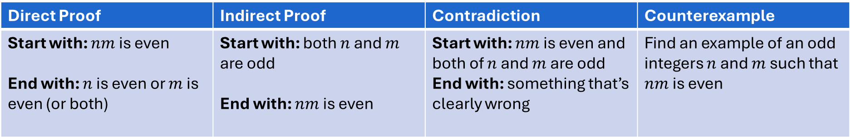

Example 5
Claim: If $nm$ is even then at least one of $n$ and $m$ is even
Do you think the statement is true or false? TRUE
Which strategy seems easiest to you? CONTRAPOSITIVE
Direct Proof | Indirect Proof | Contradiction | Counterexample
Start with: $nm$ is even End with: $n$ is even or $m$ is even (or both) | Start with: both $n$ and $m$ are odd End with: $nm$ is even | Start with: $nm$ is even and both of $n$ and $m$ are odd End with: something that’s clearly wrong | Find an example of an odd integers $n$ and $m$ such that $nm$ is even

Slide 28

Example 5: Direct proof
Claim: If $nm$ is even then at least one of $n$ and $m$ is even
Proof: suppose $nm$ is even

Slide 29
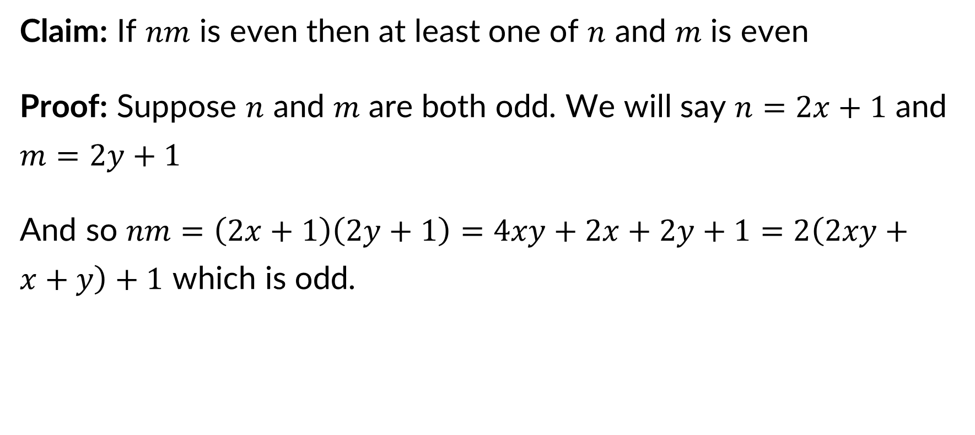
Example 5: Indirect proof
Claim: If $nm$ is even then at least one of $n$ and $m$ is even
Proof: Suppose $n$ and $m$ are both odd. We will say $n=2x+1$ and $m=2y+1$
And so $nm=\left(2x+1\right)\left(2y+1\right)=4xy+2x+2y+1=2\left(2xy+x+y\right)+1$ which is odd.

Slide 30

Example 5: Proof by Contradiction
Claim: If $nm$ is even then at least one of $n$ and $m$ is even
Proof: suppose, towards reaching a contradiction, that we have odd integers $n$ and $m$ such that $nm$ is even

Slide 31
Let’s Practice! (Example 6)

Slide 32
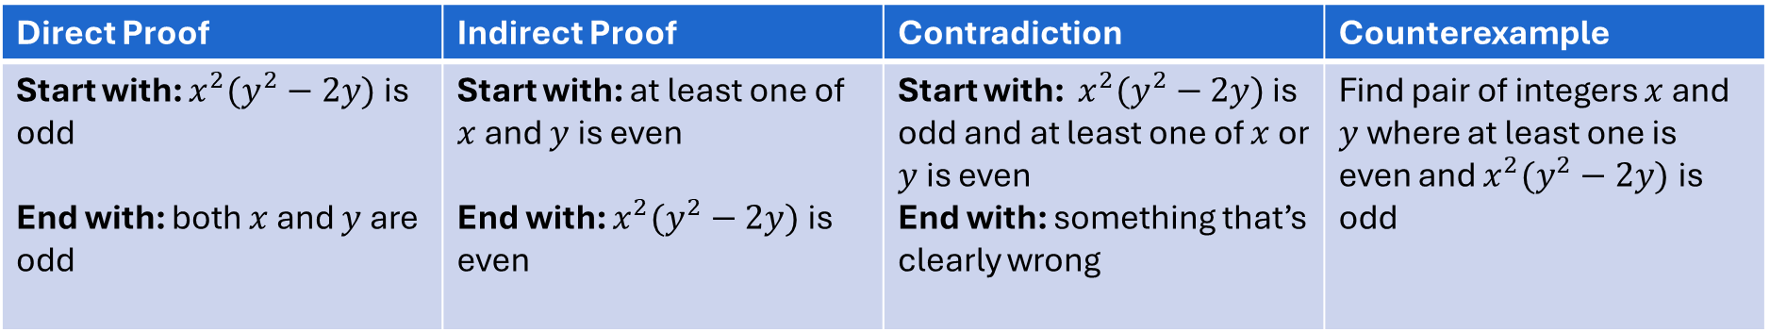

Example 6
Claim: If $x^{2}(y^{2}−2y)$ is odd then both $x$ and $y$ are odd
Do you think the statement is true or false? TRUE
Which strategy seems easiest to you? INDIRECT
Direct Proof | Indirect Proof | Contradiction | Counterexample
Start with: $x^{2}(y^{2}−2y)$ is odd End with: both $x$ and $y$ are odd | Start with: at least one of $x$ and $y$ is even End with: $x^{2}(y^{2}−2y)$ is even | Start with: $x^{2}(y^{2}−2y)$ is odd and at least one of $x$ or $y$ is even End with: something that’s clearly wrong | Find pair of integers $x$ and $y$ where at least one is even and $x^{2}(y^{2}−2y)$ is odd

Slide 33

Example 6: Direct proof
Claim: If $x^{2}(y^{2}−2y)$ is odd then both $x$ and $y$ are odd
Proof: suppose $x^{2}(y^{2}−2y)$ is odd

Slide 34

Example 6: Indirect proof
Claim: If $x^{2}(y^{2}−2y)$ is odd then both $x$ and $y$ are odd
Proof: Suppose that $x$ is even or $y$ is even
Case 1: $x$ is even
Because $x$ is even we can say $x=2a$. This means that:
$$x^{2}\left(y^{2}−2y\right)={\left(2a\right)}^{2}\left(y^{2}−2y\right)=4a^{2}\left(y^{2}−2y\right)=2\left(\left(2a^{2}\right)\left(y^{2}−2y\right)\right)$$
Which is even
Case2: $y$ is even
Because $y$ is even we can say $y=2b$. This means that:
$x^{2}\left(y^{2}−2y\right)=x^{2}\left({\left(2b\right)}^{2}−2\left(2b\right)\right)=x^{2}\left(4b^{2}−4b\right)=2\left(2x^{2}\left(b^{2}−b\right)\right)$ which is even.
Because either one of $x$ or $y$ being even makes $x^{2}\left(y^{2}−2y\right)$ even, our proof is complete

Slide 35

Example 6: Proof by Contradiction
Claim: If $x^{2}(y^{2}−2y)$ is odd then both $x$ and $y$ are odd
Proof: suppose, towards reaching a contradiction, a pair of integers $x$ and $y$ (not both odd) such that $x^{2}(y^{2}−2y)$ is even

Slide 36
Let’s Practice! (Example 7)

Slide 37


Example 7
Claim: If $4n^{3}+8$ is odd then $n$ is even
Do you think the statement is true or false?
Which strategy seems easiest to you?
Direct Proof | Indirect Proof | Contradiction | Counterexample
Start with: $4n^{3}+8$ is odd End with: $n$ is even | Start with: $n$ is odd End with:$4n^{3}+8$ is even | Start with: $n$ and $4n^{3}+8$ are both odd End with: something that’s clearly wrong | Find an example of an odd integer $n$ such that $4n^{3}+8$ is odd

Slide 38

Example 7: Direct Proof
Claim: If $4n^{3}+8$ is odd then $n$ is even
Proof: Suppose $4n^{3}+8$ is odd

Slide 39

Example 7: Indirect proof
Claim: If $4n^{3}+8$ is odd then $n$ is even
Proof: Suppose $n$ is even

Slide 40
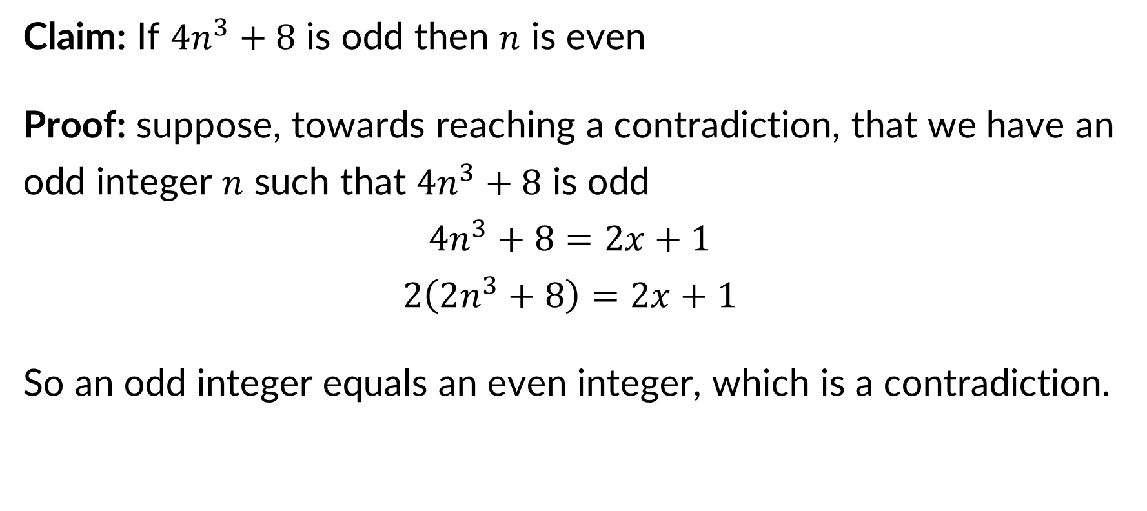
Example 7: Proof by Contradiction
Claim: If $4n^{3}+8$ is odd then $n$ is even
Proof: suppose, towards reaching a contradiction, that we have an odd integer $n$ such that $4n^{3}+8$ is odd
$$4n^{3}+8=2x+1$$
$$2\left(2n^{3}+8\right)=2x+1$$
So an odd integer equals an even integer, which is a contradiction.

Slide 41

Example 7: Counterexample
Claim: If $4n^{3}+8$ is even then $n$ is even
Proof: let $n=???$

Slide 42
Vacuous Truth
If we have a claim of the form “If property P is true then property Q is true” and it is impossible for property P to be true, the entire statement is actually a true statement!
We say that statement is “vacuously true”

Slide 43
Review: What is correctness?

Slide 44
Review: Correctness
Algorithm: A list of unambiguous instructions to solve a class of computational problems
An algorithm is correct for a given problem if it has:
​Soundness: Running it never raises exceptions/errors
​Termination: All loops terminate
​Validity: The output meets the problem specification

Slide 45
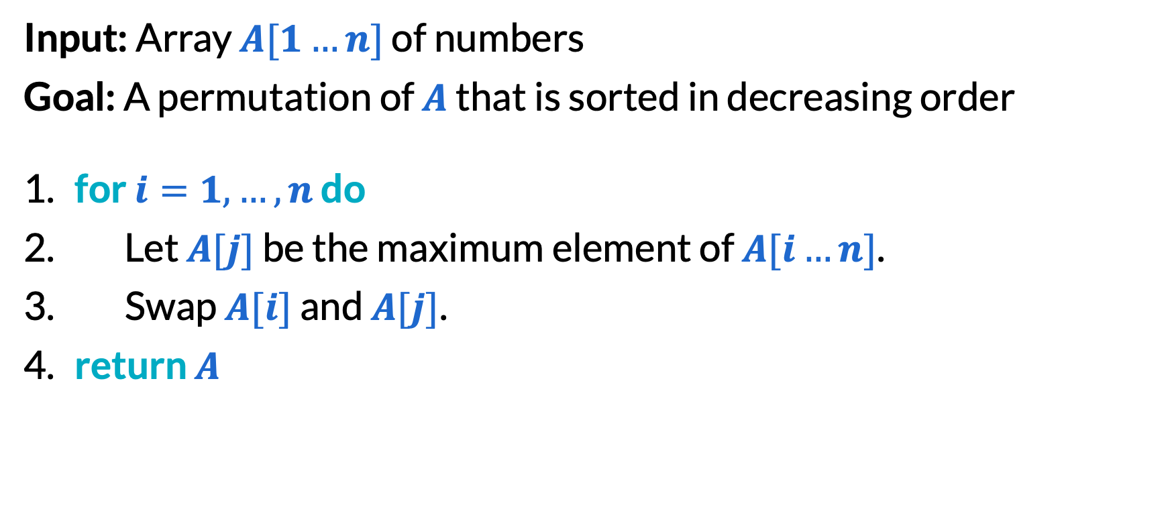
Review: Selection sort (1/6)
Input: Array $A[1…n]$ of numbers
Goal: A permutation of $A$ that is sorted in decreasing order
​for $i=1,…,n$ do
Let $A[j]$ be the maximum element of $A[i…n]$.
Swap $A[i]$ and $A[j]$.
​return $A$

Slide 46
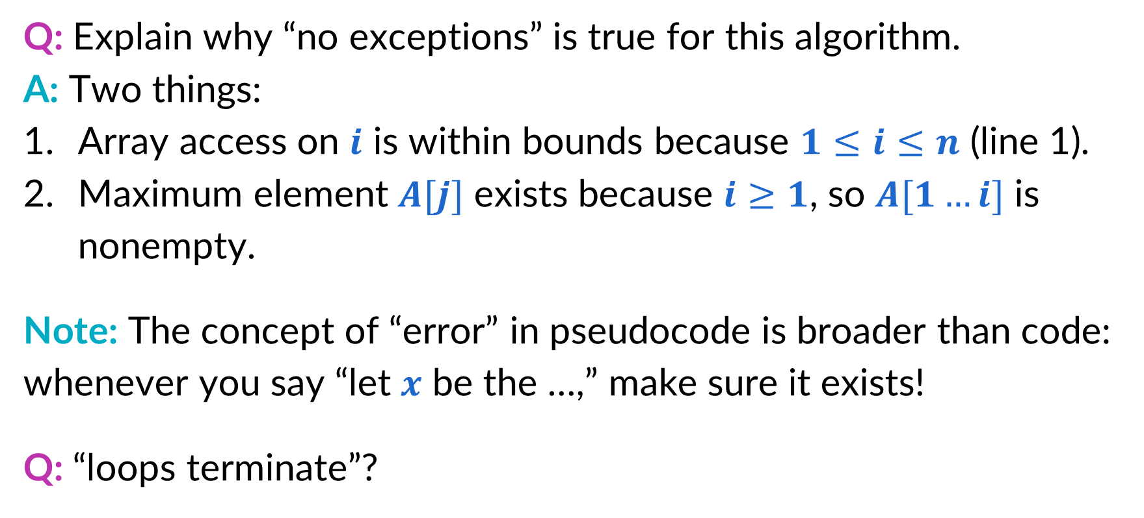
Review: Selection sort (2/6)
Q: Explain why “no exceptions” is true for this algorithm.
A: Two things:
Array access on $i$ is within bounds because $1≤i≤n$ (line 1).
Maximum element $A[j]$ exists because $i≥1$, so $A[1…i]$ is nonempty.
Note: The concept of “error” in pseudocode is broader than code: whenever you say “let $x$ be the …,” make sure it exists!
Q: “loops terminate”?
A: For-loops always terminate!

Slide 47
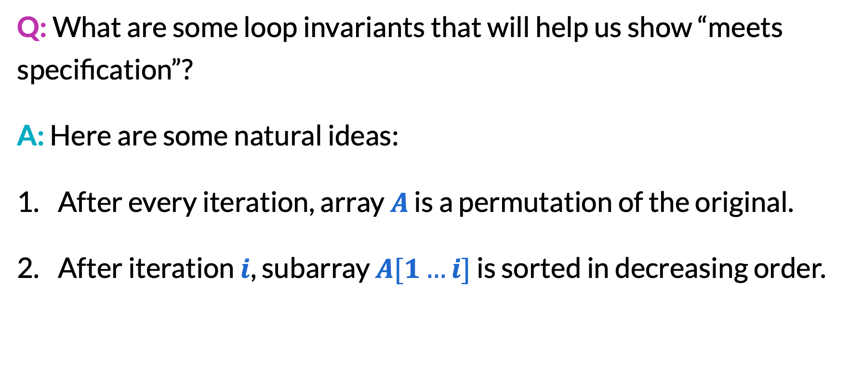
Selection sort (3/6)
Q: What are some loop invariants that will help us show “meets specification”?
A: Here are some natural ideas:
After every iteration, array $A$ is a permutation of the original.
After iteration $i$, subarray $A[1…i]$ is sorted in decreasing order.

Slide 48
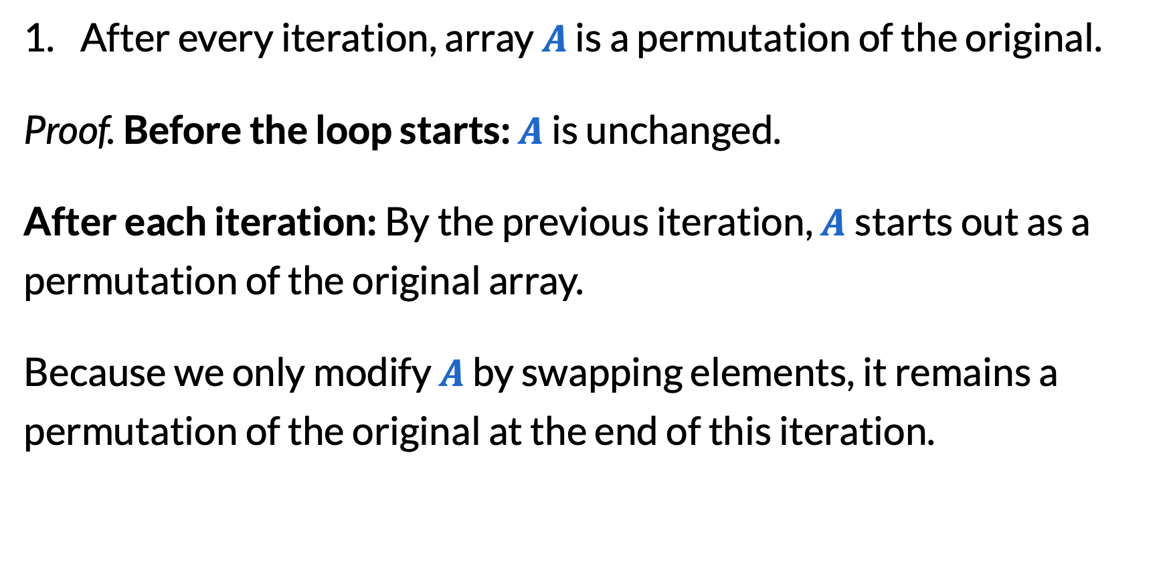
Selection sort (4/6)
After every iteration, array $A$ is a permutation of the original.
Proof. Before the loop starts: $A$ is unchanged.
After each iteration: By the previous iteration, $A$starts out as a permutation of the original array.
Because we only modify $A$ by swapping elements, it remains a permutation of the original at the end of this iteration.

Slide 49
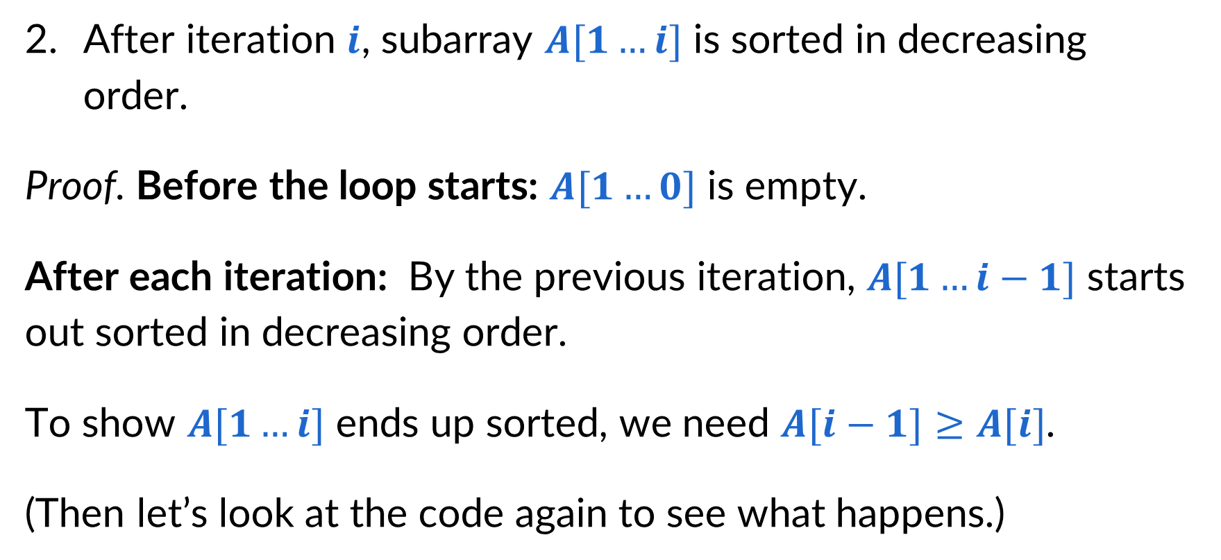
Selection sort (5/6)
After iteration $i$, subarray $A[1…i]$ is sorted in decreasing order.
Proof. Before the loop starts: $A[1…0]$ is empty.
After each iteration: By the previous iteration, $A[1…i−1]$ starts out sorted in decreasing order.
To show $A[1…i]$ ends up sorted, we need $A[i−1]≥A[i]$.
(Then let’s look at the code again to see what happens.)

Slide 50
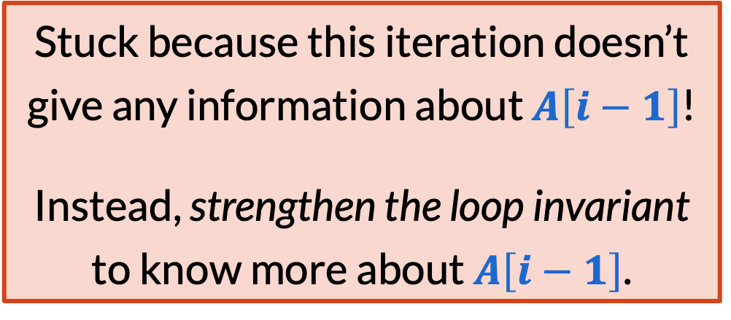
Selection sort (6/6)
Input: Array $A[1…n]$ of numbers
Goal: A permutation of $A$ that is sorted in decreasing order
​for $i=1,…,n$ do
Let $A[j]$ be the maximum element of $A[i…n]$.
Swap $A[i]$ and $A[j]$.
​return $A$
Stuck because this iteration doesn’t give any information about $A\left[i−1\right]$!
Instead, strengthen the loop invariant to know more about $A\left[i−1\right]$.

Slide 51
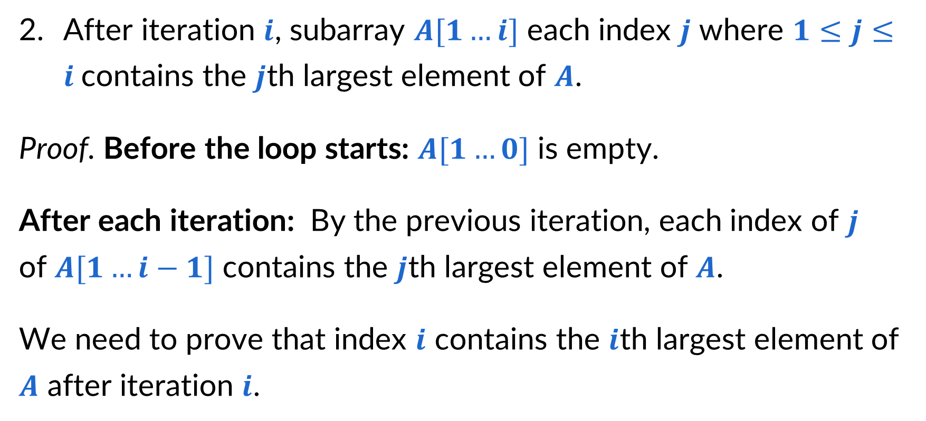
Alternative invariant (1/3)
After iteration $i$, subarray $A[1…i]$ each index $j$ where $1≤j≤i$contains the $j$th largest element of $A$.
Proof. Before the loop starts: $A[1…0]$ is empty.
After each iteration: By the previous iteration, each index of $j$ of ​$A[1…i−1]$ contains the $j$th largest element of $A$.
We need to prove that index $i$ contains the $i$th largest element of $A$ after iteration $i$.

Slide 52
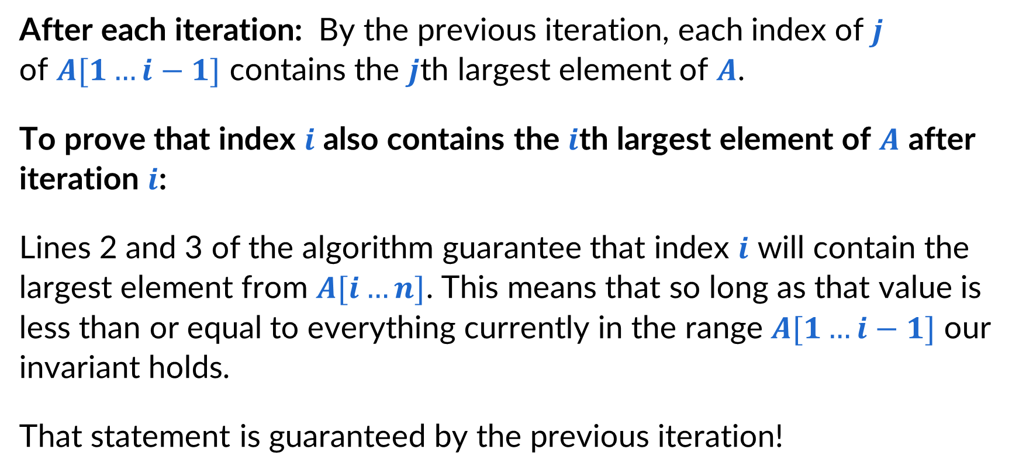
Alternative invariant (2/3)
After each iteration: By the previous iteration, each index of $j$ of ​$A[1…i−1]$ contains the $j$th largest element of $A$.
To prove that index $i$ also contains the $i$th largest element of $A$ after iteration $i$:
Lines 2 and 3 of the algorithm guarantee that index $i$ will contain the largest element from $A[i…n]$. This means that so long as that value is less than or equal to everything currently in the range $A[1…i−1]$ our invariant holds.
That statement is guaranteed by the previous iteration!

Slide 53
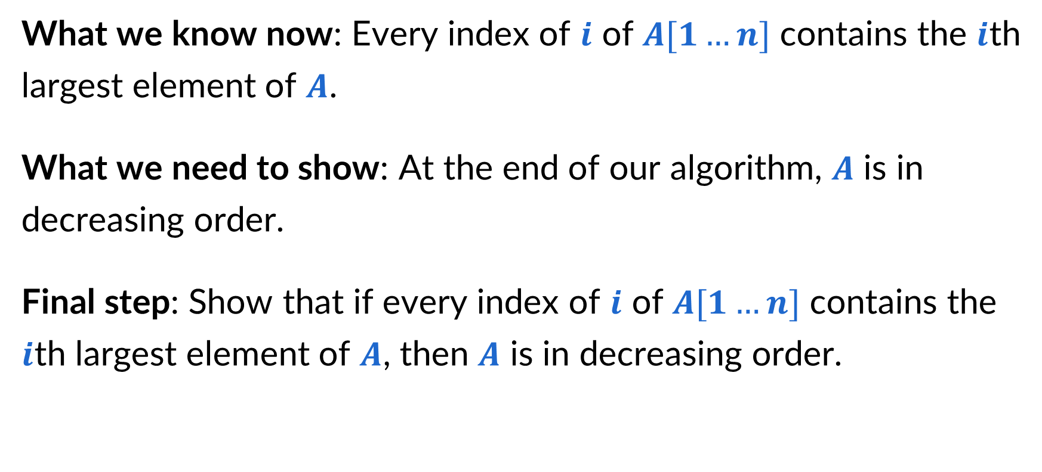
Alternative Invariant (3/3)
What we know now: Every index of $i$ of ​$A[1…n]$ contains the $i$th largest element of $A$.
What we need to show: At the end of our algorithm, $A$ is in decreasing order.
Final step: Show that if every index of $i$ of ​$A[1…n]$ contains the $i$th largest element of $A$, then $A$ is in decreasing order.

Slide 54
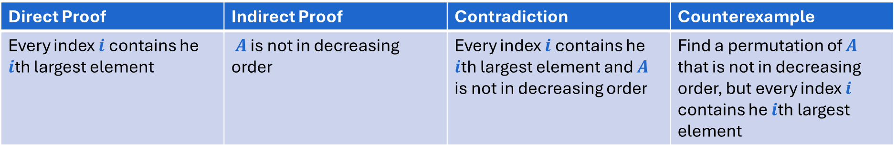
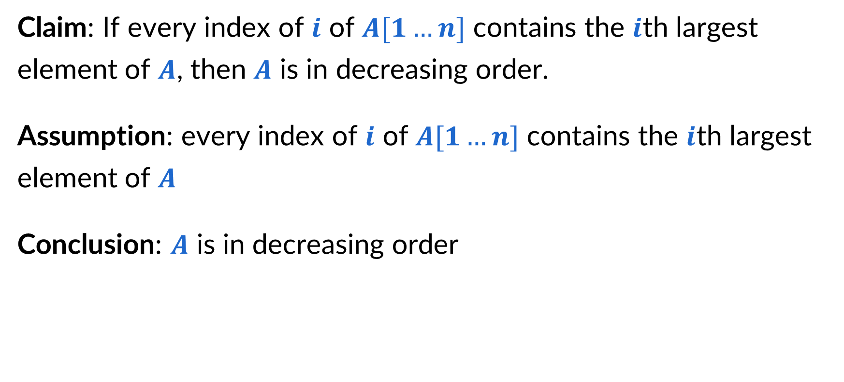
Final step
Claim: If every index of $i$ of ​$A[1…n]$ contains the $i$th largest element of $A$, then $A$ is in decreasing order.
Assumption: every index of $i$ of ​$A[1…n]$ contains the $i$th largest element of $A$
Conclusion: $A$ is in decreasing order
Direct Proof | Indirect Proof | Contradiction | Counterexample
Every index $i$ contains he $i$th largest element | $A$ is not in decreasing order | Every index $i$ contains he $i$th largest element and $A$ is not in decreasing order | Find a permutation of $A$ that is not in decreasing order, but every index $i$ contains he $i$th largest element

Slide 55
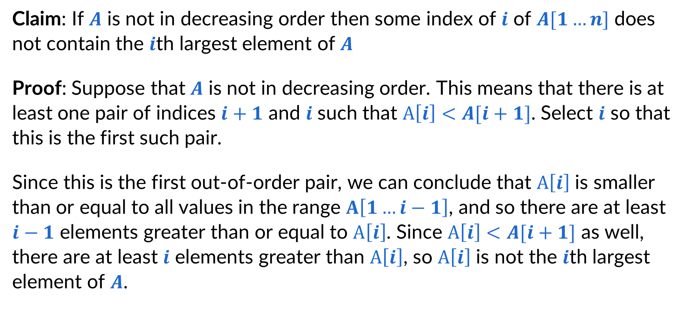
Indirect proof
Claim: If $A$ is not in decreasing order then some index of $i$ of ​$A[1…n]$ does not contain the $i$th largest element of $A$
Proof: Suppose that $A$ is not in decreasing order. This means that there is at least one pair of indices $i+1$ and $i$ such that $A\left[i\right]<A[i+1]$. Select $i$ so that this is the first such pair.
Since this is the first out-of-order pair, we can conclude that $A\left[i\right]$ is smaller than or equal to all values in the range $A\left[1…i−1\right]$, and so there are at least $i−1$ elements greater than or equal to $A\left[i\right]$. Since $A\left[i\right]<A[i+1]$ as well, there are at least $i$ elements greater than $A\left[i\right]$, so $A\left[i\right]$ is not the $i$th largest element of $A$.

Slide 56
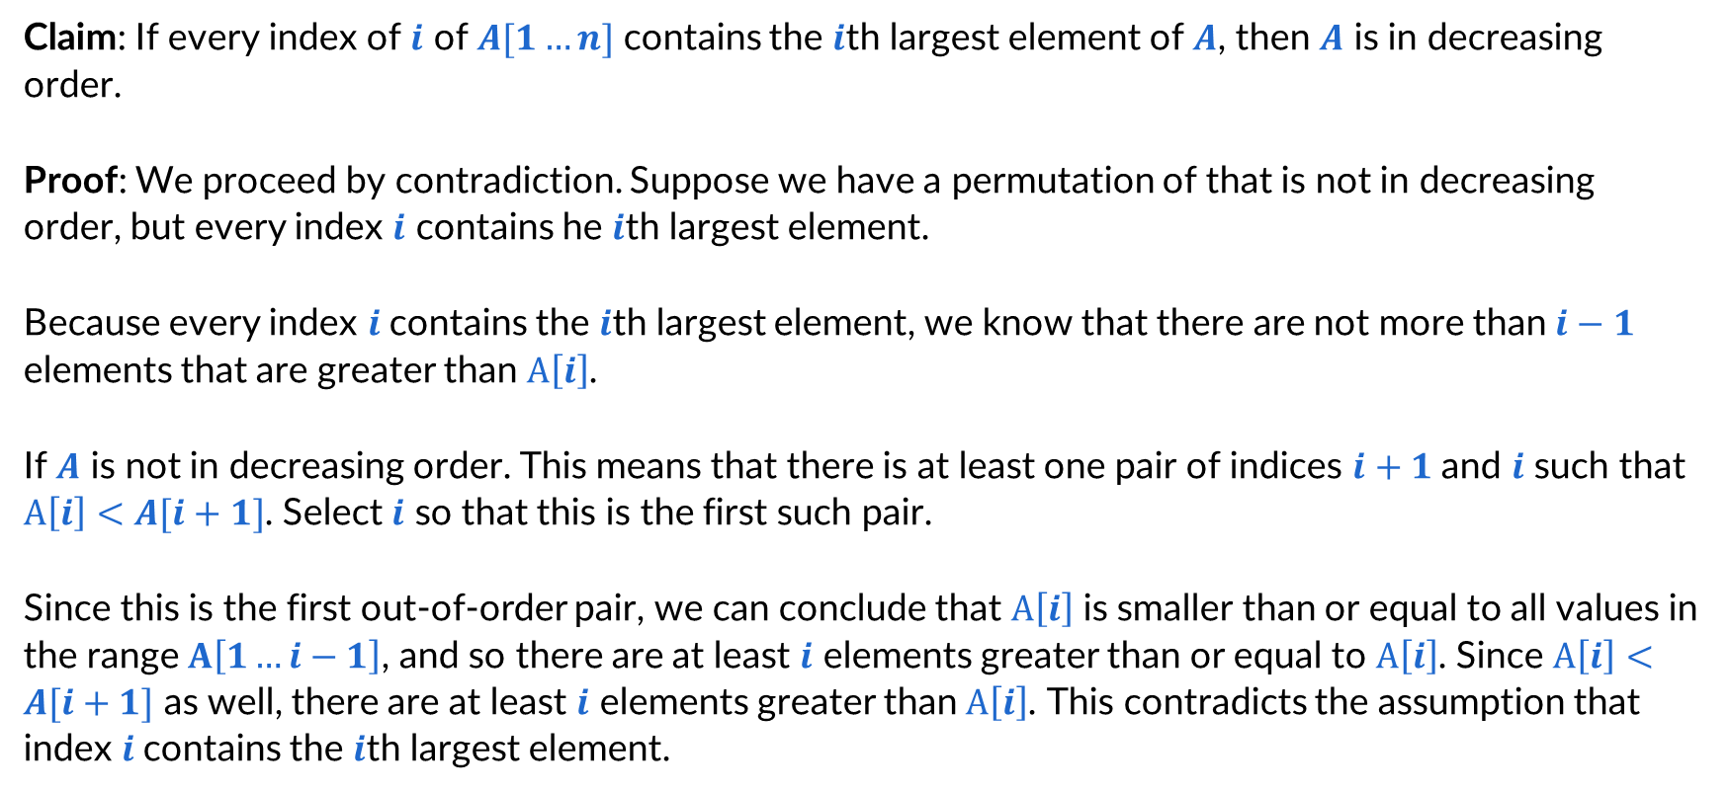
Contradiction
Claim: If every index of $i$ of ​$A[1…n]$ contains the $i$th largest element of $A$, then $A$ is in decreasing order.
Proof: We proceed by contradiction. Suppose we have a permutation of that is not in decreasing order, but every index $i$ contains he $i$th largest element.
Because every index $i$contains the $i$th largest element, we know that there are not more than $i−1$ elements that are greater than $A\left[i\right]$.
If $A$ is not in decreasing order. This means that there is at least one pair of indices $i+1$ and $i$ such that $A\left[i\right]<A[i+1]$. Select $i$ so that this is the first such pair.
Since this is the first out-of-order pair, we can conclude that $A\left[i\right]$ is smaller than or equal to all values in the range $A\left[1…i−1\right]$, and so there are at least $i$ elements greater than or equal to $A\left[i\right]$. Since $A\left[i\right]<A[i+1]$ as well, there are at least $i$ elements greater than $A\left[i\right]$. This contradicts the assumption that index $i$contains the $i$th largest element.

Slide 57
Proof writing tips
Writing proofs often involves failing. If some path seems like a dead end, try at different approach!
Start by first guessing whether the statement is true or false.
Next, write out what each proof strategy requires us to demonstrate. Then try to guess at which one seems easiest, start working on that one
Repeatedly apply definitions of things to re-express statements. Write down all things you can think of that are true and relevant based on those statements
If you get stuck, transition to another strategy. If you keep getting stuck, return to a previous one
Proof techniques are not exclusive. You may find that you embed one strategy for one part of a larger proof
If you’re getting frustrated, come to office hours!

Slide 58
Final reminders
HW1 released at 11:30am!
I have OH now-12:30pm:
Meet at front of classroom, we’ll walk over together
CSE (Allen) 343 if you’re coming later
Nathan has online OH 12–1pm:
Link on Canvas/course website
https://washington.zoom.us/my/nathanbrunelle

