Slide 1
Lecture 9: Graph search
Glenn Sun

Slide 2
Why graphs?
Graphs can be used to model many real-world situations.
Applications for just today:
MS Paint bucket fill tool
LinkedIn 1st/2nd/3rd degree connections
Prerequisite planning in universities

Slide 3
Basics about graphs

Slide 4
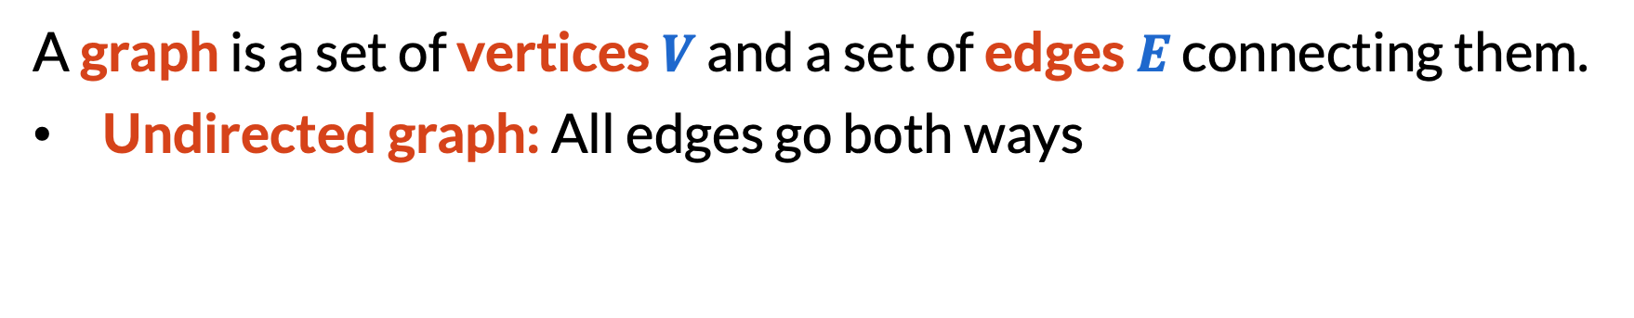
What is a graph?
A graph is a set of vertices $V$ and a set of edges $E$ connecting them.
​Undirected graph: All edges go both ways
3
8
5
1
6
9
4
2
7

Slide 5
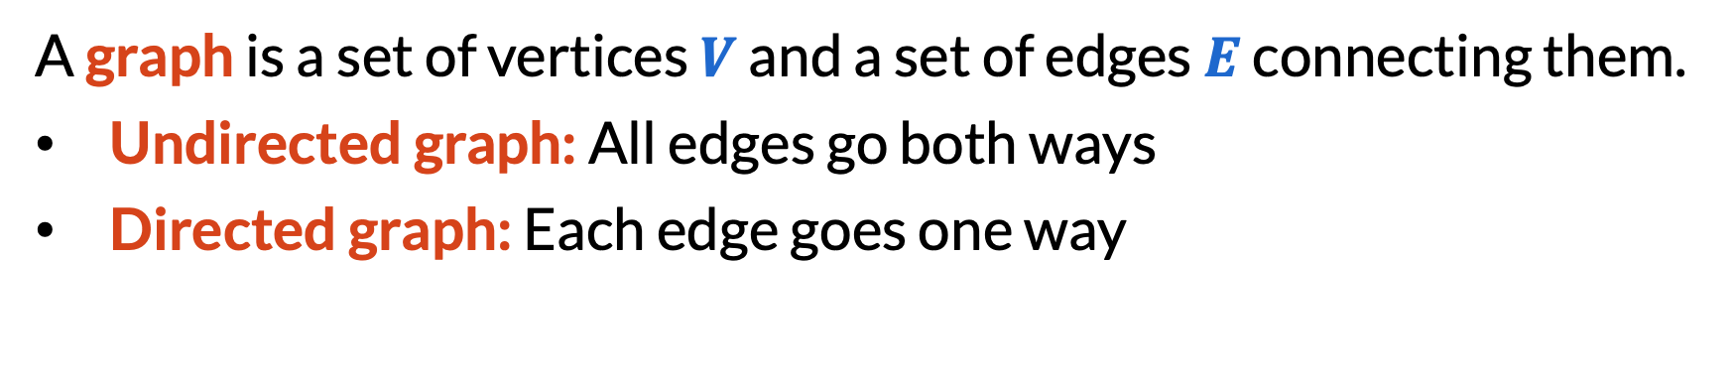
What is a graph?
A graph is a set of vertices $V$ and a set of edges $E$ connecting them.
​Undirected graph: All edges go both ways
​Directed graph: Each edge goes one way
3
8
5
1
6
9
4
2
7

Slide 6
3
8
1
789
5
1
9
2345
4
7
2
6
6

Slide 7
3
8
5
1
9
4
7
2
6

Slide 8
1
2
7
4
3
6
8
5
9

Slide 9
What is a graph?
Positioning doesn’t matter.
Graph only encodes connectivity.
6
1
3
8
5
9
4
2
7

Slide 10
Two default assumptions
No self-loops
No “parallel” edges
❌
❌

Slide 11
Some basic vocabulary
Path: sequence of distinct vertices connected by edges
3
8
5
1
6
9
4
2
7

Slide 12
Some basic vocabulary
Cycle: sequence of distinct vertices connected by edges, except the first and last vertex are the same
3
8
5
1
6
9
4
2
7

Slide 13

Some basic vocabulary
The out-neighbors of $v$ are the vertices that $v$ can go to by an edge.
3
8
5
1
6
9
$$v$$
2
7

Slide 14
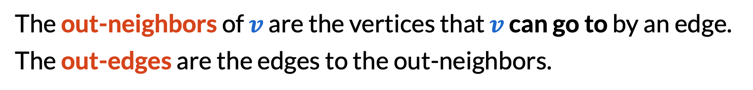
Some basic vocabulary
The out-neighbors of $v$ are the vertices that $v$ can go to by an edge.
The out-edges are the edges to the out-neighbors.
3
8
5
1
6
9
$$v$$
2
7

Slide 15
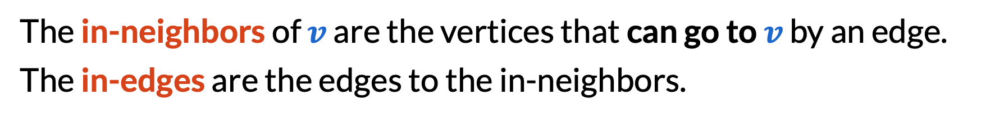
Some basic vocabulary
The in-neighbors of $v$ are the vertices that can go to $v$ by an edge.
The in-edges are the edges to the in-neighbors.
3
8
5
1
6
9
$$v$$
2
7

Slide 16
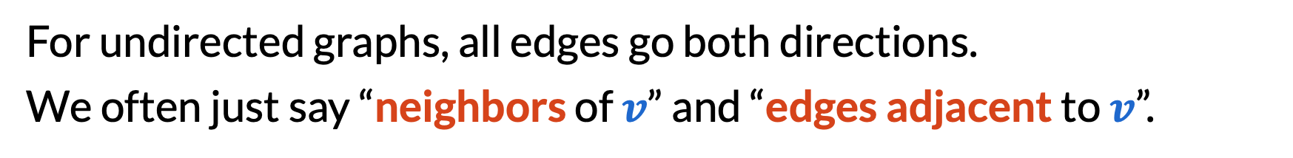
Some basic vocabulary
For undirected graphs, all edges go both directions.
We often just say “neighbors of $v$” and “edges adjacent to $v$”.
3
8
5
1
6
9
$$v$$
2
7

Slide 17







Some basic vocabulary
Careful! The word “connected” is ambiguous.
$u$ and $v$ are connected
$$u$$
$$v$$
$$u$$
$$v$$
$$u$$
$$v$$

Slide 18
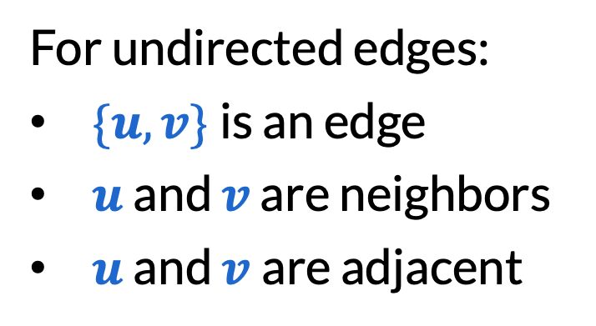
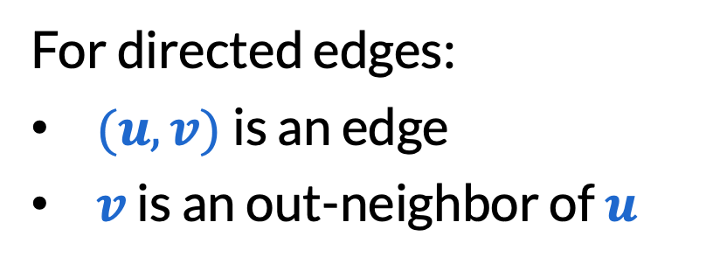
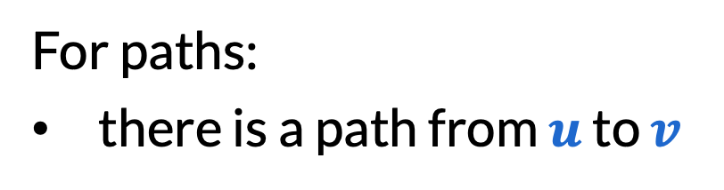
Some basic vocabulary
Instead, say:
For undirected edges:
​$\{u,v\}$is an edge
​$u$ and $v$ are neighbors
​$u$ and $v$are adjacent
For directed edges:
​$(u, v)$is an edge
​$v$ is an out-neighbor of $u$
For paths:
there is a path from $u$ to $v$

Slide 19
Some basic vocabulary
An undirected graph is connected if you can go from any vertex to any other vertex.
3
8
5
1
6
9
4
2
7

Slide 20
Some basic vocabulary
If the graph is not connected, it can be broken down into connected components, which are maximal connected subgraphs (means you can’t add vertices without becoming disconnected).
3
8
5
1
6
9
4
2
7

Slide 21
How graphs work in programming
We use adjacency list representation: list of out-neighbors for every vertex.
out[1] = [2, 3]
out[2] = [4]
out[3] = [5]
out[4] = [2, 3]
out[5] = [4]
3
5
1
4
2

Slide 22
How graphs work in programming
A bidirectional adjacency list also lists the in-neighbors separately.
out[1] = [2, 3]
out[2] = [4]
out[3] = [5]
out[4] = [2, 3]
out[5] = [4]
3
in[1] = []
in[2] = [1, 4]
in[3] = [1, 4]
in[4] = [2, 5]
in[5] = [3]
5
1
4
2

Slide 23
How graphs work in programming
For undirected graphs, one adjacency list can be used for both in/out.
neighbors[1] = [2, 3]
neighbors[2] = [1, 4]
neighbors[3] = [1, 4, 5]
neighbors[4] = [2, 3, 5]
neighbors[5] = [3, 4]
3
5
1
4
2

Slide 24
BFS and DFS

Slide 25
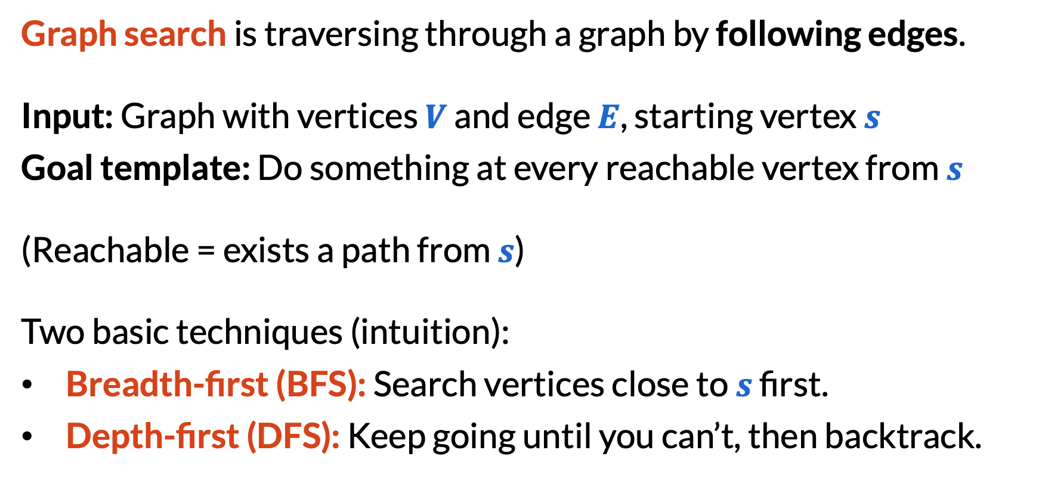
What is graph search?
Graph search is traversing through a graph by following edges.
Input: Graph with vertices $V$ and edge $E$, starting vertex $s$
Goal template: Do something at every reachable vertex from $s$
(Reachable = exists a path from $s$)
Two basic techniques (intuition):
​Breadth-first (BFS): Search vertices close to $s$ first.
​Depth-first (DFS): Keep going until you can’t, then backtrack.

Slide 26
BFS demonstration
3
8
5
1
6
9
4
2
7
Process order: 123456

Slide 27
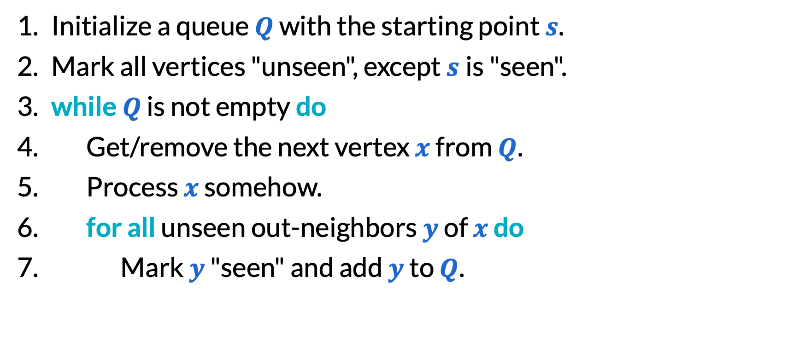
BFS pseudocode
Initialize a queue $Q$ with the starting point $s$.
Mark all vertices "unseen", except $s$is "seen".
​while $Q$ is not empty do
Get/remove the next vertex $x$ from $Q$.
Process $x$ somehow.
​for all unseen out-neighbors $y$ of $x$ do
Mark $y$ "seen" and add $y$ to $Q$.

Slide 28
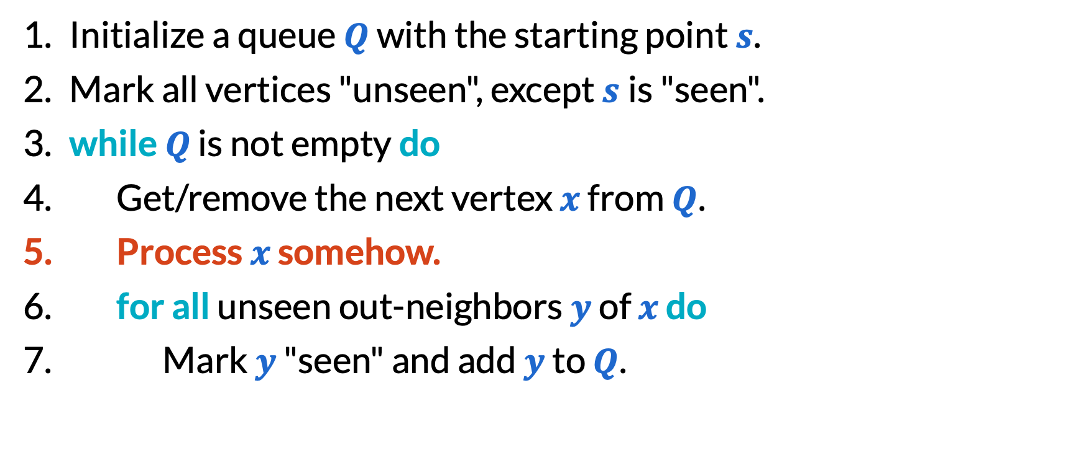
BFS pseudocode
Initialize a queue $Q$ with the starting point $s$.
Mark all vertices "unseen", except $s$is "seen".
​while $Q$ is not empty do
Get/remove the next vertex $x$ from $Q$.
Process $x$ somehow.
​for all unseen out-neighbors $y$ of $x$ do
Mark $y$ "seen" and add $y$ to $Q$.
BFS/DFS is not single algorithms, but families of algorithms!

Slide 29
DFS demonstration
3
8
5
1
6
9
4
2
7
Process order: 124356

Slide 30
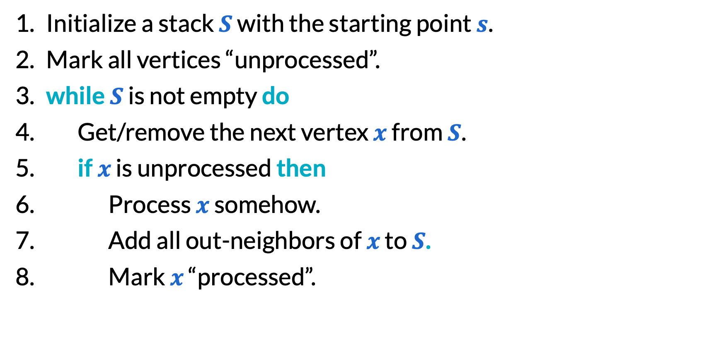
DFS pseudocode
Initialize a stack $S$ with the starting point $s$.
Mark all vertices “unprocessed”.
​while $S$ is not empty do
Get/remove the next vertex $x$ from $S$.
​if $x$ is unprocessed then
Process $x$ somehow.
​Add all out-neighbors of $x$ to $S$.
Mark $x$ “processed”.

Slide 31
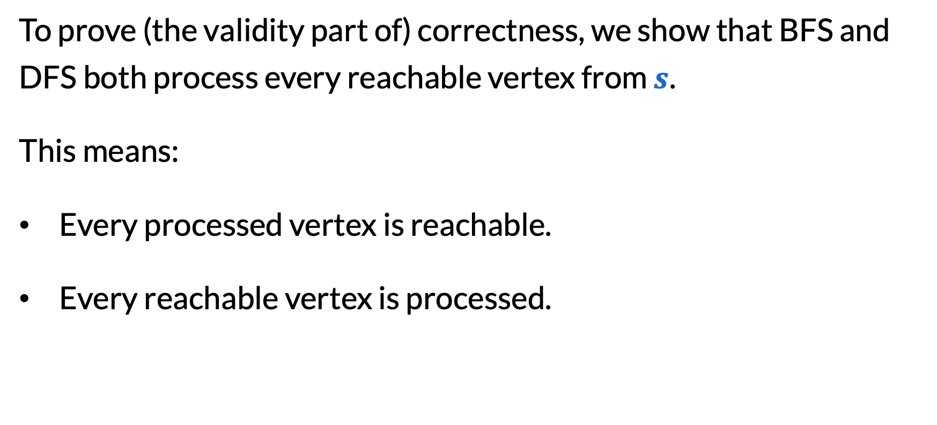
Reachability
To prove (the validity part of) correctness, we show that BFS and DFS both process every reachable vertex from $s$.
This means:
Every processed vertex is reachable.
Every reachable vertex is processed.

Slide 32
Reachability
Every processed vertex is reachable.
This is a loop invariant! All processed vertices are always reachable, because we find them via edges.
Every reachable vertex is processed.
Not true until the end of the loop. By contradiction.

Slide 33
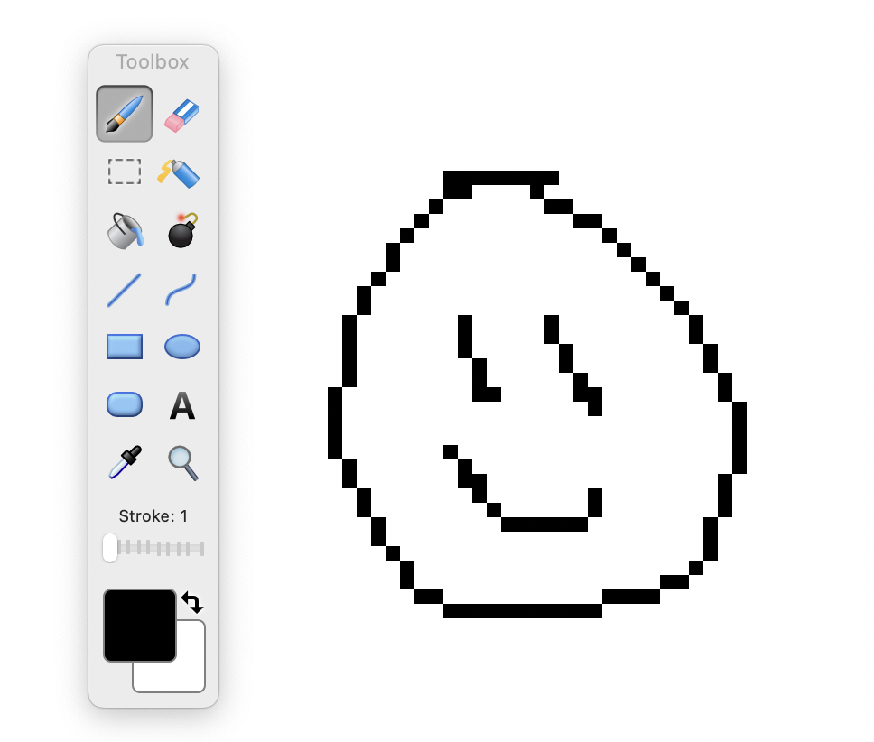


MS Paint bucket tool
Input: Grid of pixels, a color, and a starting pixel $s$
Goal: Recolor all pixels that are connected to $s$by pixels of the same color (and have the same color as $s$)

Slide 34

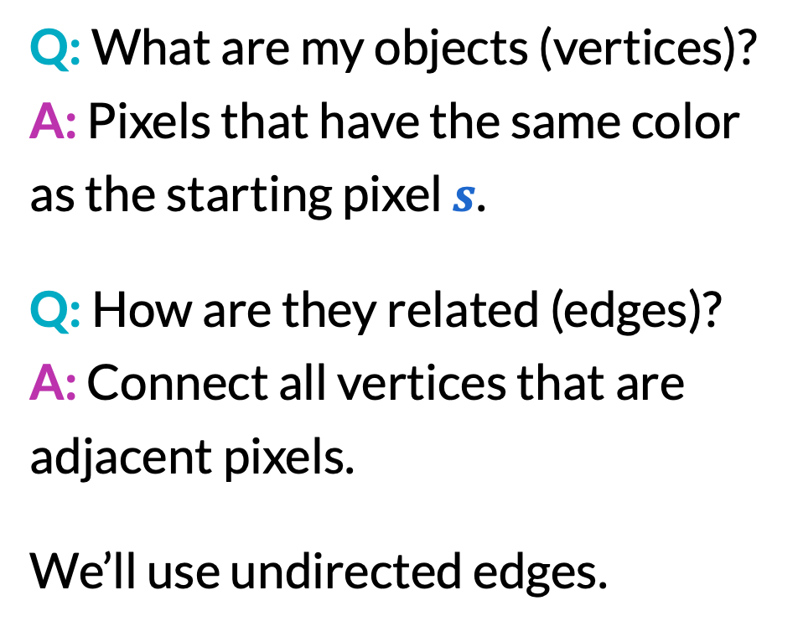
Graph modeling template
Q: What are my objects (vertices)?
A: Pixels that have the same color as the starting pixel $s$.
Q: How are they related (edges)?
A: Connect all vertices that are adjacent pixels.
We’ll use undirected edges.

Slide 35
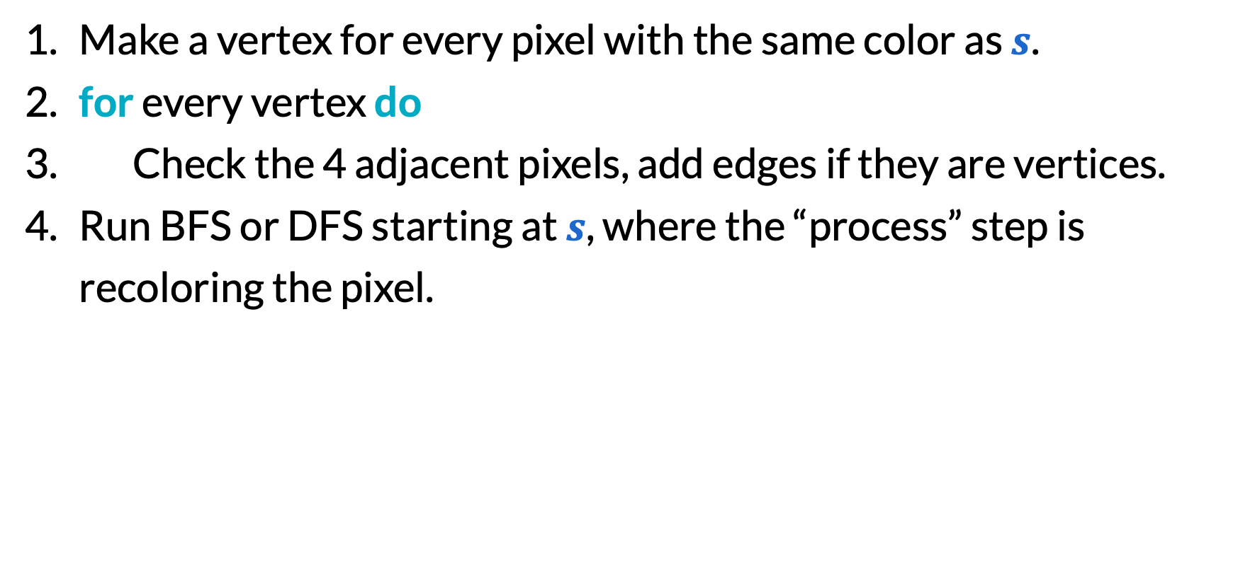
Bucket tool algorithm
Make a vertex for every pixel with the same color as $s$.
​for every vertex do
Check the 4 adjacent pixels, add edges if they are vertices.
Run BFS or DFS starting at $s$, where the “process” step is recoloring the pixel.

Slide 36
Alternative solution
Q: What are my objects (vertices)?
A: All pixels.
Q: How are they related (edges)?
A: Connect all pixels that are adjacent and have the same color.
Pixels of different colors are never connected by edges, so we still find the same connected component!

Slide 37

LinkedIn connection degrees
What does this mean?

Slide 38
LinkedIn connection degrees
On LinkedIn, connections are mutual.
​1st: People you are directly connected to.
​2nd: People with whom you have a mutual direct connection, but are not your 1st degree connections.
​3rd: People who are directly connected to your 2nd degree connections, but are not your 1st/2nd degree connections.
You
1st
2nd
3rd

Slide 39
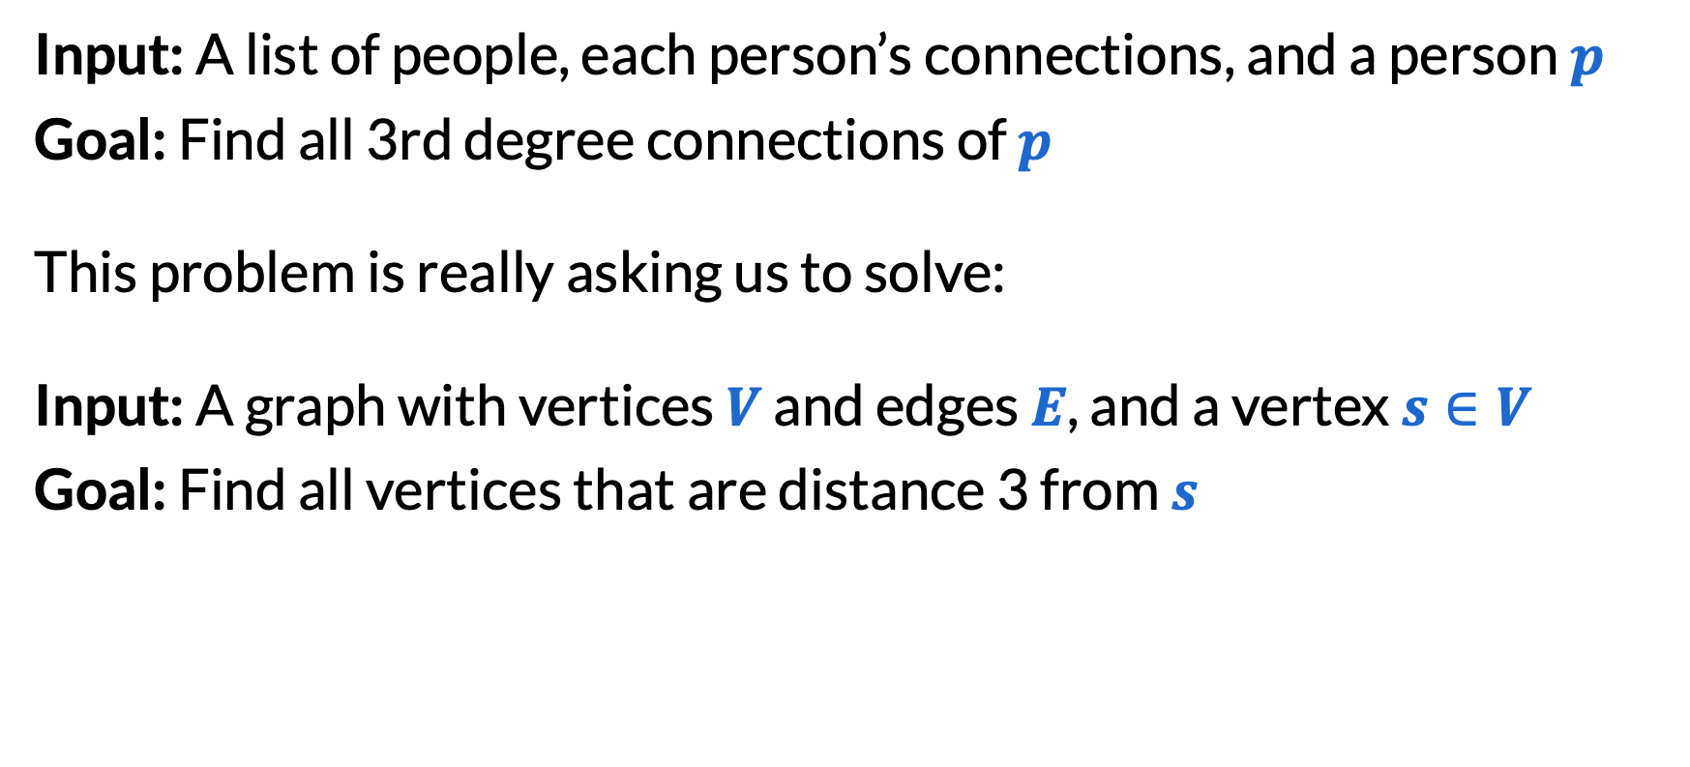
LinkedIn connection degrees
Input: A list of people, each person’s connections, and a person $p$
Goal: Find all 3rd degree connections of $p$
This problem is really asking us to solve:
Input: A graph with vertices $V$ and edges $E$, and a vertex $s∈V$
Goal: Find all vertices that are distance 3 from $s$

Slide 40
BFS with layers
Vertices in layer $i$ are distance $i$ from the start.
3
8
5
1
6
9
4
2
7

Slide 41
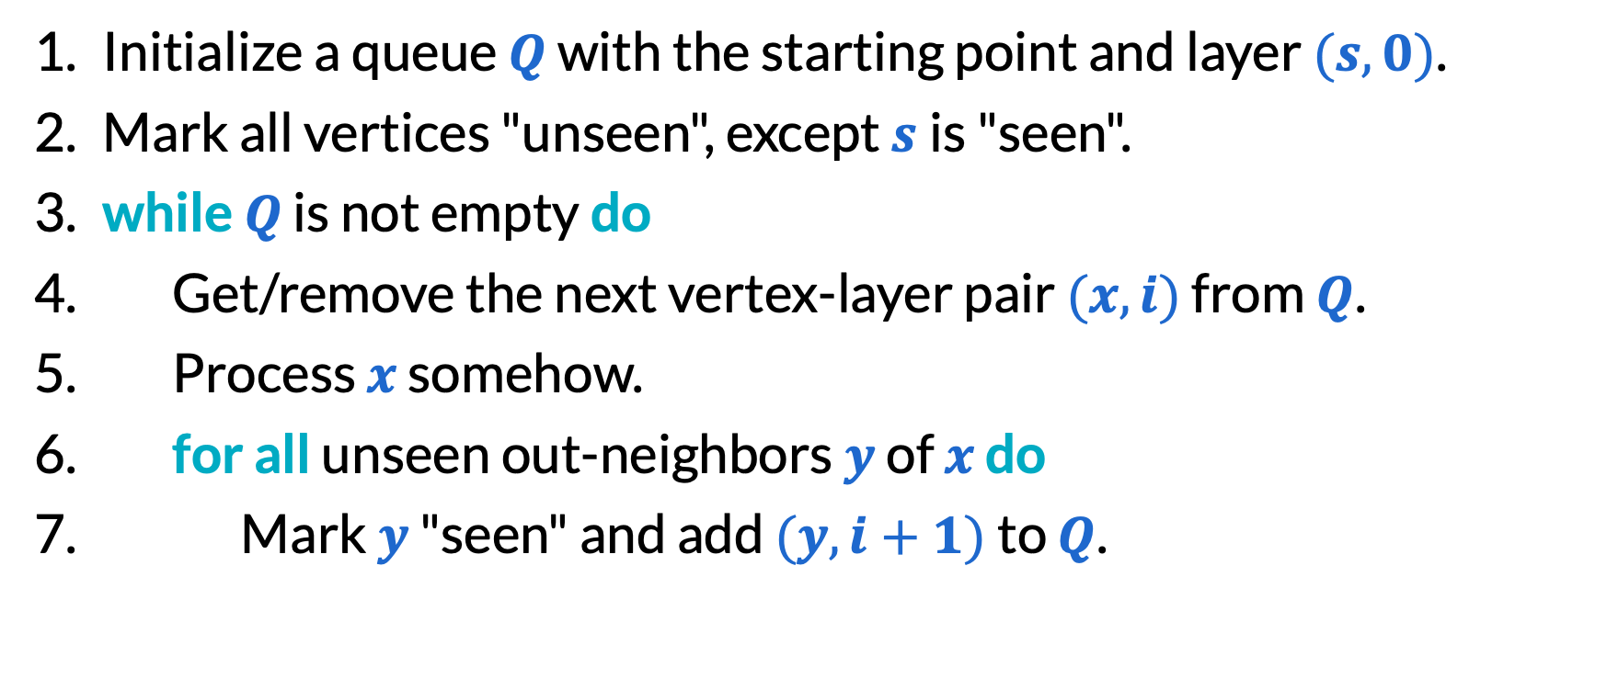
BFS with layers pseudocode
Initialize a queue $Q$ with the starting point and layer $(s,0)$.
Mark all vertices "unseen", except $s$is "seen".
​while $Q$ is not empty do
Get/remove the next vertex-layer pair $(x,i)$ from $Q$.
Process $x$ somehow.
​for all unseen out-neighbors $y$ of $x$ do
Mark $y$ "seen" and add $(y,i+1)$ to $Q$.

Slide 42
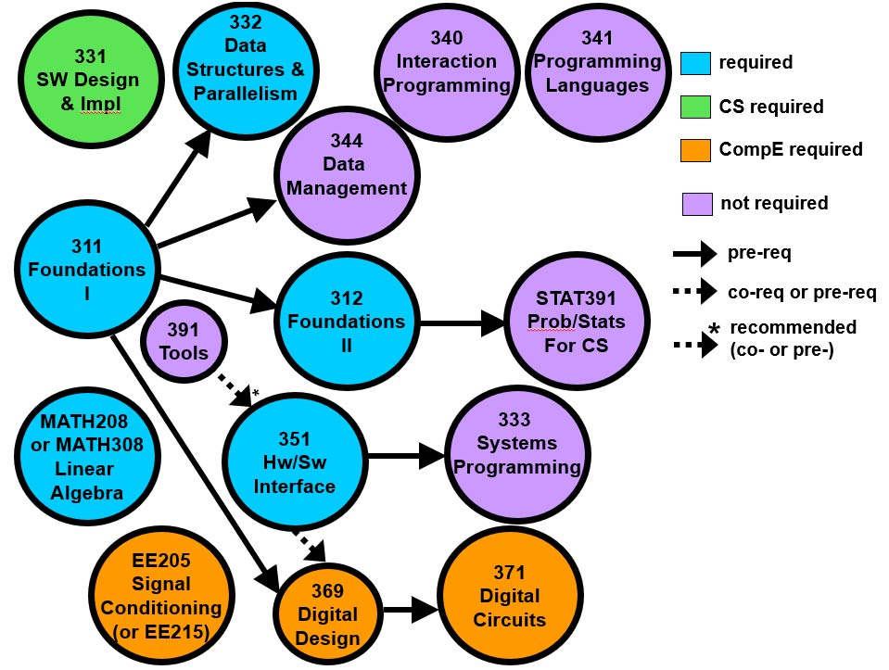
Course planning
Input: List of courses and their prerequisites
Goal: Determine if there is an order in which all courses can be taken
The bad case is when the prerequisites form a cycle!

Slide 43
Cycle detection with DFS
Divide “processed” state into “in-progress” and “finished”.
Seeing vertices “in-progress” means there is a cycle!
3
8
5
1
6
9
4
2
7

Slide 44
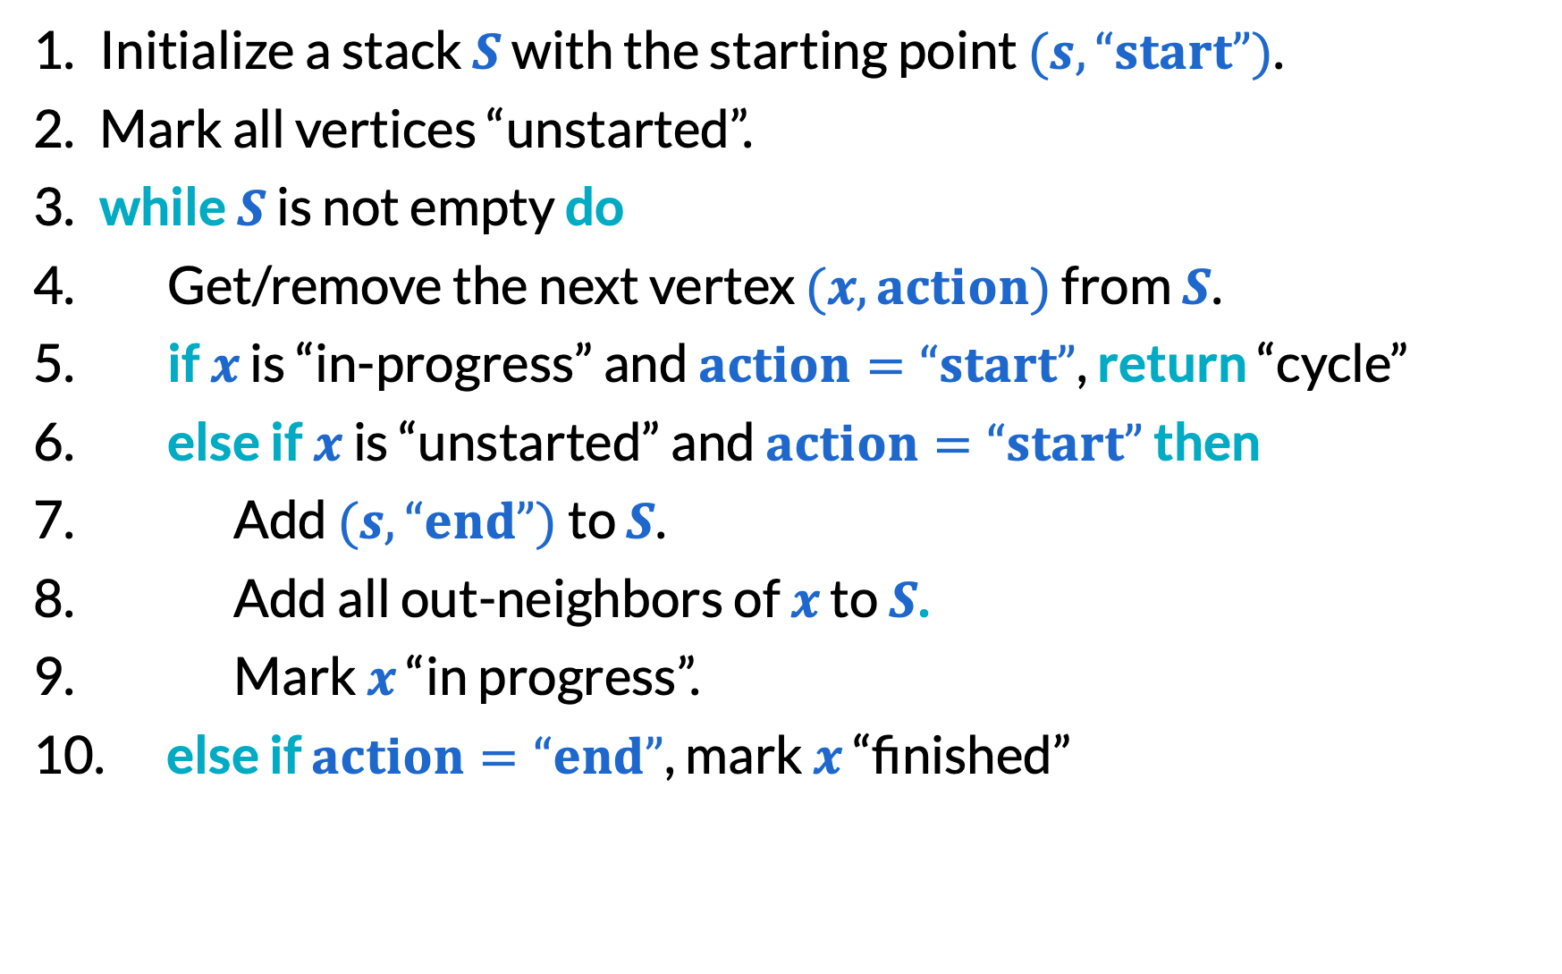
Cycle detection with DFS
Initialize a stack $S$ with the starting point $(s,“start”)$.
Mark all vertices “unstarted”.
​while $S$ is not empty do
Get/remove the next vertex $(x,action)$ from $S$.
​if $x$ is “in-progress” and $action=“start”$, return “cycle”
​else if $x$ is “unstarted” and $action=“start”$ then
​Add $(s,“end”)$ to $S$.
​Add all out-neighbors of $x$ to $S$.
Mark $x$ “in progress”.
​else ​if $action=“end”$, mark $x$ “finished”

Slide 45
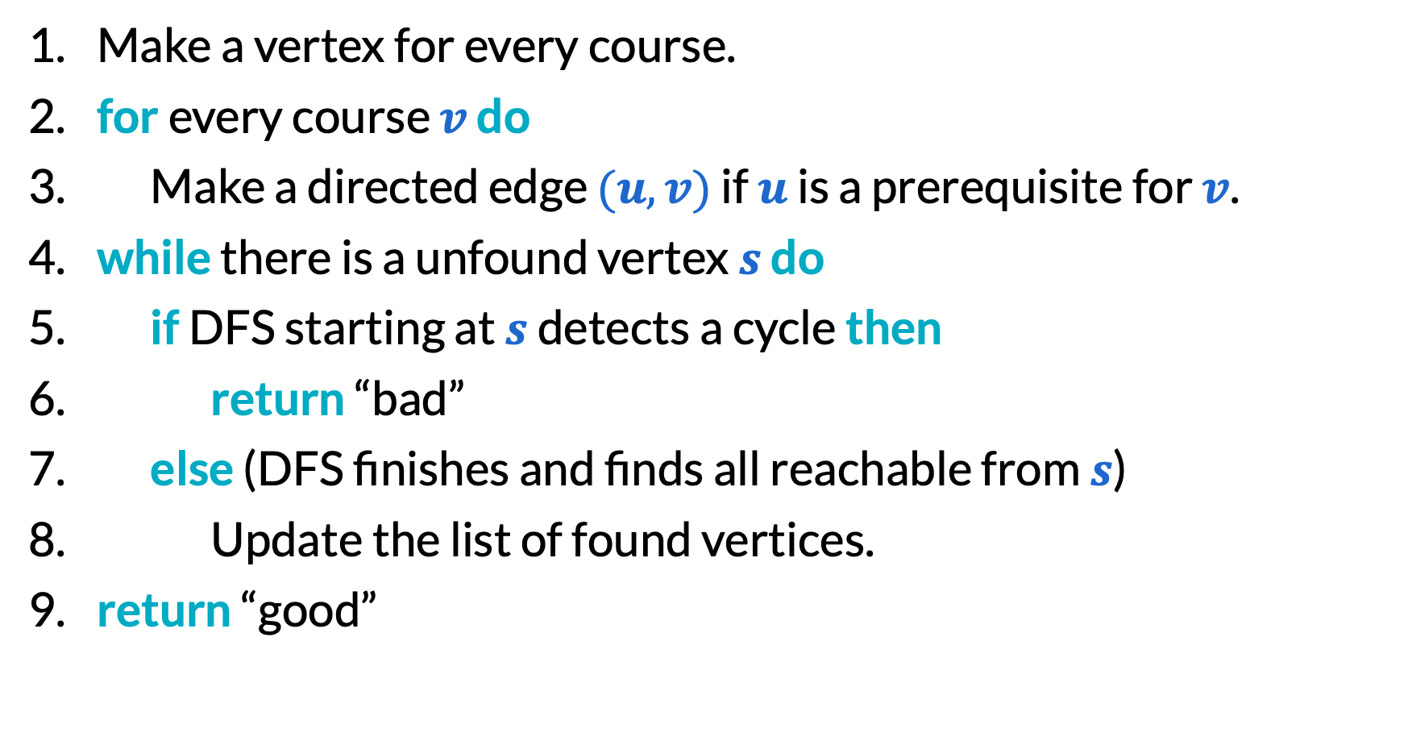
Course planning
Make a vertex for every course.
​for every course $v$ do
Make a directed edge $(u, v)$ if $u$ is a prerequisite for $v$.
​while there is a unfound vertex $s$ do
​if DFS starting at $s$ detects a cycle then
​return “bad”
​else (DFS finishes and finds all reachable from $s$)
Update the list of found vertices.
​return “good”

Slide 46
Final reminders
HW3 due Friday @ 11:59pm.
I have OH now-12:30pm:
Meet at front of classroom, we’ll walk over together
CSE (Allen) 214 if you’re coming later
Nathan has online OH 12–1pm:
Link on Canvas/course website
https://washington.zoom.us/my/nathanbrunelle

