Slide 1
CS3102 Theory of Computation
Warm up:
Think of a yes/no question about strings

Slide 2
Logistics
Homework released tomorrow
See submission page for deadlines (I’m still processing your quiz 3)
Quiz will be released Thursday, due Tuesday

Slide 3
Last Time
Exam

Slide 4
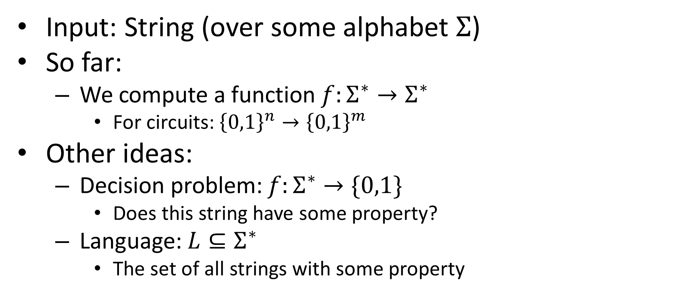
Aside: What do we compute (redux)
Input: String (over some alphabet $Σ$)
So far:
We compute a function $f:Σ^{∗}→Σ^{∗}$
For circuits: ${\left\{0,1\right\}}^{n}→{\left\{0,1\right\}}^{m}$
Other ideas:
Decision problem: $f:Σ^{∗}→\{0,1\}$
Does this string have some property?
Language: $L⊆Σ^{∗}$
The set of all strings with some property

Slide 5
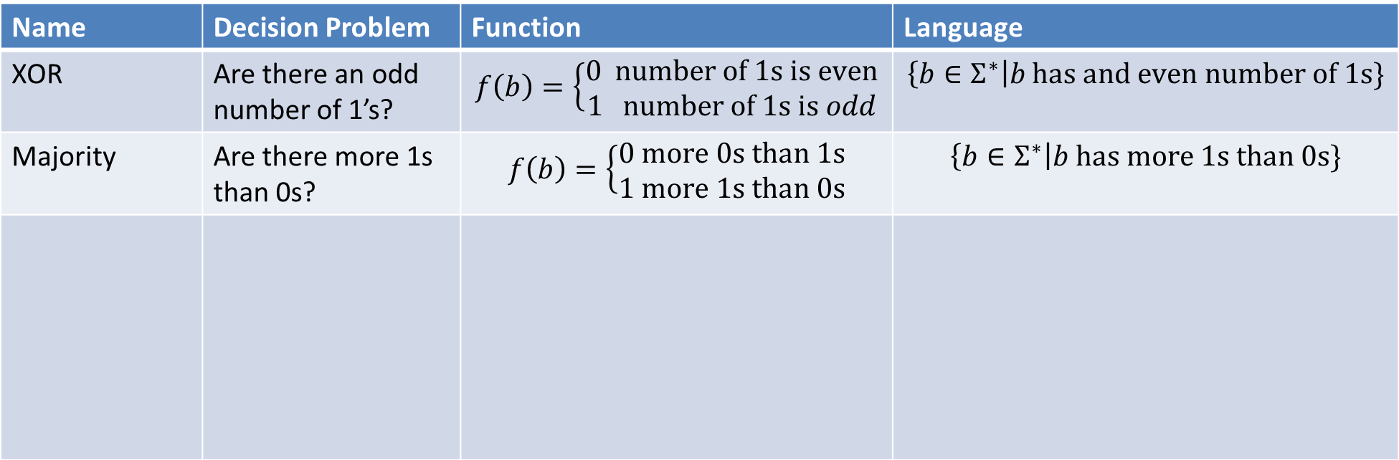
Function vs Decision vs Language
Name | Decision Problem | Function | Language
XOR | Are there an odd number of 1’s? | $$f\left(b\right)=\left\{\begin{aligned}0 number of 1s is even \\ 1 number of 1s is odd\end{aligned}\right.$$ | $$\left\{b∈Σ^{∗}\right|b has and even number of 1s\}$$
Majority | Are there more 1s than 0s? | $$f\left(b\right)=\left\{\begin{aligned}0 more 0s than 1s \\ 1 more 1s than 0s\end{aligned}\right.$$ | $$\left\{b∈Σ^{∗}\right|b has more 1s than 0s\}$$

Slide 6
Finite vs. Infinite Functions
Boolean Circuits have a drawback:
Fixed number of inputs
What we want:
A single recipe which can take infinitely many inputs

Slide 7

Example: XOR
We can define XOR to take an unbounded number of inputs
Returns 1 if there are an odd number of 1s in the input

Slide 8
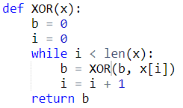
We need a new model
As a programming language:
Add loops!
As "hardware":
Automata

Slide 9
Finite State Automaton
Implementation:
Finite number of states
One start state
“Final” states
Transitions (function mapping state-character pairs to states)
Execution:
Start in the initial “state”
Read each character once, in order (no looking back)
Transition to a new state once per character (based on current state and character)
Give output depending on which state you end in

Slide 10
Computing Infinite XOR
The “state” we start in:
Even number of 1’s seen
The “state” in which we return 1
Odd number of 1’s seen
Reading one bit at a time:
If we’re currently in “Even”:
Switch to “Odd” when we see a 1
Stay in even when we see a 0
If we’re currently in “Even”:
Switch to “Odd” when we see a 1
Stay in even when we see a 0

Slide 11
Let’s Draw It!

Slide 12
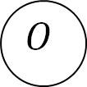



Let’s Draw It!
$$1$$
$$0$$
$$0$$
$$E$$
$$O$$
$$1$$

Slide 13



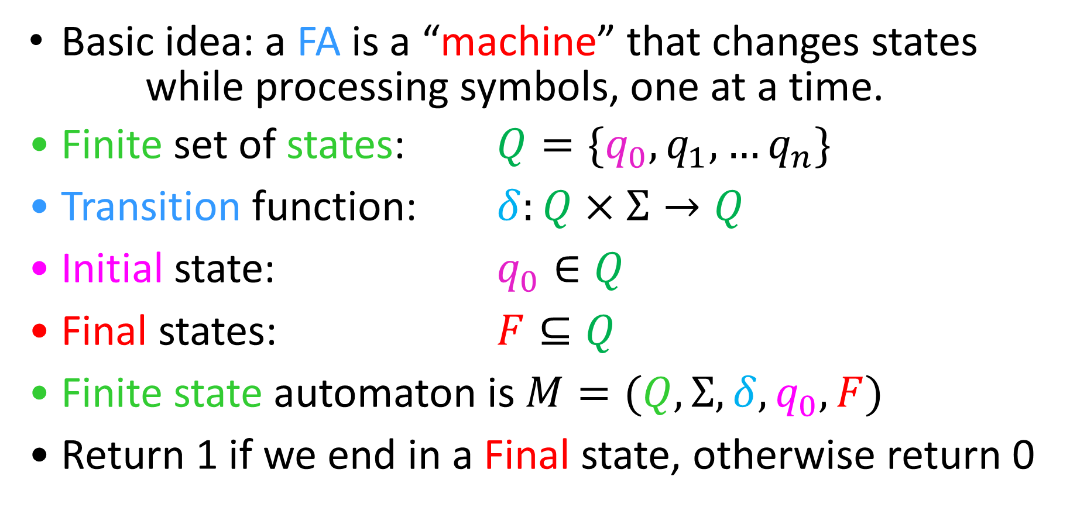



Finite State Automata
Basic idea: a FA is a “machine” that changes states
while processing symbols, one at a time.
Finite set of states: $Q=\{q_{0},q_{1},…q_{n}\}$
Transition function: $δ:Q×Σ→Q$
Initial state: $q_{0}∈Q$
Final states: $F⊆Q$
Finite state automaton is $M=(Q, Σ, δ, q_{0}, F)$
Return 1 if we end in a Final state, otherwise return 0
$$q_{1}$$
$$q_{1}$$
$$1$$
$$q_{2}$$
$$q_{0}$$
$$q_{k}$$

Slide 14
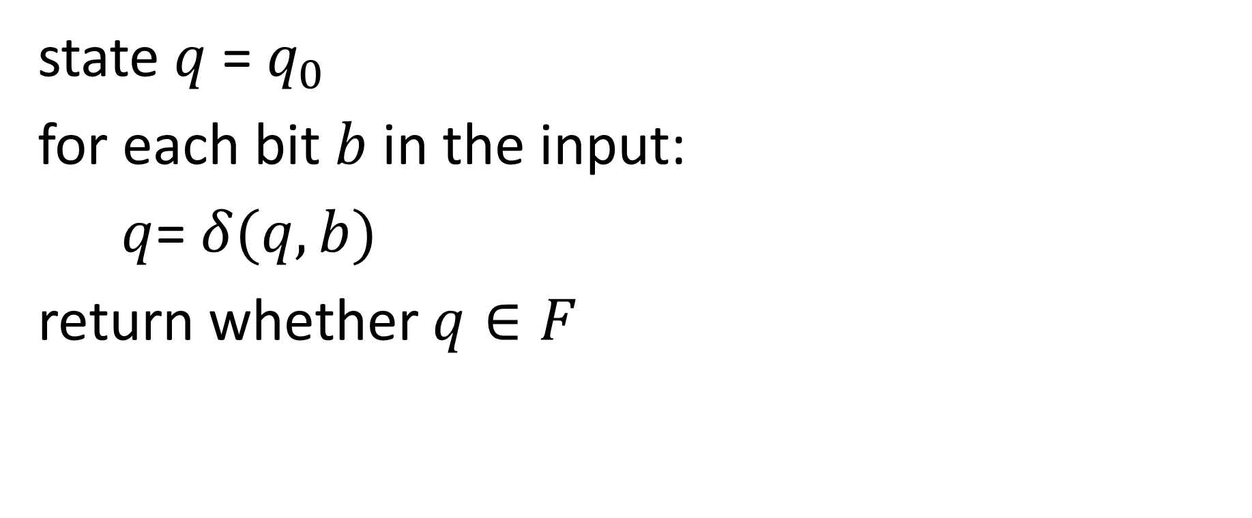
Computing with a FSA
state $q$ = $q_{0}$
for each bit $b$ in the input:
$q$= $δ(q, b)$
return whether $q∈F$

Slide 15
Example: AND

Slide 16
Example: AND

Slide 17
Example: AND

Slide 18
Example: Even1Odd0

Slide 19
Example: Even1Odd0

Slide 20
Example: Even1Odd0

Slide 21
FSA are strictly more powerful than NAND circuits
How can we show this?
Show that there is at least one function we can do with FSA but not NAND-CIRC
Done! (infinite XOR)
Show anything we can do with NAND-CIRC can also be done with FSA
How?
We need to be able to compute any finite function

Slide 22
Computing any finite function with NAND-CIRC
Summary:
"Manually Precompute" the output for every (finitely-many) possible input
When we receive the actual input, do a "lookup"
Our proof before:
Make a variable to represent each possible input, assigning its value to match the correct output
Use LOOKUP to return the proper variable for the given input

Slide 23
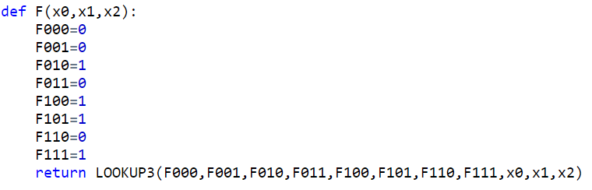
Straightline Code for f
Input | Output
000 | 0
001 | 0
010 | 1
011 | 0
100 | 1
101 | 1
110 | 0
111 | 0

Slide 24
Computing finite functions with FSA
Summary:
"Manually Precompute" the output for every (finitely-many) possible input
When we receive the actual input, do a "lookup"
Same idea, but with Automata:
Make a state for every possible input, determining whether or not it is final depending on the correct output
Do a "binary tree traversal" with the given input to navigate to its correct output

Slide 25

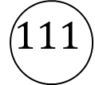


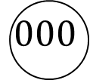


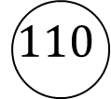
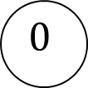




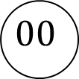









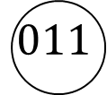



FSA for $f$
Input | Output
000 | 0
001 | 0
010 | 1
011 | 0
100 | 1
101 | 1
110 | 0
111 | 0
“”
$$0$$
$$1$$
$$0$$
$$1$$
$$0$$
$$1$$
$$0$$
$$1$$
$$00$$
$$01$$
$$10$$
$$10$$
$$0$$
$$0$$
$$1$$
$$0$$
$$0$$
$$1$$
$$000$$
$$001$$
$$010$$
$$011$$
$$100$$
$$101$$
$$110$$
$$111$$

Slide 26
Characterizing What’s computable
Things that are computable by FSA:
Functions that don’t need “memory”
Languages expressible as Regular Expressions (next time)
Things that aren’t computable by FSA:
Things that require more than finitely many states
Intuitive example: Majority

Slide 27
Majority with FSA?
Consider an inputs with lots of 0s
Recall: we read 1 bit at a time, no going back!
To count to 50,000, we'll need 50,000 states!
000...0000 111...1111
000...0000 111...1111
000...0000 111...1111
×50,000
×50,000
×50,000
×50,001
×49,999
×50,000

