Slide 1
CS3102 Theory of Computation
Warm up:
Why might we consider computing infinite functions?

Slide 2
Logistics
Exercise 3 is out
Last exercise before midterm

Slide 3
Last Time
Using a circuit to evaluate a function

Slide 4
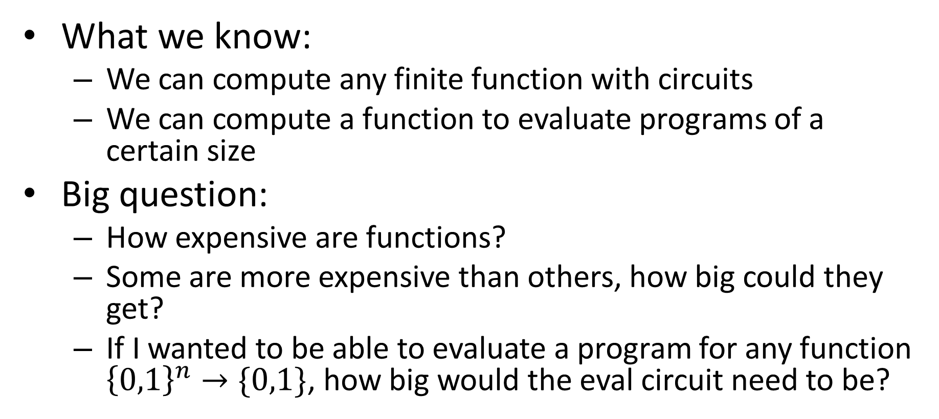
Conclusion
What we know:
We can compute any finite function with circuits
We can compute a function to evaluate programs of a certain size
Big question:
How expensive are functions?
Some are more expensive than others, how big could they get?
If I wanted to be able to evaluate a program for any function ${\left\{0,1\right\}}^{n}→\{0,1\}$, how big would the eval circuit need to be?

Slide 5
Complexity
The "complexity" of a function:
Measure of the resources required to compute that function
Complexity Class:
A set of functions defined by a complexity measure

Slide 6
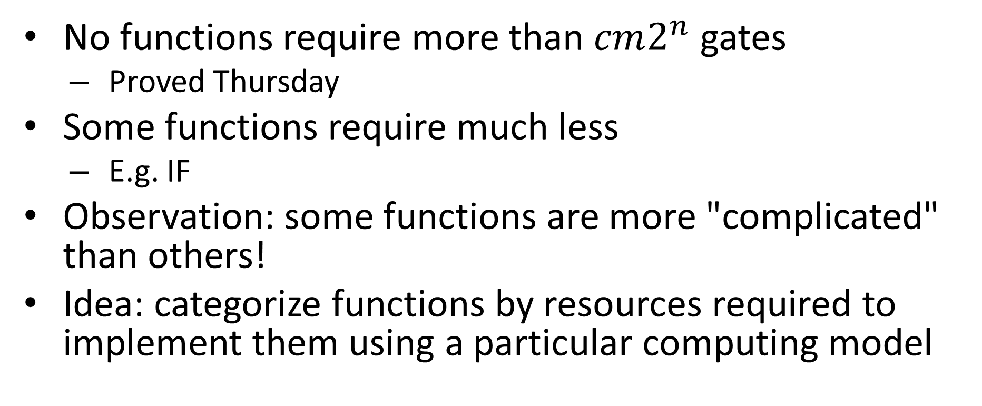
Categorizing Functions by Circuit Size
No functions require more than $cm2^{n}$ gates
Proved Thursday
Some functions require much less
E.g. IF
Observation: some functions are more "complicated" than others!
Idea: categorize functions by resources required to implement them using a particular computing model

Slide 7
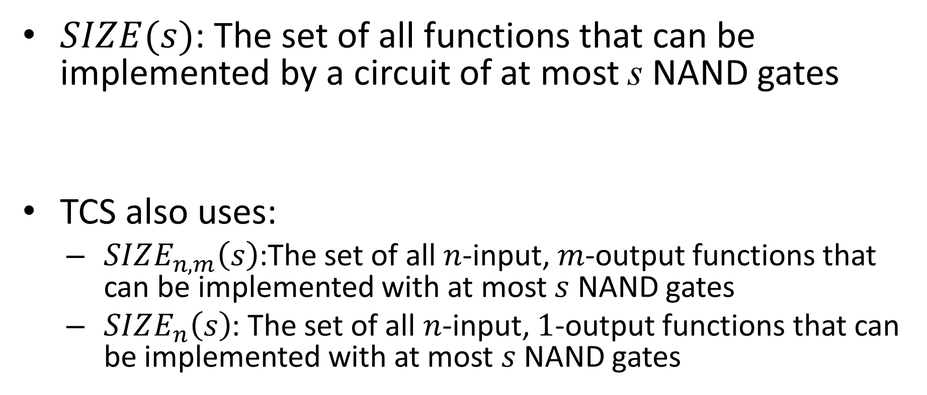
SIZE
$SIZE(s)$: The set of all functions that can be implemented by a circuit of at most s NAND gates
TCS also uses:
$SIZE_{n,m}\left(s\right)$:The set of all $n$-input, $m$-output functions that can be implemented with at most $s$ NAND gates
$SIZE_{n}\left(s\right)$: The set of all $n$-input, $1$-output functions that can be implemented with at most $s$ NAND gates
$SIZE(1000m2^{n})$ Contains all functions $f:{\left\{0,1\right\}}^{n}→{\left\{0,1\right\}}^{m}$

Slide 8
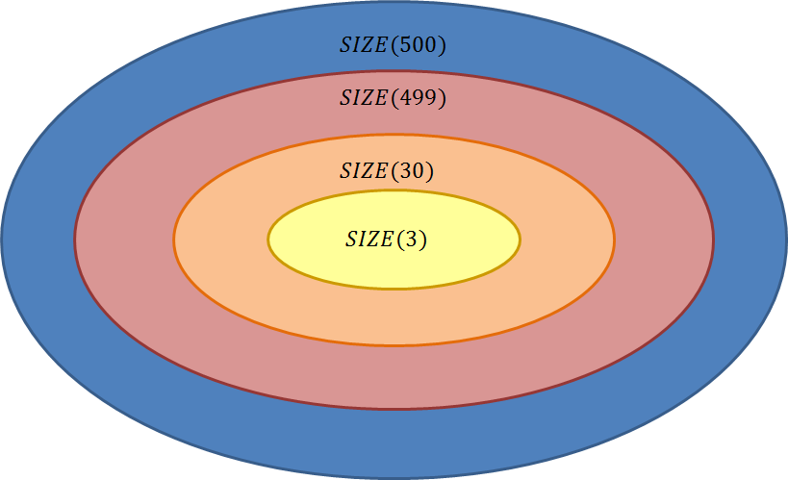
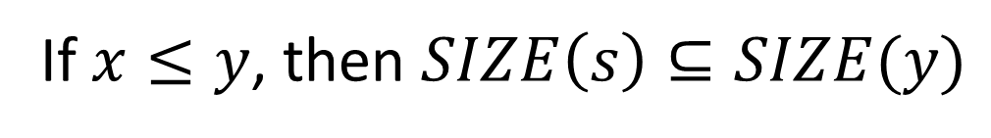
Comparing Classes
If $x≤y$, then $SIZE\left(s\right)⊆SIZE(y)$

Slide 9
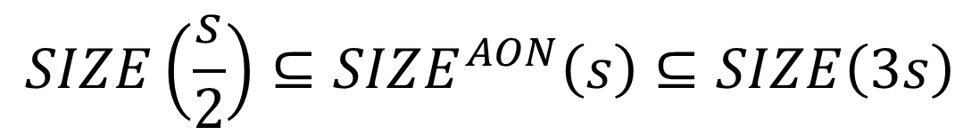

Theorem
Let $SIZE^{AON}\left(s\right)$ represent the set of all functions that can be computed using at most $s$ AND/OR/NOT gates
$$SIZE\left(\frac{s}{2}\right)⊆SIZE^{AON}\left(s\right)⊆SIZE\left(3s\right)$$

Slide 10

Proof
$$SIZE\left(\frac{s}{2}\right)⊆SIZE^{AON}\left(s\right)⊆SIZE\left(3s\right)$$

Slide 11
O, Ω, Θ
Groups functions together
Each uses a function as a bound for other functions
O (Big-Oh):
O(f(n)) = the set of all functions "asymptotically upper-bounded" by f
Ω (Big-Omega):
Ω(f(n)) = the set of all functions "asymptotically lower-bounded" by f
Θ (Big-Theta):
Θ(f(n)) = the set of all functions "asymptotically tight-bounded" by f

Slide 12
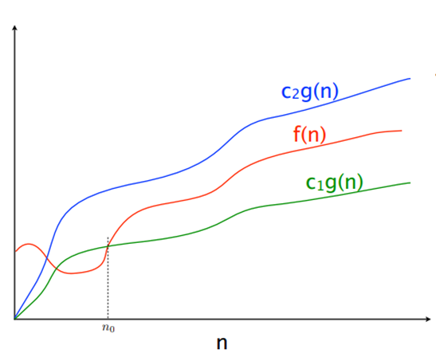




Slide 13
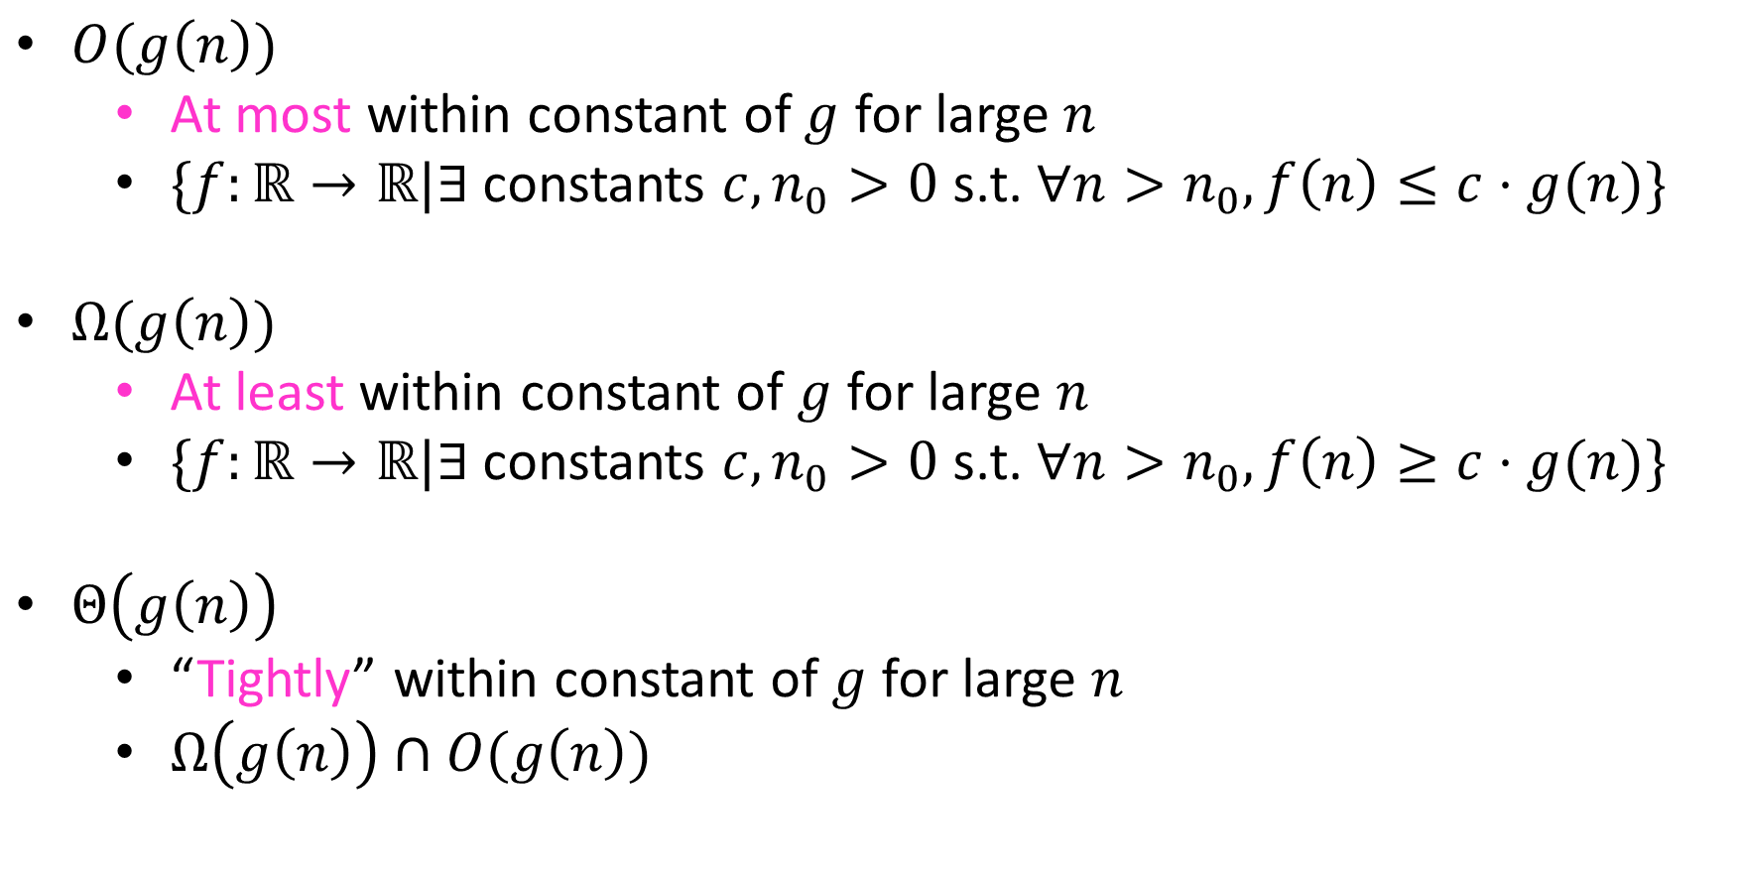
Definitions
$O(g\left(n\right))$
At most within constant of $g$ for large $n$
$\{f:\text{ℝ}→\text{ℝ}|∃$constants $c, n_{0}>0$ s.t. $∀n>n_{0}, f\left(n\right)≤c⋅g(n)\}$
$Ω(g\left(n\right))$
At least within constant of $g$ for large $n$
$\{f:\text{ℝ}→\text{ℝ}|∃$constants $c, n_{0}>0$ s.t. $∀n>n_{0}, f\left(n\right)≥c⋅g(n)\}$
$Θ\left(g\left(n\right)\right)$
“Tightly” within constant of $g$ for large $n$
$Ω\left(g\left(n\right)\right)∩O(g\left(n\right))$

Slide 14

Showing Big-Oh
To show: $n\log{n}∈O\left(n^{2}\right)$

Slide 15

Showing Big-Omega
To Show: $2^{n}∈Ω\left(n^{2}\right)$

Slide 16

Showing Big-Theta
To Show: $\log_{x}{n}=Θ\left(\log_{y}{n}\right)$

Slide 17
How does this help us?
We often want to know the “trend” of efficiency
Constants don’t matter as much (often change among models of computing)
Makes it easier to measure complexity

Slide 18
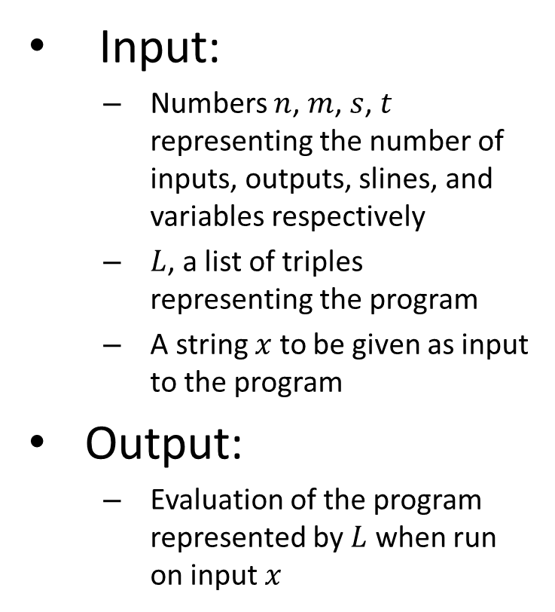

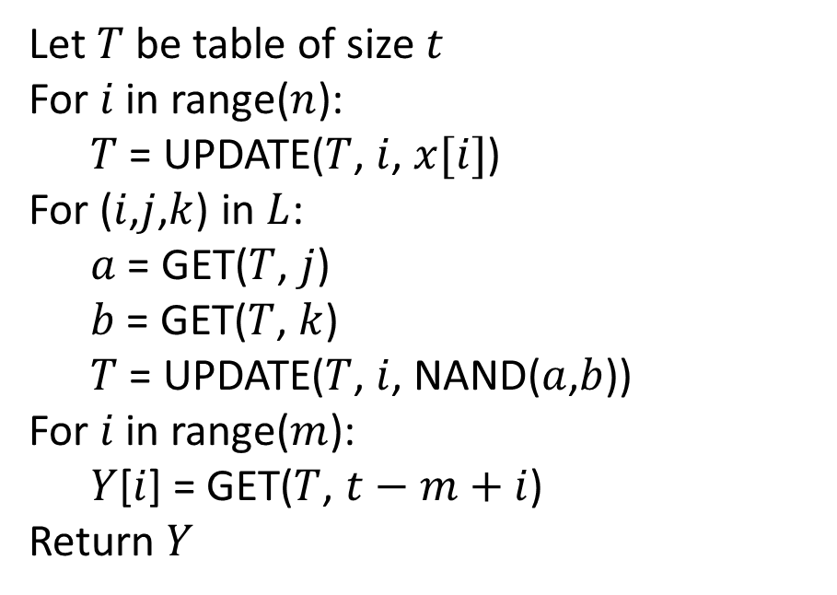
Using $O$ to measure EVAL
Input:
Numbers $n$, $m$, $s$, $t$ representing the number of inputs, outputs, slines, and variables respectively
$L$, a list of triples representing the program
A string $x$ to be given as input to the program
Output:
Evaluation of the program represented by $L$ when run on input $x$
Let $T$ be table of size $t$
For $i$ in range($n$):
$T$ = UPDATE($T$, $i$, $x[i]$)
For ($i$,$j$,$k$) in $L$:
$a$ = GET($T$, $j$)
$b$ = GET($T$, $k$)
$T$ = UPDATE($T$, $i$, NAND($a$,$b$))
For $i$ in range($m$):
$Y$[$i$] = GET($T$, $t−m+i$)
Return $Y$

Slide 19

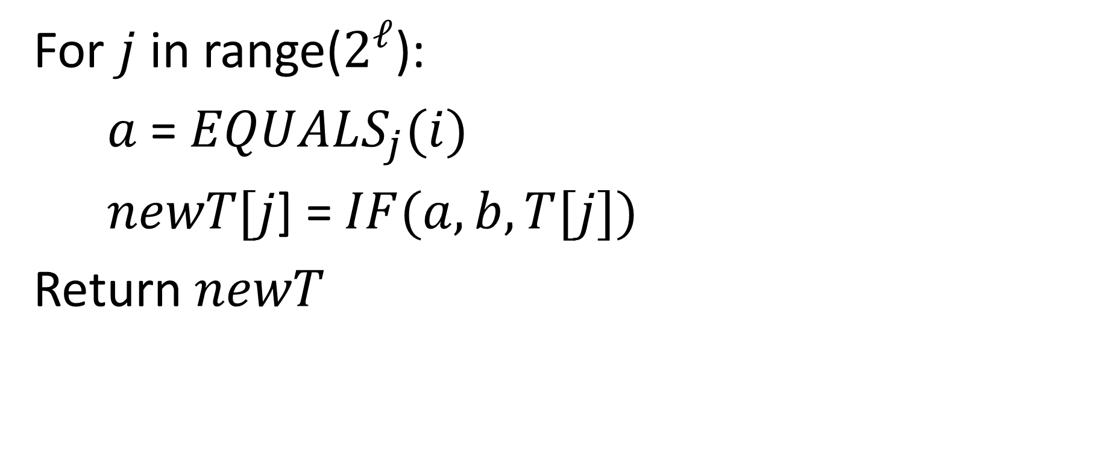
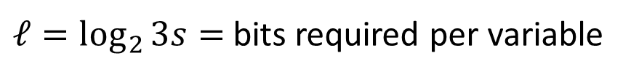
UPDATE pseudocode
For $j$ in range($2^{ℓ}$):
$a$ = $EQUALS_{j}(i)$
$newT[j$] = $IF(a, b, T[j])$
Return $newT$
Runs $2^{ℓ}$ times
$ℓ=\log_{2}{3s}=$ bits required per variable

Slide 20
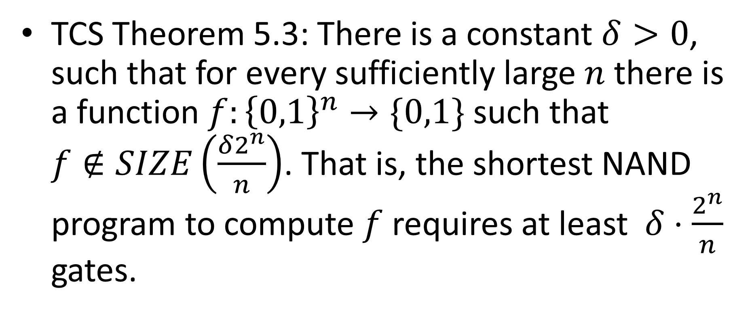
How many gates are required?
TCS Theorem 5.3: There is a constant $δ>0$, such that for every sufficiently large $n$ there is a function $f:{\left\{0,1\right\}}^{n}→\{0,1\}$ such that $f∉SIZE\left(\frac{δ2^{n}}{n}\right)$. That is, the shortest NAND program to compute $f$ requires at least $δ⋅\frac{2^{n}}{n}$ gates.

Slide 21
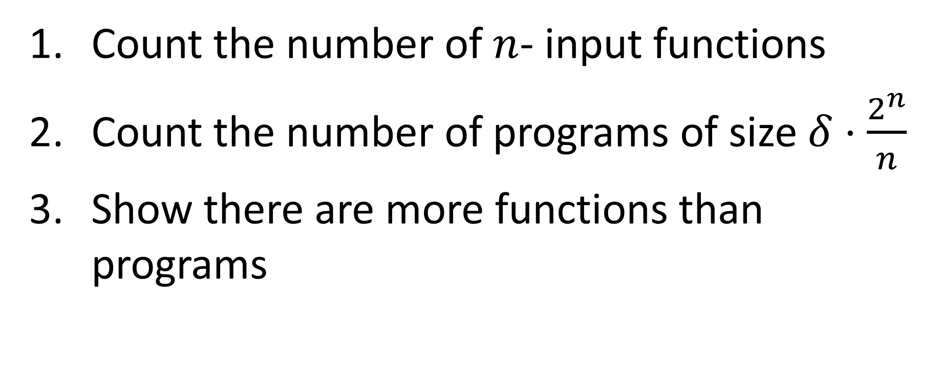
How to show this
Count the number of $n$- input functions
Count the number of programs of size $δ⋅\frac{2^{n}}{n}$
Show there are more functions than programs

Slide 22

How many functions?
How many functions are there of form ${\left\{0,1\right\}}^{n}→\{0,1\}$?
How can we count this?

Slide 23
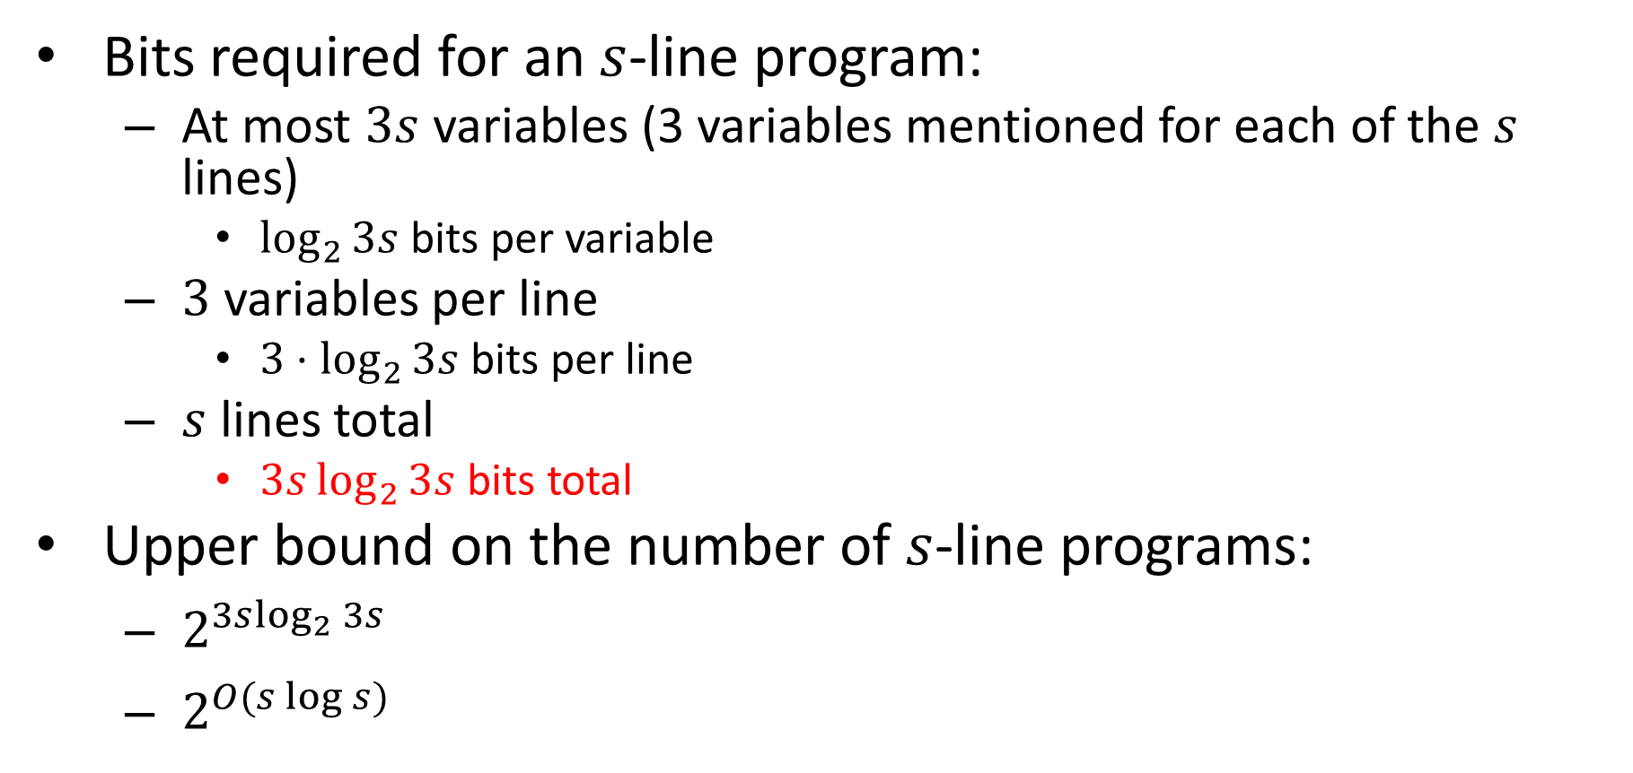
How many programs?
Bits required for an $s$-line program:
At most $3s$ variables (3 variables mentioned for each of the $s$ lines)
$\log_{2}{3s}$ bits per variable
$3$ variables per line
$3⋅\log_{2}{3s}$ bits per line
$s$ lines total
$3s\log_{2}{3s}$ bits total
Upper bound on the number of $s$-line programs:
$2^{3s\log_{2}{3s}}$
$2^{O(s\log{s})}$

Slide 24
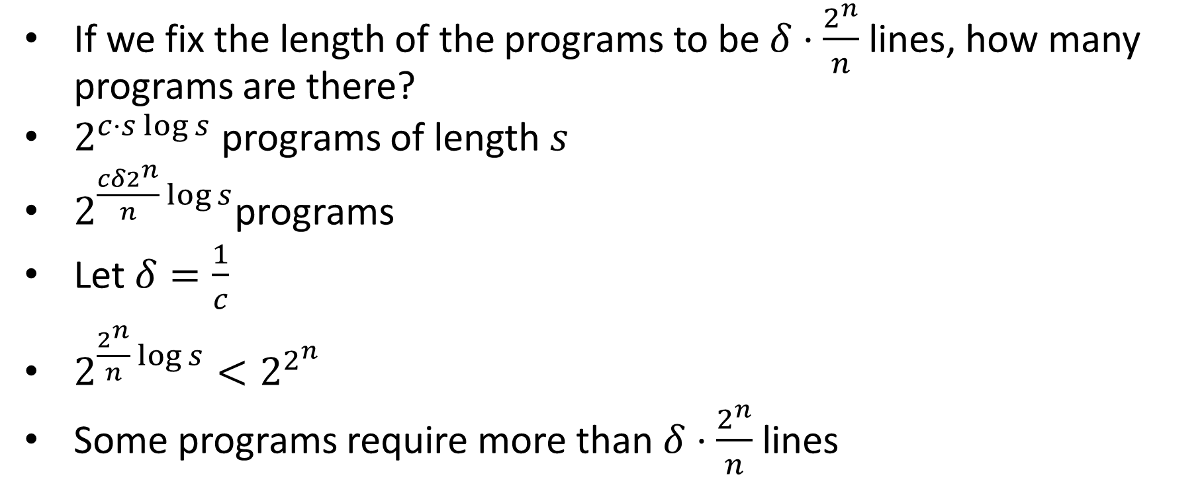
Fixing the Length
If we fix the length of the programs to be $δ⋅\frac{2^{n}}{n}$ lines, how many programs are there?
$2^{c⋅s\log{s}}$ programs of length $s$
$2^{\frac{cδ2^{n}}{n}\log{s}}$programs
Let $δ=\frac{1}{c}$
$2^{\frac{2^{n}}{n}\log{s}}<2^{2^{n}}$
Some programs require more than $δ⋅\frac{2^{n}}{n}$ lines

Slide 25
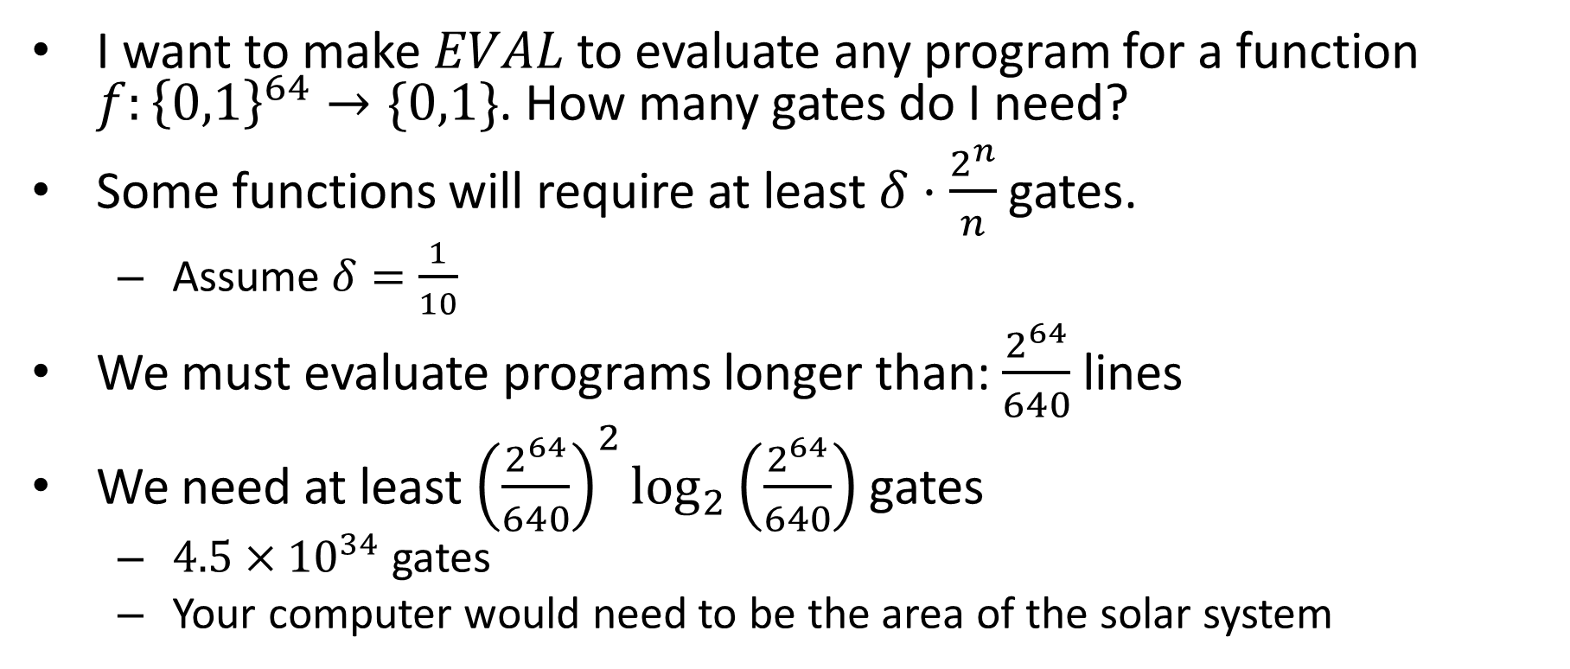
64 bit machine
I want to make $EVAL$ to evaluate any program for a function $f:{\left\{0,1\right\}}^{64}→\{0,1\}$. How many gates do I need?
Some functions will require at least $δ⋅\frac{2^{n}}{n}$ gates.
Assume $δ=\frac{1}{10}$
We must evaluate programs longer than: $\frac{2^{64}}{640}$ lines
We need at least ${\left(\frac{2^{64}}{640}\right)}^{2}\log_{2}\left(\frac{2^{64}}{640}\right)$ gates
$4.5×{10}^{34}$ gates
Your computer would need to be the area of the solar system

Slide 26
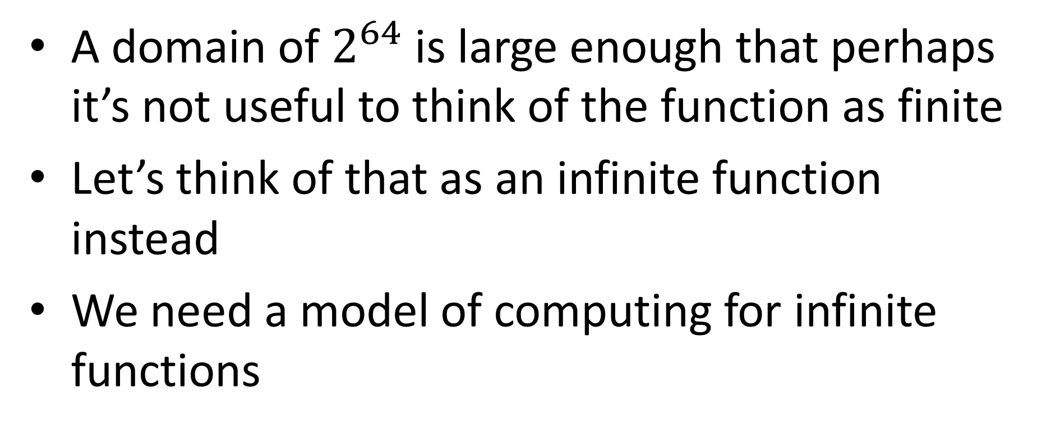
Conclusion
A domain of $2^{64}$ is large enough that perhaps it’s not useful to think of the function as finite
Let’s think of that as an infinite function instead
We need a model of computing for infinite functions

Slide 27
After the exam
A model of computing for infinite functions
How to do simple operations over and over again to compute
Real computers update memory by computing “simple” functions in hardware over and over again

