Slide 1


CS3102 Theory of Computation
www.cs.virginia.edu/~njb2b/cstheory/s2020
Warm up:
There are two “categories” of computing:
Hardware (e.g. CPU)
Software (e.g. Java)
Are they different? How are they the same?

Slide 2
Differences
Hardware (CPU)
Software (Java)

Slide 3
Similarities

Slide 4
Logistics
Exercise 0 was due last week
Didn’t complete it? No problem (this time)! Just do it soon. Ask for an extension on the assignment page.
First Quiz was due today
Didn’t complete it? No problem (this time)! Ask for an extension on the assignment page.
Exercise 1 is out.

Slide 5
Today
Finite computation
A first model of computing!!
And a second!!

Slide 6
What do we need for a model?
Define how to represent a computation
Programming languages: Syntax
Define how to perform an execution
Programming languages: compiler

Slide 7
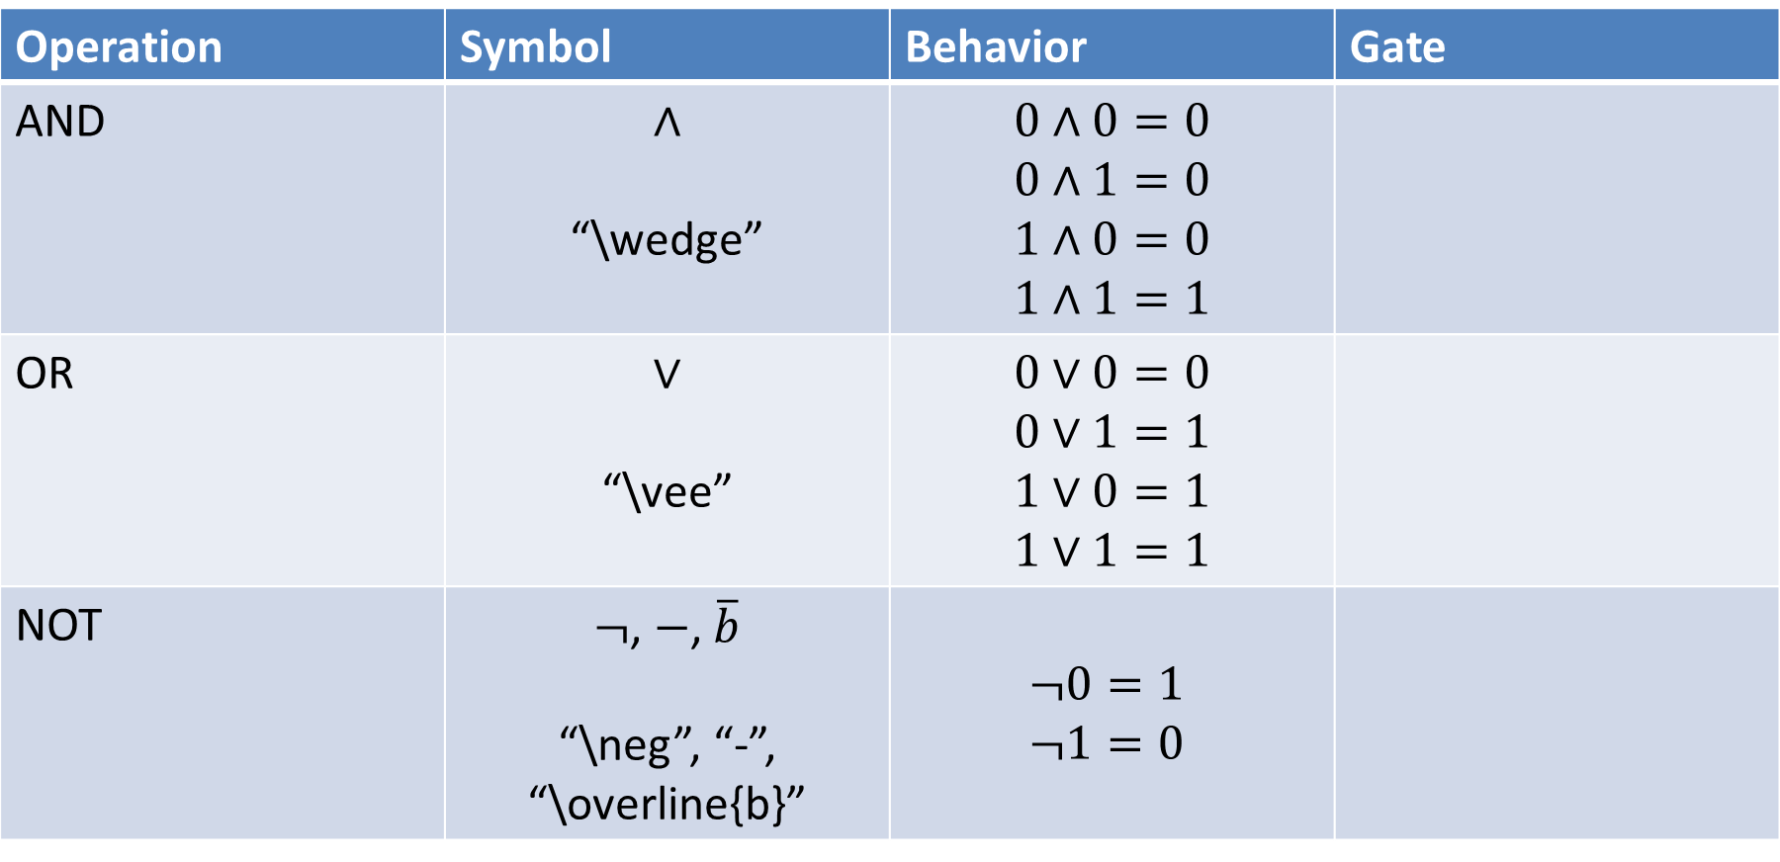
Boolean Logic
Operation | Symbol | Behavior | Gate
AND | $$∧$$ “\wedge” | $$0∧0=0$$ $$0∧1=0$$ $$1∧0=0$$ $$1∧1=1$$
OR | $$∨$$ “\vee” | $$0∨0=0$$ $$0∨1=1$$ $$1∨0=1$$ $$1∨1=1$$
NOT | $¬$, $−$, $\overline{b}$ “\neg”, “-”, “\overline{b}” | $$¬0=1$$ $$¬1=0$$

Slide 8
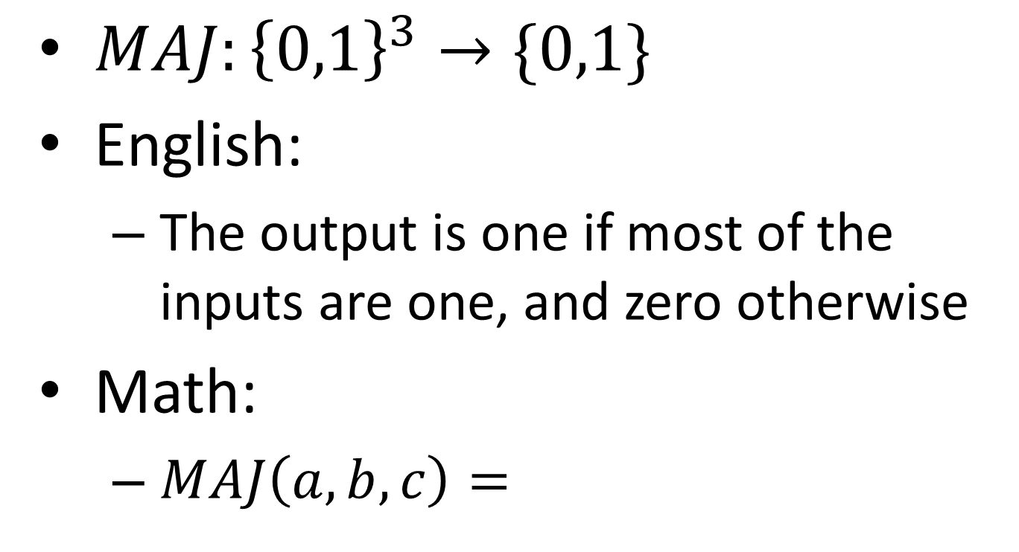
Example: Majority
$MAJ:{\left\{0,1\right\}}^{3}→\{0,1\}$
English:
The output is one if most of the inputs are one, and zero otherwise
Math:
$MAJ\left(a,b,c\right)=$
Input | Output
000 | 0
001 | 0
010 | 0
011 | 1
100 | 0
101 | 1
110 | 1
111 | 1

Slide 9





Majority as a circuit
Math:
$MAJ\left(a,b,c\right)=\left(a∧b\right)∨\left(b∧c\right)∨(a∧c)$
$$a$$
$$b$$
$$y$$
$$c$$

Slide 10




Components of a circuit
$$a$$
$$b$$
$$y$$
$$c$$

Slide 11
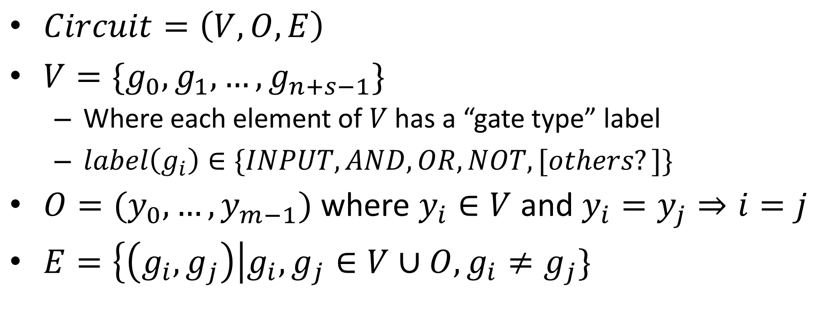
“Semiformal” Definition of a circuit
$$a$$
$Circuit=\left(V,O,E\right)$
$V=\{g_{0},g_{1},…,g_{n+s−1}\}$
Where each element of $V$ has a “gate type” label
$label\left(g_{i}\right)∈\{INPUT, AND,OR,NOT, [others?]\}$
$O=(y_{0},…,y_{m−1})$ where $y_{i}∈V$ and $y_{i}=y_{j}⇒i=j$
$E=\left\{\left(g_{i},g_{j}\right)\right|g_{i},g_{j}∈V∪O, g_{i}≠g_{j}\}$
$$b$$
$$y$$
$$c$$

Slide 12
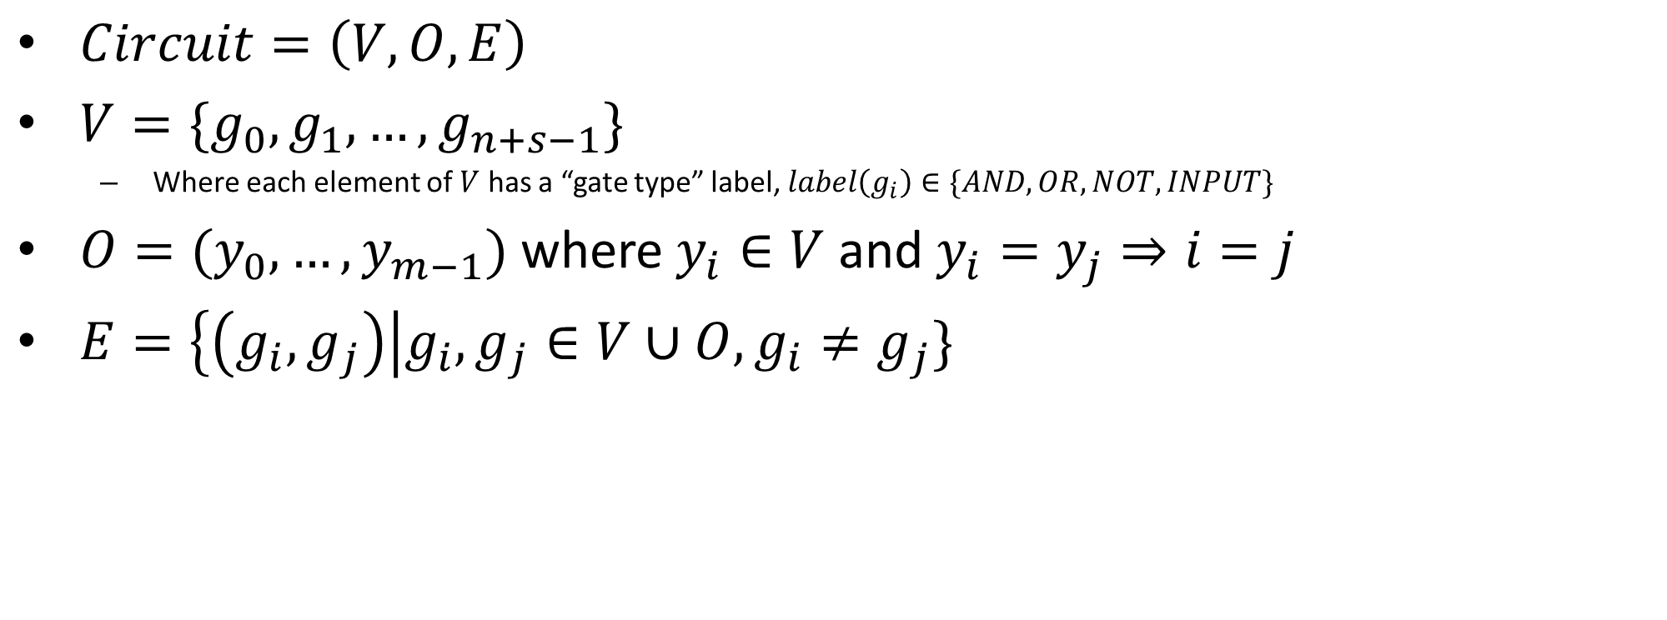
What are we assuming?
$Circuit=\left(V,O,E\right)$
$V=\{g_{0},g_{1},…,g_{n+s−1}\}$
Where each element of $V$ has a “gate type” label, $label\left(g_{i}\right)∈\{AND,OR,NOT,INPUT\}$
$O=(y_{0},…,y_{m−1})$ where $y_{i}∈V$ and $y_{i}=y_{j}⇒i=j$
$E=\left\{\left(g_{i},g_{j}\right)\right|g_{i},g_{j}∈V∪O, g_{i}≠g_{j}\}$
All gates have 2 inputs
All gates have 1 output
All gates are total functions
All gates are commutative
Number of gates is finite

Slide 13
What are we assuming?
$Circuit=\left(V,O,E\right)$
$V=\{g_{0},g_{1},…,g_{n+s−1}\}$
Where each element of $V$ has a “gate type” label, $label\left(g_{i}\right)∈\{AND,OR,NOT,INPUT\}$
$O=(y_{0},…,y_{m−1})$ where $y_{i}∈V$ and $y_{i}=y_{j}⇒i=j$
$E=\left\{\left(g_{i},g_{j}\right)\right|g_{i},g_{j}∈V∪O, g_{i}≠g_{j}\}$
All gates have 2 inputs
All gates have 1 output
All gates are total functions
All gates are commutative
Number of gates is finite

Slide 14
What are we assuming?
$Circuit=\left(V,O,E\right)$
$V=\{g_{0},g_{1},…,g_{n+s−1}\}$
Where each element of $V$ has a “gate type” label, $label\left(g_{i}\right)∈\{AND,OR,NOT,INPUT\}$
$O=(y_{0},…,y_{m−1})$ where $y_{i}∈V$ and $y_{i}=y_{j}⇒i=j$
$E=\left\{\left(g_{i},g_{j}\right)\right|g_{i},g_{j}∈V∪O, g_{i}≠g_{j}\}$
All gates have 2 inputs
All gates have 1 output
All gates are total functions
All gates are commutative
Number of gates is finite

Slide 15
What are we assuming?
$Circuit=\left(V,O,E\right)$
$V=\{g_{0},g_{1},…,g_{n+s−1}\}$
Where each element of $V$ has a “gate type” label, $label\left(g_{i}\right)∈\{AND,OR,NOT,INPUT\}$
$O=(y_{0},…,y_{m−1})$ where $y_{i}∈V$ and $y_{i}=y_{j}⇒i=j$
$E=\left\{\left(g_{i},g_{j}\right)\right|g_{i},g_{j}∈V∪O, g_{i}≠g_{j}\}$
All gates have 2 inputs
All gates have 1 output
All gates are total functions
All gates are commutative
Number of gates is finite

Slide 16
What do we need for a model?
Define how to represent a computation
Circuits: gates, edges, outputs
Define how to perform an execution

Slide 17
Executing a circuit
What we eventually want to know:
Values of the outputs
What we start with:
Values of the inputs
What do we do in between:
Find values of gates
We need to define “value of”

Slide 18
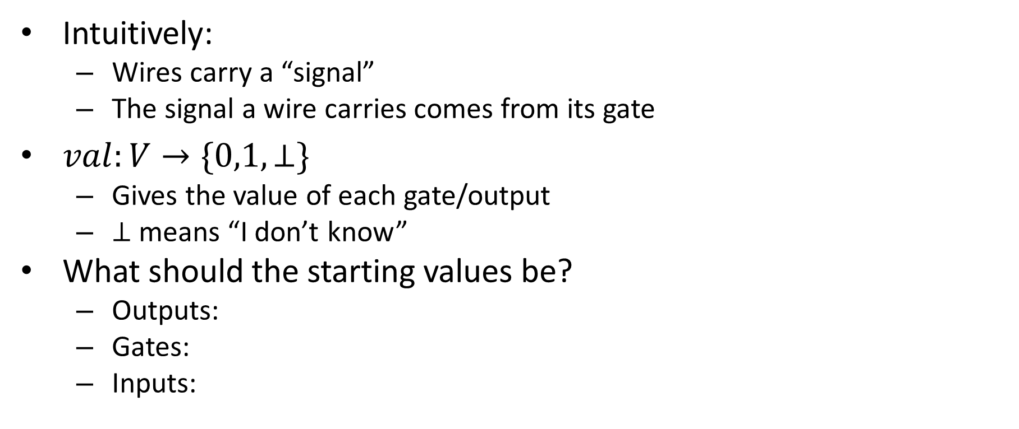
Value of
Intuitively:
Wires carry a “signal”
The signal a wire carries comes from its gate
$val:V→\{0,1,⊥\}$
Gives the value of each gate/output
$⊥$ means “I don’t know”
What should the starting values be?
Outputs:
Gates:
Inputs:

Slide 19
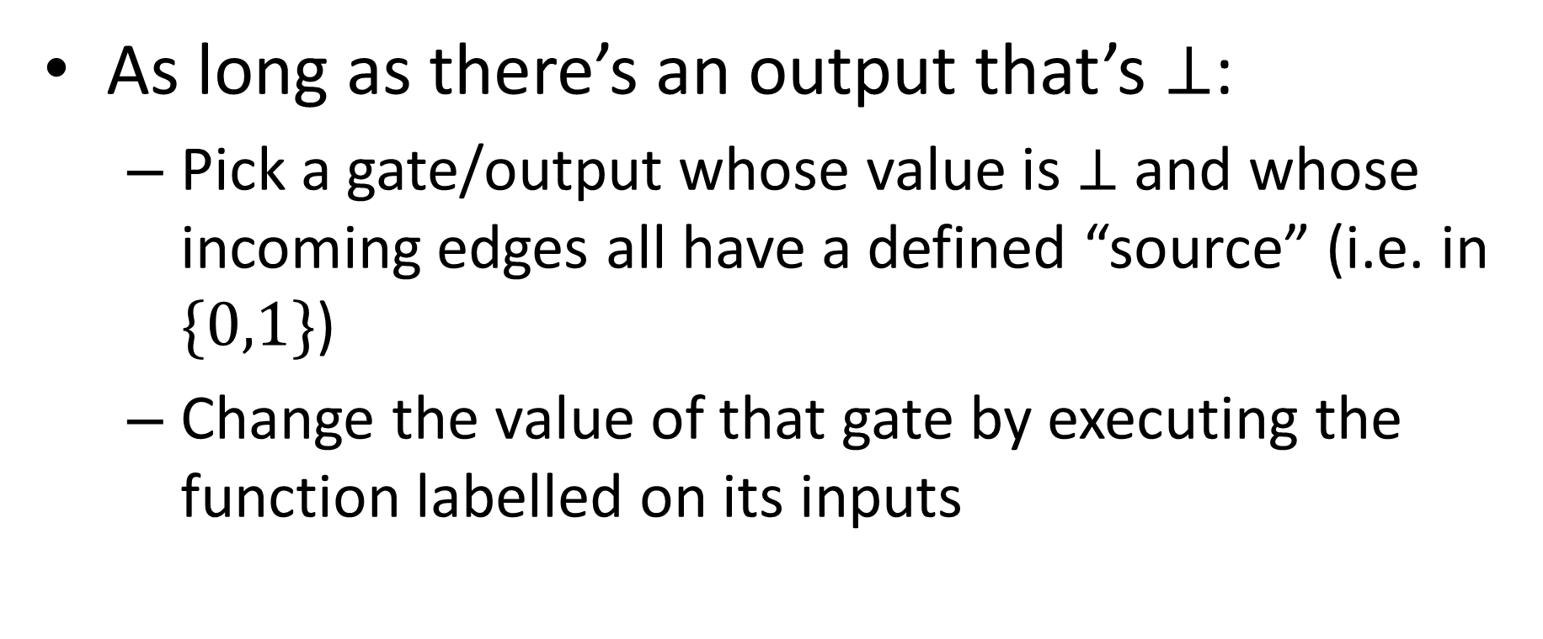
How to execute a Circuit
As long as there’s an output that’s $⊥$:
Pick a gate/output whose value is $⊥$ and whose incoming edges all have a defined “source” (i.e. in $\{0,1\}$)
Change the value of that gate by executing the function labelled on its inputs

Slide 20




Example execution
$$1$$
$$0$$
$$y$$
$$1$$

Slide 21

With your neighbor
Build a circuit for $NAND$
$NAND\left(a,b\right)=¬(a∧b)$
Input | Output
00 | 1
01 | 1
10 | 1
11 | 0

Slide 22

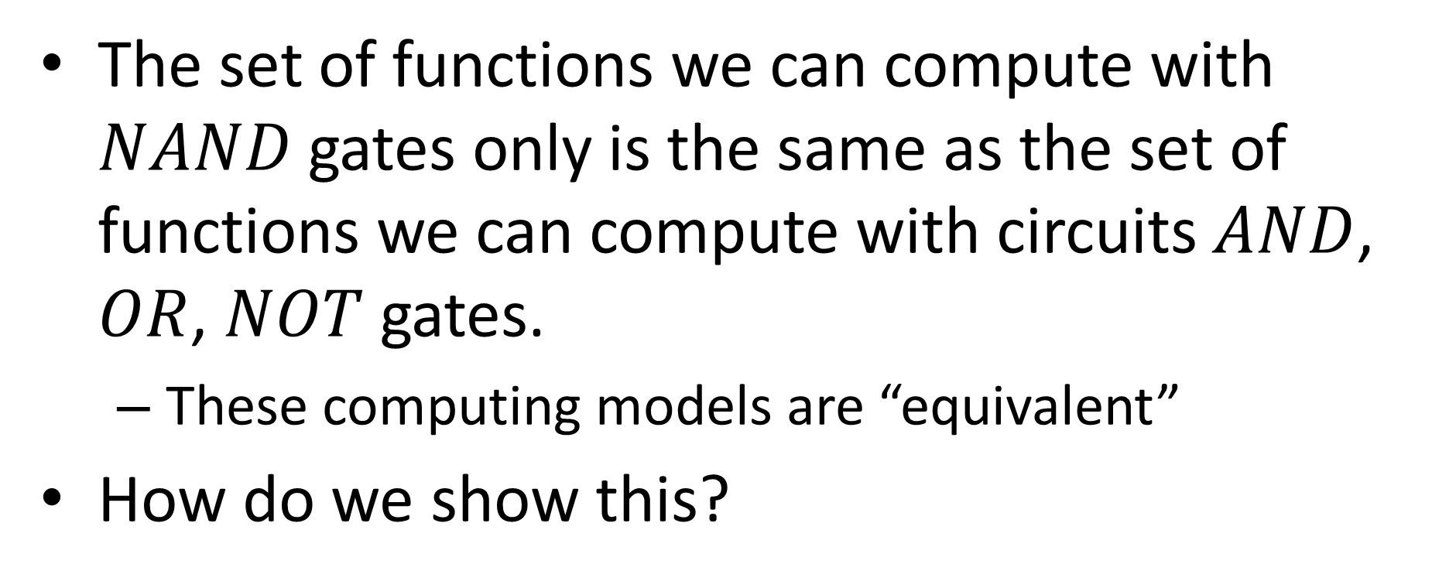
NAND Circuits
$$=$$
The set of functions we can compute with $NAND$gates only is the same as the set of functions we can compute with circuits $AND$, $OR$, $NOT$ gates.
These computing models are “equivalent”
How do we show this?

Slide 23

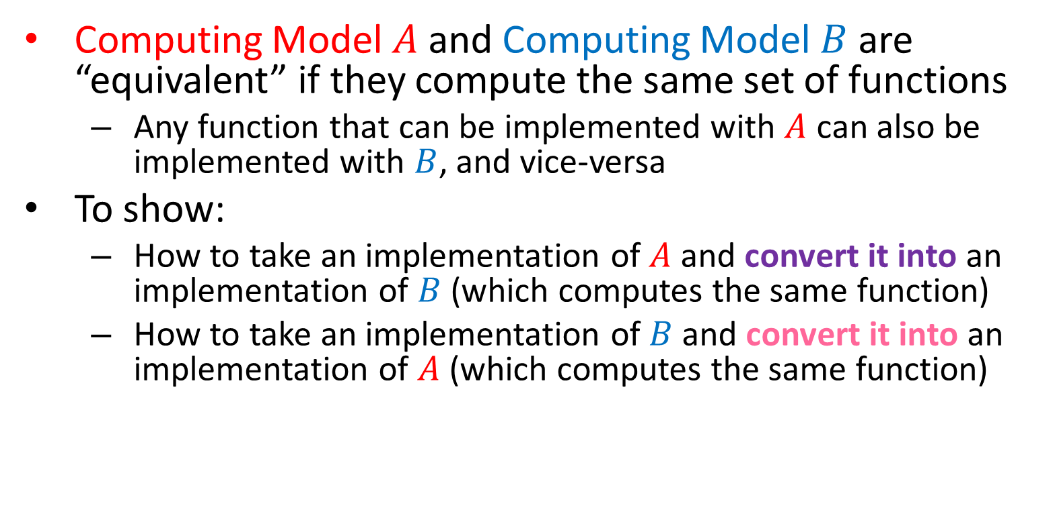

Equivalence of Computing Models
Computing Model $A$ and Computing Model $B$ are “equivalent” if they compute the same set of functions
Any function that can be implemented with $A$ can also be implemented with $B$, and vice-versa
To show:
How to take an implementation of $A$ and convert it into an implementation of $B$ (which computes the same function)
How to take an implementation of $B$ and convert it into an implementation of $A$ (which computes the same function)
$$A$$
$$B$$

Slide 24

AND/OR/NOT using NAND
$AND$
$OR$
$NOT$

Slide 25
NAND = AON
NAND to AON
AON to NAND
Everywhere you see:
Everywhere you see:
Instead put:
Instead put:
NOT
NOT
NOT
OR

Slide 26








Majority using NAND
$$a$$
5 gates
$$b$$
$$y$$
$$c$$
$$a$$
24 gates
$$b$$
$$y$$
$$c$$

Slide 27
Takeaway
We now have a hardware-based model of computing to work with
Actually two!
Meant to be similar to how CPUs operate
We’ve already made proofs about models of computation!
While some models are equivalent in what they can compute, they may not be in how efficiently they can do it
Next time: a software-like model of computing

