Slide 1


Class 7:
Universality
University of Virginia
cs3102: Theory of Computation
https://uvatoc.github.io
David Evans, Nathan Brunelle

Slide 2
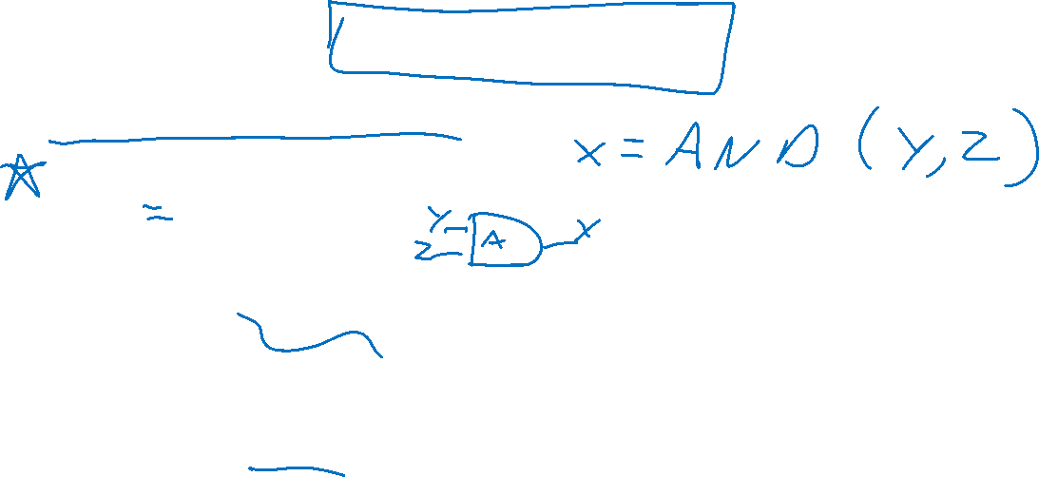
Last Classes
Models of Computation:
Straightline programs
Boolean Circuits
Next:
Making a model that looks more like familiar programming languages
Discussing Universality
Problem Set 2 is due
Friday (4:19pm)

Slide 3

With a simple programming language
AON Straightline programs
Python-like language
Define functions that take Boolean inputs
Use AND/OR/NOT within
Assign results of AND/OR/NOT to variables
Return result

Slide 4
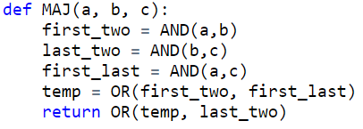
MAJ with AON straightline

Slide 5
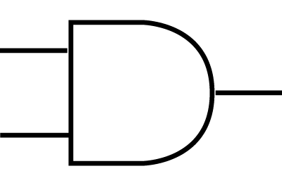
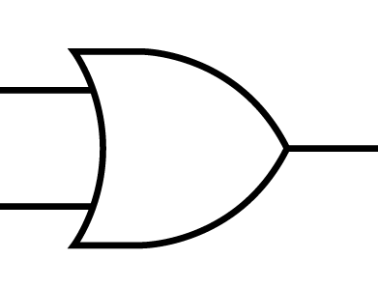
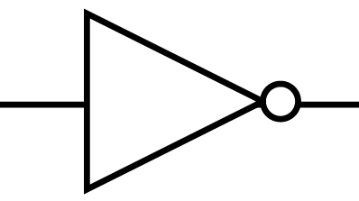
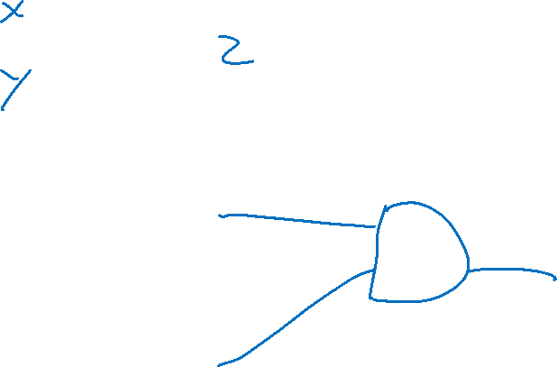
Boolean Circuits
AND
OR
NOT

Slide 6
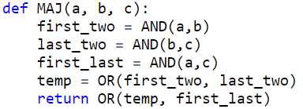
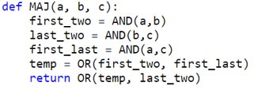
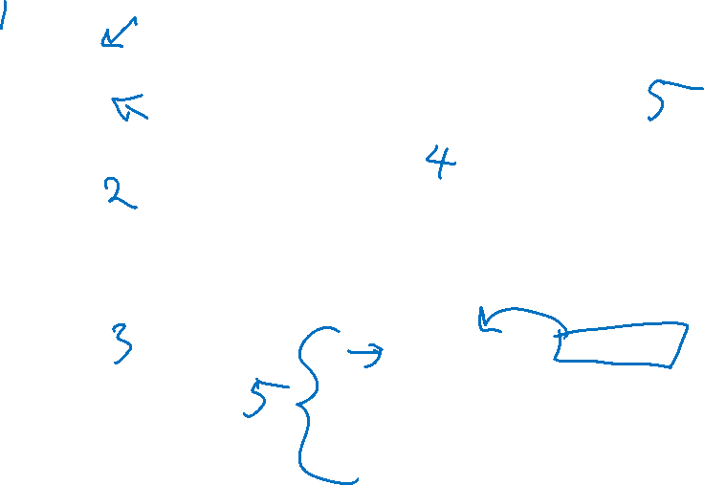
Majority with Boolean Circuits
x[0]
x[1]
x[2]

Slide 7

NAND Straightline = AON Straightline
NAND -> AON
AON -> NAND
x = NAND(a,b)
Becomes
temp = AND(a,b)
x = NOT(temp)
​
x = OR(a,b)​
Becomes​
t1 = NAND(a,a)
t2 = NAND(b,b)
x= NAND(t1,t2)
x = NOT(a)
Becomes
x= NAND(a,a)
x = AND(a,b)
Becomes
temp= NAND(a,b)
x=NAND(temp,temp)

Slide 8
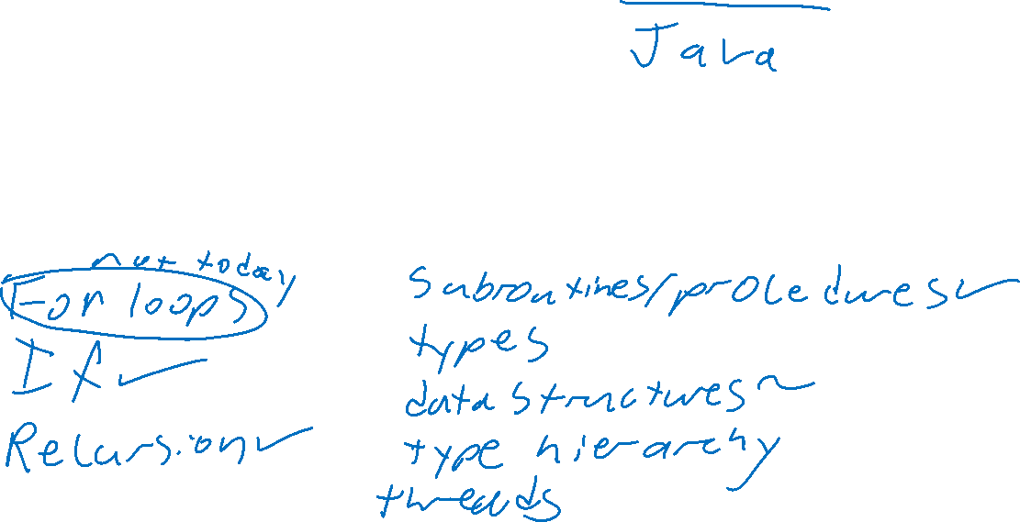
Straightline vs Python
Straightline programs:
Execute each line in sequence
Features missing:

Slide 9
Syntactic Sugar
"Full-featured" programming languages are identical to simple ones
We can add new features without changing the underlying computing model
These features can make programs easier to reason about and more readable

Slide 10
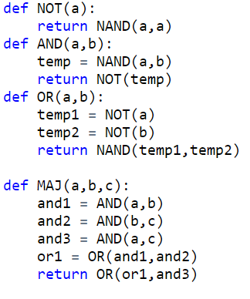

User-Defined Procedures

Slide 11
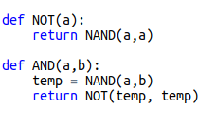
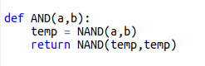

"Translating" Procedures
Adding procedures does not change computing model
We can convert a program with procedures into a program without

Slide 12


Procedure for translating procedures
Paste code from procedure
Use arguments in place of parameters
Rename variables from the procedure to be "fresh"

Slide 13
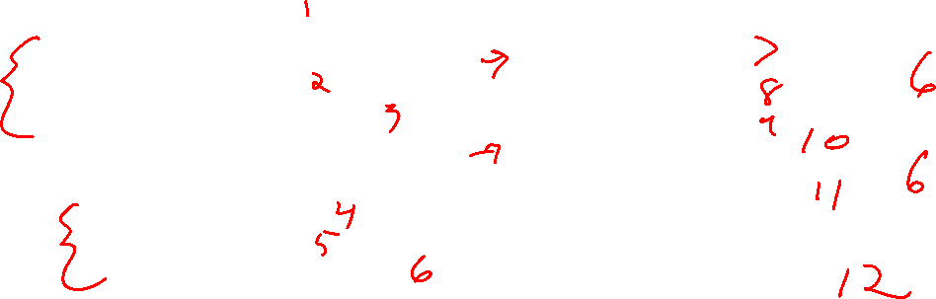
How many gates?
How many NAND gates does this use to compute MAJ?

Slide 14
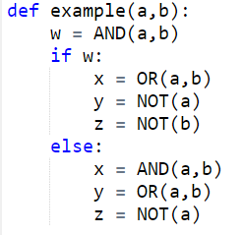

Conditionals
Values of some variables might depend on a condition

Slide 15
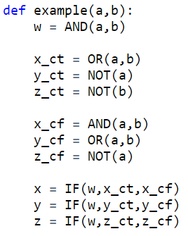
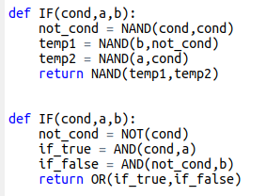
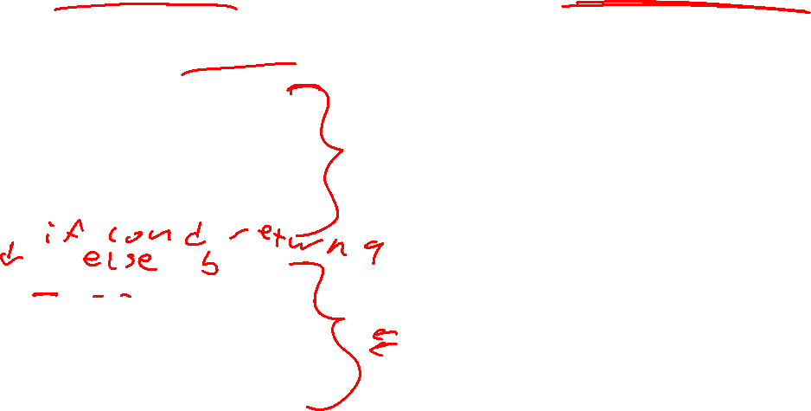
Translating Conditionals
Pre-compute each of the possible values
Use a procedure to determine which to assign

Slide 16
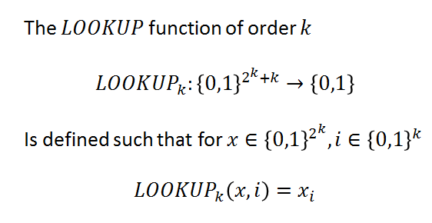

Lookup
Indexing into a bitstring

Slide 17


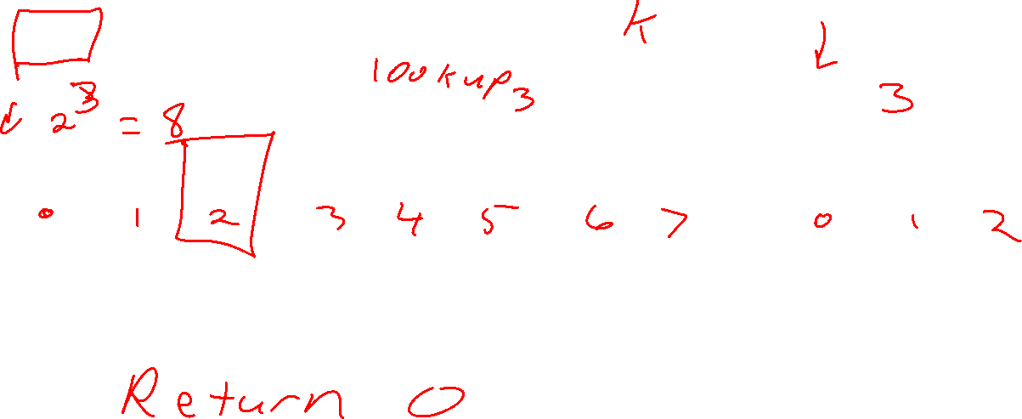
LOOKUP
k=3
x:
i:
0 | 1 | 0 | 0 | 1 | 1 | 1 | 0
0 | 1 | 0
Considered as a bitstring
Considered as an index

Slide 18
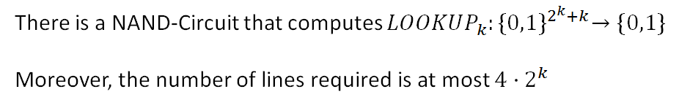

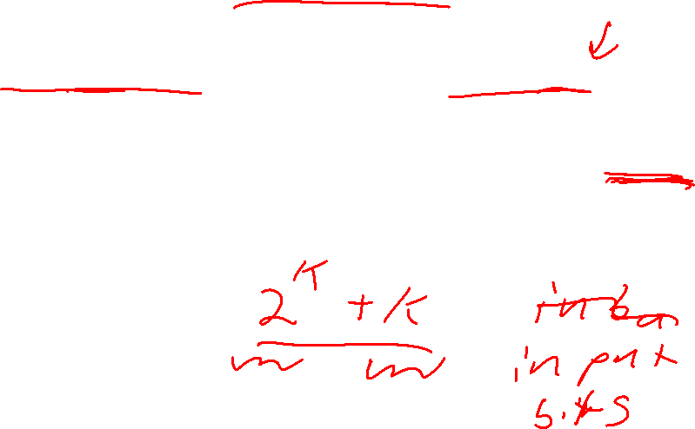
Theorem

Slide 19
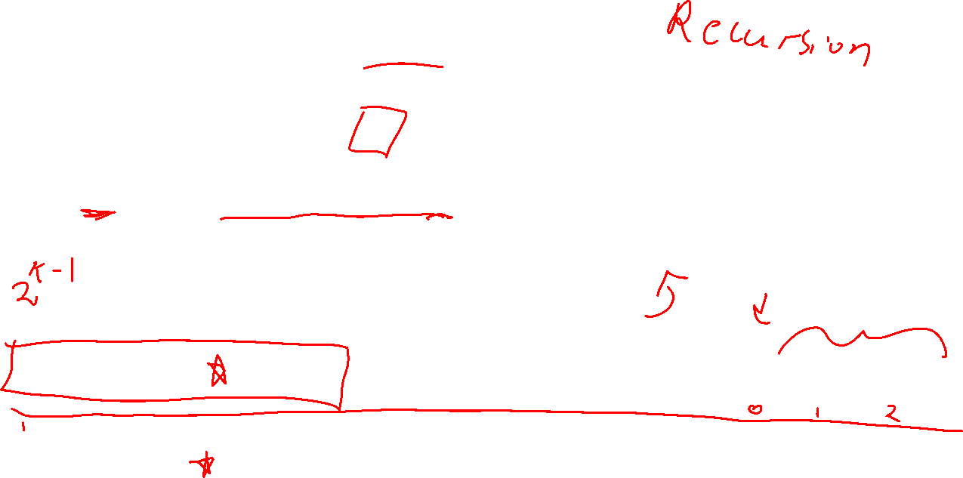
Proof idea
Consider index i
If the first bit of i is 0, then the bit we're looking for is in the first half of x
Do lookup for k-1
x:
i:
0 | 1 | 0 | 0 | 1 | 1 | 1 | 0
0 | 1 | 0
x:
i:
0 | 1 | 0 | 0
1 | 0

Slide 20
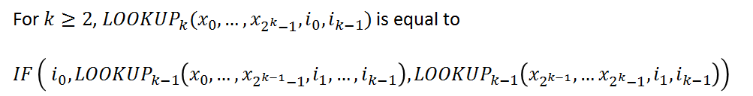
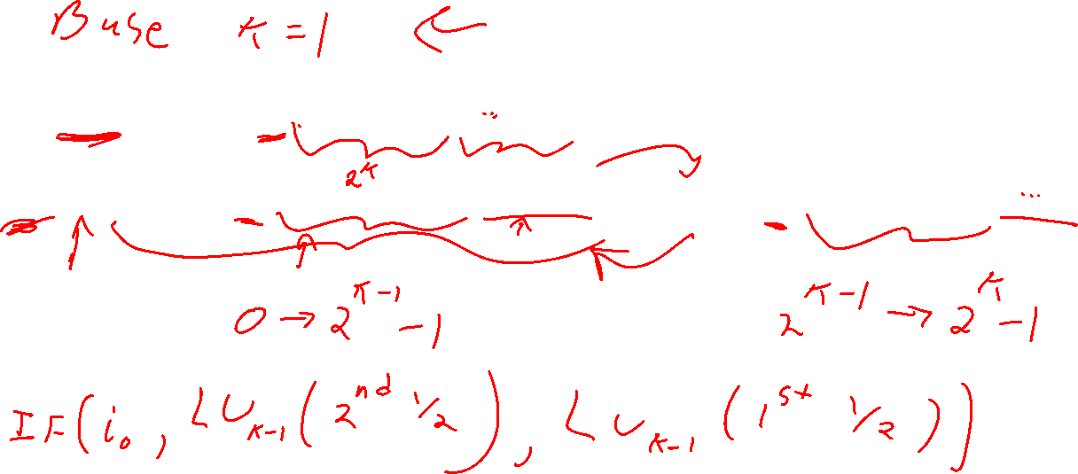
Defining LOOKUP

Slide 21


Base Case
Next Step

Slide 22
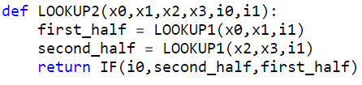
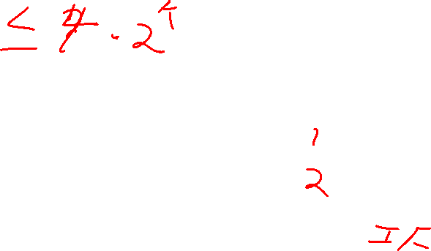
LOOKUP2

Slide 23
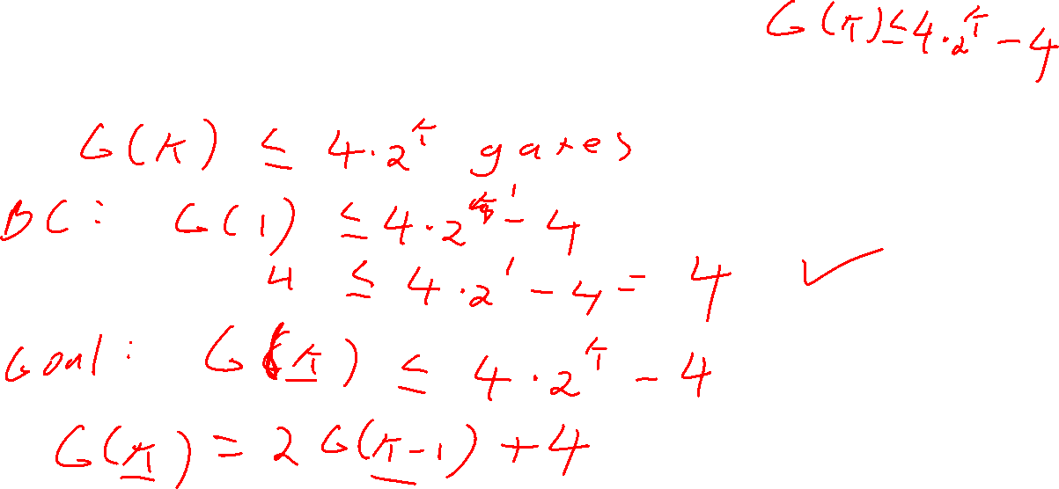
Counting Gates

Slide 24
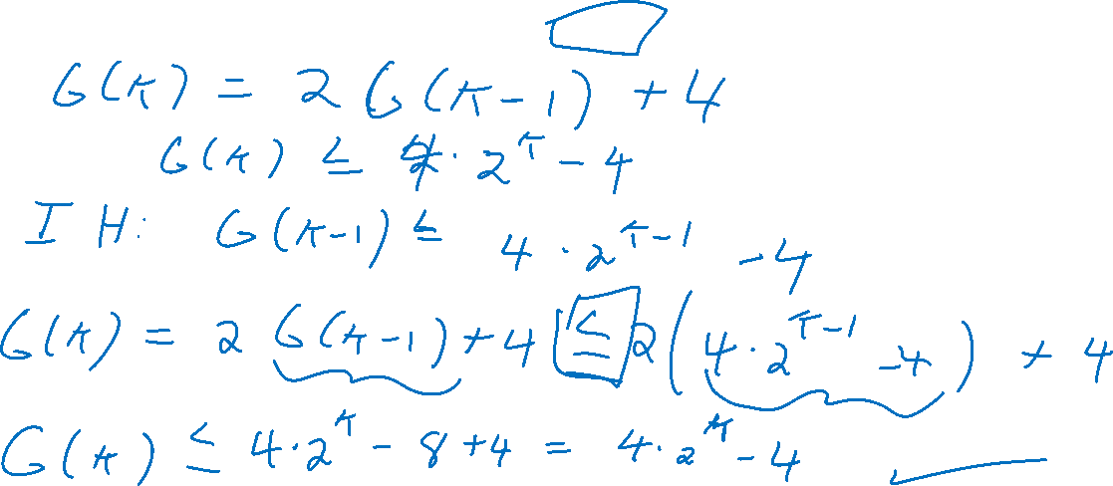
Counting Gates

Slide 25
Computing Every Finite Function
Next we'll show that NAND is universal
Any finite function can be computed by some NAND straightline program (equivalently, a NAND circuit)

Slide 26
Idea
Input | Output
000 | 0
001 | 0
010 | 1
011 | 0
100 | 1
101 | 1
110 | 0
111 | 0
We will have one variable to represent each possible input. We'll do a lookup with the actual input to select the proper output

Slide 27
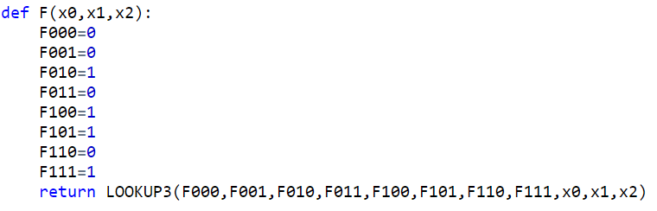
Straightline Code for F
Input | Output
000 | 0
001 | 0
010 | 1
011 | 0
100 | 1
101 | 1
110 | 0
111 | 0

Slide 28
Getting 0 and 1

Slide 29
How do we use this?
Your machine has a 64-bit processor
This means your machine has a CPU that is set up to compute functions with 64 bits of input
How do we do more than this?

