Slide 1

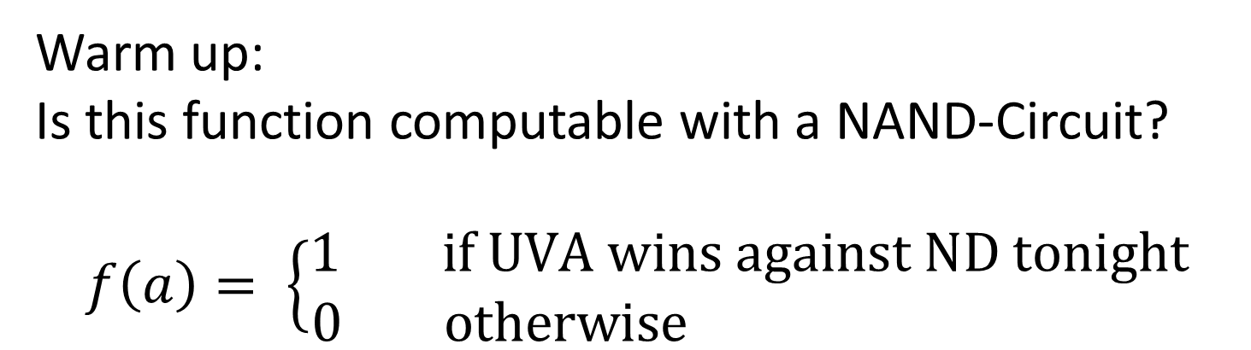
CS3102 Theory of Computation
Warm up:
Is this function computable with a NAND-Circuit?
$$f\left(a\right)= \left\{\begin{aligned}1 if UVA wins against ND tonight \\ 0 otherwise \end{aligned}\right.$$

Slide 2
Logistics
Quiz 3 out
Due Thursday
Exercise 3 is out
Last exercise before midterm

Slide 3
Last Time
Showing that NAND/AON can compute any finite function
Started showing how we could have a function that simulates programs

Slide 4
How are programs run?
Have a table of variables
Execute code in sequence
Update values in table
Return a value from the table

Slide 5

Programs as Bits
To evaluate a program with another program, we need to convert the first program into bits
Number each variable (first n go to input, last m to outputs)
Represent each line as 3 numbers (outvar, in1, in2)
Represent program as (n,m,[Lines])
Variable | Number
a | 0
b | 1
temp1 | 2
temp2 | 3
return | 4
(2,0,0)
(3,1,1)
(4,2,3)
(2,1,[(2,0,0),(3,1,1),(4,2,3)])

Slide 6
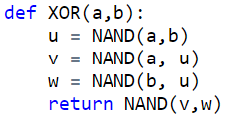

XOR to bits
Variable | Number
$n=$
$m=$
$s=$
Total bits =

Slide 7
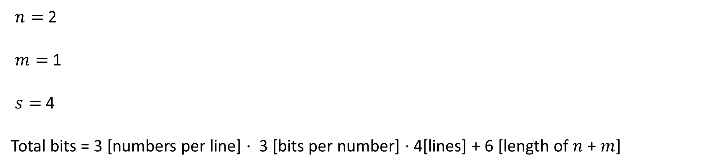
XOR to bits
Variable | Number
a | 0
b | 1
u | 2
v | 3
w | 4
return | 5
$n=$ 2
$m=$ 1
$s=$ 4
Total bits = 3 [numbers per line] $⋅$ 3 [bits per number] $⋅$ 4[lines] + 6 [length of $n$ + $m$]

Slide 8
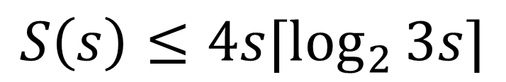
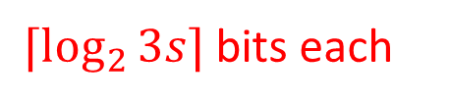
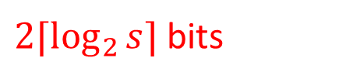

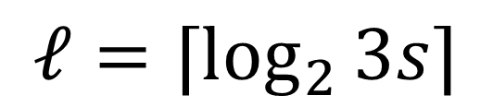
How big is this?
Number each variable
Represent each line as 3 numbers (outvar, in1, in2)
Represent program as (n,m,[Lines])
$⌈\log_{2}{3s⌉}$bits each
$3s⋅⌈\log_{2}{3s⌉}$bits
$2⌈\log_{2}{s⌉}$bits
$$S\left(s\right)≤4s⌈\log_{2}{3s}⌉$$
$$ℓ=⌈\log_{2}{3s⌉}$$

Slide 9
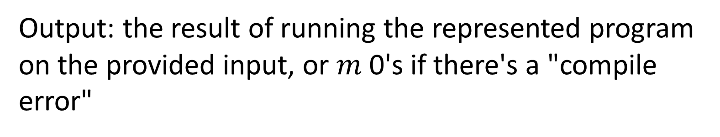
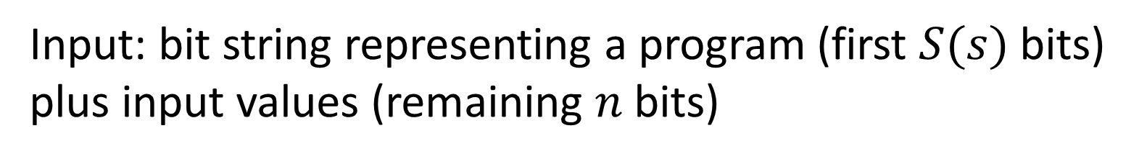
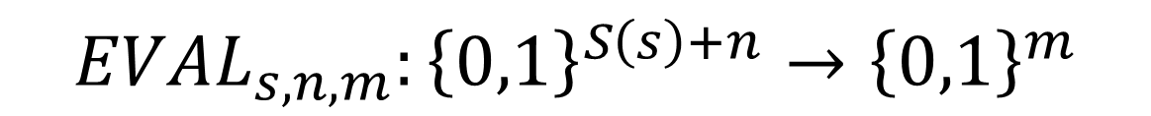
Defining EVAL
$$EVAL_{s,n,m}:{\left\{0,1\right\}}^{S\left(s\right)+n}→{\left\{0,1\right\}}^{m}$$
Input: bit string representing a program (first $S(s)$ bits) plus input values (remaining $n$ bits)
Output: the result of running the represented program on the provided input, or $m$ 0's if there's a "compile error"

Slide 10

Defining the EVAL function
$$n=2$$
$$m=1$$
Variable | Value
0
1
2
3
4
5
Representation:
(2, 0, 1),
(3, 0, 2),
(4, 1, 2),
(5, 3, 4)
Input:
0, 1

Slide 11

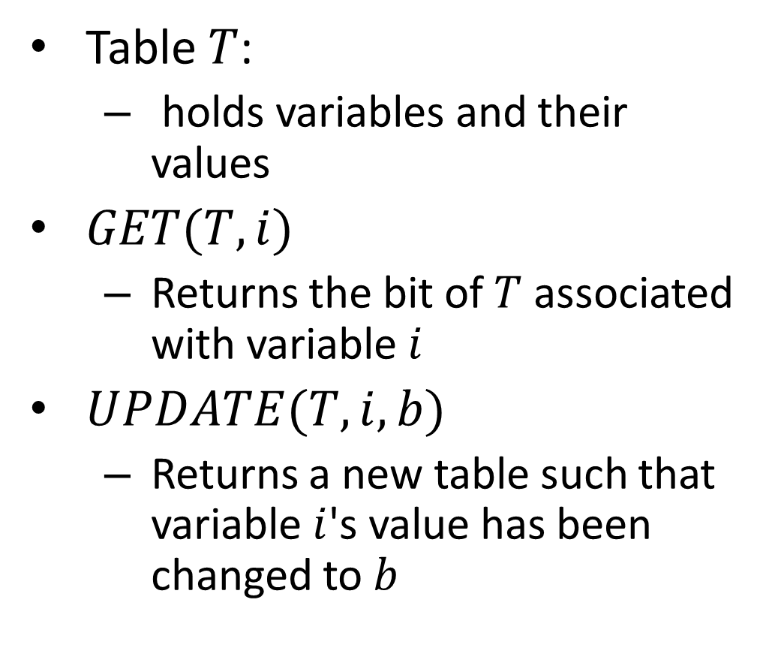
Psuedocode for EVAL
$$T$$
Table $T$:
holds variables and their values
$GET(T,i)$
Returns the bit of $T$ associated with variable$i$
$UPDATE(T, i, b)$
Returns a new table such that variable $i$'s value has been changed to $b$

Slide 12
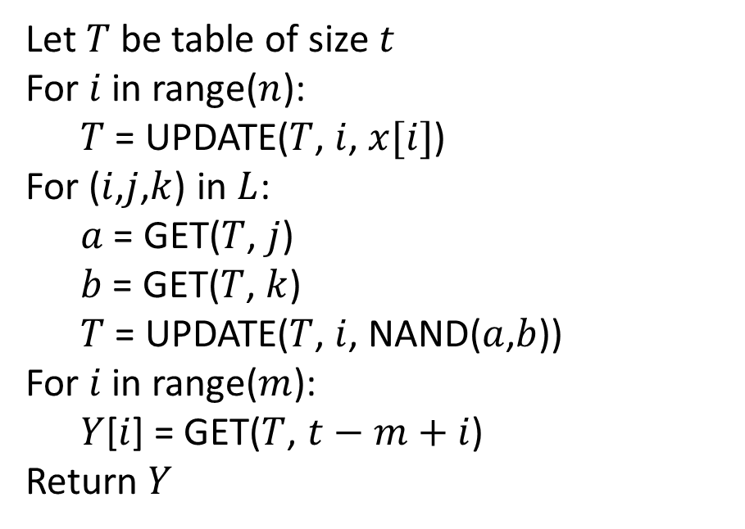
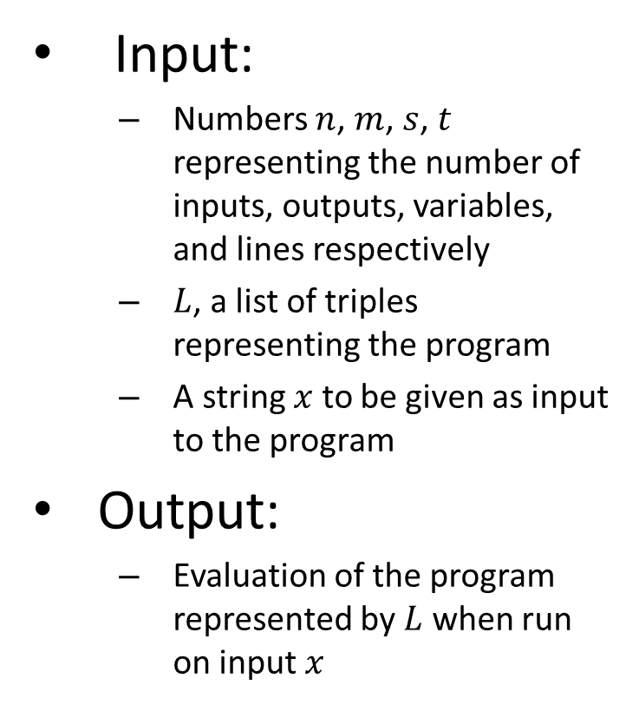
Psuedocode for EVAL
Input:
Numbers $n$, $m$, $s$, $t$ representing the number of inputs, outputs, variables, and lines respectively
$L$, a list of triples representing the program
A string $x$ to be given as input to the program
Output:
Evaluation of the program represented by $L$ when run on input $x$
Let $T$ be table of size $t$
For $i$ in range($n$):
$T$ = UPDATE($T$, $i$, $x[i]$)
For ($i$,$j$,$k$) in $L$:
$a$ = GET($T$, $j$)
$b$ = GET($T$, $k$)
$T$ = UPDATE($T$, $i$, NAND($a$,$b$))
For $i$ in range($m$):
$Y$[$i$] = GET($T$, $t−m+i$)
Return $Y$

Slide 13

EVAL in NAND
Next we implement $EVAL_{s,n,m}$ using NAND

Slide 14
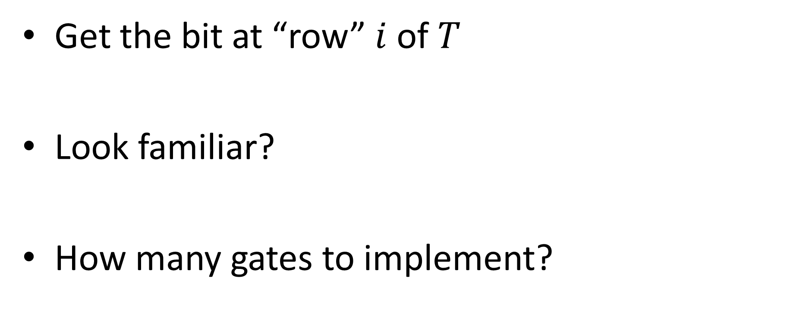

$$GET(T,i)$$
Get the bit at “row” $i$ of $T$
Look familiar?
How many gates to implement?

Slide 15
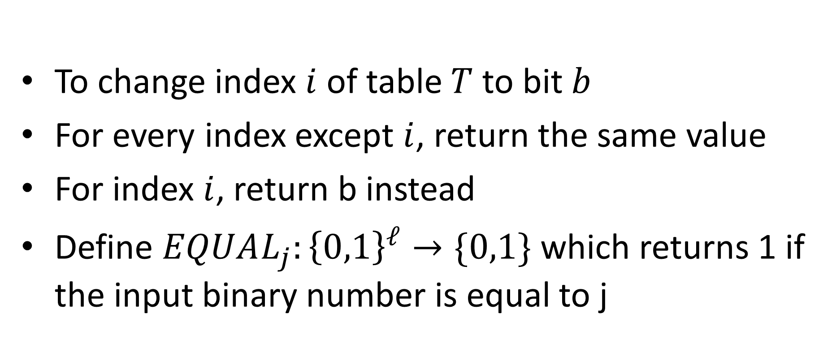
UPDATE
$$UPDATE_{ℓ}:{\left\{0,1\right\}}^{s^{ℓ}+ℓ+1}→{\left\{0,1\right\}}^{2^{ℓ}}$$
To change index $i$ of table $T$ to bit $b$
For every index except $i$, return the same value
For index $i$, return b instead
Define $EQUAL_{j}:{\left\{0,1\right\}}^{ℓ}→\{0,1\}$ which returns 1 if the input binary number is equal to j
Note: $EQUAL_{j}$ can be done in $c⋅ℓ$ gates

Slide 16

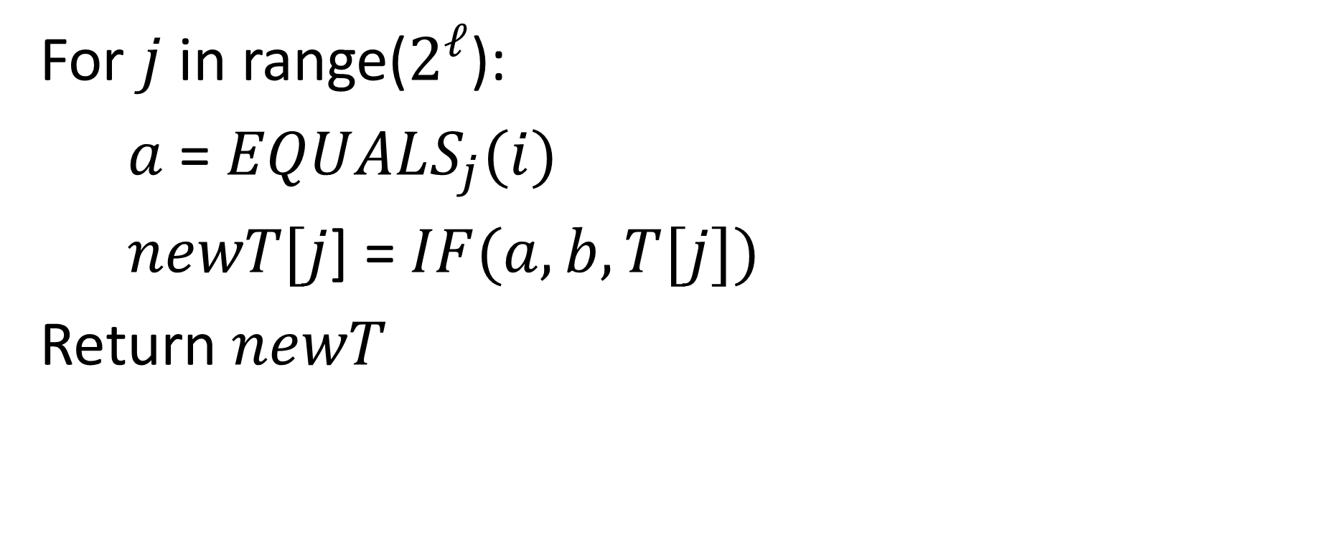
UPDATE pseudocode
For $j$ in range($2^{ℓ}$):
$a$ = $EQUALS_{j}(i)$
$newT[j$] = $IF(a, b, T[j])$
Return $newT$
Runs $2^{ℓ}$ times

Slide 17
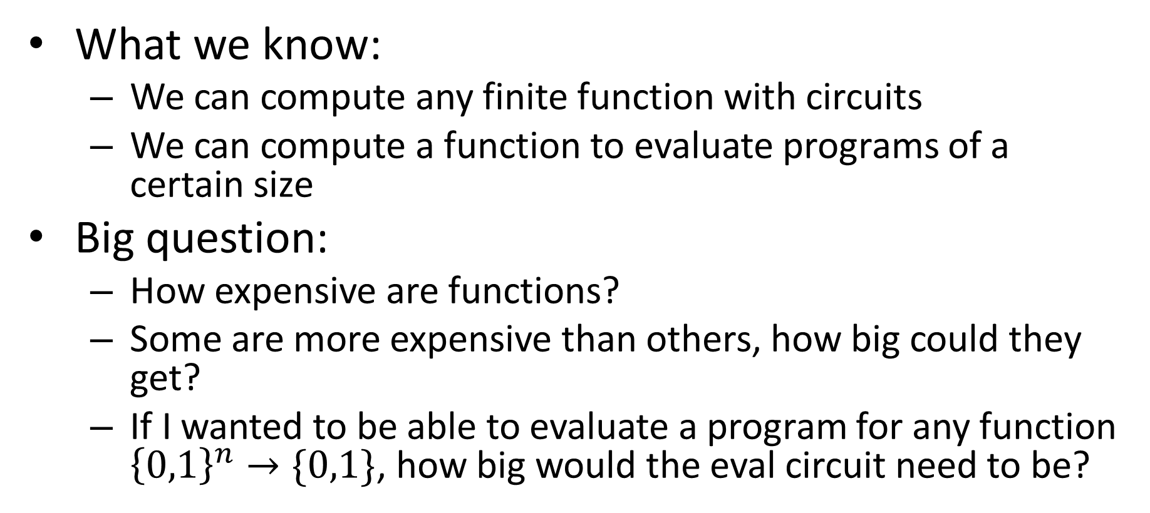
Conclusion
What we know:
We can compute any finite function with circuits
We can compute a function to evaluate programs of a certain size
Big question:
How expensive are functions?
Some are more expensive than others, how big could they get?
If I wanted to be able to evaluate a program for any function ${\left\{0,1\right\}}^{n}→\{0,1\}$, how big would the eval circuit need to be?

Slide 18
Complexity
The "complexity" of a function:
Measure of the resources required to compute that function
Complexity Class:
A set of functions defined by a complexity measure

Slide 19
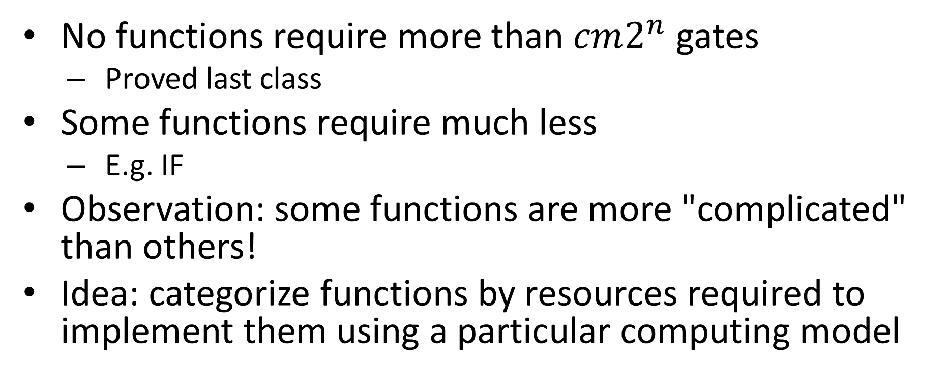
Categorizing Functions by Circuit Size
No functions require more than $cm2^{n}$ gates
Proved last class
Some functions require much less
E.g. IF
Observation: some functions are more "complicated" than others!
Idea: categorize functions by resources required to implement them using a particular computing model

Slide 20
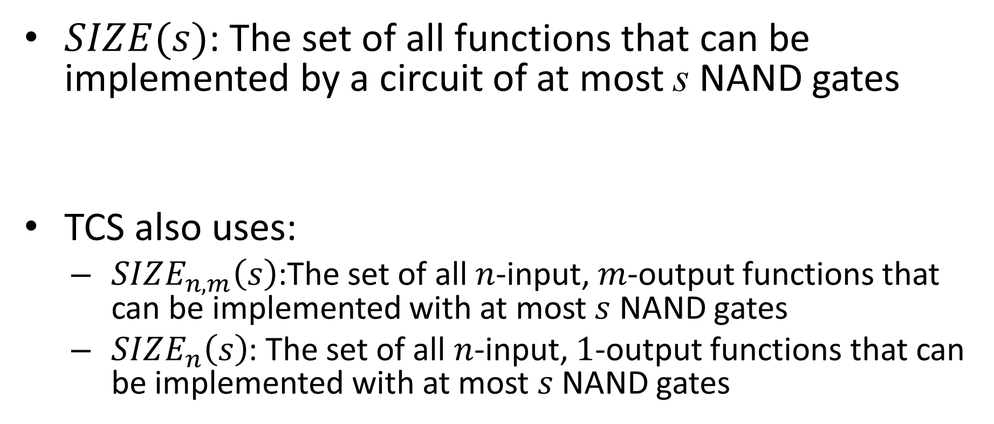
SIZE
$SIZE(s)$: The set of all functions that can be implemented by a circuit of at most s NAND gates
TCS also uses:
$SIZE_{n,m}\left(s\right)$:The set of all $n$-input, $m$-output functions that can be implemented with at most $s$ NAND gates
$SIZE_{n}\left(s\right)$: The set of all $n$-input, $1$-output functions that can be implemented with at most $s$ NAND gates
$SIZE(1000m2^{n})$ Contains all functions $f:{\left\{0,1\right\}}^{n}→{\left\{0,1\right\}}^{m}$

Slide 21
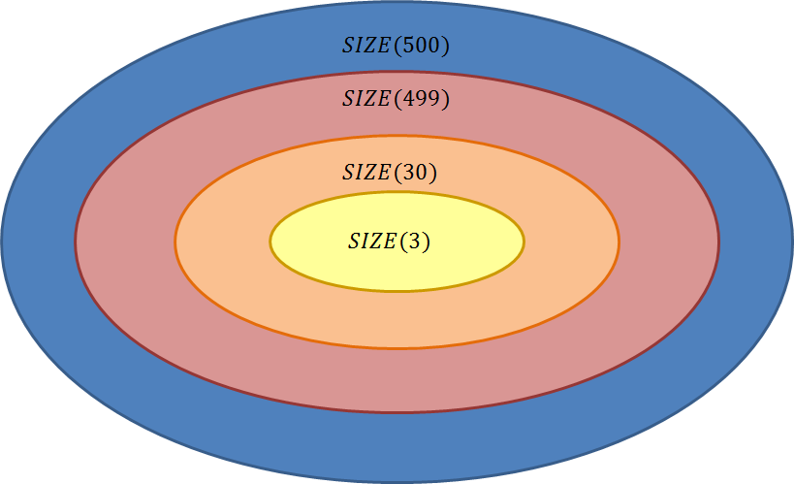
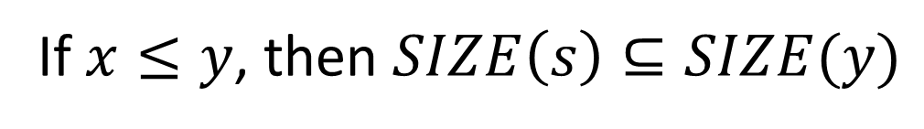
Comparing Classes
If $x≤y$, then $SIZE\left(s\right)⊆SIZE(y)$

Slide 22
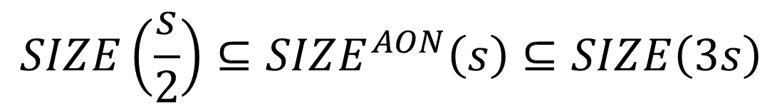

Theorem
Let $SIZE^{AON}\left(s\right)$ represent the set of all functions that can be computed using at most $s$ AND/OR/NOT gates
$$SIZE\left(\frac{s}{2}\right)⊆SIZE^{AON}\left(s\right)⊆SIZE\left(3s\right)$$

Slide 23

Proof
$$SIZE\left(\frac{s}{2}\right)⊆SIZE^{AON}\left(s\right)⊆SIZE\left(3s\right)$$

Slide 24
O, Ω, Θ
Groups functions together
Each uses a function as a bound for other functions
O (Big-Oh):
O(f(n)) = the set of all functions "asymptotically upper-bounded" by f
Ω (Big-Omega):
Ω(f(n)) = the set of all functions "asymptotically lower-bounded" by f
Θ (Big-Theta):
Θ(f(n)) = the set of all functions "asymptotically tight-bounded" by f

Slide 25
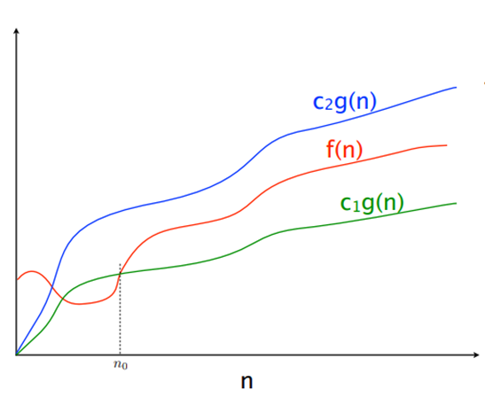




Slide 26
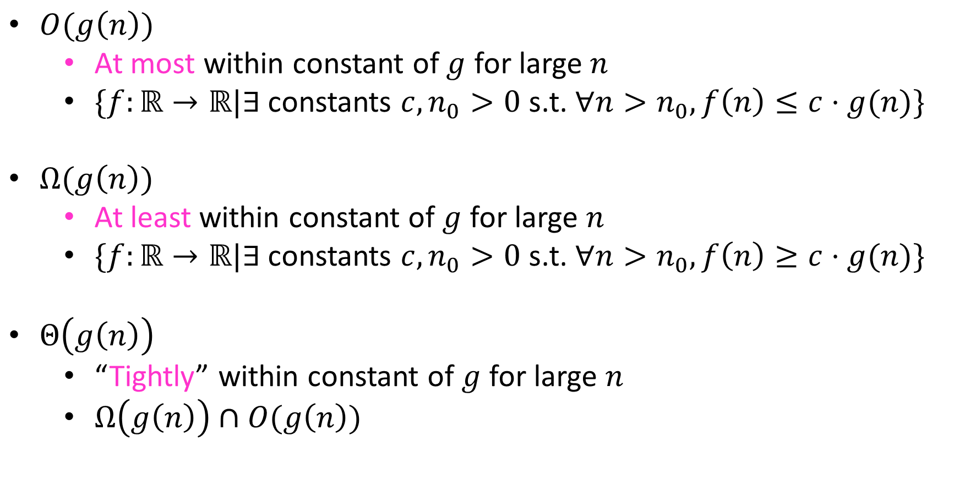
Definitions
$O(g\left(n\right))$
At most within constant of $g$ for large $n$
$\{f:\text{ℝ}→\text{ℝ}|∃$constants $c, n_{0}>0$ s.t. $∀n>n_{0}, f\left(n\right)≤c⋅g(n)\}$
$Ω(g\left(n\right))$
At least within constant of $g$ for large $n$
$\{f:\text{ℝ}→\text{ℝ}|∃$constants $c, n_{0}>0$ s.t. $∀n>n_{0}, f\left(n\right)≥c⋅g(n)\}$
$Θ\left(g\left(n\right)\right)$
“Tightly” within constant of $g$ for large $n$
$Ω\left(g\left(n\right)\right)∩O(g\left(n\right))$

Slide 27

Showing Big-Oh
To show: $n\log{n}∈O\left(n^{2}\right)$

Slide 28

Showing Big-Omega
To Show: $2^{n}∈Ω\left(n^{2}\right)$

Slide 29

Showing Big-Theta
To Show: $\log_{x}{n}=Θ\left(\log_{y}{n}\right)$

