Slide 1


Language $INFINITE$
$INFINITE=\left\{w \right| L\left(ℳ\left(w\right)\right) is infinite\}$
We will show this is not computable by using $INFINITE$to compute $HALT$

Slide 2
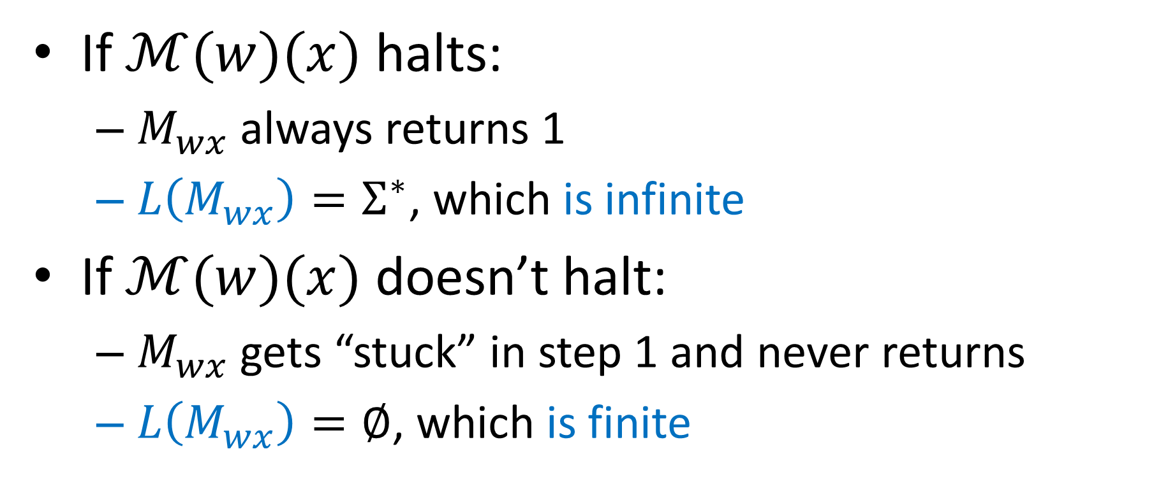

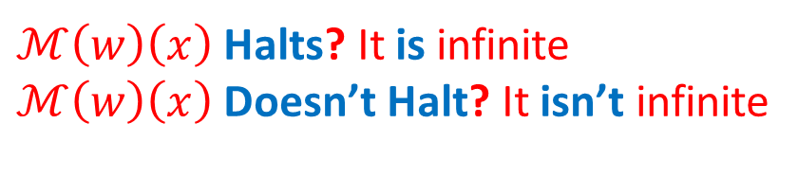

Language of $M_{wx}$
$ℳ\left(w\right)\left(x\right)$ Halts? It is infinite
$ℳ\left(w\right)\left(x\right)$ Doesn’t Halt? It isn’t infinite
Build this machine:
$M_{wx}:$
1) run $ℳ(w)(x)$
2) return 1
If $ℳ(w)(x)$ halts:
$M_{wx}$ always returns 1
$L\left(M_{wx}\right)=Σ^{∗}$, which is infinite
If $ℳ(w)(x)$ doesn’t halt:
$M_{wx}$ gets “stuck” in step 1 and never returns
$L\left(M_{wx}\right)=∅$, which is finite

Slide 3


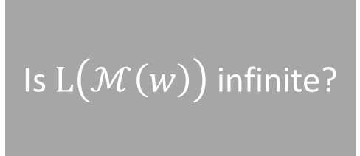




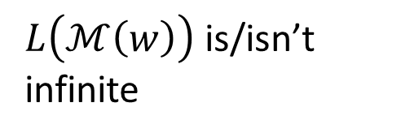
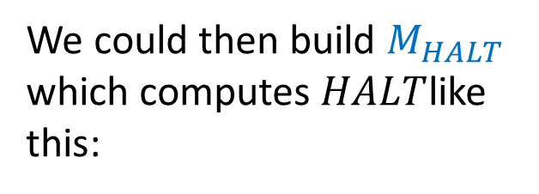

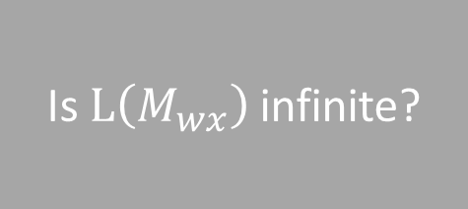
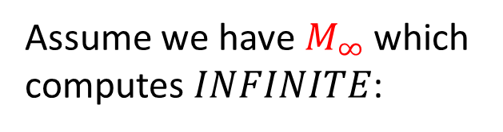

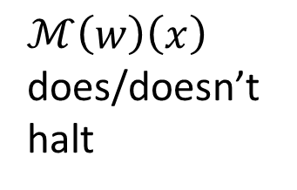
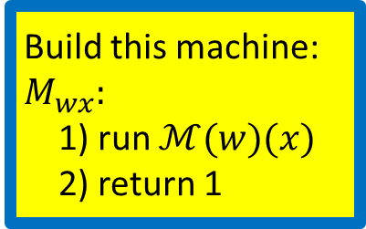
Using $INFINITE$ to build $HALT$
Assume we have $M_{∞}$ which computes $INFINITE$:
Is $L\left(ℳ\left(w\right)\right)$ infinite?
$$M_{∞}$$
$L\left(ℳ\left(w\right)\right)$ is/isn’t infinite
$$w$$
We could then build $M_{HALT}$ which computes $HALT$like this:
$$M_{HALT}$$
Does $ℳ\left(w\right)\left(x\right)$ halt?
$$w$$
Build this machine:
$M_{wx}:$
1) run $ℳ(w)(x)$
2) return 1
$$M_{∞}$$
$ℳ\left(w\right)\left(x\right)$ does/doesn’t halt
Is $L\left(M_{wx}\right)$ infinite?
$$x$$

Slide 4

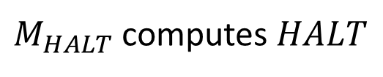

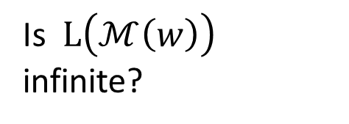
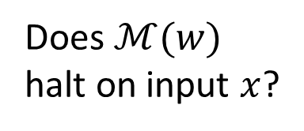

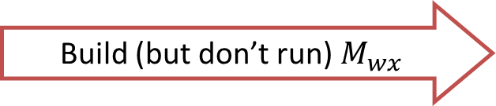



Reduction
Problem know is impossible
Problem we think is impossible
$$INFINITE$$
$$A$$
$$HALT$$
Build (but don’t run) $M_{wx}$
$$B$$
Is $L\left(ℳ\left(w\right)\right)$ infinite?
Does $ℳ(w)$ halt on input $x$?
Assume
Give $M_{wx}$ to the $INFINITE$solver, then answer the same
$M_{HALT}$ computes $HALT$
$INFINITE$ solver exists
Reduction

Slide 5

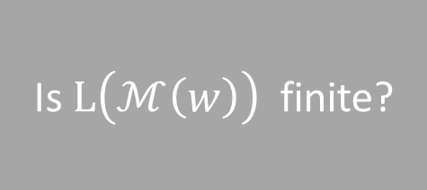
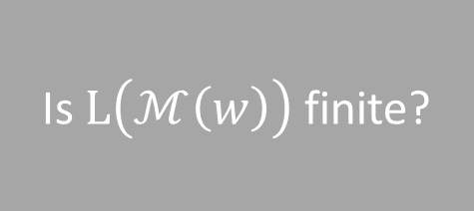




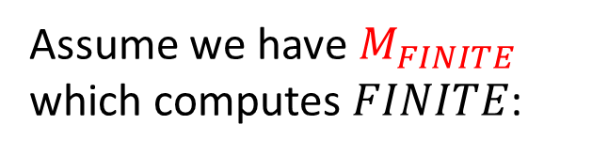

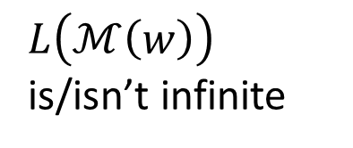

Using $FINITE$ to build $INFINITE$
Assume we have $M_{FINITE}$ which computes $FINITE$:
Is $L\left(ℳ\left(w\right)\right)$ finite?
$$M_{FINITE}$$
$L\left(ℳ\left(w\right)\right)$ is/isn’t finite
$$w$$
We could then build $M_{∞}$ which computes $INFINITE$ like this:
$$M_{∞}$$
Is $L\left(ℳ\left(w\right)\right)$ infinite?
$$w$$
$$M_{FINITE}$$
Is $L\left(ℳ\left(w\right)\right)$ finite?
$L\left(ℳ\left(w\right)\right)$ is/isn’t infinite

Slide 6


Language $NonReg$
$NonReg=\left\{w \right| L\left(ℳ\left(w\right)\right) is non−regular\}$
We will show this is not computable by using $NonReg$ to compute $HALT$

Slide 7
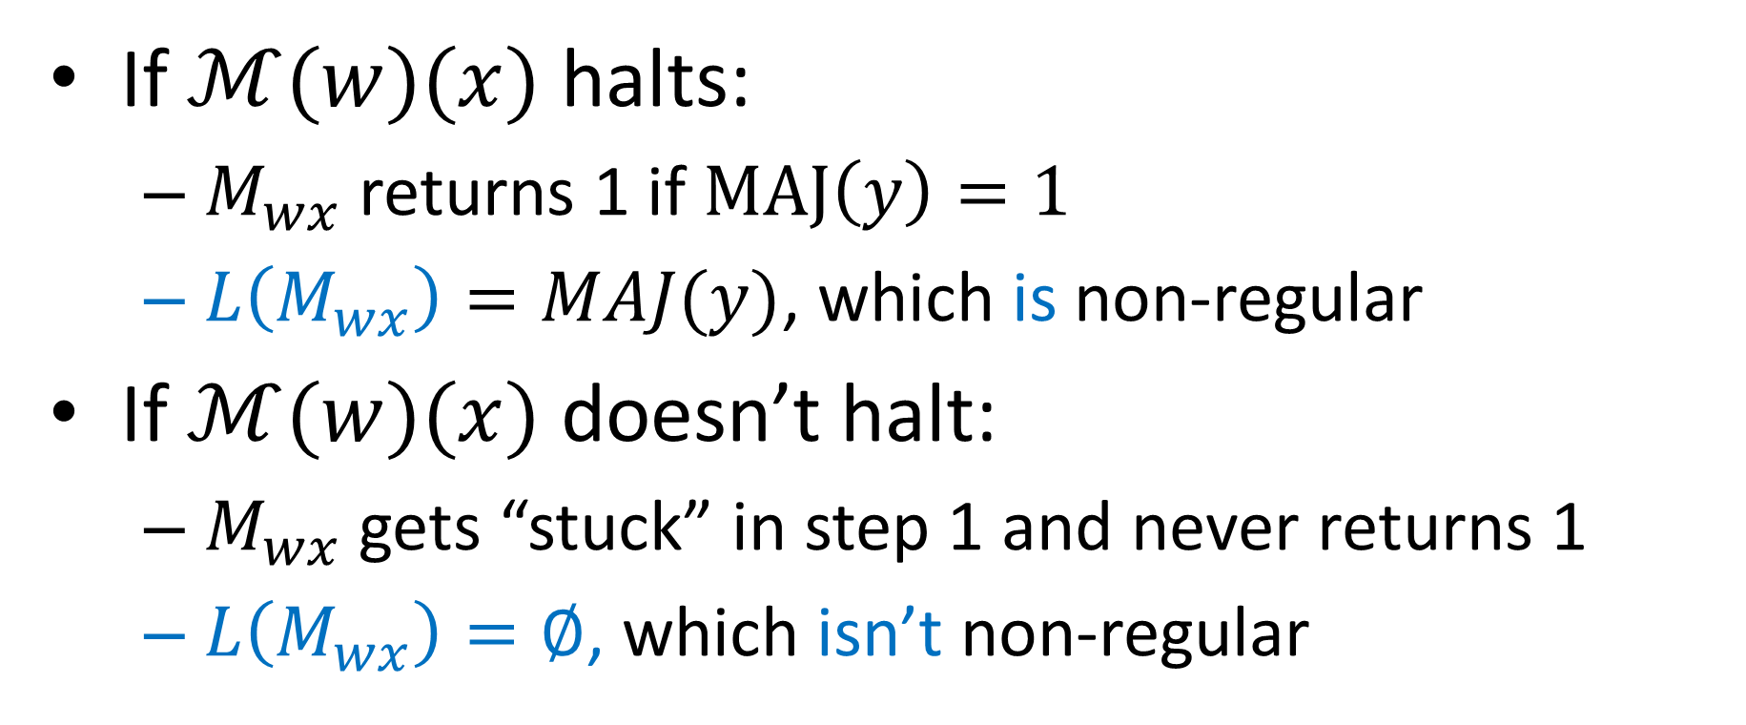

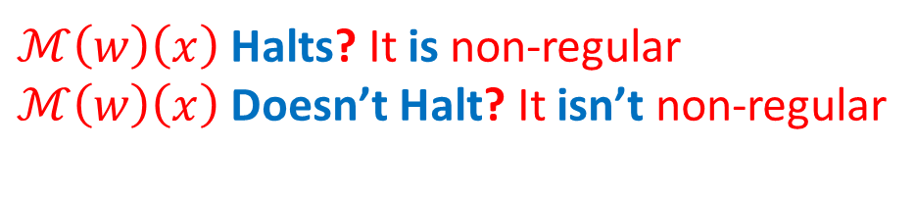

Language of $M_{wx}$
$ℳ\left(w\right)\left(x\right)$ Halts? It is non-regular
$ℳ\left(w\right)\left(x\right)$ Doesn’t Halt? It isn’t non-regular
Build this machine:
$M_{wx}(y):$
1) run $ℳ(w)(x)$
2) return $MAJ(y)$
If $ℳ(w)(x)$ halts:
$M_{wx}$ returns 1 if $MAJ\left(y\right)=1$
$L\left(M_{wx}\right)=MAJ(y)$, which is non-regular
If $ℳ(w)(x)$ doesn’t halt:
$M_{wx}$ gets “stuck” in step 1 and never returns 1
$L\left(M_{wx}\right)=∅$, which isn’t non-regular

Slide 8
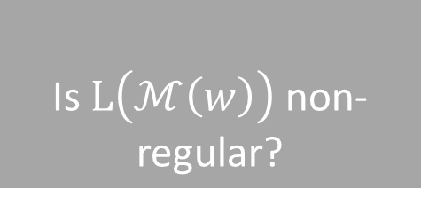


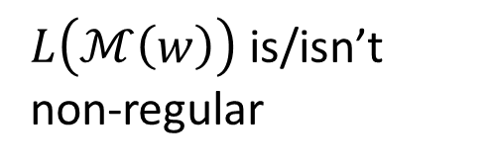

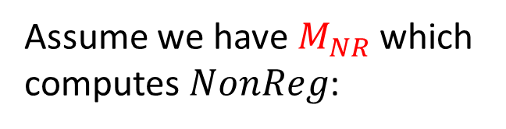

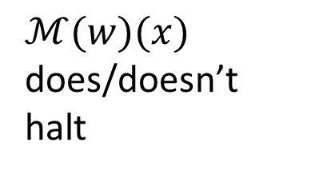

Using $NonReg$ to build $HALT$
Assume we have $M_{NR}$ which computes $NonReg$:
Is $L\left(ℳ\left(w\right)\right)$ non-regular?
$$M_{NR}$$
$L\left(ℳ\left(w\right)\right)$ is/isn’t non-regular
$$w$$
We could then build $M_{HALT}$ which computes $HALT$like this:
$$M_{HALT}$$
Does $ℳ\left(w\right)\left(x\right)$ halt?
$$w$$
Build this machine:
$M_{wx}(y):$
1) run $ℳ(w)(x)$
2) return MAJ$(y)$
$$M_{NR}$$
$ℳ(w)(x)$ does/doesn’t halt
Is $L\left(ℳ\left(w\right)\right)$ non-regular?
$$x$$

Slide 9


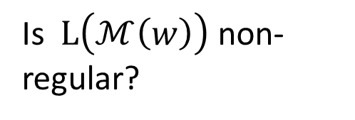
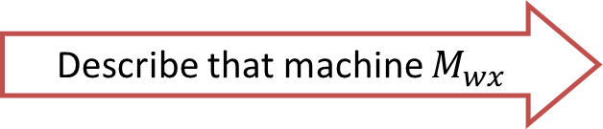

Reduction
$$NonReg$$
$$A$$
$$HALT$$
Describe that machine $M_{wx}$
$$B$$
Is $L\left(ℳ\left(w\right)\right)$ non-regular?
Does $ℳ(w)$ halt on input $x$?
Assume
Give $M_{wx}$ to the $NonReg$ solver, then answer the same
$M_{HALT}$ computes $HALT$
$NonReg$ solver exists
Reduction

Slide 10

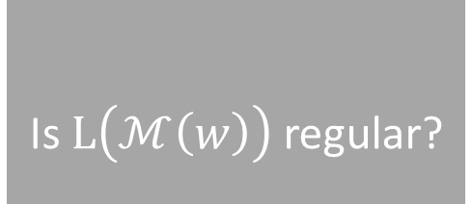
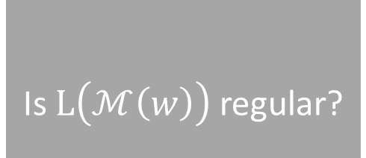


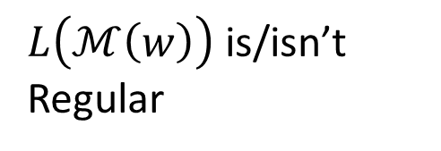
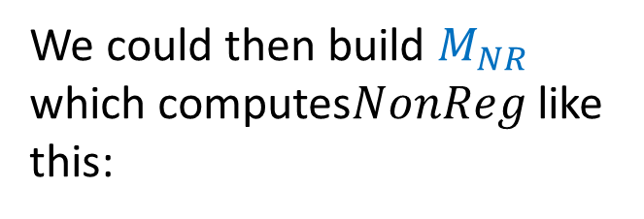
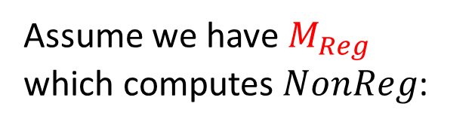

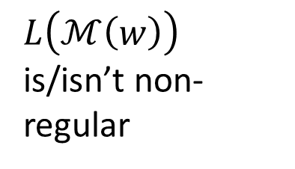

Using $Reg$ to build$NonReg$
Assume we have $M_{Reg}$ which computes $NonReg$:
Is $L\left(ℳ\left(w\right)\right)$ regular?
$$M_{Reg}$$
$L\left(ℳ\left(w\right)\right)$ is/isn’t Regular
$$w$$
We could then build $M_{NR}$ which computes$NonReg$ like this:
$$M_{NR}$$
Is $L\left(ℳ\left(w\right)\right)$ non-regular?
$$w$$
$$M_{Reg}$$
Is $L\left(ℳ\left(w\right)\right)$ regular?
$L\left(ℳ\left(w\right)\right)$ is/isn’t non-regular

Slide 11


Language $Accept101$
$Accept101=\left\{w \right| ℳ\left(w\right)\left(101\right)=1\}$
We will show this is not computable by using$Accept101$ to compute $HALT$

Slide 12
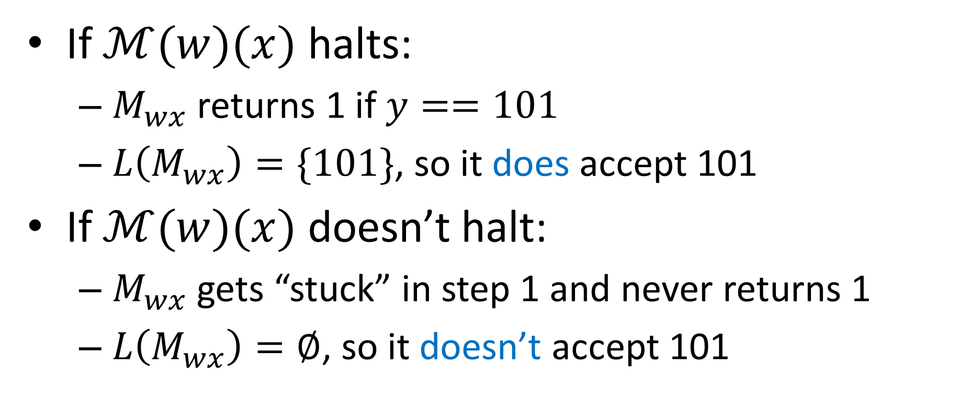

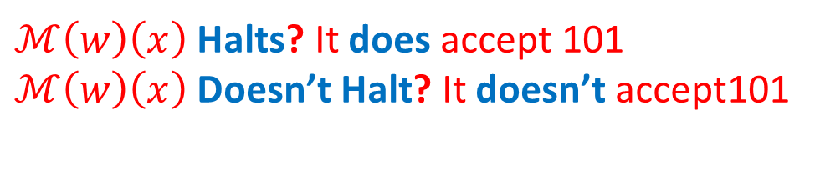

Building $M_{wx}$
$ℳ\left(w\right)\left(x\right)$ Halts? It does accept 101
$ℳ\left(w\right)\left(x\right)$ Doesn’t Halt? It doesn’t accept101
Build this machine:
$M_{wx}(y):$
1) run $ℳ(w)(x)$
2) return $y==101$
If $ℳ(w)(x)$ halts:
$M_{wx}$ returns 1 if $y==101$
$L\left(M_{wx}\right)=\{101\}$, so it does accept 101
If $ℳ(w)(x)$ doesn’t halt:
$M_{wx}$ gets “stuck” in step 1 and never returns 1
$L\left(M_{wx}\right)=∅$, so it doesn’t accept 101

Slide 13
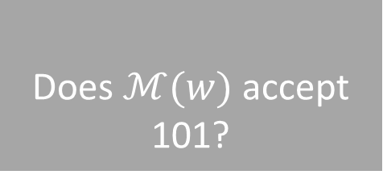


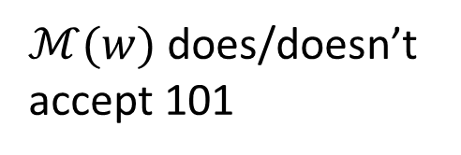
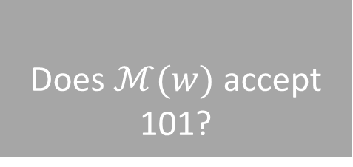
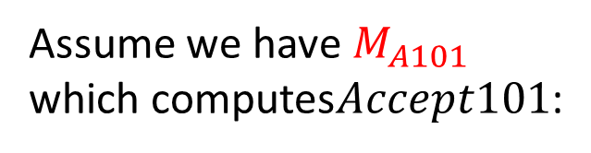


Using $Accept101$ to build $HALT$
Assume we have $M_{A101}$ which computes$Accept101$:
Does $ℳ(w)$ accept 101?
$$M_{A101}$$
$ℳ(w)$ does/doesn’t accept 101
$$w$$
We could then build $M_{HALT}$ which computes $HALT$like this:
$$M_{HALT}$$
Does $ℳ\left(w\right)\left(x\right)$ halt?
$$w$$
Build this machine:
$M_{wx}(y):$
1) run $ℳ(w)(x)$
2) return $y==101$
$$M_{A101}$$
$ℳ(w)(x)$ does/doesn’t halt
Does $ℳ(w)$ accept 101?
$$x$$

Slide 14
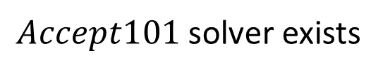




$Accept101$ Reduction
$$Accept101$$
$$A$$
$$HALT$$
Describe that machine $M_{wx}$
$$B$$
Is $101∈L\left(ℳ\left(w\right)\right)$?
Does $ℳ(w)$ halt on input $x$?
Assume
Give $M_{wx}$ to the $Accept101$solver, then answer the same
$M_{HALT}$ computes $HALT$
$Accept101$solver exists
Reduction

Slide 15











Using$Reject101$ to build $Accept101$
Assume we have $M_{R101}$ which computes $Reject$101:
Is $101∉L\left(ℳ\left(w\right)\right)$?
$$M_{R101}$$
101 isn’t/is in $L\left(ℳ\left(w\right)\right)$
$$w$$
We could then build $M_{A101}$ which computes $Accept101$ like this:
$$M_{A101}$$
Is $101∈L\left(ℳ\left(w\right)\right)$?
$$w$$
$$M_{R101}$$
Is $101∉L\left(ℳ\left(w\right)\right)$?
101 is/isn’t in $L\left(ℳ\left(w\right)\right)$

Slide 16











Computability and non-computability closed under complement
If $L$ is computable, then $L^{c}$ is computable
Assume we have $M_{L}$ which computes $L$:
Is $w∈L$?
$$M_{L}$$
$w$ is/isn’t in $L$
$$w$$
We could then build $M_{L^{c}}$ which computes $L^{c}$ like this:
$$M_{L^{c}}$$
Is $w∉L$?
$$w$$
$$M_{L}$$
Is $w∈L$?
$w$ isn’t/is in $L$

Slide 17










Complement Reduction
$$L$$
$$A$$
$$L^{c}$$
Don’t change $w$
$$B$$
$w∈L$?
$w∉L$?
If
Give $w$ to the $L$solver, then answer the opposite
$L^{c}$ solver exists
$L$solver exists
$L$solver doesn’t exist
$L^{c}$ solver doesn’t exist
Reduction

Slide 18

Sematic Property
Turing machines $M, M′$ are Functionally Equivalent if $∀x∈Σ^{∗}$, $M\left(x\right)==M\left(x^{′}\right)$
i.e. they compute the same function/language
A Semantic Property of a Turing machine is one that depends only on the input/output behavior of the machine
Formally, if $P$ is semantic, then for machine $M, M′$ that are functionally equivalent, $P\left(M\right)==P\left(M^{′}\right)$
If $M,M′$ have the same input/output behavior, and $P$ is a semantic property, then either bother $M$ and $M′$ have property $P$, or neither of them do.

Slide 19

Examples
These properties are Semantic:
Is the language of this machine finite?
Is the language of this machine Regular?
Does this machine reject 101?
Does this machine return 1001 for input 001?
Does this machine only ever return odd numbers?
Is the language of this machine computable?
These properties are not Semantic:
Does this machine ever overwrite cell 204 of its tape?
Does this machine use more than 3102 cells of its tape on input 101?
Does this machine take at least 2020 transitions for input $ε$?
Does this machine ever overwrite the $∇$ symbol?

Slide 20


Rice’s Theorem
For any Semantic property $P$ of Turing Machines, either:
Every Turing machine has property $P$
No Turing machines have property $P$
$P$ is uncomputable
In other words:
If $P$ is semantic, and computable, then one of these two machines computes it:
$P$ is “trivial”
Return 1
Return 0

Slide 21



Proof of Rice’s Theorem
Let $P$ be a semantic property of a Turing machine
Assume $M_{∅}$ (a machine whose language is $∅$) doesn’t have property $P$ (otherwise substitute $¬P$, then answer opposite)
Let $M_{P}$ be a machine that does have property $P$
Idea:
If $ℳ(w)(x)$ halts, $L\left(M_{wx}\right)=L\left(M_{has P}\right)$
If $ℳ(w)(x)$ doesn’t halt, $L\left(M_{wx}\right)=L\left(M_{∅}\right)=∅$
$L(M_{wx})$ has property $P$ if and only if $ℳ\left(w\right)\left(x\right)$ halts
Build this machine:
$M_{wx}(y):$
1) run $ℳ(w)(x)$
2) return $M_{has P}(y)$
$ℳ\left(w\right)\left(x\right)$ Halts? It has property $P$
$ℳ\left(w\right)\left(x\right)$ Doesn’t Halt? It doesn’t have property $P$

Slide 22









Using $P$ to build $HALT$
Assume we have $M_{P}$ which computes $P$:
Does $ℳ(w)$ have property $P$?
$$M_{P}$$
$ℳ(w)$ does/doesn’t have property $P$
$$w$$
We could then build $M_{HALT}$ which computes $HALT$like this:
$$M_{HALT}$$
Does $ℳ\left(w\right)\left(x\right)$ halt?
$$w$$
Build this machine:
$M_{wx}(y):$
1) run $ℳ(w)(x)$
2) return $M_{has P}(y)$
$$M_{P}$$
$ℳ(w)$ does/doesn’t have property $P$
Does $ℳ(w)$ have property $P$?
$$x$$

Slide 23



What if $P$ is “trivial”?
If $P$ applies to all Turing machines:
It applies to $M_{∅}$, so we’ll consider $¬P$ which applies to no Turing machines
If $P$ applies to no Turing machines:
$M_{Has P}$ can’t exist
Build this machine:
$M_{wx}(y):$
1) run $ℳ(w)(x)$
2) return $M_{Has P}(y)$

Slide 24

Using Rice’s Theorem
These properties are Semantic:
Is the language of this machine finite?
Is the language of this machine Regular?
Does this machine reject 101?
Does this machine return 1001 for input 001?
Does this machine only ever return odd numbers?
Is the language of this machine computable?
These properties are not Semantic:
Does this machine ever overwrite cell 204 of its tape?
Does this machine use more than 3102 cells of its tape on input 101?
Does this machine take at least 2020 transitions for input $ε$?
Does this machine ever overwrite the $∇$ symbol on input $ε$?

Slide 25


$$Steps2020$$
$Steps2020=\{w|ℳ\left(w\right) takes at least 2020 steps\}$
Is $Steps2020$ computable?

Slide 26


$$Overwrite∇$$
$Overwrite∇=\left\{w \right| ℳ\left(w\right) overwrites ∇ on input ε\}$
Is $Overwrite∇$ computable?

Slide 27
CS3102 Theory of Computation
www.cs.virginia.edu/~njb2b/cstheory/s2020
Warm up:
To measure the “cost” of computing something, what would units should we use?

Slide 28
Units

Slide 29
Computing Cost
What do we actually care about with computing cost?

Slide 30

Notions of function “difficulty”
Can an algorithm for function $f$ be implemented using this computing model?
NAND-CIRC: answer is YES iff $f$ is finite
FSA: answer is YES if function doesn’t require “memory”
TM: Answer is NO for $HALT_{TM},FINITE, …$ (and many other things)
How efficient is an algorithm for function $f$ implemented using this computing model?
NAND-CIRC: How many gates?
FSA: (we never talked about this)
TM: How many transitions are required (time)? How many tape cells are required (space)?

Slide 31

Larger inputs = More time
Run time is not measured by a number, but a function.
Running time: $T\left(n\right)$ is a function mapping naturals to naturals. We say $F:{\left\{0,1\right\}}^{∗}→{\left\{0,1\right\}}^{∗}$ is computable in $T\left(n\right)$ time if there exists a TM $M$ s.t. for every large $n$ and ever input $x∈{\left\{0,1\right\}}^{n}$, $M$ halts after at most $T\left(n\right)$ steps and outputs $F\left(x\right)$.
$TIME\left(T\left(n\right)\right)$ represents the set of boolean functions computable within $T\left(n\right)$ time

Slide 32

Examples
How long will $XOR$ take on a Turing Machine?
We have an even state and an odd state
For each bit, move right, switch states if 1
Halt when you get to end of input
How long will $MAJ$ take on a Turing Machine?
Find a zero, cross it off
Go to beginning
Find a one, cross it off
Go to beginning
Halt when no more 0s or no more 1s

Slide 33



More time gives more functions
$$TIME\left(2^{n}\right)$$
$$TIME\left(n^{3}\right)$$
$$TIME\left(10n\right)$$
$$TIME\left(n\right)$$

Slide 34
Different computing Models may have Different Running Times
So far: a TM uses a tape. Can only visit a neighboring cell from the current one.

Slide 35

1960s
A tape was probably a reasonable memory model

Slide 36

Today
Can look up two locations without visiting all locations between.
“Random” access
(RAM)

Slide 37
RAM Machine
We can go directly to a certain index in the tape
To transition:
Have a second tape to keep track of current location (increment each time we move right, decrement for left)
Have a third tape to record the target location
Move until the two tapes match
Maybe we need another tape to do this?
(details not important, but if you want them, see 7.2 in text)
Important observation: Tape-machine takes more steps than a RAM machine (if a RAM-TM computes $f$ in $T(n)$ time, a tape TM can compute $f$ in ${\left(T\left(n\right)\right)}^{4}$ time, see theorem 12.5 for details)

Slide 38
Finding Running Times
We will find running times for the following:
Shortest Path in a graph
Longest Path in a graph
3SAT
2SAT

Slide 39
Graphs
Vertices/Nodes
Definition: $G=(V,E)$
$w\left(e\right)=$ weight of edge $e$
Edges
8
B
E
$$V=\{A,B,C,D,E,F,G,H,I\}$$
10
8
$$E=\{\left(A,B\right),\left(A,C\right),\left(B,C\right),…\}$$
7
H
A
2
9
D
5
9
I
12
3
C
3
11
G
1
F
6

Slide 40

Adjacency List Representation
A
B
C
B
8
B
A
C
E
10
E
8
7
H
C
A
B
D
F
A
9
2
D
5
9
I
D
C
E
F
12
3
C
3
E
B
D
G
H
11
G
1
F
6
F
C
D
G
Tradeoffs
Space:
Time to list neighbors:
Time to check edge $(A,B)$:
G
E
F
H
I
$$V+E$$
H
E
G
I
$$Degree(A)$$
$$Degree(A)$$
I
G
H

Slide 41

Adjacency Matrix Representation
B
8
A
B
C
D
E
F
G
H
I
10
E
8
A
1
1
7
H
B
1
1
1
A
9
2
D
5
C
1
1
1
1
9
I
D
1
1
1
12
3
E
1
1
1
1
C
3
F
1
1
1
11
G
1
1
1
1
G
1
F
6
H
1
1
1
I
1
1
Tradeoffs
Space:
Time to list neighbors:
Time to check edge $(A,B)$:
$$V^{2}$$
$$V$$
$$O(1)$$

Slide 42

Definition: Path
A sequence of nodes $(v_{1},v_{2},…, v_{k})$
s.t. $∀1≤i≤k−1$, $\left(v_{i},v_{i+1}\right)∈E$
B
8
10
E
8
7
H
A
9
2
D
5
9
I
12
3
C
3
11
G
1
F
6
Simple Path:
A path in which each node appears at most once
Cycle:
A path of $>2$ nodes in which $v_{1}=v_{k}$

Slide 43
Shortest Path
Given an unweighted graph, start node $s$ and an end node $t$, how long is shortest path from $s$ to $t$?
B
E
H
A
D
I
Shortest path from A to E
has length 2
C
G
F

Slide 44
Breadth First Search
Find a path from $s$ to $t$
Keep a queue $Q$ of nodes
$hops=0$
$Q.enqueue((s, hops))$
While $Q$ is not empty and $v !=t$:
$v,hops=Q.dequeue()$
for each “unvisited” $u∈V$ s.t. $\left(v,u\right)∈E$:
$Q.enqueue((u, hops+1))$
Running time: $O\left(\left|V\right|+\left|E\right|\right)$

Slide 45

Longest Path
Given a start node $s$ and an end node $t$, how long is longest path from $s$ to $t$?

Slide 46

Longest Path
Enumerate all possible sequences of nodes check if it’s a path print the length of the longest one
Running time: $n!$

