Slide 1
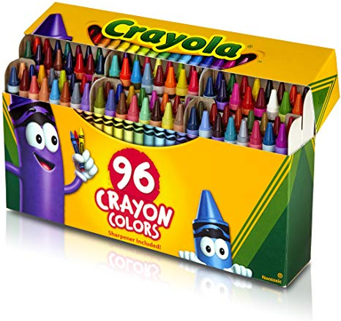
CS3102 Theory of Computation
www.cs.virginia.edu/~njb2b/cstheory/s2020
Warm up:
What are examples of ways to implement functions?
What properties should implementations have?

Slide 2
Logistics
TA Office hours starting this week (see webpage soon for when/where)
Course registration survey was due Thursday
Didn’t complete it? No problem! Just do it soon
Exercise 0_2 due today
Didn’t complete it? No problem (this time)! Just request an extension
Exercise 0_3 due Thursday
Pick one of python/java
Decided to enroll late and need to catch up? No problem! Just request an extension if you can’t get it in on time
Exercise due/release dates will be more “batched” going forward, staggered this time to test out the submission system
First Quiz
Released Friday, due Tuesday

Slide 3
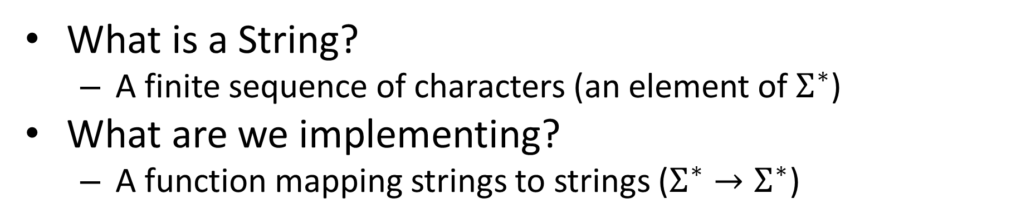
Last Class
Implementation (according to a computing model)
Output
String
Input
String
What is a String?
A finite sequence of characters (an element of $Σ^{∗}$)
What are we implementing?
A function mapping strings to strings ($Σ^{∗}→Σ^{∗}$)

Slide 4
Computing a Function
Implementation (according to a computing model)
Output
String
Input
String
To define a computing model (which will implement functions):
Define how to receive an input
Define how to produce an output
Define the steps taken to convert input into output

Slide 5
Implementing a Function
Examples of ways to implement a function:
Properties we want of implementations:

Slide 6
Are all functions computable?
How could we approach this question?

Slide 7
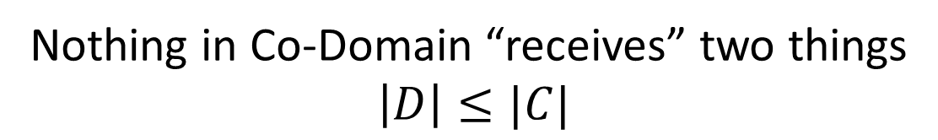
1-1, Injective Functions
Domain
Co-Domain
Domain
Co-Domain
INJECTIVE FUNCTION
NON-INJECTIVE FUNCTION
Nothing in Co-Domain “receives” two things
$$\left|D\right|≤|C|$$

Slide 8
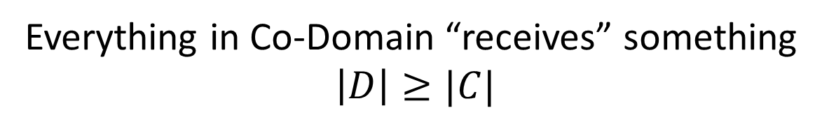
Onto, Surjective Functions
Domain
Co-Domain
Domain
Co-Domain
SURJECTIVE FUNCTION
NON-SURJECTIVE FUNCTION
Everything in Co-Domain “receives” something
$$\left|D\right|≥|C|$$

Slide 9
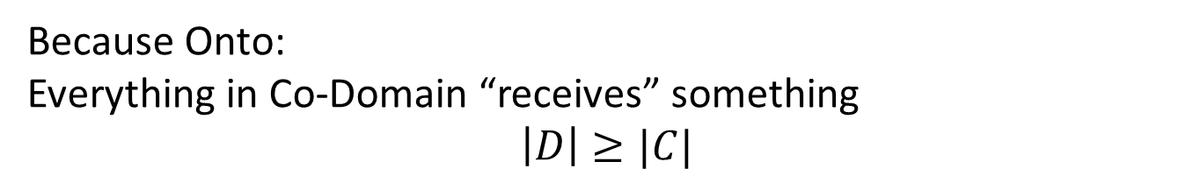
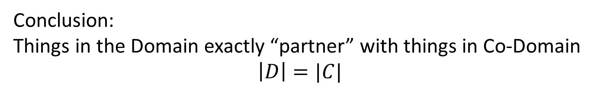
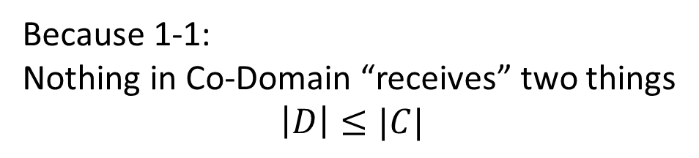
Bijective Functions
Domain
Co-Domain
Because Onto:
Everything in Co-Domain “receives” something
$$\left|D\right|≥|C|$$
BIJECTIVE FUNCTION
Because 1-1:
Nothing in Co-Domain “receives” two things
$$\left|D\right|≤|C|$$
Conclusion:
Things in the Domain exactly “partner” with things in Co-Domain
$$\left|D\right|=|C|$$

Slide 10
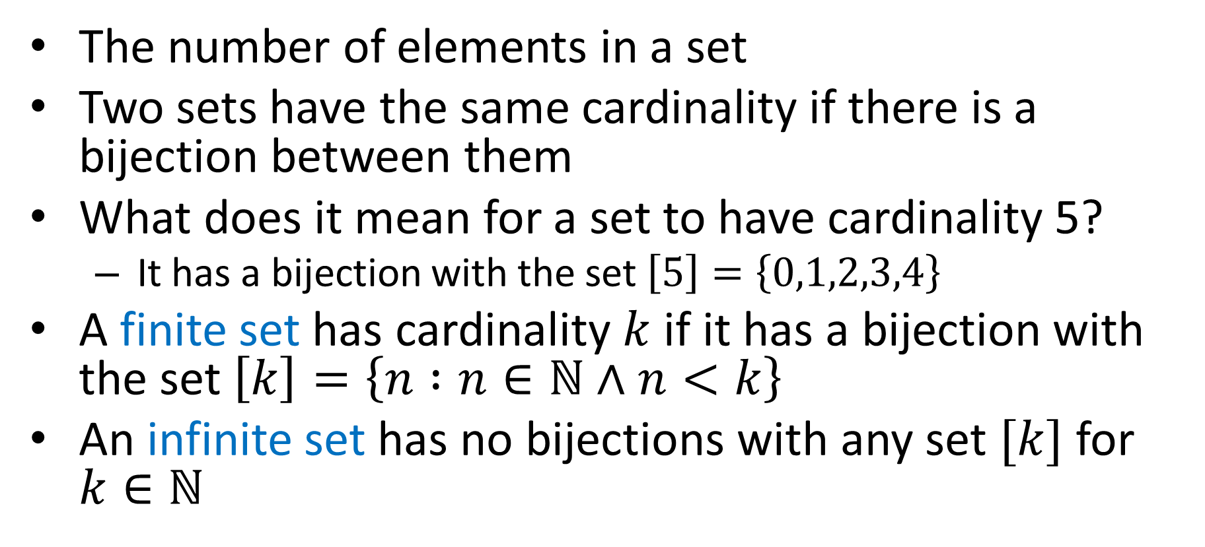
Cardinality
The number of elements in a set
Two sets have the same cardinality if there is a bijection between them
What does it mean for a set to have cardinality 5?
It has a bijection with the set $\left[5\right]=\left\{0,1,2,3,4\right\}$
A finite set has cardinality $k$ if it has a bijection with the set $\left[k\right]=\left\{n :n∈\text{ℕ}∧n<k\right\}$
An infinite set has no bijections with any set $[k]$ for $k∈\text{ℕ}$

Slide 11
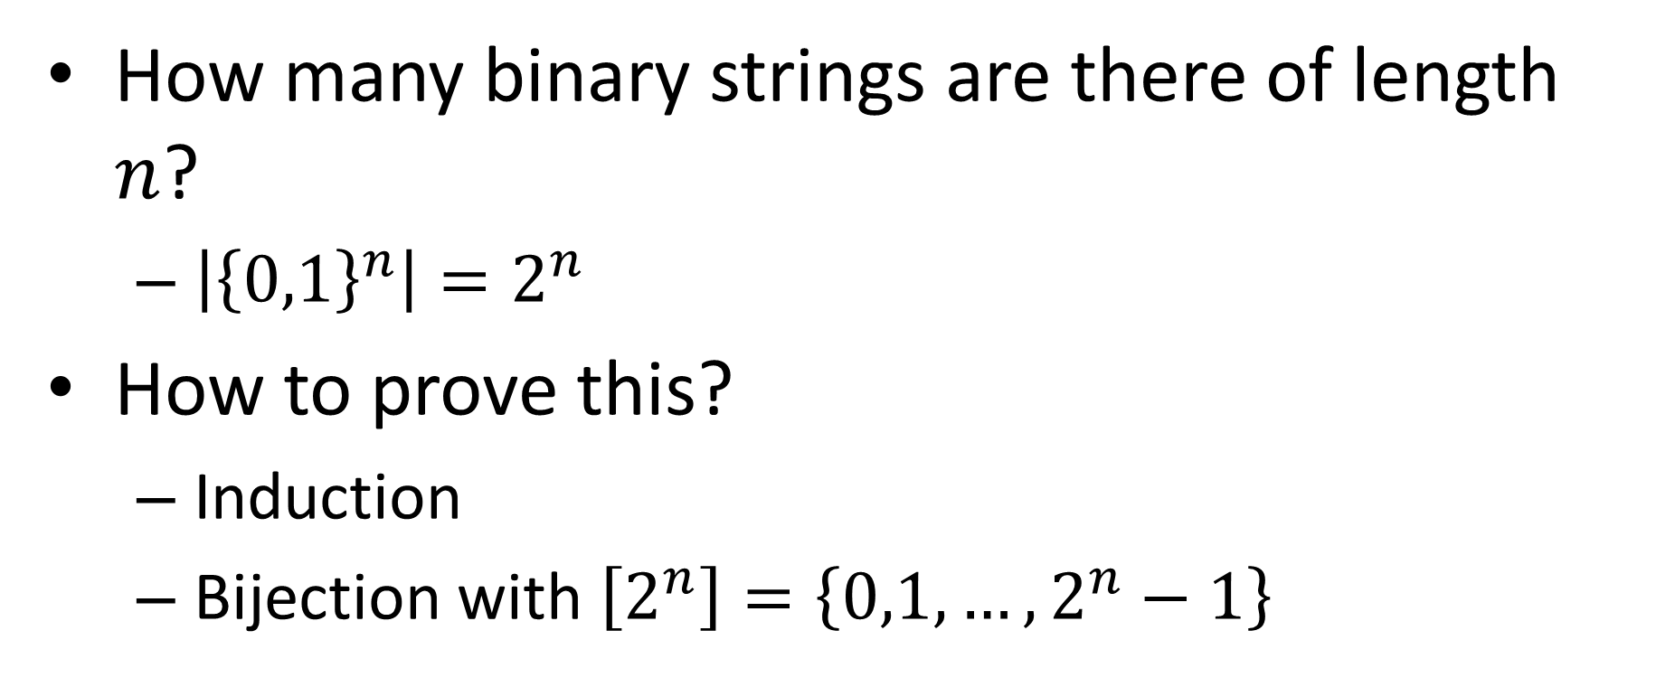
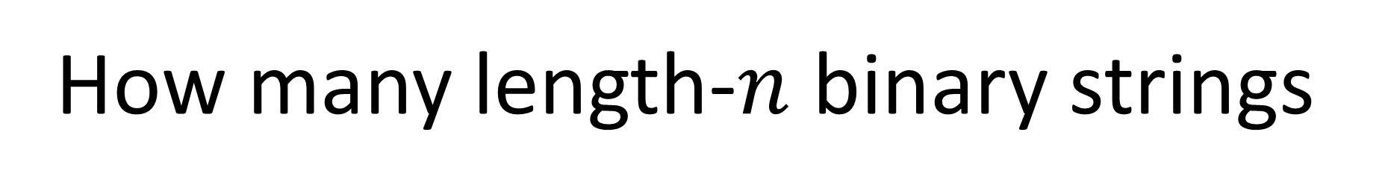
How many length-$n$ binary strings
How many binary strings are there of length $n$?
$\left|{\left\{0,1\right\}}^{n}\right|=2^{n}$
How to prove this?
Induction
Bijection with $\left[2^{n}\right]=\left\{0,1,…,2^{n}−1\right\}$
“”
0
1
00
01
10
11

Slide 12
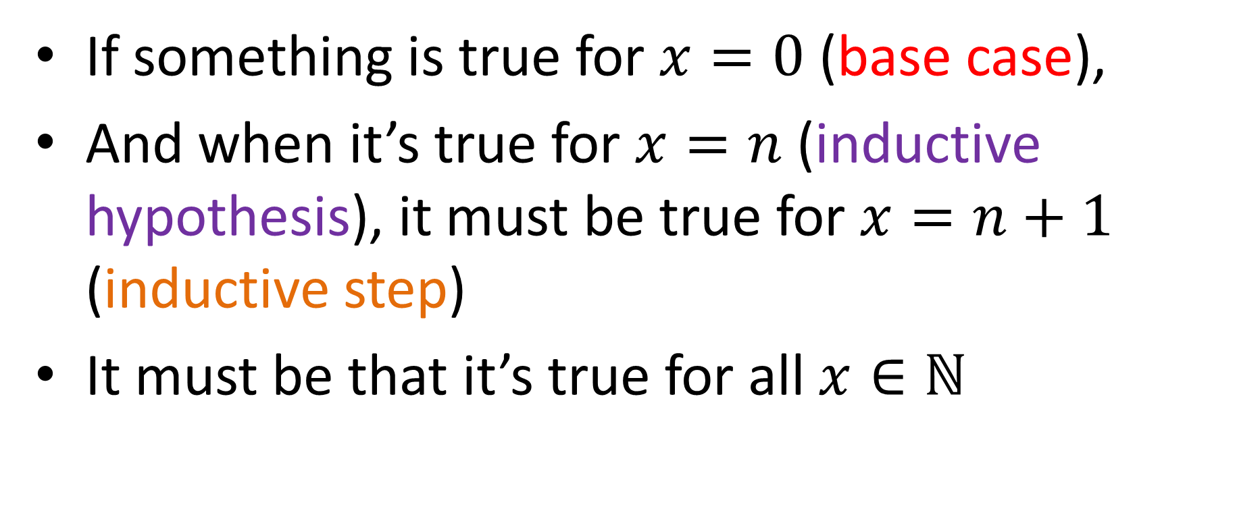
Principle of Induction
If something is true for $x=0$ (base case),
And when it’s true for $x=n$ (inductive hypothesis), it must be true for $x=n+1$ (inductive step)
It must be that it’s true for all $x∈\text{ℕ}$

Slide 13
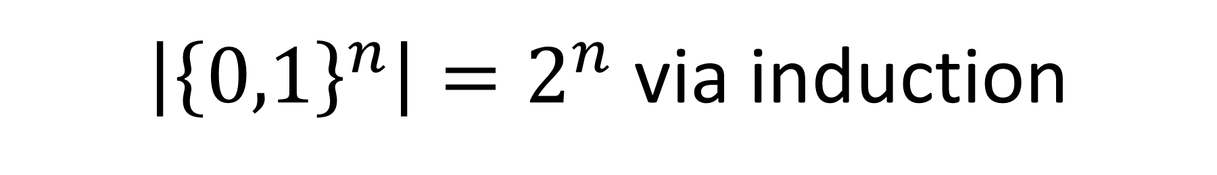
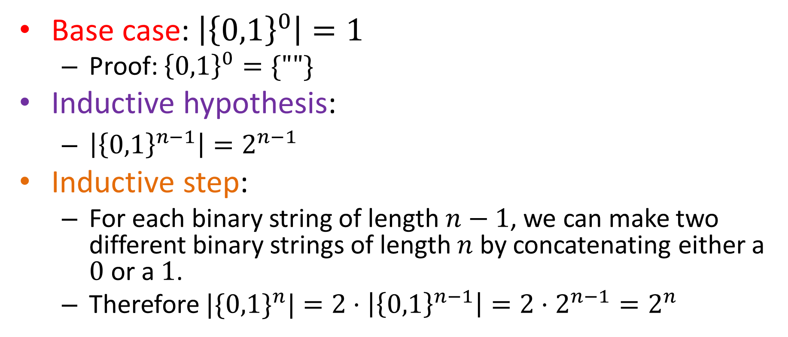
$\left|{\left\{0,1\right\}}^{n}\right|=2^{n}$ via induction
Base case: $\left|{\left\{0,1\right\}}^{0}\right|=1$
Proof: ${\left\{0,1\right\}}^{0}=\{""\}$
Inductive hypothesis:
$\left|{\left\{0,1\right\}}^{n−1}\right|=2^{n−1}$
Inductive step:
For each binary string of length $n−1$, we can make two different binary strings of length $n$ by concatenating either a $0$ or a $1$.
Therefore ${|\{0,1\}}^{n}|=2⋅\left|{\left\{0,1\right\}}^{n−1}\right|=2⋅2^{n−1}=2^{n}$
“”
0
1
00
01
10
11

Slide 14
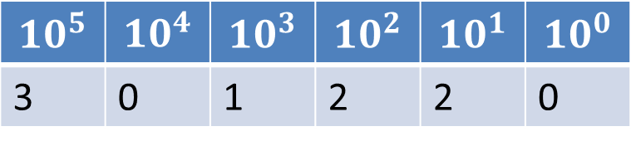

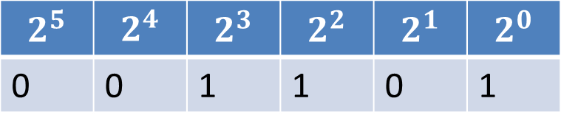
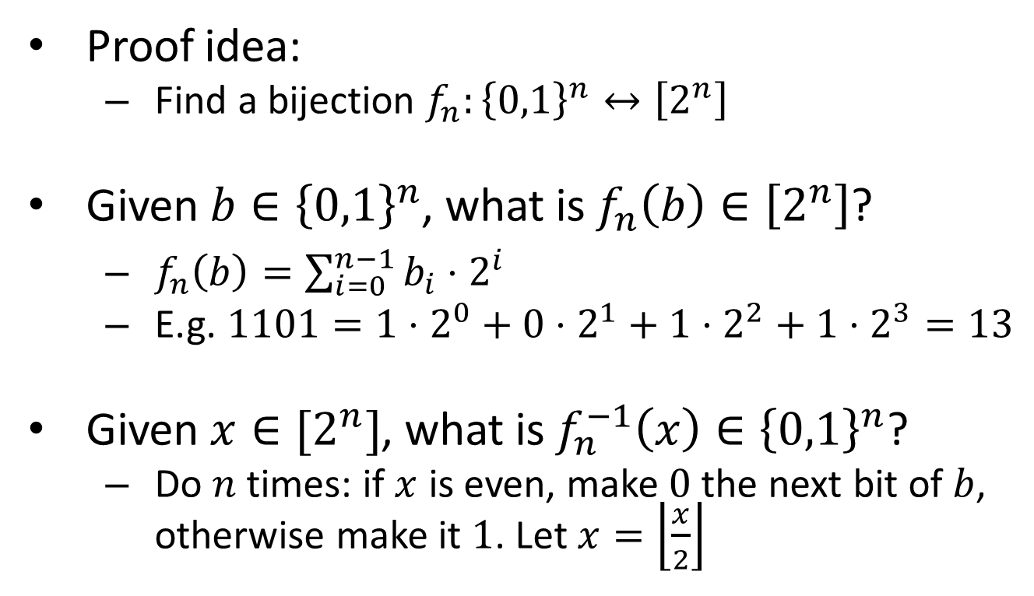
$\left|{\left\{0,1\right\}}^{n}\right|=2^{n}$ via bijection
Proof idea:
Find a bijection $f_{n}:{\left\{0,1\right\}}^{n}↔\left[2^{n}\right]$
Given $b∈{\left\{0,1\right\}}^{n}$, what is $f_{n}\left(b\right)∈\left[2^{n}\right]$?
$f_{n}\left(b\right)=\sum_{i=0}^{n−1}{{b_{i}⋅2}^{i}}$
E.g. $1101=1⋅2^{0}+0⋅2^{1}+1⋅2^{2}+1⋅2^{3}=13$
Given $x∈[2^{n}]$, what is $f_{n}^{−1}\left(x\right)∈{\left\{0,1\right\}}^{n}$?
Do $n$ times: if $x$ is even, make $0$ the next bit of $b$, otherwise make it $1$. Let $x=\left\lfloor \frac{x}{2}\right\rfloor$
$$10^{5}$$ | $$10^{4}$$ | $$10^{3}$$ | $$10^{2}$$ | $$10^{1}$$ | $$10^{0}$$
3 | 0 | 1 | 2 | 2 | 0
$$2^{5}$$ | $$2^{4}$$ | $$2^{3}$$ | $$2^{2}$$ | $$2^{1}$$ | $$2^{0}$$
0 | 0 | 1 | 1 | 0 | 1

Slide 15


Calculating binary of 13
$13$ is odd, so last bit is $1$
$x=\left\lfloor \frac{13}{2}\right\rfloor =6$
6 is even, so next bit is $0$
$x=\left\lfloor \frac{6}{2}\right\rfloor =3$
3 is odd, so next bit is 1
$x=\left\lfloor \frac{3}{2}\right\rfloor =1$
1 is odd, so next bit is 1
$$b=$$
1
1
0
1

Slide 16
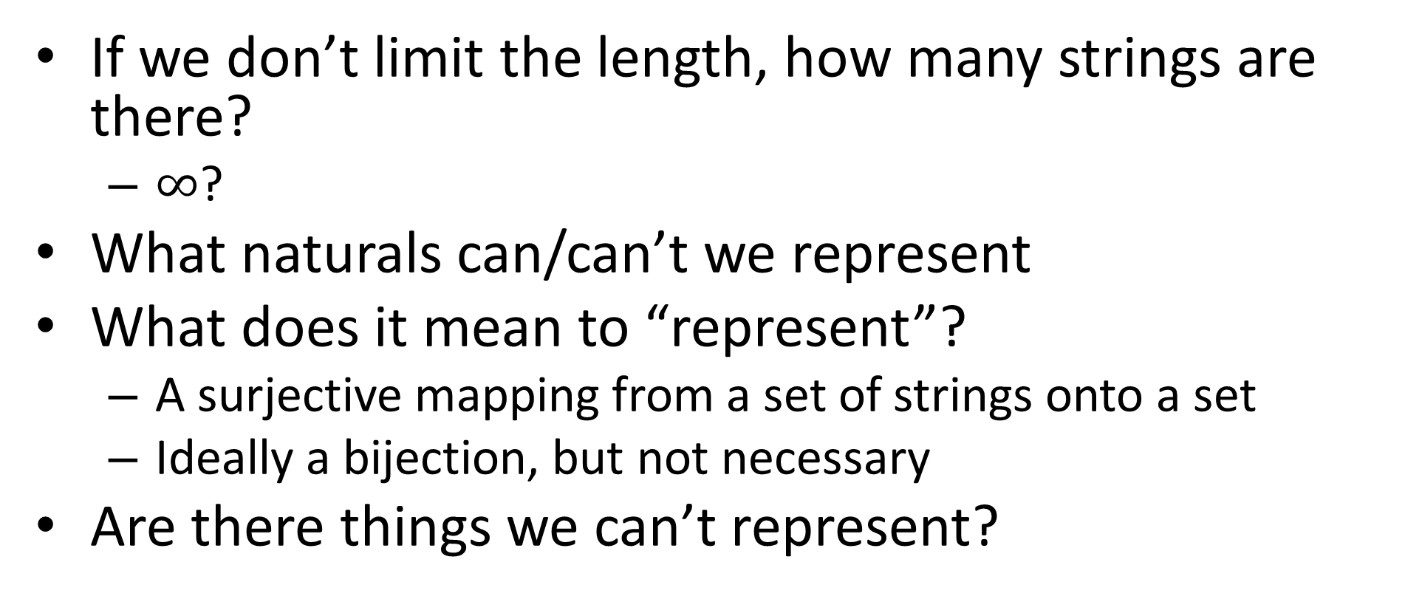
How many binary strings of any length?
If we don’t limit the length, how many strings are there?
$∞$?
What naturals can/can’t we represent
What does it mean to “represent”?
A surjective mapping from a set of strings onto a set
Ideally a bijection, but not necessary
Are there things we can’t represent?

Slide 17
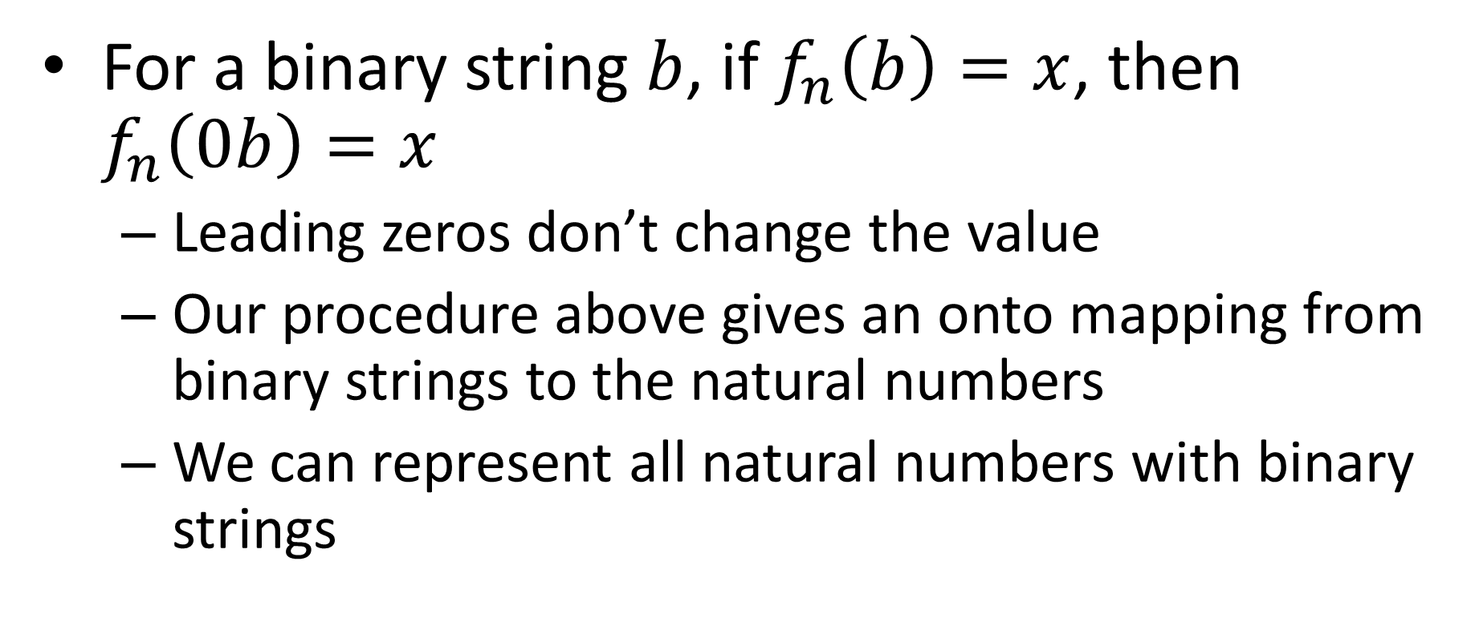
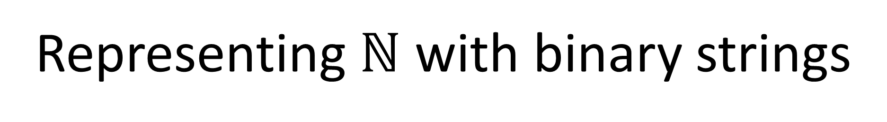
Representing $\text{ℕ}$ with binary strings
For a binary string $b$, if $f_{n}\left(b\right)=x$, then $f_{n}\left(0b\right)=x$
Leading zeros don’t change the value
Our procedure above gives an onto mapping from binary strings to the natural numbers
We can represent all natural numbers with binary strings

Slide 18
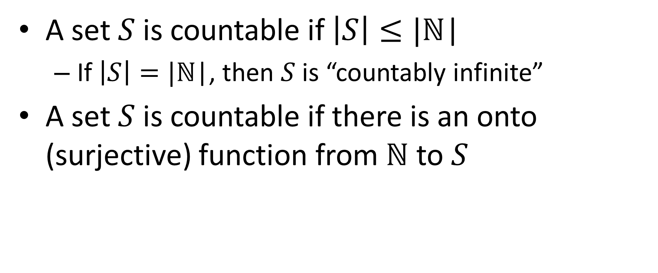
Countablility and Uncountability
A set $S$ is countable if $\left|S\right|≤|\text{ℕ}\text{|}$
If $\left|S\right|=|\text{ℕ}\text{|}$, then $S$ is “countably infinite”
A set $S$ is countable if there is an onto (surjective) function from $\text{ℕ}$ to $S$

Slide 19
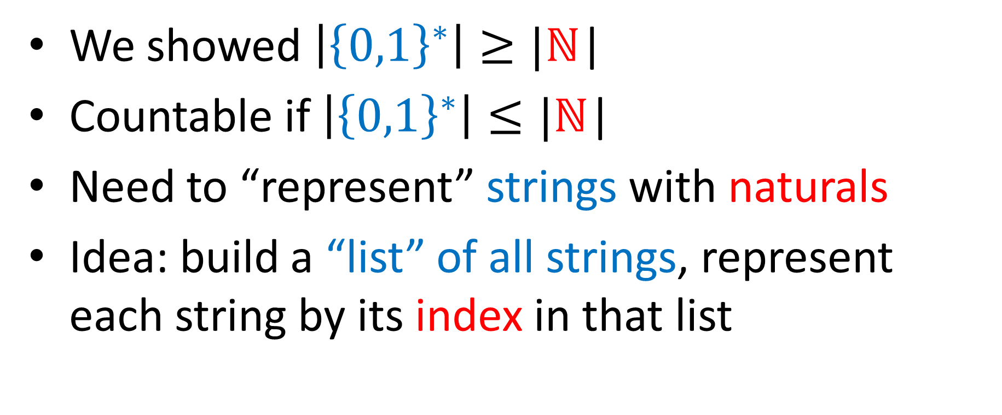

${\left\{0,1\right\}}^{∗}$ is countable
We showed $\left|{\left\{0,1\right\}}^{∗}\right|≥|\text{ℕ}\text{|}$
Countable if $\left|{\left\{0,1\right\}}^{∗}\right|≤|\text{ℕ}\text{|}$
Need to “represent” strings with naturals
Idea: build a “list” of all strings, represent each string by its index in that list

Slide 20
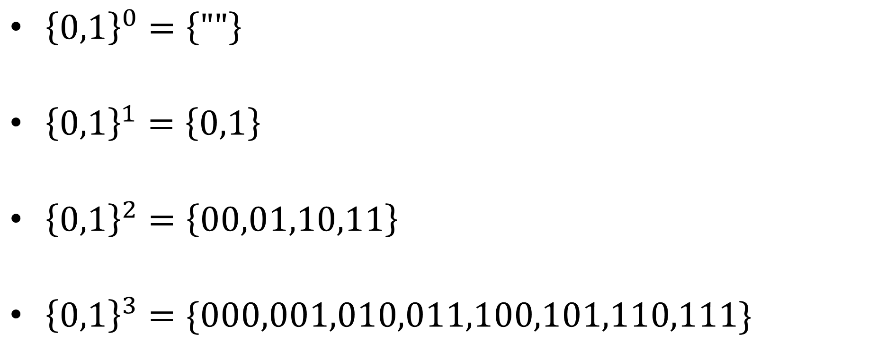
Listing all strings
${\left\{0,1\right\}}^{0}=\left\{""\right\}$
${\left\{0,1\right\}}^{1}=\left\{0,1\right\}$
${\left\{0,1\right\}}^{2}=\left\{00,01,10,11\right\}$
${\left\{0,1\right\}}^{3}=\{000,001,010,011,100,101,110,111\}$
0
1
2
3
4
5
6
7
8
9
10
11
12
13
14

Slide 21
How Many Python/Java programs?
How do we represent Java/Python programs?
How many things can we represent using that method?

Slide 22
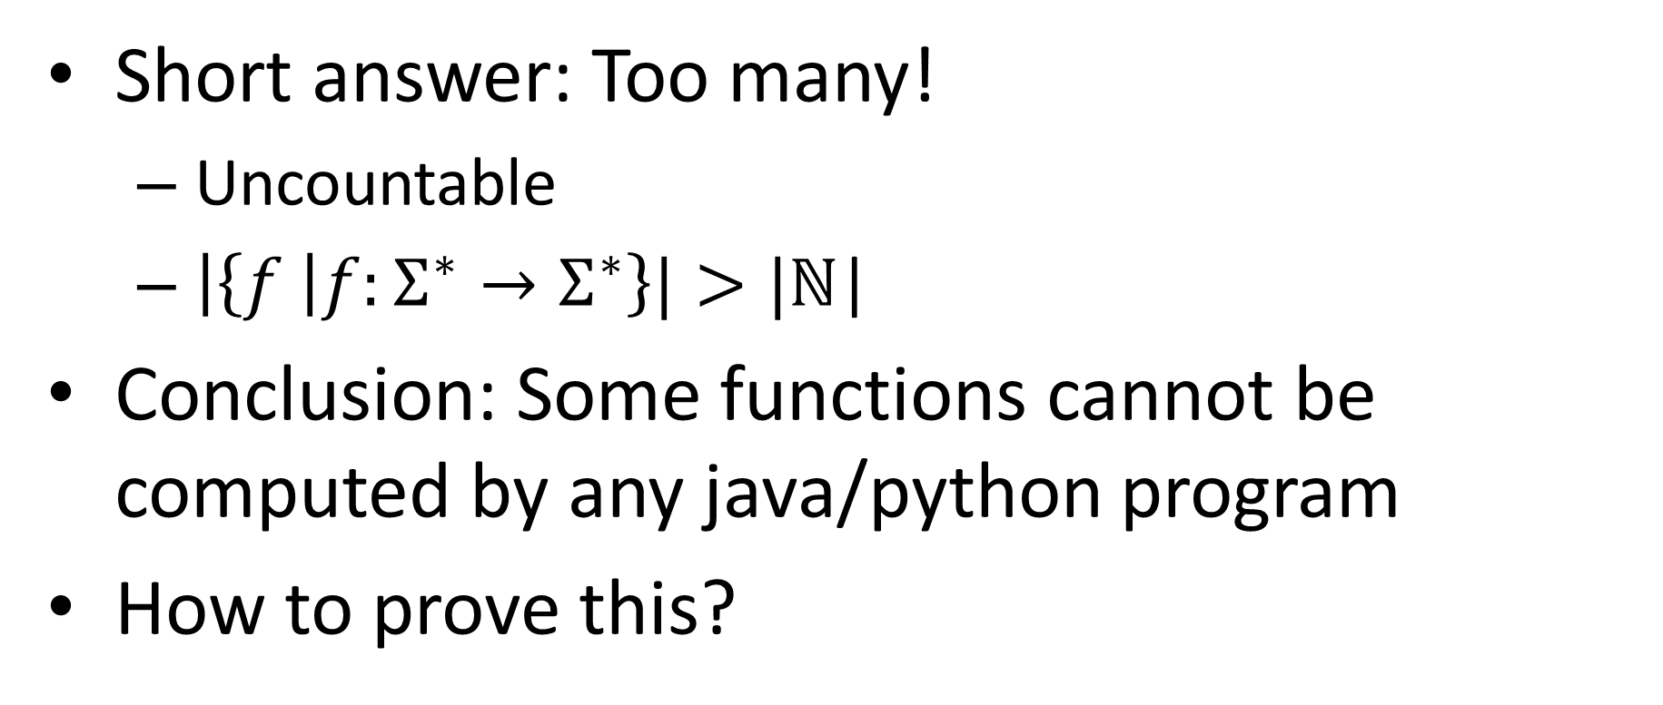
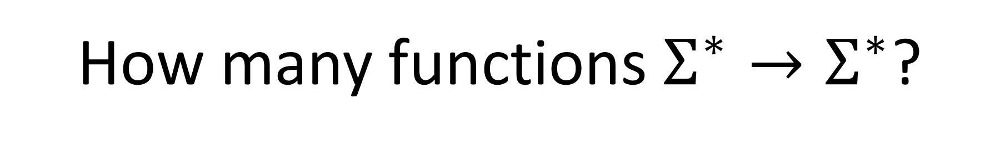
How many functions $Σ^{∗}→Σ^{∗}$?
Short answer: Too many!
Uncountable
$\left|\left\{f \right|f:Σ^{∗}→Σ^{∗}\right\}|>|\text{ℕ}\text{|}$
Conclusion: Some functions cannot be computed by any java/python program
How to prove this?

Slide 23
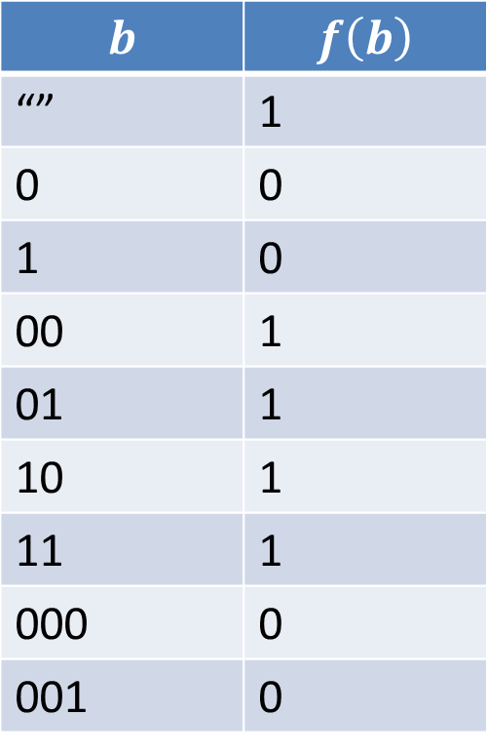
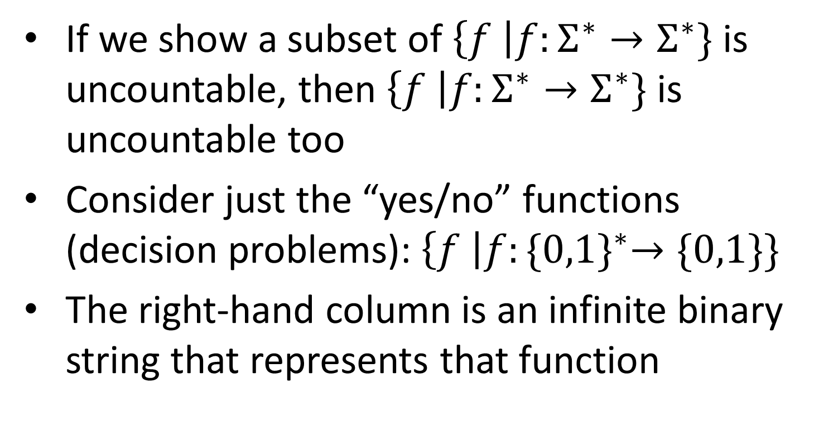
Uncountably many functions
$$b$$ | $$f\left(b\right)$$
“” | 1
0 | 0
1 | 0
00 | 1
01 | 1
10 | 1
11 | 1
000 | 0
001 | 0
If we show a subset of $\left\{f \right|f:Σ^{∗}→Σ^{∗}\}$is uncountable, then $\left\{f \right|f:Σ^{∗}→Σ^{∗}\}$ is uncountable too
Consider just the “yes/no” functions (decision problems): $\left\{f \right|f:{\{0,1\}}^{∗}→\{0,1\}\}$
The right-hand column is an infinite binary string that represents that function

Slide 24

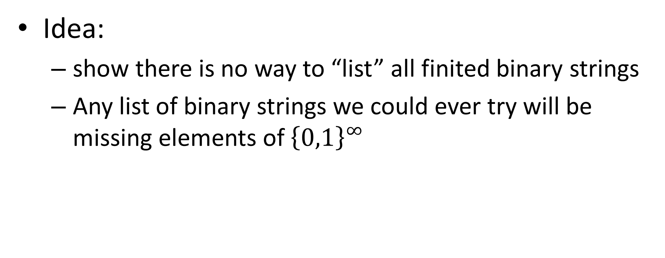

$$\left|{\left\{0,1\right\}}^{∞}\right|>|\text{ℕ}\text{|}$$
Idea:
show there is no way to “list” all finited binary strings
Any list of binary strings we could ever try will be missing elements of ${\left\{0,1\right\}}^{∞}$

Slide 25
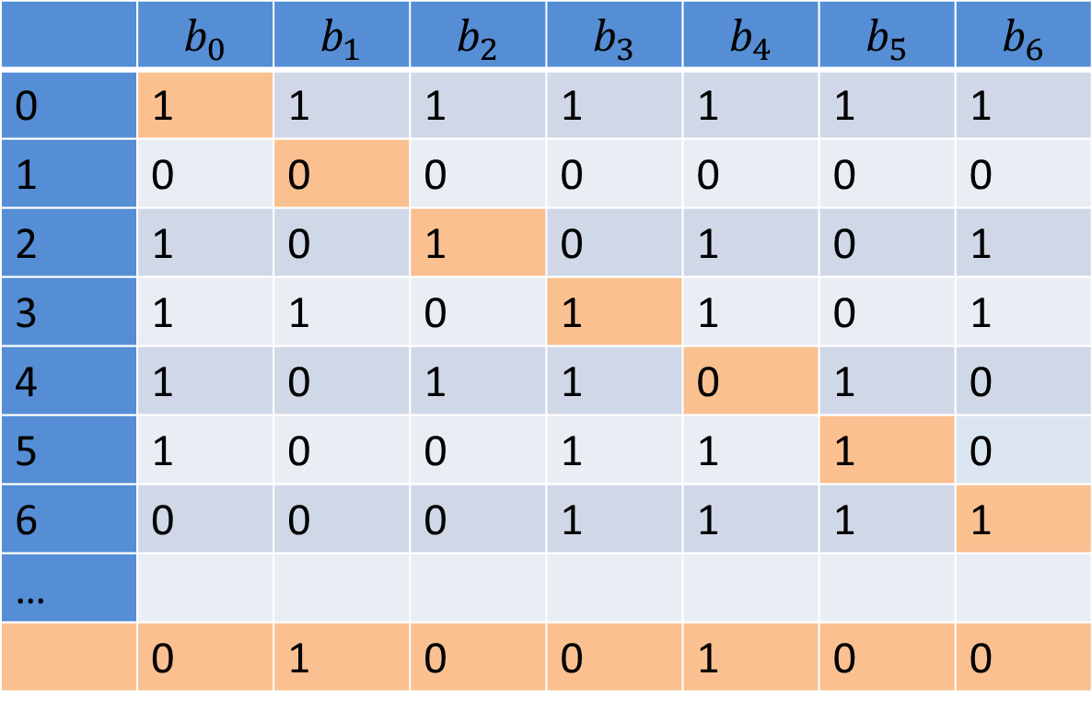

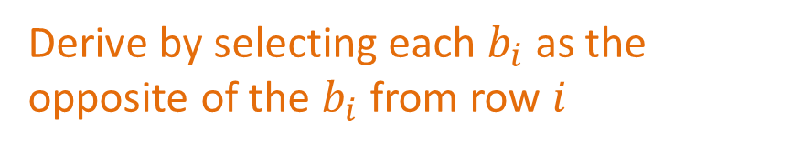
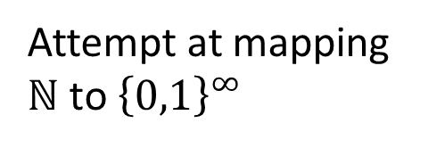
$$\left|{\left\{0,1\right\}}^{∞}\right|>|\text{ℕ}\text{|}$$
 | $$b_{0}$$ | $$b_{1}$$ | $$b_{2}$$ | $$b_{3}$$ | $$b_{4}$$ | $$b_{5}$$ | $$b_{6}$$
0 | 1 | 1 | 1 | 1 | 1 | 1 | 1
1 | 0 | 0 | 0 | 0 | 0 | 0 | 0
2 | 1 | 0 | 1 | 0 | 1 | 0 | 1
3 | 1 | 1 | 0 | 1 | 1 | 0 | 1
4 | 1 | 0 | 1 | 1 | 0 | 1 | 0
5 | 1 | 0 | 0 | 1 | 1 | 1 | 0
6 | 0 | 0 | 0 | 1 | 1 | 1 | 1
…
 | 0 | 1 | 0 | 0 | 1 | 0 | 0
Attempt at mapping $\text{ℕ}$ to ${\left\{0,1\right\}}^{∞}$
A string that our attempt missed
Derive by selecting each $b_{i}$ as the opposite of the $b_{i}$ from row $i$

Slide 26
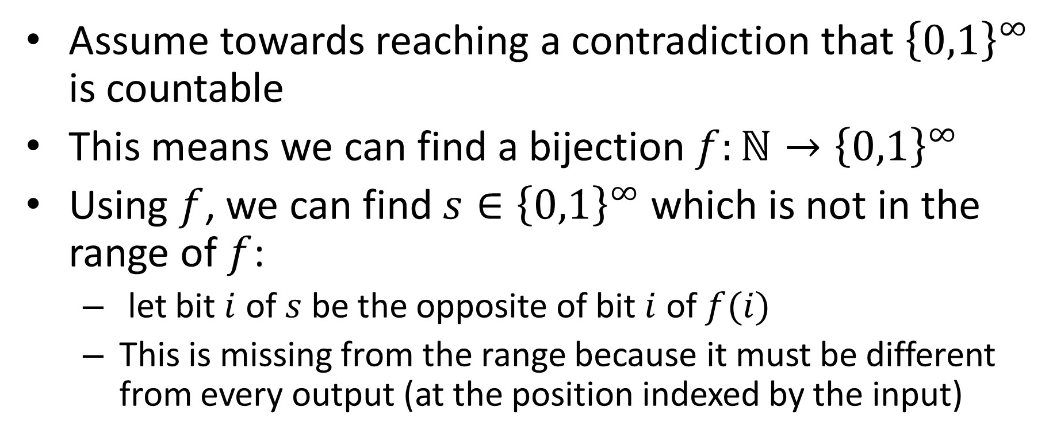
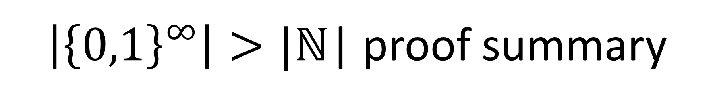
$\left|{\left\{0,1\right\}}^{∞}\right|>|\text{ℕ}\text{|}$ proof summary
Assume towards reaching a contradiction that ${\left\{0,1\right\}}^{∞}$ is countable
This means we can find a bijection $f:\text{ℕ}→{\left\{0,1\right\}}^{∞}$
Using $f$, we can find $s∈{\left\{0,1\right\}}^{∞}$ which is not in the range of $f$:
let bit $i$ of $s$ be the opposite of bit $i$ of $f(i)$
This is missing from the range because it must be different from every output (at the position indexed by the input)

Slide 27
Conclusion
There are countably many strings
And therefore binary strings, programs, etc.
We can’t write down (or compute) all things from an uncountable set
There are uncountably many functions
Some functions can’t be implemented

Slide 28
Other countable/uncountable sets
Countable sets:
Integers
Rational numbers
Uncountable Sets:
Real numbers

Slide 29
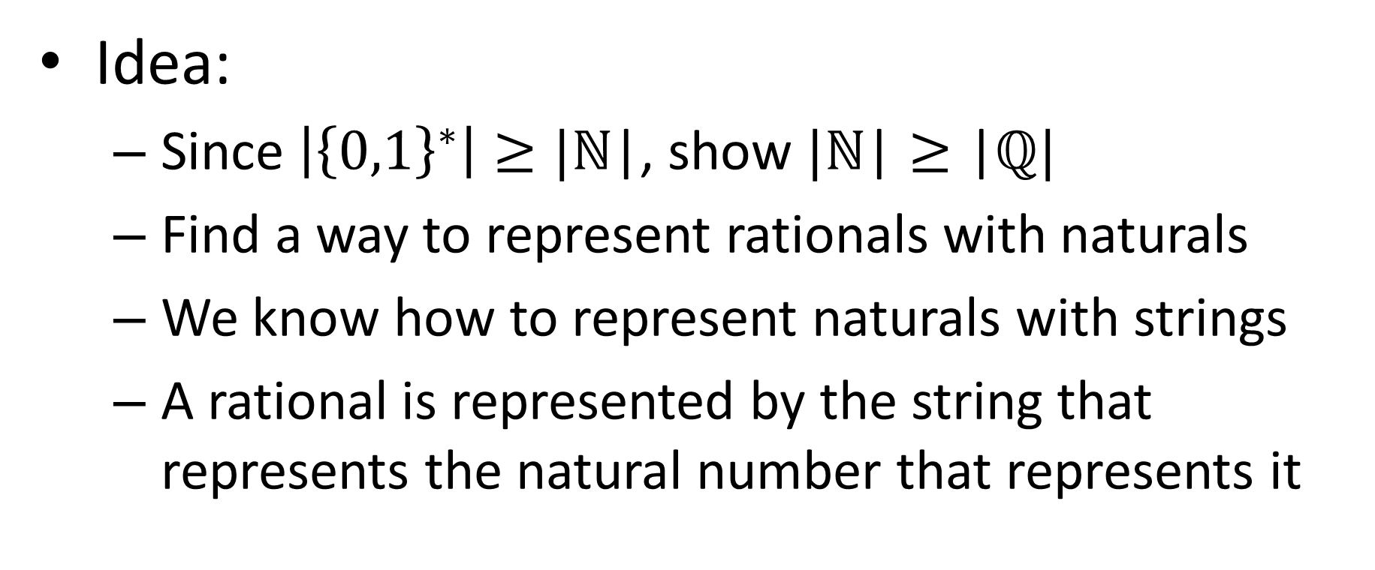
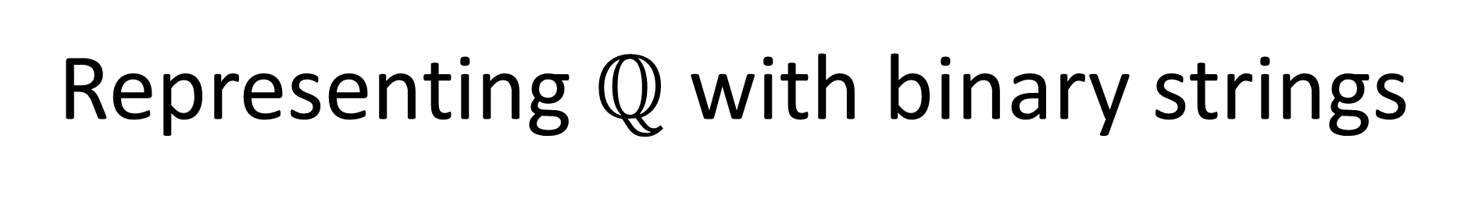
Representing $ℚ$ with binary strings
Idea:
Since $\left|{\left\{0,1\right\}}^{∗}\right|≥|\text{ℕ}\text{|}$, show $|\text{ℕ}\text{|}≥\text{|}ℚ|$
Find a way to represent rationals with naturals
We know how to represent naturals with strings
A rational is represented by the string that represents the natural number that represents it

Slide 30



Representing $ℚ$ with $\text{ℕ}$
$$ℕ$$
0 1 2 3 4 5
$$ℕ$$
0
0/0 0/1 0/2 0/3 0/4 0/5
…
1
1/0 1/1 1/2 1/3 1/4 1/5
…
2
2/0 2/1 2/2 2/3 2/4 2/5
…
3
3/0 3/1 3/2 3/3 3/4 3/5
…
4
4/0 4/1 4/2 4/3 4/4 4/5
…
…
…
…
…
…
…
…

Slide 31

$ℝ$ is uncountable
Show a subset of real numbers is uncountable
Specifically, the set of all real numbers between 0 and 1 where the fractional portion is only 1s and 0s
E.g. 0.00111101101111
We get different reals for each different fractional part, there are the same number of fractional parts as there are infinite strings

Slide 32

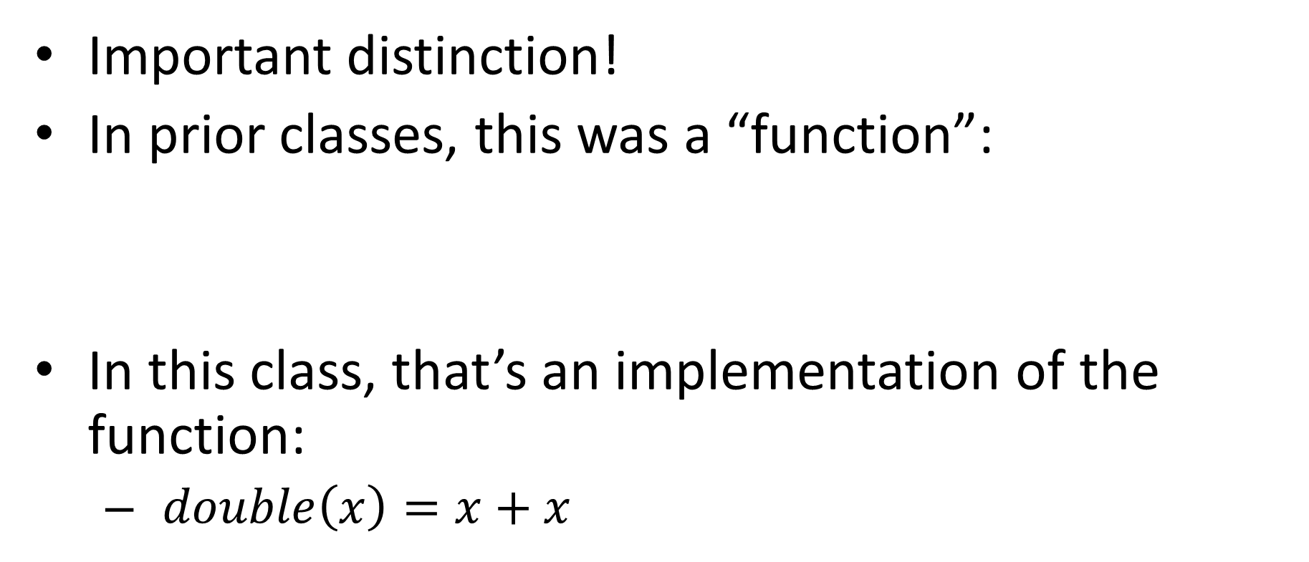
Function vs. Implementation
Important distinction!
In prior classes, this was a “function”:
In this class, that’s an implementation of the function:
$double\left(x\right)=x+x$

Slide 33
Languages

