Slide 1
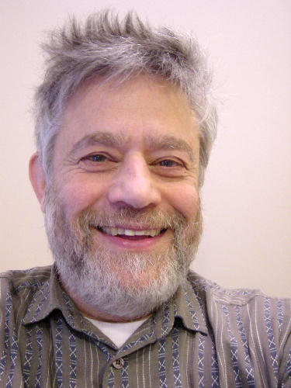
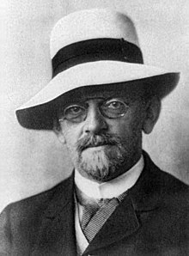
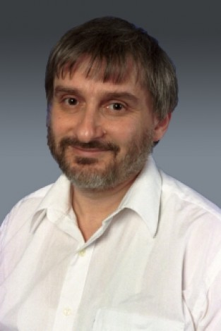
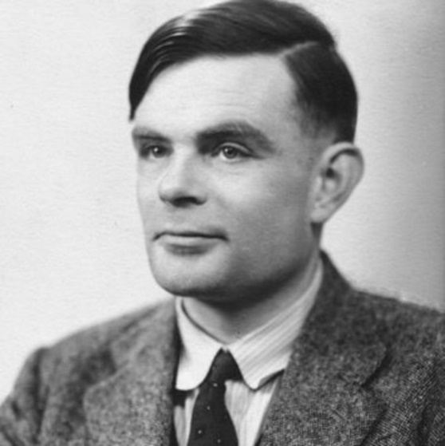
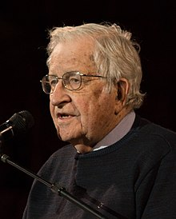
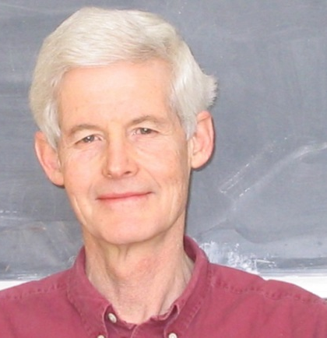
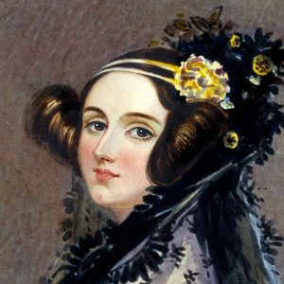
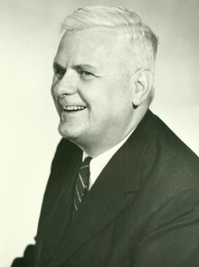
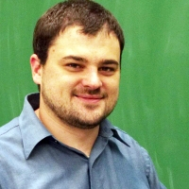
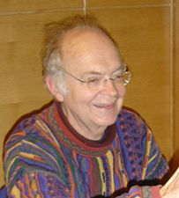
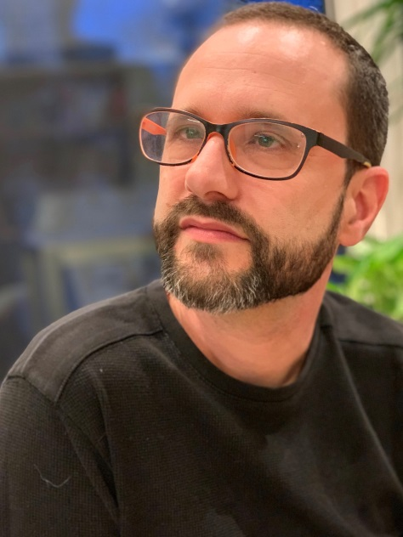
CS3102 Theory of Computation
www.cs.virginia.edu/~njb2b/cstheory/s2020

Slide 2
CS3102 Theory of Computation
www.cs.virginia.edu/~njb2b/cstheory/s2020
David Hilbert
Manuel Blum
Leonid Levin
Alan Turing
Noam Chomsky
Stephen Cook
Nate Brunelle
Alonzo Church
Donald Knuth
Boaz Barak
Ada Lovelace

Slide 3
Why Study Theory?
Foundational knowledge of the field
A way to clearly communicate ideas
Develop a general “computational thinking”
What is or isn’t attainable
Connect CS with other disciplines
Gives a framework for considering questions

Slide 4
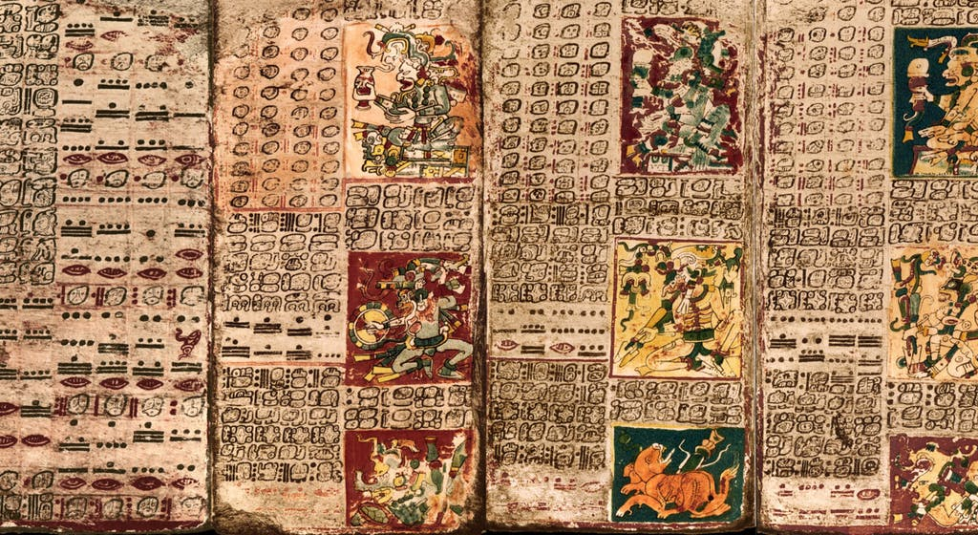
Consider a Mayan Astronomer

Slide 5
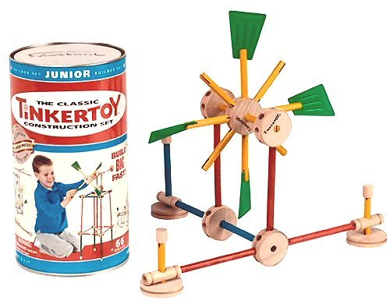
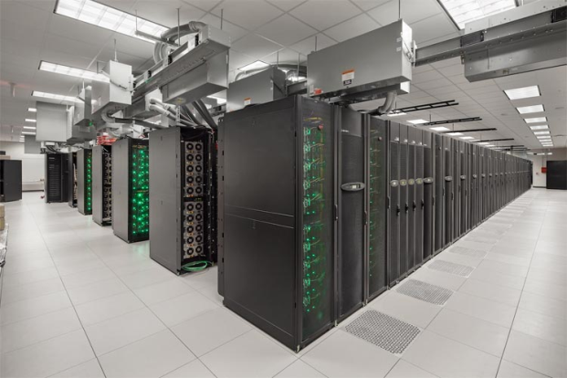
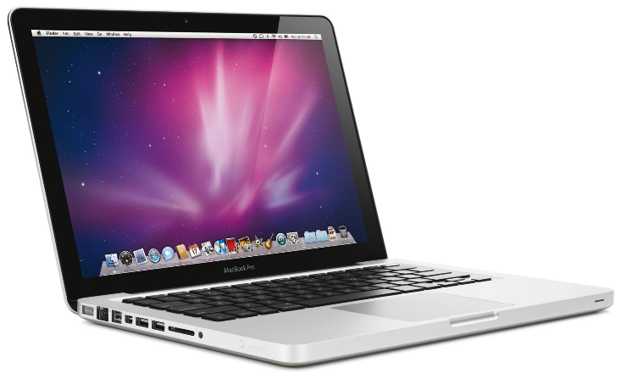
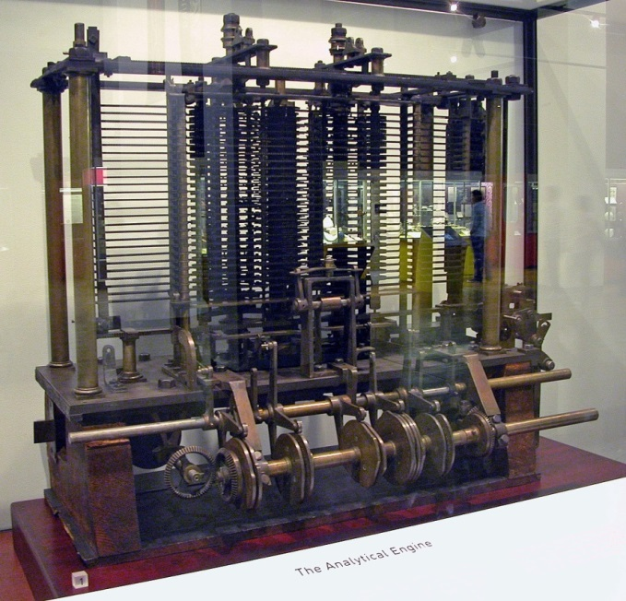
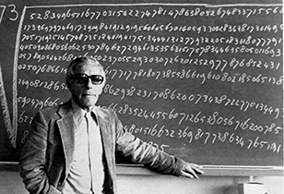
Computers

Slide 6
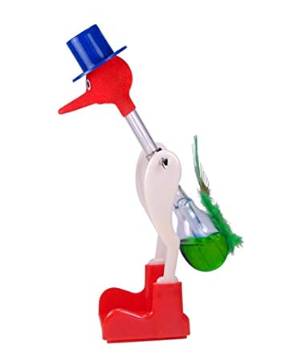
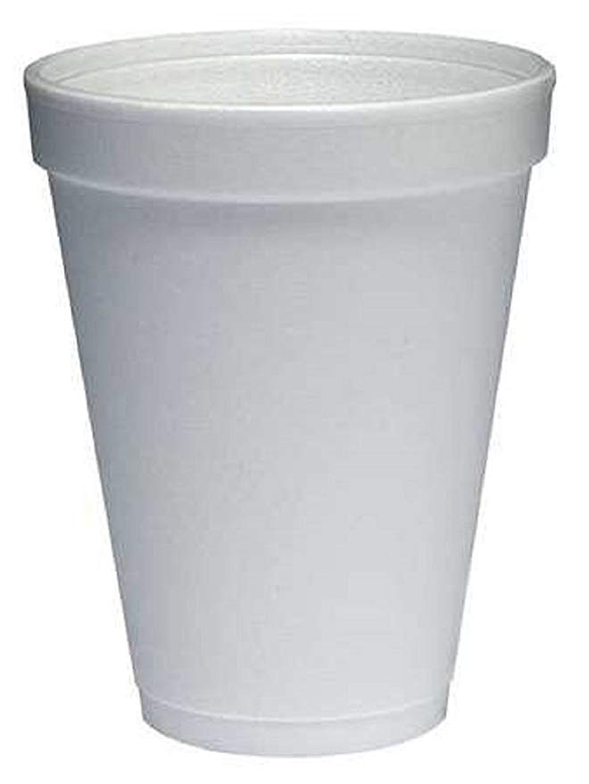
How Does it Work?

Slide 7
How Does it Work?
Evaporative Cooling
Lower Pressure
Higher Pressure

Slide 8
How would I power Charlottesville with a drinking bird?
Double-headed bird
More birds!
Big bird
Different liquid inside (novac 1230)
Narrow straw
Something besides water to evaropate
Remove the hat
Add flames/racing stripes, or a spoiler
Circulating water source
Define Charlottesville to have 0 population
lubricant

Slide 9
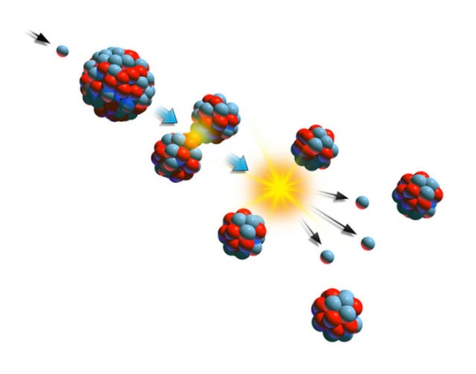
How does a nuclear power plant work?
Steam
Turbine Generator
Heavy Water
Heavy Water
Fission

Slide 10
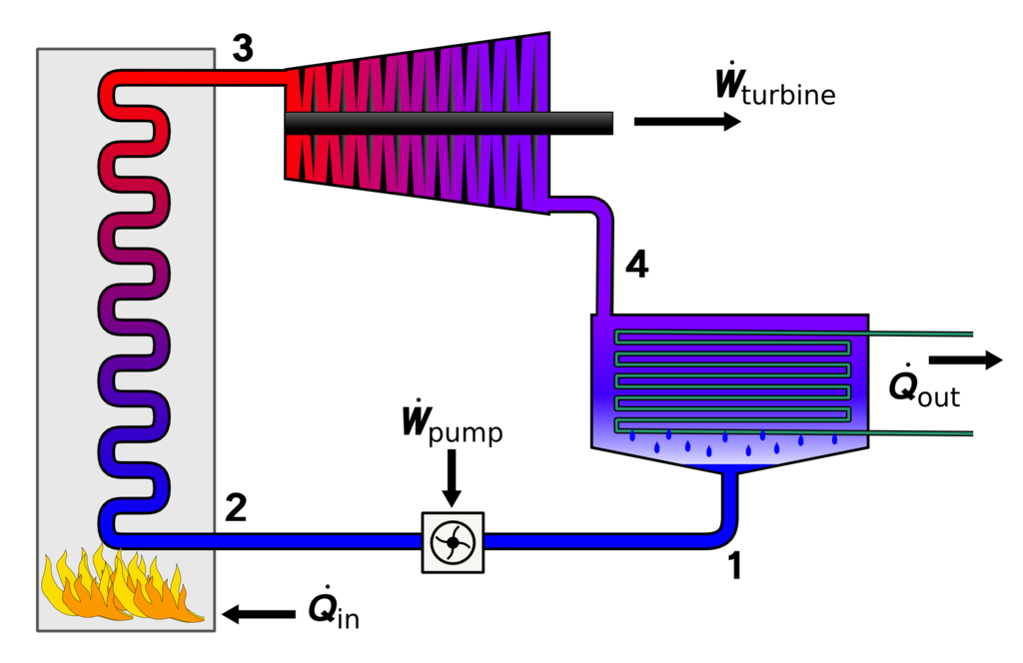

Slide 11
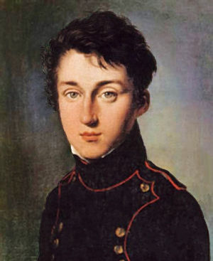
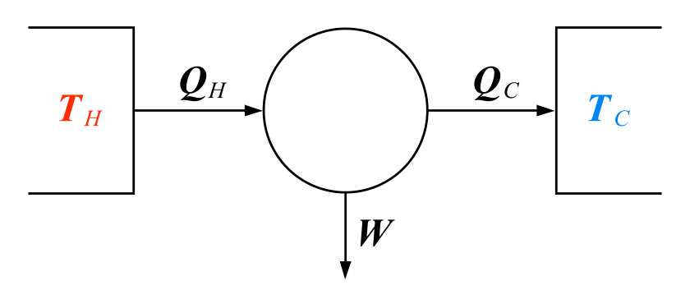
Carnot Engine
Model of any heat engine
Independent of specifics of construction
Provides fundamental limits on efficiency
Nicolas Lèonard Sadi Carnot
(1796-1832)

Slide 12
“Carnot Engine” for computers?
General enough to describe any computation
Independent of specifics of construction
Enable discussion of limits of computability
Input
Computing Machine
/ Program / Algorithm
Output
What goes in here?

Slide 13
Goals
Write convincing arguments using formal definitions and mathematical reasoning.
Reason about the differences between finite and infinite models of computation and what they can and cannot compute.
Express intuitively and formally what makes some problems too expensive to solve, and what can be done in practice when an unsolvable or intractable problem is encountered.
Reason formally about the cost of computation, and be able to prove useful bounds on the costs of solving problems, including showing that certain problems are intractable.

Slide 14
Warning
This may be uncomfortable
Material can subtle
Focused on making strong/elegant/compelling arguments
Lots of opportunities to succeed!

Slide 15
Office Hours
Nate’s
Rice 209
Mondays, Wednesdays 3:30pm-5:30pm
TA
TBD

Slide 16
Requirements
Discrete Math (CS 2102)
Software Development Methods (CS 2110)
Tenacity
Inquisitiveness
Creativity

Slide 17
Text
Boaz Barak, Introduction to Theoretical Computer Science
introtcs.org

Slide 18
Tasks
Exercises
Quizzes
Exams

Slide 19
Survey
Due Thursday, January 16, 5:30pm
Includes a short reading
I expect it will take 20 minutes

