Slide 1

CS3102 Theory of Computation
Warm up:
What’s the language of this NFA?
start
$$0,ε$$
final

Slide 2
Logistics

Slide 3
Last Time
Non-determinism

Slide 4

Showing Regex $≤$ FSA
Show how to convert any regex into a FSA for the same language
Idea: show how to build each “piece” of a regex using FSA

Slide 5
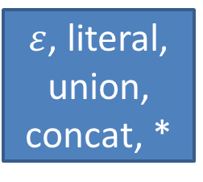
Proof “Storyboard”
FSA
Regex
=
Computability by FSA closed under
How to build a Regex
$ε$, literal, union, concat, *
Makes that easy
Non-determinism

Slide 6
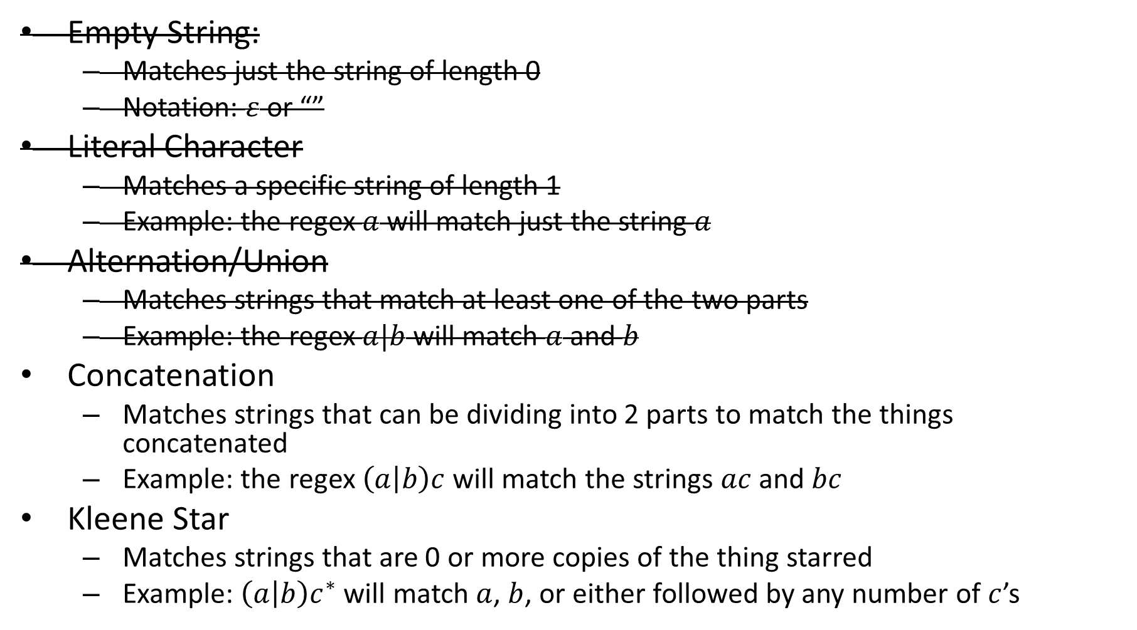
“Pieces” of a Regex
Empty String:
Matches just the string of length 0
Notation: $ε$ or “”
Literal Character
Matches a specific string of length 1
Example: the regex $a$ will match just the string $a$
Alternation/Union
Matches strings that match at least one of the two parts
Example: the regex $a|b$ will match $a$ and $b$
Concatenation
Matches strings that can be dividing into 2 parts to match the things concatenated
Example: the regex $\left(a | b\right)c$ will match the strings $ac$ and $bc$
Kleene Star
Matches strings that are 0 or more copies of the thing starred
Example: $\left(a | b\right)c^{∗}$ will match $a$, $b$, or either followed by any number of $c$’s

Slide 7
Non-determinism
Things could get easier if we “relax” our automata
So far:
Must have exactly one transition per character per state
Can only be in one state at a time
Non-deterministic Finite Automata:
Allowed to be in multiple (or zero) states!
Can have multiple or zero transitions for a character
Can take transitions without using a character
Models parallel computing

Slide 8


Nondeterminism
Driving to a friend’s house
Friend forgets to mention a fork in the directions
Which way do you go?
Why not both?
?

Slide 9
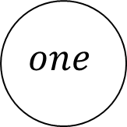

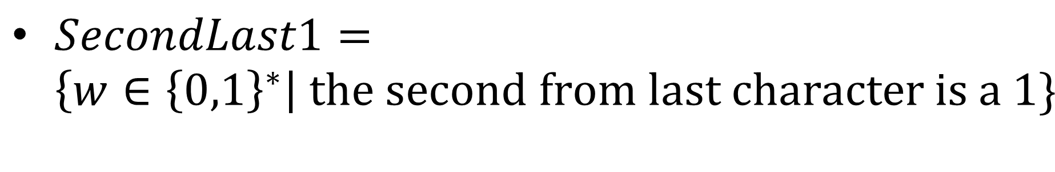
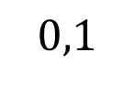

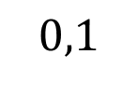
Example Non-deterministic Finite Automaton
$SecondLast1=\left\{w∈{\left\{0,1\right\}}^{∗}\right| the second from last character is a 1\}$
$$0,1$$
start
$$1$$
$$one$$
$$0,1$$
$$next$$

Slide 10
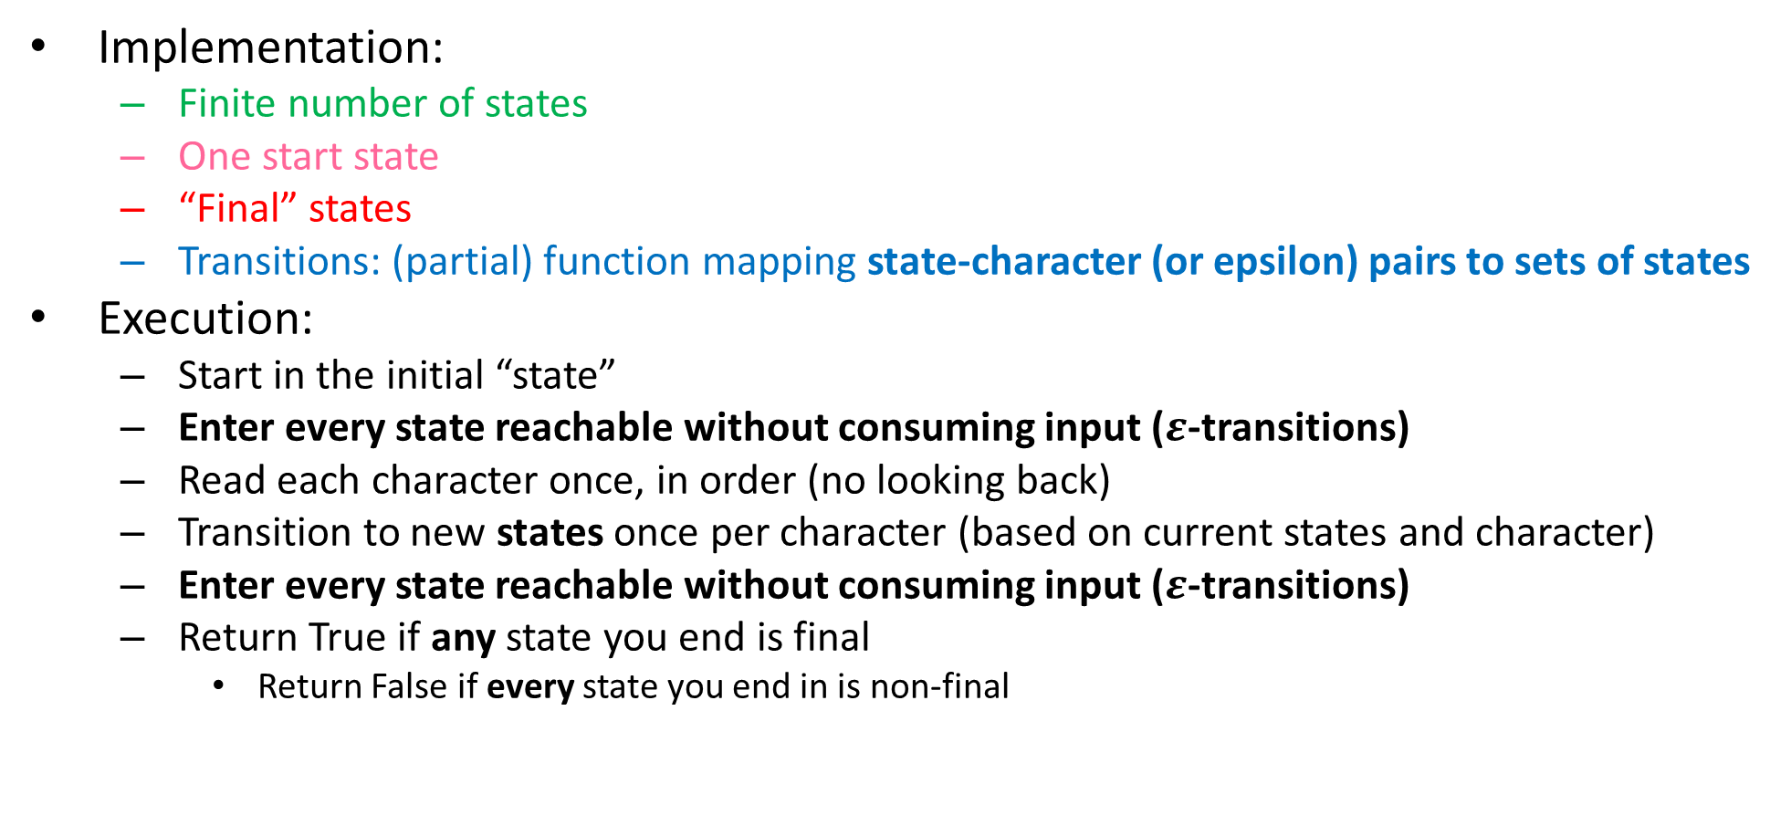
Non-Deterministic Finite State Automaton
Implementation:
Finite number of states
One start state
“Final” states
Transitions: (partial) function mapping state-character (or epsilon) pairs to sets of states
Execution:
Start in the initial “state”
Enter every state reachable without consuming input ($ε$-transitions)
Read each character once, in order (no looking back)
Transition to new states once per character (based on current states and character)
Enter every state reachable without consuming input ($ε$-transitions)
Return True if any state you end is final
Return False if every state you end in is non-final

Slide 11
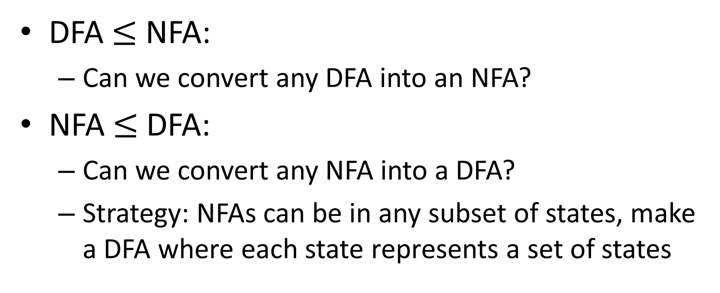
NFA = DFA
DFA $≤$ NFA:
Can we convert any DFA into an NFA?
NFA $≤$ DFA:
Can we convert any NFA into a DFA?
Strategy: NFAs can be in any subset of states, make a DFA where each state represents a set of states

Slide 12
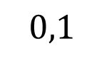
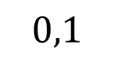

Powerset Construction
$$0,1$$
start
$$1$$
one
$$0,1$$
next
start
one
next
{}
Start,
One,
next
Start,
one
Start,
next
One,
next

Slide 13








Powerset Construction
$$0,1$$
start
$$1$$
one
$$0,1$$
next
$$0$$
start
one
next
{}
$$1$$
Start,
One,
next
$$0$$
$$1$$
$$1$$
Start,
one
Start,
next
One,
next
$$0$$
$$0$$
$$1$$

Slide 14
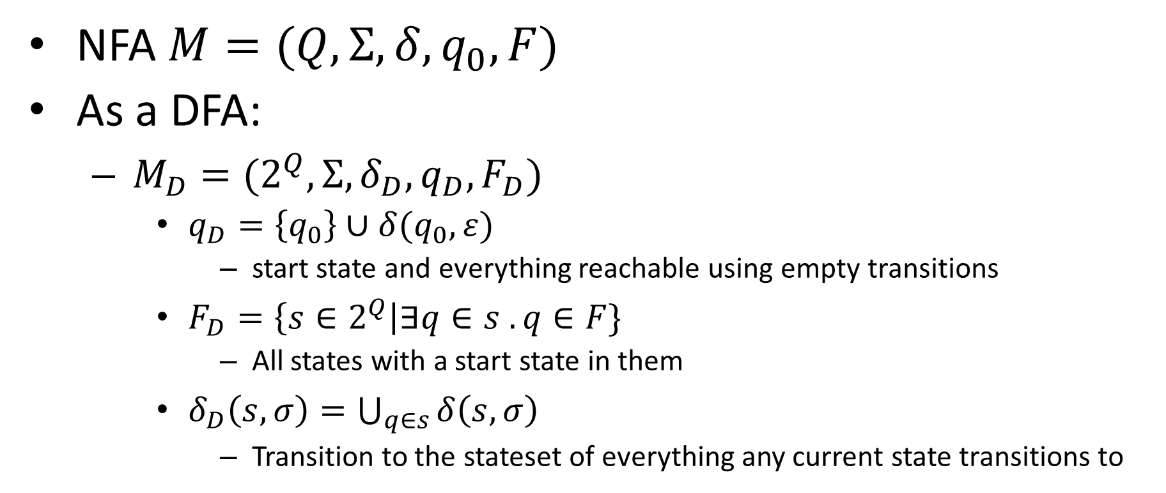
Powerset Construction (symbolic)
NFA $M=(Q, Σ, δ,q_{0}, F)$
As a DFA:
$M_{D}=(2^{Q}, Σ, δ_{D},q_{D},F_{D})$
$q_{D}=\left\{q_{0}\right\}∪δ(q_{0}, ε)$
start state and everything reachable using empty transitions
$F_{D}=\left\{s∈2^{Q}\right|∃q∈s . q∈F\}$
All states with a start state in them
$δ_{D}\left(s, σ\right)=\bigcup_{q∈s}{δ\left(s,σ\right)}$
Transition to the stateset of everything any current state transitions to

Slide 15









Union Using Non-Determinism
Some 0s
$$0,1$$
Goal: Return 1 if either machine returns 1
Strategy: Run both machines in parallel (non-deterministically) by transitioning to the start states for both without using input
$$0$$
new
_{start}
$$0$$
$$1$$
No 0s
$$1$$
$$1$$
$$0$$
Odd
Even
$$0$$
$$1$$

Slide 16



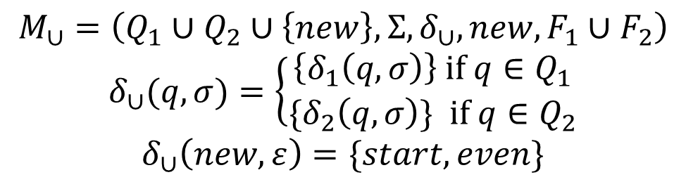

Union Using Non-Determinism
Some 0s
$$M_{1}$$
$$0,1$$
$$0$$
ε
new
$$ε$$
ε
$$M_{2}$$
_{start}
$$0$$
$$ε$$
$$M_{∪}=\left(Q_{1}∪Q_{2}∪\left\{new\right\}, Σ, δ_{∪}, new,F_{1}∪F_{2}\right)$$
$$δ_{∪}(q,σ)=\left\{\begin{aligned}\left\{δ_{1}\left(q,σ\right)\right\} if q∈Q_{1} \\ {\{δ}_{2}\left(q,σ\right)\} if q∈Q_{2}\end{aligned}\right.$$
$$δ_{∪}\left(new, ε\right)=\{start, even\}$$
$$1$$
No 0s
$$1$$
$$1$$
$$0$$
Odd
Even
$$0$$
$$1$$

Slide 17
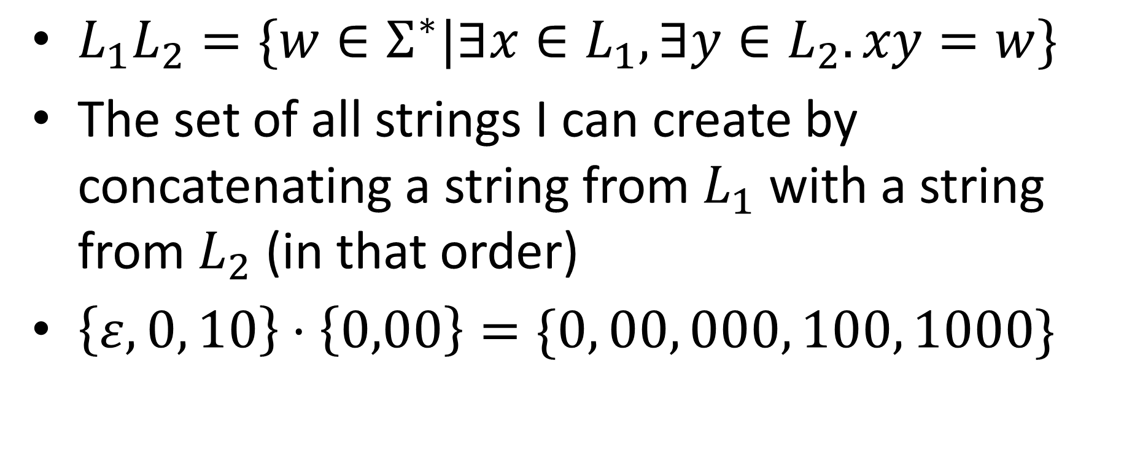
Language Concatenation
$L_{1}L_{2}=\{w∈Σ^{∗}|∃x∈L_{1},∃y∈L_{2}. xy=w\}$
The set of all strings I can create by concatenating a string from $L_{1}$ with a string from $L_{2}$ (in that order)
$\left\{ε,0, 10\right\}⋅\left\{0,00\right\}=\{0, 00, 000, 100, 1000\}$

Slide 18

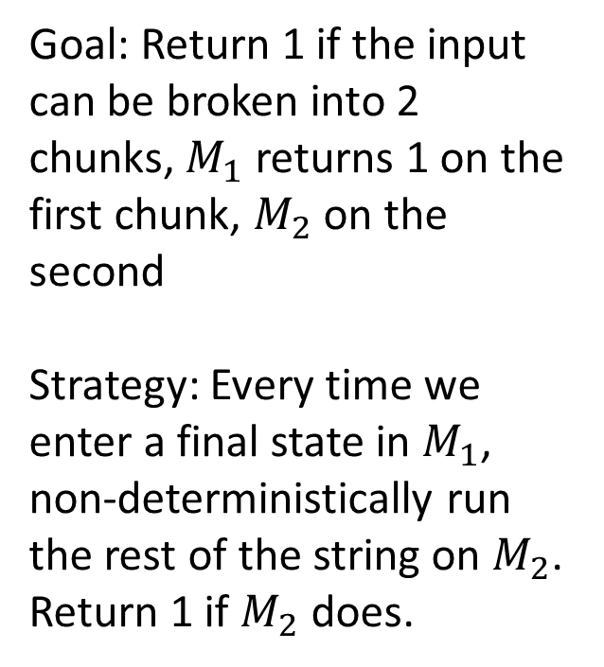
Concatenation using NFA
ε
$$M_{2}$$
$$M_{1}$$
ε
Goal: Return 1 if the input can be broken into 2 chunks, $M_{1}$ returns 1 on the first chunk, $M_{2}$ on the second
Strategy: Every time we enter a final state in $M_{1}$, non-deterministically run the rest of the string on $M_{2}$. Return 1 if $M_{2}$ does.
Some 0s
$$0,1$$
$$0$$
$$1$$
$$0$$
_{start}
$$0$$
Odd
Even
$$0$$
$$1$$
No 0s
$$1$$
$$1$$

Slide 19

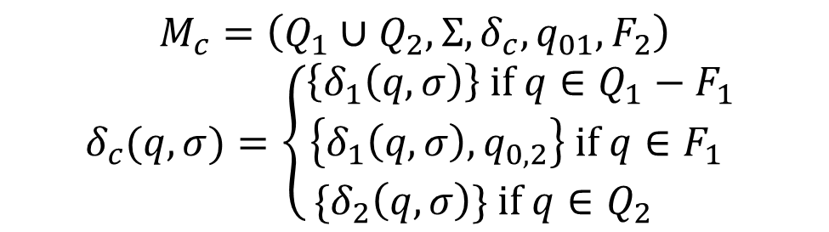



Concatenation using NFA
ε
$$M_{2}$$
$$M_{1}$$
ε
$$M_{c}=\left(Q_{1}∪Q_{2}, Σ, δ_{c}, q_{01}, F_{2}\right)$$
$$δ_{c}(q, σ)=\left\{\begin{aligned}\left\{δ_{1}\left(q,σ\right)\right\} if q∈Q_{1}−F_{1} \\ \left\{δ_{1}\left(q,σ\right), q_{0,2}\right\} if q∈F_{1} \\ {\{δ}_{2}\left(q,σ\right)\} if q∈Q_{2} \end{aligned}\right.$$
Some 0s
$$0,1$$
$$0$$
$$1$$
$$0$$
_{start}
$$ε$$
Odd
Even
$$0$$
$$0$$
$$1$$
$$ε$$
$$1$$
No 0s
$$1$$

Slide 20
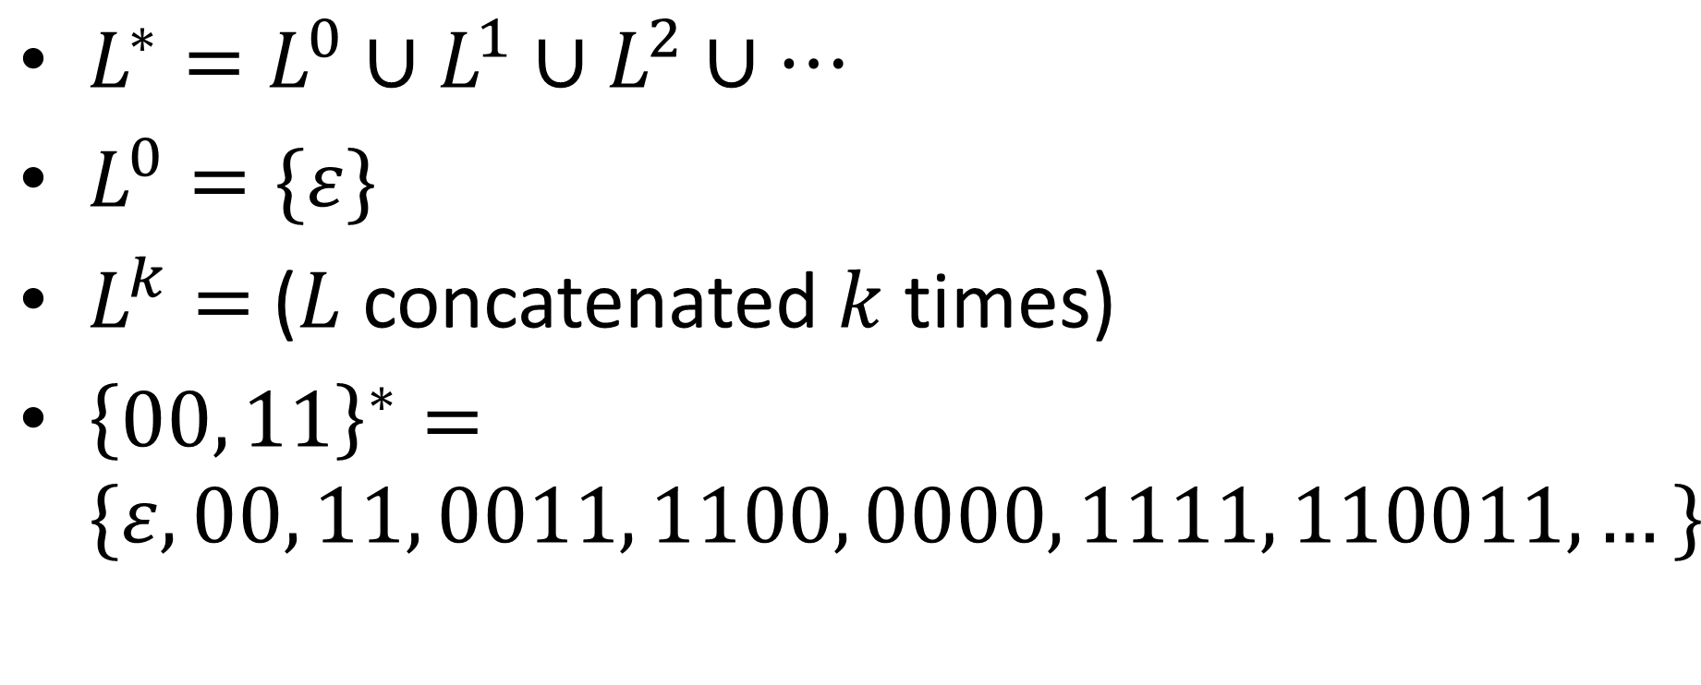
Kleene Star
$L^{∗}=L^{0}∪L^{1}∪L^{2}∪…$
$L^{0}=\{ε\}$
$L^{k}=$ ($L$ concatenated $k$ times)
${\left\{00, 11\right\}}^{∗}=\{ε, 00, 11, 0011, 1100, 0000, 1111, 110011, …\}$

Slide 21

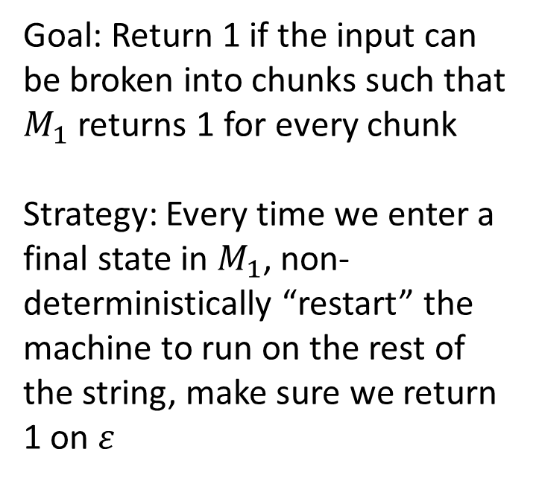
Kleene Star using NFA
ε
$$M_{1}$$
ε
ε
Some 0s
Goal: Return 1 if the input can be broken into chunks such that $M_{1}$ returns 1 for every chunk
Strategy: Every time we enter a final state in $M_{1}$, non-deterministically “restart” the machine to run on the rest of the string, make sure we return 1 on $ε$
$$0,1$$
$$0$$
_{start}
$$0$$
$$1$$
No 0s
$$1$$

Slide 22








Kleene Star using NFA
ε
$$M_{1}$$
ε
ε
Some 0s
Goal: Return 1 if the input can be broken into chunks such that $M_{1}$ returns 1 for every chunk
Strategy: Every time we enter a final state in $M_{1}$, non-deterministically “restart” the machine to run on the rest of the string, make sure we return 1 on $ε$
$$0,1$$
$$0$$
$$ε$$
_{start}
$$0$$
$$ε$$
$$ε$$
$$1$$
No 0s
$$1$$
empty

Slide 23
Conclusion
Any language expressible as a regular expression is computable by a NFA
Any language computable by a NFA is computable by a DFA
NFA = Regex = DFA
Call any such language a “regular language”

Slide 24
Characterizing What’s computable
Things that are computable by FSA:
Functions that don’t need “memory”
Languages expressible as Regular Expressions
Things that aren’t computable by FSA:
Things that require more than finitely many states
Intuitive example: Majority

Slide 25
Majority with FSA?
Consider an inputs with lots of 0s
Recall: we read 1 bit at a time, no going back!
To count to 50,000, we'll need 50,000 states!
000...0000 111...1111
000...0000 111...1111
000...0000 111...1111
×50,000
×50,000
×50,000
×50,001
×49,999
×50,000

