Slide 1
CS3102 Theory of Computation
www.cs.virginia.edu/~njb2b/cstheory/s2020
Warm up:
How are you?

Slide 2
Going Online Logistics
Lecture
Important Zoom features:
Go faster
Go slower
Raise hand
Yes/no
Office Hours
Office hours queue
Services
Exams

Slide 3
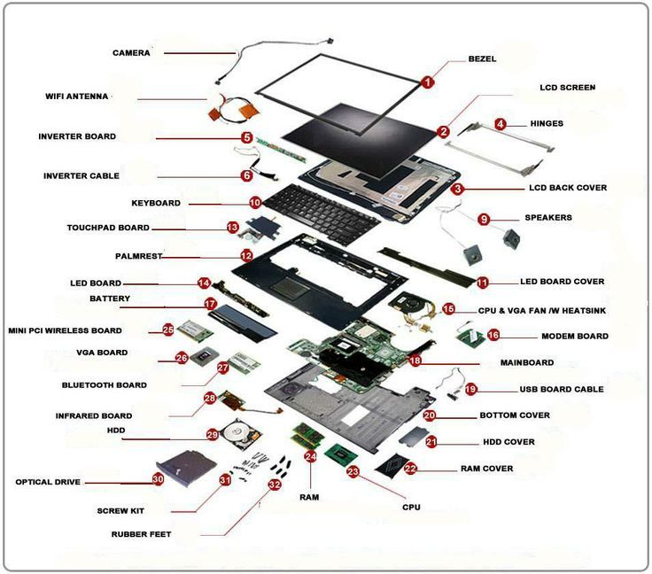
“Dissecting” a Computer

Slide 4
Most important parts (according to Nate)
CPU
Circuits of transistors
RAM
Limited memory
HDD/SSD
Large memory

Slide 5
What does it mean to compute?
We’ll discuss several ideas this semester
Several “models” of computing
Vague idea: take and input and produce an output
Computing Machine
/ Program / Algorithm
Output
Input

Slide 6
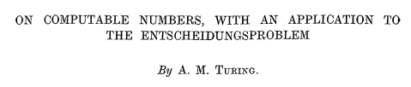
Defining Our Input/Output
Computing Machine
/ Program / Algorithm
Output
Input
What are the “types”?
What we compute on: representations of things (e.g. numbers)

Slide 7
What do we compute on?
String: an ordered sequence of characters
Is a representation of something
Characters come from an alphabet
Let’s formally define them

Slide 8
What do we compute, then?
Computing Machine
/ Program / Algorithm
Output
Input
Input and output are strings
Black box is an implementation
What are we implementing?
Functions
Languages

Slide 9
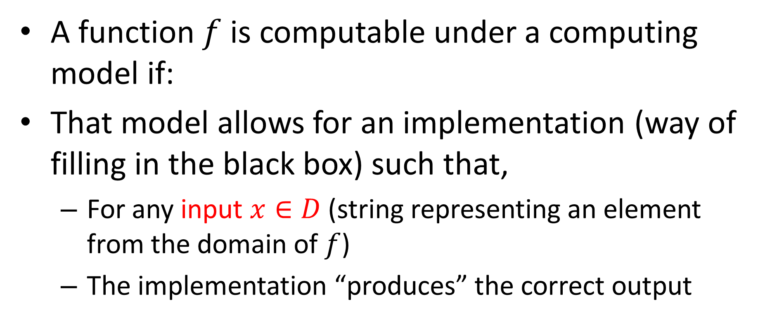
Computing a Function
Computing Machine
/ Program / Algorithm
Output
Input
A function $f$ is computable under a computing model if:
That model allows for an implementation (way of filling in the black box) such that,
For any input $x∈D$ (string representing an element from the domain of $f$)
The implementation “produces” the correct output

Slide 10
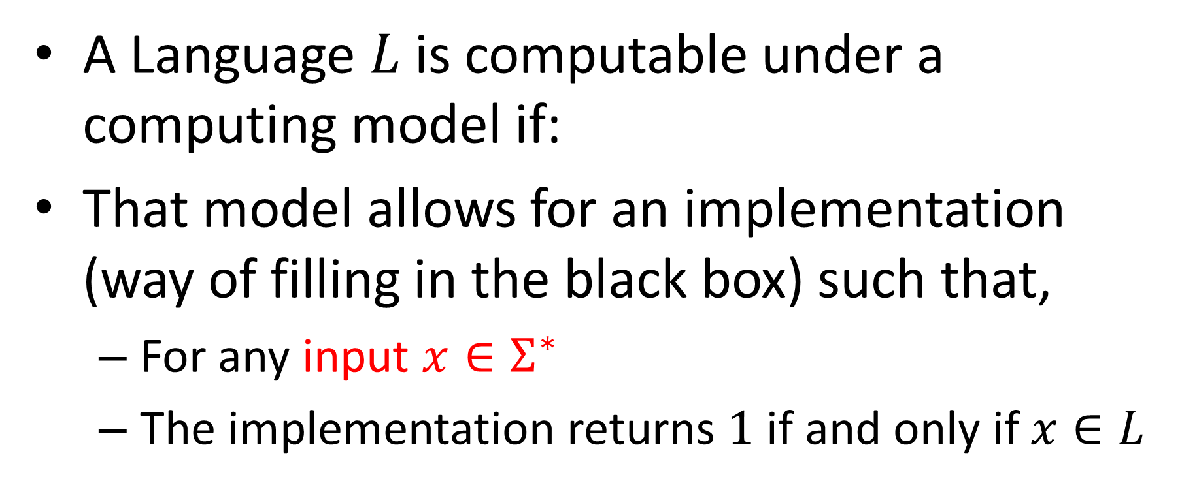
Computing a Language
Computing Machine
/ Program / Algorithm
Output
Input
A Language $L$ is computable under a computing model if:
That model allows for an implementation (way of filling in the black box) such that,
For any input $x∈Σ^{∗}$
The implementation returns $1$ if and only if $x∈L$

Slide 11
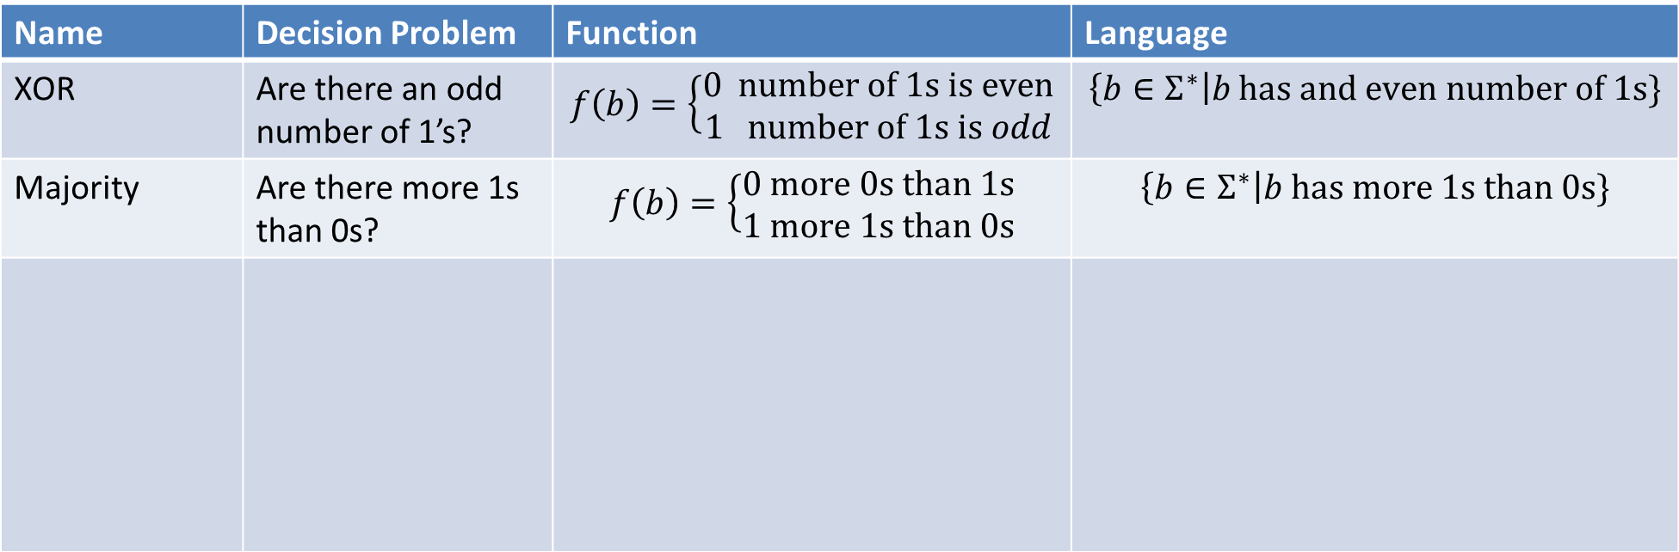
Function vs Decision vs Language
Name | Decision Problem | Function | Language
XOR | Are there an odd number of 1’s? | $$f\left(b\right)=\left\{\begin{aligned}0 number of 1s is even \\ 1 number of 1s is odd\end{aligned}\right.$$ | $$\left\{b∈Σ^{∗}\right|b has and even number of 1s\}$$
Majority | Are there more 1s than 0s? | $$f\left(b\right)=\left\{\begin{aligned}0 more 0s than 1s \\ 1 more 1s than 0s\end{aligned}\right.$$ | $$\left\{b∈Σ^{∗}\right|b has more 1s than 0s\}$$

Slide 12

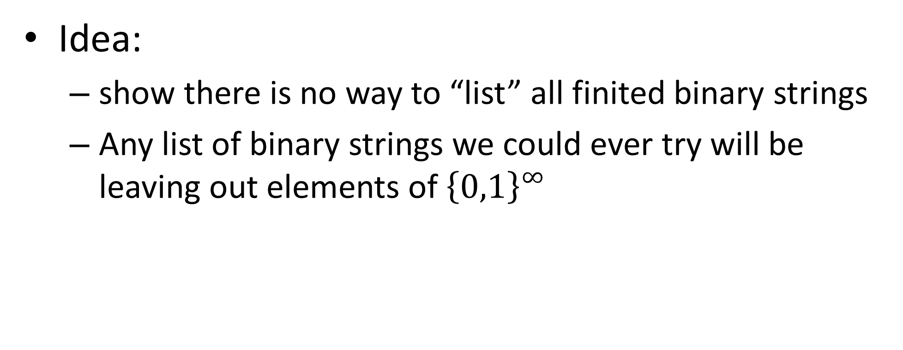

$$\left|{\left\{0,1\right\}}^{∞}\right|>|\text{ℕ}\text{|}$$
Idea:
show there is no way to “list” all finited binary strings
Any list of binary strings we could ever try will be leaving out elements of ${\left\{0,1\right\}}^{∞}$

Slide 13
Differences
Hardware (CPU)
Software (Java)
Concrete
Fixed
Simpler (each unit of computation does “less”)
Computation has smaller steps
Doesn’t ever need to be software
Everything is always doing physics
“idealized”, “abstract”
Reconfigurable
Transportable
Each “step” is bigger
Needs to “become” hardware
Needs to be translated
Sequential (limited parallel)

Slide 14




Defining the AON circuit model
Define how to represent a computation
And/Or/Not circuit:
Number of inputs
Number of outputs
Gates and their labels
Wires connecting the above
Define how to perform an execution
For each component, find its value once all its inputs are defined
Inputs start of with their value defined
Things labelled as output are the result
$$1$$
$$0$$
$$y$$
$$1$$

Slide 15
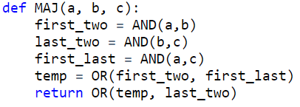
A circuit-like programming language
Define how to represent a computation
Inputs as positional arguments
Outputs as return statements
Variable assignments using boolean operators AND/OR/NOT
Define how to perform an execution
Evaluate each variable assignment sequentially
AON-Straightline

Slide 16
Issues and Solutions
What were the limitations of circuits?
No loops: meaning only finite functions
Fixed input sizes
How can we overcome those?
Finite state automata (the execution definition allowed for infinite)
Iterated: do some work, update “state”, do more work, until no more input

Slide 17






Finite State Automaton
$$1$$
$$0$$
Implementation:
Finite number of states
One start state
“Final” states
Transitions (function mapping state-character pairs to states)
Execution:
Start in the initial “state”
Read each character once, in order (no looking back)
Transition to a new state once per character (based on current state and character)
Give output depending on which state you end in
$$0$$
$$E$$
$$O$$
$$1$$

Slide 18
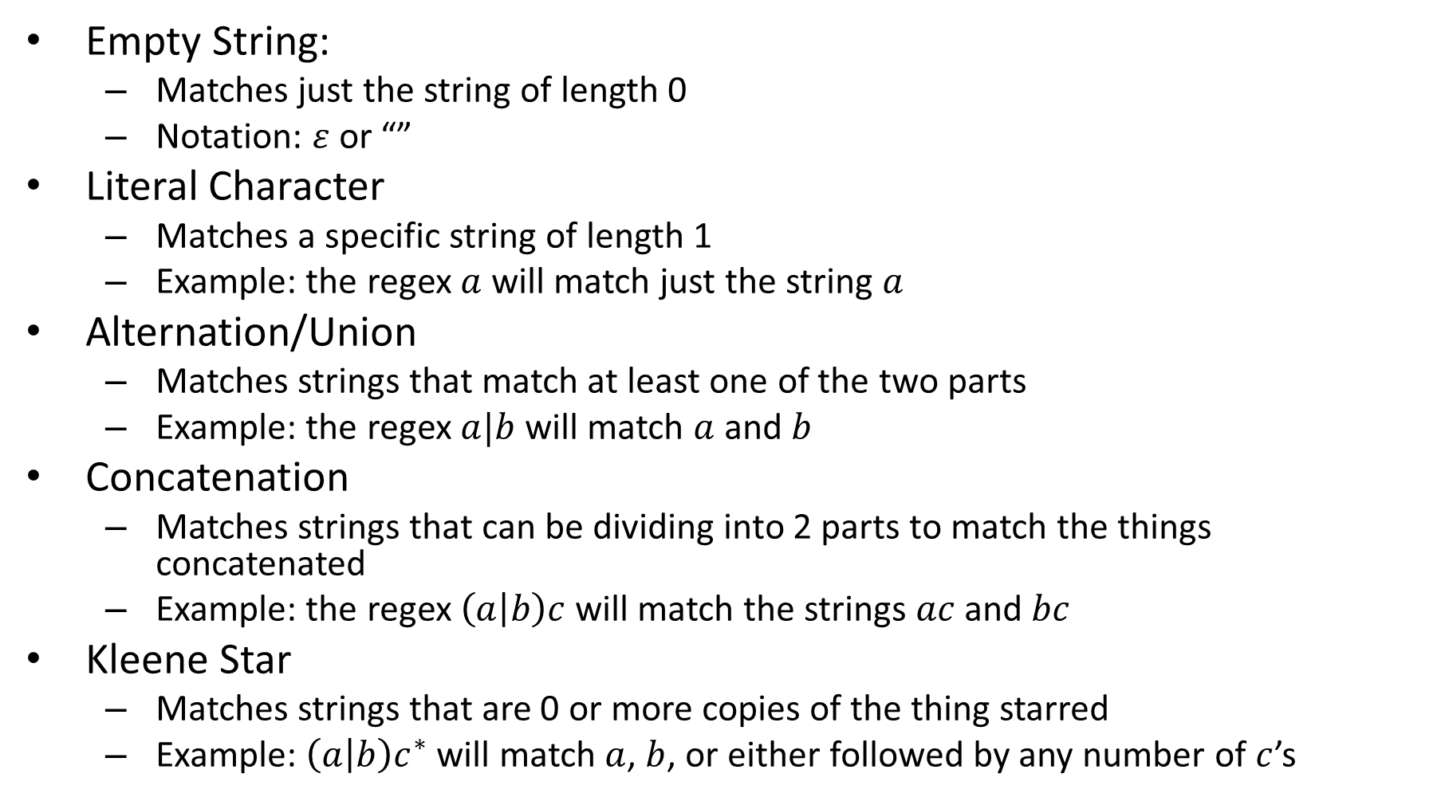
“Pieces” of a Regex
Empty String:
Matches just the string of length 0
Notation: $ε$ or “”
Literal Character
Matches a specific string of length 1
Example: the regex $a$ will match just the string $a$
Alternation/Union
Matches strings that match at least one of the two parts
Example: the regex $a|b$ will match $a$ and $b$
Concatenation
Matches strings that can be dividing into 2 parts to match the things concatenated
Example: the regex $\left(a | b\right)c$ will match the strings $ac$ and $bc$
Kleene Star
Matches strings that are 0 or more copies of the thing starred
Example: $\left(a | b\right)c^{∗}$ will match $a$, $b$, or either followed by any number of $c$’s
Note: The compents here are the minimal necessary. In practice, regexes have other components as well, those are just “syntactic sugar”.

Slide 19


Nondeterminism
Driving to a friend’s house
Friend forgets to mention a fork in the directions
Which way do you go?
Why not both?
?

Slide 20
Issues and Solutions
What were the limitations of circuits?
Actually infinite inputs (not relevant to us)
No looking back!
Change the machine mid-process
Limited storage, bigger inputs require more memory for some functions
Larger output space (only 0 or 1)
Non-determinism: no communication among parallel paths
Outside the scope of this semester
Alternation
How can we overcome those?
You can look backwards!
Lots of / Plentiful / enough memory: infinite!
Make machines that can play the roll of another machine, compute machines (macros)
Execution model that allows for long strings to be outputs

Slide 21
Characterizing What’s computable
Things that are computable by FSA:
Functions that don’t need “memory”
Languages expressible as Regular Expressions
Things that aren’t computable by FSA:
Things that require more than finitely many states
Intuitive example: Majority

Slide 22
Majority with FSA?
Consider an inputs with lots of 0s
Recall: we read 1 bit at a time, no going back!
To count to 50,000, we'll need 50,000 states!
000...0000 111...1111
000...0000 111...1111
000...0000 111...1111
×50,000
×50,000
×50,000
×50,001
×49,999
×50,000

