Slide 1
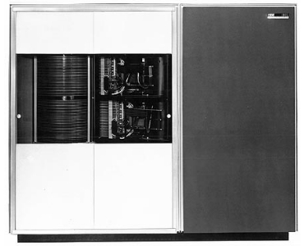
CS3102 Theory of Computation
www.cs.virginia.edu/~njb2b/cstheory/s2020
Warm up:
Why does math consider infinity?
Do infinite things exist
IBM 1301 disk storage unit (1961)
28MB capacity
$2,100 per month ($18,000 today)

Slide 2
Logistics
Course registration survey was due Thursday
Didn’t complete it? No problem! Just do it soon
Exercise 0_2 due Tuesday
Didn’t complete it? No problem (this time)! Just request an extension.
Exercise 0_3 due Today
Pick one of python/java
Didn’t complete it? No problem(this time)! Just request an extension.
Exercise due/release dates will be more “batched” going forward, staggered this time to test out the submission system
First Quiz
Released Tomorrow, due Tuesday
Exercises 1_x released tomorrow, see assignments page for deadlines

Slide 3
Last Class
What does it mean to “represent” things with strings?
How can we represent natural numbers with binary strings?
How can we count things?
What does it mean for a set to be infinite?

Slide 4
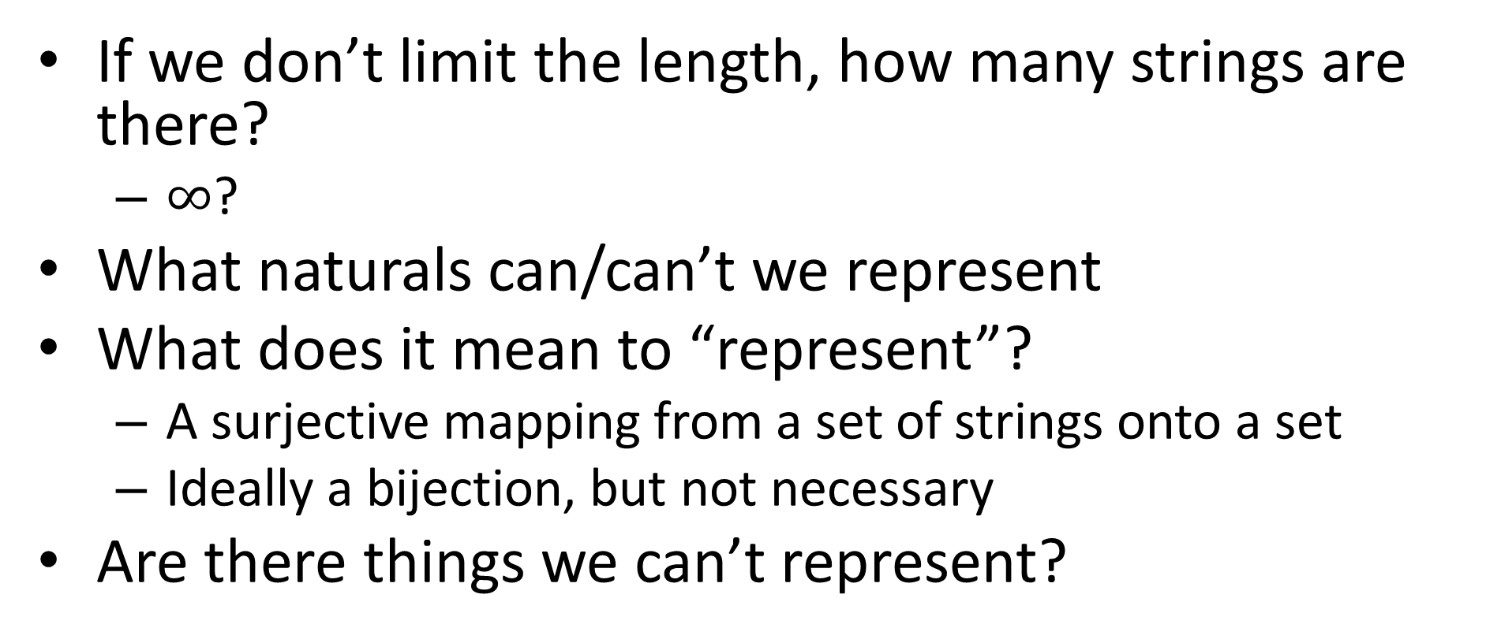
How many binary strings of any length?
If we don’t limit the length, how many strings are there?
$∞$?
What naturals can/can’t we represent
What does it mean to “represent”?
A surjective mapping from a set of strings onto a set
Ideally a bijection, but not necessary
Are there things we can’t represent?

Slide 5
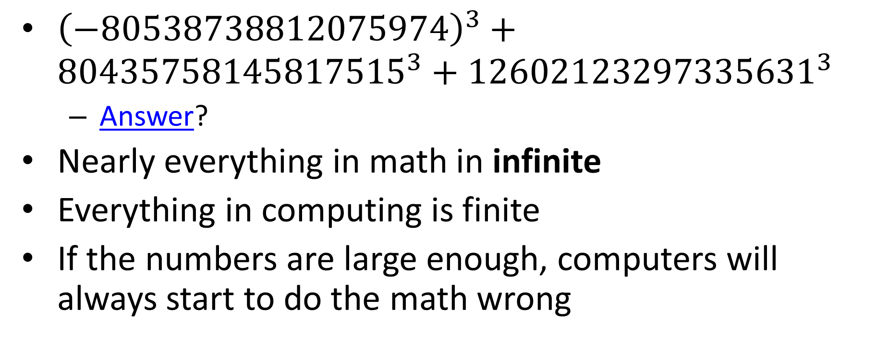
Differences Between “real” computing and Math
${\left(−80538738812075974\right)}^{3}+{80435758145817515}^{3}+{12602123297335631}^{3}$
Answer?
Nearly everything in math in infinite
Everything in computing is finite
If the numbers are large enough, computers will always start to do the math wrong

Slide 6
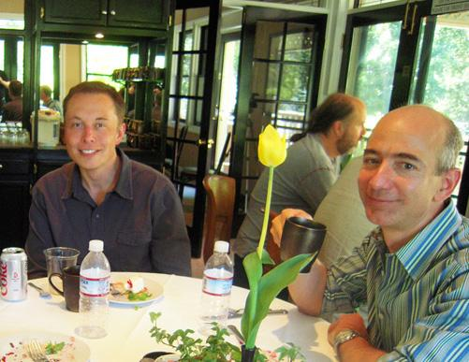
Why bother with infinity?

Slide 7
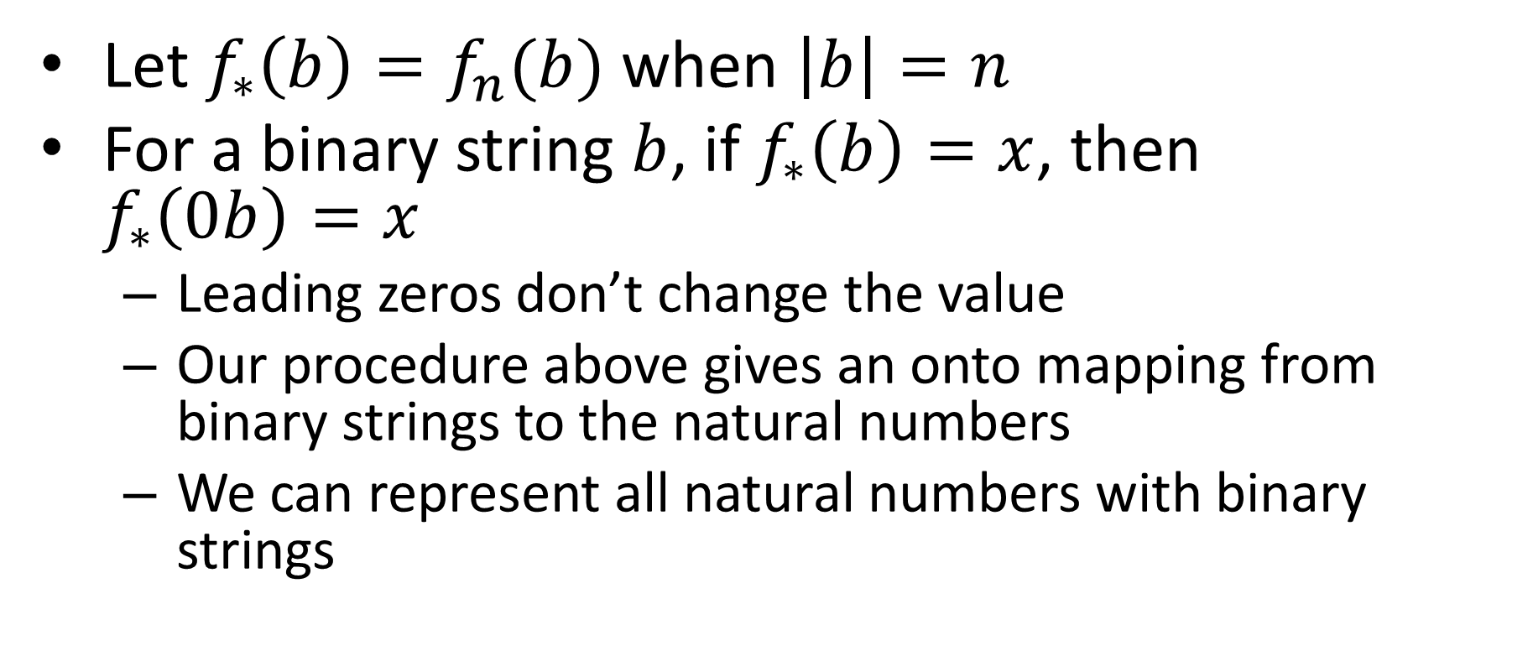
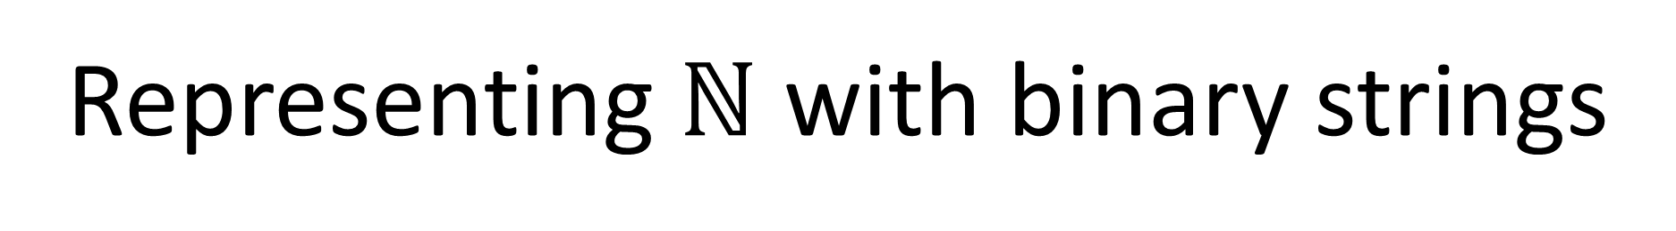
Representing $\text{ℕ}$ with binary strings
Let $f_{∗}\left(b\right)=f_{n}(b)$ when $\left|b\right|=n$
For a binary string $b$, if $f_{∗}\left(b\right)=x$, then $f_{∗}\left(0b\right)=x$
Leading zeros don’t change the value
Our procedure above gives an onto mapping from binary strings to the natural numbers
We can represent all natural numbers with binary strings

Slide 8
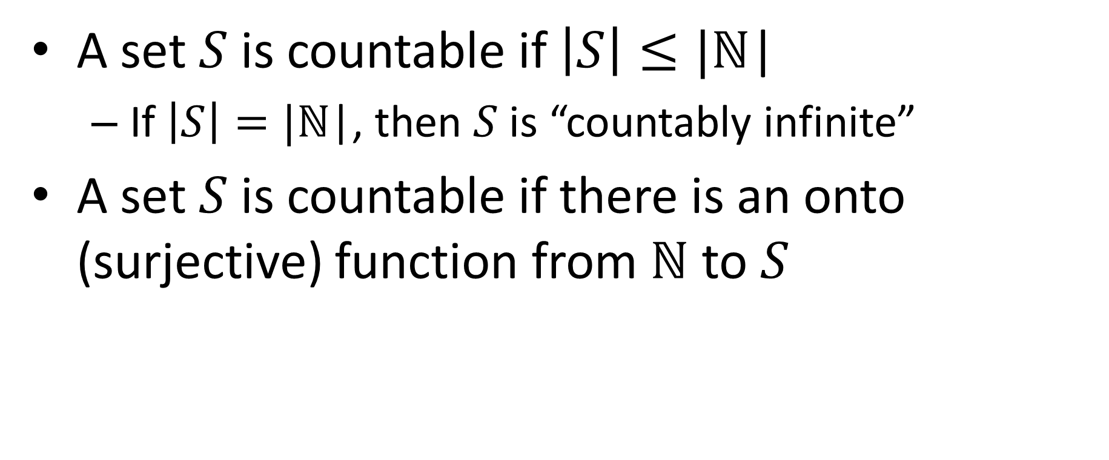
Countablility and Uncountability
A set $S$ is countable if $\left|S\right|≤|\text{ℕ}\text{|}$
If $\left|S\right|=|\text{ℕ}\text{|}$, then $S$ is “countably infinite”
A set $S$ is countable if there is an onto (surjective) function from $\text{ℕ}$ to $S$

Slide 9
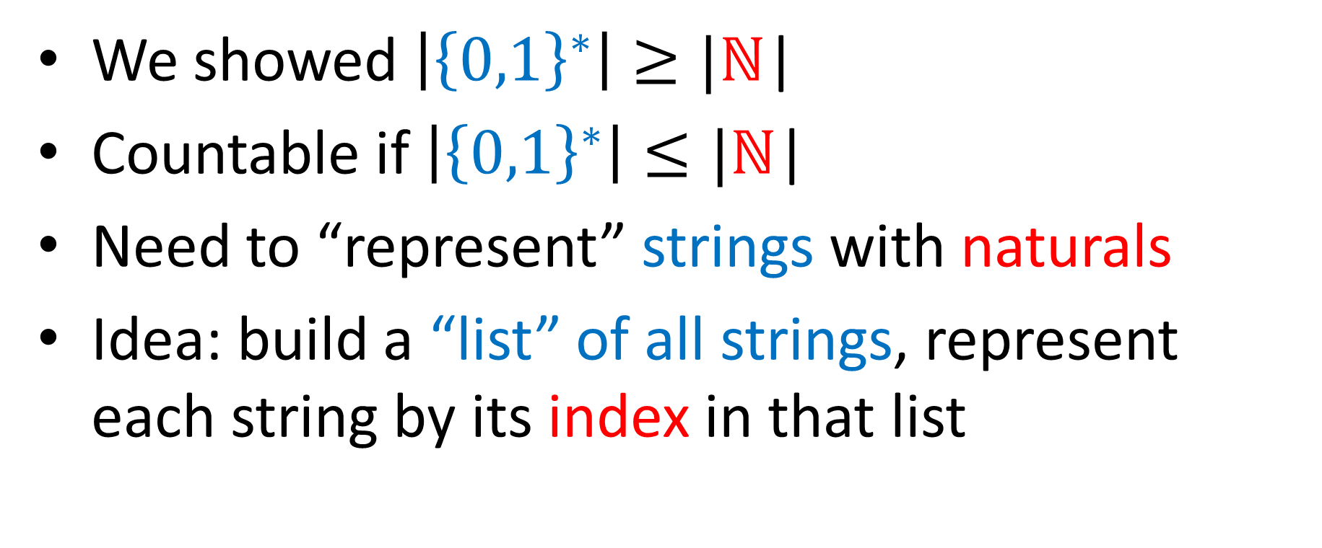

${\left\{0,1\right\}}^{∗}$ is countable
We showed $\left|{\left\{0,1\right\}}^{∗}\right|≥|\text{ℕ}\text{|}$
Countable if $\left|{\left\{0,1\right\}}^{∗}\right|≤|\text{ℕ}\text{|}$
Need to “represent” strings with naturals
Idea: build a “list” of all strings, represent each string by its index in that list

Slide 10
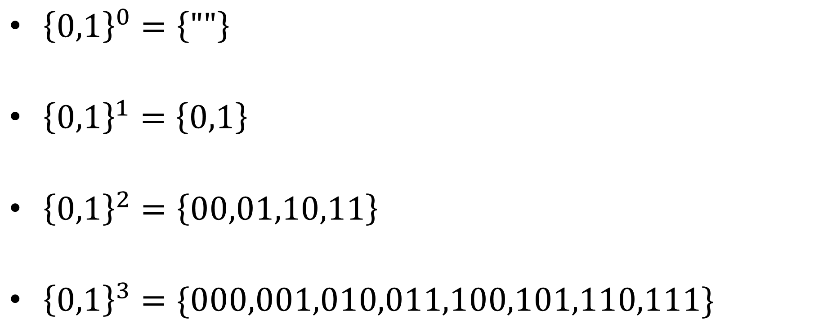
Listing all strings
${\left\{0,1\right\}}^{0}=\left\{""\right\}$
${\left\{0,1\right\}}^{1}=\left\{0,1\right\}$
${\left\{0,1\right\}}^{2}=\left\{00,01,10,11\right\}$
${\left\{0,1\right\}}^{3}=\{000,001,010,011,100,101,110,111\}$
0
1
2
3
4
5
6
7
8
9
10
11
12
13
14

Slide 11
How Many Python/Java programs?
How do we represent Java/Python programs?
How many things can we represent using that method?

Slide 12
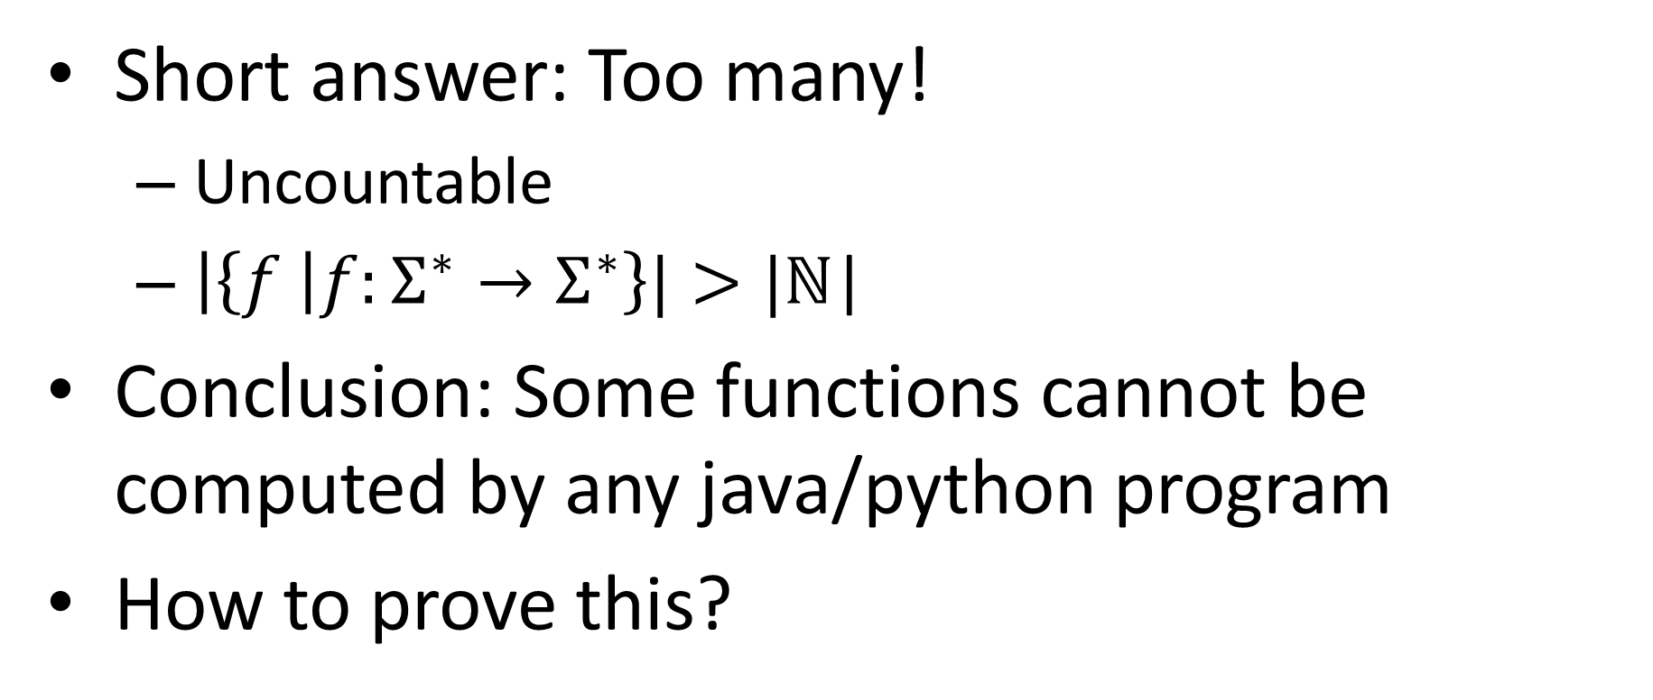
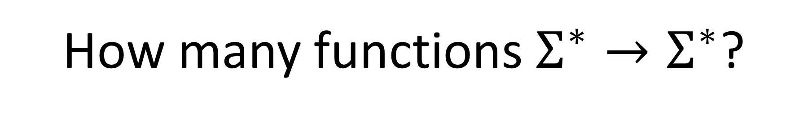
How many functions $Σ^{∗}→Σ^{∗}$?
Short answer: Too many!
Uncountable
$\left|\left\{f \right|f:Σ^{∗}→Σ^{∗}\right\}|>|\text{ℕ}\text{|}$
Conclusion: Some functions cannot be computed by any java/python program
How to prove this?

Slide 13
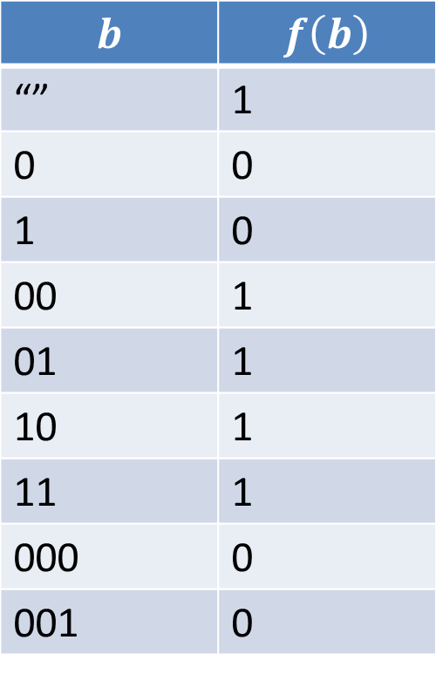
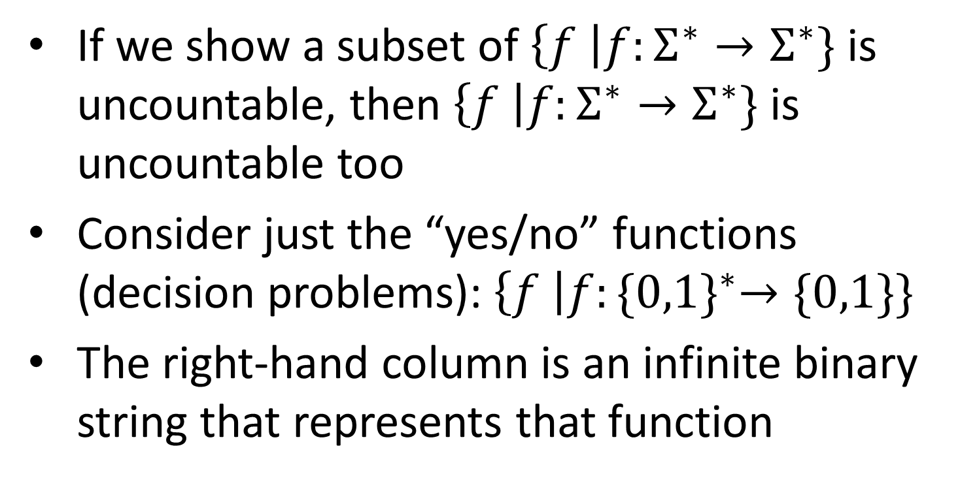
Uncountably many functions
$$b$$ | $$f\left(b\right)$$
“” | 1
0 | 0
1 | 0
00 | 1
01 | 1
10 | 1
11 | 1
000 | 0
001 | 0
If we show a subset of $\left\{f \right|f:Σ^{∗}→Σ^{∗}\}$is uncountable, then $\left\{f \right|f:Σ^{∗}→Σ^{∗}\}$ is uncountable too
Consider just the “yes/no” functions (decision problems): $\left\{f \right|f:{\{0,1\}}^{∗}→\{0,1\}\}$
The right-hand column is an infinite binary string that represents that function

Slide 14
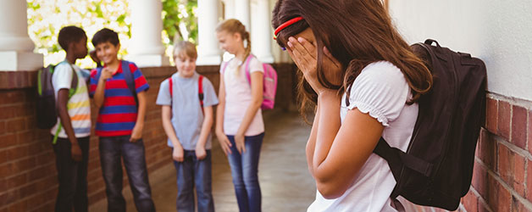
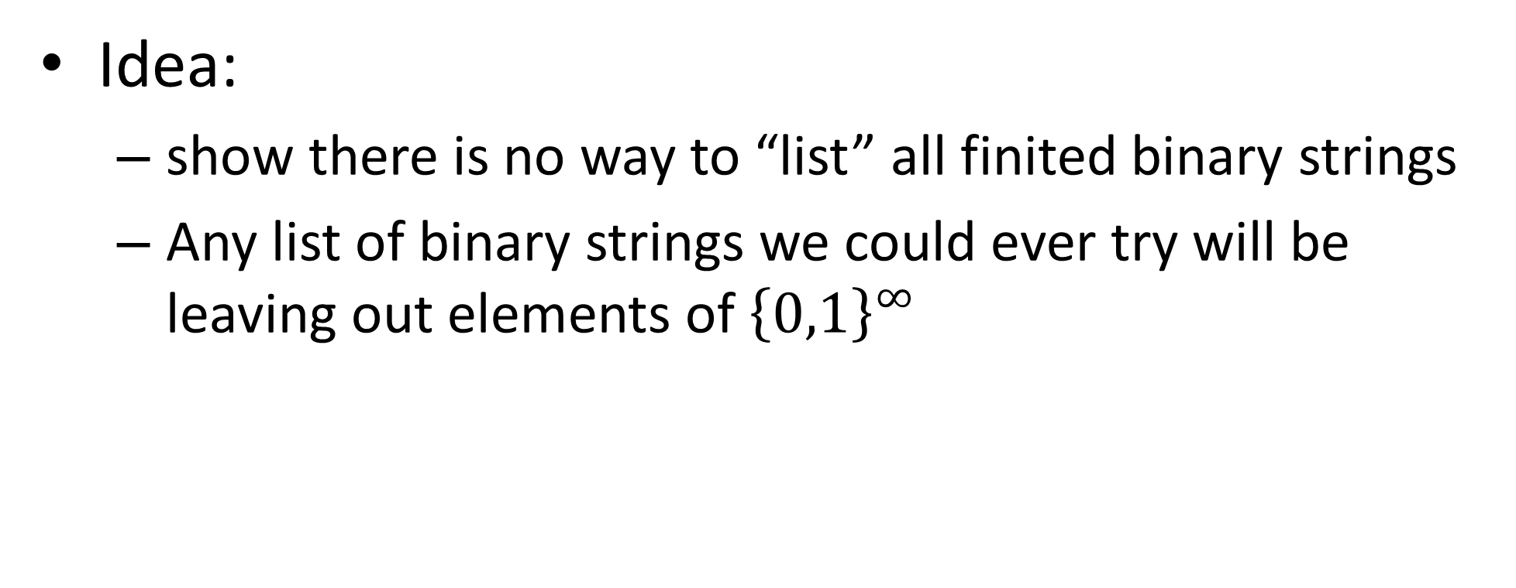

$$\left|{\left\{0,1\right\}}^{∞}\right|>|\text{ℕ}\text{|}$$
Idea:
show there is no way to “list” all finited binary strings
Any list of binary strings we could ever try will be leaving out elements of ${\left\{0,1\right\}}^{∞}$

Slide 15
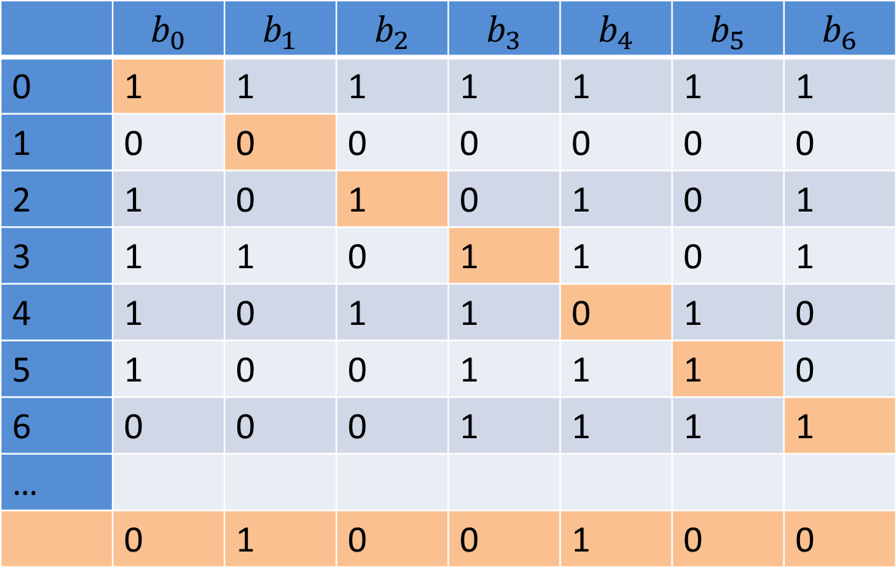

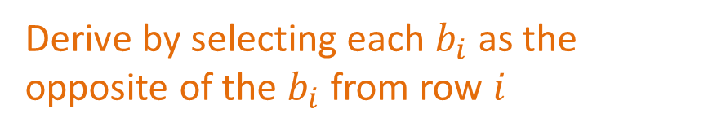
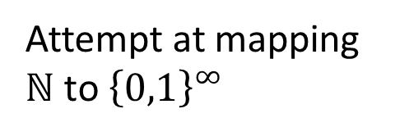
$$\left|{\left\{0,1\right\}}^{∞}\right|>|\text{ℕ}\text{|}$$
 | $$b_{0}$$ | $$b_{1}$$ | $$b_{2}$$ | $$b_{3}$$ | $$b_{4}$$ | $$b_{5}$$ | $$b_{6}$$
0 | 1 | 1 | 1 | 1 | 1 | 1 | 1
1 | 0 | 0 | 0 | 0 | 0 | 0 | 0
2 | 1 | 0 | 1 | 0 | 1 | 0 | 1
3 | 1 | 1 | 0 | 1 | 1 | 0 | 1
4 | 1 | 0 | 1 | 1 | 0 | 1 | 0
5 | 1 | 0 | 0 | 1 | 1 | 1 | 0
6 | 0 | 0 | 0 | 1 | 1 | 1 | 1
…
 | 0 | 1 | 0 | 0 | 1 | 0 | 0
Attempt at mapping $\text{ℕ}$ to ${\left\{0,1\right\}}^{∞}$
A string that our attempt missed
Derive by selecting each $b_{i}$ as the opposite of the $b_{i}$ from row $i$

Slide 16
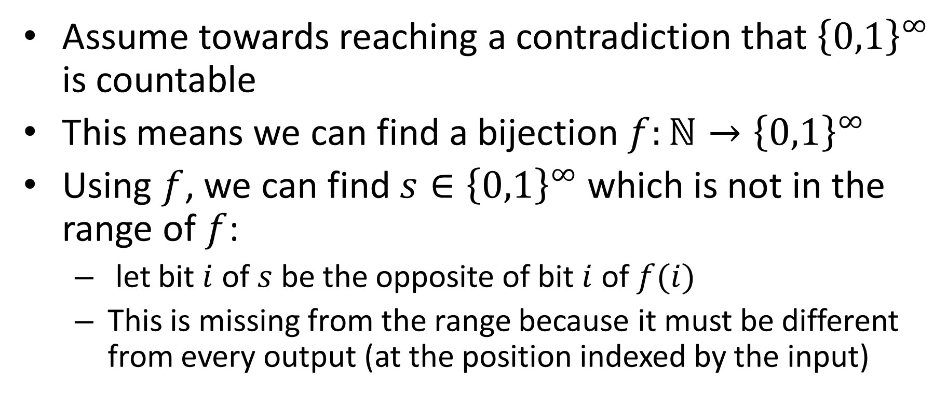
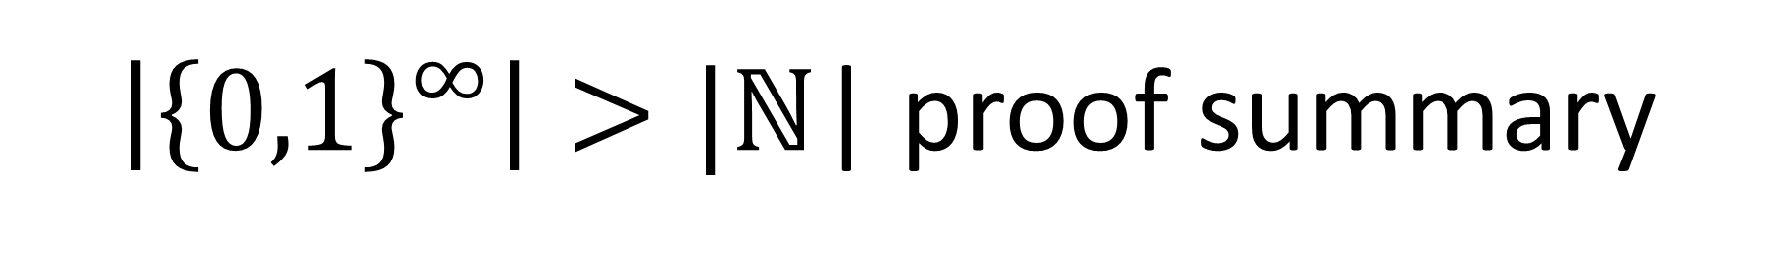
$\left|{\left\{0,1\right\}}^{∞}\right|>|\text{ℕ}\text{|}$ proof summary
Assume towards reaching a contradiction that ${\left\{0,1\right\}}^{∞}$ is countable
This means we can find a bijection $f:\text{ℕ}→{\left\{0,1\right\}}^{∞}$
Using $f$, we can find $s∈{\left\{0,1\right\}}^{∞}$ which is not in the range of $f$:
let bit $i$ of $s$ be the opposite of bit $i$ of $f(i)$
This is missing from the range because it must be different from every output (at the position indexed by the input)

Slide 17
Other countable/uncountable sets
Countable sets:
Integers
Rational numbers
Any finite set
Uncountable Sets:
Real numbers
The power set of any infinite set

Slide 18
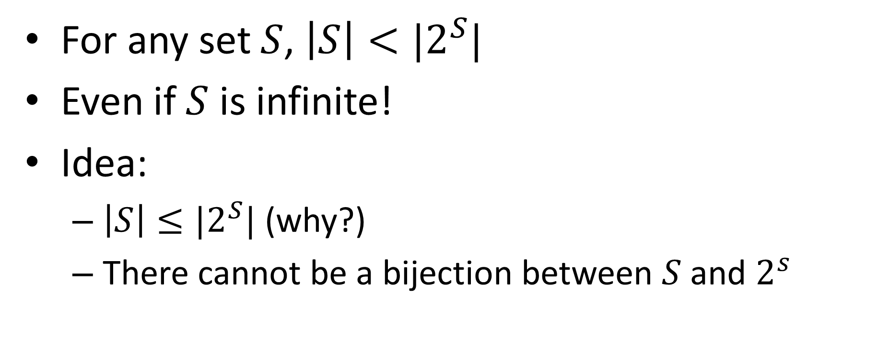
Cantor’s Theorem
For any set $S$, $\left|S\right|<|2^{S}|$
Even if $S$ is infinite!
Idea:
$\left|S\right|≤|2^{S}|$ (why?)
There cannot be a bijection between $S$ and $2^{s}$

Slide 19
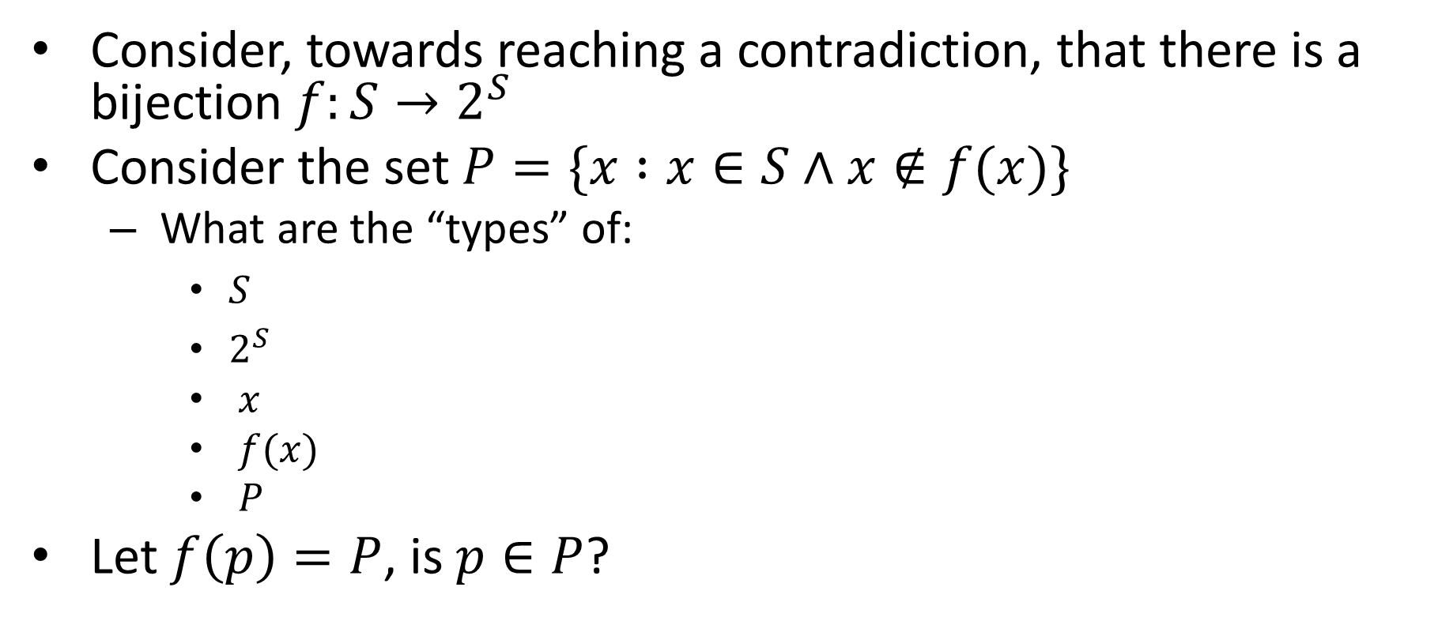

$$\left|S\right|≠|2^{S}|$$
Consider, towards reaching a contradiction, that there is a bijection $f:S→2^{S}$
Consider the set $P=\{x :x∈S∧x∉f(x)\}$
What are the “types” of:
$S$
$2^{S}$
$x$
$f(x)$
$P$
Let $f\left(p\right)=P$, is $p∈P$?

Slide 20
Conclusion
There are countably many strings
And therefore binary strings, programs, etc.
We can’t write down (or compute) all things from an uncountable set
There are uncountably many functions
Some functions can’t be implemented

Slide 21
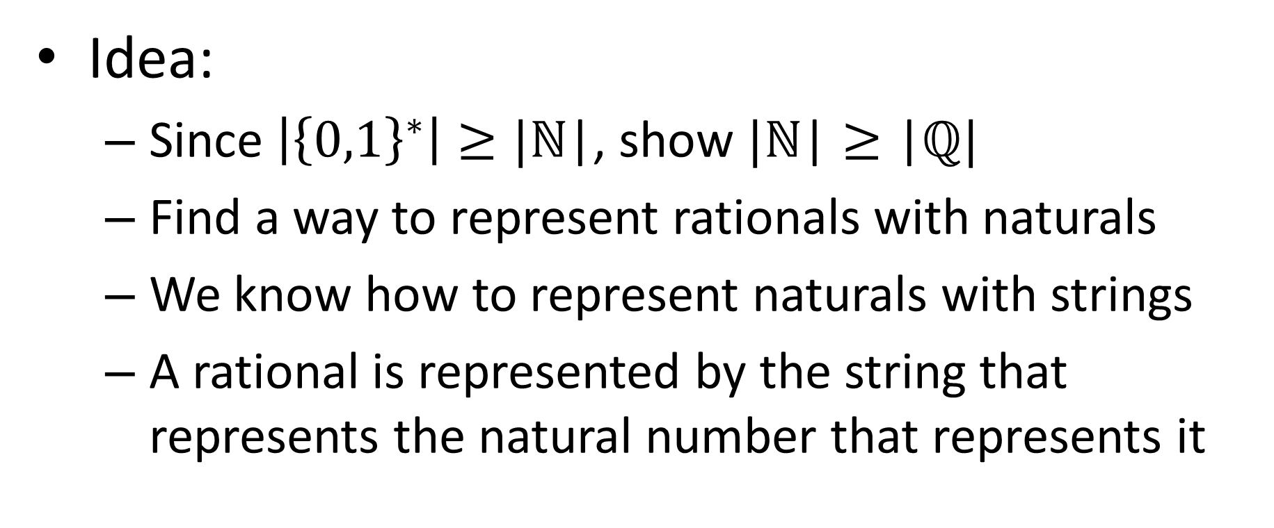
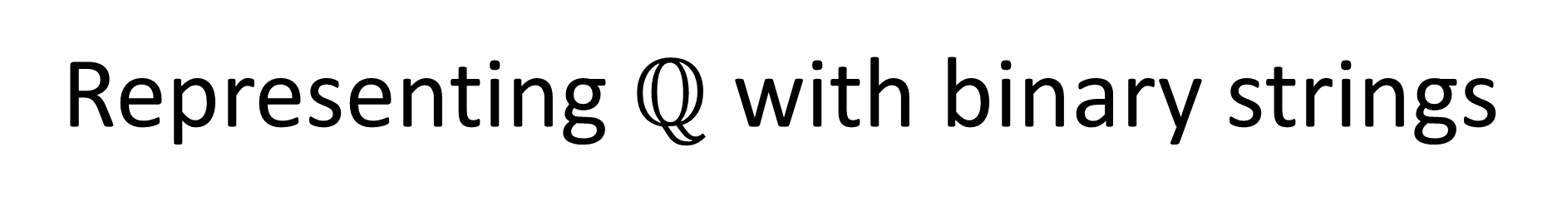
Representing $ℚ$ with binary strings
Idea:
Since $\left|{\left\{0,1\right\}}^{∗}\right|≥|\text{ℕ}\text{|}$, show $|\text{ℕ}\text{|}≥\text{|}ℚ|$
Find a way to represent rationals with naturals
We know how to represent naturals with strings
A rational is represented by the string that represents the natural number that represents it

Slide 22



Representing $ℚ$ with $\text{ℕ}$
$$ℕ$$
0 1 2 3 4 5
$$ℕ$$
0
0/0 0/1 0/2 0/3 0/4 0/5
…
1
1/0 1/1 1/2 1/3 1/4 1/5
…
2
2/0 2/1 2/2 2/3 2/4 2/5
…
3
3/0 3/1 3/2 3/3 3/4 3/5
…
4
4/0 4/1 4/2 4/3 4/4 4/5
…
…
…
…
…
…
…
…

Slide 23

$ℝ$ is uncountable
Show a subset of real numbers is uncountable
Specifically, the set of all real numbers between 0 and 1 where the fractional portion is only 1s and 0s
E.g. 0.00111101101111
We get different reals for each different fractional part, there are the same number of fractional parts as there are infinite strings

