Slide 1
CS3102 Theory of Computation
www.cs.virginia.edu/~njb2b/cstheory/s2020
Warm up:
How might we compare models of computing?
By what metrics might we say model A is “better” than model B?

Slide 2
Logistics
Exercise 0 was due last week
Didn’t complete it? No problem (this time)! Just do it soon. Ask for an extension on the assignment page.
First Quiz was due today
Didn’t complete it? No problem (this time)! Ask for an extension on the assignment page.
Exercise 1 is out.

Slide 3
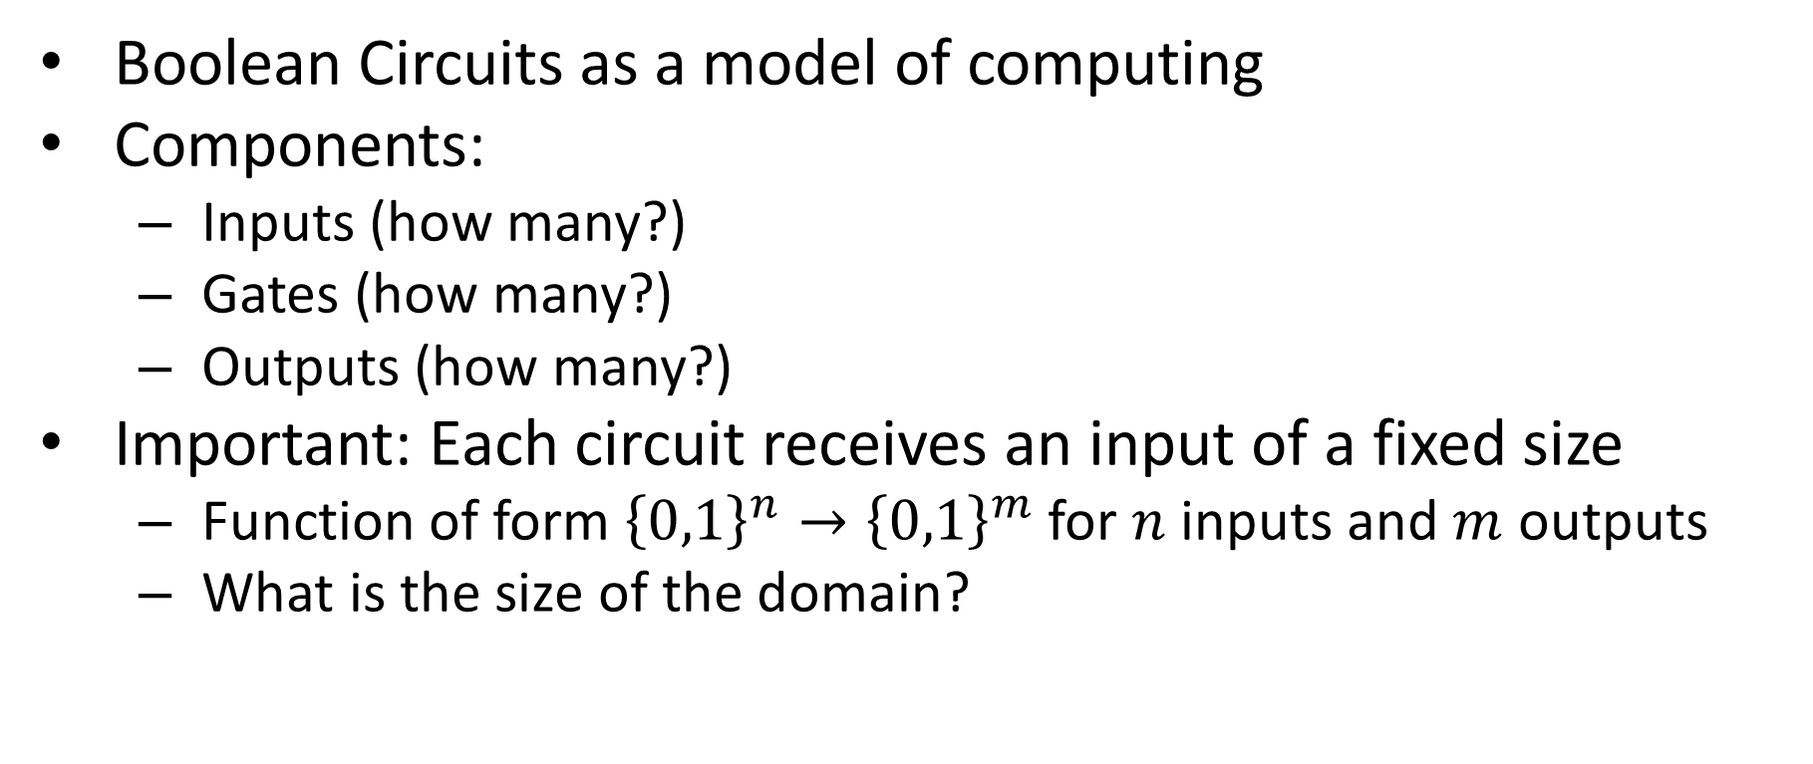
Last Time
Boolean Circuits as a model of computing
Components:
Inputs (how many?)
Gates (how many?)
Outputs (how many?)
Important: Each circuit receives an input of a fixed size
Function of form ${\left\{0,1\right\}}^{n}→{\left\{0,1\right\}}^{m}$ for $n$ inputs and $m$ outputs
What is the size of the domain?

Slide 4
Defining the AON circuit model
Define how to represent a computation
And/Or/Not circuit:
Number of inputs
Number of outputs
Gates and their labels
Wires connecting the above
Define how to perform an execution
For each component, find its value once all its inputs are defined
Inputs start of with their value defined
Things labelled as output are the result

Slide 5

NAND with AON
Build a circuit for $NAND$
$NAND\left(a,b\right)=¬(a∧b)$
Input | Output
00 | 1
01 | 1
10 | 1
11 | 0
=

Slide 6
Today
Comparing models of computing
And/Or/Not circuits vs NAND circuits
Circuits vs languages

Slide 7

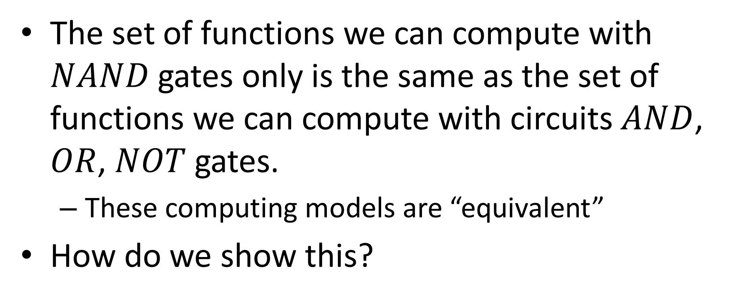
NAND Circuits
$$=$$
The set of functions we can compute with $NAND$gates only is the same as the set of functions we can compute with circuits $AND$, $OR$, $NOT$ gates.
These computing models are “equivalent”
How do we show this?

Slide 8

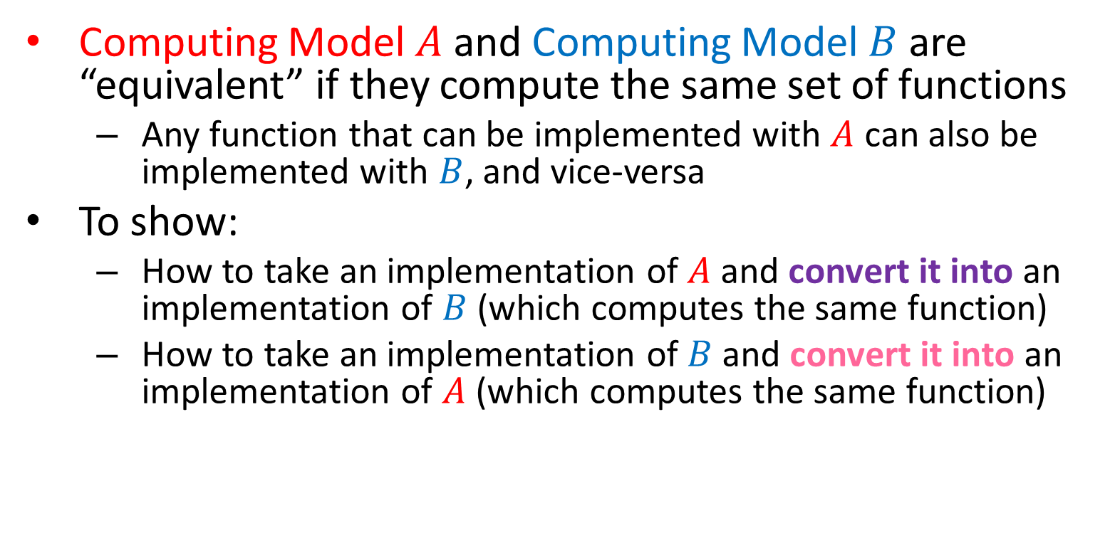

Equivalence of Computing Models
Computing Model $A$ and Computing Model $B$ are “equivalent” if they compute the same set of functions
Any function that can be implemented with $A$ can also be implemented with $B$, and vice-versa
To show:
How to take an implementation of $A$ and convert it into an implementation of $B$ (which computes the same function)
How to take an implementation of $B$ and convert it into an implementation of $A$ (which computes the same function)
$$A$$
$$B$$

Slide 9

AND/OR/NOT using NAND
$AND$
$OR$
$NOT$

Slide 10
NAND = AON
NAND to AON
AON to NAND
Everywhere you see:
Everywhere you see:
Instead put:
Instead put:
NOT
NOT
NOT
OR

Slide 11








Majority using NAND
$$a$$
5 gates
$$b$$
$$y$$
$$c$$
$$a$$
24 gates
$$b$$
$$y$$
$$c$$

Slide 12
Takeaway
We now have a hardware-based model of computing to work with
Actually two!
Meant to be similar to how CPUs operate
We’ve already made proofs about models of computation!
While some models are equivalent in what they can compute, they may not be in how efficiently they can do it
Next time: a software-like model of computing

Slide 13
A circuit-like programming language
Define how to represent a computation
Inputs as positional arguments
Outputs as return statements
Variable assignments using boolean operators AND/OR/NOT
Define how to perform an execution
Evaluate each variable assignment sequentially
AON-Straightline

Slide 14
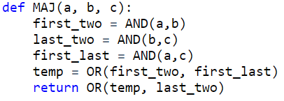
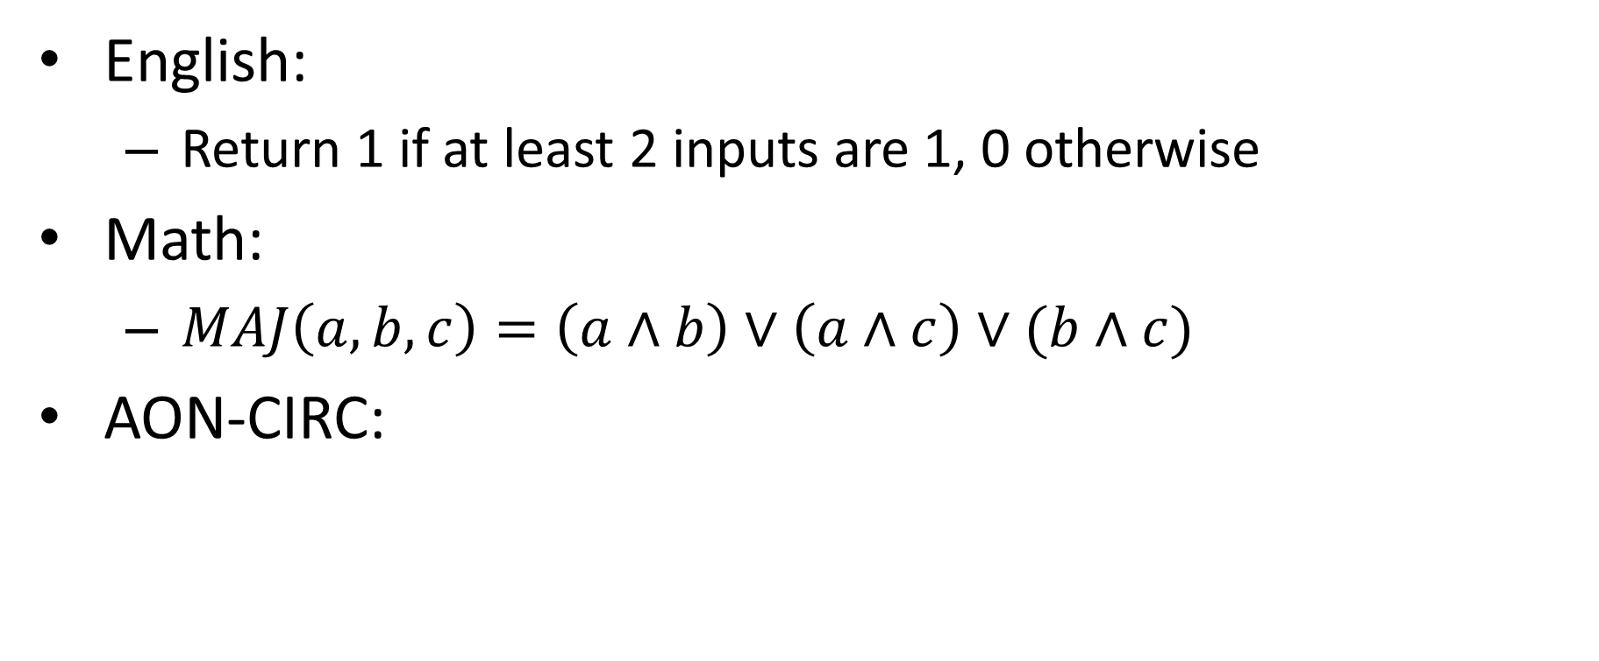
MAJ with our language
English:
Return 1 if at least 2 inputs are 1, 0 otherwise
Math:
$MAJ\left(a,b,c\right)=\left(a∧b\right)∨\left(a∧c\right)∨(b∧c)$
AON-CIRC:

Slide 15



With your neighbors
$$NAND$$
Input | Output
00 | 1
01 | 1
10 | 1
11 | 0
Write AON-straightline programs:
$NAND\left(a,b\right)$
$XOR(a,b)$
$$XOR$$
Input | Output
00 | 0
01 | 1
10 | 1
11 | 0

Slide 16

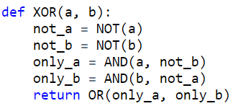
With your neighbors
$$NAND$$
Input | Output
00 | 1
01 | 1
10 | 1
11 | 0
Write AON-straightline programs:
$NAND\left(a,b\right)$
$XOR(a,b)$
$$XOR$$
Input | Output
00 | 0
01 | 1
10 | 1
11 | 0

Slide 17
AON-Straightline = NAND-Straightline
Show any function I can implement in the AON-Straightline language can be implemented such that the only operation is NAND

Slide 18
NAND Straightline = AON Straightline
NAND -> AON
AON -> NAND

Slide 19
NAND Straightline = AON Straightline
NAND -> AON
AON -> NAND
x = NAND(a,b)
Becomes
temp = AND(a,b)
x = NOT(temp)
​
x = OR(a,b)​
Becomes​
t1 = NAND(a,a)
t2 = NAND(b,b)
x= NAND(t1,t2)
x = NOT(a)
Becomes
x= NAND(a,a)
x = AND(a,b)
Becomes
temp= NAND(a,b)
x=NAND(temp,temp)

Slide 20
Circuits equivalent to AON Straightline
How do we show this?

Slide 21
Convert Expression of each into the other
NAND-Straightline Components
Inputs as positional arguments
Outputs as return statements
Variable assignments using boolean operator NAND
NAND-Circuit Components
Number of inputs
Number of outputs
Gates and their labels
Wires connecting the above

Slide 22
Circuit to Straightline
Inputs as positional arguments
Come from:
Outputs as return statements
Come from:
Variable assignments using boolean operator NAND
Come from:

Slide 23
Circuit to Straightline

Slide 24
Straightline to Circuit
Number of inputs
Come from:
Number of outputs
Come from:
Gates and their labels
Come from:
Wires connecting the above
Come from:

Slide 25
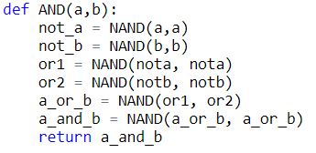
Straightline to Circuit

