Slide 1
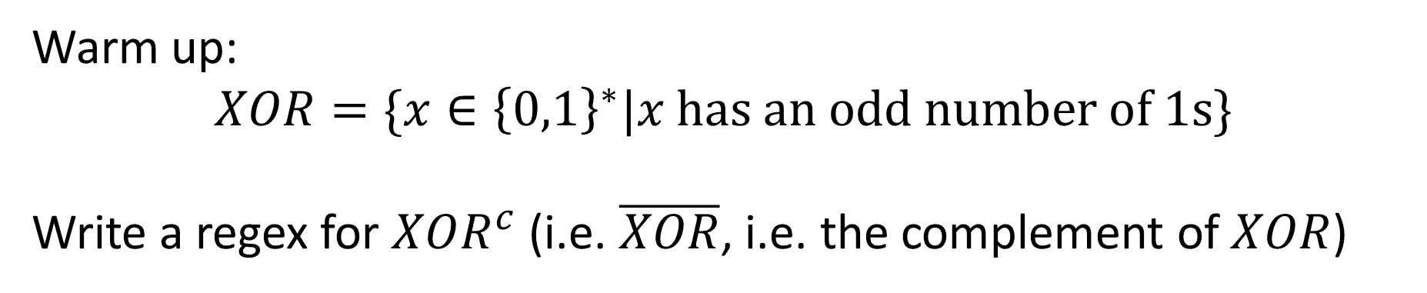
CS3102 Theory of Computation
Warm up:
$$XOR=\{x∈{\left\{0,1\right\}}^{∗}|x has an odd number of 1s\}$$
Write a regex for $XOR^{c}$ (i.e. $\overline{XOR}$, i.e. the complement of $XOR$)

Slide 2


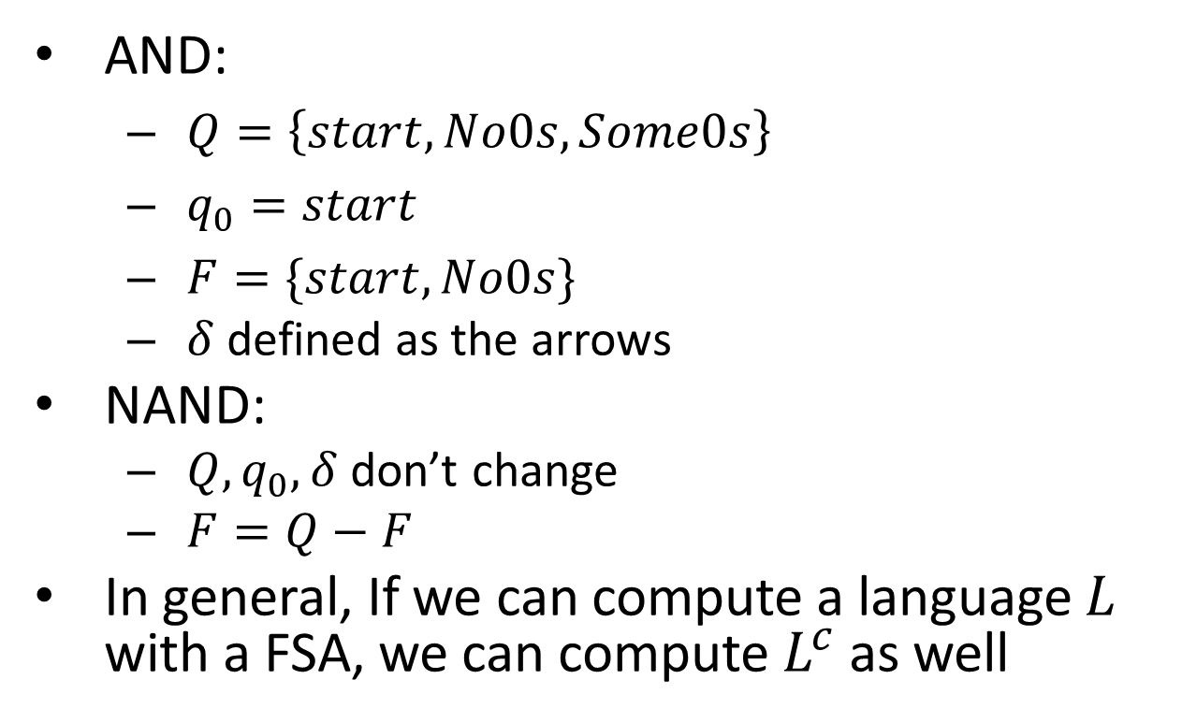



AND to NAND
AND:
$Q=\left\{start, No0s, Some0s\right\}$
$q_{0}=start$
$F=\{start, No0s\}$
$δ$ defined as the arrows
NAND:
$Q, q_{0}, δ$ don’t change
$F=Q−F$
In general, If we can compute a language $L$ with a FSA, we can compute $L^{c}$ as well
Some 0s
$$0,1$$
$$0$$
_{start}
$$0$$
$$1$$
_{No 0s}
$$1$$

Slide 3
Logistics
Homework released tomorrow
See submission page for deadlines (I’m still processing your quiz 3)
Quiz will be released Thursday, due Tuesday

Slide 4
Last Time
Languages and decision problems
A different way of thinking about functions
Introducing Finite State Automata
DFA: Deterministic finite state automaton
Language of a FSA: The set of strings for which that automaton returns 1

Slide 5
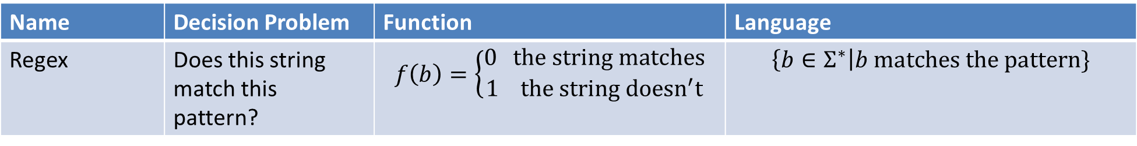
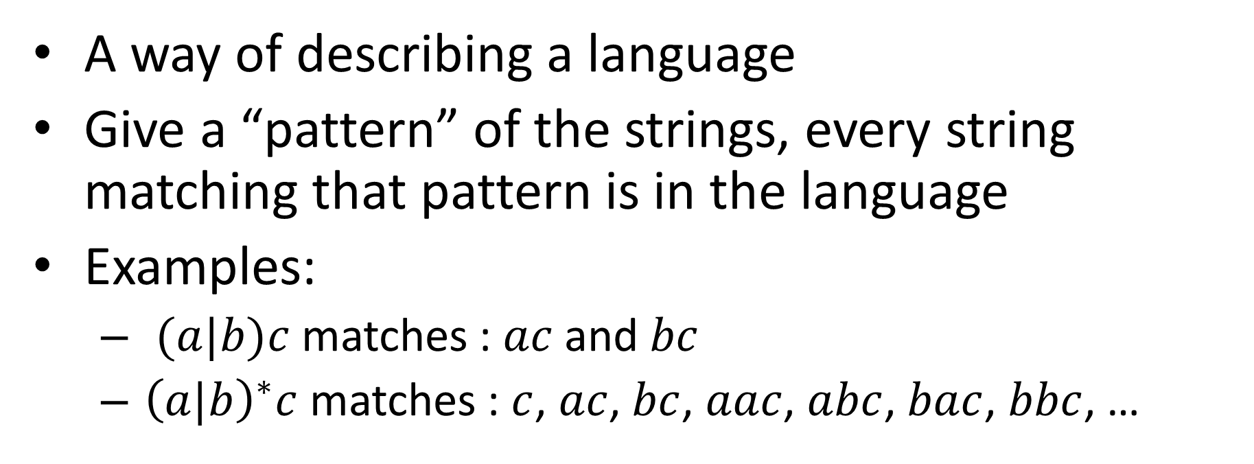
Regular Expressions
Name | Decision Problem | Function | Language
Regex | Does this string match this pattern? | $$f\left(b\right)=\left\{\begin{aligned}0 the string matches \\ 1 the string doesn^{′}t\end{aligned}\right.$$ | $$\left\{b∈Σ^{∗}\right|b matches the pattern\}$$
A way of describing a language
Give a “pattern” of the strings, every string matching that pattern is in the language
Examples:
$(a|b)c$ matches : $ac$ and $bc$
${\left(a|b\right)}^{∗}c$ matches : $c$, $ac$, $bc$, $aac$, $abc$, $bac$, $bbc$, …

Slide 6
FSA = Regex
Finite state Automata and Regular Expressions are equivalent models of computing
Any language I can represent as a FSA I can also represent as a Regex (and vice versa)
How would I show this?

Slide 7

Showing FSA $≤$ Regex
Show how to convert any FSA into a Regex for the same language
We’re going to skip this:
It’s tedious, and people virtually never go this direction in practice, but you can do it (see textbook theorem 9.12)

Slide 8

Showing Regex $≤$ FSA
Show how to convert any regex into a FSA for the same language
Idea: show how to build each “piece” of a regex using FSA

Slide 9
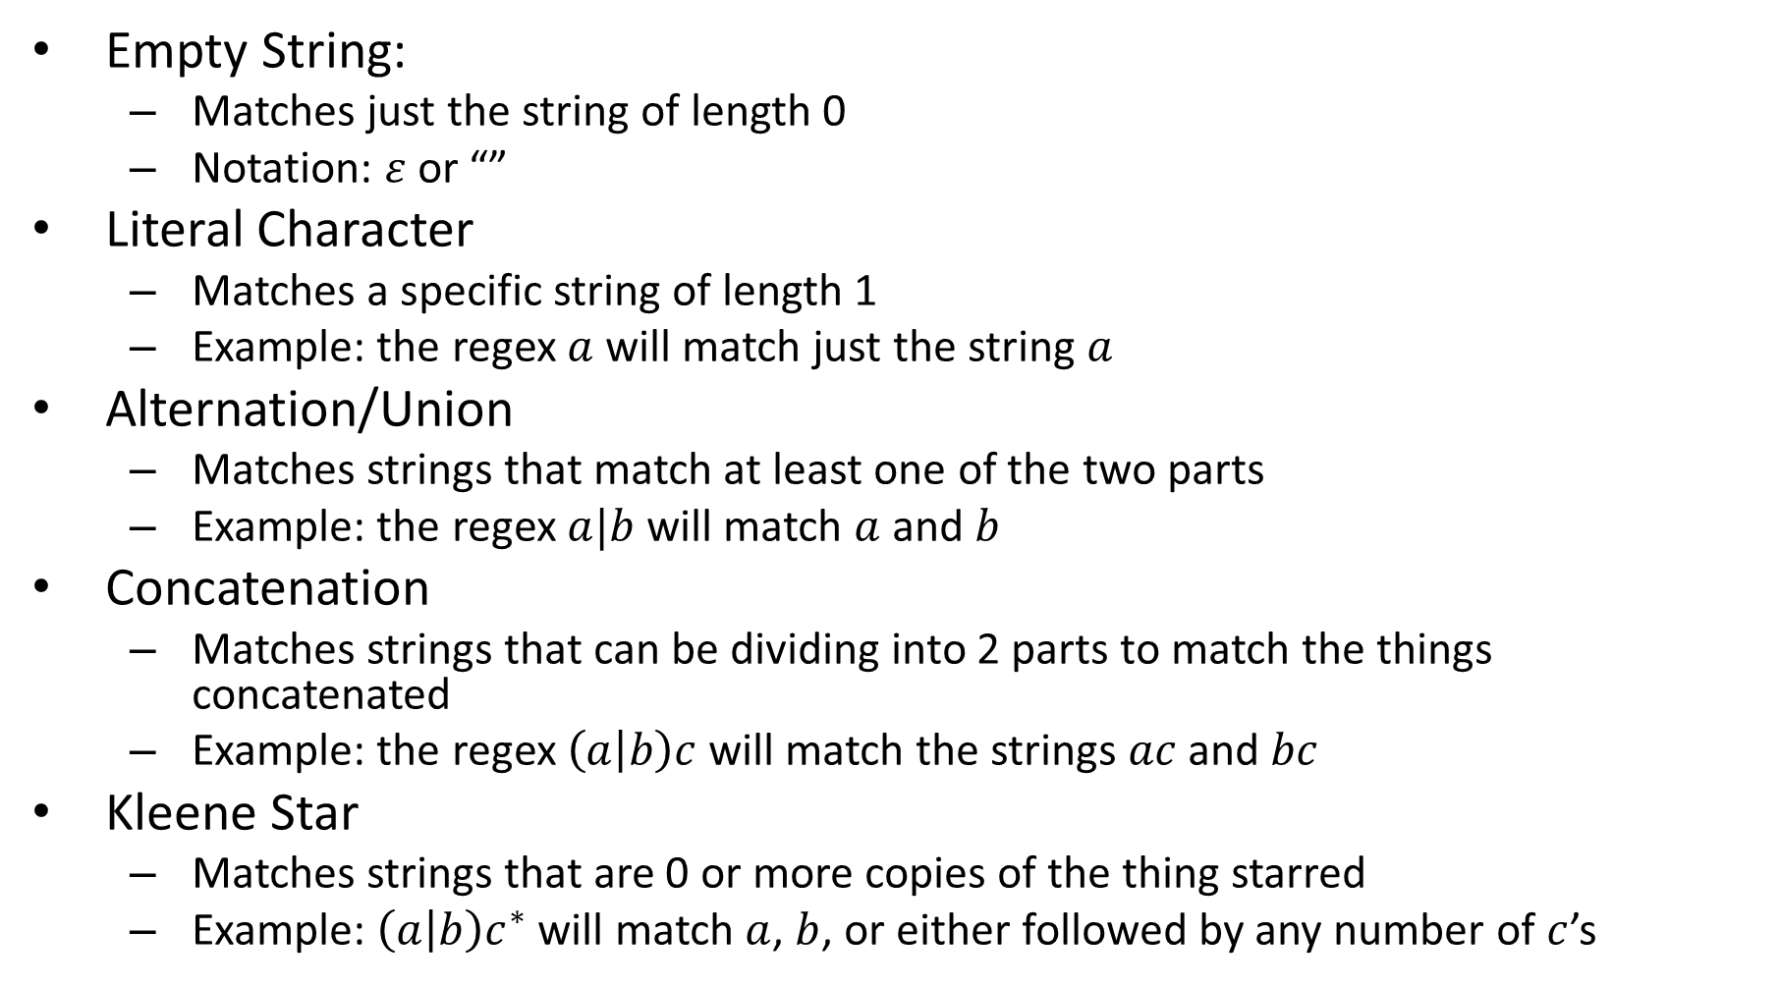
“Pieces” of a Regex
Empty String:
Matches just the string of length 0
Notation: $ε$ or “”
Literal Character
Matches a specific string of length 1
Example: the regex $a$ will match just the string $a$
Alternation/Union
Matches strings that match at least one of the two parts
Example: the regex $a|b$ will match $a$ and $b$
Concatenation
Matches strings that can be dividing into 2 parts to match the things concatenated
Example: the regex $\left(a | b\right)c$ will match the strings $ac$ and $bc$
Kleene Star
Matches strings that are 0 or more copies of the thing starred
Example: $\left(a | b\right)c^{∗}$ will match $a$, $b$, or either followed by any number of $c$’s

Slide 10
FSA for the empty string

Slide 11
FSA for a literal character

Slide 12
FSA for Alternation/Union
Tricky…
What does it need to do?

Slide 13
Recall: AND to NAND
AND:
$Q=\left\{start, No0s, Some0s\right\}$
$q_{0}=start$
$F=\{start, No0s\}$
$δ$ defined as the arrows
NAND:
$Q, q_{0}, δ$ don’t change
$F=Q−F$
In general, If we can compute a language $L$ with a FSA, we can compute $L^{c}$ as well
Some 0s
$$0,1$$
$$0$$
_{start}
$$0$$
$$1$$
_{No 0s}
$$1$$

Slide 14
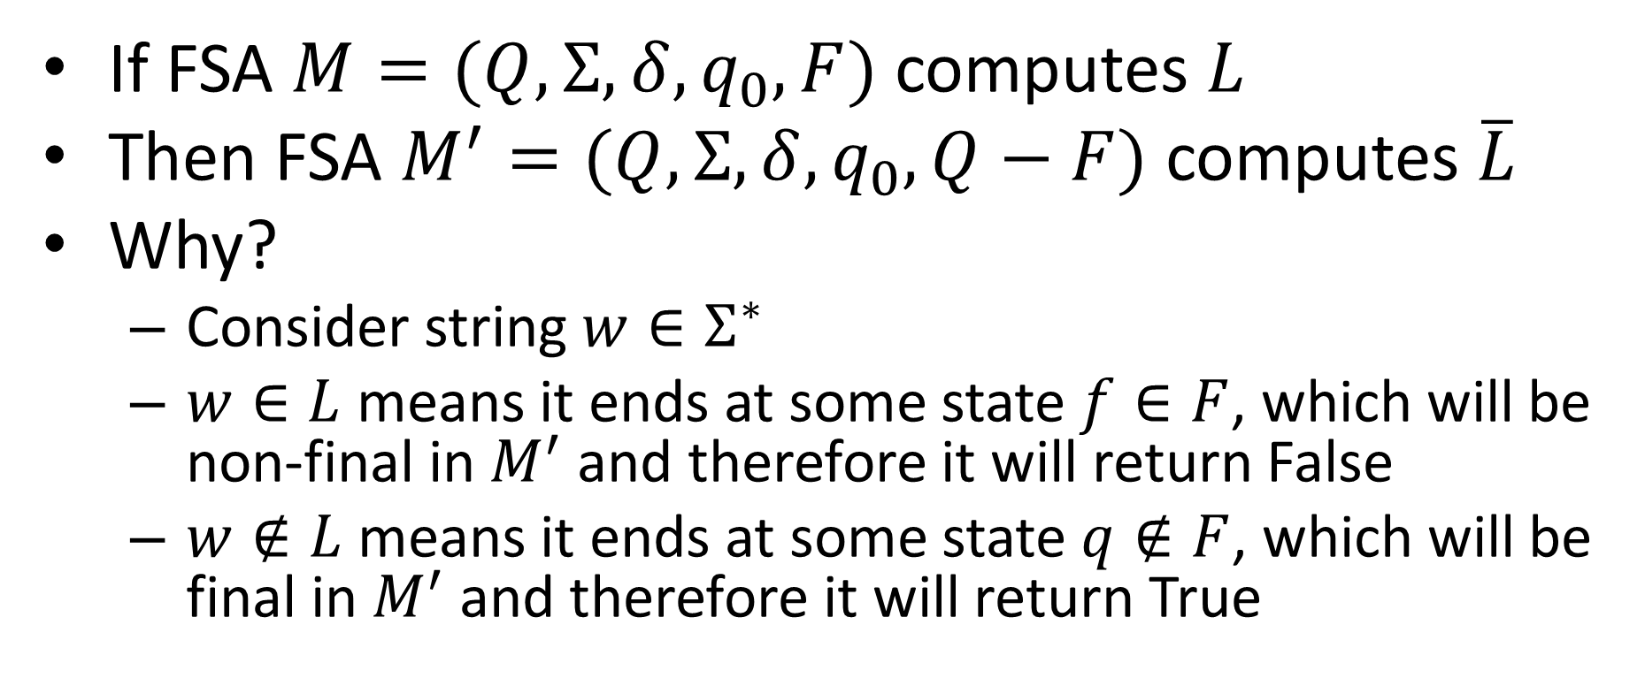
Computing Complement
If FSA $M=(Q,Σ,δ,q_{0},F)$ computes $L$
Then FSA $M^{′}=(Q, Σ,δ,q_{0},Q−F)$ computes $\overline{L}$
Why?
Consider string $w∈Σ^{∗}$
$w∈L$ means it ends at some state $f∈F$, which will be non-final in $M^{′}$ and therefore it will return False
$w∉L$ means it ends at some state $q∉F$, which will be final in $M^{′}$ and therefore it will return True

Slide 15
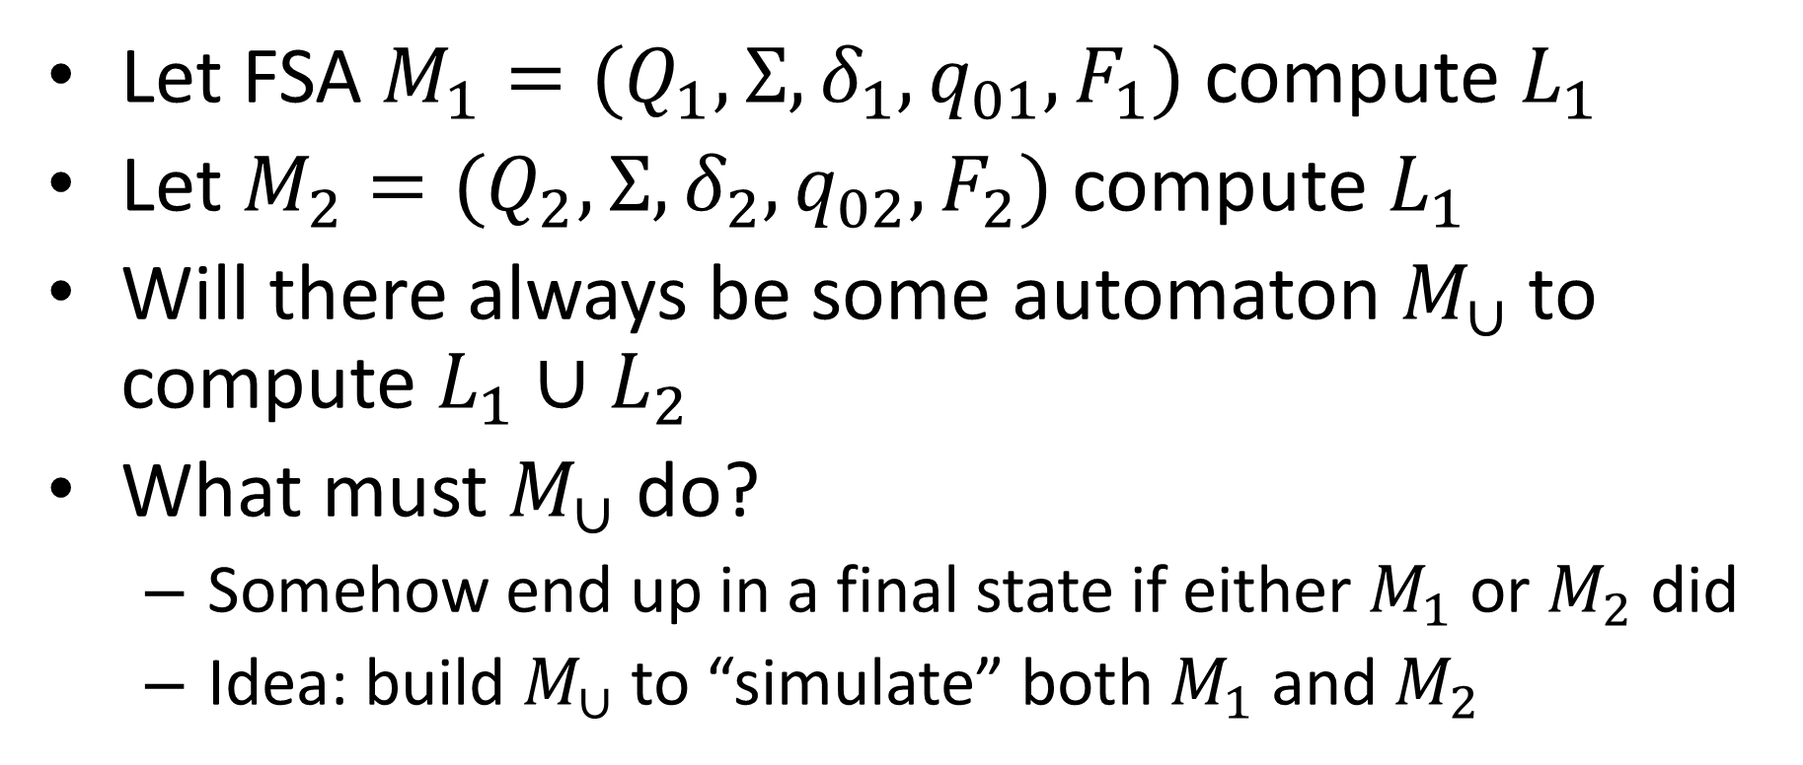
Computing Union
Let FSA $M_{1}=(Q_{1},Σ,δ_{1},q_{01},F_{1})$ compute $L_{1}$
Let $M_{2}=(Q_{2},Σ,δ_{2},q_{02},F_{2})$ compute $L_{1}$
Will there always be some automaton $M_{∪}$ to compute $L_{1}∪L_{2}$
What must $M_{∪}$ do?
Somehow end up in a final state if either $M_{1}$ or $M_{2}$ did
Idea: build $M_{∪}$ to “simulate” both $M_{1}$ and $M_{2}$

Slide 16





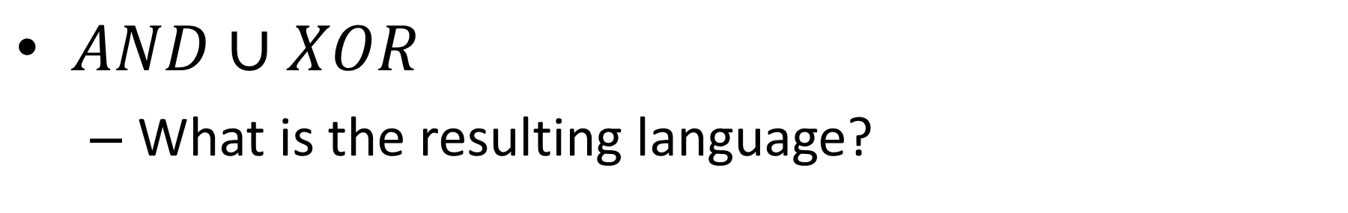






Example
$AND∪XOR$
What is the resulting language?
$$M_{AND}$$
Some 0s
$$0,1$$
$$0$$
$$M_{XOR}$$
$$1$$
_{start}
$$0$$
$$0$$
Odd
Even
$$0$$
$$1$$
No 0s
$$1$$
$$1$$

Slide 17








Cross-Product Construction
2 machines at once!
Start
Even
Start
Odd
$$M_{AND}$$
Some 0s
$$0,1$$
$$0$$
_{start}
$$0$$
Some0s
Even
Some0s
Odd
$$1$$
No 0s
$$1$$
$$M_{XOR}$$
$$1$$
No0s
Even
No0s
Odd
$$0$$
Even
Odd
$$0$$
$$1$$

Slide 18










Cross-Product Construction
2 machines at once!
Start
Even
Start
Odd
$$M_{AND}$$
$$1$$
Some 0s
$$0,1$$
$$0$$
$$0$$
$$1$$
_{start}
$$0$$
Some0s
Even
Some0s
Odd
$$0$$
$$0$$
$$1$$
No 0s
$$1$$
$$1$$
$$0$$
$$0$$
$$M_{XOR}$$
$$1$$
No0s
Even
$$1$$
No0s
Odd
$$0$$
Even
Odd
$$0$$
$$1$$
$$1$$

Slide 19
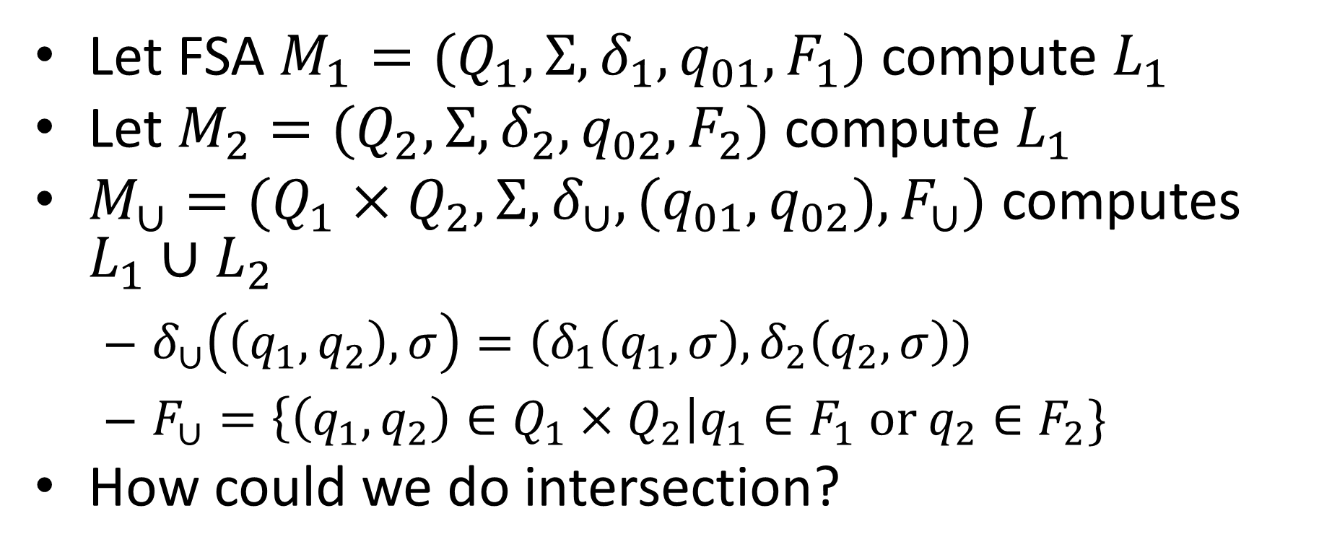
Cross Product Construction
Let FSA $M_{1}=(Q_{1},Σ,δ_{1},q_{01},F_{1})$ compute $L_{1}$
Let $M_{2}=(Q_{2},Σ,δ_{2},q_{02},F_{2})$ compute $L_{1}$
$M_{∪}=(Q_{1}×Q_{2},Σ, δ_{∪}, (q_{01},q_{02}),F_{∪})$ computes $L_{1}∪L_{2}$
$δ_{∪}\left(\left(q_{1},q_{2}\right), σ\right)=\left(δ_{1}\left(q_{1},σ\right), δ_{2}\left(q_{2}, σ\right)\right)$
$F_{∪}=\left\{\left(q_{1},q_{2}\right)∈Q_{1}×Q_{2}\right|q_{1}∈F_{1} or q_{2}∈F_{2}\}$
How could we do intersection?

Slide 20
Non-determinism
Things could get easier if we “relax” our automata
So far:
Must have exactly one transition per character per state
Can only be in one state at a time
Non-deterministic Finite Automata:
Allowed to be in multiple (or zero) states!
Can have multiple or zero transitions for a character
Can take transitions without using a character
Models parallel computing

Slide 21


Nondeterminism
Driving to a friend’s house
Friend forgets to mention a fork in the directions
Which way do you go?
Why not both?
?

Slide 22
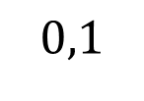
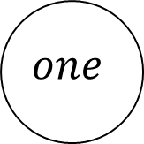
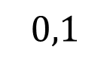
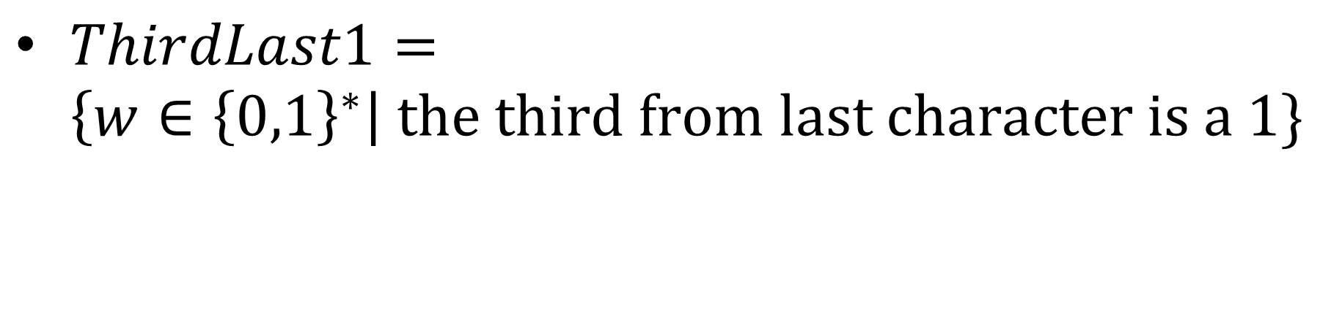

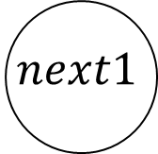
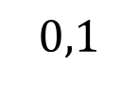

Example Non-deterministic Finite Automaton
$ThirdLast1=\left\{w∈{\left\{0,1\right\}}^{∗}\right| the third from last character is a 1\}$
$$0,1$$
$$next2$$
start
$$one$$
$$next1$$
$$1$$
$$0,1$$
$$0,1$$

Slide 23
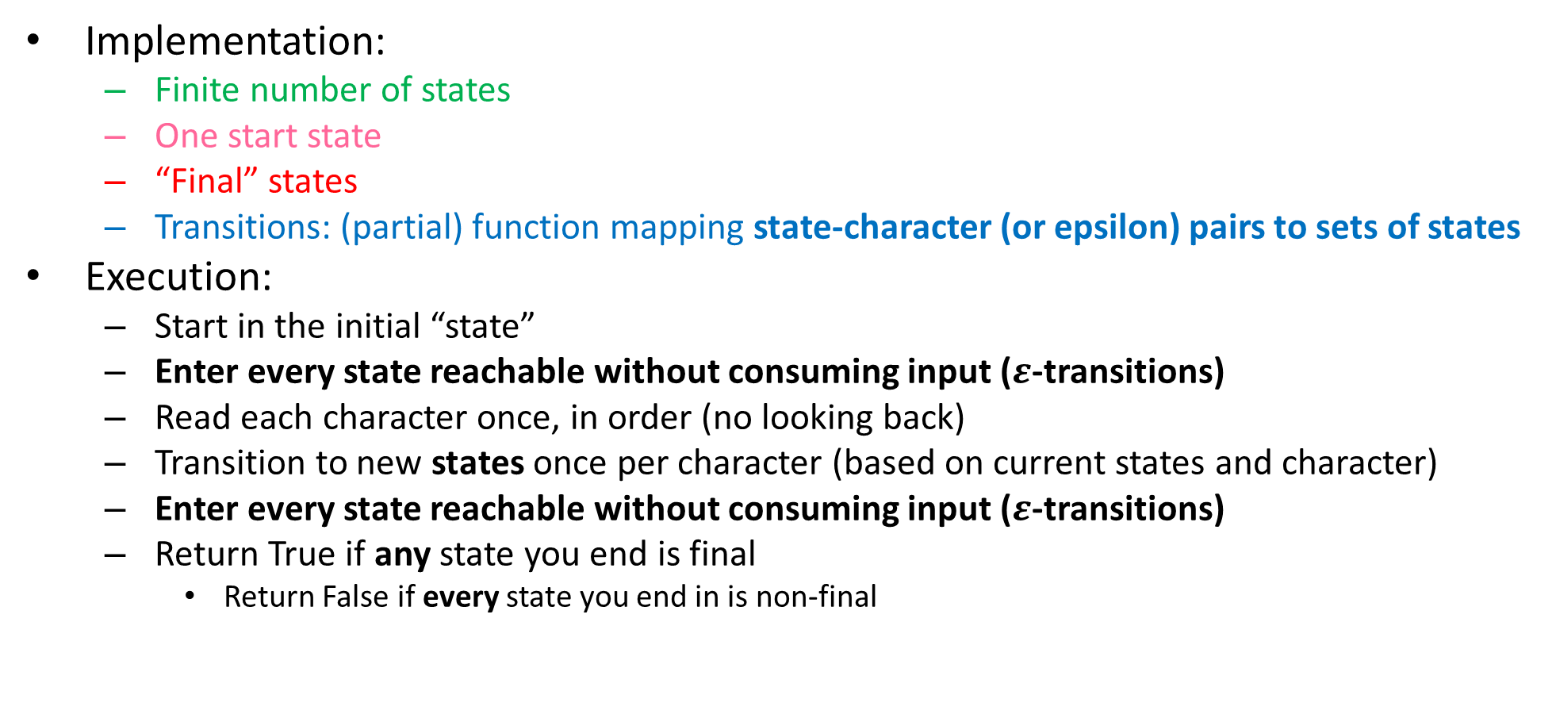
Non-Deterministic Finite State Automaton
Implementation:
Finite number of states
One start state
“Final” states
Transitions: (partial) function mapping state-character (or epsilon) pairs to sets of states
Execution:
Start in the initial “state”
Enter every state reachable without consuming input ($ε$-transitions)
Read each character once, in order (no looking back)
Transition to new states once per character (based on current states and character)
Enter every state reachable without consuming input ($ε$-transitions)
Return True if any state you end is final
Return False if every state you end in is non-final

Slide 24




Union Using Non-Determinism
Some 0s
$$0,1$$
$$0$$
New
start
_{start}
$$0$$
$$1$$
No 0s
$$1$$
$$1$$
$$0$$
Odd
Even
$$0$$
$$1$$

Slide 25


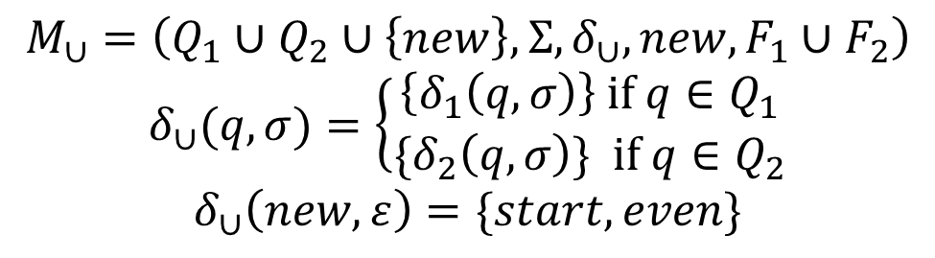
Union Using Non-Determinism
Some 0s
$$0,1$$
$$0$$
new
$$ε$$
_{start}
$$0$$
$$ε$$
$$1$$
No 0s
$$1$$
$$1$$
$$0$$
Odd
$$M_{∪}=\left(Q_{1}∪Q_{2}∪\left\{new\right\}, Σ, δ_{∪}, new,F_{1}∪F_{2}\right)$$
$$δ_{∪}(q,σ)=\left\{\begin{aligned}\left\{δ_{1}\left(q,σ\right)\right\} if q∈Q_{1} \\ {\{δ}_{2}\left(q,σ\right)\} if q∈Q_{2}\end{aligned}\right.$$
$$δ_{∪}\left(new, ε\right)=\{start, even\}$$
Even
$$0$$
$$1$$

Slide 26

What’s the language?
start
$$0,ε$$
final

Slide 27

NFA Example
$$\{w∈{\left\{0,1\right\}}^{∗}|w contains 0101\}$$

