Slide 1
CS3102 Theory of Computation
www.cs.virginia.edu/~njb2b/cstheory/s2020
Warm up:
Is it harder to TA a course, or to take it?

Slide 2
Logistics
Quiz and exercise 8 released
Quiz due Friday April 24 at 11:59pm
Exercise due Tuesday April 28 11:59pm

Slide 3
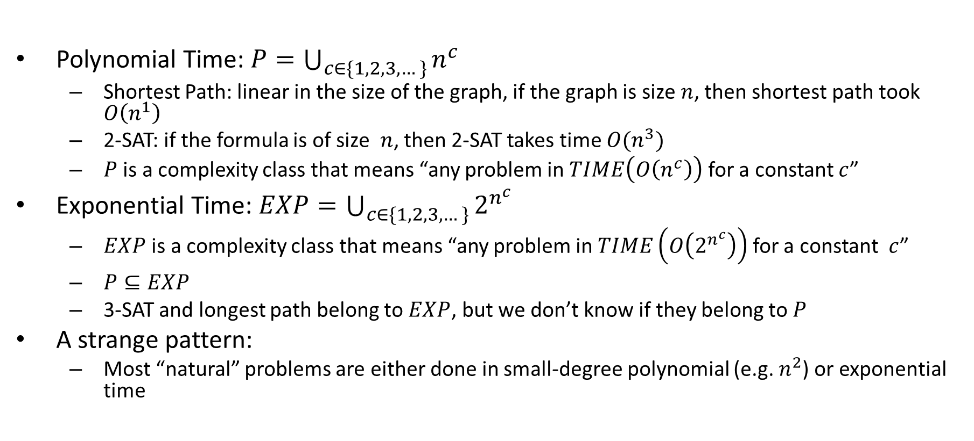
Polynomial Time vs Exponential Time
Polynomial Time: $P=\bigcup_{c∈\{1,2,3,…\}}{n^{c}}$
Shortest Path: linear in the size of the graph, if the graph is size $n$, then shortest path took $O\left(n^{1}\right)$
2-SAT: if the formula is of size $n$, then 2-SAT takes time ${O(n}^{3})$
$P$ is a complexity class that means “any problem in $TIME\left(O\left(n^{c}\right)\right)$ for a constant $c$”
Exponential Time: $EXP=\bigcup_{c∈\{1,2,3,…\}}{2^{n^{c}}}$
$EXP$ is a complexity class that means “any problem in $TIME\left(O\left(2^{n^{c}}\right)\right)$ for a constant $c$”
$P⊆EXP$
3-SAT and longest path belong to $EXP$, but we don’t know if they belong to $P$
A strange pattern:
Most “natural” problems are either done in small-degree polynomial (e.g. $n^{2}$) or exponential time

Slide 4
Tractability
Tractable:
Feasible to solve in the “real world”
Intractable:
Infeasible to solve in the “real world”
Whether a problem is considered “tractable” or “intractable” depends on the use case
For theory: Tractable = polynomial time, Intractable = Exponential time

Slide 5
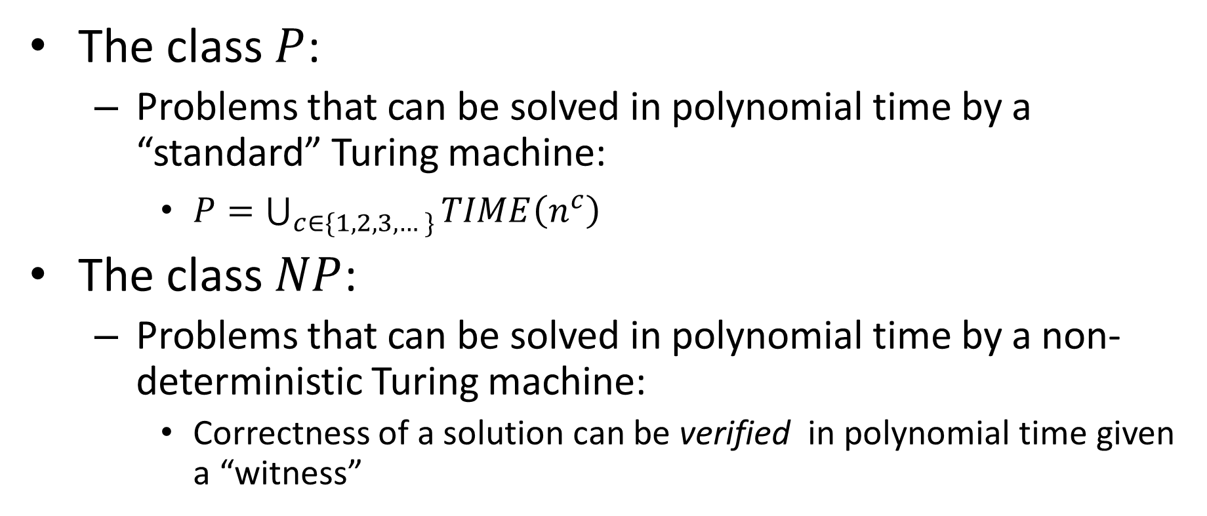
P vs NP
The class $P$:
Problems that can be solved in polynomial time by a “standard” Turing machine:
$P=\bigcup_{c∈\{1,2,3,…\}}{TIME\left(n^{c}\right)}$
The class $NP$:
Problems that can be solved in polynomial time by a non-deterministic Turing machine:
Correctness of a solution can be verified in polynomial time given a “witness”

Slide 6


Nondeterminism
Driving to a friend’s house
Friend forgets to mention a fork in the directions
Which way do you go?
Why not both?
?

Slide 7

$$P⊆NP$$
Why?
Deterministic machines are a “special case” of non-deterministic machines that don’t use their “power”
Any Turing machine that is a polynomial-time deterministic machine is also a polynomial-time non-determinstic machine

Slide 8
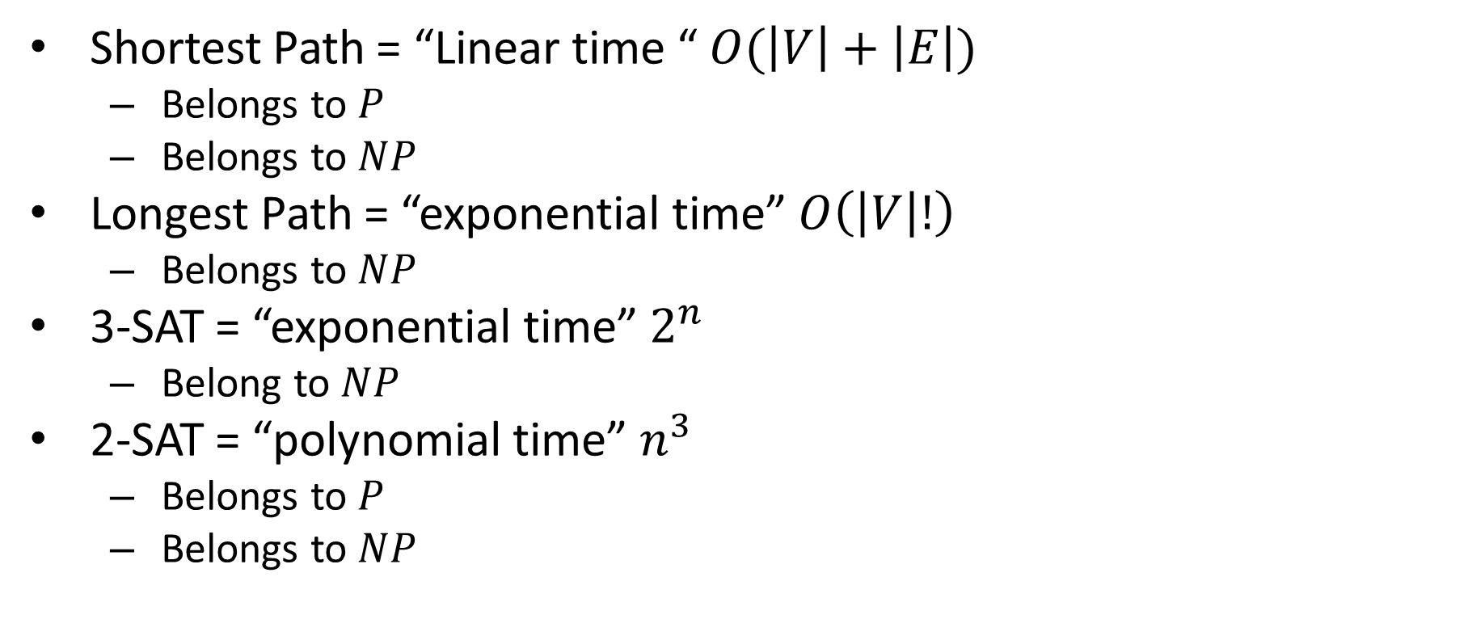
Last class
Shortest Path = “Linear time “ $O(\left|V\right|+\left|E\right|)$
Belongs to $P$
Belongs to $NP$
Longest Path = “exponential time” $O\left(\left|V\right|!\right)$
Belongs to $NP$
3-SAT = “exponential time” $2^{n}$
Belong to $NP$
2-SAT = “polynomial time” $n^{3}$
Belongs to $P$
Belongs to $NP$

Slide 9
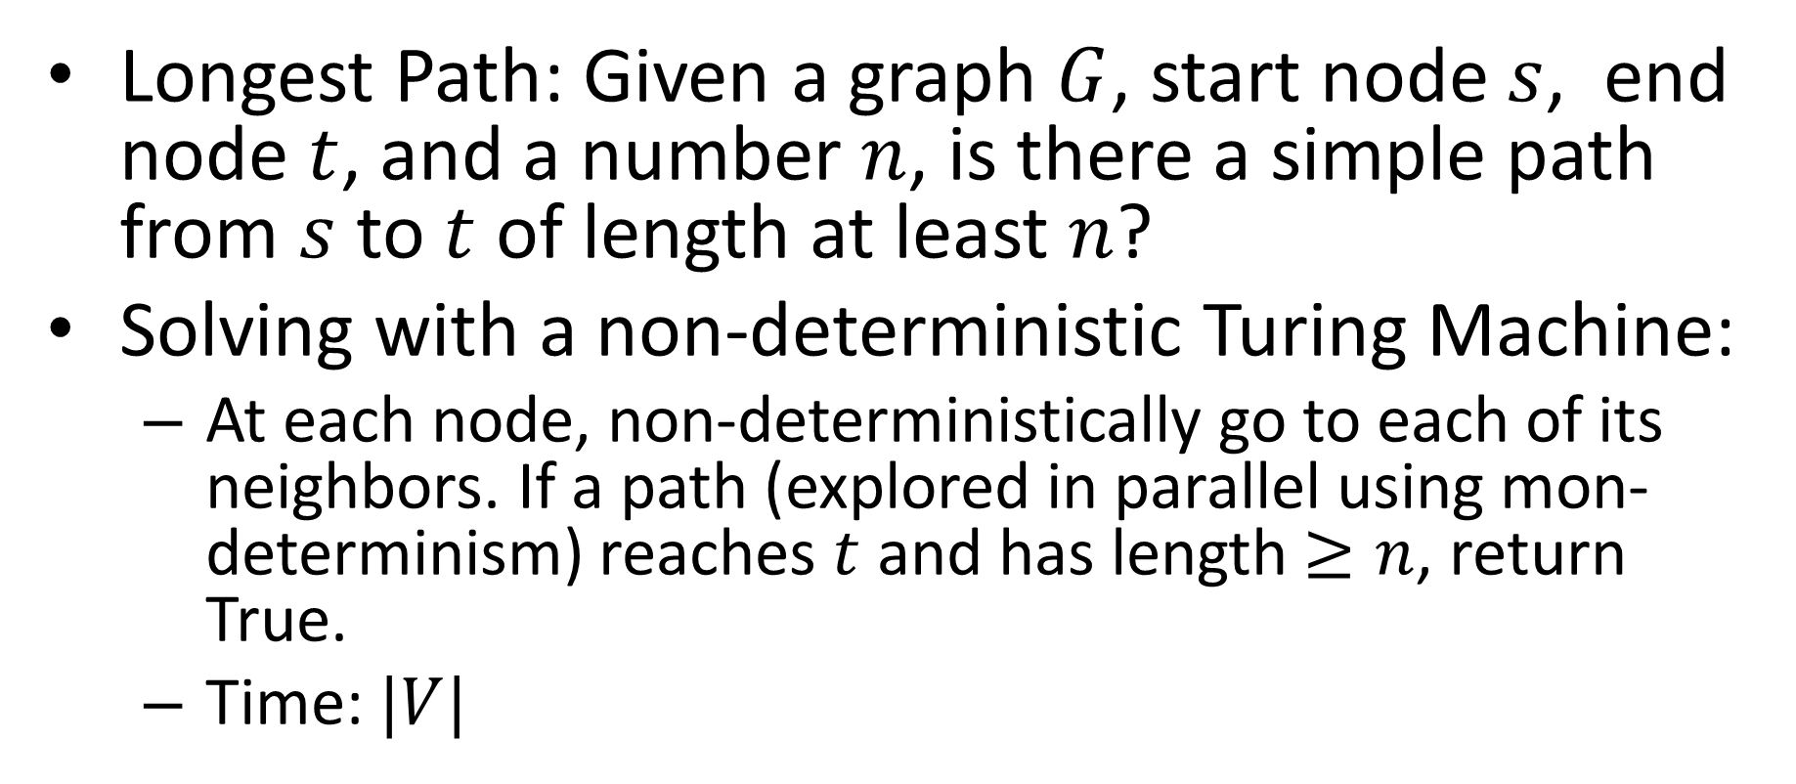

Longest Path $∈NP$?
Longest Path: Given a graph $G$, start node $s$, end node $t$, and a number $n$, is there a simple path from $s$ to $t$ of length at least $n$?
Solving with a non-deterministic Turing Machine:
At each node, non-deterministically go to each of its neighbors. If a path (explored in parallel using mon-determinism) reaches $t$ and has length $≥n$, return True.
Time: $|V|$

Slide 10
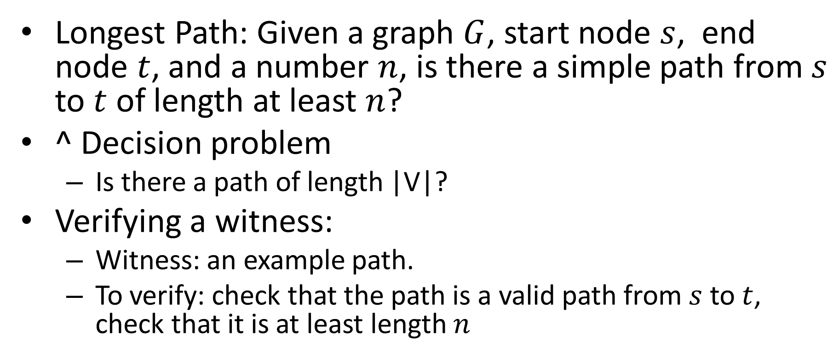
Longest Path $∈NP$?
Longest Path: Given a graph $G$, start node $s$, end node $t$, and a number $n$, is there a simple path from $s$ to $t$ of length at least $n$?
^ Decision problem
Is there a path of length |V|?
Verifying a witness:
Witness: an example path.
To verify: check that the path is a valid path from $s$ to $t$, check that it is at least length $n$

Slide 11
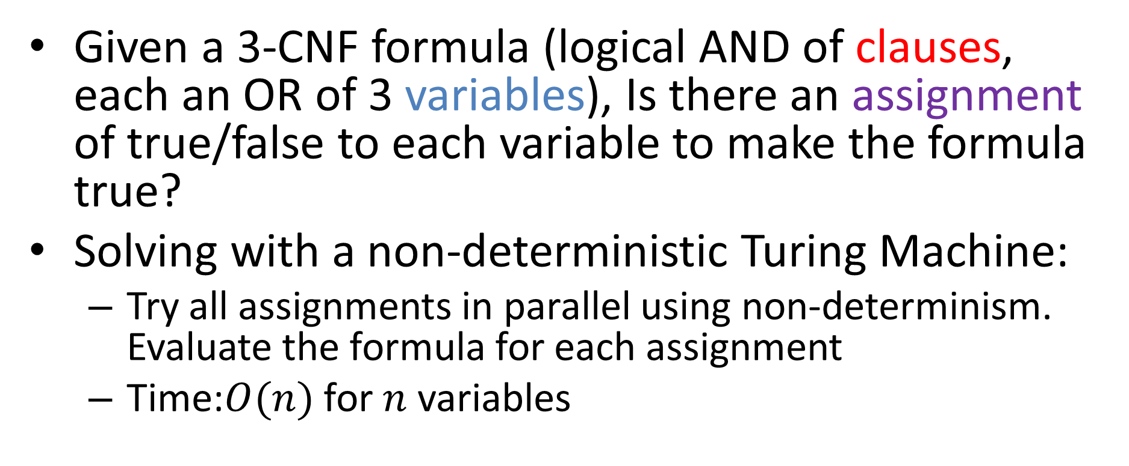

3-SAT $∈NP$?
Given a 3-CNF formula (logical AND of clauses, each an OR of 3 variables), Is there an assignment of true/false to each variable to make the formula true?
Solving with a non-deterministic Turing Machine:
Try all assignments in parallel using non-determinism. Evaluate the formula for each assignment
Time:$O(n)$ for $n$ variables

Slide 12
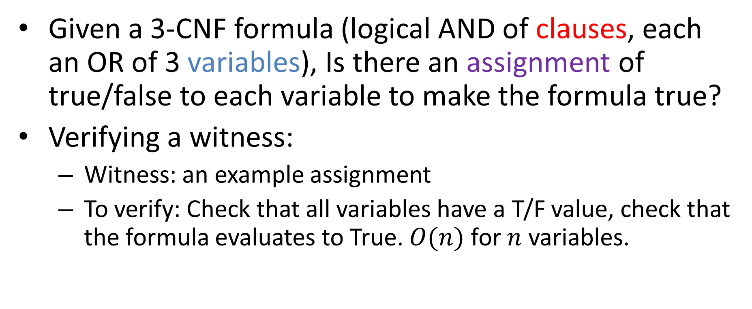
3-SAT $∈NP$?
Given a 3-CNF formula (logical AND of clauses, each an OR of 3 variables), Is there an assignment of true/false to each variable to make the formula true?
Verifying a witness:
Witness: an example assignment
To verify: Check that all variables have a T/F value, check that the formula evaluates to True. $O(n)$ for $n$ variables.

Slide 13




Overview
$$NP$$
Verify in
polynomial time
$$P$$
Solve in
polynomial time
$$Shortest Path$$
$$2−SAT$$
$$Longest Path$$
$$3−SAT$$
Might be there

Slide 14
Intuitive Restatement of P vs NP
Are the problems that are easy to verify also easy to solve?
Cure cancer
Manufacture antibodies for COVID-19
Protein folding is in NP
Most people believe: No…
Why do we care?

Slide 15
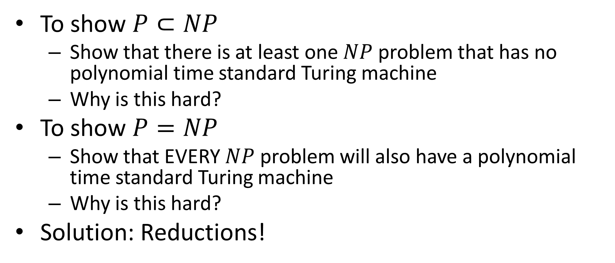
How do we show it?
To show $P⊂NP$
Show that there is at least one $NP$ problem that has no polynomial time standard Turing machine
Why is this hard?
To show $P=NP$
Show that EVERY $NP$ problem will also have a polynomial time standard Turing machine
Why is this hard?
Solution: Reductions!

Slide 16


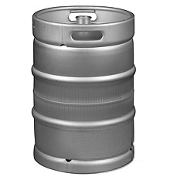

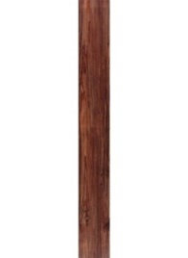



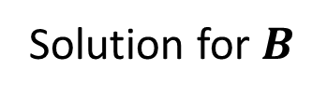
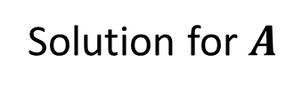

Reductions so far
1) If This is impossible
2) And this is possible
Opening a door
Lighting a fire
$$A$$
$$B$$
Aim duct at door, insert keg
3) Then this is impossible
If
Solution for $A$
Keg cannon battering ram
Solution for $B$
Alcohol, wood, matches
Put fire under the Keg
Reduction

Slide 17
Reductions so far
3) Then this is possible
2) And this is possible
Opening a door
Lighting a fire
$$A$$
$$B$$
Aim duct at door, insert keg
1) If this is
possible
If
Solution for $A$
Keg cannon battering ram
Solution for $B$
Alcohol, wood, matches
Put fire under the Keg
Reduction

Slide 18
Polynomial Time Reductions
1) If this is slow
2) And this is fast
Opening a door
Lighting a fire
$$A$$
$$B$$
Aim duct at door, insert keg
3) Then this is slow
If
Solution for $A$
Keg cannon battering ram
Solution for $B$
Alcohol, wood, matches
Put fire under the Keg
Reduction

Slide 19
Polynomial Time Reductions
3) Then this is fast
2) And this is fast
Opening a door
Lighting a fire
$$A$$
$$B$$
Aim duct at door, insert keg
1) If this is
fast
If
Solution for $A$
Keg cannon battering ram
Solution for $B$
Alcohol, wood, matches
Put fire under the Keg
Reduction

Slide 20
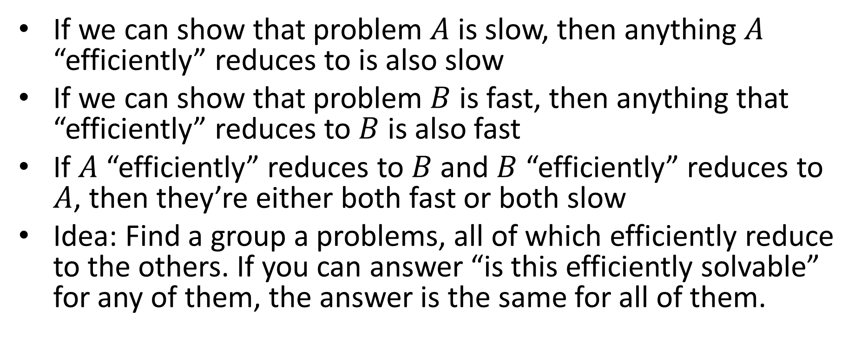
How does this help?
If we can show that problem $A$ is slow, then anything $A$ “efficiently” reduces to is also slow
If we can show that problem $B$ is fast, then anything that “efficiently” reduces to $B$ is also fast
If $A$ “efficiently” reduces to $B$ and $B$ “efficiently” reduces to $A$, then they’re either both fast or both slow
Idea: Find a group a problems, all of which efficiently reduce to the others. If you can answer “is this efficiently solvable” for any of them, the answer is the same for all of them.

Slide 21
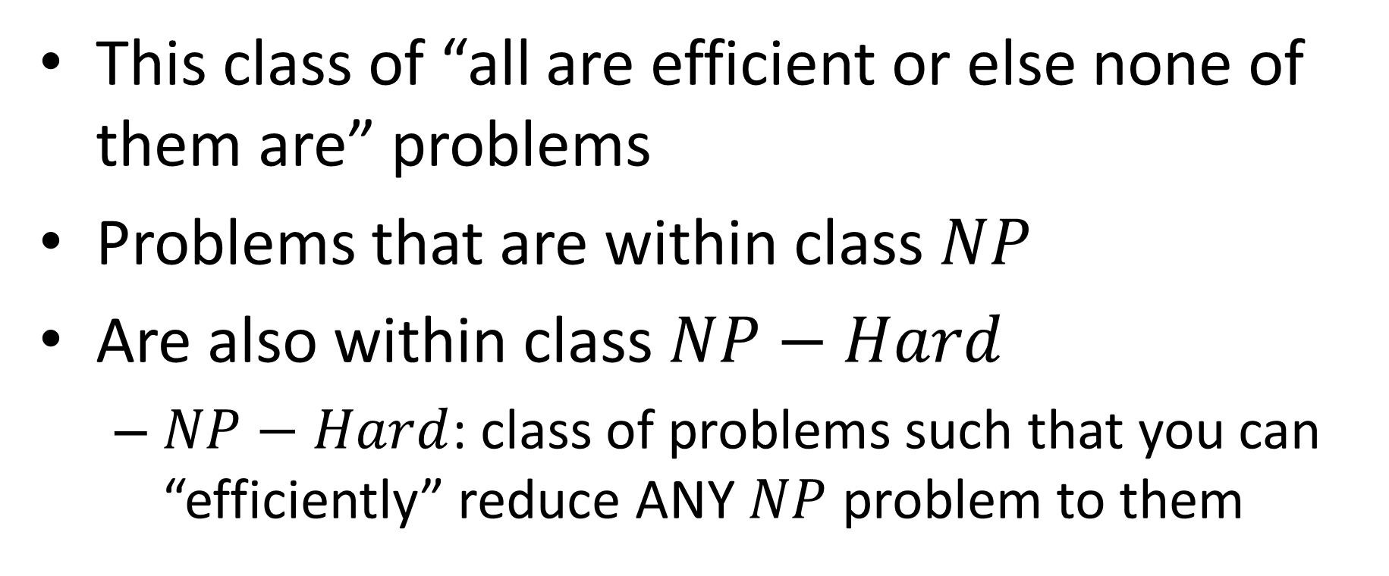
NP-Complete
This class of “all are efficient or else none of them are” problems
Problems that are within class $NP$
Are also within class $NP−Hard$
$NP−Hard$: class of problems such that you can “efficiently” reduce ANY $NP$ problem to them

Slide 22
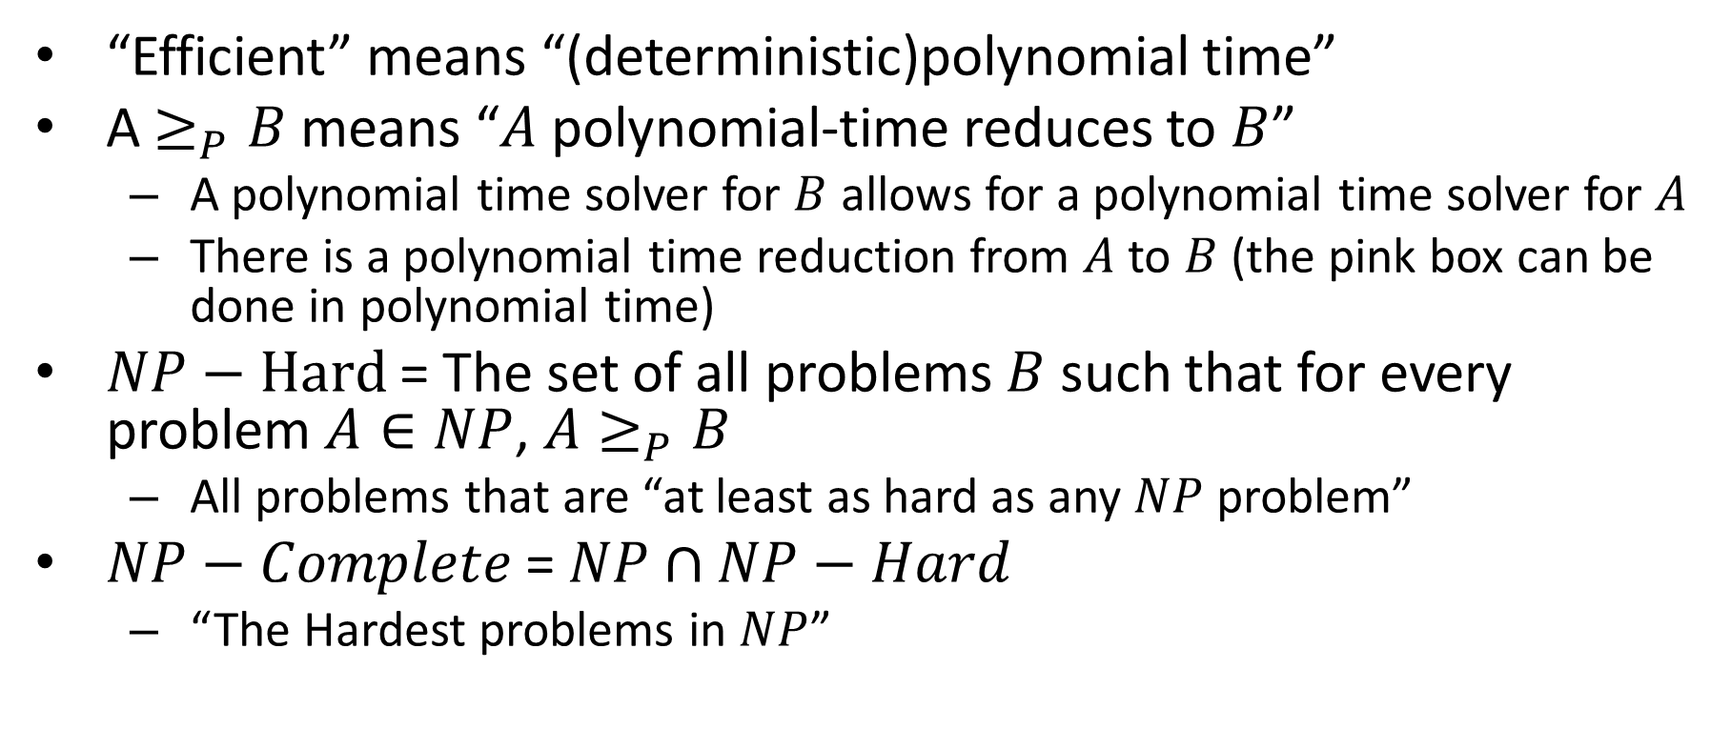
P vs NP, Formally
“Efficient” means “(deterministic)polynomial time”
A $≥_{P}B$ means “$A$ polynomial-time reduces to $B$”
A polynomial time solver for $B$ allows for a polynomial time solver for $A$
There is a polynomial time reduction from $A$ to $B$ (the pink box can be done in polynomial time)
$NP−Hard$ = The set of all problems $B$ such that for every problem $A∈NP$, $A≥_{P}B$
All problems that are “at least as hard as any $NP$ problem”
$NP−Complete$ = $NP∩NP−Hard$
“The Hardest problems in $NP$”

Slide 23
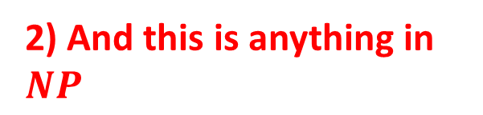
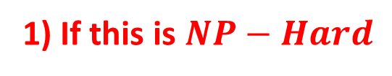
NP-Hard
2) And this is anything in $NP$
3) There’s a way to do this in polynomial time
1) If this is $NP−Hard$
Opening a door
Lighting a fire
$$A$$
$$B$$
Aim duct at door, insert keg
If
Solution for $A$
Keg cannon battering ram
Solution for $B$
Alcohol, wood, matches
Put fire under the Keg
Reduction

Slide 24
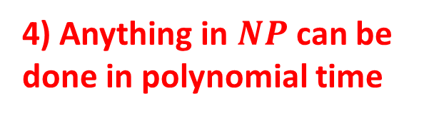
Why NP-Hard is helpful
4) Anything in $NP$ can be done in polynomial time
3) Then since this is polynomial time
1) If this is $NP−Hard$
Opening a door
Lighting a fire
$$A$$
$$B$$
Aim duct at door, insert keg
2) And There’s a way to do this in polynomial time
If
Solution for $A$
Keg cannon battering ram
Solution for $B$
Alcohol, wood, matches
Put fire under the Keg
Reduction

Slide 25
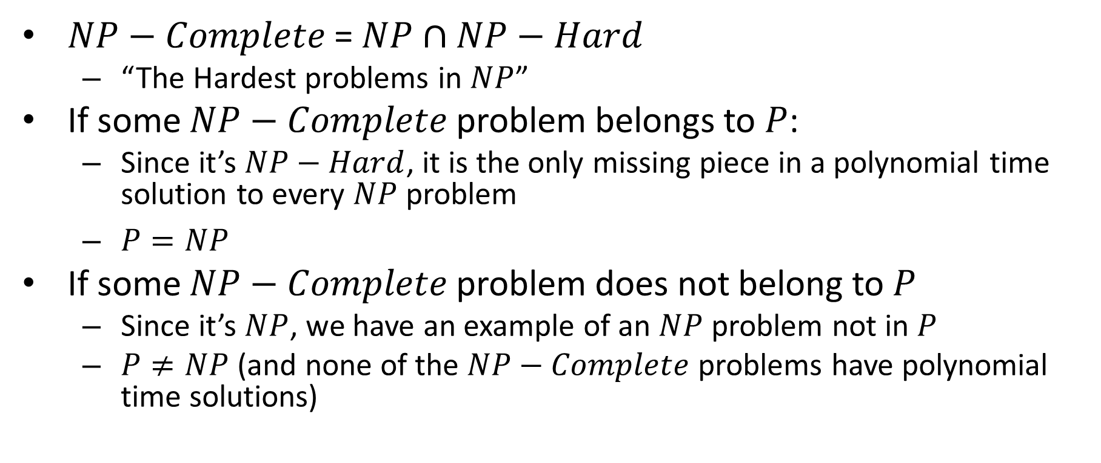
NP-Completeness
$NP−Complete$ = $NP∩NP−Hard$
“The Hardest problems in $NP$”
If some $NP−Complete$ problem belongs to $P$:
Since it’s $NP−Hard$, it is the only missing piece in a polynomial time solution to every $NP$ problem
$P=NP$
If some $NP−Complete$ problem does not belong to $P$
Since it’s $NP$, we have an example of an $NP$ problem not in $P$
$P≠NP$ (and none of the $NP−Complete$ problems have polynomial time solutions)

Slide 26
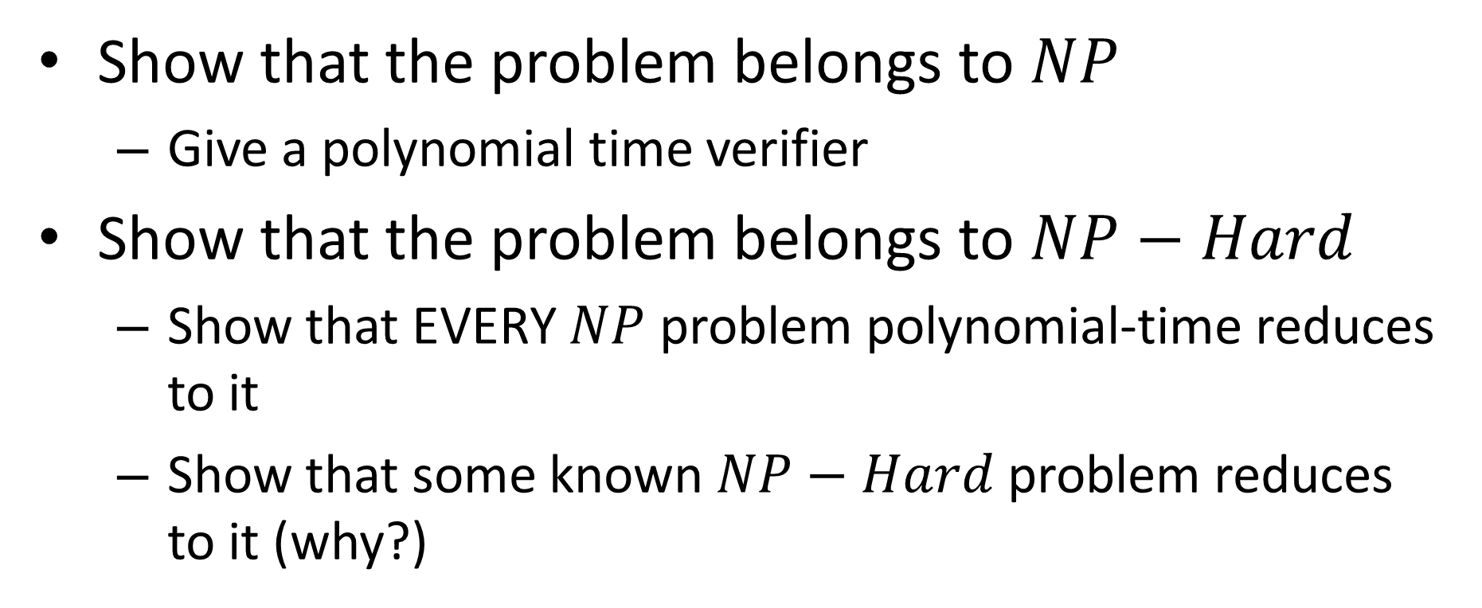

Showing $NP−Completeness$
Show that the problem belongs to $NP$
Give a polynomial time verifier
Show that the problem belongs to $NP−Hard$
Show that EVERY $NP$ problem polynomial-time reduces to it
Show that some known $NP−Hard$ problem reduces to it (why?)

Slide 27

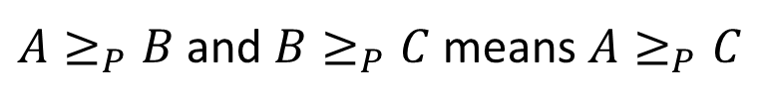



“Chaining” Reductions
$$A$$
$$B$$
C
Solution for $B$
Solution for $C$
Solution for $A$
Poly-time Reduction
Poly-time Reduction
$A≥_{P}B$ and $B≥_{P}C$ means $A≥_{P}C$

Slide 28
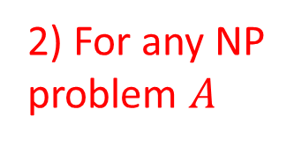




Showing NP-Hard
5) This is NP-Hard
2) For any NP problem $A$
1) If This is NP-Hard
3) This is polynomial time
4) So if this is polynomial time
$$A$$
$$B$$
C
Solution for $B$
Solution for $C$
Solution for $A$
Poly-time Reduction
Poly-time Reduction
$A≥_{P}B$ and $B≥_{P}C$ means $A≥_{P}C$

Slide 29
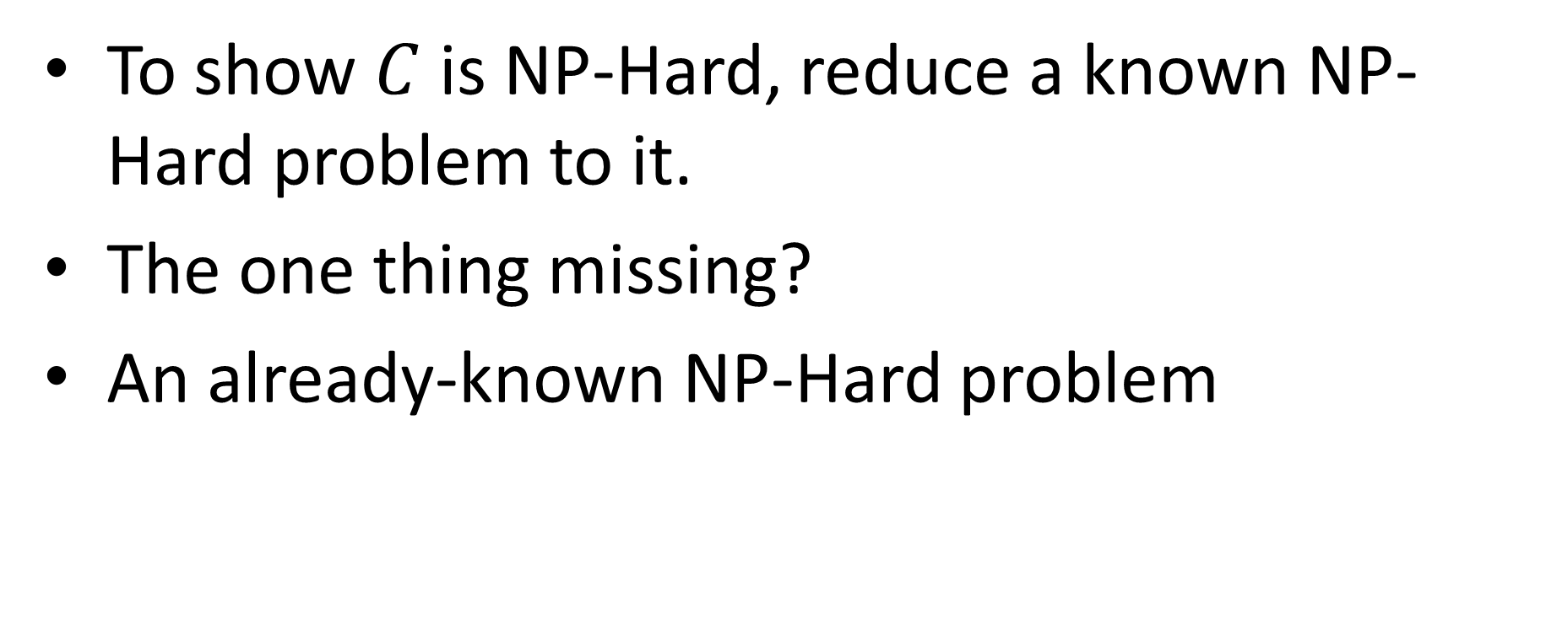
Showing NP-Hardness
To show $C$ is NP-Hard, reduce a known NP-Hard problem to it.
The one thing missing?
An already-known NP-Hard problem

Slide 30
3-SAT is NP-Hard
Cook-Levin Theorem:
Any non-deterministic polynomial time Turing machine, input pair can be converted to a 3-CNF formula such that the formula is satisfiable if and only if the Turing machine accepts the input
You can use a 3-CNF formula to simulate a non-deterministic Turing machine in polynomial time

Slide 31
Another NP-Complete Problem
4-SAT: given a 4-CNF formula, is it satisfiable?
Show 4-SAT belongs to NP.
2-SAT: Is this 2-CNF formula satisfiable?
3-SAT: Is this 3-CNF formula satisfiable?
4-SAT: is this 4-CNF forumla satisfiable?
Give a boolean formula in CNF with exactly 4 variables per clause, is that formula satisfiable?
Verifying a solution in polynomial time:
If I have some example assignment of T/F to each variable, determine whether that was a satisfying assignment.
How: Plug in T/F for each variable, evaluate the formula, check if it’s True.

Slide 32
Another NP-Complete Problem
4-SAT: given a 4-CNF formula, is it satisfiable?
Show 4-SAT belongs to NP-Hard.
How do we show this? Show that some NP-Hard problem reduces to it (in polynomial time).
Reduce 3-SAT to 4-SAT in polynomial time.
We want to show that solving 4-SAT allows us to solve 3-SAT, use a 4-SAT solver to solve 3-SAT
Add a variable that can’t be true to each clause
$\left(f∨x∨y∨z\right)∧\left(f∨x∨\overline{y}∨y\right)∧\left(f∨u∨y∨\overline{z}\right)∧\left(f∨z∨\overline{x}∨u\right)∧\left(f∨\overline{x}∨\overline{y}∨\overline{z}\right)∧(\overline{f}∨\overline{f}∨\overline{f}∨\overline{f}$)

Slide 33
CAUTION
Tempting (but incorrect) argument: We know 2-SAT is P, 3-SAT is NP-Hard. More variables per clause makes the problem more difficult (since we need to solve 3-SAT in order to solve 4-SAT), so 4-SAT must also be NP-Hard
Problem? “we need to solve 3-SAT in order to solve 4-SAT” is hard to defend.
Instead use a reduction. “In the time it takes to solve 4-SAT, we could have solved 3-SAT”

Slide 34
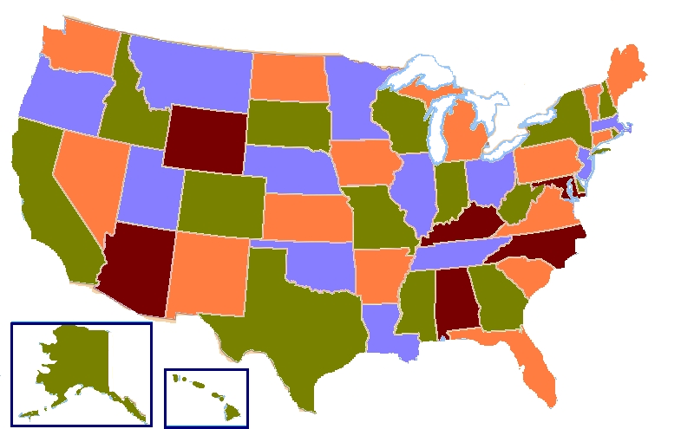
Why “A is necessary for B” is dangerous
Map Coloring: Given a geographical map of states/countries, can I give each region a color so that no bordering regions share their colors?
1-colorable? Trivial (yes iff no bordering regions)
2-colorable? Easy (BFS works)
3-colorable? NP-Hard
4-colorable? Trivial (answer is always yes)

Slide 35
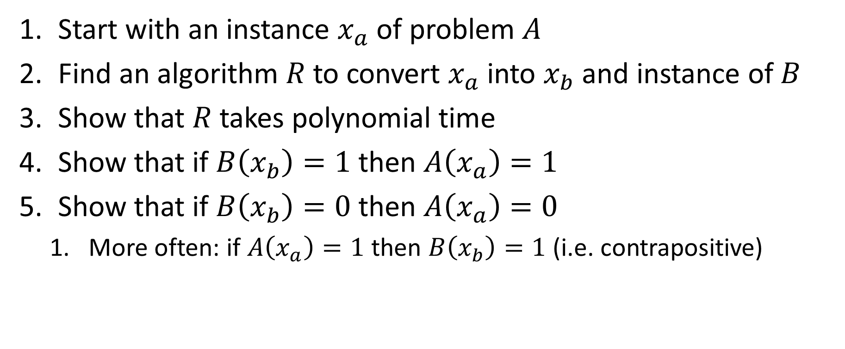

Procedure for showing $A≤_{p}B$
Start with an instance $x_{a}$ of problem $A$
Find an algorithm $R$ to convert $x_{a}$ into $x_{b}$ and instance of $B$
Show that $R$ takes polynomial time
Show that if $B\left(x_{b}\right)=1$ then $A\left(x_{a}\right)=1$
Show that if $B\left(x_{b}\right)=0$ then $A\left(x_{a}\right)=0$
More often: if $A\left(x_{a}\right)=1$ then $B\left(x_{b}\right)=1$ (i.e. contrapositive)

Slide 36


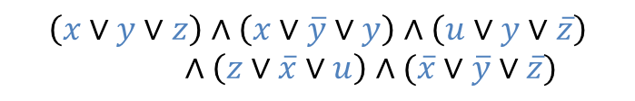











3-SAT $≤_{P}$ Longest Path
How long is the longest simple path?
3-SAT
Create a graph
$$x$$
$$x$$
$$x$$
$$x$$
$$x$$
$$\left(x∨y∨z\right)∧\left(x∨\overline{y}∨y\right)∧\left(u∨y∨\overline{z}\right)∧\left(z∨\overline{x}∨u\right)∧(\overline{x}∨\overline{y}∨\overline{z})$$
Assign $x$
Clause 2
$$\overline{x}$$
$$\overline{x}$$
$$\overline{x}$$
$$\overline{x}$$
$$\overline{x}$$
$$y$$
$$y$$
$$y$$
$$y$$
$$y$$
Assign $y$
Clause 2 done
$$\overline{y}$$
$$\overline{y}$$
$$\overline{y}$$
$$\overline{y}$$
$$\overline{y}$$
Solution for 3-SAT
Is that length long enough?
How?
Solution exists if and only if there is a “long enough” path
Get the length of the longest path
Reduction

Slide 37
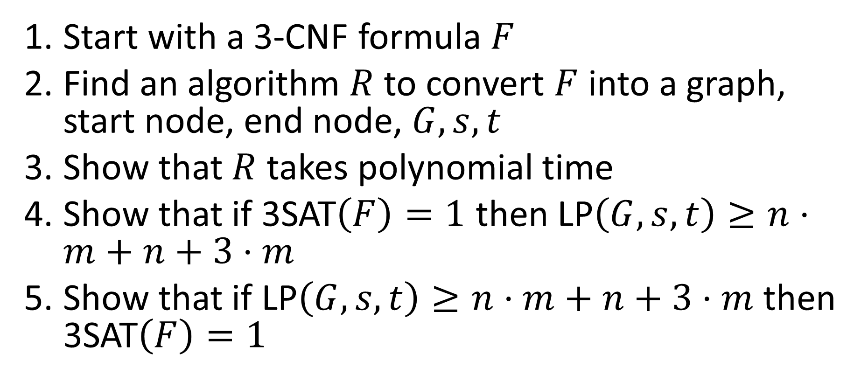
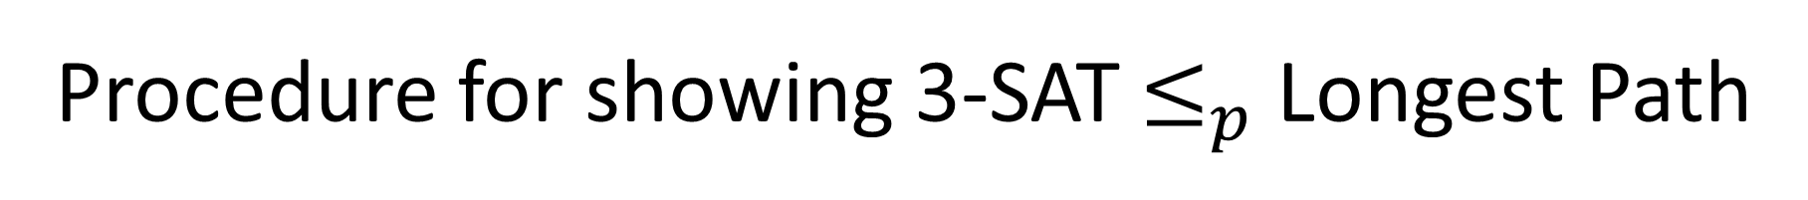
Procedure for showing 3-SAT $≤_{p}$ Longest Path
Start with a 3-CNF formula $F$
Find an algorithm $R$ to convert $F$ into a graph, start node, end node, $G,s,t$
Show that $R$ takes polynomial time
Show that if 3SAT$\left(F\right)=1$ then LP$\left(G,s,t\right)≥n⋅m+n+3⋅m$
Show that if LP$\left(G,s,t\right)≥n⋅m+n+3⋅m$ then 3SAT$\left(F\right)=1$

Slide 38

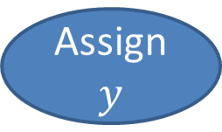

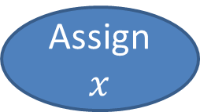







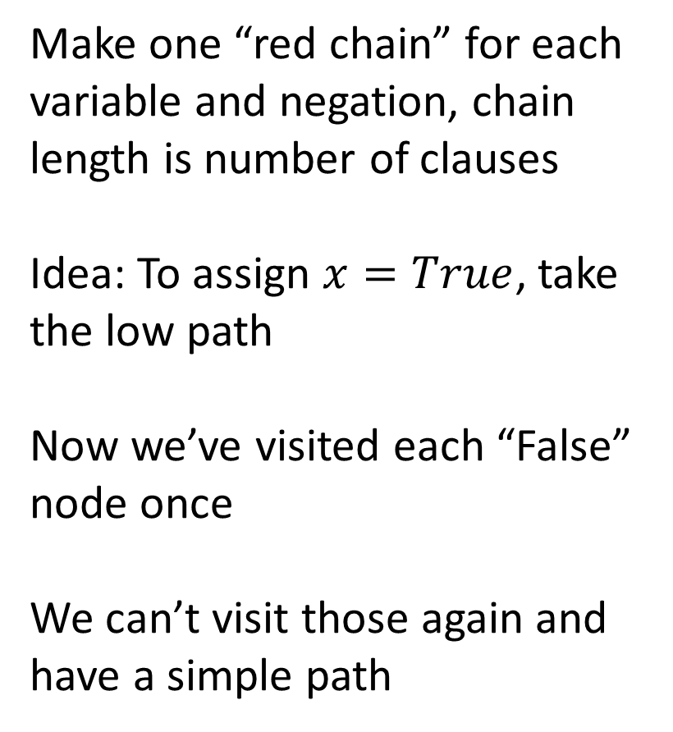
Converting 3-SAT to longest path
$$\left(x∨y∨z\right)∧\left(x∨\overline{y}∨y\right)∧\left(u∨y∨\overline{z}\right)∧\left(z∨\overline{x}∨u\right)∧(\overline{x}∨\overline{y}∨\overline{z})$$
Make one “red chain” for each variable and negation, chain length is number of clauses
Idea: To assign $x=True$, take the low path
Now we’ve visited each “False” node once
We can’t visit those again and have a simple path
$$x$$
$$x$$
$$x$$
$$x$$
$$x$$
Assign $x$
$$\overline{x}$$
$$\overline{x}$$
$$\overline{x}$$
$$\overline{x}$$
$$\overline{x}$$
$$y$$
$$y$$
$$y$$
$$y$$
$$y$$
Assign $y$
$$\overline{y}$$
$$\overline{y}$$
$$\overline{y}$$
$$\overline{y}$$
$$\overline{y}$$

Slide 39
Converting 3-SAT to longest path
$$\left(x∨y∨z\right)∧\left(x∨\overline{y}∨y\right)∧\left(u∨y∨\overline{z}\right)∧\left(z∨\overline{x}∨u\right)∧(\overline{x}∨\overline{y}∨\overline{z})$$
Make 2 nodes per clause. You can only get from the first to the second via a satisfying variable’s node
That path will only be simple if that variable was True
$$x$$
$$x$$
$$x$$
$$x$$
$$x$$
Assign $x$
$$\overline{x}$$
$$\overline{x}$$
$$\overline{x}$$
$$\overline{x}$$
$$\overline{x}$$
Clause 2
$$y$$
$$y$$
$$y$$
$$y$$
$$y$$
Assign $y$
$$\overline{y}$$
$$\overline{y}$$
$$\overline{y}$$
$$\overline{y}$$
$$\overline{y}$$
Clause 2 done

Slide 40
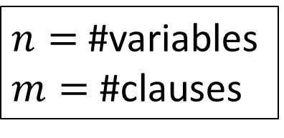
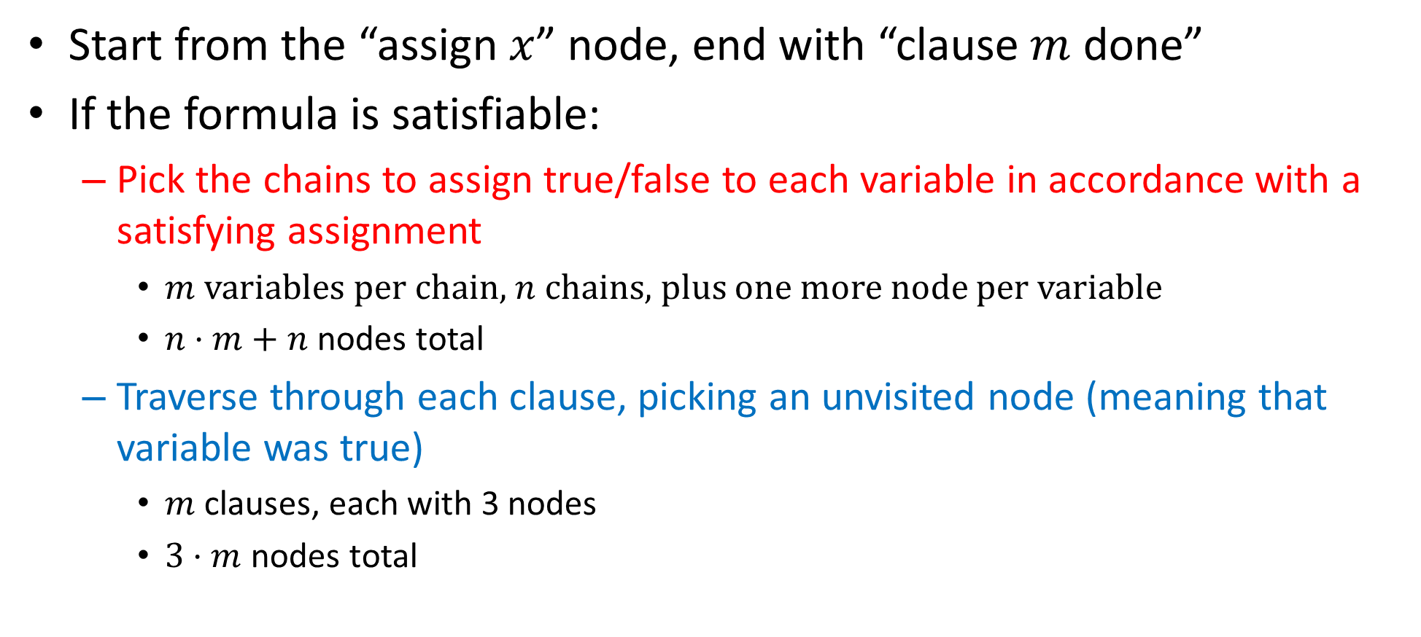
How Long Is the Longest Path?
$n=$ #variables
$m=$ #clauses
Start from the “assign $x$” node, end with “clause $m$ done”
If the formula is satisfiable:
Pick the chains to assign true/false to each variable in accordance with a satisfying assignment
$m$ variables per chain, $n$ chains, plus one more node per variable
$n⋅m+n$ nodes total
Traverse through each clause, picking an unvisited node (meaning that variable was true)
$m$ clauses, each with 3 nodes
$3⋅m$ nodes total

Slide 41

3-SAT $≤_{P}$ Longest Path
How long is the longest simple path?
3-SAT
Create a graph
$$x$$
$$x$$
$$x$$
$$x$$
$$x$$
$$\left(x∨y∨z\right)∧\left(x∨\overline{y}∨y\right)∧\left(u∨y∨\overline{z}\right)∧\left(z∨\overline{x}∨u\right)∧(\overline{x}∨\overline{y}∨\overline{z})$$
Assign $x$
Clause 2
$$\overline{x}$$
$$\overline{x}$$
$$\overline{x}$$
$$\overline{x}$$
$$\overline{x}$$
$$y$$
$$y$$
$$y$$
$$y$$
$$y$$
Assign $y$
Clause 2 done
$$\overline{y}$$
$$\overline{y}$$
$$\overline{y}$$
$$\overline{y}$$
$$\overline{y}$$
Solution for 3-SAT
Is that length $n⋅m+n+3⋅m$?
How?
If it is, the formula was satisfiable
Get the length of the longest path
Reduction

Slide 42
What can we conclude?
If we found a polynomial time solution for Longest Path:
This procedure is a polynomial time solution for 3SAT
If we somehow knew that it was impossible to find a polynomial time solution for 3SAT
We could never find a polynomial time solution for Longest Path

