Slide 1

CS3102 Theory of Computation
www.cs.virginia.edu/~njb2b/cstheory/s2020
Warm up:
Recall:
$ACCEPTS\left(w,x\right)=$ 1 if $w$ (as a TM description, call it $ℳ\left(w\right)$) accepts $x$, 0 otherwise
Why would $ACCEPTS$ be a useful function to implement?

Slide 2
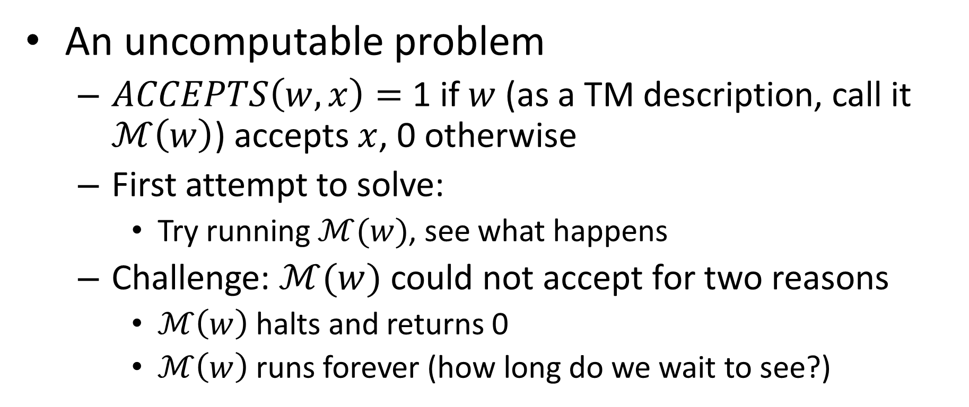
Last Time
An uncomputable problem
$ACCEPTS\left(w,x\right)=$ 1 if $w$ (as a TM description, call it $ℳ\left(w\right)$) accepts $x$, 0 otherwise
First attempt to solve:
Try running $ℳ(w)$, see what happens
Challenge: $ℳ(w)$ could not accept for two reasons
$ℳ\left(w\right)$ halts and returns 0
$ℳ\left(w\right)$ runs forever (how long do we wait to see?)

Slide 3
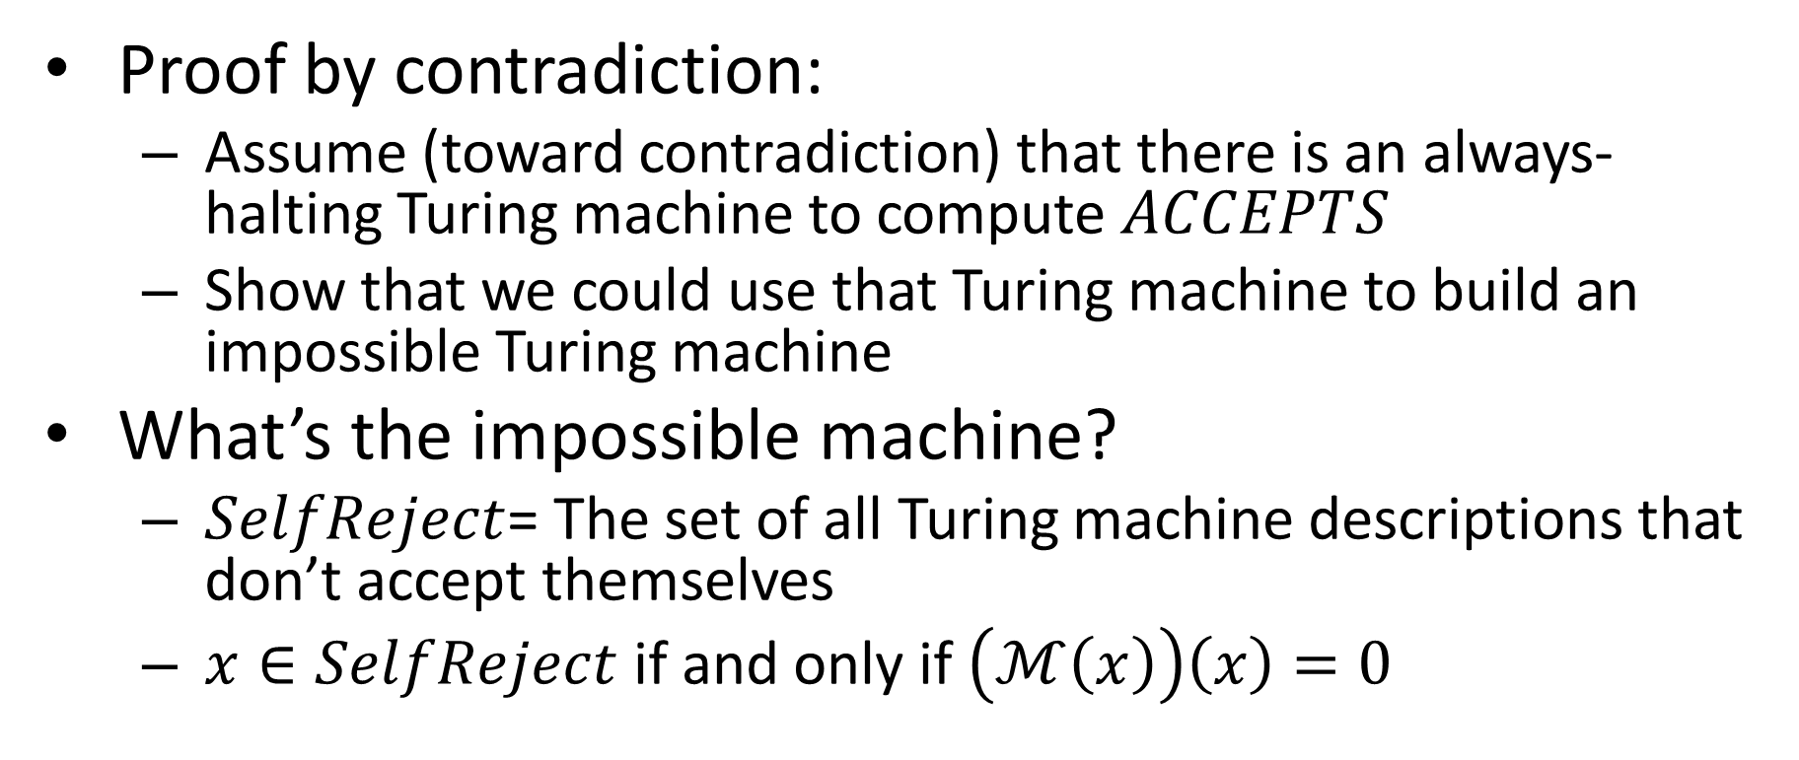

Proving $ACCEPTS$ is uncomputable
Proof by contradiction:
Assume (toward contradiction) that there is an always-halting Turing machine to compute $ACCEPTS$
Show that we could use that Turing machine to build an impossible Turing machine
What’s the impossible machine?
$SelfReject$= The set of all Turing machine descriptions that don’t accept themselves
$x∈SelfReject$ if and only if $\left(ℳ\left(x\right)\right)\left(x\right)=0$

Slide 4


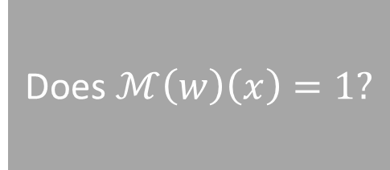


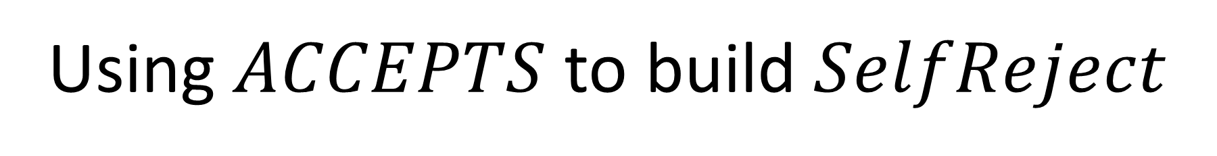



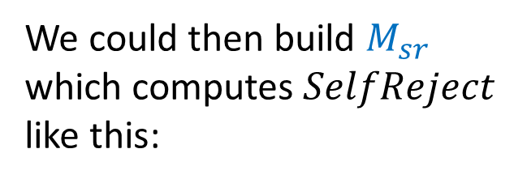
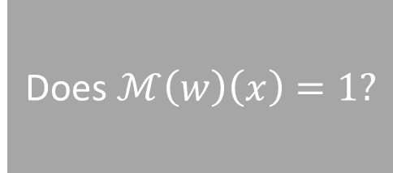


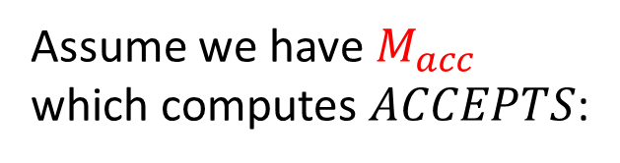
Using $ACCEPTS$ to build $SelfReject$
Assume we have $M_{acc}$ which computes $ACCEPTS$:
$$w$$
Does $ℳ\left(w\right)\left(x\right)=1?$
$$M_{acc}$$
$$ℳ\left(w\right)\left(x\right)==1?$$
$$x$$
We could then build $M_{sr}$ which computes $SelfReject$ like this:
$$M_{sr}$$
Does $ℳ\left(w\right)\left(w\right)=0?$
Does $ℳ\left(w\right)\left(x\right)=1?$
$$w$$
$$M_{acc}$$
$$ℳ\left(w\right)\left(1\right)==0?$$

Slide 5
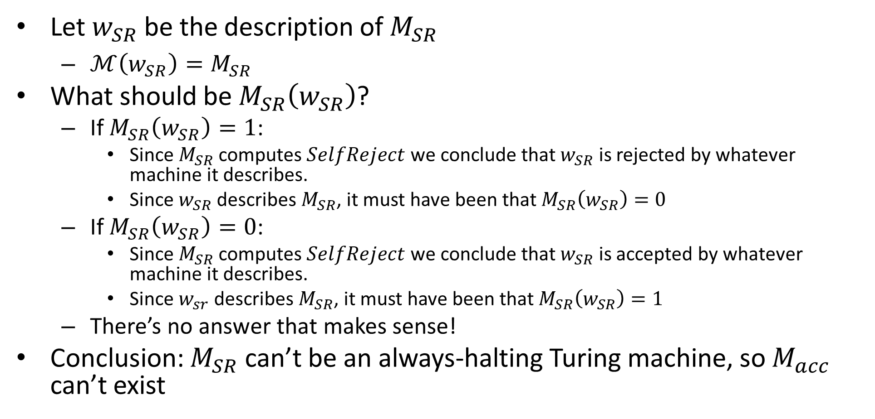

Can $M_{SR}$ exist?
Let $w_{SR}$ be the description of $M_{SR}$
$ℳ\left(w_{SR}\right)=M_{SR}$
What should be $M_{SR}\left(w_{SR}\right)$?
If $M_{SR}\left(w_{SR}\right)=1$:
Since $M_{SR}$ computes $SelfReject$ we conclude that $w_{SR}$ is rejected by whatever machine it describes.
Since $w_{SR}$ describes $M_{SR}$, it must have been that $M_{SR}\left(w_{SR}\right)=0$
If $M_{SR}\left(w_{SR}\right)=0$:
Since $M_{SR}$ computes $SelfReject$ we conclude that $w_{SR}$ is accepted by whatever machine it describes.
Since $w_{sr}$ describes $M_{SR}$, it must have been that $M_{SR}\left(w_{SR}\right)=1$
There’s no answer that makes sense!
Conclusion: $M_{SR}$ can’t be an always-halting Turing machine, so $M_{acc}$ can’t exist

Slide 6

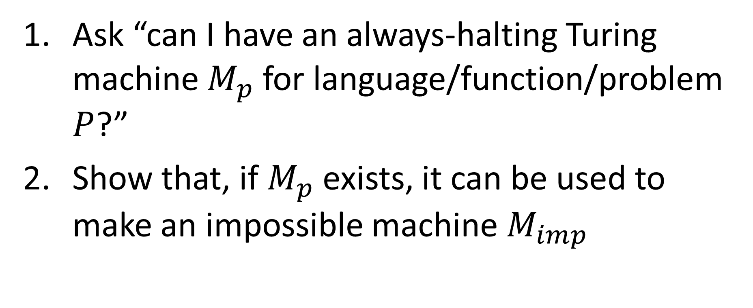
How to show things aren’t computable
Ask “can I have an always-halting Turing machine $M_{p}$ for language/function/problem $P$?”
Show that, if $M_{p}$ exists, it can be used to make an impossible machine $M_{imp}$
How do we know a machine is impossible?
Option 1: It contradicts itself (e.g. $M_{SR}$)
Option 2: Someone has done this before (e.g. $M_{acc}$)

Slide 7
Proving Other Problems are Uncomputable
Reduction
Convert some problem into a known uncomputable one (using only computable steps)

Slide 8


Proof by Reduction
Shows how two different problems relate to each other
MOVIE TIME!

Slide 9
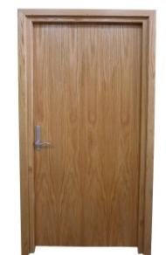

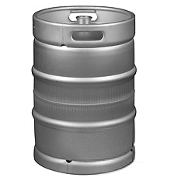



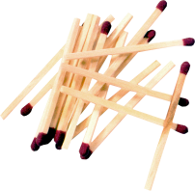





Reduction Proofs
Opening a door
Lighting a fire
$$A$$
reduces to
$$B$$
Alcohol, wood, matches
$$X$$
Keg cannon battering ram
$$Y$$
can be used to make
that can solve B
that can solve A
$A$ is not a harder problem than $B$
$A≤B$
The name “reduces” is confusing: it is in the opposite direction of the making

Slide 10
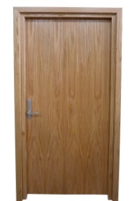
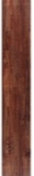







Proof of Impossibility by Reduction
$$X$$
1. X isn’t possible
(e.g., X = some way to open the door)
$$Y$$
2. Assume Y is possible
(Y = some way to light a fire)
$$X$$
$$Y$$
3. Show how to use Y to perform X.
4. X isn’t possible, but Y could be used to perform X
conclusion: Y must not be possible either

Slide 11
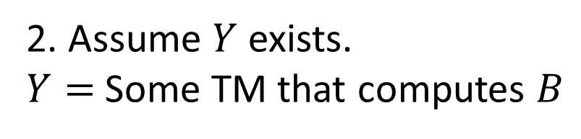
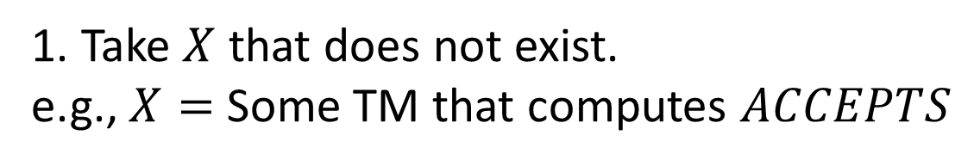
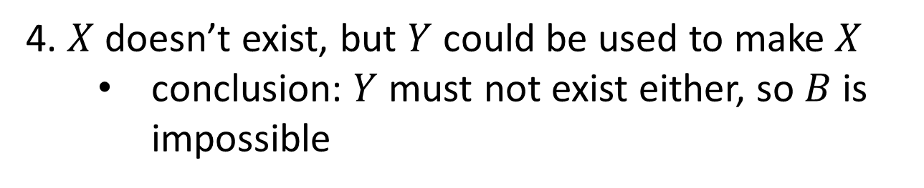
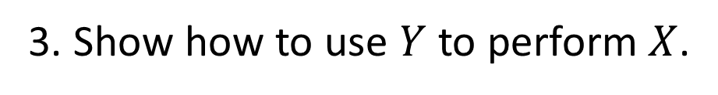
Proof of Impossibility by Reduction
$$X$$
1. Take $X$ that does not exist.
e.g., $X=$ Some TM that computes $ACCEPTS$
$$Y$$
2. Assume $Y$ exists.
$Y=$ Some TM that computes $B$
$$X$$
$$Y$$
3. Show how to use $Y$ to perform $X$.
4. $X$ doesn’t exist, but $Y$ could be used to make $X$
conclusion: $Y$ must not exist either, so $B$ is impossible

Slide 12

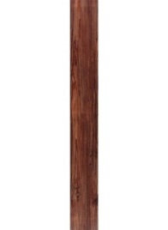
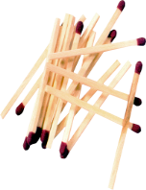

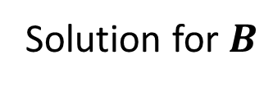


MacGyver’s Reduction
Problem know is impossible
Problem we think is impossible
Opening a door
Lighting a fire
$$A$$
$$B$$
Aim duct at door, insert keg
If
Solution for $A$
Keg cannon battering ram
Solution for $B$
Alcohol, wood, matches
Put fire under the Keg
Reduction

Slide 13


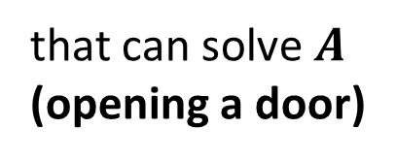
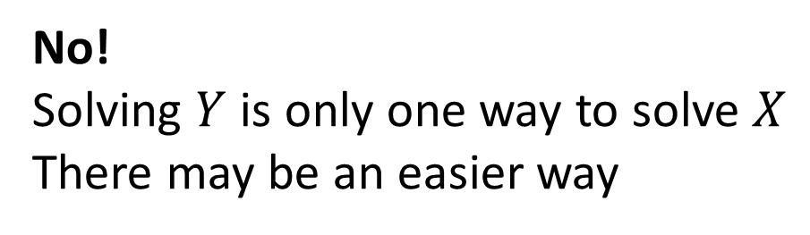

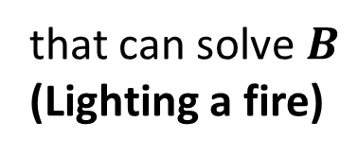
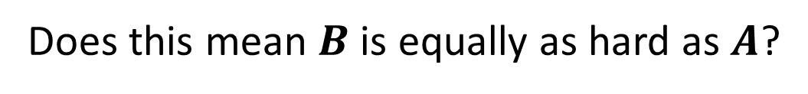




Converse?
$A$ reduces to $B$
$$X$$
$$Y$$
can be used to make
that can solve $B$
(Lighting a fire)
$A$ is not harder to solve than $B$
that can solve $A$
(opening a door)
$$A≤B$$
Does this mean $B$ is equally as hard as $A$?
$$A=B$$
No!
Solving $Y$ is only one way to solve $X$
There may be an easier way

Slide 14

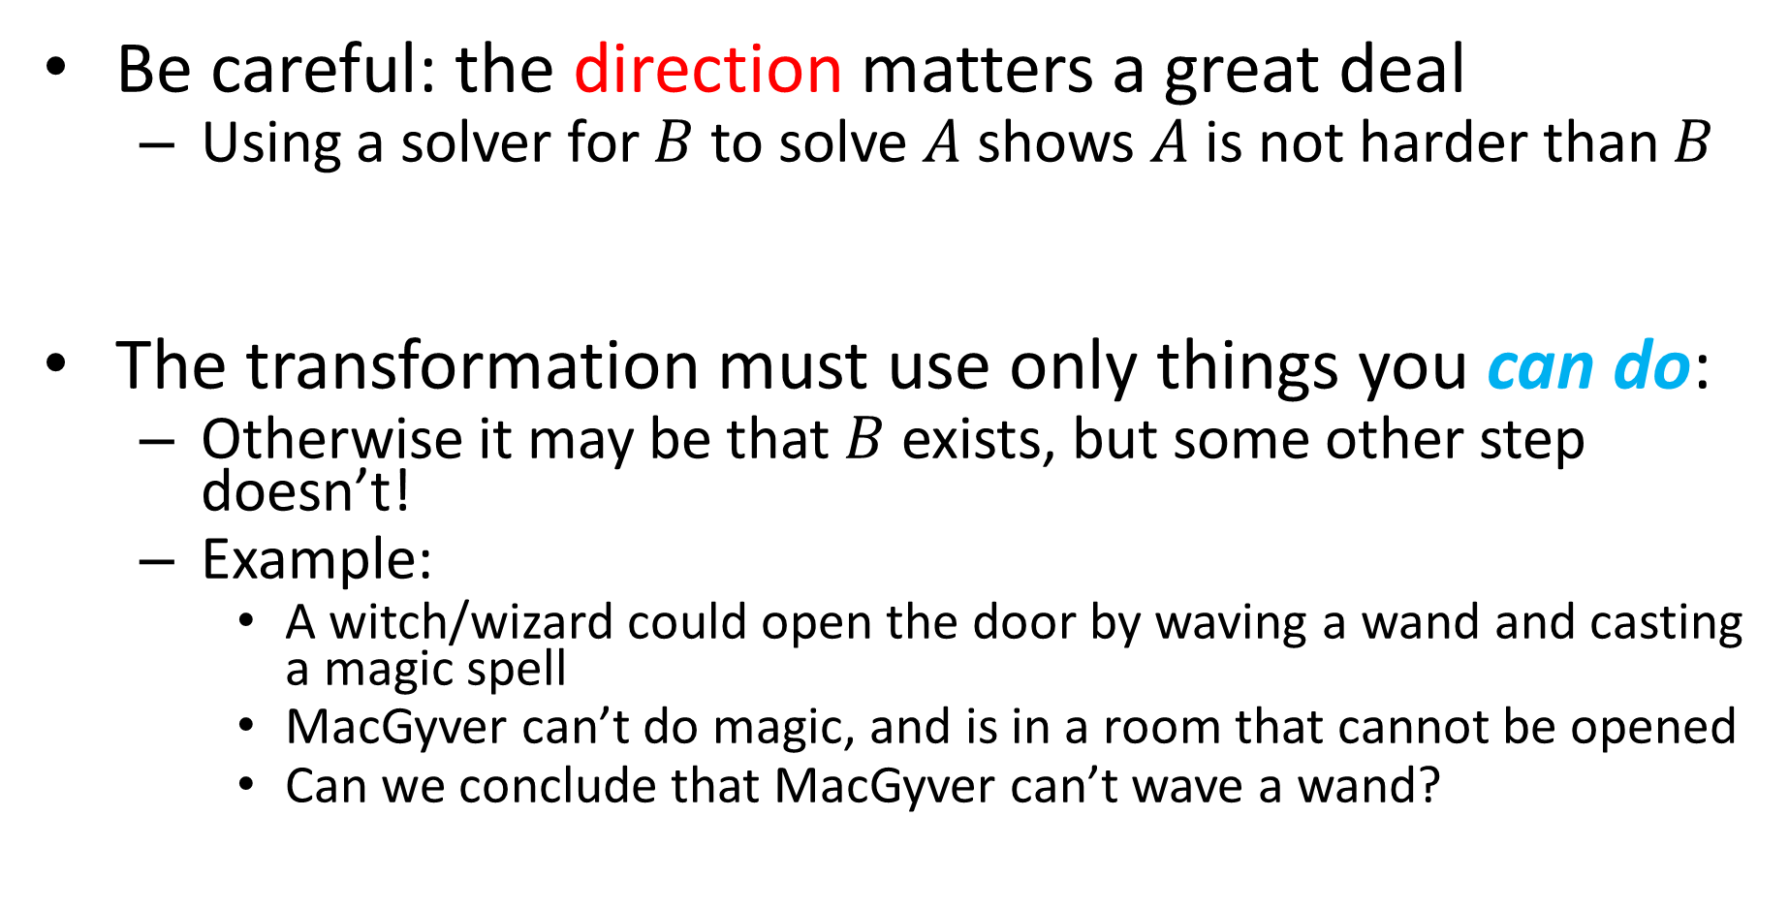

Common Reduction Traps
Be careful: the direction matters a great deal
Using a solver for $B$ to solve $A$ shows $A$ is not harder than $B$
The transformation must use only things you can do:
Otherwise it may be that $B$ exists, but some other step doesn’t!
Example:
A witch/wizard could open the door by waving a wand and casting a magic spell
MacGyver can’t do magic, and is in a room that cannot be opened
Can we conclude that MacGyver can’t wave a wand?
$$A$$
$$B$$
___ Reduces to ___

Slide 15
What “Can Do” Means
Tools used in a reduction are limited by what you are proving
Undecidability:
You are proving something about all TMs:
The transformation “can do” things a terminating TM “can do”
Spoiler alert!
Complexity:
You are proving something about time required:
The time it takes to do the transformation is limited

Slide 16
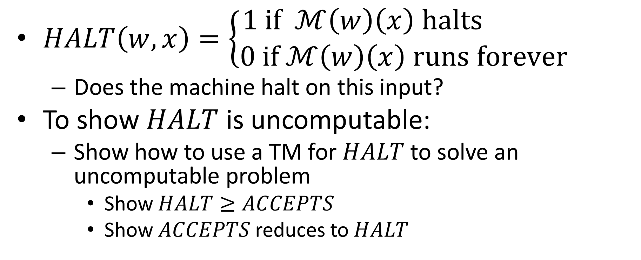
Example
$HALT\left(w, x\right)=\left\{\begin{aligned}1 if ℳ\left(w\right)\left(x\right) halts \\ 0 if ℳ\left(w\right)\left(x\right) runs forever\end{aligned}\right.$
Does the machine halt on this input?
To show $HALT$ is uncomputable:
Show how to use a TM for $HALT$ to solve an uncomputable problem
Show $HALT≥ACCEPTS$
Show $ACCEPTS$ reduces to $HALT$

Slide 17

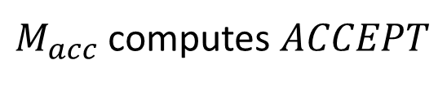

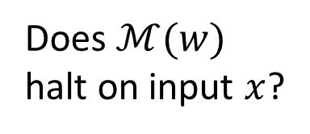
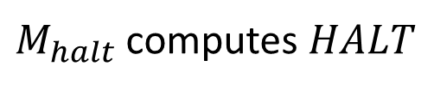
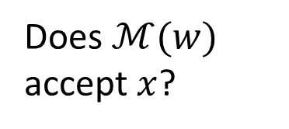

$HALT$ Reduction
Problem know is impossible
Problem we think is impossible
$$HALT$$
$$A$$
$$ACCEPTS$$
$$B$$
Does $ℳ(w)$ halt on input $x$?
Does $ℳ(w)$ accept $x$?
Assume
$M_{acc}$ computes $ACCEPT$
$M_{halt}$ computes $HALT$
Reduction

Slide 18



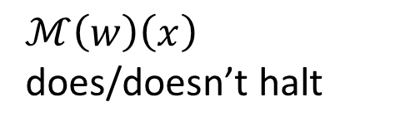




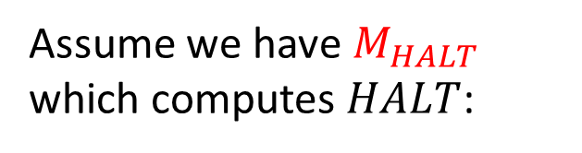





Using $HALT$ to build $ACCEPTS$
Assume we have $M_{HALT}$ which computes $HALT$:
$$w$$
Does $ℳ\left(w\right)\left(x\right)$ halt?
$$M_{HALT}$$
$ℳ\left(w\right)\left(x\right)$ does/doesn’t halt
$$x$$
We could then build $M_{acc}$ which computes $ACCEPTS$ like this:
$$M_{acc}$$
Does $ℳ\left(w\right)\left(w\right)=1?$
If it halts:
Return $ℳ(w)$
$$w$$
Does $ℳ\left(w\right)\left(x\right)$ halt?
$$M_{HALT}$$
$$ℳ\left(w\right)\left(1\right)==1$$
$$x$$
If it doesn’t halt:
Return 0

Slide 19

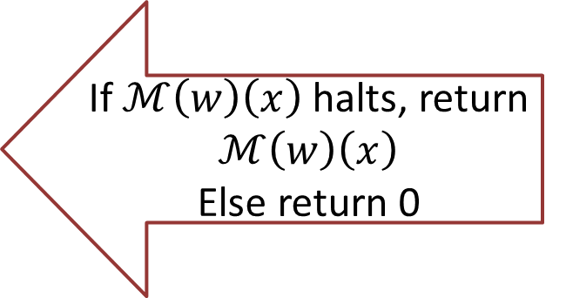
$HALT$ Reduction
Problem know is impossible
Problem we think is impossible
$$HALT$$
$$A$$
$$ACCEPTS$$
Give $w,x$ as inputs to $HALT$
$$B$$
Does $ℳ(w)$ halt on input $x$?
Does $ℳ(w)$ accept $x$?
Assume
If $ℳ\left(w\right)\left(x\right)$ halts, return $ℳ\left(w\right)\left(x\right)$
Else return 0
$M_{acc}$ computes $ACCEPT$
$M_{halt}$ computes $HALT$
Reduction

Slide 20
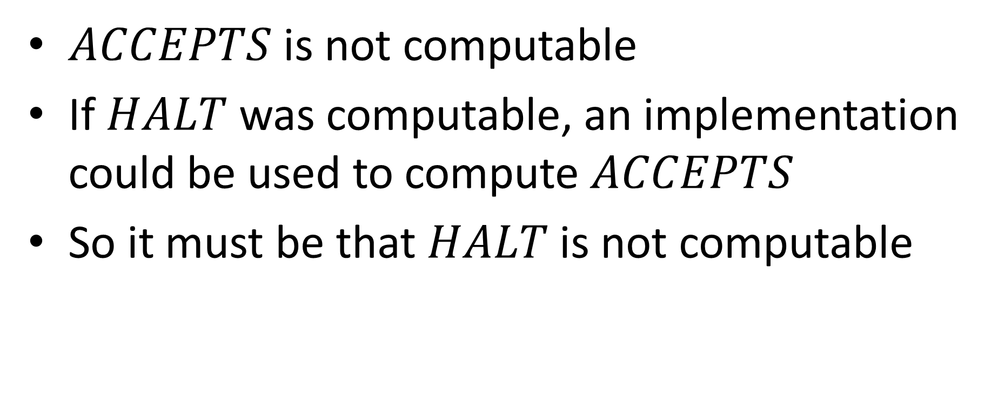
Conclusion
$ACCEPTS$ is not computable
If $HALT$ was computable, an implementation could be used to compute $ACCEPTS$
So it must be that $HALT$ is not computable

Slide 21
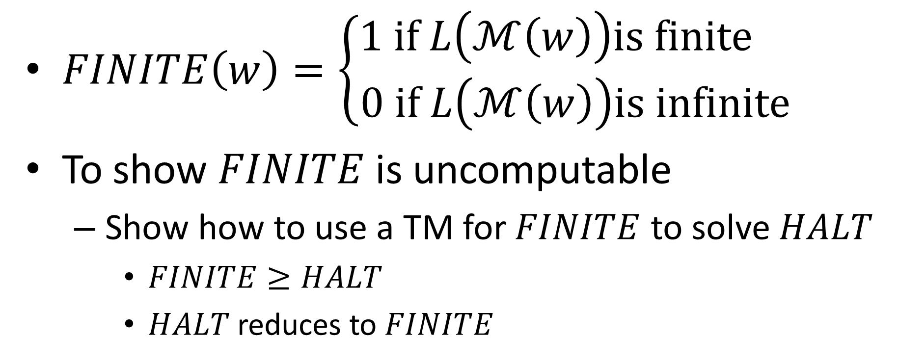

Example: $FINITE$
$FINITE\left(w\right)=\left\{\begin{aligned}1 if L\left(ℳ\left(w\right)\right)is finite \\ 0 if L\left(ℳ\left(w\right)\right)is infinite\end{aligned}\right.$
To show $FINITE$ is uncomputable
Show how to use a TM for $FINITE$ to solve $HALT$
$FINITE≥HALT$
$HALT$ reduces to $FINITE$

Slide 22

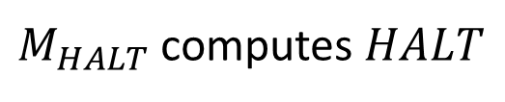


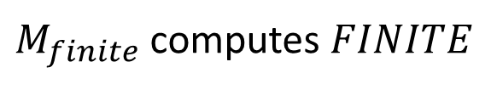
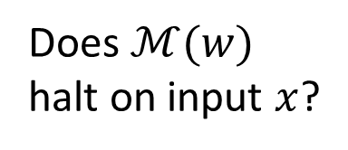

$FINITE$ Reduction
Problem know is impossible
Problem we think is impossible
$$FINITE$$
$$A$$
$$HALT$$
$$B$$
Is $L\left(ℳ\left(w\right)\right)$ finite?
Does $ℳ(w)$ halt on input $x$?
Assume
$M_{HALT}$ computes $HALT$
$M_{finite}$ computes $FINITE$
Reduction

Slide 23
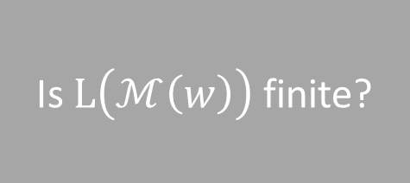



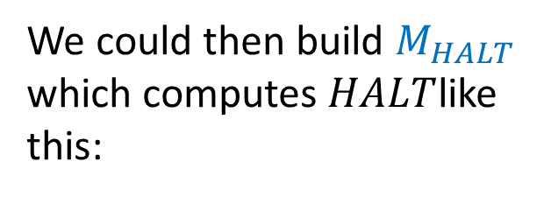

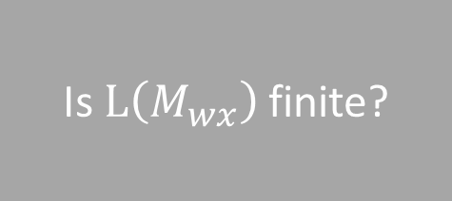




Using $HALT$ to build $ACCEPTS$
Assume we have $M_{FINITE}$ which computes $FINITE$:
Is $L\left(ℳ\left(w\right)\right)$ finite?
$$M_{FINITE}$$
$L\left(ℳ\left(w\right)\right)$ is/isn’t finite
$$w$$
We could then build $M_{HALT}$ which computes $HALT$like this:
$$M_{HALT}$$
Does $ℳ\left(w\right)\left(w\right)=1?$
$$w$$
Build this machine:
$M_{wx}:$
1) run $ℳ(w)(x)$
2) return 1
$$M_{FINITE}$$
$$ℳ\left(w\right)\left(1\right)==1$$
Is $L\left(M_{wx}\right)$ finite?
$$x$$

Slide 24
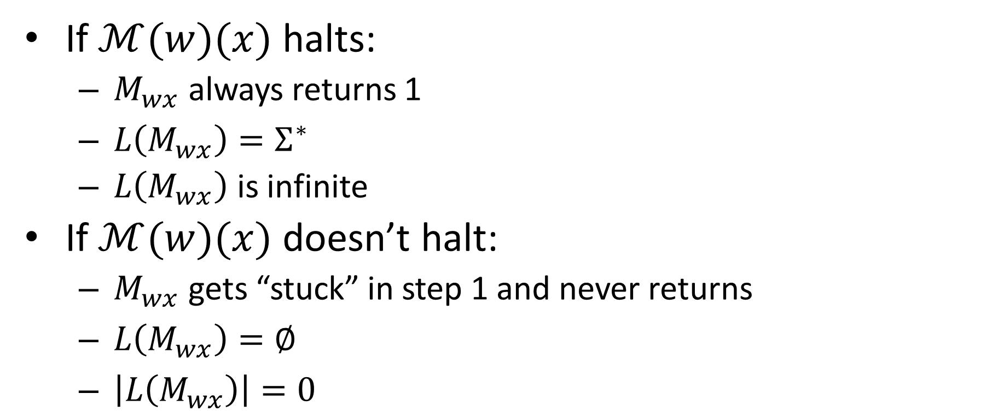


What’s the Language of $M_{wx}$?
Build this machine:
$M_{wx}:$
1) run $ℳ(w)(x)$
2) return 1
If $ℳ(w)(x)$ halts:
$M_{wx}$ always returns 1
$L\left(M_{wx}\right)=Σ^{∗}$
$L\left(M_{wx}\right)$ is infinite
If $ℳ(w)(x)$ doesn’t halt:
$M_{wx}$ gets “stuck” in step 1 and never returns
$L\left(M_{wx}\right)=∅$
$\left|L\left(M_{wx}\right)\right|=0$

Slide 25


$FINITE$ Reduction
Problem know is impossible
Problem we think is impossible
$$FINITE$$
$$A$$
$$HALT$$
Build (but don’t run) $M_{wx}$
$$B$$
Is $L\left(ℳ\left(w\right)\right)$ finite?
Does $ℳ(w)$ halt on input $x$?
Assume
Give $M_{wx}$ as input to $M_{finite}$
$M_{HALT}$ computes $HALT$
$M_{finite}$ computes $FINITE$
Reduction

