Slide 1


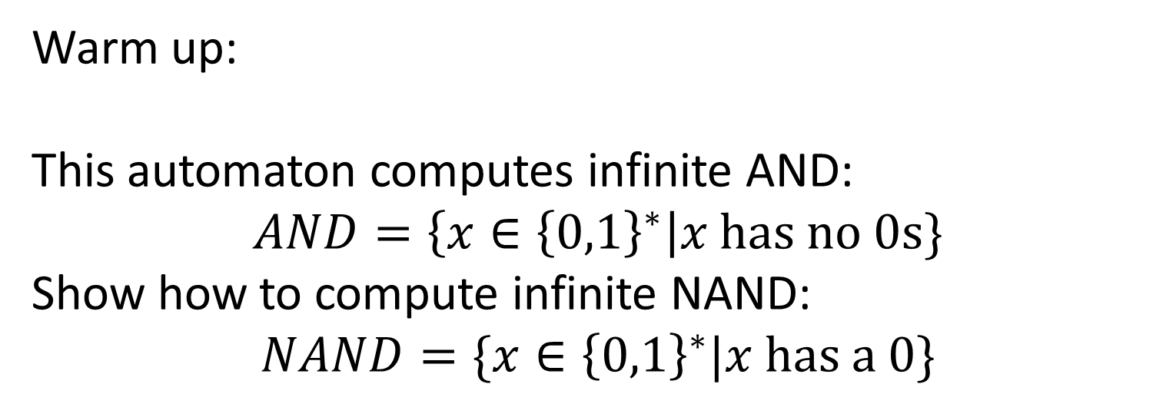



CS3102 Theory of Computation
Some 0s
$$0,1$$
$$0$$
_{start}
$$0$$
$$1$$
No 0s
$$1$$
Warm up:
This automaton computes infinite AND:
$$AND=\left\{x∈{\left\{0,1\right\}}^{∗}\right|x has no 0s\}$$
Show how to compute infinite NAND:
$$NAND=\{x∈{\left\{0,1\right\}}^{∗}|x has a 0\}$$

Slide 2


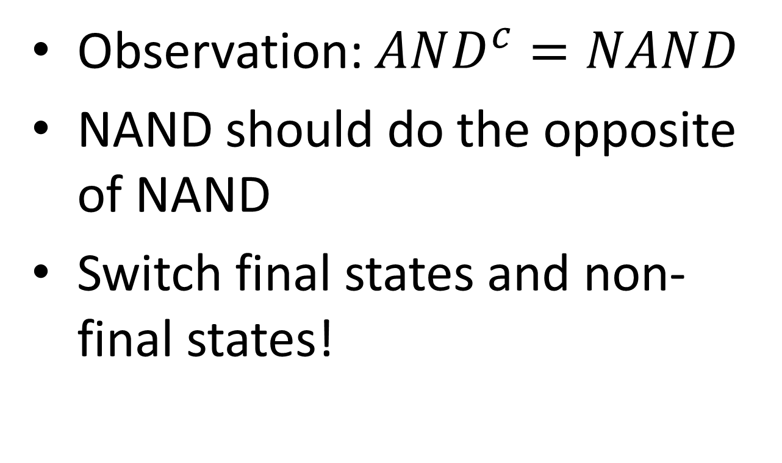



Infinite NAND Automaton
Observation: $AND^{c}=NAND$
NAND should do the opposite of NAND
Switch final states and non-final states!
Some 0s
$$0,1$$
$$0$$
_{start}
$$0$$
$$1$$
_{No 0s}
$$1$$

Slide 3
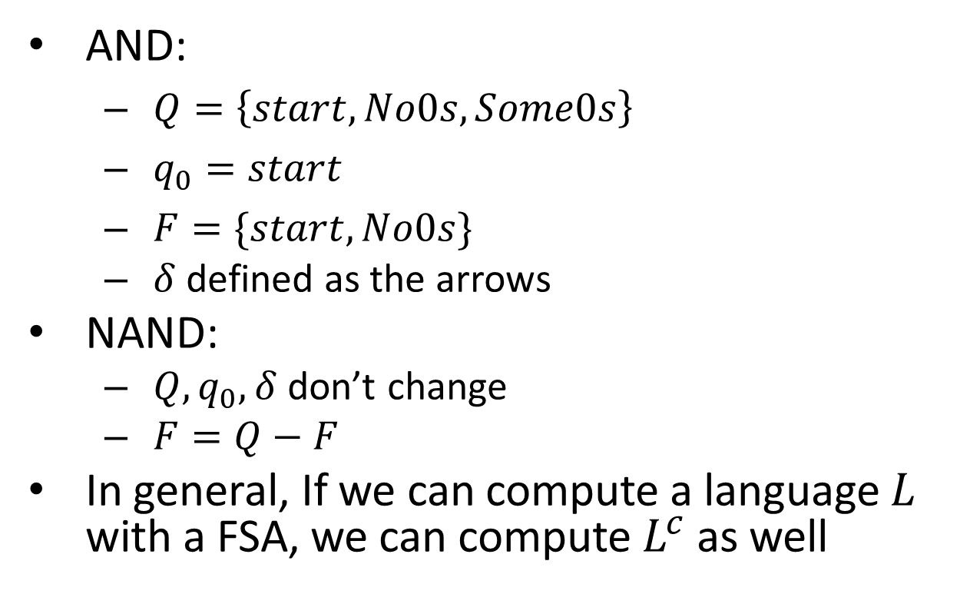
AND to NAND
AND:
$Q=\left\{start, No0s, Some0s\right\}$
$q_{0}=start$
$F=\{start, No0s\}$
$δ$ defined as the arrows
NAND:
$Q, q_{0}, δ$ don’t change
$F=Q−F$
In general, If we can compute a language $L$ with a FSA, we can compute $L^{c}$ as well
Some 0s
$$0,1$$
$$0$$
_{start}
$$0$$
$$1$$
_{No 0s}
$$1$$

Slide 4
Logistics
Homework released tomorrow
See submission page for deadlines (I’m still processing your quiz 3)
Quiz will be released Thursday, due Tuesday

Slide 5
Last Time
Languages and decision problems
A different way of thinking about functions
Introducing Finite State Automata
DFA: Deterministic finite state automaton
Language of a FSA: The set of strings for which that automaton returns 1

Slide 6
FSA are strictly more powerful than NAND circuits
How can we show this?
Show that there is at least one function we can do with FSA but not NAND-CIRC
Done! (infinite XOR)
Show anything we can do with NAND-CIRC can also be done with FSA
How?
We need to be able to compute any finite function

Slide 7
Computing any finite function with NAND-CIRC
Summary:
"Manually Precompute" the output for every (finitely-many) possible input
When we receive the actual input, do a "lookup"
Our proof before:
Make a variable to represent each possible input, assigning its value to match the correct output
Use LOOKUP to return the proper variable for the given input

Slide 8
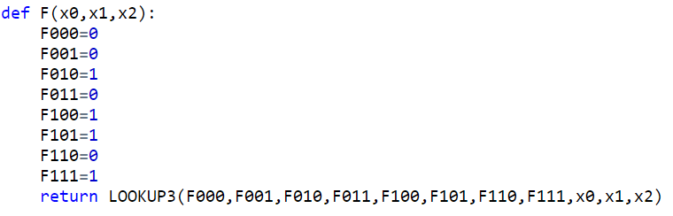
Straightline Code for f
Input | Output
000 | 0
001 | 0
010 | 1
011 | 0
100 | 1
101 | 1
110 | 0
111 | 0

Slide 9
Computing finite functions with FSA
Summary:
"Manually Precompute" the output for every (finitely-many) possible input
When we receive the actual input, do a "lookup"
Same idea, but with Automata:
Make a state for every possible input, determining whether or not it is final depending on the correct output
Do a "binary tree traversal" with the given input to navigate to its correct output

Slide 10

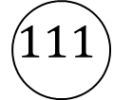





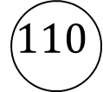
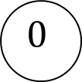





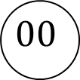















FSA for $f$
Input | Output
000 | 0
001 | 0
010 | 1
011 | 0
100 | 1
101 | 1
110 | 0
111 | 0
“”
$$0$$
$$1$$
$$0$$
$$1$$
$$0$$
$$1$$
$$0$$
$$1$$
$$00$$
$$01$$
$$10$$
$$10$$
$$0$$
$$0$$
$$1$$
$$0$$
$$0$$
$$1$$
$$000$$
$$001$$
$$010$$
$$011$$
$$100$$
$$101$$
$$110$$
$$111$$
$$0,1$$
trash
$$0,1$$
$$0,1$$

Slide 11
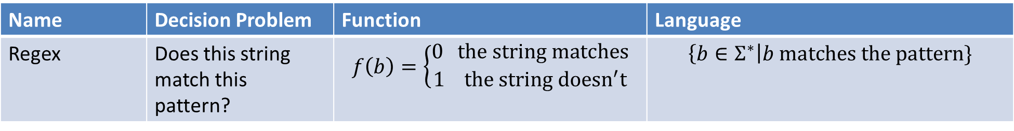
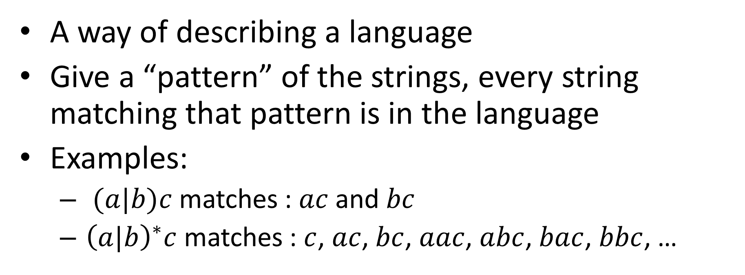
Regular Expressions
Name | Decision Problem | Function | Language
Regex | Does this string match this pattern? | $$f\left(b\right)=\left\{\begin{aligned}0 the string matches \\ 1 the string doesn^{′}t\end{aligned}\right.$$ | $$\left\{b∈Σ^{∗}\right|b matches the pattern\}$$
A way of describing a language
Give a “pattern” of the strings, every string matching that pattern is in the language
Examples:
$(a|b)c$ matches : $ac$ and $bc$
${\left(a|b\right)}^{∗}c$ matches : $c$, $ac$, $bc$, $aac$, $abc$, $bac$, $bbc$, …

Slide 12
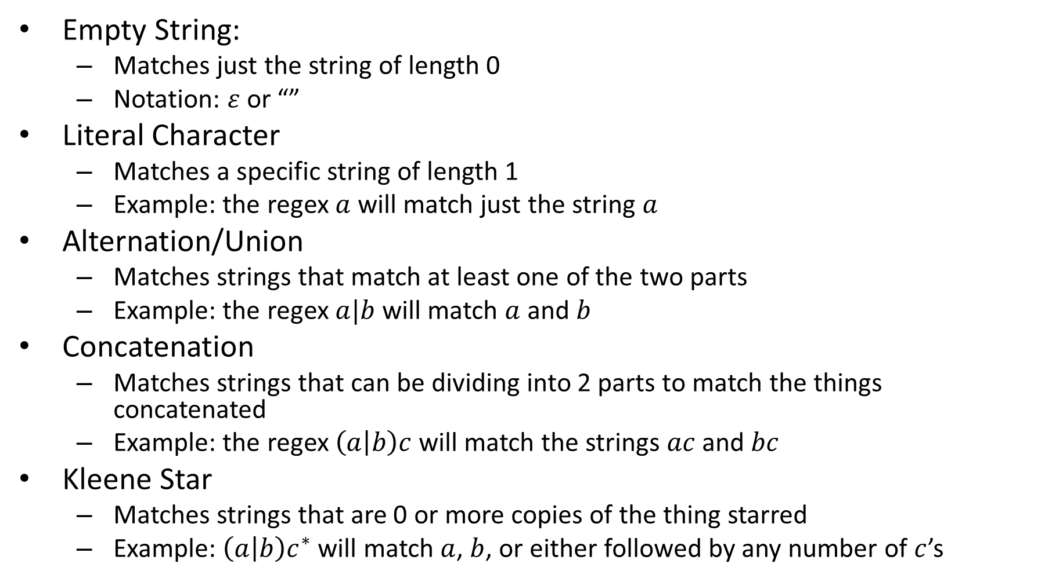
“Pieces” of a Regex
Empty String:
Matches just the string of length 0
Notation: $ε$ or “”
Literal Character
Matches a specific string of length 1
Example: the regex $a$ will match just the string $a$
Alternation/Union
Matches strings that match at least one of the two parts
Example: the regex $a|b$ will match $a$ and $b$
Concatenation
Matches strings that can be dividing into 2 parts to match the things concatenated
Example: the regex $\left(a | b\right)c$ will match the strings $ac$ and $bc$
Kleene Star
Matches strings that are 0 or more copies of the thing starred
Example: $\left(a | b\right)c^{∗}$ will match $a$, $b$, or either followed by any number of $c$’s
Note: The compents here are the minimal necessary. In practice, regexes have other components as well, those are just “syntactic sugar”.

Slide 13
Regex for UVA computing IDs
A UVA computing id is formatted as:
2-3 letters
A digit
1-3 letters

Slide 14

AND as a Regex
$AND=\left\{x∈{\left\{0,1\right\}}^{∗}\right|x has no 0s\}$

Slide 15

NAND as a Regex
$NAND=\{x∈{\left\{0,1\right\}}^{∗}|x has a 0\}$

Slide 16

XOR as a Regex
$XOR=\{x∈{\left\{0,1\right\}}^{∗}|x has an odd number of 1s\}$

Slide 17
FSA = Regex
Finite state Automata and Regular Expressions are equivalent models of computing
Any language I can represent as a FSA I can also represent as a Regex (and vice versa)
How would I show this?

Slide 18

Showing FSA $≤$ Regex
Show how to convert any FSA into a Regex for the same language
We’re going to skip this:
It’s tedious, and people virtually never go this direction in practice, but you can do it (see textbook theorem 9.12)

Slide 19

Showing Regex $≤$ FSA
Show how to convert any regex into a FSA for the same language
Idea: show how to build each “piece” of a regex using FSA

Slide 20
“Pieces” of a Regex
Empty String:
Matches just the string of length 0
Notation: $ε$ or “”
Literal Character
Matches a specific string of length 1
Example: the regex $a$ will match just the string $a$
Alternation/Union
Matches strings that match at least one of the two parts
Example: the regex $a|b$ will match $a$ and $b$
Concatenation
Matches strings that can be dividing into 2 parts to match the things concatenated
Example: the regex $\left(a | b\right)c$ will match the strings $ac$ and $bc$
Kleene Star
Matches strings that are 0 or more copies of the thing starred
Example: $\left(a | b\right)c^{∗}$ will match $a$, $b$, or either followed by any number of $c$’s

Slide 21
FSA for the empty string

Slide 22
FSA for a literal character

Slide 23
FSA for Alternation/Union
Tricky…
What does it need to do?

Slide 24
Characterizing What’s computable
Things that are computable by FSA:
Functions that don’t need “memory”
Languages expressible as Regular Expressions (next time)
Things that aren’t computable by FSA:
Things that require more than finitely many states
Intuitive example: Majority

Slide 25
Majority with FSA?
Consider an inputs with lots of 0s
Recall: we read 1 bit at a time, no going back!
To count to 50,000, we'll need 50,000 states!
000...0000 111...1111
000...0000 111...1111
000...0000 111...1111
×50,000
×50,000
×50,000
×50,001
×49,999
×50,000

