Slide 1
CS3102 Theory of Computation
Warm up:
We showed that NAND gates are “Universal”. We also showed that not all things are “Computable”. How can both things be true?

Slide 2
Logistics
Midterm on Thursday in class
Review session tomorrow evening
6:30pm – 8:00pm
Thornton E316

Slide 3
Last Time
Complexity
SIZE
Complexity Classes
Big-Oh

Slide 4
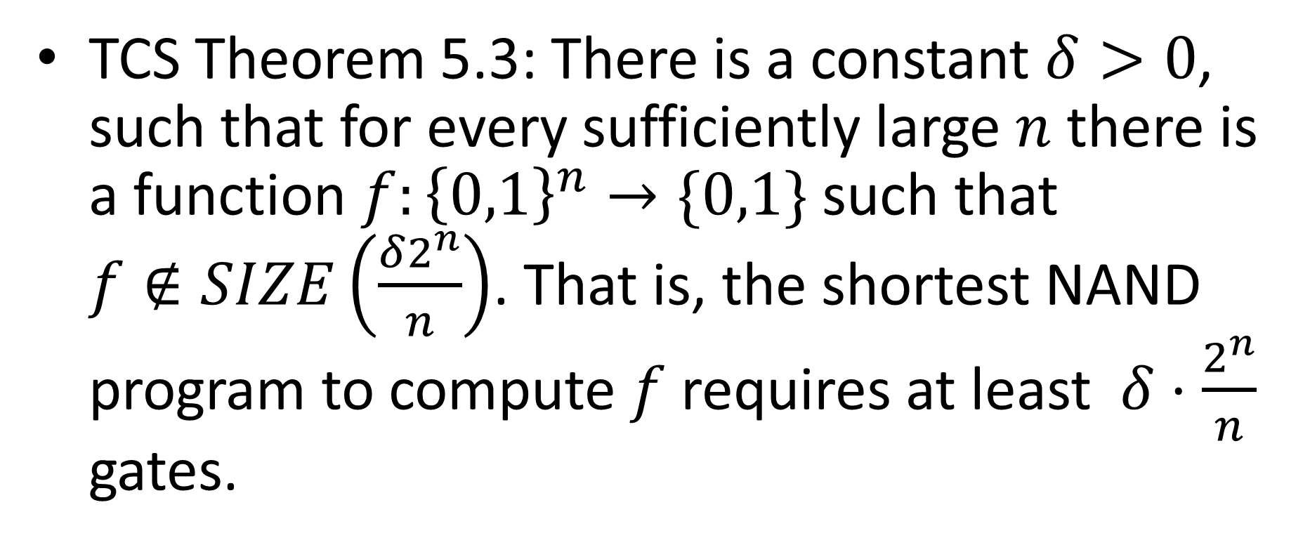
How many gates are required?
TCS Theorem 5.3: There is a constant $δ>0$, such that for every sufficiently large $n$ there is a function $f:{\left\{0,1\right\}}^{n}→\{0,1\}$ such that $f∉SIZE\left(\frac{δ2^{n}}{n}\right)$. That is, the shortest NAND program to compute $f$ requires at least $δ⋅\frac{2^{n}}{n}$ gates.

Slide 5
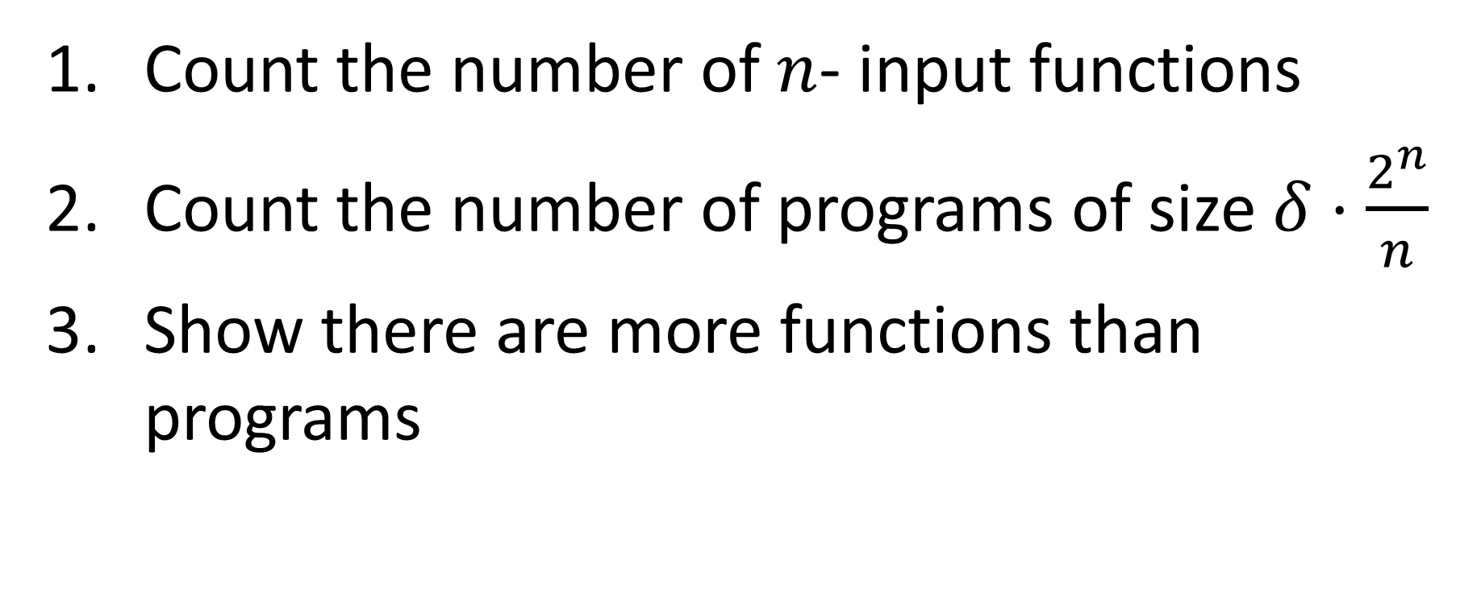
How to show this
Count the number of $n$- input functions
Count the number of programs of size $δ⋅\frac{2^{n}}{n}$
Show there are more functions than programs

Slide 6

How many functions?
How many functions are there of form ${\left\{0,1\right\}}^{n}→\{0,1\}$?
How can we count this?

Slide 7
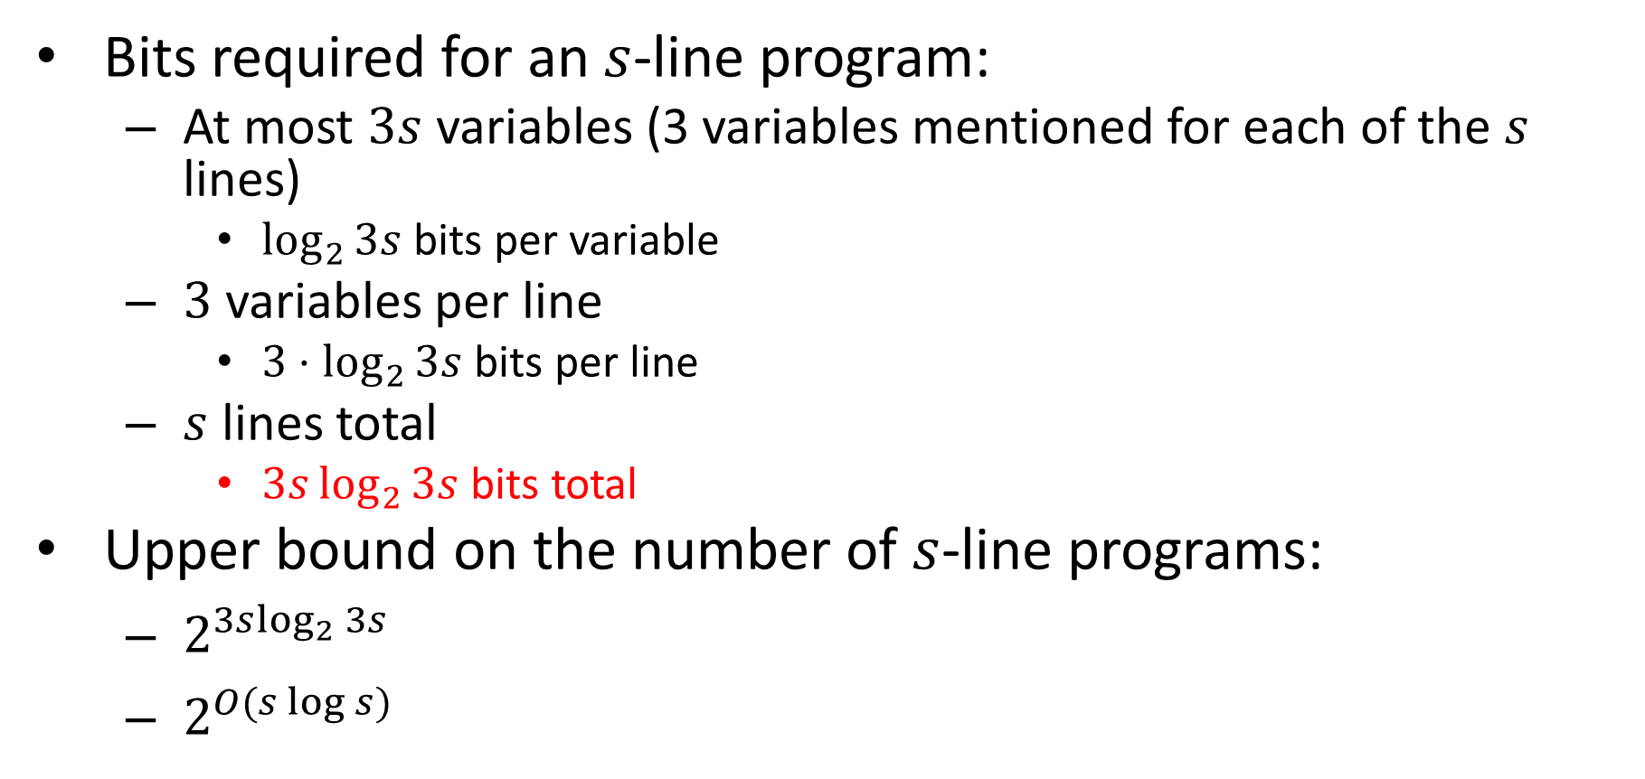
How many programs?
Bits required for an $s$-line program:
At most $3s$ variables (3 variables mentioned for each of the $s$ lines)
$\log_{2}{3s}$ bits per variable
$3$ variables per line
$3⋅\log_{2}{3s}$ bits per line
$s$ lines total
$3s\log_{2}{3s}$ bits total
Upper bound on the number of $s$-line programs:
$2^{3s\log_{2}{3s}}$
$2^{O(s\log{s})}$

Slide 8
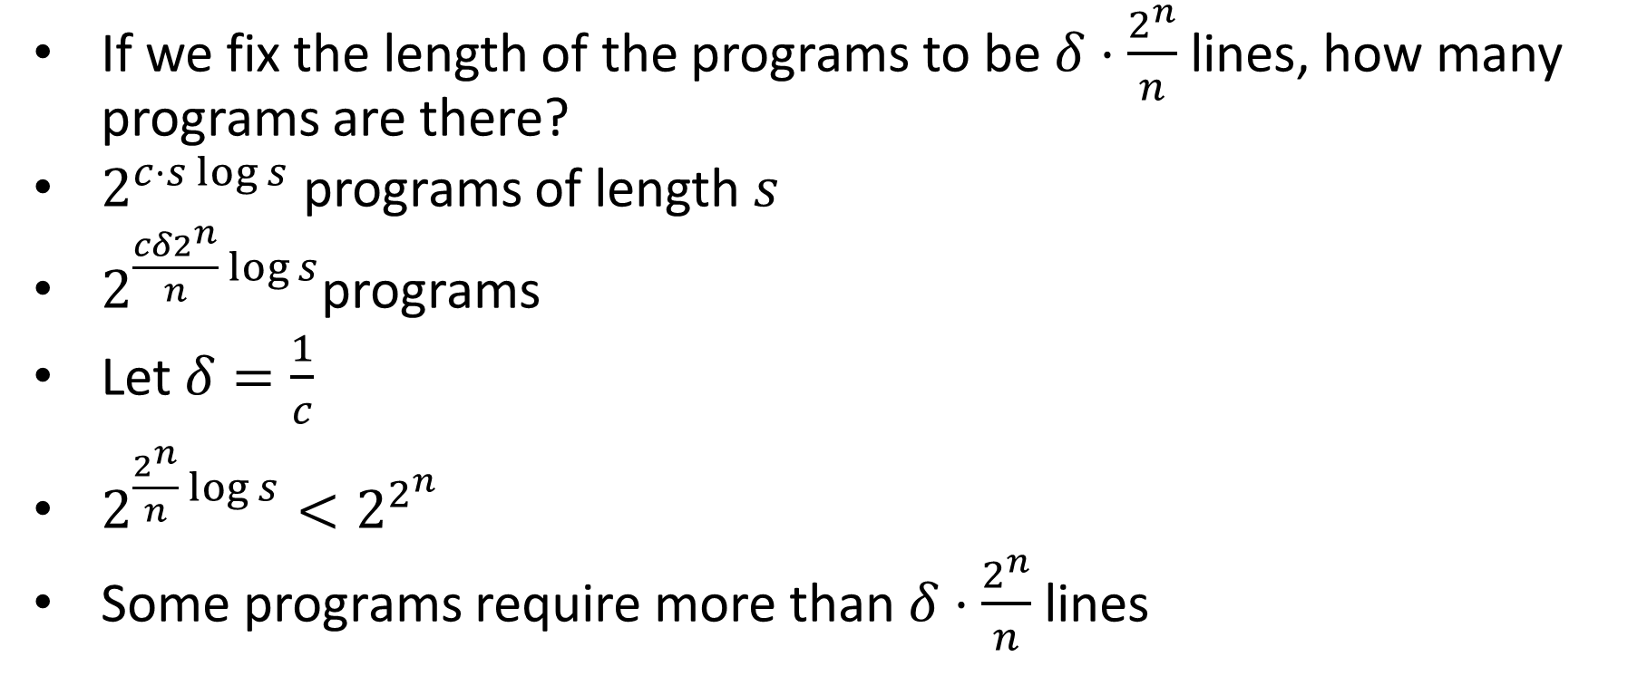
Fixing the Length
If we fix the length of the programs to be $δ⋅\frac{2^{n}}{n}$ lines, how many programs are there?
$2^{c⋅s\log{s}}$ programs of length $s$
$2^{\frac{cδ2^{n}}{n}\log{s}}$programs
Let $δ=\frac{1}{c}$
$2^{\frac{2^{n}}{n}\log{s}}<2^{2^{n}}$
Some programs require more than $δ⋅\frac{2^{n}}{n}$ lines

Slide 9
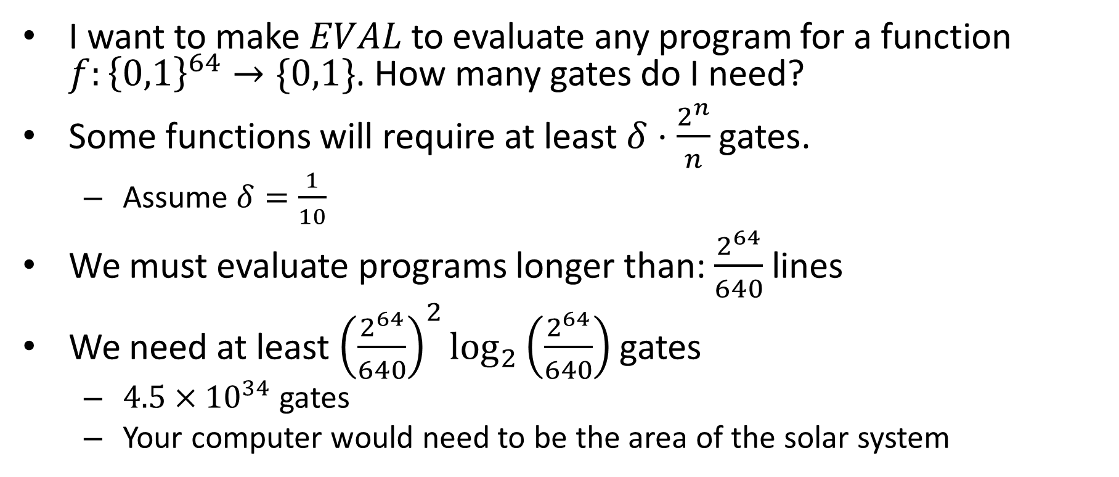
64 bit machine
I want to make $EVAL$ to evaluate any program for a function $f:{\left\{0,1\right\}}^{64}→\{0,1\}$. How many gates do I need?
Some functions will require at least $δ⋅\frac{2^{n}}{n}$ gates.
Assume $δ=\frac{1}{10}$
We must evaluate programs longer than: $\frac{2^{64}}{640}$ lines
We need at least ${\left(\frac{2^{64}}{640}\right)}^{2}\log_{2}\left(\frac{2^{64}}{640}\right)$ gates
$4.5×{10}^{34}$ gates
Your computer would need to be the area of the solar system

Slide 10
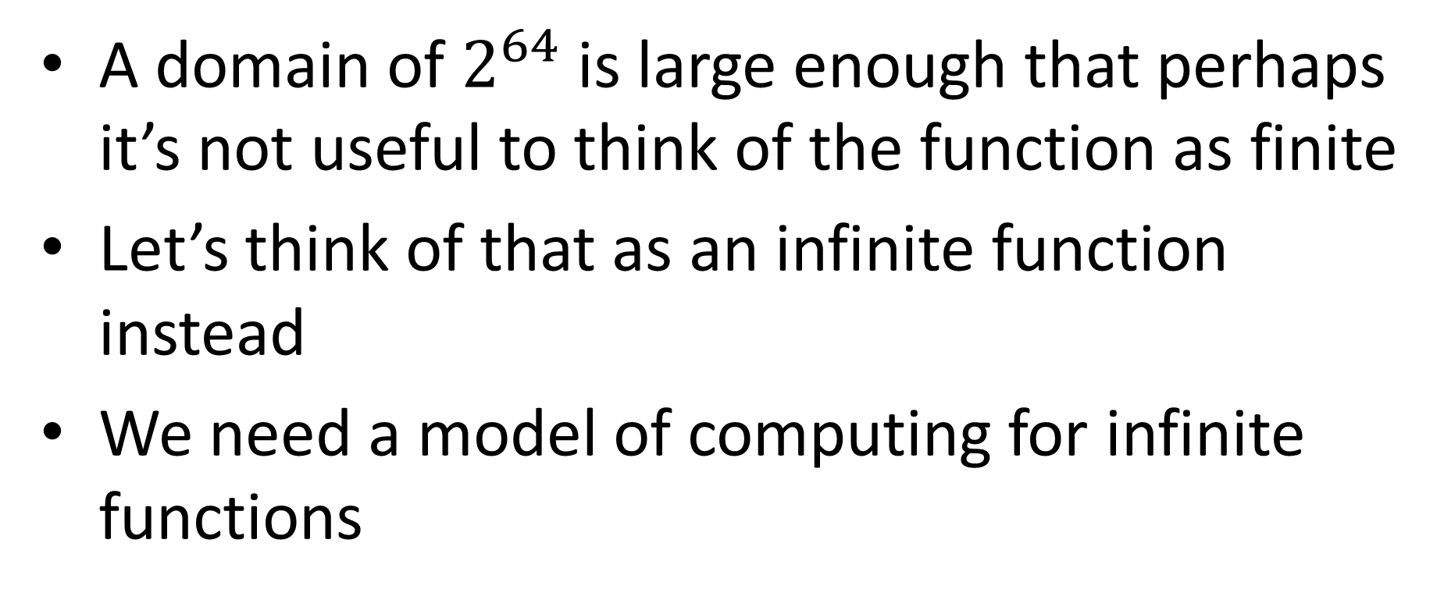
Conclusion
A domain of $2^{64}$ is large enough that perhaps it’s not useful to think of the function as finite
Let’s think of that as an infinite function instead
We need a model of computing for infinite functions

Slide 11
After the exam
A model of computing for infinite functions
How to do simple operations over and over again to compute
Real computers update memory by computing “simple” functions in hardware over and over again

Slide 12
Major topics
Representing things as strings
Computing requires finite representations
There are more functions than finite representations of things, so some functions aren’t computable!
Boolean gates/programs as a model of computing
Computing with logic!
Simple components can build complicated behavior
With just NAND we can do complex functions
ANY finite function, actually
Including evaluating programs
With a model of computing we can measure efficiency of computing
Allows us to categoriz functions by difficulty

Slide 13
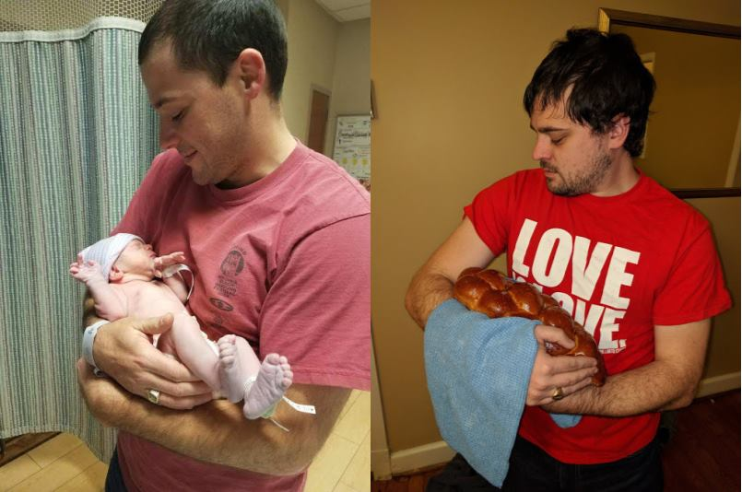
Is there a baby in the picture?

Slide 14
Computing the “Baby” function
First: Represent pictures as strings (in binary)
Assumption: all our pictures will be scaled to be the same size

Slide 15
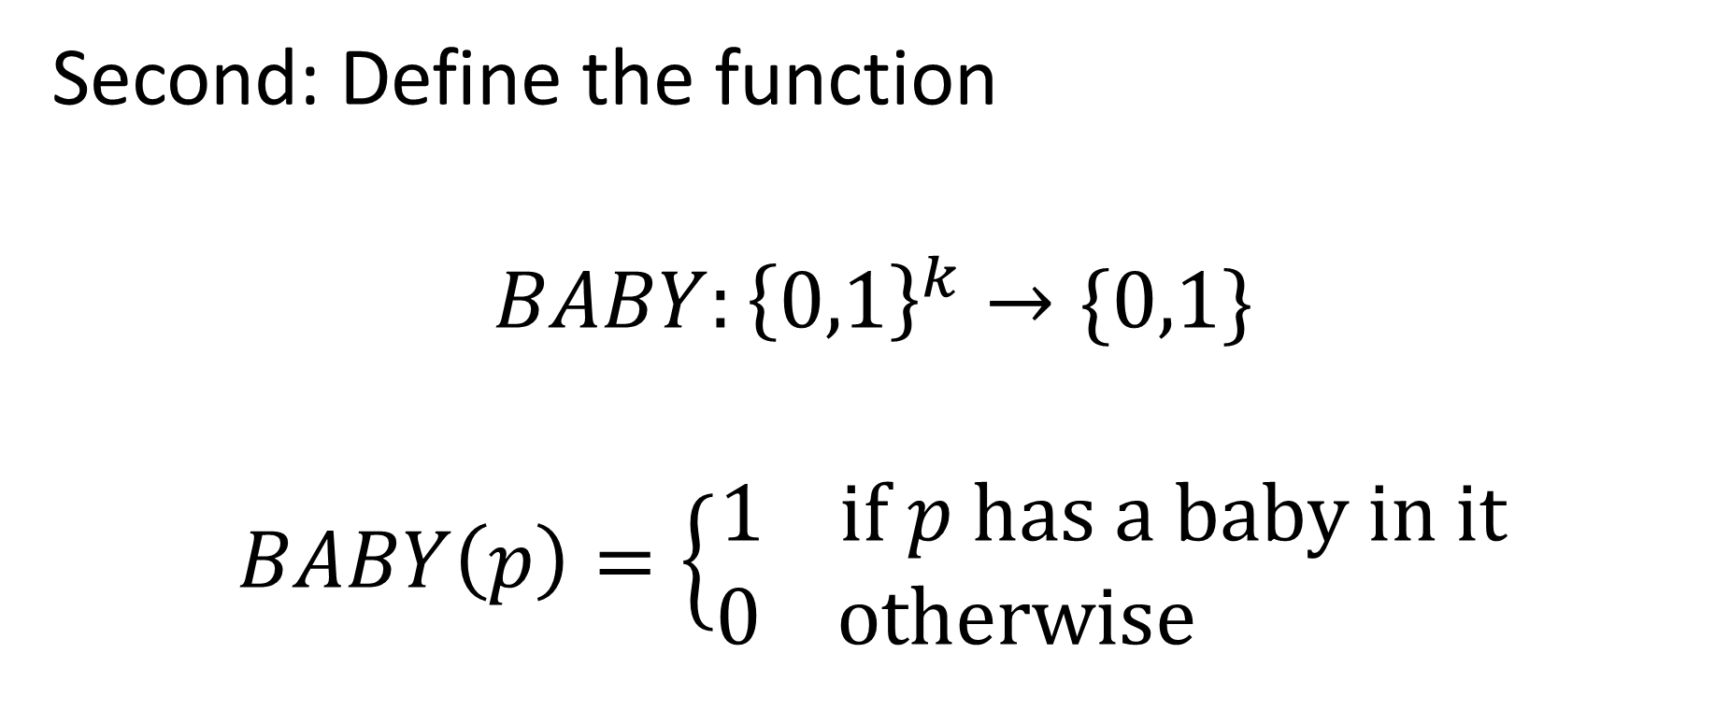
Computing the “Baby” function
Second: Define the function
$$BABY:{\left\{0,1\right\}}^{k}→\{0,1\}$$
$$BABY\left(p\right)=\left\{\begin{aligned}1 if p has a baby in it \\ 0 otherwise \end{aligned}\right.$$

Slide 16
Computing the “Baby” function
Third: Build a NAND-circuit/program for the function
How can we tell if that’s possible?

