Slide 1

CS3102 Theory of Computation
www.cs.virginia.edu/~njb2b/cstheory/s2020
Warm up:
How might we try to show that this language is not computable:
$$Infinite=\left\{w \right| L\left(ℳ\left(w\right)\right) is infinite\}$$

Slide 2

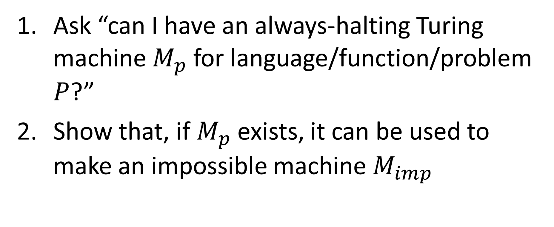
How to show things aren’t computable
Ask “can I have an always-halting Turing machine $M_{p}$ for language/function/problem $P$?”
Show that, if $M_{p}$ exists, it can be used to make an impossible machine $M_{imp}$
How do we know a machine is impossible?
Option 1: It contradicts itself (e.g. $M_{SR}$)
Option 2: Someone has done this before (e.g. $M_{acc}$)

Slide 3
Proving Other Problems are Uncomputable
Reduction
Convert some problem into a known uncomputable one (using only computable steps)
Show how you can use a solution to one problem to help you to solve another

Slide 4
Non-Computable Problems

Slide 5

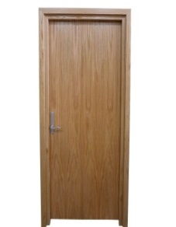
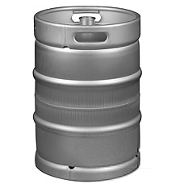

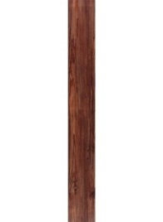



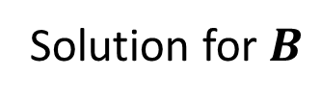


MacGyver’s Reduction
Problem know is impossible
Problem we think is impossible
Opening a door
Lighting a fire
$$A$$
$$B$$
Aim duct at door, insert keg
If
Solution for $A$
Keg cannon battering ram
Solution for $B$
Alcohol, wood, matches
Put fire under the Keg
Reduction

Slide 6
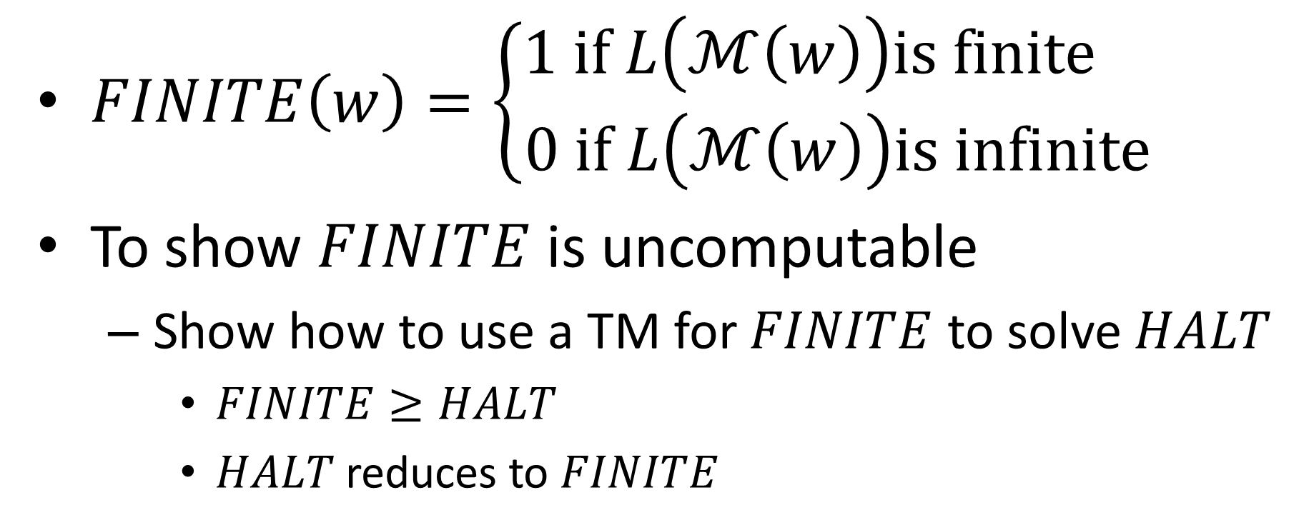

Example: $FINITE$
$FINITE\left(w\right)=\left\{\begin{aligned}1 if L\left(ℳ\left(w\right)\right)is finite \\ 0 if L\left(ℳ\left(w\right)\right)is infinite\end{aligned}\right.$
To show $FINITE$ is uncomputable
Show how to use a TM for $FINITE$ to solve $HALT$
$FINITE≥HALT$
$HALT$ reduces to $FINITE$

Slide 7
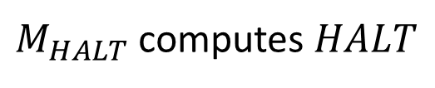



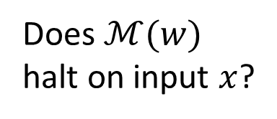
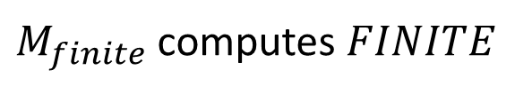
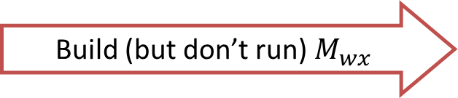


$FINITE$ Reduction
Problem know is impossible
Problem we think is impossible
$$FINITE$$
$$A$$
$$HALT$$
Build (but don’t run) $M_{wx}$
$$B$$
Is $L\left(ℳ\left(w\right)\right)$ finite?
Does $ℳ(w)$ halt on input $x$?
Assume
Give $M_{wx}$ as input to $M_{finite}$ answer opposite
$M_{HALT}$ computes $HALT$
$M_{finite}$ computes $FINITE$
Reduction

Slide 8
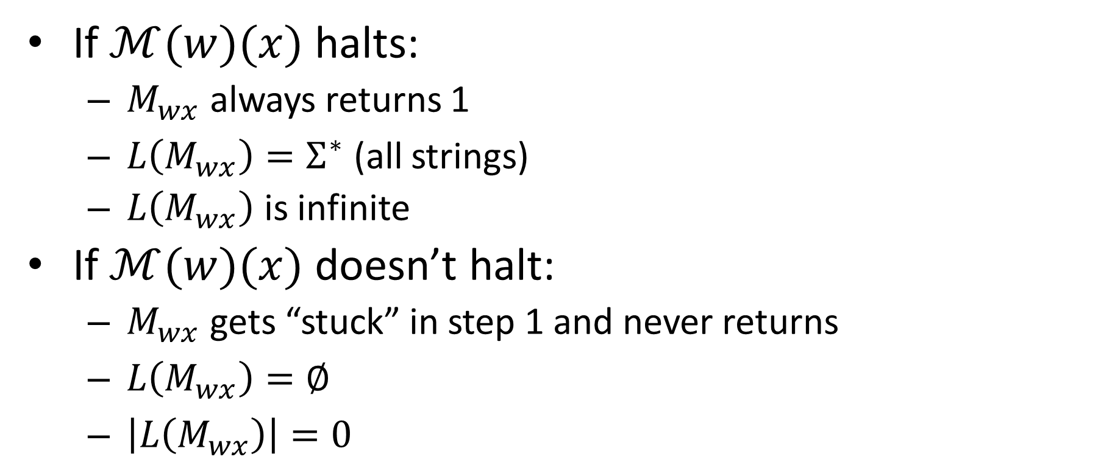
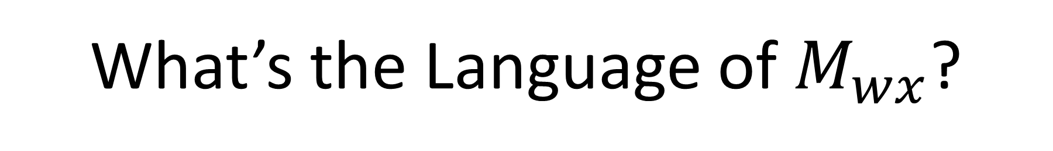

What’s the Language of $M_{wx}$?
Build this machine:
$M_{wx}:$
1) run $ℳ(w)(x)$
2) return 1
If $ℳ(w)(x)$ halts:
$M_{wx}$ always returns 1
$L\left(M_{wx}\right)=Σ^{∗}$ (all strings)
$L\left(M_{wx}\right)$ is infinite
If $ℳ(w)(x)$ doesn’t halt:
$M_{wx}$ gets “stuck” in step 1 and never returns
$L\left(M_{wx}\right)=∅$
$\left|L\left(M_{wx}\right)\right|=0$

Slide 9


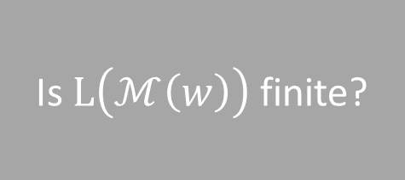





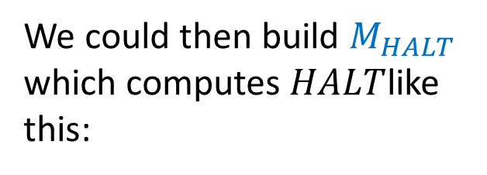

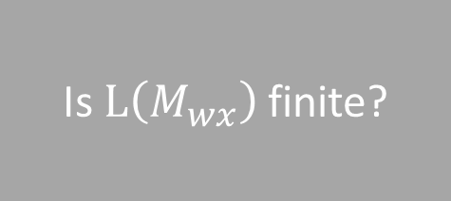
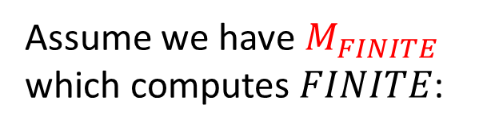



Using $FINITE$ to build $HALT$
Assume we have $M_{FINITE}$ which computes $FINITE$:
Is $L\left(ℳ\left(w\right)\right)$ finite?
$$M_{FINITE}$$
$L\left(ℳ\left(w\right)\right)$ is/isn’t finite
$$w$$
We could then build $M_{HALT}$ which computes $HALT$like this:
$$M_{HALT}$$
Does $ℳ\left(w\right)\left(x\right)$ halt?
$$w$$
Build this machine:
$M_{wx}:$
1) run $ℳ(w)(x)$
2) return 1
$$M_{FINITE}$$
$$ℳ\left(w\right)\left(1\right)!=1$$
Is $L\left(M_{wx}\right)$ finite?
$$x$$

Slide 10

Showing $INFINITE$ is not computable
Use _____ to build _____.

Slide 11

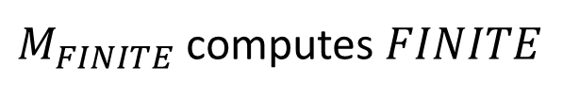

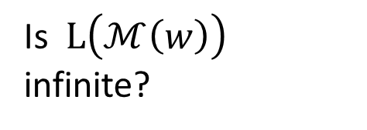
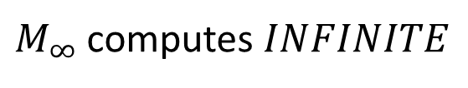
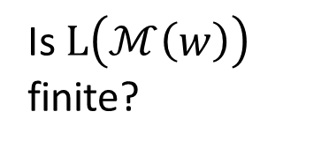

$INFINITE$ Reduction
$$INFINITE$$
$$A$$
$$FINITE$$
$$B$$
Is $L\left(ℳ\left(w\right)\right)$ infinite?
Is $L\left(ℳ\left(w\right)\right)$ finite?
Assume
$M_{FINITE}$ computes $FINITE$
$M_{∞}$ computes $INFINITE$
Reduction

Slide 12

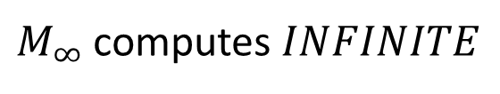
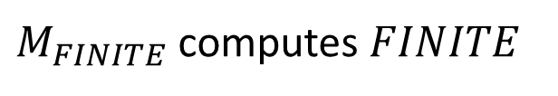
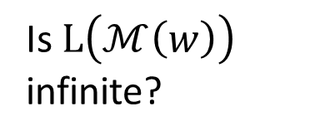
$INFINITE$ Reduction
$$FINITE$$
$$A$$
$$INFINITE$$
$$B$$
Is $L\left(ℳ\left(w\right)\right)$ finite?
Is $L\left(ℳ\left(w\right)\right)$ infinite?
Assume
$M_{∞}$ computes $INFINITE$
$M_{FINITE}$ computes $FINITE$
Reduction

Slide 13

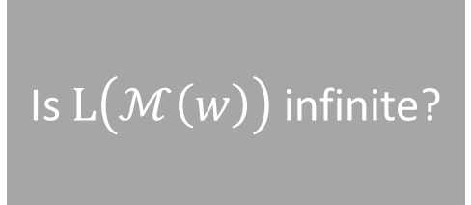





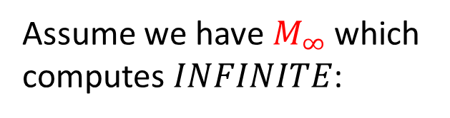

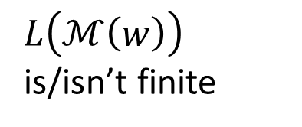
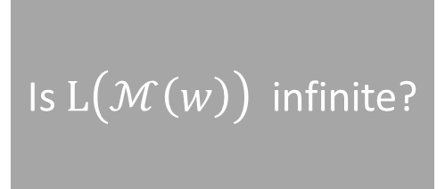
Using $INFINITE$ to build $FINITE$
Assume we have $M_{∞}$ which computes $INFINITE$:
Is $L\left(ℳ\left(w\right)\right)$ infinite?
$$M_{∞}$$
$L\left(ℳ\left(w\right)\right)$ is/isn’t infinite
$$w$$
We could then build $M_{FINITE}$ which computes $FINITE$ like this:
$$M_{FINITE}$$
Is $L\left(ℳ\left(w\right)\right)$ finite?
$$w$$
$$M_{∞}$$
Is $L\left(ℳ\left(w\right)\right)$ infinite?
$L\left(ℳ\left(w\right)\right)$ is/isn’t finite
$$x$$

Slide 14
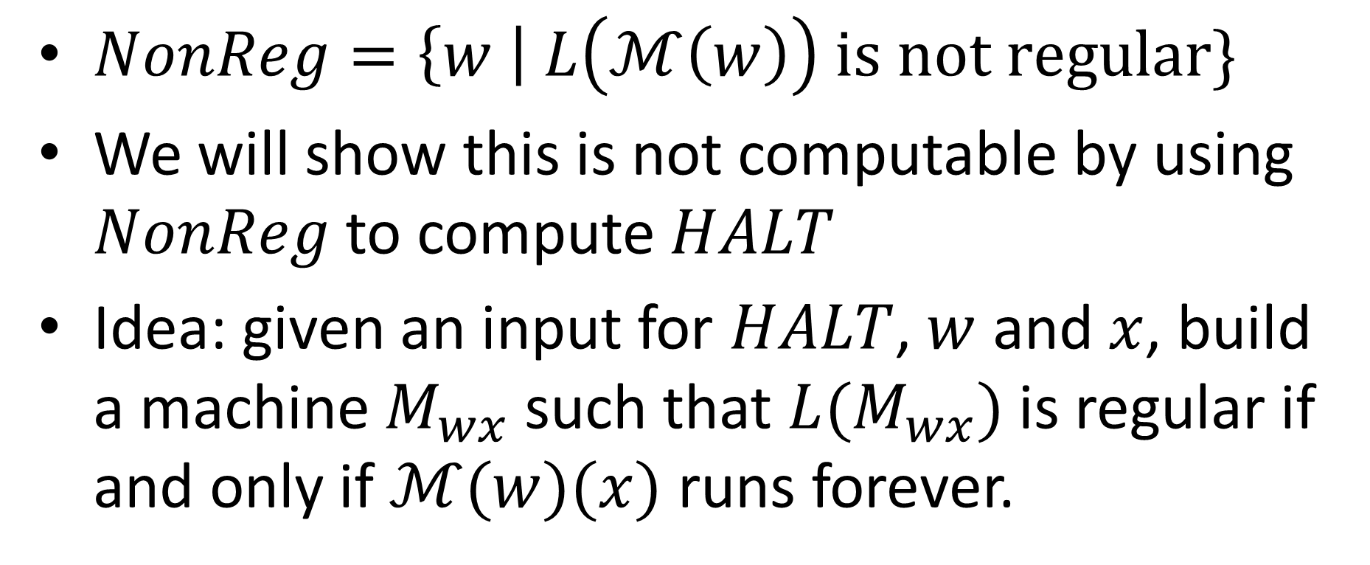

Language $NonReg$
$NonReg=\left\{w \right| L\left(ℳ\left(w\right)\right) is not regular\}$
We will show this is not computable by using $NonReg$to compute $HALT$
Idea: given an input for $HALT$, $w$ and $x$, build a machine $M_{wx}$ such that $L(M_{wx})$ is regular if and only if $ℳ(w)(x)$ runs forever.

Slide 15
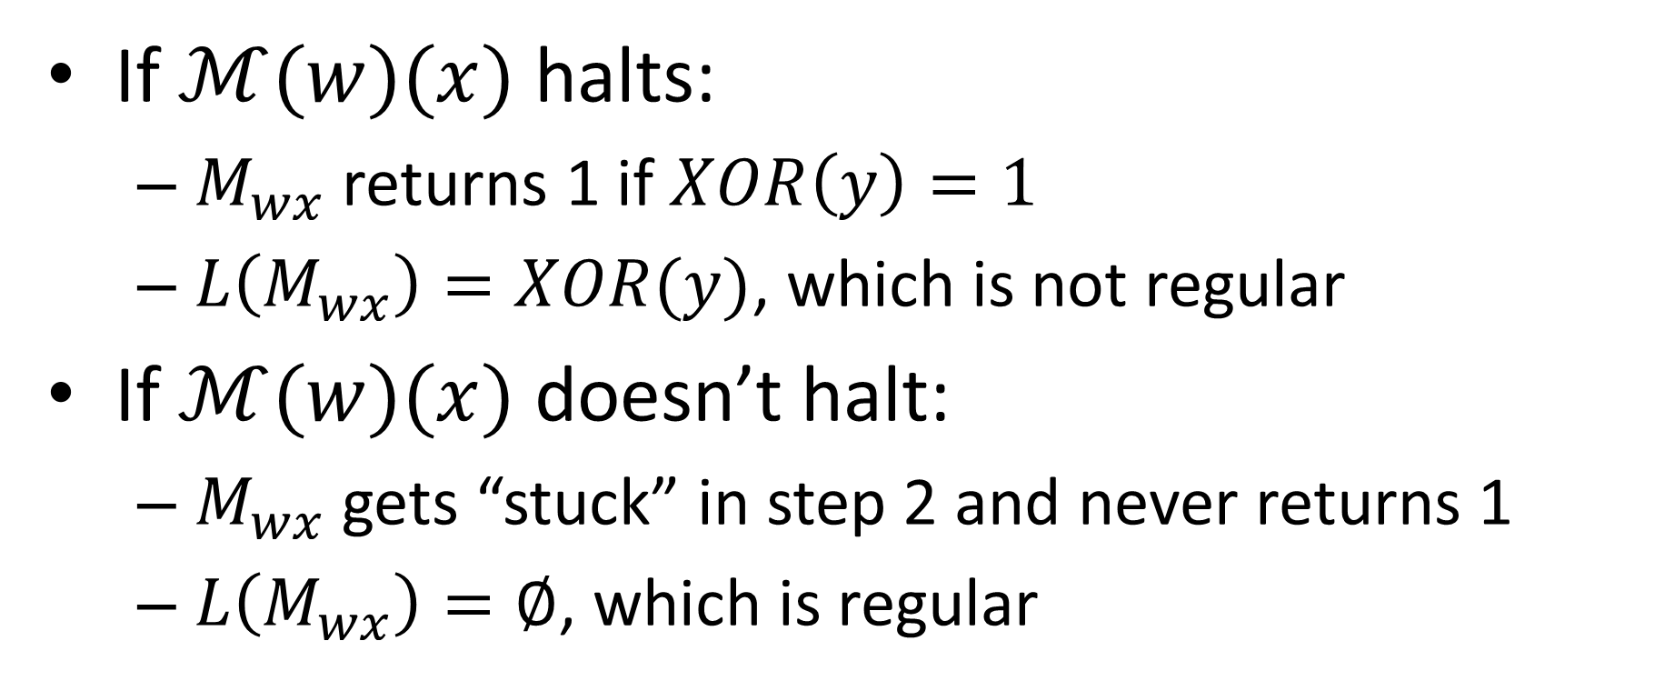


Building $M_{wx}$
Build this machine:
$M_{wx}(y):$
1) run $ℳ(w)(x)$
2) return $XOR(y)$
If $ℳ(w)(x)$ halts:
$M_{wx}$ returns 1 if $XOR\left(y\right)=1$
$L\left(M_{wx}\right)=XOR(y)$, which is not regular
If $ℳ(w)(x)$ doesn’t halt:
$M_{wx}$ gets “stuck” in step 2 and never returns 1
$L\left(M_{wx}\right)=∅$, which is regular

Slide 16
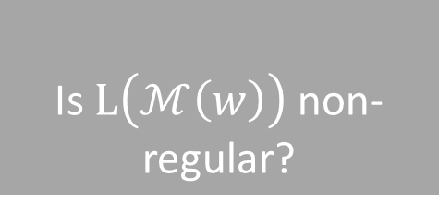


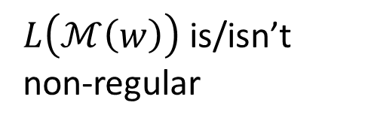
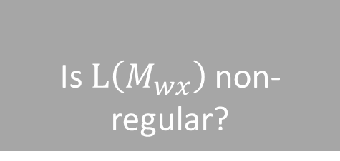
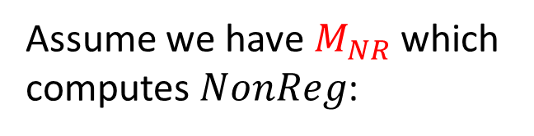

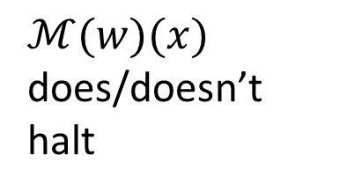

Using $NonReg$ to build $HALT$
Assume we have $M_{NR}$ which computes $NonReg$:
Is $L\left(ℳ\left(w\right)\right)$ non-regular?
$$M_{NR}$$
$L\left(ℳ\left(w\right)\right)$ is/isn’t non-regular
$$w$$
We could then build $M_{HALT}$ which computes $HALT$like this:
$$M_{HALT}$$
Does $ℳ\left(w\right)\left(x\right)$ halt?
$$w$$
Build this machine:
$M_{wx}(y):$
1) run $ℳ(w)(x)$
2) return $XOR(y)$
$$M_{NR}$$
$ℳ(w)(x)$ does/doesn’t halt
Is $L\left(M_{wx}\right)$ non-regular?
$$x$$

Slide 17
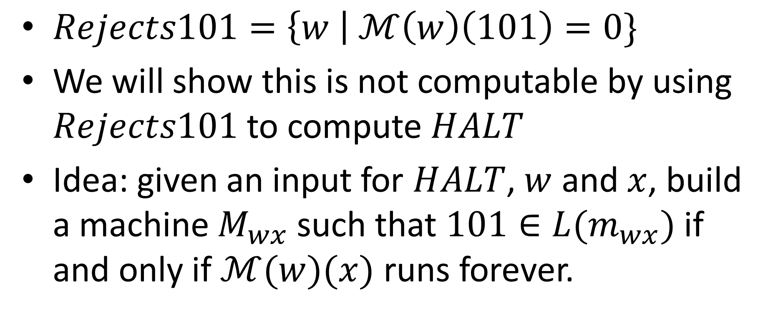

Language $Rejects101$
$Rejects101=\left\{w \right| ℳ\left(w\right)\left(101\right)=0\}$
We will show this is not computable by using $Rejects101$ to compute $HALT$
Idea: given an input for $HALT$, $w$ and $x$, build a machine $M_{wx}$ such that $101∈L(m_{wx})$ if and only if $ℳ(w)(x)$ runs forever.

Slide 18
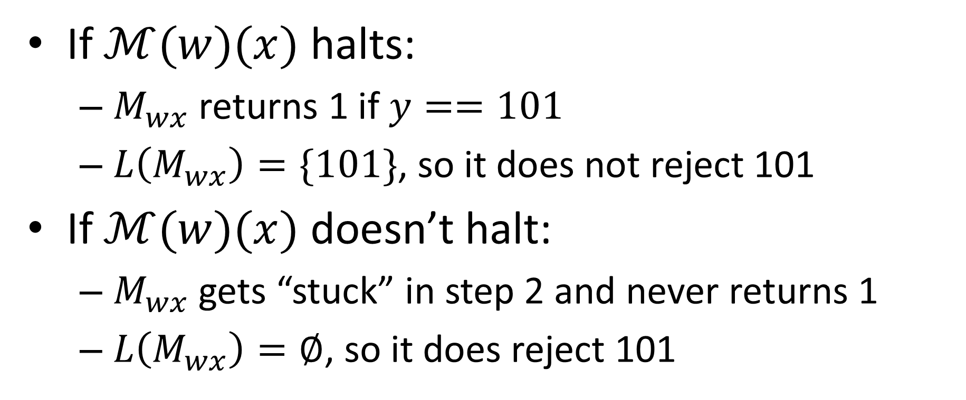

Building $M_{wx}$
Build this machine:
$M_{wx}(y):$
1) run $ℳ(w)(x)$
2) return $y==101$
If $ℳ(w)(x)$ halts:
$M_{wx}$ returns 1 if $y==101$
$L\left(M_{wx}\right)=\{101\}$, so it does not reject 101
If $ℳ(w)(x)$ doesn’t halt:
$M_{wx}$ gets “stuck” in step 2 and never returns 1
$L\left(M_{wx}\right)=∅$, so it does reject 101

Slide 19
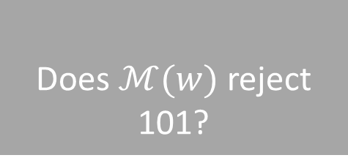


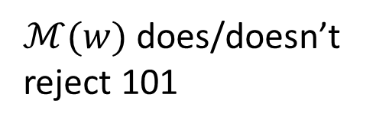
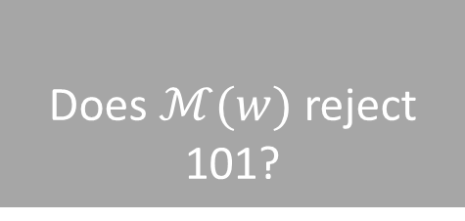
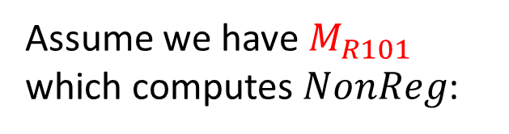


Using $Rejects101$ to build $HALT$
Assume we have $M_{R101}$ which computes $NonReg$:
Does $ℳ(w)$ reject 101?
$$M_{R101}$$
$ℳ(w)$ does/doesn’t reject 101
$$w$$
We could then build $M_{HALT}$ which computes $HALT$like this:
$$M_{HALT}$$
Does $ℳ\left(w\right)\left(x\right)$ halt?
$$w$$
Build this machine:
$M_{wx}(y):$
1) run $ℳ(w)(x)$
2) return $y==101$
$$M_{R101}$$
$ℳ(w)(x)$ does/doesn’t halt
Does $ℳ(w)$ reject 101?
$$x$$

Slide 20

Sematic Property
Turing machines $M, M′$ are Functionally Equivalent if $∀x∈Σ^{∗}$, $M\left(x\right)==M\left(x^{′}\right)$
i.e. they compute the same function/language
A Semantic Property of a Turing machine is one that depends only on the input/output behavior of the machine
Formally, if $P$ is semantic, then for machine $M, M′$ that are functionally equivalent, $P\left(M\right)==P\left(M^{′}\right)$
If $M,M′$ have the same input/output behavior, and $P$ is a semantic property, then either bother $M$ and $M′$ have property $P$, or neither of them do.

Slide 21

Examples
These properties are Semantic:
Is the language of this machine finite?
Is the language of this machine Regular?
Does this machine reject 101?
Does this machine return 1001 for input 001?
Does this machine only ever return odd numbers?
Is the language of this machine computable?
These properties are not Semantic:
Does this machine ever overwrite cell 204 of its tape?
Does this machine use more than 3102 cells of its tape on input 101?
Does this machine take at least 2020 transitions for input $ε$?
Does this machine ever overwrite the $∇$ symbol?

Slide 22


Rice’s Theorem
For any Semantic property $P$ of Turing Machines, either:
Every Turing machine has property $P$
No Turing machines have property $P$
$P$ is uncomputable
In other words:
If $P$ is semantic, and computable, then one of these two machines computes it:
$P$ is “trivial”
Return 1
Return 0

Slide 23


Proof of Rice’s Theorem
Let $P$ be a semantic property of a Turing machine
Assume $M_{∅}$ (a machine whose language is $∅$) has property $P$ (otherwise substitute $¬P$, then answer opposite)
Let $M_{FALSE}$ be a machine that doesn’t have property $P$
Idea:
If $ℳ(w)(x)$ halts, $L\left(M_{wx}\right)=L\left(M_{FALSE}\right)$
If $ℳ(w)(x)$ doesn’t halt, $L\left(M_{wx}\right)=L\left(M_{∅}\right)=∅$
$L(M_{wx})$ has property $P$ if and only if $ℳ\left(w\right)\left(x\right)$ runs forever
Build this machine:
$M_{wx}(y):$
1) run $ℳ(w)(x)$
2) return $M_{False}(y)$

Slide 24









Using $P$ to build $HALT$
Assume we have $M_{P}$ which computes $P$:
Does $ℳ(w)$ have property $P$?
$$M_{P}$$
$ℳ(w)$ does/doesn’t have property $P$
$$w$$
We could then build $M_{HALT}$ which computes $HALT$like this:
$$M_{HALT}$$
Does $ℳ\left(w\right)\left(x\right)$ halt?
$$w$$
Build this machine:
$M_{wx}(y):$
1) run $ℳ(w)(x)$
2) return $M_{False}(y)$
$$M_{P}$$
$ℳ(w)$ does/doesn’t have property $P$
Does $ℳ(w)$ have property $P$?
$$x$$

Slide 25


What if $P$ is “trivial”?
If $P$ applies to no Turing machines:
$M_{False}$ can’t exist
If $P$ applies to all Turing machines:
It applies to $M_{∅}$, $¬P$ applies to all machines
Build this machine:
$M_{wx}(y):$
1) run $ℳ(w)(x)$
2) return $M_{False}(y)$

Slide 26

Using Rice’s Theorem
These properties are Semantic:
Is the language of this machine finite?
Is the language of this machine Regular?
Does this machine reject 101?
Does this machine return 1001 for input 001?
Does this machine only ever return odd numbers?
Is the language of this machine computable?
These properties are not Semantic:
Does this machine ever overwrite cell 204 of its tape?
Does this machine use more than 3102 cells of its tape on input 101?
Does this machine take at least 2020 transitions for input $ε$?
Does this machine ever overwrite the $∇$ symbol on input $ε$?

Slide 27


$$Steps2020$$
$Steps2020=\{w|ℳ\left(w\right) takes at least 2020 steps\}$
Is $Steps2020$ computable?

Slide 28


$$Overwrite∇$$
$Overwrite∇=\left\{w \right| ℳ\left(w\right) overwrites ∇ on input ε\}$
Is $Overwrite∇$ computable?

