Slide 1

CS3102 Theory of Computation
www.cs.virginia.edu/~njb2b/cstheory/s2020
Warm up:
What piece(s) of a computer actually make it compute?
Is there one responsible component or many?
If there are many, which is/are most important?

Slide 2
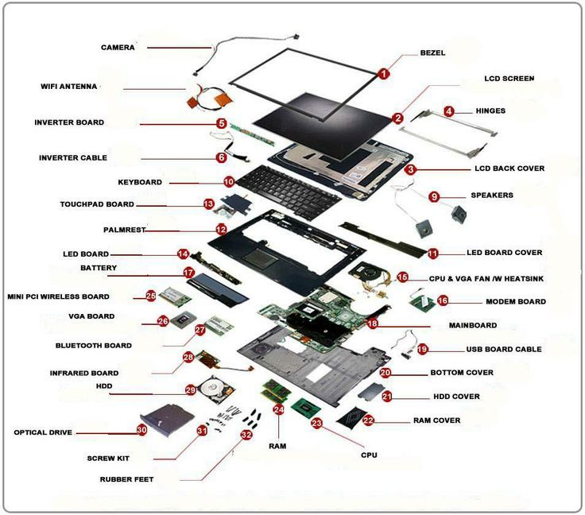

Slide 3
Most important parts (according to Nate)
CPU
Circuits of transistors
RAM
HDD/SSD

Slide 4
Agenda
Last class:
History, Motive, Logistics
Today:
Breaking down a computer, building up to models of computing
Upcoming deadlines:
Today: Exercise 0-1, Course registration survey
Tuesday: Exercise 0-2, Getting Started with LaTeX

Slide 5
What does it mean to compute?
We’ll discuss several ideas this semester
Several “models” of computing
Vague idea: take and input and produce an output
Computing Machine
/ Program / Algorithm
Output
Input

Slide 6
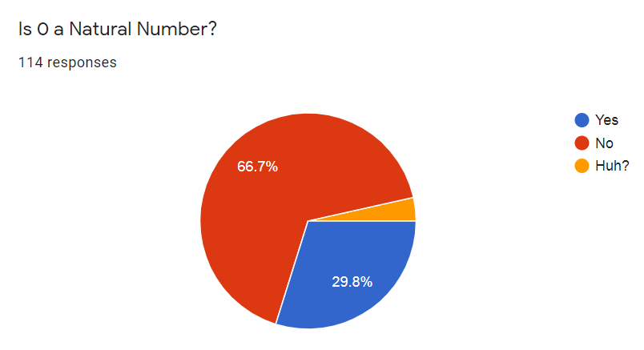
3.5%
The answer should follow from the definition of “Natural Number”, but there isn’t one universally accepted definition and you haven’t told us which one to use!

Slide 7
What makes a good definition?
Non-recursive
Unambiguous
There is only one interpretation
Small # of assumptions
All things match or don’t
Self-explanatory:
Understandable for my audience

Slide 8
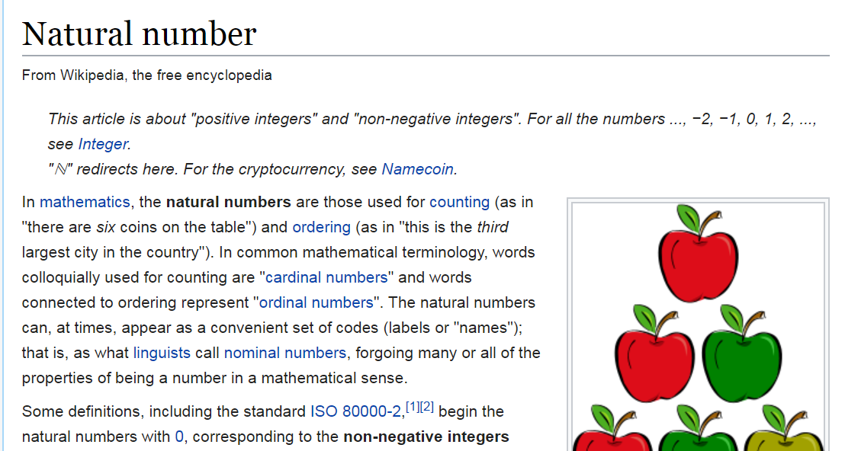
Defining Natural Numbers

Slide 9
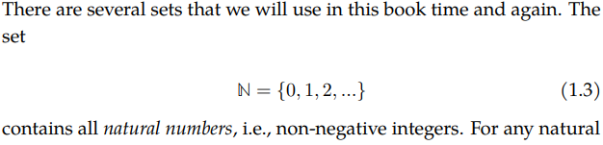
Defining Natural Numbers
MCS (The textbook many of you used in cs2102)
TCS (our textbook)

Slide 10
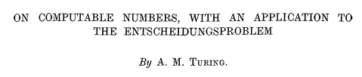
Defining Our Input/Output
Computing Machine
/ Program / Algorithm
Output
Input
What are the “types”?
What we compute on: representations of things (e.g. numbers)

Slide 11
What do we compute on?
String: an ordered sequence of characters
Is a representation of something
Characters come from an alphabet
Let’s formally define them

Slide 12

Alphabet
Alphabet is a finite set of characters
Notation: $Σ$ (\Sigma in LaTeX)
Examples: $\{0,1\}$, $\{a,b,c,d,…,z\}$, $\{0,1,2,…,9\}$

Slide 13
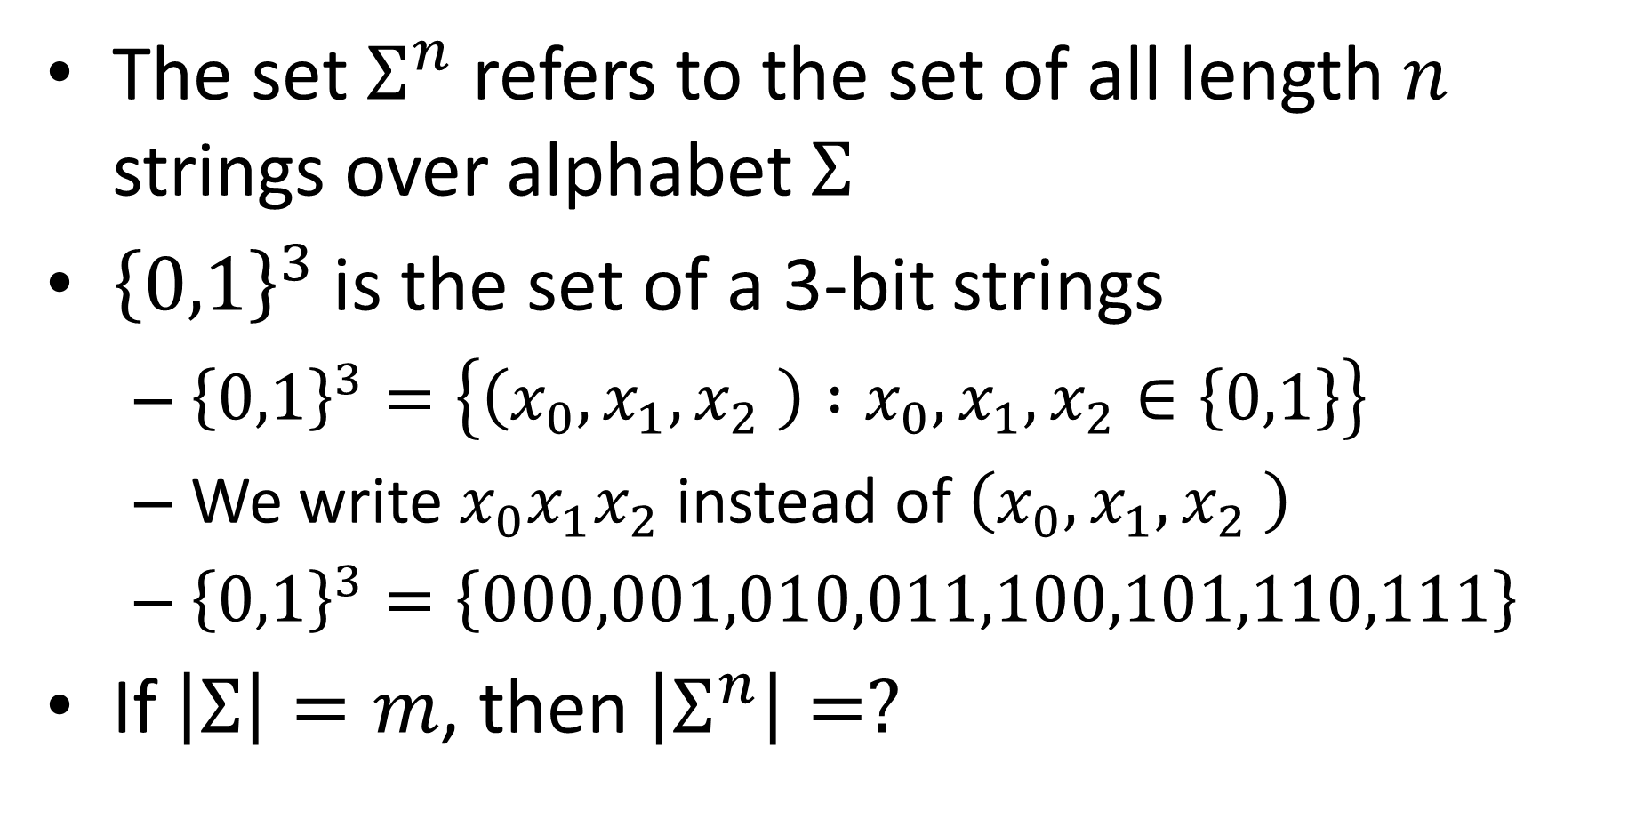
String
The set $Σ^{n}$ refers to the set of all length $n$ strings over alphabet $Σ$
${\left\{0,1\right\}}^{3}$ is the set of a 3-bit strings
${\left\{0,1\right\}}^{3}=\left\{\left(x_{0},x_{1},x_{2} \right) :x_{0},x_{1},x_{2}∈\left\{0,1\right\}\right\}$
We write $x_{0}x_{1}x_{2}$ instead of $\left(x_{0},x_{1},x_{2} \right)$
${\left\{0,1\right\}}^{3}=\left\{000,001,010,011,100,101,110,111\right\}$
If $\left|Σ\right|=m$, then $\left|Σ^{n}\right|=?$

Slide 14
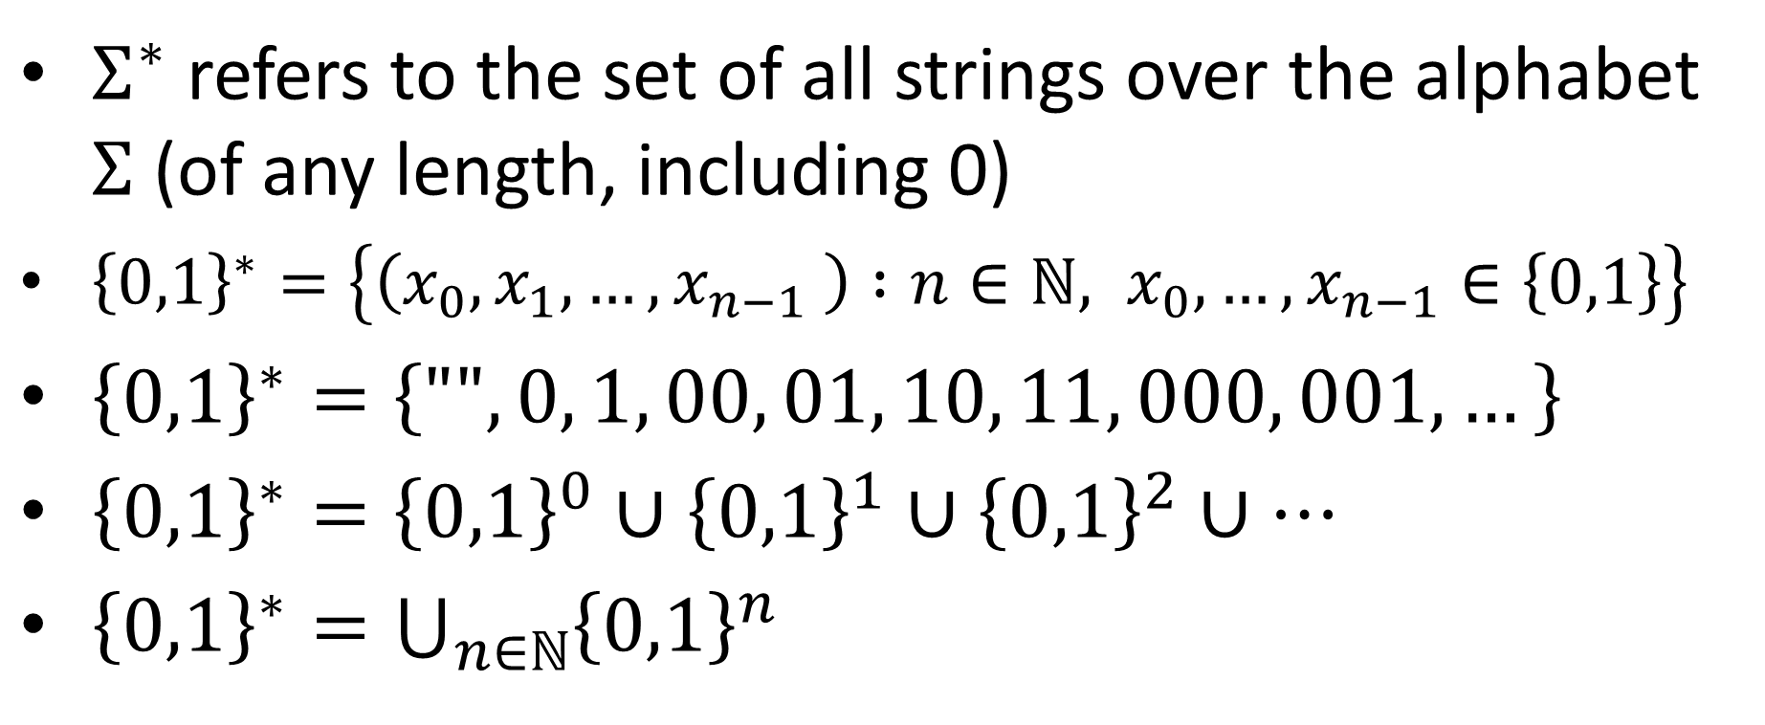
Kleene Star Operator
$Σ^{∗}$ refers to the set of all strings over the alphabet $Σ$ (of any length, including 0)
${\left\{0,1\right\}}^{∗}=\left\{\left(x_{0},x_{1},…,x_{n−1} \right) :n∈\text{ℕ}, x_{0},…,x_{n−1}∈\left\{0,1\right\}\right\}$
${\left\{0,1\right\}}^{∗}=\left\{"",0, 1, 00, 01, 10, 11, 000, 001,…\right\}$
${\left\{0,1\right\}}^{∗}={\left\{0,1\right\}}^{0}∪{\left\{0,1\right\}}^{1}∪{\left\{0,1\right\}}^{2}∪…$
${\left\{0,1\right\}}^{∗}=\bigcup_{n∈ℕ}{{\left\{0,1\right\}}^{n}}$

Slide 15
What do we compute, then?
Computing Machine
/ Program / Algorithm
Output
Input
Input and output are strings
Black box is an implementation
What are we implementing?
Functions
Languages

Slide 16
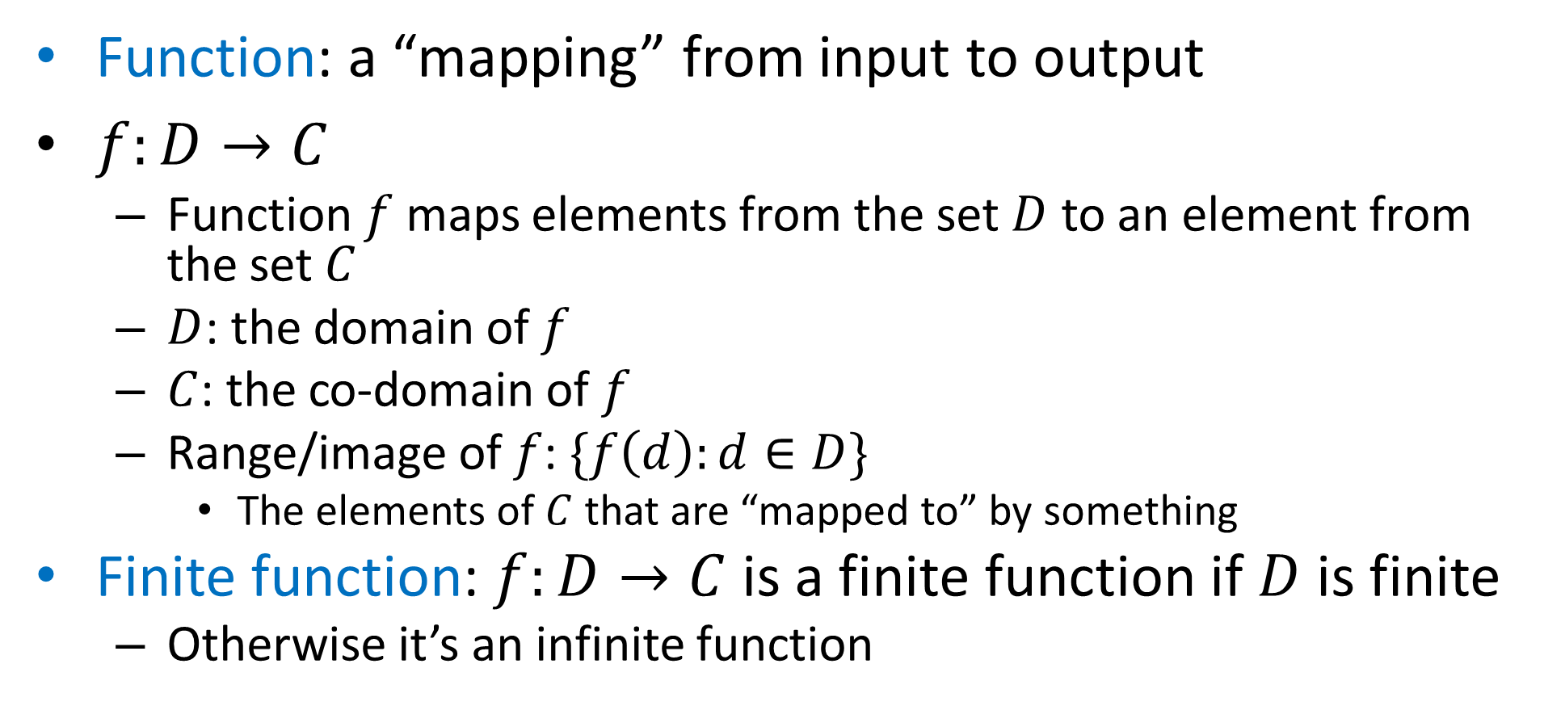
Functions
Function: a “mapping” from input to output
$f:D→C$
Function $f$ maps elements from the set $D$ to an element from the set $C$
$D$: the domain of $f$
$C$: the co-domain of $f$
Range/image of $f$: $\{f\left(d\right):d∈D\}$
The elements of $C$ that are “mapped to” by something
Finite function: $f:D→C$ is a finite function if $D$ is finite
Otherwise it’s an infinite function

Slide 17
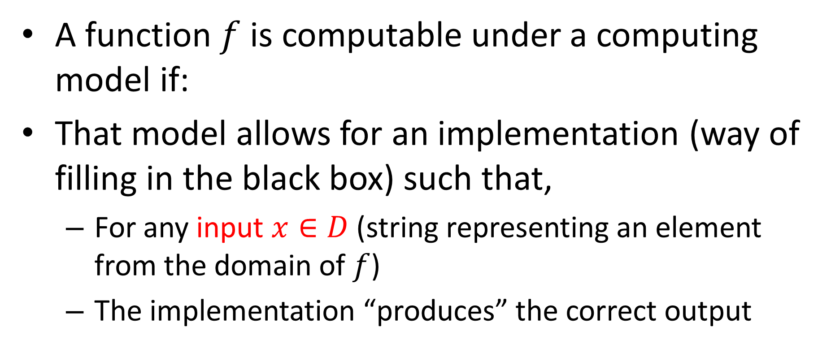
Computing a Function
Computing Machine
/ Program / Algorithm
Output
Input
A function $f$ is computable under a computing model if:
That model allows for an implementation (way of filling in the black box) such that,
For any input $x∈D$ (string representing an element from the domain of $f$)
The implementation “produces” the correct output

Slide 18
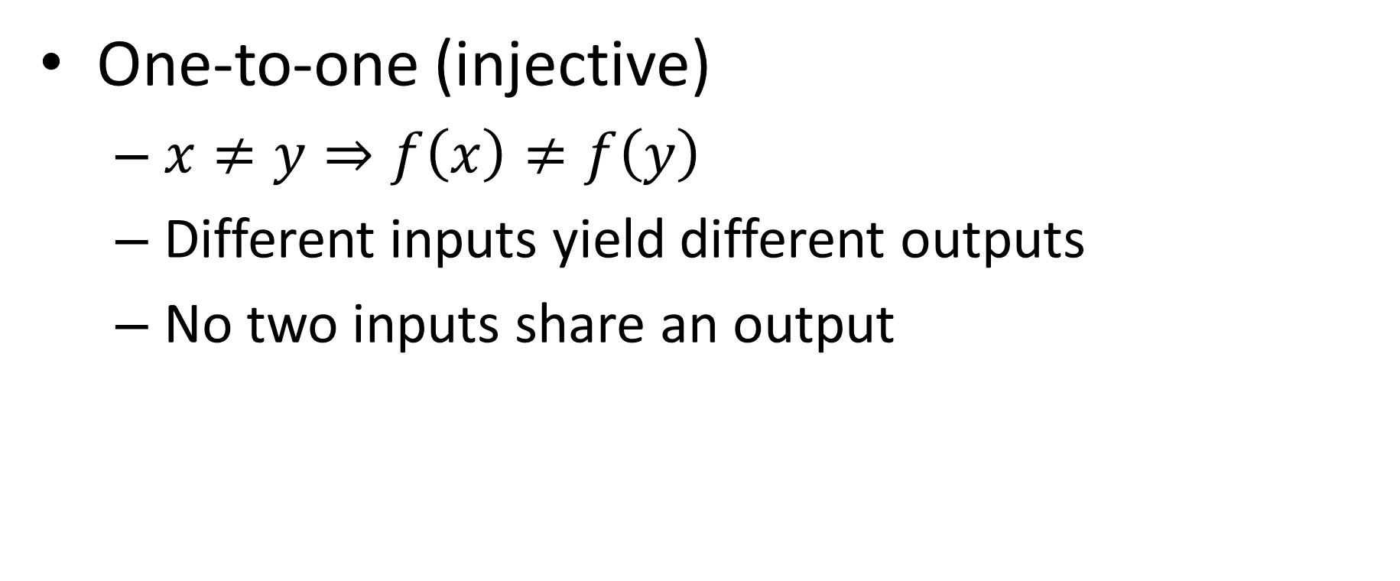
Properties of Functions
One-to-one (injective)
$x≠y⇒f\left(x\right)≠f\left(y\right)$
Different inputs yield different outputs
No two inputs share an output

Slide 19

1-1, Injective Functions
Domain
Co-Domain
Domain
Co-Domain
INJECTIVE FUNCTION
NON-INJECTIVE FUNCTION
Nothing in Co-Domain “receives” two things
$$\left|D\right|≤|C|$$

Slide 20
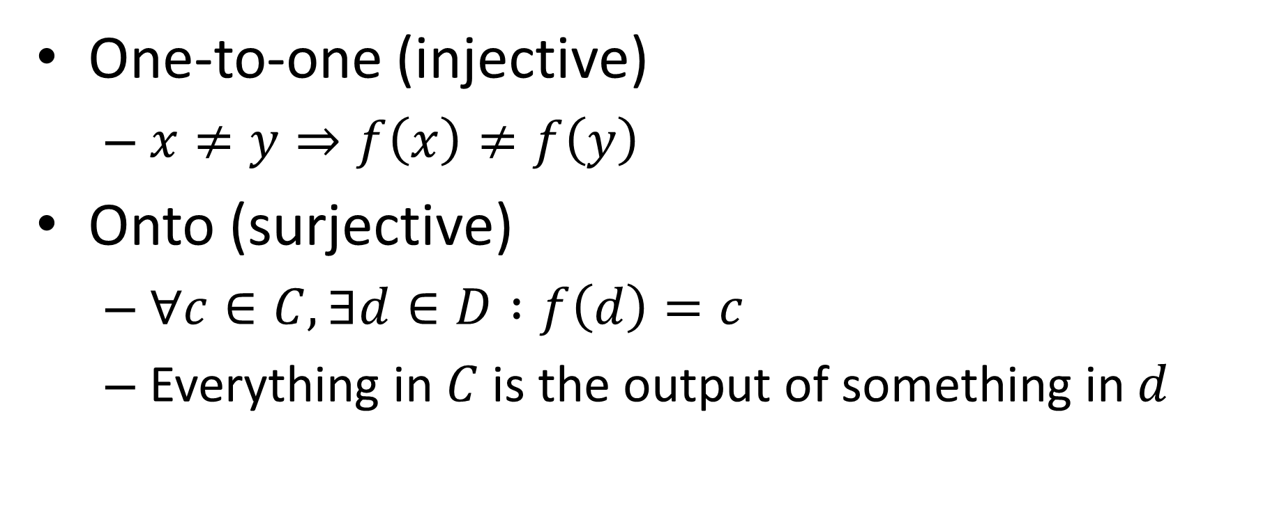
Properties of Functions
One-to-one (injective)
$x≠y⇒f\left(x\right)≠f\left(y\right)$
Onto (surjective)
$∀c∈C, ∃d∈D :f\left(d\right)=c$
Everything in $C$ is the output of something in $d$

Slide 21
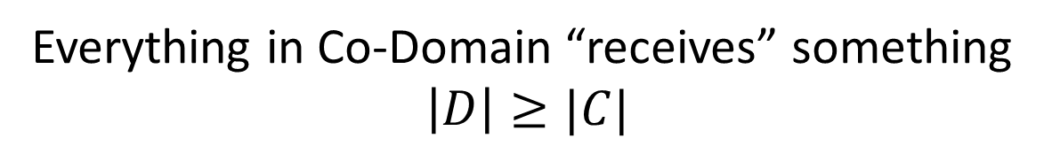
Onto, Surjective Functions
Domain
Co-Domain
Domain
Co-Domain
SURJECTIVE FUNCTION
NON-SURJECTIVE FUNCTION
Everything in Co-Domain “receives” something
$$\left|D\right|≥|C|$$

Slide 22
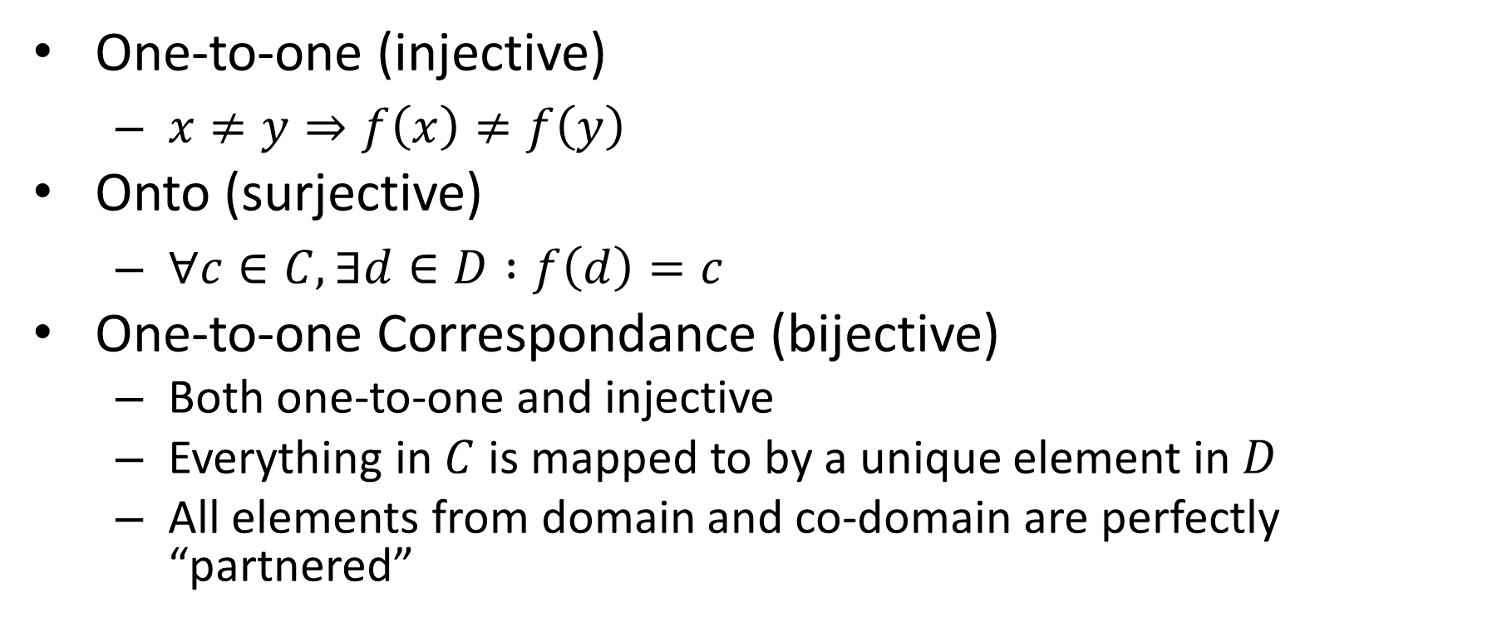
Properties of Functions
One-to-one (injective)
$x≠y⇒f\left(x\right)≠f\left(y\right)$
Onto (surjective)
$∀c∈C, ∃d∈D :f\left(d\right)=c$
One-to-one Correspondance (bijective)
Both one-to-one and injective
Everything in $C$ is mapped to by a unique element in $D$
All elements from domain and co-domain are perfectly “partnered”

Slide 23
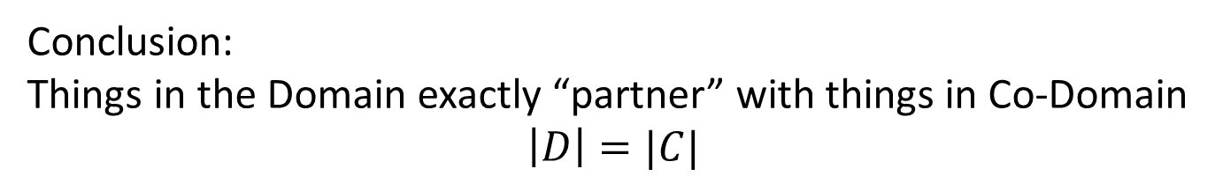
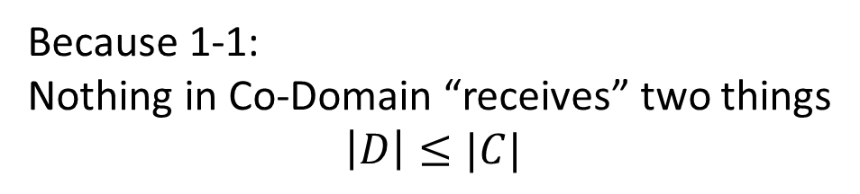
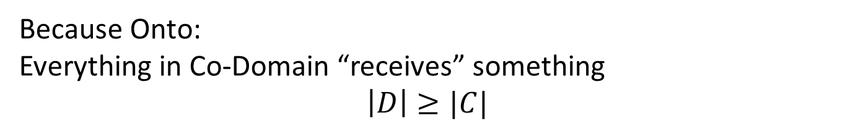
Bijective Functions
Domain
Co-Domain
Because Onto:
Everything in Co-Domain “receives” something
$$\left|D\right|≥|C|$$
BIJECTIVE FUNCTION
Because 1-1:
Nothing in Co-Domain “receives” two things
$$\left|D\right|≤|C|$$
Conclusion:
Things in the Domain exactly “partner” with things in Co-Domain
$$\left|D\right|=|C|$$

Slide 24
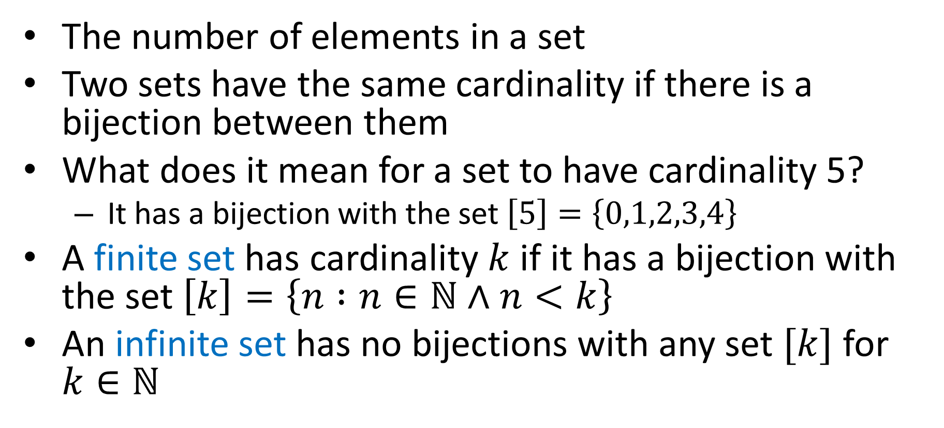
Cardinality
The number of elements in a set
Two sets have the same cardinality if there is a bijection between them
What does it mean for a set to have cardinality 5?
It has a bijection with the set $\left[5\right]=\left\{0,1,2,3,4\right\}$
A finite set has cardinality $k$ if it has a bijection with the set $\left[k\right]=\left\{n :n∈\text{ℕ}∧n<k\right\}$
An infinite set has no bijections with any set $[k]$ for $k∈\text{ℕ}$

Slide 25
Are all functions computable?
How could we approach this question?

Slide 26
Implementing a Function
Examples of ways to implement a function:
Properties we want of implementations:

Slide 27
Next Time
For any “reasonable” model of computing, there will be some uncomputable functions

Slide 28

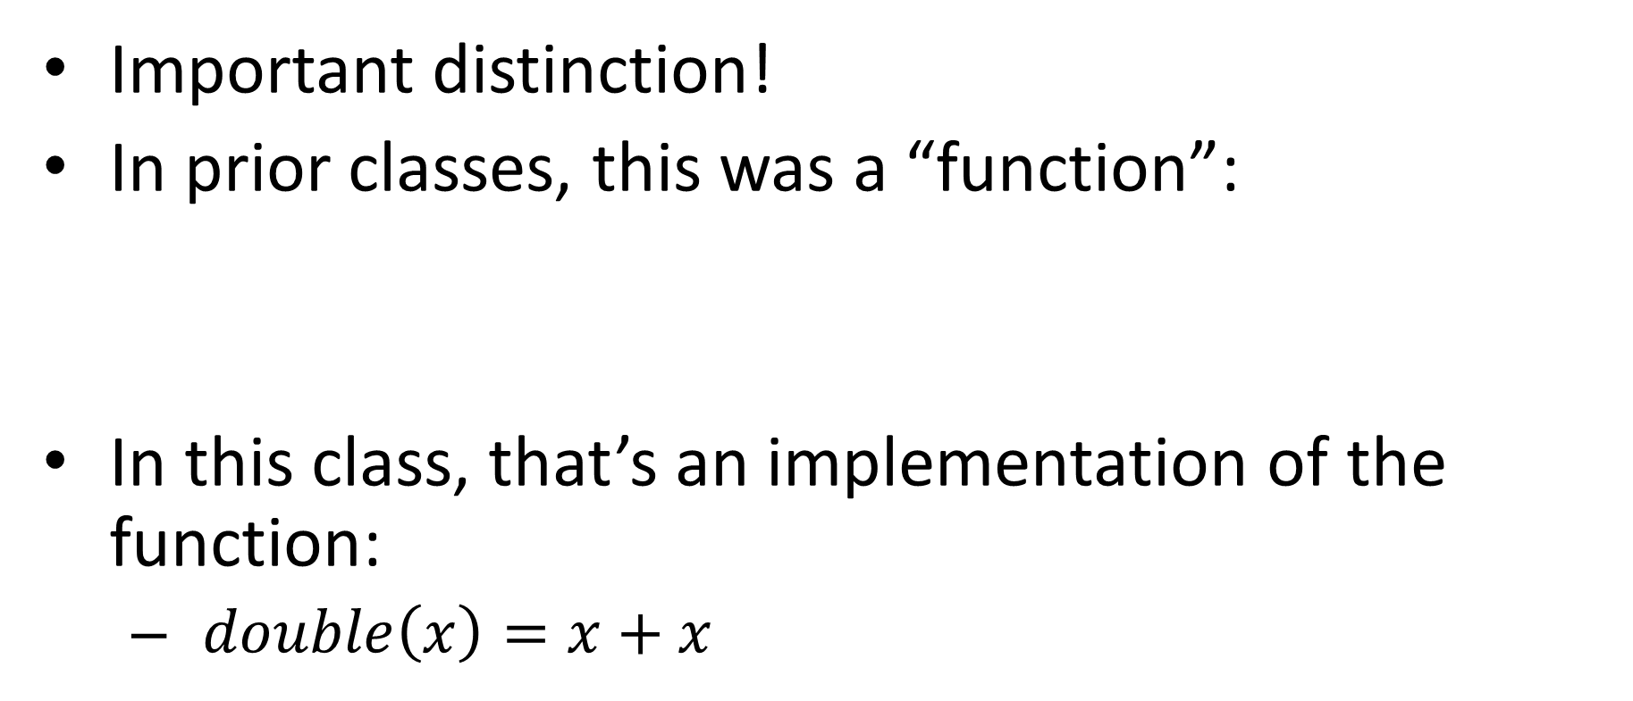
Function vs. Implementation
Important distinction!
In prior classes, this was a “function”:
In this class, that’s an implementation of the function:
$double\left(x\right)=x+x$

Slide 29
Languages

