Slide 1
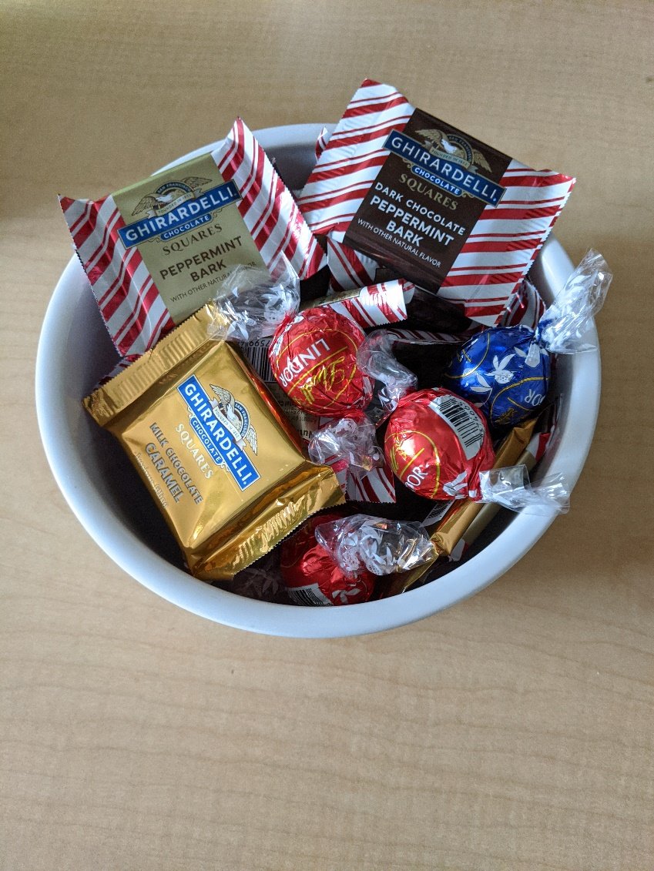
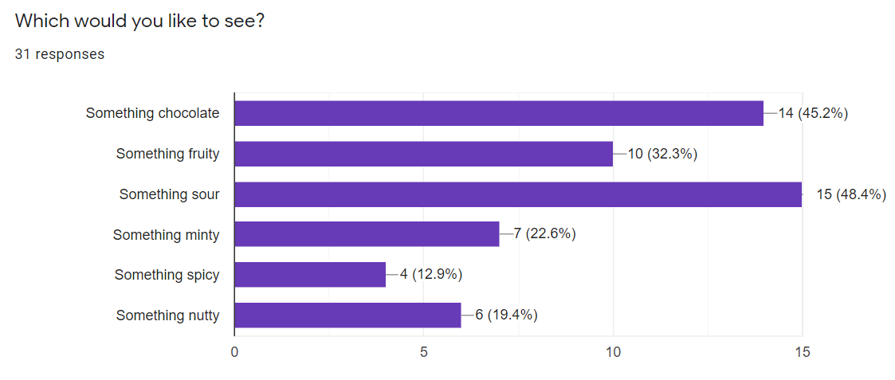
CS3102 Theory of Computation
www.cs.virginia.edu/~njb2b/cstheory/s2020
Warm up:
What features present in Java/Python are missing from straightline programs?
RIP

Slide 2
Missing Features

Slide 3
Logistics
Exercise 1 due this afternoon
Didn’t submit? You have 48 hours to do so with a 25% penalty
Quiz 2 due today
Exercise 2 is out.
Some stuff due Thursday, the rest due Tuesday

Slide 4
Last Time
Boolean Circuits as a model of computing
Straightline Programs as a model of computing
Proved NAND-Straightline = NAND-Circ = AON-Circ = AON-straightline

Slide 5
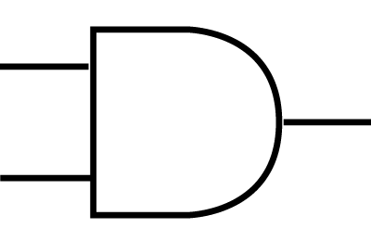
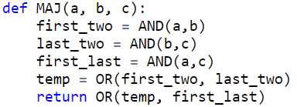
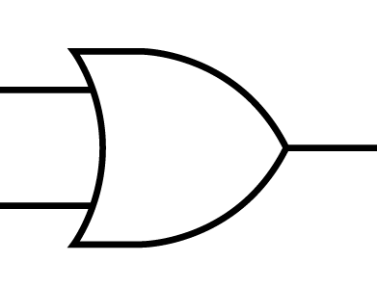
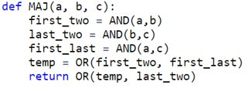
Majority with Boolean Circuits
# Gates = # Lines
x[0]
x[1]
x[2]

Slide 6
NAND Straightline = AON Straightline
NAND -> AON
AON -> NAND
x = NAND(a,b)
Becomes
temp = AND(a,b)
x = NOT(temp)
​
x = OR(a,b)​
Becomes​
t1 = NAND(a,a)
t2 = NAND(b,b)
x= NAND(t1,t2)
x = NOT(a)
Becomes
x= NAND(a,a)
x = AND(a,b)
Becomes
temp= NAND(a,b)
x=NAND(temp,temp)

Slide 7
Syntactic Sugar
"Full-featured" programming languages are identical to simple ones
We can add new features without changing the underlying computing model
These features can make programs easier to reason about and more readable

Slide 8
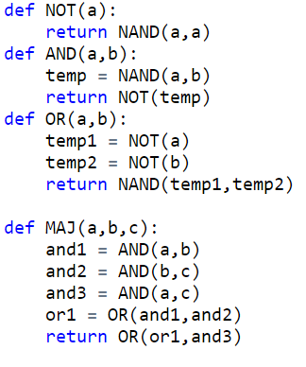
User-Defined Procedures

Slide 9
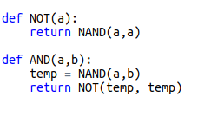
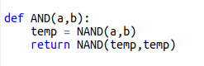
"Translating" Procedures
Adding procedures does not change computing model
We can convert a program with procedures into a program without them

Slide 10

Procedure for translating procedures
Paste code from procedure
Use arguments in place of parameters
Rename variables from the procedure to be "fresh"
Before
After

Slide 11
How many gates?
How many NAND gates does this use to compute MAJ?

Slide 12
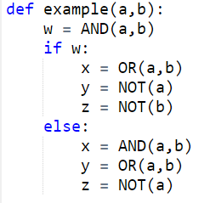
Conditionals
Values of some variables might depend on a condition
Code
Translated

Slide 13
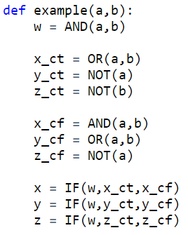
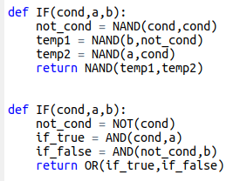
Translating Conditionals
Pre-compute each of the possible values
Use a procedure to determine which to assign

Slide 14
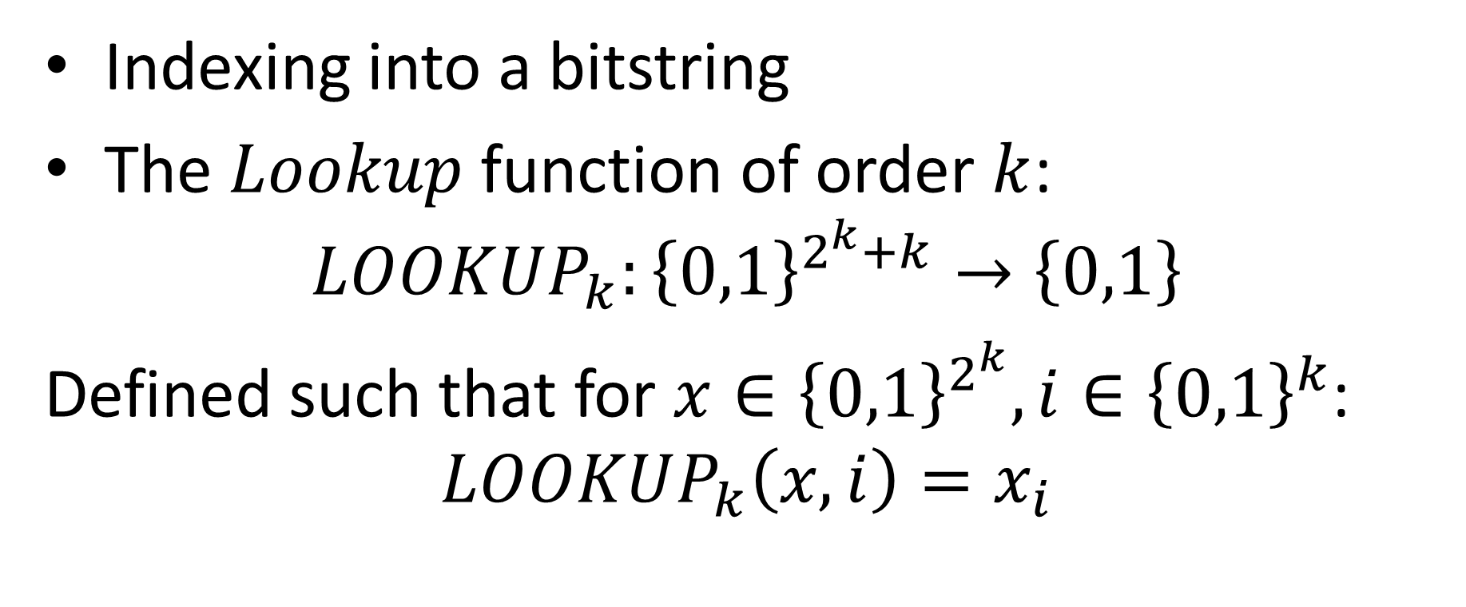
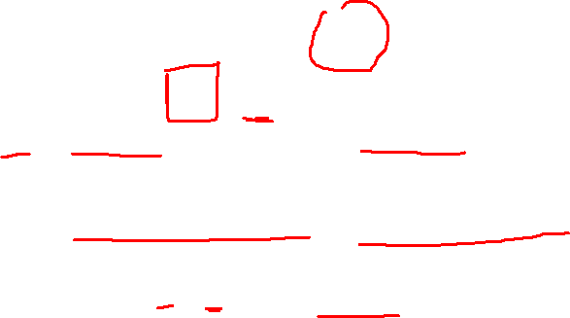
Lookup
Indexing into a bitstring
The $Lookup$ function of order $k$:
$$LOOKUP_{k}:{\left\{0,1\right\}}^{2^{k}+k}→\left\{0,1\right\}$$
Defined such that for $x∈{\left\{0,1\right\}}^{2^{k}}, i∈{\left\{0,1\right\}}^{k}$:
$$LOOKUP_{k}\left(x,i\right)=x_{i}$$

Slide 15
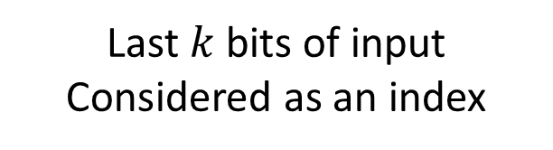
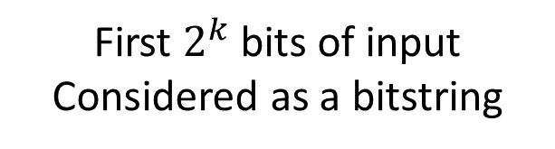


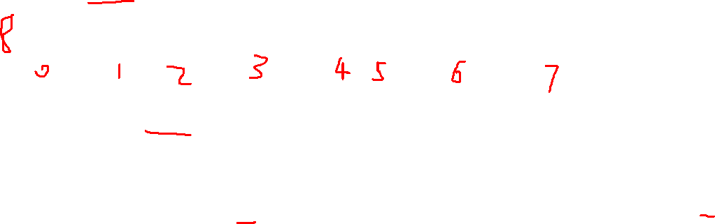
$$LOOKUP_{k}$$
$$k=3$$
x:
i:
0 | 1 | 0 | 0 | 1 | 1 | 1 | 0
0 | 1 | 0
First $2^{k}$ bits of input
Considered as a bitstring
Last $k$ bits of input
Considered as an index

Slide 16


Theorem
There is a NAND-Cricuit that computes $LOOKUP_{k}:{\left\{0,1\right\}}^{2^{k}+k}→\{0,1\}$
Moreover, the number of gates required is at most $4⋅2^{k}$

Slide 17
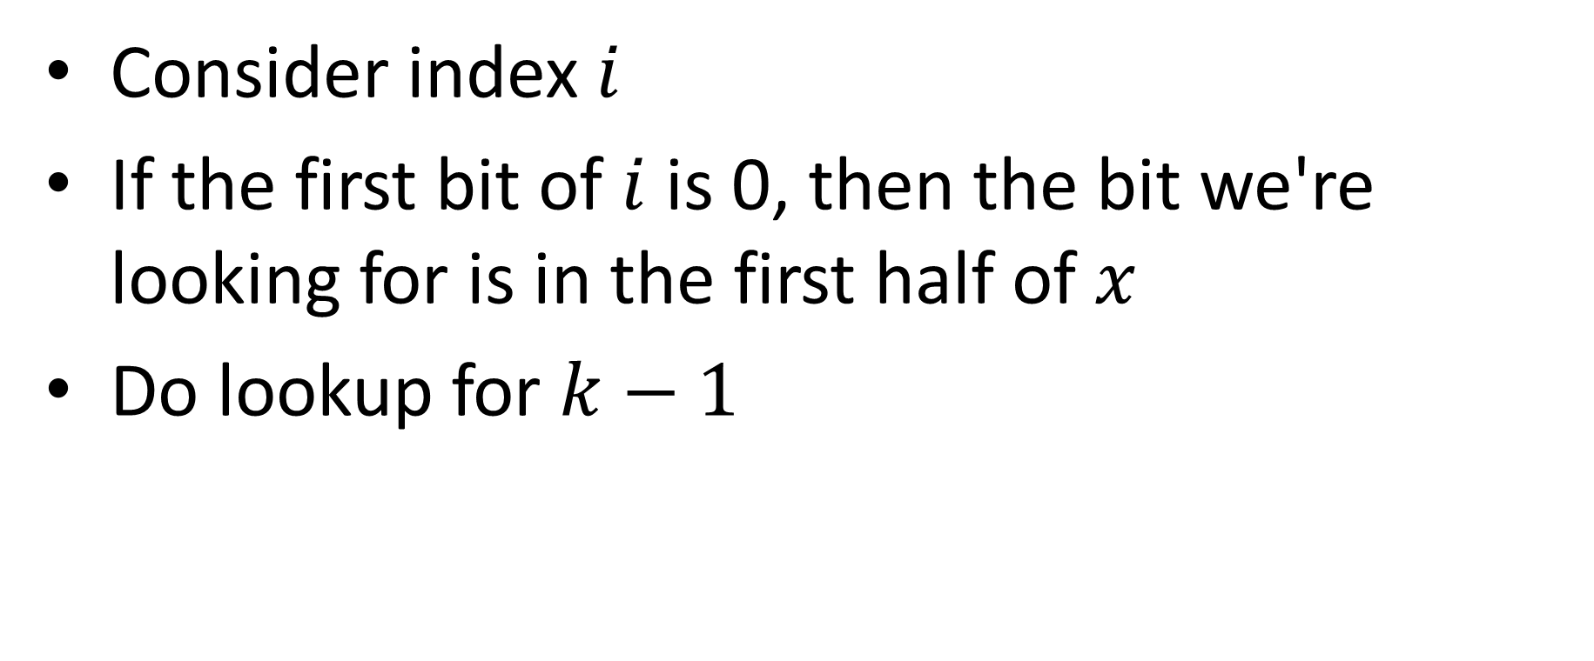
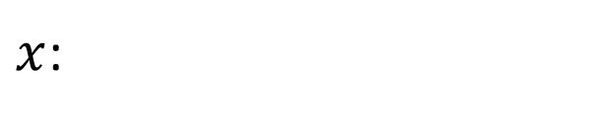
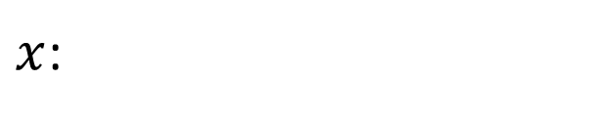
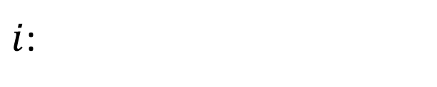
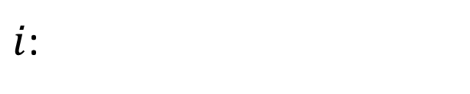
Proof idea
Consider index $i$
If the first bit of $i$ is 0, then the bit we're looking for is in the first half of $x$
Do lookup for $k−1$
$x$:
$i$:
0 | 1 | 0 | 0 | 1 | 1 | 1 | 0
0 | 1 | 0
$x$:
$i$:
0 | 1 | 0 | 0
1 | 0

Slide 18
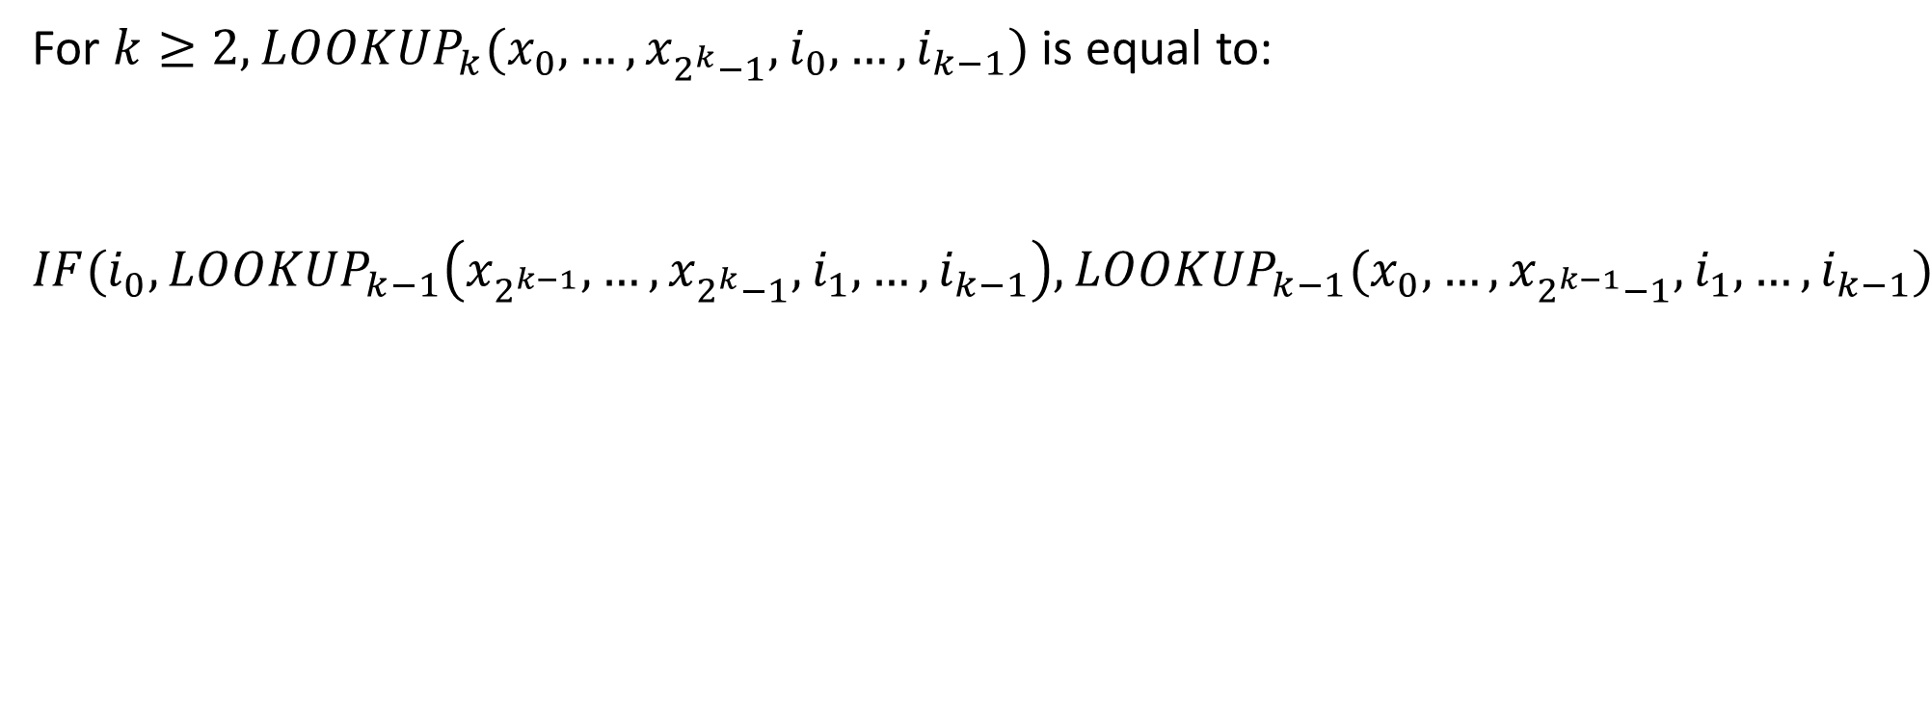

Defining $LOOKUP_{k}$
For $k≥2, LOOKUP_{k}(x_{0},…,x_{2^{k}−1}, i_{0},…,i_{k−1})$ is equal to:
$$IF(i_{0},LOOKUP_{k−1}\left(x_{2^{k−1}}, …,x_{2^{k}−1}, i_{1},…,i_{k−1}\right),LOOKUP_{k−1}(x_{0}, …,x_{2^{k−1}−1}, i_{1},…,i_{k−1})$$

Slide 19

Base Case
Next Step

Slide 20
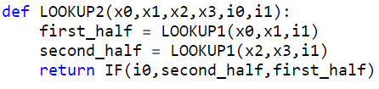
LOOKUP2
LOOKUP3 and 4

Slide 21

Counting Gates
Show this uses at most $3⋅2^{k}$ gates (lines of code)

Slide 22

Counting Gates
Show this uses at most $4⋅2^{k}$ gates (lines of code)

Slide 23
Computing Every Finite Function
Next we'll show that NAND is universal
Any finite function can be computed by some NAND-straightline program (equivalently, a NAND-circuit)

Slide 24
Idea
Input | Output
000 | 0
001 | 0
010 | 1
011 | 0
100 | 1
101 | 1
110 | 0
111 | 0
We will have one variable to represent each possible input. We'll do a lookup with the actual input to select the proper output

Slide 25
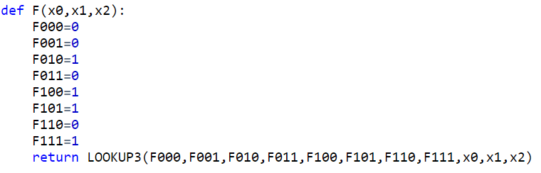
Straightline Code for F
Input | Output
000 | 0
001 | 0
010 | 1
011 | 0
100 | 1
101 | 1
110 | 0
111 | 0

Slide 26
Getting 0 and 1

Slide 27
Computing any function
Make a variable to represent each possible input
Assign its value to match the correct output
Use LOOKUP to select the proper output for the given input

Slide 28
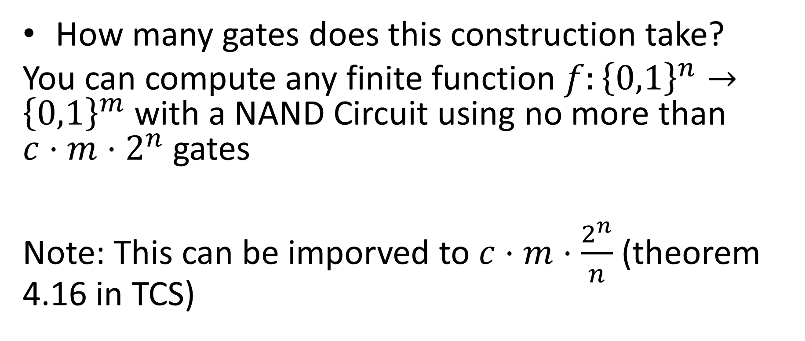
How many gates?
How many gates does this construction take?
You can compute any finite function $f:{\left\{0,1\right\}}^{n}→{\left\{0,1\right\}}^{m}$ with a NAND Circuit using no more than $c⋅m⋅2^{n}$ gates
Note: This can be imporved to $c⋅m⋅\frac{2^{n}}{n}$ (theorem 4.16 in TCS)

Slide 29
Counting gates
Create variables for each input
Assign 0,1 to each input
Do the LOOKUP

Slide 30

What does this mean?
Your laptop is a 64-bit machine. Given enough transistors, it can compute any function $f:{\left\{0,1\right\}}^{64}→{\left\{0,1\right\}}^{64}$

