Slide 1
Logistics
Quiz and exercise 7 released tomorrow
Quiz due Tuesday at 11:59pm
Exercise due Friday 11:59pm
Just a few reductions

Slide 2
CS3102 Theory of Computation
www.cs.virginia.edu/~njb2b/cstheory/s2020
Warm up:
To measure the “cost” of computing something, what would units should we use?

Slide 3
Units

Slide 4
Computing Cost
What do we actually care about with computing cost?

Slide 5
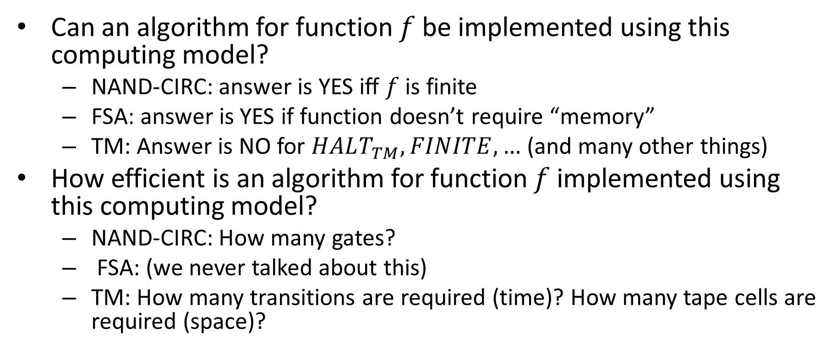
Notions of function “difficulty”
Can an algorithm for function $f$ be implemented using this computing model?
NAND-CIRC: answer is YES iff $f$ is finite
FSA: answer is YES if function doesn’t require “memory”
TM: Answer is NO for $HALT_{TM},FINITE, …$ (and many other things)
How efficient is an algorithm for function $f$ implemented using this computing model?
NAND-CIRC: How many gates?
FSA: (we never talked about this)
TM: How many transitions are required (time)? How many tape cells are required (space)?

Slide 6
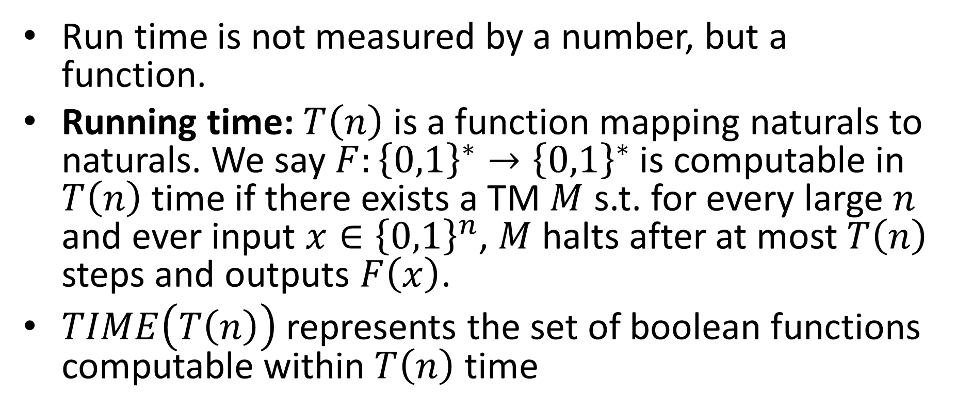
Larger inputs = More time
Run time is not measured by a number, but a function.
Running time: $T\left(n\right)$ is a function mapping naturals to naturals. We say $F:{\left\{0,1\right\}}^{∗}→{\left\{0,1\right\}}^{∗}$ is computable in $T\left(n\right)$ time if there exists a TM $M$ s.t. for every large $n$ and ever input $x∈{\left\{0,1\right\}}^{n}$, $M$ halts after at most $T\left(n\right)$ steps and outputs $F\left(x\right)$.
$TIME\left(T\left(n\right)\right)$ represents the set of boolean functions computable within $T\left(n\right)$ time

Slide 7
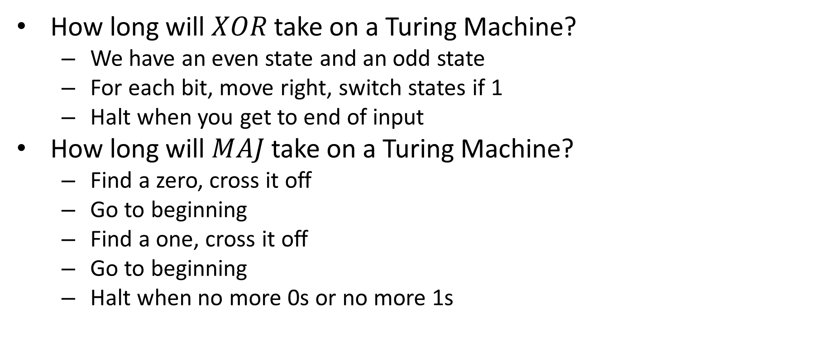
Examples
How long will $XOR$ take on a Turing Machine?
We have an even state and an odd state
For each bit, move right, switch states if 1
Halt when you get to end of input
How long will $MAJ$ take on a Turing Machine?
Find a zero, cross it off
Go to beginning
Find a one, cross it off
Go to beginning
Halt when no more 0s or no more 1s

Slide 8


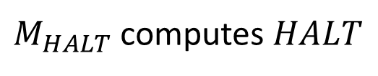

More time gives more functions
$$TIME\left(2^{n}\right)$$
$$TIME\left(n^{3}\right)$$
$$TIME\left(10n\right)$$
$$TIME\left(n\right)$$

Slide 9
Different computing Models may have Different Running Times
So far: a TM uses a tape. Can only visit a neighboring cell from the current one.

Slide 10
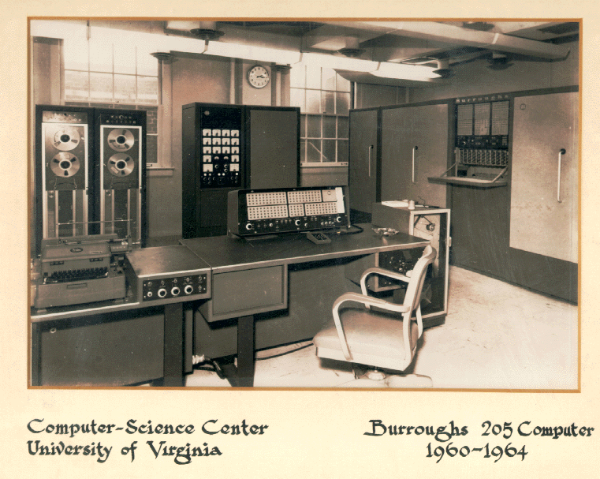
1960s
A tape was probably a reasonable memory model

Slide 11
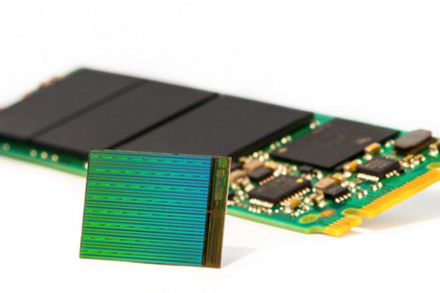
Today
Can look up two locations without visiting all locations between.
“Random” access
(RAM)

Slide 12
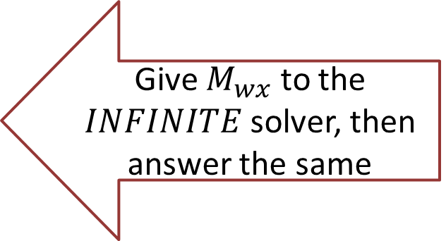
RAM Machine
We can go directly to a certain index in the tape
To transition:
Have a second tape to keep track of current location (increment each time we move right, decrement for left)
Have a third tape to record the target location
Move until the two tapes match
Maybe we need another tape to do this?
(details not important, but if you want them, see 7.2 in text)
Important observation: Tape-machine takes more steps than a RAM machine (if a RAM-TM computes $f$ in $T(n)$ time, a tape TM can compute $f$ in ${\left(T\left(n\right)\right)}^{4}$ time, see theorem 12.5 for details)

Slide 13
Finding Running Times
We will find running times for the following:
Shortest Path in a graph
Longest Path in a graph
3SAT
2SAT

Slide 14
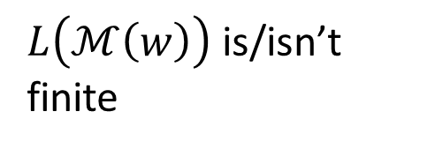



Graphs
Vertices/Nodes
Definition: $G=(V,E)$
$w\left(e\right)=$ weight of edge $e$
Edges
8
B
E
$$V=\{A,B,C,D,E,F,G,H,I\}$$
10
8
$$E=\{\left(A,B\right),\left(A,C\right),\left(B,C\right),…\}$$
7
H
A
2
9
D
5
9
I
12
3
C
3
11
G
1
F
6

Slide 15
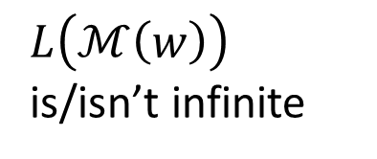
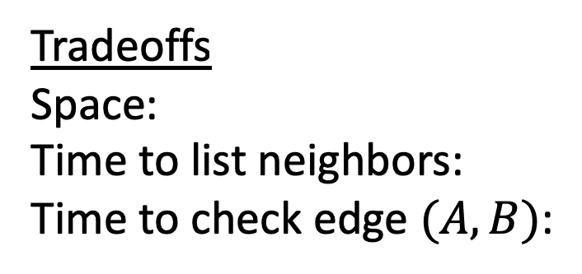
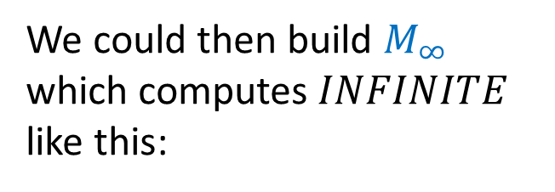
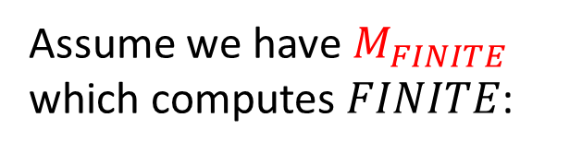
Adjacency List Representation
A
B
C
B
8
B
A
C
E
10
E
8
7
H
C
A
B
D
F
A
9
2
D
5
9
I
D
C
E
F
12
3
C
3
E
B
D
G
H
11
G
1
F
6
F
C
D
G
Tradeoffs
Space:
Time to list neighbors:
Time to check edge $(A,B)$:
G
E
F
H
I
$$V+E$$
H
E
G
I
$$Degree(A)$$
$$Degree(A)$$
I
G
H

Slide 16



Adjacency Matrix Representation
B
8
A
B
C
D
E
F
G
H
I
10
E
8
A
1
1
7
H
B
1
1
1
A
9
2
D
5
C
1
1
1
1
9
I
D
1
1
1
12
3
E
1
1
1
1
C
3
F
1
1
1
11
G
1
1
1
1
G
1
F
6
H
1
1
1
I
1
1
Tradeoffs
Space:
Time to list neighbors:
Time to check edge $(A,B)$:
$$V^{2}$$
$$V$$
$$O(1)$$

Slide 17

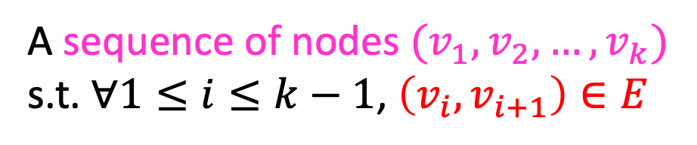
Definition: Path
A sequence of nodes $(v_{1},v_{2},…, v_{k})$
s.t. $∀1≤i≤k−1$, $\left(v_{i},v_{i+1}\right)∈E$
B
8
10
E
8
7
H
A
9
2
D
5
9
I
12
3
C
3
11
G
1
F
6
Simple Path:
A path in which each node appears at most once
Cycle:
A path of $>2$ nodes in which $v_{1}=v_{k}$

Slide 18
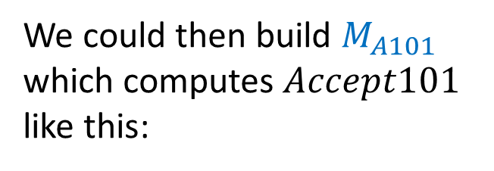
Shortest Path
Given an unweighted graph, start node $s$ and an end node $t$, how long is shortest path from $s$ to $t$?
B
E
H
A
D
I
Shortest path from A to E
has length 2
C
G
F

Slide 19

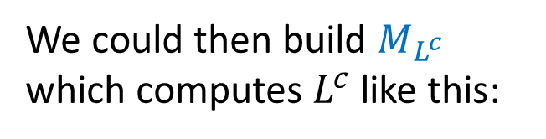
Breadth First Search
Find a path from $s$ to $t$
Keep a queue $Q$ of nodes
$hops=0$
$Q.enqueue((s, hops))$
While $Q$ is not empty and $v !=t$:
$v,hops=Q.dequeue()$
for each “unvisited” $u∈V$ s.t. $\left(v,u\right)∈E$:
$Q.enqueue((u, hops+1))$
Running time: $O\left(\left|V\right|+\left|E\right|\right)$

Slide 20

Longest Path
Given a start node $s$ and an end node $t$, how long is longest path from $s$ to $t$?

Slide 21
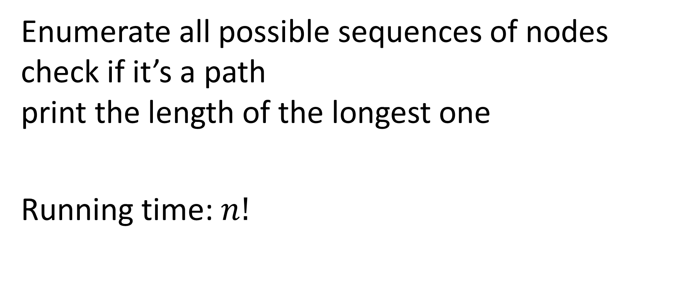
Longest Path
Enumerate all possible sequences of nodes check if it’s a path print the length of the longest one
Running time: $n!$

