Slide 1
Logistics
Quiz and exercise 7 released tomorrow
Quiz due Tuesday at 11:59pm
Exercise due Friday 11:59pm
Just a few reductions

Slide 2
CS3102 Theory of Computation
www.cs.virginia.edu/~njb2b/cstheory/s2020
Warm up:
To measure the “cost” of computing something, what would units should we use?

Slide 3
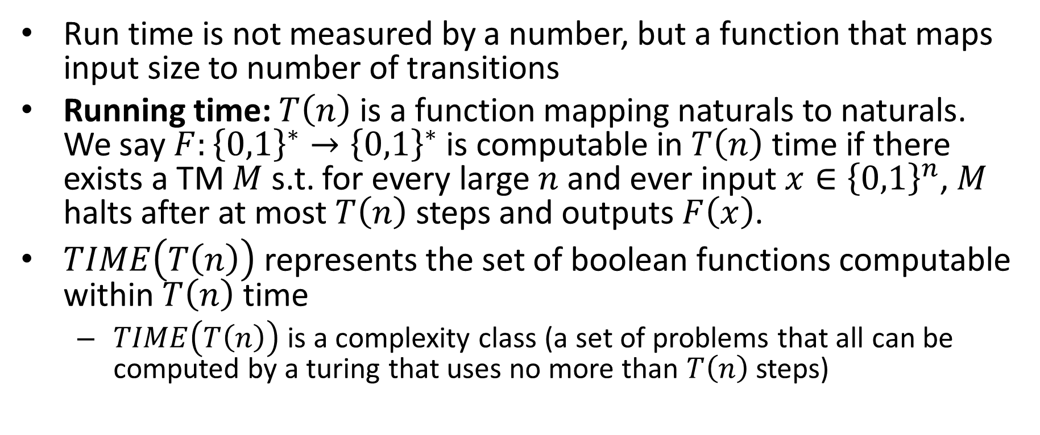
Larger inputs = More time
Run time is not measured by a number, but a function that maps input size to number of transitions
Running time: $T\left(n\right)$ is a function mapping naturals to naturals. We say $F:{\left\{0,1\right\}}^{∗}→{\left\{0,1\right\}}^{∗}$ is computable in $T\left(n\right)$ time if there exists a TM $M$ s.t. for every large $n$ and ever input $x∈{\left\{0,1\right\}}^{n}$, $M$ halts after at most $T\left(n\right)$ steps and outputs $F\left(x\right)$.
$TIME\left(T\left(n\right)\right)$ represents the set of boolean functions computable within $T\left(n\right)$ time
$TIME\left(T\left(n\right)\right)$ is a complexity class (a set of problems that all can be computed by a turing that uses no more than $T\left(n\right)$ steps)

Slide 4


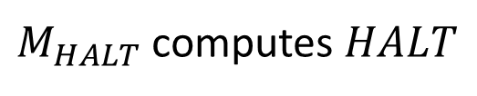

More time gives more functions
$$TIME\left(2^{n}\right)$$
$$TIME\left(n^{3}\right)$$
$$TIME\left(10n\right)$$
$$TIME\left(n\right)$$

Slide 5
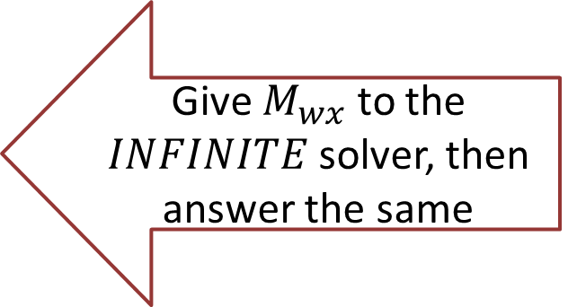
RAM Machine
We can go directly to a certain index in the tape
To transition:
Have a second tape to keep track of current location (increment each time we move right, decrement for left)
Have a third tape to record the target location
Move until the two tapes match
Maybe we need another tape to do this?
(details not important, but if you want them, see 7.2 in text)
Important observation: Tape-machine takes more steps than a RAM machine (if a RAM-TM computes $f$ in $T(n)$ time, a tape TM can compute $f$ in ${\left(T\left(n\right)\right)}^{4}$ time, see theorem 12.5 for details)

Slide 6
Finding Running Times
We will find running times for the following:
Shortest Path in a graph
Longest Path in a graph
3SAT
2SAT

Slide 7
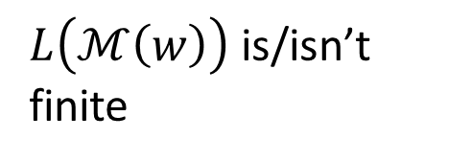



Graphs
Vertices/Nodes
Definition: $G=(V,E)$
$w\left(e\right)=$ weight of edge $e$
Edges
8
B
E
$$V=\{A,B,C,D,E,F,G,H,I\}$$
10
8
$$E=\{\left(A,B\right),\left(A,C\right),\left(B,C\right),…\}$$
7
H
A
2
9
D
5
9
I
12
3
C
3
11
G
1
F
6

Slide 8

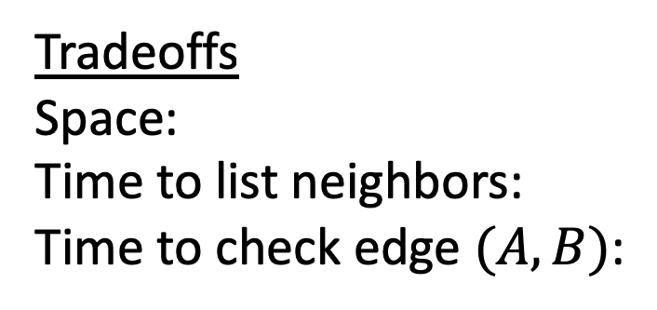
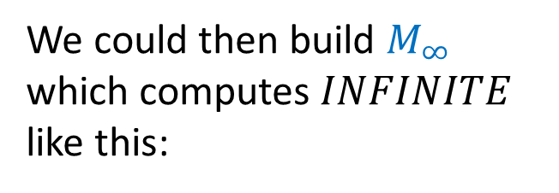
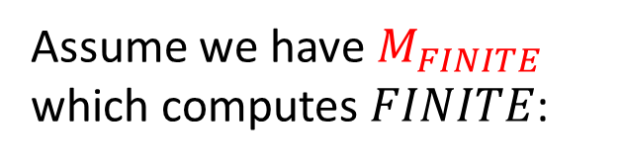
Adjacency List Representation
A
B
C
B
8
B
A
C
E
10
E
8
7
H
C
A
B
D
F
A
9
2
D
5
9
I
D
C
E
F
12
3
C
3
E
B
D
G
H
11
G
1
F
6
F
C
D
G
Tradeoffs
Space:
Time to list neighbors:
Time to check edge $(A,B)$:
G
E
F
H
I
$$|V|+|E|$$
H
E
G
I
$$Degree(A)$$
$$Degree(A)$$
I
G
H

Slide 9



Adjacency Matrix Representation
B
8
A
B
C
D
E
F
G
H
I
10
E
8
A
1
1
7
H
B
1
1
1
A
9
2
D
5
C
1
1
1
1
9
I
D
1
1
1
12
3
E
1
1
1
1
C
3
F
1
1
1
11
G
1
1
1
1
G
1
F
6
H
1
1
1
I
1
1
Tradeoffs
Space:
Time to list neighbors:
Time to check edge $(A,B)$:
$$V^{2}$$
$$V$$
$$O(1)$$

Slide 10

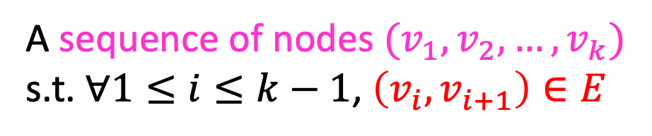
Definition: Path
A sequence of nodes $(v_{1},v_{2},…, v_{k})$
s.t. $∀1≤i≤k−1$, $\left(v_{i},v_{i+1}\right)∈E$
B
8
10
E
8
7
H
A
9
2
D
5
9
I
12
3
C
3
11
G
1
F
6
Simple Path:
A path in which each node appears at most once
Cycle:
A path of $>2$ nodes in which $v_{1}=v_{k}$

Slide 11
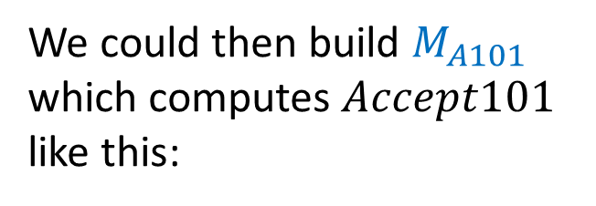
Shortest Path
Given an unweighted graph, start node $s$ and an end node $t$, how long is shortest path from $s$ to $t$?
B
E
H
A
D
I
Shortest path from A to E
has length 2
C
G
F

Slide 12

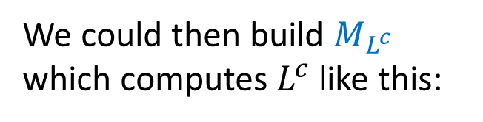
Breadth First Search
Find a path from $s$ to $t$
Keep a queue $Q$ of nodes
$hops=0$
$Q.enqueue((s, hops))$
While $Q$ is not empty and $v !=t$:
$v,hops=Q.dequeue()$
for each “unvisited” $u∈V$ s.t. $\left(v,u\right)∈E$:
$Q.enqueue((u, hops+1))$
Running time: $O\left(\left|V\right|+\left|E\right|\right)$

Slide 13

Longest Path
Given a start node $s$ and an end node $t$, how long is longest path from $s$ to $t$?

Slide 14
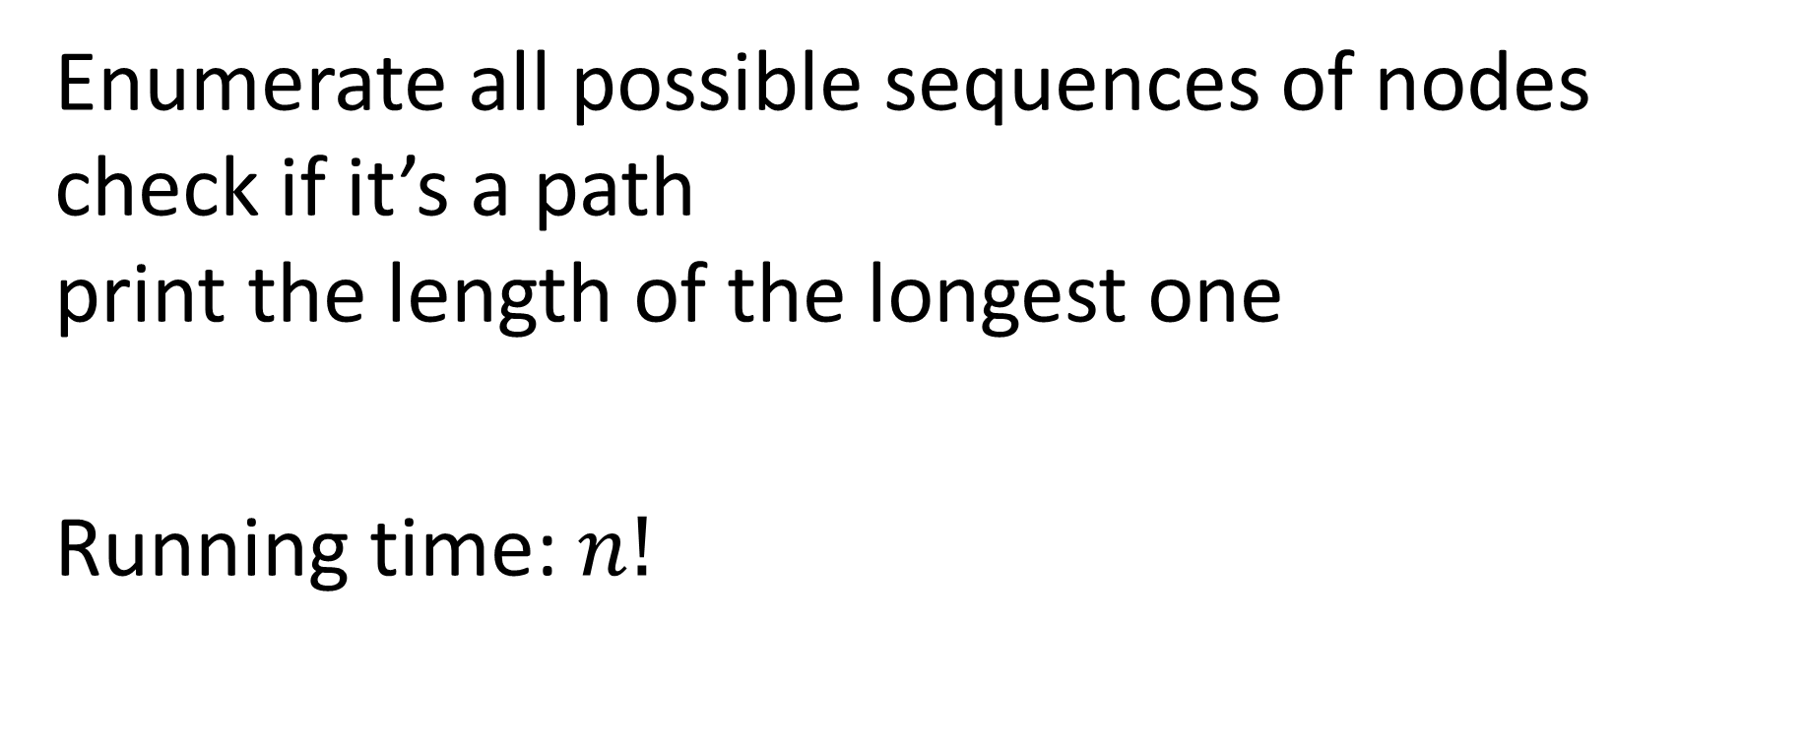
Longest Path
Enumerate all possible sequences of nodes check if it’s a path print the length of the longest one
Running time: $n!$

Slide 15
(3-)CNF
Conjunctive Normal Form (CNF) formula:
Logical AND of clauses
Each clause being an OR of variables
3-CNF: Each clause has 3 variables
$$\left(x∨y∨z\right)∧\left(x∨\overline{y}∨y\right)∧\left(u∨y∨\overline{z}\right)∧\left(z∨\overline{x}∨u\right)∧(\overline{x}∨\overline{y}∨\overline{z})$$
Clause
Variables

Slide 16
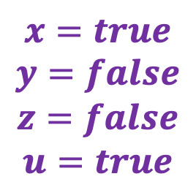
3-SAT
Given a 3-CNF formula (logical AND of clauses, each an OR of 3 variables), Is there an assignment of true/false to each variable to make the formula true?
$$\left(x∨y∨z\right)∧\left(x∨\overline{y}∨y\right)∧\left(u∨y∨\overline{z}\right)∧\left(z∨\overline{x}∨u\right)∧(\overline{x}∨\overline{y}∨\overline{z})$$
Clause
$$x=true$$
$$y=false$$
$$z=false$$
$$u=true$$
Variables

Slide 17
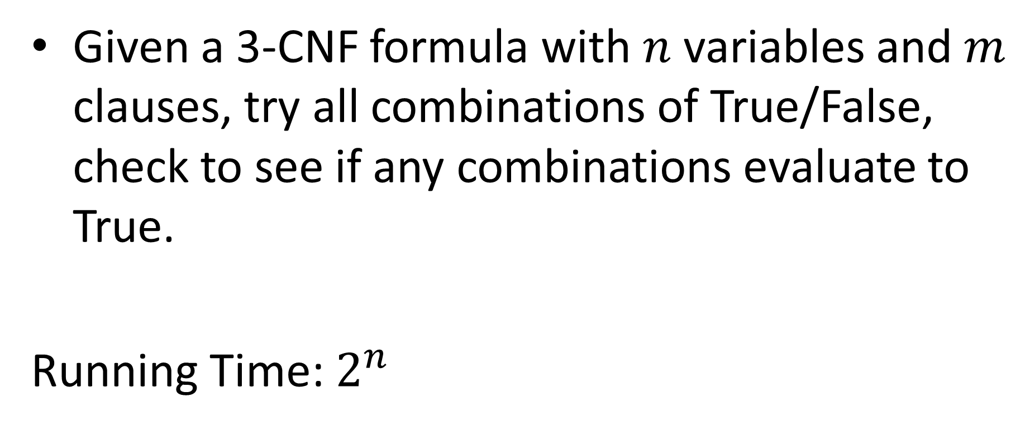
3-SAT algorithm
Given a 3-CNF formula with $n$ variables and $m$ clauses, try all combinations of True/False, check to see if any combinations evaluate to True.
Running Time: $2^{n}$

Slide 18
2-SAT
Given a 2-CNF formula (logical AND of clauses, each an OR of 2 variables), Is there an assignment of true/false to each variable to make the formula true?
$$\left(x∨y\right)∧\left(x∨\overline{y}\right)∧\left(y∨\overline{z}\right)∧\left(z∨u\right)∧(\overline{y}∨\overline{z})$$
$$x=true$$
$$y=false$$
$$z=false$$
$$u=true$$
Clause
Variables

Slide 19




























2-SAT in Polynomial Time
Convert formula to an “implication graph”
$$\left(x∨y\right) ∧ \left(x∨\overline{y}\right) ∧ \left(y∨\overline{z}\right) ∧ \left(z∨u\right) ∧ (\overline{y}∨\overline{z})$$
Are there any cycles with a variable and its negation?
$$\overline{x}$$
$$y$$
$$\overline{x}$$
$$\overline{y}$$
$$\overline{y}$$
$$\overline{z}$$
$$\overline{z}$$
$$u$$
$$y$$
$$\overline{z}$$
$$x$$
$$\overline{y}$$
$$x$$
$$y$$
$$y$$
$$z$$
$$z$$
$$\overline{u}$$
$$\overline{y}$$
$$z$$
$$x$$
$$y$$
$$z$$
$$u$$
$$\overline{x}$$
$$\overline{y}$$
$$\overline{z}$$
$$\overline{u}$$

Slide 20

2-SAT in Polynomial Time
Convert formula to an “implication graph”
$$\left(x∨y\right) ∧ \left(\overline{x}∨y\right) ∧ \left(x∨\overline{y}\right)∧(\overline{x}∨\overline{y})$$
Are there any cycles with a variable and its negation?

Slide 21
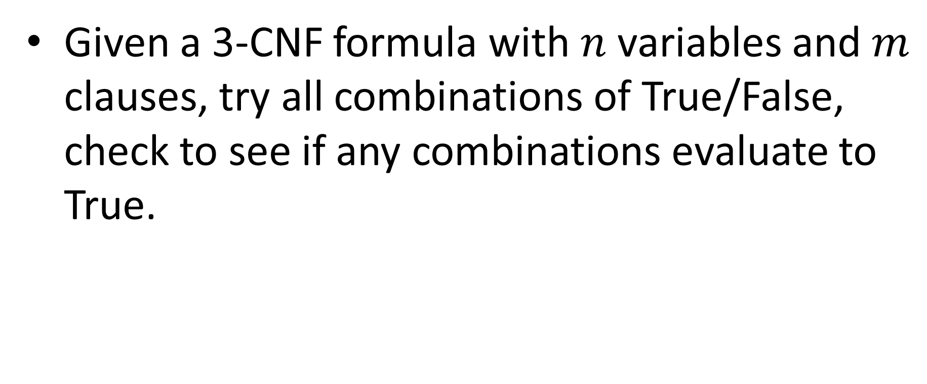
3-SAT algorithm
Given a 3-CNF formula with $n$ variables and $m$ clauses, try all combinations of True/False, check to see if any combinations evaluate to True.

Slide 22
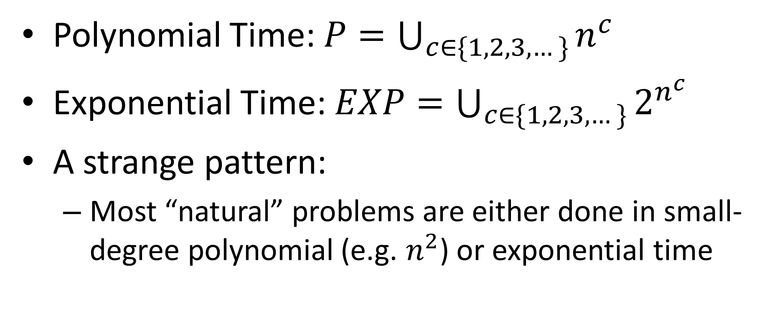
Polynomial Time vs Exponential Time
Polynomial Time: $P=\bigcup_{c∈\{1,2,3,…\}}{n^{c}}$
Exponential Time: $EXP=\bigcup_{c∈\{1,2,3,…\}}{2^{n^{c}}}$
A strange pattern:
Most “natural” problems are either done in small-degree polynomial (e.g. $n^{2}$) or exponential time

Slide 23
Tractability
Tractable:
Feasible to solve in the “real world”
Intractable:
Infeasible to solve in the “real world”
Whether a problem is considered “tractable” or “intractable” depends on the use case
For theory: Tractable = polynomial time, Intractable = Exponential time

