Slide 1
Exams
Why do exams exist?
Proctored, solo, and timed evaluation of your knowledge
Everyone takes the exam on their own, and limits resources for themselves
Doesn’t work well
Everyone takes the exam during the normal class time
What happens if you have internet connectivity issues?
What will be the format of the exam so that you can take it, and have a readable digital version to submit?
Can I make the exam take longer than 75 minutes?
What does the sudden move to online do to a class/students/professors/etc?
It stresses everybody out
Best I could hope for with the online format is that ya’ll learn stuff
Exams are super stressful and they are “forcing factor” for learning rather than an exercise in learning
What I’m going to do:
I’m going to assume that you want to learn the stuff
Trust that exercises and quizzes are sufficient opportunity for you to learn the stuff
Exam 2 and the final exam will be optional for all students

Slide 2
CS3102 Theory of Computation
www.cs.virginia.edu/~njb2b/cstheory/s2020
Warm up:
What did “Universality” mean in the context of Circuits?
What might “Universality” mean in the context of Turing Machines?

Slide 3
Turing Universality
Your thoughts:
It solves all infininite functions
Fewer implementations than infinite functions
Countable number of implementations, but uncountably many infinite functions
Not possible
It can compute anything that’s computable
Some infinite functions are computable
We used Turing machines to define computability
A thing is computable if an always-halting Turing machine can implement it

Slide 4
Last Time
Church-Turing Thesis
Why are Turing Machines the “goto” model of computing?

Slide 5
What can a Turing Machine compute?
For sure:
Any Java/Python program
If the Church-Turing Thesis is Correct:
Anything that a human can compute
Some evidence that it might be correct:
Simulating a nematode

Slide 6
Today
What can’t Turing Machines do?

Slide 7
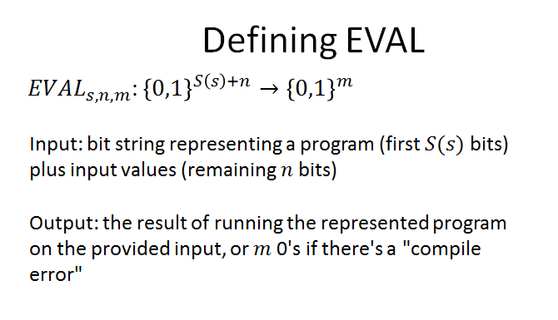
Circuit Universality
A set of gates is universal if they can be used to compute any finite function
Conquence: A circuit to evaluate other Circuits:

Slide 8
Turing Universality
Turing Machines are “Universal” in the sense that you can have a Turing Machine which can “simulate” any other Turing Machine
Universal Turing Machine:
Input: The “description” of a machine and an input for that machine
Output: The same as the output the described machine would give for its input

Slide 9

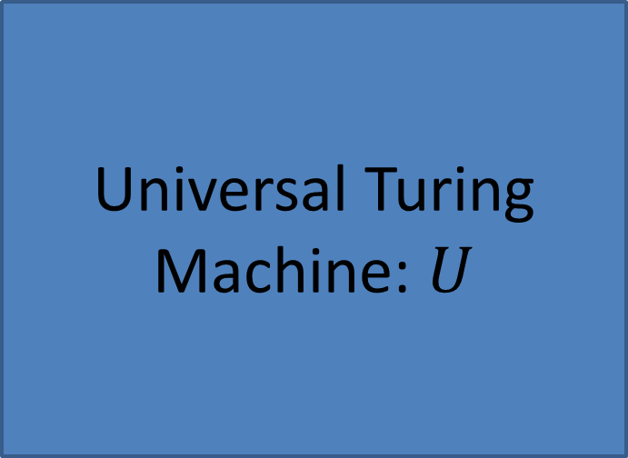
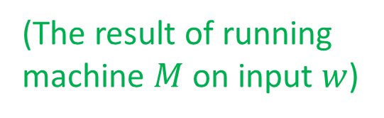


Universal Turing Machine
Input:
Output
$$M$$
Universal Turing Machine: $U$
(a TM description)
$$M(w)$$
(The result of running machine $M$ on input $w$)
$$w$$
(a string)

Slide 10
What does it need?
What does a Universal Turing Machine need to have?
Memory in order to maintain the configuration of the machine you’re simulating
Tape contents
Finite state “controller”
Current state
Current position on the tape
A way to take a transition
A way to keep going

Slide 11



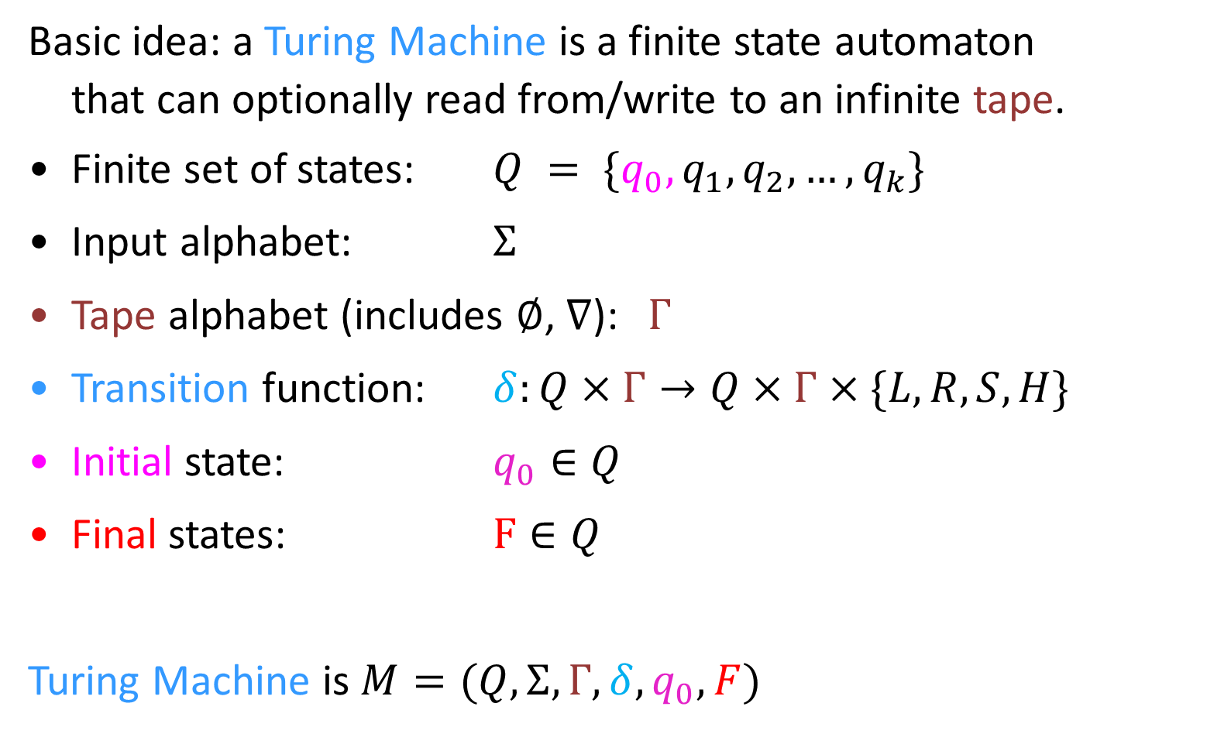
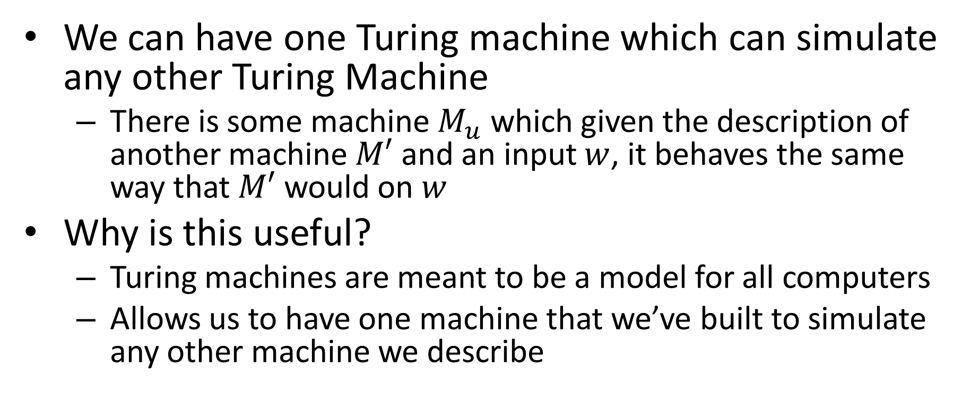
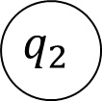
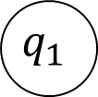
Turing Machine
Basic idea: a Turing Machine is a finite state automaton
that can optionally read from/write to an infinite tape.
Finite set of states: $Q = \{q_{0}, q_{1},q_{2}, …, q_{k}\}$
Input alphabet: $Σ$
Tape alphabet (includes $∅$, $∇$): $Γ$
Transition function: $δ:Q×Γ→Q×Γ×\{L,R,S,H\}$
Initial state: $q_{0}∈Q$
Final states: $F∈Q$
Turing Machine is $M=(Q,Σ,Γ,δ,q_{0},F)$
$$q_{1}$$
Read
Move
$$a, b, L$$
Write
$$q_{1}$$
$$q_{2}$$
$$q_{0}$$
read, write, move
$$A$$

Slide 12






Some Turing Machines never return
while(true){
twiddle(thumbs);
}
In this case they run forever
3 behaviors
Return 1
Return 0
Run forever
This is necessary for computation
while(x != 1){
if(x%2 == 0){
x = x / 2;
}
else{
x = 3x+1;
}
}
$$1,1,H$$
$$∇,∇,R$$
$$0,0,H$$
$$∅,∅,L$$
$$∇,∇,R$$
$$∇∅∅∅…$$

Slide 13
What is Computable?
Definition:
A function/language is computable provided there is some always-halting Turing machine for it
Function: computable provided there is an always-halting Turing machine which, when run on a tape containing only the input, always halts with only the corresponding output on the tape
Langauge: computable provided there is an always-halting Turing machine which, when run on a tape containing only the input, always halts and returns 1 if that string was in the langauge, and 0 otherwise
Assertion:
This definition is the most powerful definition of computability that is physically possible
Why…?

Slide 14
What can’t be computed?
Turing machines are really powerful
They can do complicated functions
Turing machines are so powerful, you can use them to describe “nonsense”
Nonsense- paradox
“colorful green ideas sleep furiously”
“this statement is false” <- build a TM that says exactly this

Slide 15
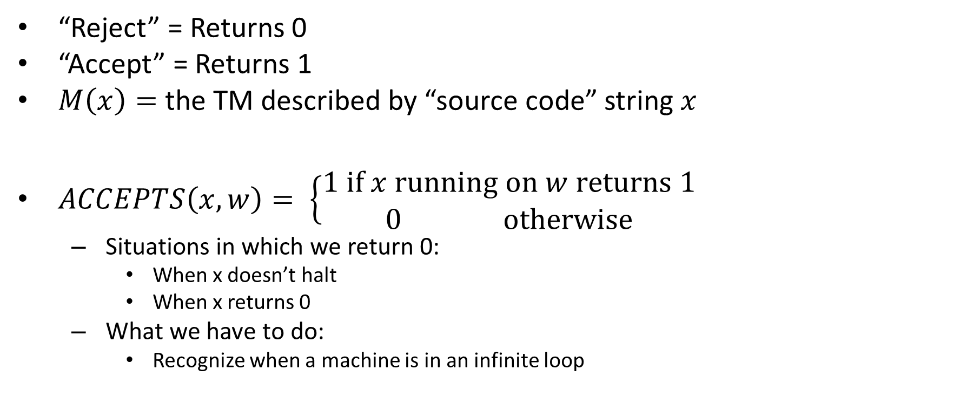

The $ACCEPTS$ function
“Reject” = Returns 0
“Accept” = Returns 1
$M\left(x\right)=$the TM described by “source code” string $x$
$ACCEPTS\left(x, w\right)= \left\{\begin{aligned}1 if x running on w returns 1 \\ 0 otherwise\end{aligned}\right.$
Situations in which we return 0:
When x doesn’t halt
When x returns 0
What we have to do:
Recognize when a machine is in an infinite loop

Slide 16
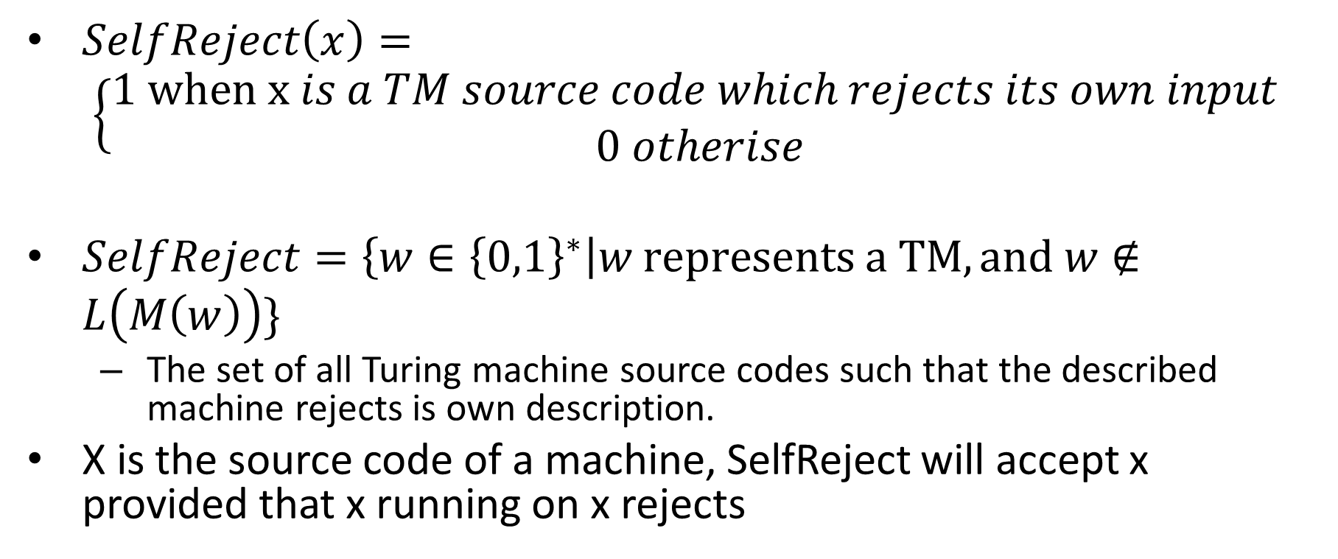
Self-Rejecting Function
$SelfReject\left(x\right)= \left\{\begin{aligned}1 when x is a TM source code which rejects its own input \\ 0 otherise\end{aligned}\right.$
$SelfReject=\left\{w∈{\left\{0,1\right\}}^{∗}\right|w represents a TM, and w∉L\left(M\left(w\right)\right)\}$
The set of all Turing machine source codes such that the described machine rejects is own description.
X is the source code of a machine, SelfReject will accept x provided that x running on x rejects

Slide 17
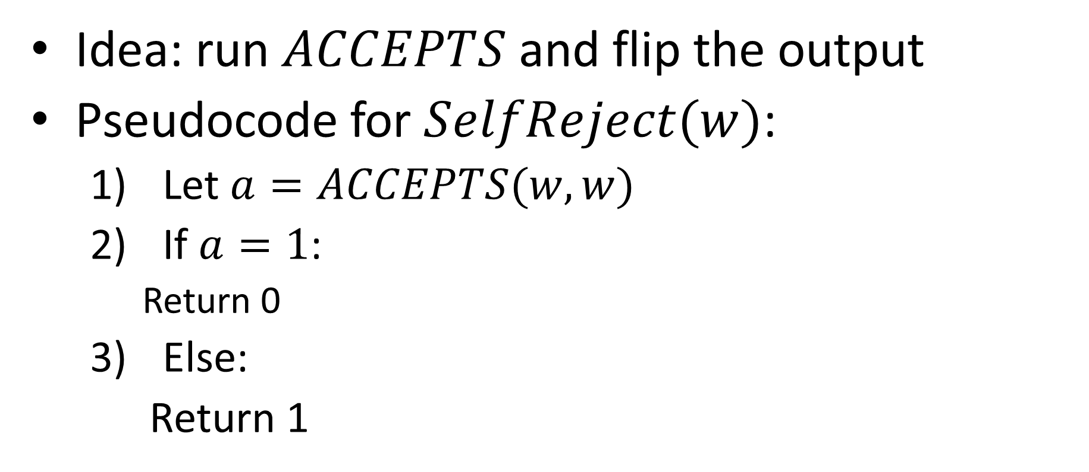

Implementing $SelfReject$ With $ACCEPTS$
Idea: run $ACCEPTS$ and flip the output
Pseudocode for $SelfReject(w)$:
Let $a=ACCEPTS(w,w)$
If $a=1$:
Return 0
Else:
Return 1

Slide 18
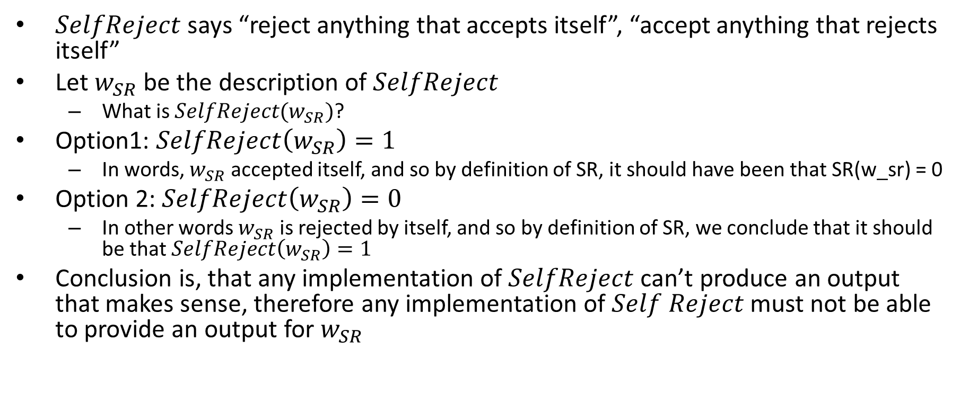
What’s the problem?
$SelfReject$ says “reject anything that accepts itself”, “accept anything that rejects itself”
Let $w_{SR}$ be the description of $SelfReject$
What is $SelfReject(w_{SR})$?
Option1: $SelfReject\left(w_{SR}\right)=1$
In words, $w_{SR}$ accepted itself, and so by definition of SR, it should have been that SR(w_sr) = 0
Option 2: $SelfReject\left(w_{SR}\right)=0$
In other words $w_{SR}$ is rejected by itself, and so by definition of SR, we conclude that it should be that $SelfReject\left(w_{SR}\right)=1$
Conclusion is, that any implementation of $SelfReject$ can’t produce an output that makes sense, therefore any implementation of $Self Reject$ must not be able to provide an output for $w_{SR}$

Slide 19
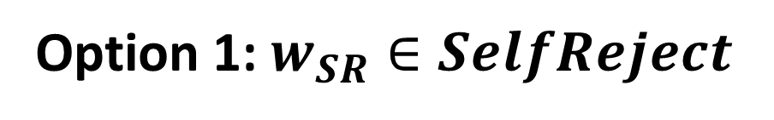

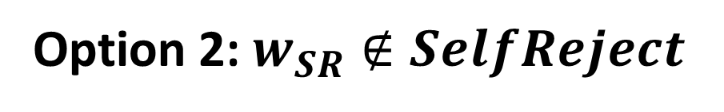
$w_{SR}∈SelfReject$?
Option 1: $w_{SR}∈SelfReject$
Option 2: $w_{SR}∉SelfReject$

