Slide 1
CS3102 Theory of Computation
www.cs.virginia.edu/~njb2b/cstheory/s2020
Warm up:
Software can be reconfigured, hardware cannot.
When we build hardware, how do we decide what to implement?
If you found the fitbit, the owner is down front, and is upset about all her wasted steps from the past 2 days.

Slide 3
Logistics
Exercise 2 due Tuesday
Quiz 3 released Friday
Exercise 3 is out this weekend
Last “regular-sized” exercise before midterm
There will be a “tiny” exercise 4 due the Tuesday before the midterm

Slide 4
Last Time
Boolean Circuits as a model of computing
Straightline Programs as a model of computing
Proved NAND-Straightline = NAND-Circ = AON-Circ = AON-straightline

Slide 5
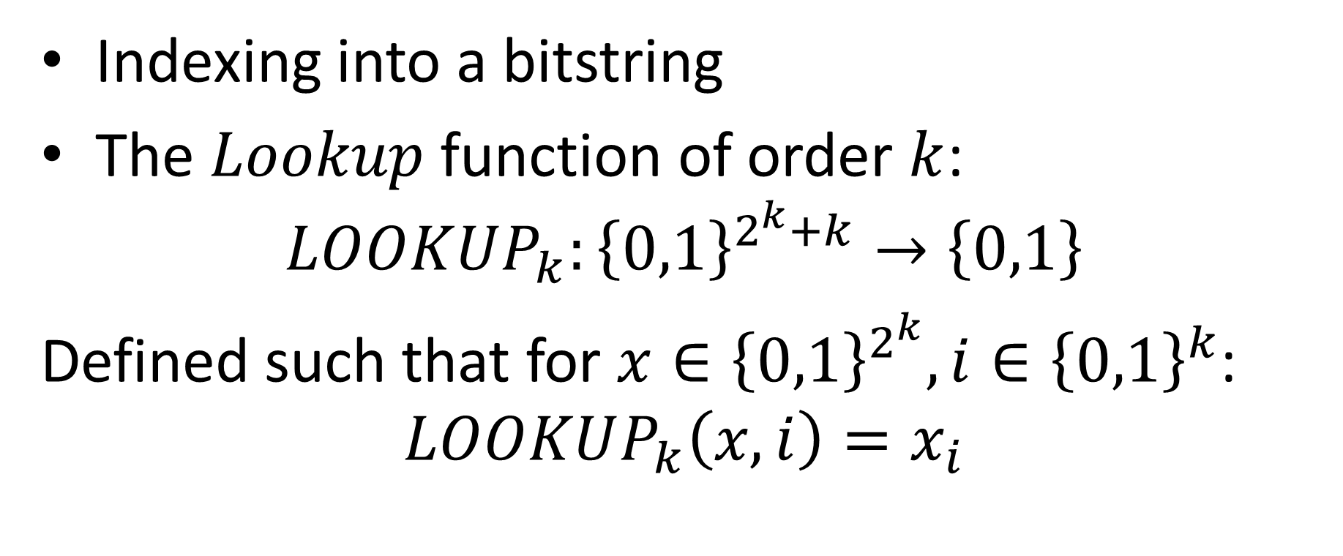
Lookup
Indexing into a bitstring
The $Lookup$ function of order $k$:
$$LOOKUP_{k}:{\left\{0,1\right\}}^{2^{k}+k}→\left\{0,1\right\}$$
Defined such that for $x∈{\left\{0,1\right\}}^{2^{k}}, i∈{\left\{0,1\right\}}^{k}$:
$$LOOKUP_{k}\left(x,i\right)=x_{i}$$

Slide 6
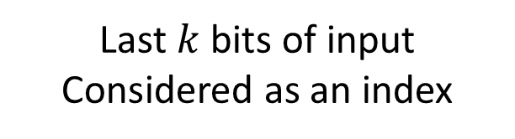
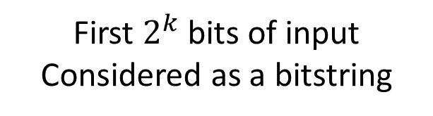


$$LOOKUP_{k}$$
$$k=3$$
x:
i:
0 | 1 | 0 | 0 | 1 | 1 | 1 | 0
0 | 1 | 0
First $2^{k}$ bits of input
Considered as a bitstring
Last $k$ bits of input
Considered as an index

Slide 7

Theorem
There is a NAND-Cricuit that computes $LOOKUP_{k}:{\left\{0,1\right\}}^{2^{k}+k}→\{0,1\}$
Moreover, the number of gates required is at most $4⋅2^{k}$

Slide 8
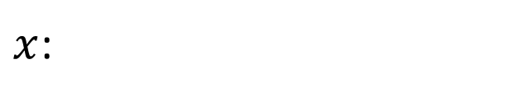
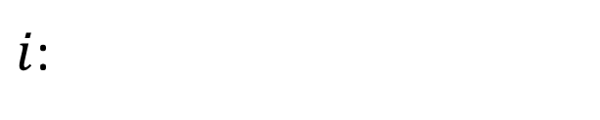

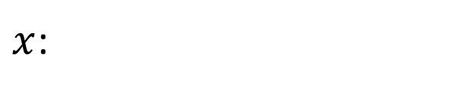
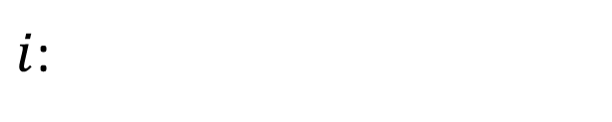
Proof idea
Consider index $i$
If the first bit of $i$ is 0, then the bit we're looking for is in the first half of $x$
Do lookup for $k−1$
$x$:
$i$:
0 | 1 | 0 | 0 | 1 | 1 | 1 | 0
0 | 1 | 0
$x$:
$i$:
0 | 1 | 0 | 0
1 | 0

Slide 9
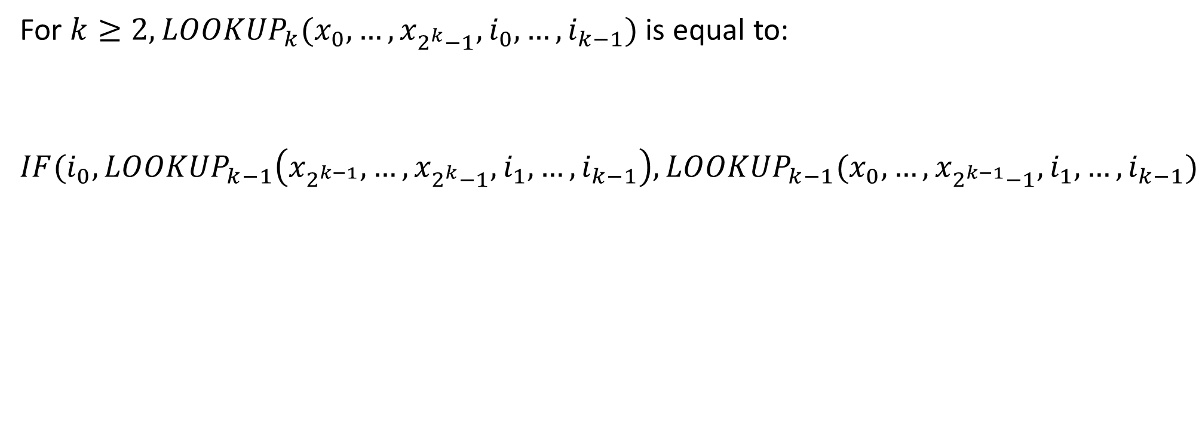

Defining $LOOKUP_{k}$
For $k≥2, LOOKUP_{k}(x_{0},…,x_{2^{k}−1}, i_{0},…,i_{k−1})$ is equal to:
$$IF(i_{0},LOOKUP_{k−1}\left(x_{2^{k−1}}, …,x_{2^{k}−1}, i_{1},…,i_{k−1}\right),LOOKUP_{k−1}(x_{0}, …,x_{2^{k−1}−1}, i_{1},…,i_{k−1})$$

Slide 10

Base Case
Next Step

Slide 11
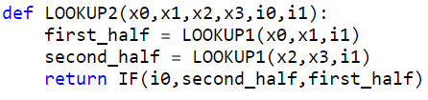
LOOKUP2
LOOKUP3 and 4

Slide 12

Counting Gates
Show this uses at most $4⋅2^{k}−4$ gates (lines of code)

Slide 13
Counting Gates
Show this uses at most $4⋅2^{k}−4$ gates (lines of code)

Slide 14
Computing Every Finite Function
Next we'll show that NAND is “universal”
Any finite function can be computed by some NAND-straightline program (equivalently, a NAND-circuit)

Slide 15
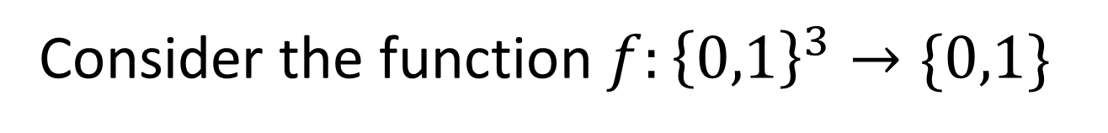
Idea
Consider the function $f:{\left\{0,1\right\}}^{3}→\{0,1\}$
Input | Output
000 | 0
001 | 0
010 | 1
011 | 0
100 | 1
101 | 1
110 | 0
111 | 0
We will have one variable to represent each possible input. We'll do a lookup with the actual input to select the proper output

Slide 16
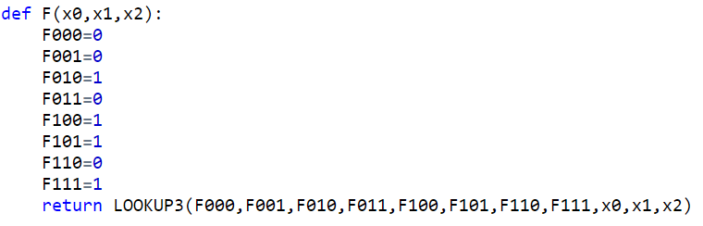
Straightline Code for F
Input | Output
000 | 0
001 | 0
010 | 1
011 | 0
100 | 1
101 | 1
110 | 0
111 | 0

Slide 17
Getting 0 and 1

Slide 18


Getting 0 and 1

Slide 19
Computing any function
Make a variable to represent each possible input
Assign its value to match the correct output
Use LOOKUP to select the proper output for the given input

Slide 20
Straightline Code for F
Input | Output
000 | 0
001 | 0
010 | 1
011 | 0
100 | 1
101 | 1
110 | 0
111 | 0

Slide 21
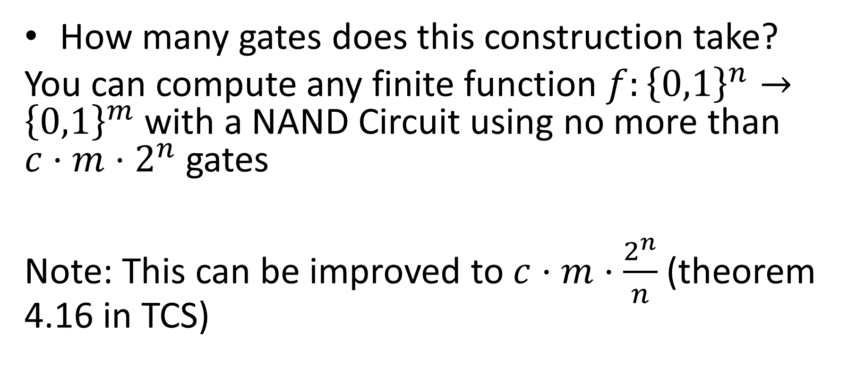
How many gates?
How many gates does this construction take?
You can compute any finite function $f:{\left\{0,1\right\}}^{n}→{\left\{0,1\right\}}^{m}$ with a NAND Circuit using no more than $c⋅m⋅2^{n}$ gates
Note: This can be improved to $c⋅m⋅\frac{2^{n}}{n}$ (theorem 4.16 in TCS)

Slide 22
Counting gates
Create variables for each input
Assign 0,1 to each input
Do the LOOKUP

Slide 24

What does this mean?
Your laptop is a 64-bit machine. Given enough transistors, it can compute any function $f:{\left\{0,1\right\}}^{64}→{\left\{0,1\right\}}^{64}$

Slide 25
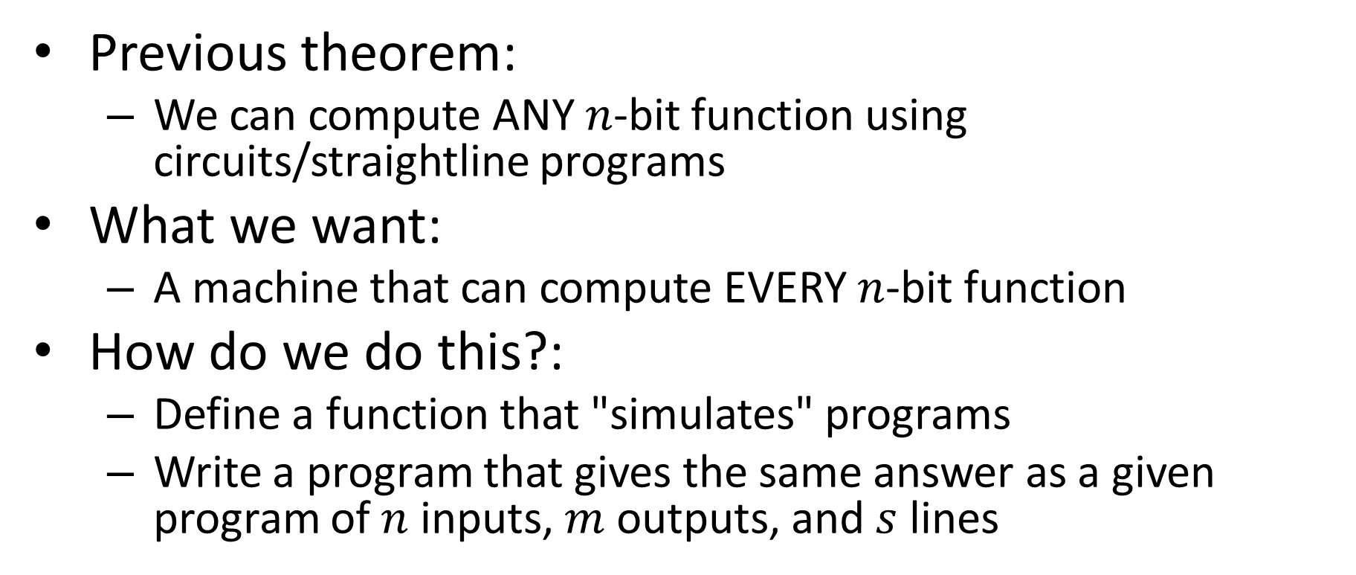
Any to Every
Previous theorem:
We can compute ANY $n$-bit function using circuits/straightline programs
What we want:
A machine that can compute EVERY $n$-bit function
How do we do this?:
Define a function that "simulates" programs
Write a program that gives the same answer as a given program of $n$ inputs, $m$ outputs, and $s$ lines

Slide 26
How are programs run?
Have a table of variables
Execute code in sequence
Update values in table
Return a value from the table

Slide 27
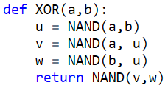
Simulating XOR
Variable | Value

Slide 28
Simulating XOR
Variable | Value
a | 0
b | 1
u | 1
v | 1
w | 0
return | 1

Slide 29
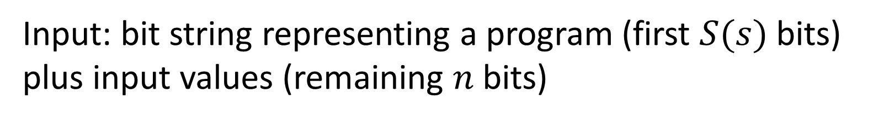
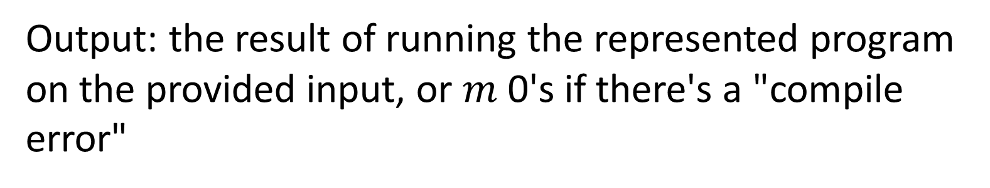
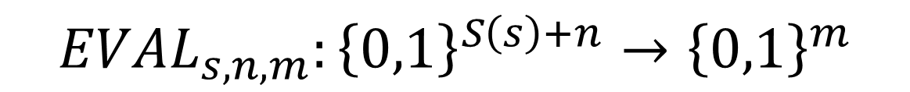
Defining EVAL
$$EVAL_{s,n,m}:{\left\{0,1\right\}}^{S\left(s\right)+n}→{\left\{0,1\right\}}^{m}$$
Input: bit string representing a program (first $S(s)$ bits) plus input values (remaining $n$ bits)
Output: the result of running the represented program on the provided input, or $m$ 0's if there's a "compile error"

Slide 30

Programs as Bits
To evaluate a program with another program, we need to convert the first program into bits
Number each variable (first n go to input, last m to outputs)
Represent each line as 3 numbers (outvar, in1, in2)
Represent program as (n,m,[Lines])
Variable | Number
a | 0
b | 1
temp1 | 2
temp2 | 3
return | 4
(2,0,0)
(3,1,1)
(4,2,3)
(2,1,[(2,0,0),(3,1,1),(4,2,3)])

Slide 31

XOR to bits
Variable | Number
$n=$
$m=$
$s=$
Total bits =

Slide 32
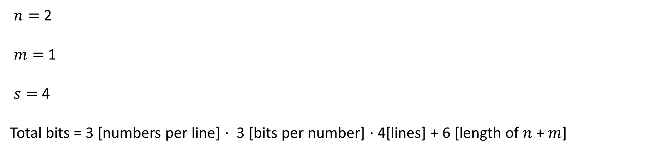
XOR to bits
Variable | Number
a | 0
b | 1
u | 2
v | 3
w | 4
return | 5
$n=$ 2
$m=$ 1
$s=$ 4
Total bits = 3 [numbers per line] $⋅$ 3 [bits per number] $⋅$ 4[lines] + 6 [length of $n$ + $m$]

Slide 33
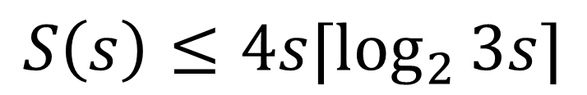
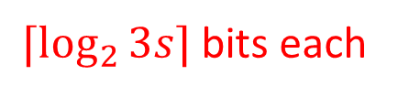
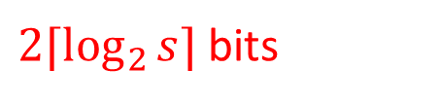

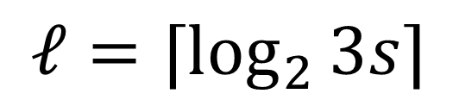
How big is this?
Number each variable
Represent each line as 3 numbers (outvar, in1, in2)
Represent program as (n,m,[Lines])
$⌈\log_{2}{3s⌉}$bits each
$3s⋅⌈\log_{2}{3s⌉}$bits
$2⌈\log_{2}{s⌉}$bits
$$S\left(s\right)≤4s⌈\log_{2}{3s}⌉$$
$$ℓ=⌈\log_{2}{3s⌉}$$

Slide 34
Defining EVAL
$$EVAL_{s,n,m}:{\left\{0,1\right\}}^{S\left(s\right)+n}→{\left\{0,1\right\}}^{m}$$
Input: bit string representing a program (first $S(s)$ bits) plus input values (remaining $n$ bits)
Output: the result of running the represented program on the provided input, or $m$ 0's if there's a "compile error"

Slide 35

Defining the EVAL function
$$n=2$$
$$m=1$$
Variable | Value
0
1
2
3
4
5
Representation:
(2, 0, 1),
(3, 0, 2),
(4, 1, 2),
(5, 3, 4)
Input:
0, 1

Slide 36

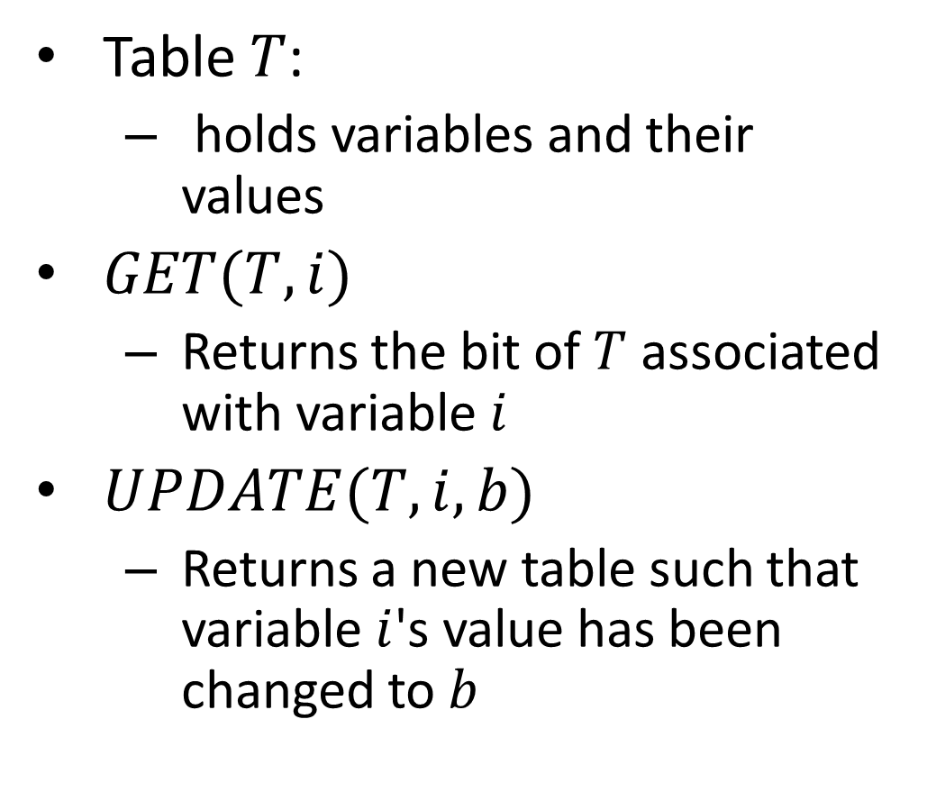
Psuedocode for EVAL
$$T$$
Table $T$:
holds variables and their values
$GET(T,i)$
Returns the bit of $T$ associated with variable$i$
$UPDATE(T, i, b)$
Returns a new table such that variable $i$'s value has been changed to $b$

Slide 37
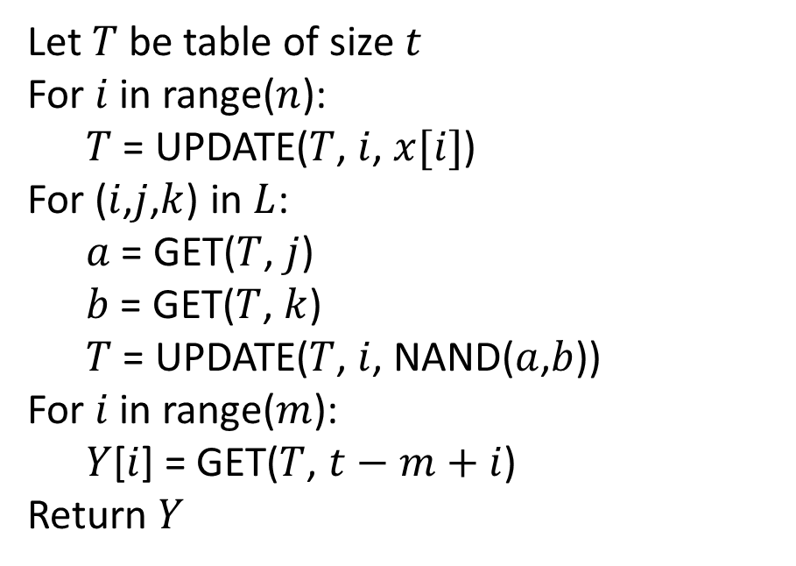
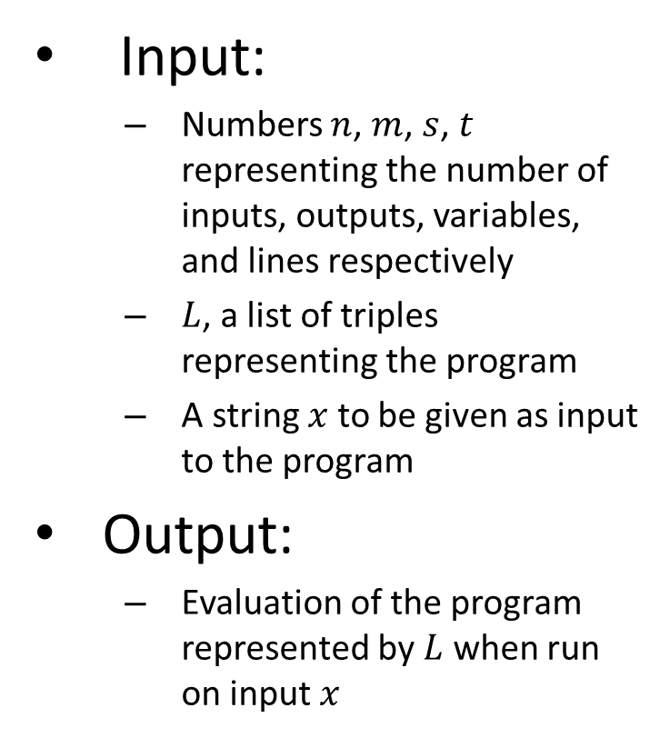
Psuedocode for EVAL
Input:
Numbers $n$, $m$, $s$, $t$ representing the number of inputs, outputs, variables, and lines respectively
$L$, a list of triples representing the program
A string $x$ to be given as input to the program
Output:
Evaluation of the program represented by $L$ when run on input $x$
Let $T$ be table of size $t$
For $i$ in range($n$):
$T$ = UPDATE($T$, $i$, $x[i]$)
For ($i$,$j$,$k$) in $L$:
$a$ = GET($T$, $j$)
$b$ = GET($T$, $k$)
$T$ = UPDATE($T$, $i$, NAND($a$,$b$))
For $i$ in range($m$):
$Y$[$i$] = GET($T$, $t−m+i$)
Return $Y$

Slide 38

EVAL in NAND
Next we implement $EVAL_{s,n,m}$ using NAND

Slide 39
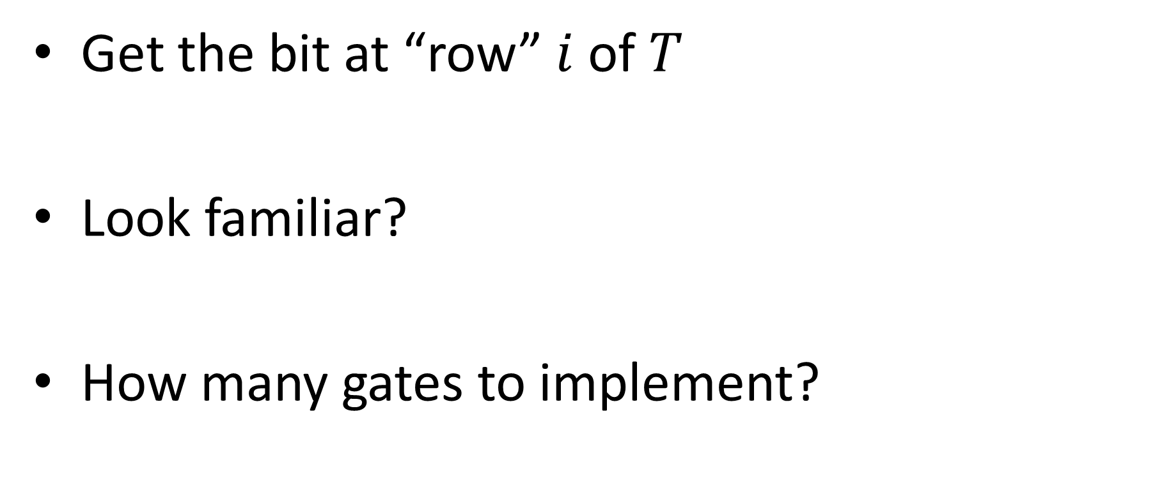

$$GET(T,i)$$
Get the bit at “row” $i$ of $T$
Look familiar?
How many gates to implement?

Slide 40
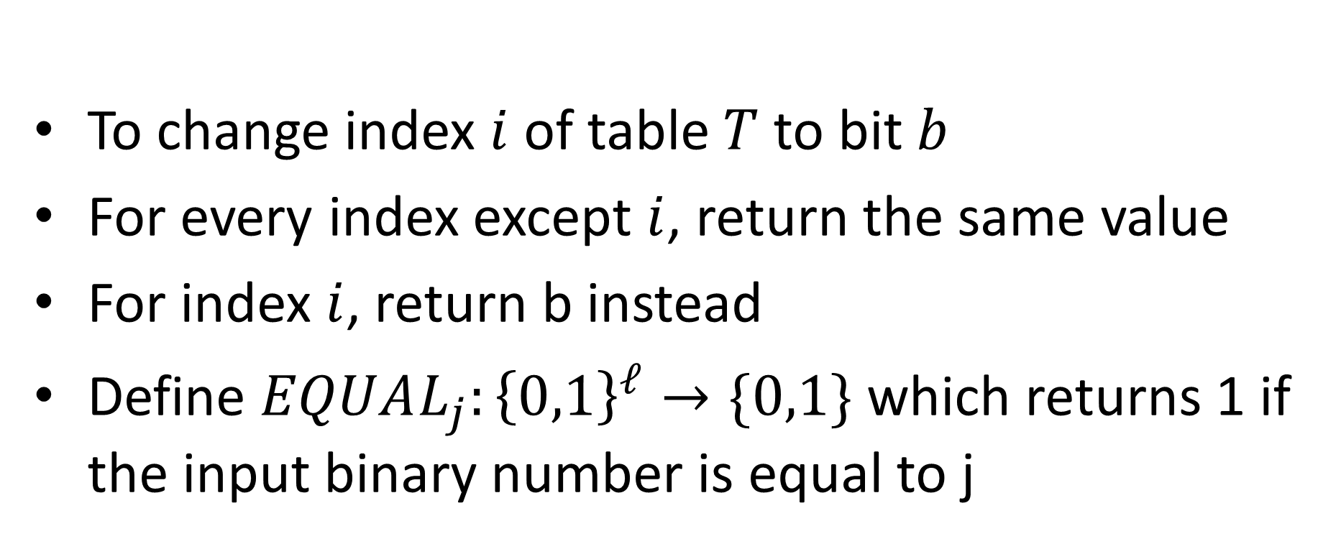
UPDATE
$$UPDATE_{ℓ}:{\left\{0,1\right\}}^{s^{ℓ}+ℓ+1}→{\left\{0,1\right\}}^{2^{ℓ}}$$
To change index $i$ of table $T$ to bit $b$
For every index except $i$, return the same value
For index $i$, return b instead
Define $EQUAL_{j}:{\left\{0,1\right\}}^{ℓ}→\{0,1\}$ which returns 1 if the input binary number is equal to j
Note: $EQUAL_{j}$ can be done in $c⋅ℓ$ gates

Slide 41

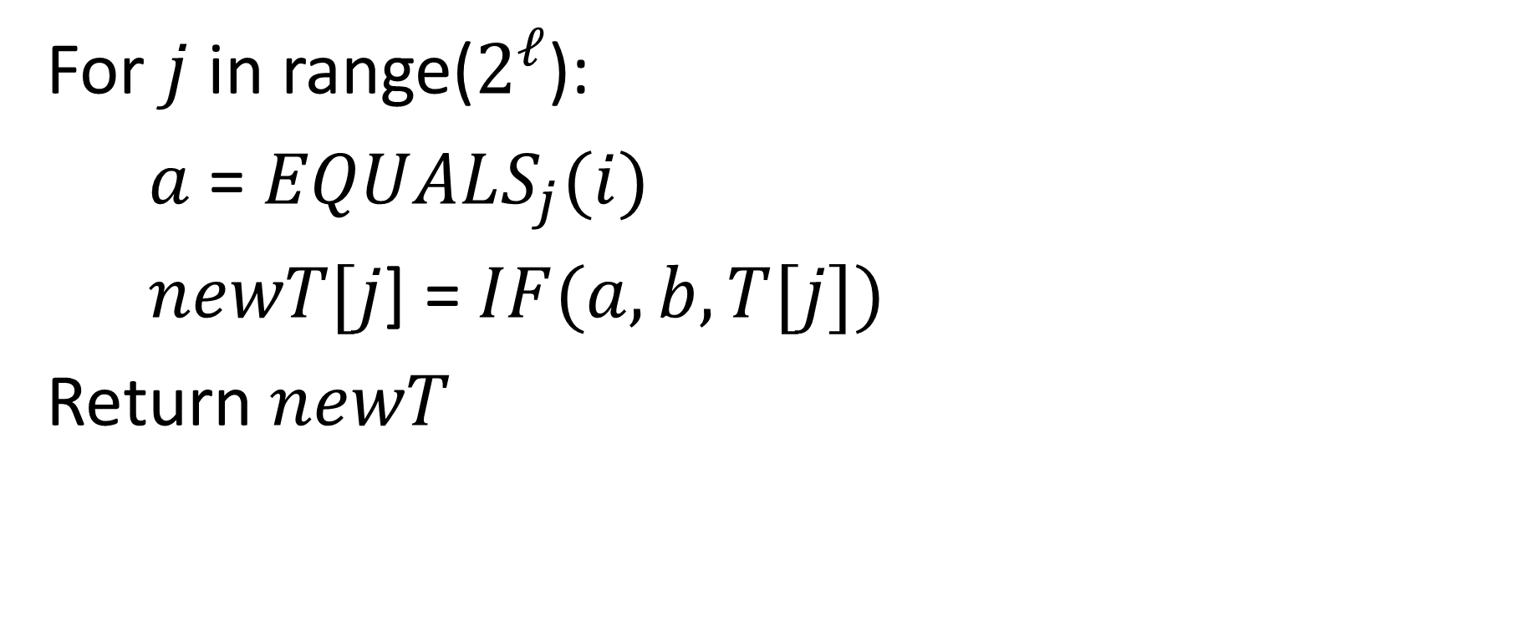
UPDATE pseudocode
For $j$ in range($2^{ℓ}$):
$a$ = $EQUALS_{j}(i)$
$newT[j$] = $IF(a, b, T[j])$
Return $newT$
Runs $2^{ℓ}$ times

Slide 42
Conclusion

