Slide 1
Cross-Domain Evaluation of
Retrieval-Augmented Generation
A Controlled Study of Domain Mismatch in RAG Pipelines
Aditya Jekkula · Ibaad Mohammed · Nate Dailey
Advanced Topics in AI · May 2026

Slide 2
OVERVIEW
What We'll Cover
01
Introduction & Research Questions
06
Evaluation Metrics
02
Datasets Selected & Why
07
Results & Quantitative Analysis
03
Pipeline Architecture
08
Qualitative Examples & Failures
04
Retrievers: BM25 & Dense
09
Future Work
05
Generator & LLM-Only Baseline

Slide 3
INTRODUCTION
The Problem with RAG in the Wild
Why RAG?
Research Questions
LLMs have fixed knowledge cutoffs
They hallucinate facts not seen in training
They cannot access proprietary data
RAG fixes this — but only if retrieval works
1
How does cross-domain retrieval affect relevance (Recall@K)?
2
Does domain mismatch hurt generation quality (F1, EM)?
The Gap We Study
3
Where does the pipeline fail — retrieval or generation?
What happens when query domain ≠ corpus domain?
Does bad retrieval hurt more than no retrieval?
Where does the pipeline fail — retrieval or generation?
4
Does bad retrieval hurt more than no retrieval at all?

Slide 4
DATASETS
Three Datasets — Chosen for Domain Contrast
SQuAD
Natural Questions
TriviaQA (rc)
Domain
Domain
Domain
Wikipedia (structured passages)
Wikipedia (Google queries)
Trivia / quiz sources
Answer Type
Answer Type
Answer Type
Short extractive span
Short extractive answer
Short extractive answer
Why chosen
Why chosen
Why chosen
Passage-specific questions. Perfect in-domain baseline. RAG should excel here.
Real search queries — more natural than SQuAD. Tests query-style mismatch.
Entertainment, sport, history — genuinely different domain from Wikipedia text.
Corpus
Corpus
Corpus
87K train examples → 5K corpus pool
300K+ examples → 2K corpus pool
138K examples → 3K corpus pool
Why NOT PubMedQA? Ground truth long_answer does not appear in source abstracts → Recall@K always 0% regardless of retrieval quality. Replaced with TriviaQA for clean, comparable evaluation.

Slide 5
PIPELINE
RAG Pipeline Architecture
RAG Path
Query
Retriever
Top-K Chunks
Generator
Answer
User question
BM25 or Dense
k=5 retrieved
Qwen 0.5-7B
Final output
LLM-Only Baseline Path
LLM-Only
Generator
Answer
No retrieval
Qwen 0.5-7B
Baseline output

Slide 6
CHUNKING
Text Chunking Strategy
Why Chunking?
def chunk_text(text,
max_words=250, overlap=50):
sentences = sent_tokenize(text)
chunks, chunk, n = [], [], 0
for sent in sentences:
words = sent.split()
if n + len(words) > max_words:
chunks.append(' '.join(chunk))
ow = ' '.join(chunk).split()[-overlap:]
chunk = [' '.join(ow)]
n = len(ow)
chunk.append(sent)
n += len(words)
chunks.append(' '.join(chunk))
return chunks
Retrieving entire documents is too coarse
Smaller chunks = more precise retrieval
Overlap prevents losing context at boundaries
Sentence-aware: never cuts mid-sentence
Max chunk size
250 words
Overlap
50 words
Dataset | Pool | Chunks
SQuAD | 5,000 | 842
NQ | 2,000 | 1,983
TriviaQA | 3,000 | 5,409
Splitting
NLTK sent_tokenize
Dedup
Identical chunks removed

Slide 7
RETRIEVER
BM25 — Sparse Keyword Retrieval
How BM25 Works
def retrieve_bm25(query,
bm25_idx, chunks, k=5):
scores = bm25_idx.get_scores(
query.split())
idx = np.argsort(scores)[::-1]
results, seen = [], set()
for i in idx:
text = chunks[i]
if text not in seen:
results.append(
(text, float(scores[i])))
seen.add(text)
if len(results)==k: break
return results
Purely lexical — no semantic understanding
Scores chunks by term frequency (TF) and inverse document frequency (IDF)
Penalizes long documents (length normalization)
Uses BM25Okapi from rank_bm25 library
Deduplication filter prevents same chunk appearing multiple times
Strengths vs Weaknesses
Scenario | Recall@5 | MRR
SQuAD→SQuAD | 0.750 | 0.584
Trivia→Trivia | 0.255 | 0.172
SQuAD→Trivia | 0.055 | 0.031
Trivia→SQuAD | 0.025 | 0.019
✓ Fast — no GPU needed
✗ No semantic understanding
✓ Interpretable scores
✗ Fails on synonyms / paraphrases
✓ Strong on exact keyword matches
✗ Sensitive to vocabulary mismatch
✓ Works well with named entities

Slide 8
RETRIEVER
Dense Retrieval — Semantic Embeddings (MiniLM + FAISS)
How Dense Retrieval Works
def retrieve_dense(query,
faiss_idx, chunks, k=5):
q_emb = embed_model.encode(
[query], convert_to_numpy=True)
D, I = faiss_idx.search(
q_emb, k*3)
results, seen = [], set()
for dist, idx in zip(D[0],I[0]):
if idx < len(chunks):
text = chunks[idx]
if text not in seen:
results.append((text,dist))
seen.add(text)
if len(results)==k: break
return results
Encodes query and chunks into 384-dim embedding vectors
Model: all-MiniLM-L6-v2 — distilled BERT, 80M params
Retrieval by L2 distance search using FAISS IndexFlatL2
Understands semantic meaning: synonyms and paraphrases can match
Exact search (no approximation) — corpus is small enough
Why MiniLM over larger models?
Scenario | Recall@5 | MRR
SQuAD→SQuAD | 0.925 | 0.792
Trivia→Trivia | 0.325 | 0.246
SQuAD→Trivia | 0.050 | 0.021
Trivia→SQuAD | 0.070 | 0.044
Strong accuracy-efficiency tradeoff for general semantic similarity
NOT fine-tuned on our datasets — reflects general semantic knowledge
Fast enough for N=200 × 3 corpora within Colab session limits

Slide 9
GENERATOR
Qwen 2.5-0.5B-Instruct — The Generator
0.5B
float16
NVIDIA GTX 1650
60
Parameters
Precision
GPU
Max New Tokens
RAG Prompt
LLM-Only Prompt
'Answer using the information in the context below.
Give a concise, direct answer.'
'Context: {context}'
'Question: {question}'
'Answer:'
'Answer the following question as
accurately and concisely as
possible.'
'Question: {question}'
'Answer:'
Generation cleanup: split on 'Human:', 'Question:', 'You are an AI' to remove model leakage artifacts.

Slide 10
EVALUATION
Evaluation Metrics — Independent at Each Stage
Recall@K · Retrieval
MRR · Retrieval
Does the correct answer appear in the top-K retrieved chunks? Uses 80% token overlap threshold.
hit=1 if 80% of answer tokens
appear in any chunk
Mean Reciprocal Rank — rank of the first correct chunk. Rewards higher-ranked correct chunks.
MRR = 1/rank of first hit
(0 if no hit in top-K)
Exact Match (EM) · Generation
F1 Score · Generation
1 if normalized prediction exactly matches normalized ground truth. Strict metric.
normalize: lowercase,
remove punctuation
Token-level overlap between prediction and ground truth. Rewards partial matches.
F1 = 2·P·R/(P+R)
P=precision, R=recall
Failure Classification (Dense-RAG): Retrieval Failure = Recall@K=0 · Generation Failure = Recall=1 but F1<0.3 · Success = Recall=1 and F1≥0.3

Slide 11
RESULTS
Quantitative Results — All Scenarios
Scenario | Type | LLM-Only F1 | BM25 R@5 | Dense R@5 | BM25-RAG F1 | Dense-RAG F1 | RAG vs Baseline
A: SQuAD→SQuAD | In-domain | 0.028 | 0.750 | 0.925 | 0.118 | 0.126 | +0.098 ↑
B: NQ→NQ | In-domain | 0.040 | 0.015 | 0.015 | 0.037 | 0.041 | +0.001 ↑
C: Trivia→Trivia | In-domain | 0.040 | 0.255 | 0.325 | 0.066 | 0.060 | +0.019 ↑
D: SQuAD→NQ | Cross-domain | 0.028 | 0.015 | 0.005 | 0.036 | 0.030 | +0.002 ↑
E: SQuAD→Trivia | Cross-domain | 0.028 | 0.055 | 0.050 | 0.034 | 0.026 | -0.001 ↓
F: Trivia→SQuAD | Cross-domain | 0.040 | 0.025 | 0.070 | 0.032 | 0.032 | -0.008 ↓
Key finding: Only Scenario A (in-domain) shows meaningful RAG improvement (+9.8% F1). Cross-domain scenarios show minimal or negative impact; near-zero F1 scores across all methods.

Slide 12
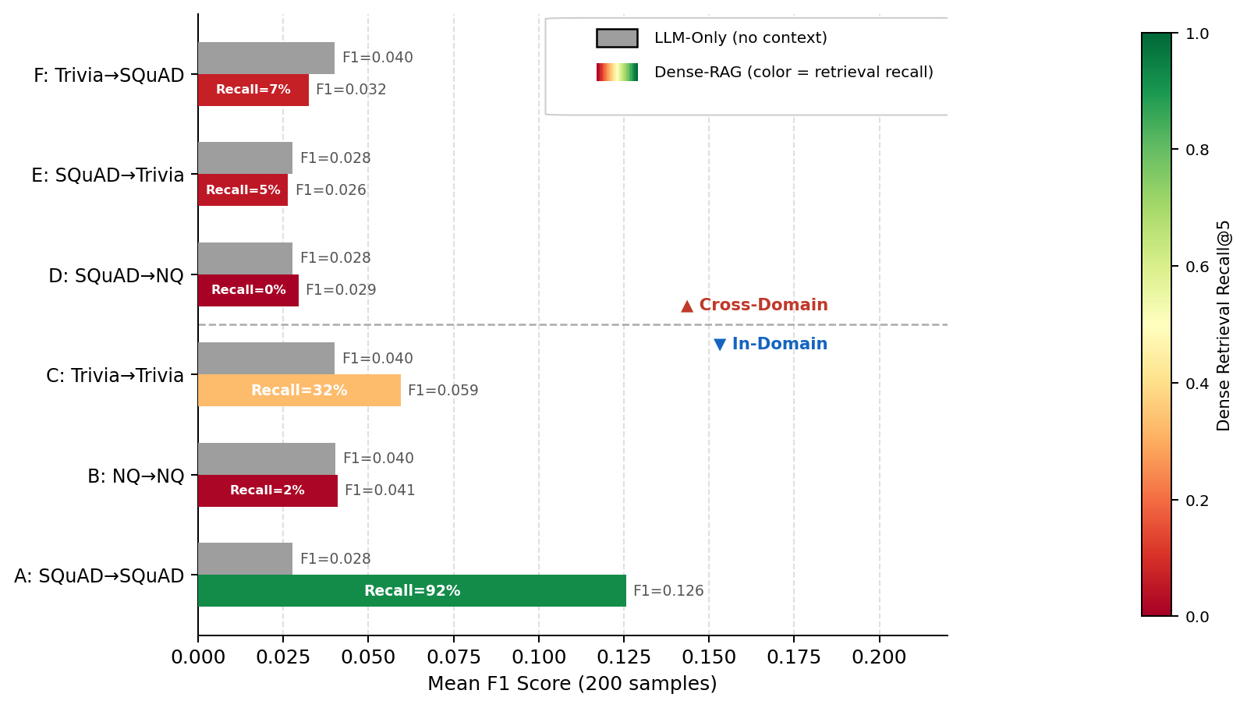
RESULTS
Retrieval Quality Drives F1 — Context Without Recall Adds Nothing
Scenario A
Recall=92%: the only scenario with relevant context. Dense-RAG F1=0.126, 4.5× the LLM-only baseline.
Cross-Domain
Recall ≤7%: injected context is almost always irrelevant. Dense-RAG F1 matches or falls below LLM-only.
NQ In-Domain
Recall=2%: HTML artifact contamination means virtually no useful context is retrieved.
Trivia In-Domain
Recall=32%: partial retrieval gives some lift but generation failures still dominate (F1=0.060).

Slide 13
QUALITATIVE
Example 1 — RAG Success (Scenario A: SQuAD In-Domain)
Question
To whom did the Virgin Mary allegedly appear in 1858 in Lourdes France?
Ground Truth
Saint Bernadette Soubirous
Retrieved Chunk (BM25 ✅ Dense ✅)
Architecturally, the school has a Catholic character. Atop the Main Building's gold dome is a golden statue of the Virgin Mary. Immediately in front of the Main Building...
LLM-Only
The Virgin Mary allegedly appeared to a group of people in Lourdes, France in 1858. This event is known as the “Lourdes Miracle”... [F1=0.000]
BM25-RAG
The Virgin Mary allegedly appeared to Saint Bernadette Soubirous in 1858 in Lourdes, France. [F1=0.353, EM=0]
Dense-RAG
The Virgin Mary allegedly appeared to Saint Bernadette Soubirous in 1858 in Lourdes, France. This event is described in detail in the text provided. [F1=0.222, EM=0]
Insight: LLM fails to answer (F1=0.00). Retrieval provides the correct context and improves F1 to 0.353 (BM25) and 0.222 (Dense). RAG provides meaningful improvement over the baseline.

Slide 14
QUALITATIVE
Example 2 — Context Poisoning (Scenario E: SQuAD→TriviaQA)
Question
What is in front of the Notre Dame Main Building?
Ground Truth
a copper statue of Christ
BM25 Retrieved
Round One Jeopardy Template / The name of Dr. Seuss's egg-hatching elephant... — Trivia chunk about trivia games
Dense Retrieved
Consisting of 27 structures resembling petals of the lotus flower that open onto a central hall around 40m high... — Trivia chunk about architecture
LLM-Only
The Notre Dame Main Building, also known as the Notre Dame Cathedral or simply Notre Dame, is a massive Gothic cathedral... [F1=0.073]
BM25-RAG
The main building of Notre Dame Cathedral is located in front of the Notre Dame Main Building. [F1=0.091] ← WRONG
Dense-RAG
The Notre Dame Main Building is behind the Basilica of Saint Mary Major. However, I'm sorry, but I cannot provide a concise, direct answer... [F1=0.070]
Insight: BM25 retrieved an unrelated Jeopardy template; Dense retrieved a lotus-flower building description — both complete misses. BM25-RAG generates a circular wrong answer (F1=0.091, marginally above LLM-only F1=0.073 by chance, but still factually wrong). Dense-RAG refuses to commit and scores F1=0.070, below baseline.

Slide 15
QUALITATIVE
Example 3 — Generation Failure Despite Correct Retrieval
Question
The Basilica of the Sacred Heart at Notre Dame is beside to which structure?
Ground Truth
the Main Building
BM25 Chunk
Because of its Catholic identity, a number of religious buildings stand on campus... (contains the answer)
BM25-RAG
The Basilica of the Sacred Heart at Notre Dame is located next to the Old College building. The Old College building, which stands on the site of Fr.... [F1=0.074]
Dense Chunk
Because of its Catholic identity... The Basilica of the Sacred Heart is immediately behind the Main Building.
Dense-RAG
The Basilica of the Sacred Heart is situated next to the Basilica of the Sacred Heart. This can be inferred from the following sentence in the given text... [F1=0.065]
Insight: Both retrievers found the correct chunk, but both models confidently hallucinated wrong answers — BM25-RAG invented "the Old College building"; Dense-RAG produced a circular answer placing the Basilica next to itself. Neither hedged; both were confidently wrong. Correct retrieval is necessary but not sufficient.

Slide 16
ANALYSIS
Root Causes & Remedies
Cross-domain retrieval failure
Cause: Query and corpus use different vocabulary and structure. Retriever returns unrelated chunks (93–95% failure rate).
Remedy: Domain classifier to route queries to correct corpus. Confidence threshold fallback to LLM-only when similarity scores are low.
Context poisoning
Cause: Retrieved irrelevant chunks actively confuse the generator. Model produces confident wrong answers instead of abstaining.
Remedy: Relevance filtering before generation. Instruction tuning the model to abstain when context is clearly off-topic.
NQ HTML contamination
Cause: Wikipedia HTML in NQ passages left CSS classes (.mw-spinner), JS, and navigation boilerplate after naive tag stripping.
Remedy: Multi-stage cleaning: strip script/style blocks first, then tags, then CSS blocks, then collapse whitespace.
Generation over-verbosity
Cause: Model paraphrases the answer rather than extracting it. Correct answer buried in longer response, reducing F1 against short ground truth.
Remedy: Shorter max_new_tokens, stronger extraction instruction in prompt, or constrained decoding.

Slide 17
FUTURE WORK
Future Directions
01
Domain-Aware Routing
04
Long-Form Answer Evaluation
Lightweight classifier routes queries to the correct corpus. Confidence-based fallback to LLM-only when top-K similarity is below threshold.
Token F1 fails for paragraph-length answers. Evaluate with BERTScore or ROUGE-L. Would enable re-evaluation of PubMedQA.
02
Fine-Tuned Dense Retrieval
05
Multi-Model Generator Study
Domain-specific fine-tuning of MiniLM using DPR-style contrastive learning. Would substantially improve in-domain recall for NQ and TriviaQA.
Test Mistral-7B, and other models, to evaluate RAG performance across a wider variety of situations.
03
Hybrid BM25 + Dense (RRF)
06
Adversarial Cross-Domain Tests
Reciprocal Rank Fusion combines lexical and semantic retrieval. BM25 and dense often retrieve different correct chunks — fusion improves recall.
Construct scenarios where retrieved chunks are semantically similar but factually wrong. Precisely measure context poisoning susceptibility.

Slide 18
Key Takeaways
In-domain RAG works
Dense RAG: SQuAD F1 0.028 → 0.126 (4.5×). Retrieval improves generation when corpus and query align.
Cross-domain RAG hurts
Most cross-domain scenarios show near-zero or negative impact. Domain mismatch severely limits RAG gains.
Retrieval failure dominates
93–95% retrieval failure cross-domain. Domain gap defeats both BM25 and dense.
Dense > BM25 in-domain
Dense retrieval outperforms BM25 in most in-domain scenarios (Scenarios A and B), though BM25 edges Dense in Scenario C (0.066 vs 0.060). The advantage disappears entirely cross-domain.
Context poisoning is real
Irrelevant context causes confident wrong answers — not just low scores, actively wrong predictions.
Aditya Jekkula · Ibaad Mohammed · Nate Dailey · May 2026

