Slide 1
This is a customer facing deck.
However, it contains a lot of details that might make the Databricks platform look more complicated than necessary. Please consider to only share the slides with customers necessary for the purpose of your session.
Delete before sharing
Notes:
tag:overview,azure,aws,gcp

Slide 2
Changes
2024-07-29
Added generic serverless compute architecture
Added architecture overview for model serving, online tables and vector search
Enhanced Dashboards to AI/BI in the reference architecture, including Dashboards and Genie
Aligned Mosaic overview with the 6 Mosaic AI architecture deck
Added data access patterns from Unity Catalog deck
2024-10-30
Modern Platform framework
Added “Databricks Apps” and “Lakeflow Connect”, “MLOps” to Automation, “Iceberg” to cloud storage
Replaced “SQL Connectors” with “AI functions”
Reference architectures
Removed Private Preview from Lakeflow Connect
Added “Databricks Apps”
Renamed “Orchestration” to “Automation & Orchestration” and added details
Added “Feature Engineering” to “Data Science & Machine Learning”
Added a new high level workflow “Ingestion”
2025-03-19
Replaced UniForm with Iceberg
Added Interoperability view for external apps with Delta and Iceberg
Reference Architectures
Added connectors and APIs capability to the Data Warehouse domain
Added use case for adding Catalog Federation
Added Clean Rooms
Added use case using data from Databricks Marketplace and Delta Sharing (D2D)
2025-04-01
Replaced “Delta Live Tables” with “DLT” (we don’t use the long form any more)
Removed DatabricksIQ
Added “App Developer” persona to the scope slides
2025-07-10
Replaced “DLT” with “Lakeflow Declarative Pipelines”
Replaced “Workflows” with “Lakeflow Jobs”
Added “Operational Database” domain with “Lakebase”
Reworked the High Level Architecture section to include Lakebase

Slide 3
System Architecture
Cloud agnostic Overview
Bernhard Walter Last updated 2025-04-02
Notes:
tag:overview

Slide 4
Positioning
Notes:
tag:overview,intro

Slide 5
Data Intelligence Platform
Notes:
tag:overview

Slide 6
Modern Data Platform - Framework
Data Engineer
ML Engineer
Data Scientist
Business Analyst
App Developer
Business Partner
ETL & DS tools
BI Tools
Data and AI Apps
Collaboration
Orchestration
Ingest & Transform
Advanced Analytics, ML & AI
Data Warehouse
Operational Database
AI Engine
Data & AI Governance
Cloud Storage
Notes:
tag:overview,L100-200
This is a simple framework for a modern data platform
It shows on top the 5 main persona using the platform:
Data engineer
ML engineer
Data scientist
Business analyst
Business partner
And it comes with 4 layers:
The “Storage” layer: All data files are stored in the Cloud Object Storage
The “Data Governance” layer contains capabilities around access control, metadata management, lineage tracking, …
The “Engine” layers, actually comprises of 3 sub layers:
The bottom layer is the AI engine layer. In this layer AI and Gen AI models will be provided that support all other functions in the platform
The value generation layer. It consist of the domains for the 3 main workload types:
Data ingest and transformations for all tasks to get data into the platform
The “Advanced Analytics, ML & AI” engine for ML, Ai and Gen AI use cases
The “Data Warehouse” engine for data warehouse and BI use cases
The orchestration layer that provides all capabilities around workflow management
The “Consumption” layer containing the front-ends and tools for all workloads

Slide 7
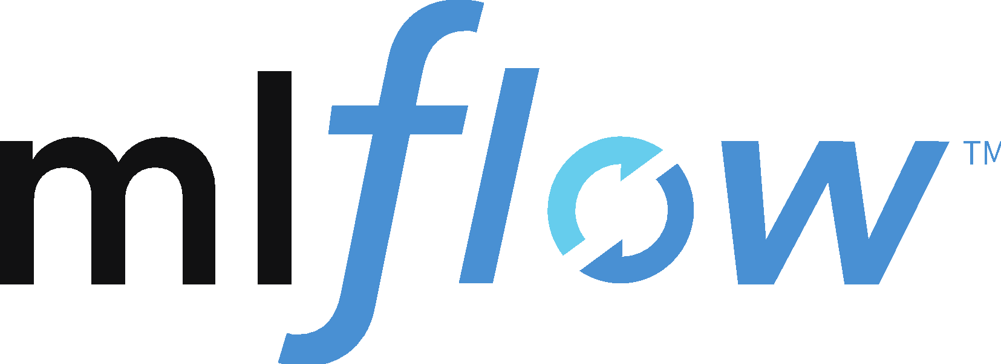

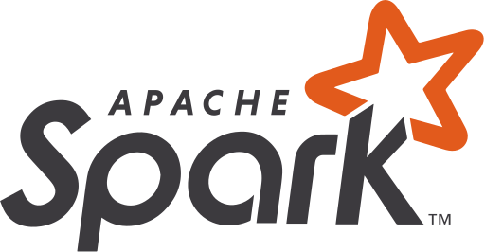






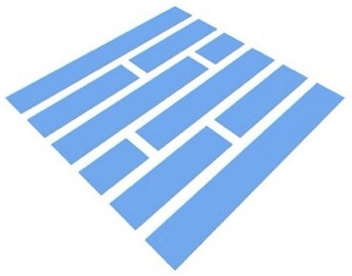

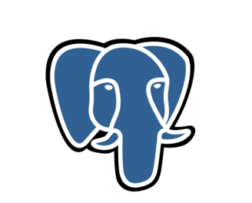
Databricks “Data Intelligence Platform”
Data Engineer
ML Engineer
Data Scientist
Business Analyst
App Developer
Business Partner
Dev tools
BI
Apps
Collaboration
IDE support
Notebooks
AI/BI Genie
AI/BI Dashboard
SQL Editor
Databricks Apps
Automation
Lakeflow Jobs
CI/CD
MLOps
Delta Sharing
Ingest & Transform
Advanced Analytics, ML & AI
Data Warehouse
Operational Database
Marketplace
Batch & Streaming
Data Quality
ML
Modeling
Gen AI
AI Functions
Databricks SQL
Lakebase
Clean Rooms
Lakeflow Connect
Lakeflow Decla- rative Pipelines
Real time Analytics
Model Serving
Photon
AI Engine
Data Intelligence
Search & Discover
Assistant
Performance Optimizations
Data & AI Governance
Unity Catalog
Access Control
Auditing
Discovery
Lineage
Federation
Business Semantics
Quality Monitoring
Cloud Storage
Amazon S3
JSON
CSV
images
arbitrary
. . .
Microsoft ADLS
Delta Lake
Delta
Iceberg
Parquet
No proprietary data formats
Google Cloud Storage
Database
Notes:
tag:overview,L100-200
In this view we map the capabilities of the Data Intelligence Platform onto this framework to visualize the scope of the overall platform

Slide 8
Databricks AI
Notes:
tag:overview,L100-200

Slide 9
Mosaic AI
End to end AI capabilities …
Databricks AI
External Services
Move Code, Data, and Models between development and production
Manage Models, Features, Experiments
MLOps + LLMOps
Prepare Data
Discover & Transform Structured Data into Features
Chunk & Create Embeddings from Unstructured Data
Develop & Evaluate AI
Train and Test Algorithms
Fine-Tune & Prompt Engineer Models
Create GenAI agents & tools
Evaluate Experiments
Serve Data & AI
Low Latency Model Serving
Log Model Requests/ Responses
Low Latency Feature Serving
Query Embeddings in Vector DB
AI Models & Tools
Commercial AI models
Community AI models
Community tools
AI driven discovery and search
AI Assistant
AI driven performance optimization and scaling
AI Engine
Manage security & permissions
Manage models, features, and functions
Track model lineage
Data monitoring
AI monitoring (metrics, model quality, drift of data and predictions)
Data & AI Governance
Cloud Storage
Notes:
tag:overview,L100-200
This is a more detailed view of the Databricks AI architecture taking the whole Data Intelligence Platform into account.
The center is still the 3-step process, the high level “Model” step is qualified a bit more as “Develop and evaluate AI”
The Data Intelligence Platform is an open platform. As such it does have access to 3rd party AI tools and services (both commercial and community driven)
Commercial AI models: OpenAI, Claude, …
Community AI models: E.g. from HuggingFace
Community tools: E.g. LangChain, LlamaIndex, …

Slide 10



Mosaic AI
… fully integrated into the Data Intelligence Platform
Lakehouse common capabilities
Mosaic AI specific capabilities
External Services
Asset Bundles (CI/CD support)
MLOps + LLMOps
MLFlow
Prepare Data
Develop & Evaluate AI
Serve Apps
AI Models & Tools
Notebooks
SQL
Notebooks
AutoML
AI Playground
AI Gateway
Model Serving
Lakeflow DP
Lakeflow Jobs
MLflow
Model Training
Lakeflow Jobs
AI Functions#
Lakeflow Connect
Hugging Face
OpenAI
LangChain
Agent Bricks
Agent Framework
Agent Evaluation
Batch Inference
Databricks Apps
…
Serve Data
Function Serving
Feature Serving
Vector Search
Unity Catalog
Lakehouse Monitoring
Model Registry in UC
Feature Store in UC
Data & AI Governance
Delta Sharing
Tools Catalog in UC
Models in Marketplace
Cloud Storage
Delta (structured)
Files/Volumes (unstructured)
# Calling models from SQL
Notes:
L200
Drift data
Mosaic AI is fully integrated into the Lakehouse platform.
For example, for creating features the same Lakehouse capabilities will used as to create ETL pipelines in data engineering. Since AI features are also tables, they are treated exactly like all other tables and exposed and governed by Unity Catalog.
The grey features in this diagram are common Lakehouse tools used for all workloads like ETL, feature engineering, monitoring orchestrating pipelines, …
The green boxes show capabilities that have specifically created and integrated in the Lakehouse for ML, AI and Gen AI tasks.
Examples for capabilities enhanced or built specifically for Gen AI:
AutoML: AutoML for Embeddings
Mosaic: Fine-tuning with Mosaic
Model Serving: With GPU optimized for LLMs. Also manages access to AI services like OpenAI, Hugging Face and to the internal Model registry (unified API)
AI functions: SQL functions to work with AI from SQL queries
Functions: For features that need calculation in real time (online tables)
27.06.2024: Replace “AI Playground” by “Agent Framework”; Added “AI Gateway”

Slide 11
The Lakehouse and the Data Intelligence Platform
Notes:
tag:overview,L100-200

Slide 12

From Lakehouse to Data Intelligence Platform
Lakehouse
Data Intelligence Platform
Orchestration
Orchestration
Lakeflow Jobs
Lakeflow Jobs
ETL & Real-time Analytics
Data Science & AI
Data Warehousing
ETL & Real-time Analytics
Data Science & AI
Data Warehousing
LDP
Databricks AI
Databricks SQL
LDP
Databricks AI
Databricks SQL
Unified security, governance, and cataloging
Unity Catalog
Generative AI to understand the semantics of your data
Intelligence Engine
Unified data storage for reliability and sharing
Delta Lake
Unified security, governance, and cataloging
Unified security, governance, and cataloging
Unity Catalog
Unity Catalog
Unified data storage for reliability and sharing
Unified data storage for reliability and sharing
Delta Lake
Delta Lake
Unity Catalog is the foundation of the Intelligence Engine
The Intelligence Engine simplifies the platform experience on every layer
Notes:
tag:overview,L100-200

Slide 13
High Level Architecture
Notes:
tag:overview,L100-200

Slide 14





Data Intelligence Platform Overview
Customer
Control Plane
Unity Catalog
Intelligence Engine
Platform Services
Users
Apps
Serverless Compute Plane
Classic Compute Plane
Lakebase (OLTP DB)
Serverless SQL
Model Serving
Workspace clusters
(ETL and AI)
SQL Warehouses
(DWH and BI)
Compute
Serverless notebooks
Vector Search
Serverless jobs
Storage
Cloud Storage (long term storage)
Cloud Storage (AWS only)
Cloud Storage
Notes:
tag:overview,L100-200
The Databricks platform runs in two different accounts:
The Control Plane (which hosts the Web App, Unity Catalog and management services) and the Serverless Compute Plane (the compute layer of the serverless product) are deployed in the Databricks account
The Compute Plane, which is the compute layer for non-serverless product lines (Databricks Workspaces, Databricks SQL) and the cloud storage are in the customer account

Slide 15
Data Intelligence Platform Classic
Storage and compute in customer subscription
Customer
Control Plane
Unity Catalog
Intelligence Engine
Platform Services
Users
Apps
Serverless Compute Plane
Classic Compute Plane
Lakebase (OLTP DB)
Serverless SQL
Model Serving
Workspace clusters
(ETL and AI)
SQL Warehouses
(DWH and BI)
Compute
Serverless notebooks
Vector Search
Serverless jobs
Storage
Cloud Storage (long term storage)
Cloud Storage (AWS only)
Cloud Storage
Notes:
tag:overview,L100-200
The Databricks platform runs in two different accounts:
The Control Plane (which hosts the Web App, Unity Catalog and management services) and the Serverless Compute Plane (the compute layer of the serverless product) are deployed in the Databricks account
The Compute Plane, which is the compute layer for non-serverless product lines (Databricks Workspaces, Databricks SQL) and the cloud storage are in the customer account

Slide 16
Data Intelligence Platform Serverless
Storage in customer subscription, compute in Databricks subscription
Customer
Control Plane
Unity Catalog
Intelligence Engine
Platform Services
Users
Apps
Serverless Compute Plane
Classic Compute Plane
Lakebase (OLTP DB)
Serverless SQL
Model Serving
Workspace clusters
(ETL and AI)
SQL Warehouses
(DWH and BI)
Compute
Serverless notebooks
Vector Search
Serverless jobs
Storage
Cloud Storage (long term storage)
Cloud Storage (AWS only)
Cloud Storage
Notes:
tag:overview,L100-200
The Databricks platform runs in two different accounts:
The Control Plane (which hosts the Web App, Unity Catalog and management services) and the Serverless Compute Plane (the compute layer of the serverless product) are deployed in the Databricks account
The Compute Plane, which is the compute layer for non-serverless product lines (Databricks Workspaces, Databricks SQL) and the cloud storage are in the customer account

Slide 17
Data Intelligence Platform Serverless
Storage and compute in Databricks subscription
Customer
Control Plane
Unity Catalog
Intelligence Engine
Platform Services
Users
Apps
Serverless Compute Plane
Classic Compute Plane
Lakebase (OLTP DB)
Serverless SQL
Model Serving
Workspace clusters
(ETL and AI)
SQL Warehouses
(DWH and BI)
Compute
Serverless notebooks
Vector Search
Serverless jobs
Storage
Cloud Storage (long term storage)
Cloud Storage (AWS only)
Cloud Storage
Notes:
tag:overview,L100-200
The Databricks platform runs in two different accounts:
The Control Plane (which hosts the Web App, Unity Catalog and management services) and the Serverless Compute Plane (the compute layer of the serverless product) are deployed in the Databricks account
The Compute Plane, which is the compute layer for non-serverless product lines (Databricks Workspaces, Databricks SQL) and the cloud storage are in the customer account

Slide 18
Classic Compute
Notes:
tag:overview

Slide 19

High Level Architecture
Databricks Workspaces
Customer
Account Console
Classic Compute
Other data sources
Control Plane
cluster
cluster
Intelligence Engine
Unity Catalog
Platform Services
Cloud Storage
ID Provider
Notes:
tag:overview,L100-200
To dive a little deeper into the services running in the Databricks subscription.
The account console is where you administer your Databricks account: workspace creation, user management, metastore management, … It is available for all three clouds
The control plane has several services
Web App: Serves the Databricks UI for the customer to access Databricks
Workflow Management: Lakeflow Jobs and Lakeflow Declarative Pipelines to orchestrate tasks in multiple ways
Compute Management: Cluster Manager to configure and set up Spark clusters
Jobs: Scheduled tasks
Unity Catalog: Data Governance around access control, metadata management, lineage and data discovery
Intelligence Engine: Compute plane and Control Plane services use the models of the Intelligence Engine
Most components in the customer subscription have already been introduced. The ID provider is the central user management of the customer. On Azure this is Azure Active Directory (AAD), on the other clouds also other ID Providers, e.g. Okta, can be used

Slide 20

Detailed High Level Architecture
Databricks Workspaces
Customer
Account Console
Classic Compute
Other data sources
Clusters
Control Plane
Driver
Intelligence Engine
DatabricksIQ
Assistant
worker
Photon
Metastore (Catalogs)
Unity Catalog
Access control
Jobs Manager
Query Manager
Cloud Storage
ID Provider
Data/Lineage Explorer
Compute Manager
Web App Portal, REST API
Platform Services
login
SSO
Users
Notes:
tag:overview
Unity Catalog consists of several capabilities
Metastore to hold
table schema
feature store 2.0 (preview)
volumes
functions
set SQL access permissions
Access control based on defined SQL access permissions
Data explorer to discover data sets
Lineage explorer to understand the end-to-end lineage of each dataset in the metastore
The Intelligence Engine comprises of several capabilities
DatabricksIQ, which is the foundation of services like the Assistant
Optimizer: For example predictive IO, predictive Optimization
Clusters in the Compute Plane are Spark clusters, consisting of one Spark driver and zero (!) or more Spark workers (aka executors).
By default, the runtime of these clusters uses Apache Spark, but can also be configured to leverage Photon (higher dbu multiplier)
Finally, users always log into the Web App of the Control Plane and also the REST API uses the Control Plane as endpoint

Slide 21
SQL Warehouse
Notes:
tag:overview

Slide 22

High Level Architecture
Databricks SQL - SQL Warehouse
Customer
Account Console
Classic Compute
Other data sources
Control Plane
Intelligence Engine
SQL Warehouse (load balanced clusters)
Unity Catalog
Platform Services
Cloud Storage
ID Provider
Notes:
tag:overview,L100-200
Instead of just clusters, Databricks SQL uses “SQL Warehouses”, which are compute resource optimized for SQL for all your data warehousing needs.
A SQL Warehouse uses one or more compute clusters in the customer’s cloud account behind a load balancer. This allows to scale up and down the warehouse to adapt to the number of concurrent queries (upscaling of clusters per warehouse is based on query throughput, the rate of incoming queries, and the queue size)
SQL Warehouses also provide a query editor (aka Redash) and optimized connectors for standard BI tools like PowerBI or Tableau

Slide 23
Detailed High Level Architecture
Databricks SQL - SQL Warehouse
Customer
Account Console
Classic Compute
Other data sources
Control Plane
SQL Warehouses
load balanced
Intelligence Engine
DatabricksIQ
Assistant
Driver
Driver
Worker
Worker
Metastore (Catalogs)
Photon
Photon
Unity Catalog
Access control
Jobs Manager
Query Manager
Cloud Storage
ID Provider
Data/Lineage Explorer
Compute Manager
Web App Portal, REST API
Platform Services
DB SQL query editor
BI tools via connectors or JDBC/ODBC
SSO
Users
Notes:
tag:overview
Databricks SQL uses the same Databricks platform as Databricks Workspaces, as such SSO is supported, it uses the same Web App and, again, Unity Catalog provides data governance services.
Instead of notebooks, Databricks SQL provides a SQL Query Editor (Redash) to develop workloads in SQL and to create and share dashboards.
SQL Warehouses use Photon as SQL engine.

Slide 24
Serverless Compute
Notes:
tag:overview

Slide 25
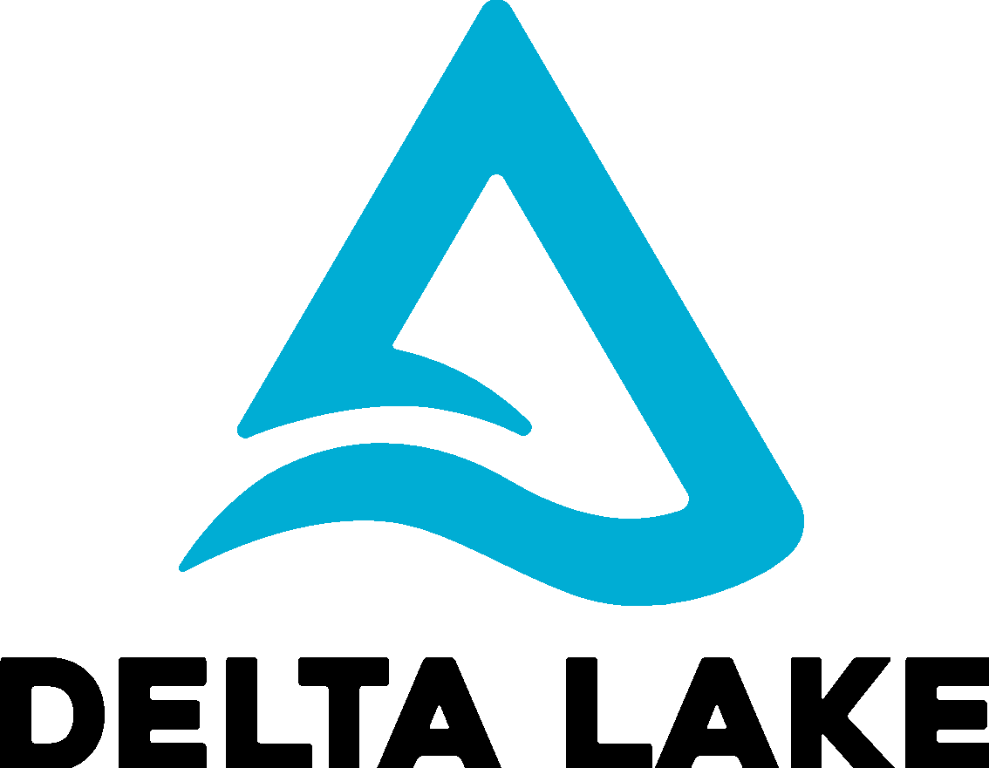


High Level Architecture
Databricks Serverless Compute (storage in customer subscription)
Customer
Account Console
Serverless Compute
Cloud Storage
Control Plane
DB SQL Clusters
DatabricksIQ
Notebooks, Lakeflow Jobs, LDP
root bucket (DBFS)
Unity Catalog
Platform Services
Other data sources
Serverless Compute Manager
Unallocated Pool
ID Provider
Notes:
tag:overview,L100-200
The quick starting times are achieved by leveraging a pool of “unassigned clusters”: when a customer executes the initial query, a dedicated cluster from the pool will be assigned to the tenant.
Between tenants these clusters are isolated on different levels (VM, network, containers, …)
Since Serverless SQL Warehouses share the same platform as classical SQL Warehouses, login still supports SSO using the ID provider of the respective tenant.
On Azure, Private Link from Serverless Compute Plane can be enabled to the customer’s storage accounts (in preview)

Slide 26


High Level Architecture
Databricks SQL - Serverless SQL Compute (storage in customer subscription)
Customer
Account Console
Serverless Compute
A
Cloud Storage
Control Plane
clusters
Other data sources
Customer A
DatabricksIQ
ID Provider
Unity Catalog
Web App
Jobs Manager
Compute Manager
Connectors
Query Manager
B
Cloud Storage
clusters
Customer B
Other data sources
ID Provider
Notes:
tag:overview,L100-200
Serverless SQL Warehouse uses the compute resources in the Databricks account, which means that the Compute Plane is now in the customer’s Databricks cloud account (Serverless Compute Plane) instead of the customer cloud account.
Serverless SQL is a secure multi-tenant offering that ensures that clusters are dedicated to each tenant and do not get reused between tenants. Each tenant cluster can only access the cloud resources (cloud storage, IP provider and other data sources) of its tenant.
The main advantages compared to classical SQL Warehouses are less maintenance effort for the customer and cluster starting times in the range of seconds (leading to a much better efficiency for the customer)

Slide 27
High Level Architecture - Details
Serverless SQL Compute (storage in customer subscription)
Customer
Account Console
Serverless Compute
A
Cloud Storage
Unassigned clusters
root bucket (DBFS)
Control Plane
Customer A
Isolated Networks
Isolated VMs
Isolated Containers
Least Privileges
Other data sources
Driver
Driver
Unity Catalog
DatabricksIQ
worker
worker
ID Provider
assign as dedicated compute resources
Photon
Driver
B
Lakeflow Jobs
Queries
Customer B
Cloud Storage
worker
root bucket (DBFS)
Driver
Driver
Web App (Portal/REST API)
Driver
worker
worker
Other data sources
worker
assign as dedicated compute resources
Photon
Photon
ID Provider
SSO (with ID Provider from A or B)
User (from A or B)
Encryption at rest and in transit
Notes:
tag:overview
The quick starting times are achieved by leveraging a pool of “unassigned clusters”: when a customer executes the initial query, a dedicated cluster from the pool will be assigned to the tenant.
Between tenants these clusters are isolated on different levels (VM, network, containers, …)
Since Serverless SQL Warehouses share the same platform as classical SQL Warehouses, login still supports SSO using the ID provider of the respective tenant.
On Azure, Private Link from Serverless Compute Plane can be enabled to the customer’s storage accounts (in preview)

Slide 28
Serverless Model Serving, Vector Search, Online Tables
Notes:
tag:overview

Slide 29

High Level Architecture
Serverless Model Serving, Vector Search, Online Tables
Customer
Account Console
Serverless Compute
Sync delta table
Control Plane
Cloud Storage
Online Tables
LDP
DatabricksIQ
Unity Catalog
Web App (API proxy)
Model Serving Proxy
Model Serving
Sync delta table
*
Vector Search
Vector Index
LDP
AI App
* Access embedding model
Notes:
tag:overview,L100-200
The quick starting times are achieved by leveraging a pool of “unassigned clusters”: when a customer executes the initial query, a dedicated cluster from the pool will be assigned to the tenant.
Between tenants these clusters are isolated on different levels (VM, network, containers, …)
Since Serverless SQL Warehouses share the same platform as classical SQL Warehouses, login still supports SSO using the ID provider of the respective tenant.
On Azure, Private Link from Serverless Compute Plane can be enabled to the customer’s storage accounts (in preview)

Slide 30
Online Transaction Processing
Notes:
tag:overview

Slide 31
High Level Architecture
Lakebase
REST API
native
Users
Apps
Control Plane
Serverless Compute
Platform Services (UI / REST API)
Lakebase (Postgres OLTP)
Postgres
Postgres
Postgres
Unity Catalog
Lakebase Storage Service
Cloud Storage
Database
Database
Database

Slide 32
Lakebase integration
Separation of compute/storage for independent scaling
Postgres drivers and ecosystem
native
REST API
Control Plane
JDBC/ODBC
native drivers
…
Apps
Users
Platform Services (UI / REST API)
Serverless Compute
Register postgres table as catalog in Unity Catalog (Lakehouse Federation), …
Lakebase (Postgres OLTP)
Unity Catalog
Postgres
Postgres
Postgres
… and read data via JDBC
Compute (classic or serverless)
Lakebase Storage Service
Lakeflow Decla- rative Pipeline
Synch to postgres read-only table
Synch from postgres table*
Cloud Storage
Database
Database
Database
Delta
Delta Strea- ming table
(row format)
(columnar format)
* Private Preview

Slide 33
Security High Level (Databricks Workspaces and Databricks SQL)
Notes:
tag:overview

Slide 34
Security Highlights
Secure Cluster Connectivity (SCC), IP Access Lists, Single Sign On (SSO)
Customer
Account Console
Classic Compute
Other data sources
Control Plane
Cluster
SQL Warehouse
SCC* Relay
Metastore (Catalogs)
DatabricksIQ
Cluster Manager
...
...
Jobs Manager
Web App Portal, REST API
Cloud Storage
ID Provider
IP Access Lists
(IP address)
Single Sign On (SSO)
login
Users
* Secure Cluster Connectivity
Notes:
tag:overview
Let’s look at some security highlights:
“Secure Cluster Connectivity” (SCC) between Databricks Control Plane and Compute Plane: With SCC enabled, customer’s virtual networks have no open ports and the clusters in the Compute Plane have no public IP addresses (SCC is also known as No Public IP / NPIP).
“Single Sign On”: Single sign-on (SSO) enables customers to authenticate their users using the organization’s identity provider. No passwords are stored in the Databricks platform.
“IP Access Lists”: All incoming access to the web application and REST APIs requires the user connect from an authorized IP address

Slide 35
Secure Cluster Communication workspaces
Ports and communication for SCC on Azure and AWS *
Customer
Account Console
Classic Compute
Internal calls (from compute plane to control plane only)
Other data sources
Control Plane
8443-8451
Hive Metastore
3306
443
main comm tunnel
Cluster
SQL Warehouse
443
Metastore (Catalogs)
DatabricksIQ
Cluster Manager
SCC Relay
...
...
Jobs Manager
full job results
Web App Portal, REST API
443
Interactive login / REST calls
443
Cloud Storage
ID Provider
root bucket
80
Auto-redirect to 443
from
to
Users
Notes:
tag:overview
The communication between the different components of the Data Intelligence Platform is secured by TLS.
Users will access the Web App via https (port 443), same applies to clients of the REST API
Both Control Plane and Compute Plane will connect to the SCC relay on port 443.
Furthermore, full job results will be stored in DBFS and the Web App access DBFS also on port 443
Note, in case of a migration from legacy Hive Metastore to Unity Metastore, there will be an additional link from the Compute Plane to port 3306 of the Metastore in the Control Plane

Slide 36
Private Link for end-to-end private connectivity
Private connectivity between users, workloads and data
Customer
Account Console
Compute Plane VNet/VPC
Private Link
Classic Compute
Control Plane
Private Link Service
Cluster
SQL Warehouse
Private Link
Transit VNet/VPC
Private Link
Cloud Storage
Front-end: User to workspace
Back-end: Compute Plane to Control Plane
VPN
Customer Corp. Network
Users
VPN: Virtual Private Network (or similar cloud service)
Notes:
tag:overview

Slide 37






Customer Managed Keys
Encrypt data at rest with customer’s own encryption keys
Customer
Account Console
Key Management (KMS, AKV, …)
Control Plane
Customer Managed Key
Notebooks
DB SQL queries
Secrets
Cloud Storage
Integrates with cloud native key management services
Key rotation enables periodic rotation of root keys
Cluster disks
DBFS
Notes:
tag:overview

Slide 38
Lakebase security highlights
Customer
Ingress Security
(IP ACLs / Private Link / DDOS protection)
Users
Apps
Databricks Web UI and REST API
PostgreSQL Wire Protocol (native)
(Postgres drivers and ecosystem)
Control Plane
Serverless Compute
Databricks-managed and PostgreSQL native authentication options:
OAuth for service principals (OAuth M2M)
OAuth for users (OAuth U2M)
PostgreSQL username & password
PostgreSQL native and UC-managed governance authorization options:
Native PostgreSQL permissions and privileges
UC-managed governance for native services such as Notebooks, REST API, DB SQL, Model Serving
Unity Catalog
UI / REST API
Lakebase
(Managed Postgres)
Lakebase Storage Service
Cloud Storage
(long term storage)

Slide 39
Scaling Databricks
Notes:
tag:overview

Slide 40
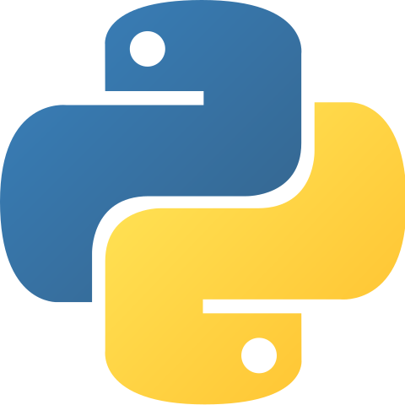
Scaling Databricks Compute
Autoscaling (Horizontal) Clusters Only
Bigger Nodes (Vertical)
Driver
Driver
Driver
Driver
Driver
worker
New worker
worker
worker
Single node DS
WHY? Changing query and data volumes
WHY? Performance and working with larger data in single node DS and with pandas udfs
Multiple Clusters
Multiple Clusters - Load Balanced SQL Warehouses only
SQL Warehouses in Databricks SQL
Driver
Driver
worker
Driver
Driver
Driver
worker
worker
worker
worker
WHY? Separate workloads (i.e. ETL, DS, BI).
Dedicated, temporary clusters for jobs
WHY? Support more simultaneous queries
Note: The easiest way to scale compute in Databricks is to use serverless services (Serverless SQL Warehouses and Model Serving)
Notes:
tag:overview
In general information systems can be scaled in different ways. The same hold for the Data Intelligence platform.
If you want to analyse large data sets, there are two ways:
If your node(s) get too small for the amount of data that needs to be hold in memory on one node, then switch over to a bigger machine (vertical scaling). This for reaches a limit when no (affordable) bigger machine exists any more.
If you are dealing with a distributed workload, then more nodes can be easily added (horizontal scaling)
Specifically in Databricks there are two more scenarios:
If you want to separate workloads (e.g. ETL, DS, BI), use different clusters for them
If you are dealing with SQL Warehouse workloads and lots of concurrent queries, then use SQL Warehouse autoscaling which will transparently add/remove additional clusters depending on workload needs.

Slide 41



Multi Workspace Architecture
Customer
Customer
Control Plane
Compute Plane
Cloud Storage
Web App Portal, REST API
Users
Intelligence Engine
Workspace
Workspace
Clusters
Clusters
isolation / scaling
ID Provider
Account Console
User Management
Unity Catalog
Metastore
Model Registry
Feature Store
Cloud Storage
SQL Ware houses
SQL Ware houses
synch users & groups
Isolation / scaling
Shared Control Plane services
Split Workspaces, e.g.
along dev process stages (DEV, STG, PROD)
along business units
to overcome resource limits (cloud account/subscription)
Notes:
tag:overview
Another approach to scale the platform is to split into several workspaces and several cloud storage buckets/containers
Besides isolating workloads this can help to overcome workspace limitations or storage limitations

Slide 42
High Level Data Architecture
Notes:
tag:overview,L100-200

Slide 43
Data architecture
Notes:
tag:overview

Slide 44



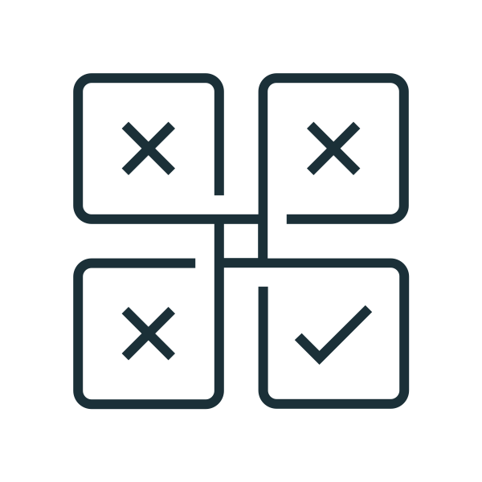


Medallion, the best practice pipeline
Bronze
Silver
Gold
Final
Time series resampled & interpolated
Ingestion
Curated
Spark stream
Feature reduction
Feature enhanced
Raw data
No data processing
Data kept around to fix mistakes
Cleansed and conformed data
Directly queryable
PII masking/redaction
Curated business-level tables
Project/use case specific
de-normalized and read- optimized data models
Notes:
tag:overview,L100-200
The best practice pipeline consists of three layers:
The Bronze layer is where we land all the data from external source systems. The table structures in this layer correspond to the source system table structures "as-is," along with any additional metadata columns that capture the load date/time, process ID, etc.
In the Silver layer, the data from the Bronze layer is matched, merged, conformed and cleansed so that the Silver layer can provide an "Enterprise view" of all its key business entities, concepts and transactions
Data in the Gold layer is typically organized in consumption-ready "project-specific" databases. The Gold layer is for reporting and uses more de-normalized and read-optimized data models with fewer joins.

Slide 45
Data Modeling: Dimensional Modeling for DWHs
Landing (bronze)
Raw data in its original format (temporarily)
Ingestion (bronze)
Raw data converted to Delta (from Avro, CSV, parquet, XML, JSON format in Landing)
Verified data contract: schema (typically derived from the source), timeframe, …
Sometimes called Staging
Integration - Physical data model (silver)
Detailed information covering multiple business domains (including glossary and taxonomy)
Integrates all data sources
Does not necessarily use a dimensional model but feeds dimensional models.
Data Mart (gold)
Subset of the Integrated layer, sometimes filtered or aggregated data
Focus on dimensional modeling with star schema
Typically oriented to a specific line of business or team
bronze
silver
gold
Landing
Integration
Presentation
Raw data (temp.)
Data Mart
Business Information Model
Dim. Model
SQL
Logical Data Model (3NF*)
Ingestion
Data Mart
Verified data
Physical Data Model
Dim. Model
Dimensional model (star schema)
Order
Dim
Fact
Dim
Customer
Product
Dim
Time
ETL/ELT
* 3NF = “Third normal form” in data modelling
Notes:
tag:overview

Slide 46
Data Modeling: Modern use cases (ML and AI)
Landing (bronze)
Raw data in its original format (could be temporarily). Having a landing zone allows to have bronze in Delta format, independent of the original input format
Ingestion (bronze)
Delta data converted from Raw (from Avro, CSV, parquet, XML, JSON format in Landing)
Verification typically lightweight compared to DWH
No other transformation or business logic is applied
Often “schema on read” approach
Curation (silver)
Cleansed data, filtered data and augmented data
Final (gold)
Business level aggregates
Masked, reduced, anonymized for project purposes
Denormalized for performance if needed
bronze
silver
gold
Landing
Curation
Final
Raw data (temp.)
Project data
Augmented data
Python R
SQL Scala
Cleansed data
Filtered data
Business level aggregates
Ingestion
Verified data
ETL/ELT
Notes:
tag:overview

Slide 47
Enhanced medallion architecture
For modern AI use cases and classic DWH/BI use cases
Cloud storage
batch
bronze
silver
gold
Modern use cases
Landing Raw data, temp.
Curation Cleansed, augmented, …
Final Business specific
BI use cases (strictly modeled and verified data)
streaming
Ingestion
Verified data
Integration Business information model
Presentation Data marts
Landing: Raw data in its original format
Ingestion: Raw data verified and converted to Delta
Data Lake for modern use cases
Curation: Cleansed, homogenized and fundamental business logic applied
Final: Business/project ready datasets
DWH for BI use cases
Integration: Enterprise DWH (could be multiple)
Presentation: Business ready DWH information (data marts)
Notes:
tag:overview
Combining both worlds, the data lake approach (Ingestion ⇒ Curation ⇒ Final) with the Data Warehouse approach (Ingestion ⇒ Integration ⇒ Presentation), leads to an extension of the Medallion Architecture

Slide 48
Data access
Notes:
tag:overview

Slide 49
High Level Data Access from Databricks
Clusters and SQL Warehouses with Unity Catalog
Unity Catalog
Cloud Storage
Managed table container / bucket
Compute Plane
Cluster / SQL Warehouse
External table containers / buckets
External table containers / buckets
DBFS
*
/
root container / bucket
virtual filesystem
Access control by Unity Catalog
*
No access control, don’t use for production data
Notes:
tag:overview,L100-200
With Unity Catalog and “Shared clusters”, there are two types of storage containers/buckets:
The “managed table container/bucket”, that gets created with a metastore to store data of managed tables. There exists one managed table container/bucket per metastore
“External table containers/bucket” are provided by the customer and should only be used to store data that is access controlled by Unity Catalog
While “Shared clusters” cannot access DBFS by default, “Single user” clusters can also access DBFS.
Note: DBFS does not provide access permissions!

Slide 50
Data Access Security
ID Provider
Account Console
IDs
Unity Catalog
Access Control
Check Table ACLs
Classic / Serverless Compute Plane
Access via scoped down temporary tokens
Cloud Storage
1a
Managed table
Cluster
Managed container / bucket
Driver
1b
worker
External container / bucket
External table
Notes:
tag:overview
As a prerequisite, the principals (IDs) need to be synched to the Account Console (once for all Workspaces!). From there access to Workspaces can be assigned to suers and groups.
With Unity Catalog there is just one way to securely access cloud storage:
The cluster will check the access permissions against the ACL database in Unity Catalog (1a) and either access managed tables in the managed table container/bucket or external tables in other cloud containers/buckets (1b). The authorization happens in both cases via short lived signed access tokens.

Slide 51






Life of a query with Unity Catalog
Shared clusters
Creates an IAM role (AWS)/ Managed Identities (Azure)
Creates storage credentials/ external locations in Unity Catalog
Defines access policies in Unity Catalog
Admin
Check namespace , metadata and grants
Write
audit log
Cluster or SQL warehouse
2
Audit log
Send query (SQL
Python, R, Scala,)
Return list of paths/data files and scoped down temporary tokens
User
1
4
Assume IAM Role /
Managed Identities
3
8
Send result
Request/ingest data from paths/data files with temporary tokens
5
Cloud Storage
Enforce policies
7
6
Return data
(S3, ADLS)
Notes:
L200
Let’s dive deeper into how Table ACLs work without Unity Catalog:
A client send a SQL, Python, R or Scala based query to the cluster or SQL Warehouse
The cluster checks the metadata and grants with Unity Catalog
If access is permitted, Unity Catalog (and not the cluster!) assumes the IAM role (AWS) or the Service Principal (Azure) and creates signed urls with short lived tokens
Unity Catalog returns these signed URLS to the cluster
The cluster reads the data from the cloud storage using the these signed URLs. Note, no other files can be accessed via these tokens
The cloud storage returns the data
The cluster filters unauthorized data (e.g. due to for row level policies, …)…
… and sends back the result to the client
As a prerequisite, the admin created credentials and configures permissions in UC

Slide 52
Life of a query with Unity Catalog
Single-user clusters for fine grained access tables
Creates an IAM role (AWS)/ Managed Identities (Azure)
Creates storage credentials/ external locations in Unity Catalog
Defines access policies in Unity Catalog
Send query (SQL
Python, R, Scala,)
Admin
User
1
Single-User cluster
8
Send result
Check namespace , metadata and grants
Write
audit log
2
Audit log
Serverless filtering service
Fine Grained Access Control (serverless charges apply)
Return list of paths/data files and scoped down temporary tokens
4
Assume IAM Role /
Managed Identities
3
Request/ingest data from paths/data files with temporary tokens
5
Cloud Storage
Enforce policies
7
6
Return data
(S3, ADLS)
Notes:
L200
Let’s dive deeper into how Table ACLs work without Unity Catalog:
A client send a SQL, Python, R or Scala based query to the cluster or SQL Warehouse
The cluster checks the metadata and grants with Unity Catalog
If access is permitted, Unity Catalog (and not the cluster!) assumes the IAM role (AWS) or the Service Principal (Azure) and creates signed urls with short lived tokens
Unity Catalog returns these signed URLS to the cluster
The cluster reads the data from the cloud storage using the these signed URLs. Note, no other files can be accessed via these tokens
The cloud storage returns the data
The cluster filters unauthorized data (e.g. due to for row level policies, …)…
… and sends back the result to the client
As a prerequisite, the admin created credentials and configures permissions in UC

Slide 53
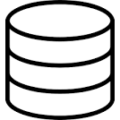
Querying database sources with Unity
Defines Connection object with JDBC connection information to database.
Registers foreign catalog
Defines access policies in Unity Catalog
Admin
Check namespace , metadata and grants, enforce policies
2
Write
audit log
Cluster or SQL warehouse
Audit log
Send query (SQL
Python, R, Scala,)
Returns encrypted credential information to the cluster or warehouse
User
1
3
Metadata changes in the data are pushed to UC Control Plane
Send result
Request / ingest data with predicate pushdown by directly connecting to database
5
8
4
JDBC Database
(Snowflake, SQL Server, Postgres, Mysql, etc)
Enforce policies
7
6
Return data
Notes:
Let me run you through the life of a query with Unity Catalog
A user submits a query or action, this can be any query/action on any language, Python, R, Scala, SQL. Unity Catalog works across all languages.
This query hits an warehouse or cluster, this can be a standard, user isolation or multi user cluster, a DBSQL Warehouse or a Serverless DBSQL Warehouse, Unity Catalog works across all compute.
The first thing that warehouse or cluster does is hit Unity’s control plane services, to check the namespace, metadata and evaluate the grants for that user.
UC will evaluate whether or not that user has access to read the objects specified in the query or action, a pass or a fail
Depending on that, an appropriate audit log record will be written out.
In the event the user has access, UC will, for each object in the query or action, assume the underlying Credential that controls the external location or managed datasource where that object resides
This could be a Service Principal or an IAM Role
UC will return short lived tokens, roles, or signed URLs to the cluster/warehouse
Short lived is 1 hour
These are presigned urls or downscoped roles in S3 or SAS URLs in ADLS
Keep in mind steps 2,3,4 are control plane activity, so this operation happens in milliseconds
Once the cluster or warehouse has these tokens or presigned urls it will go grab the data files directly from Cloud storage.
UC is not in the path of data.
–
Because UC will grant access to data at the partition level, the last mile of filtering for row level filtering or column level filtering will happen on the cluster or warehouse
Before the information is finally sent back to the user or requestor.

Slide 54
Delta & Iceberg
Notes:
tag:overview

Slide 55
Data Formats - Parquet
What can go wrong with Parquet?
Small file problem
customers
duration
p1
p2
p3
p..
p..
task
p..
p..
p..
p..
p..
Goal:
Reliable data and optimal file sizes
task
p..
p..
p..
p..
p..
task
customers
duration
p..
p..
p..
p..
pn
task
overall
p1
task
Corrupt data
p2
task
customers
duration
p3
task
p1
task
p4
task
schema broken
FAIL
overall
p2
task
file corrupt
FAIL
p3
task
p4
task
overall
FAIL
Notes:
tag:overview
To understand the most important benefits of Delta, it helps to look at some issues around the well known format Parquet:
The small file problem: Over time when more and more data has been appended to a parquet file, it can happen that it contains lots of small files (in the MBs or even KBs). For small files the time to open and close them takes a significant time of the total read operation. Overall, this leads to very poor read and query performance
Corrupt data: Parquet does not guard against adding data that isn’t compliant with the schema. Additionally, when a write job dies before finishing the write, a corrupt parquet chunk file remains in the parquet folder. In both cases, Spark tasks can fail and with that the overall query.
The goal from a query perspective is to have sufficiently large files that are all consistent and compliant with the schema. This will enable successful queries downstream and these queries will be fast.
Another big pain point is that data can’t be updated or deleted in a Parquet file (e.g. for GDPR deletion requests). Usually complex pipeline had to be set up that use temp copies to achieve this.

Slide 56
Delta: Reliability and performance features
Consistency (never read broken, unfinished or wrong data)
Optimizations on the fly (no need to have a complex pipeline)
✔︎
customers
write
customers
read
p1
!
p1
TX log
p2
customers
TX log
p2
✔︎
p3
p1’
stream
p3
stream
p2’
p4
TX log
p3’
customers
p4’
p1
p2
p3
p..
p..
!
p..
p..
p..
p..
p..
Schema enforcement
TX log
p..
p..
p..
p..
p..
p..
p..
p..
p..
pn
Direct updates and deletes
(no need to have a complex pipeline)
Time travel
(implicit snapshots)
customers
customers
customers
customers
p1
GDPR
Change Data Capture (CDC & SCD)
p1
p1
p1
p2
TX log
p2
TX log
p2
TX log
p2
TX log
p3
p3
p3
✘
p3
✘
✘
✘
p4
p4
p4
p4
V0
V1
V2
Notes:
tag:overview,L100-200
Delta addresses many issues known in Big Data file formats like parquet:
It uses the Parquet file format for the payload and adds a transaction log to it.
This transaction log enables (amongst other things) four main features:
Consistency: Write tasks and streaming tasks can be used with reading tasks at the same time. Delta will take care that the data is consistent at any time. It additionally enforces the underlying schema of the Delta file which is also important to ensure consistent data. As such you will never read broken, unfinished or wrong data)
Optimizations on the fly: Being based on Parquet, Delta still can suffer from small files. However Delta can deal with them in two ways:
Separate optimization jobs combine the small files to optimal file sizes. Due to the transaction support of Delta, they can run without maintenance window and without complex pipelines
Delta can be configured to already optimize at write time or use idle times to perform optimizations automatically
Direct updates and deletes: Delta allows to update or delete single rows by just copying the chunk file of the Delta file where the respective row is stored. For large datasets this is a significant advantage. And, remember, due to the transaction support, the whole dataset will be consistent at any point of time
Time travel: Since every change is recorded in the transaction log and is manifested in new and changed chunk files - while the original chunk files are marked invalid), Delta allows to travel back in time and provide the state of the data at that time

Slide 57


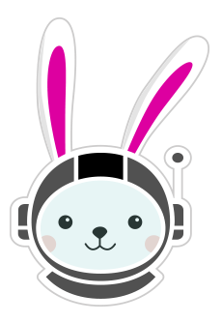








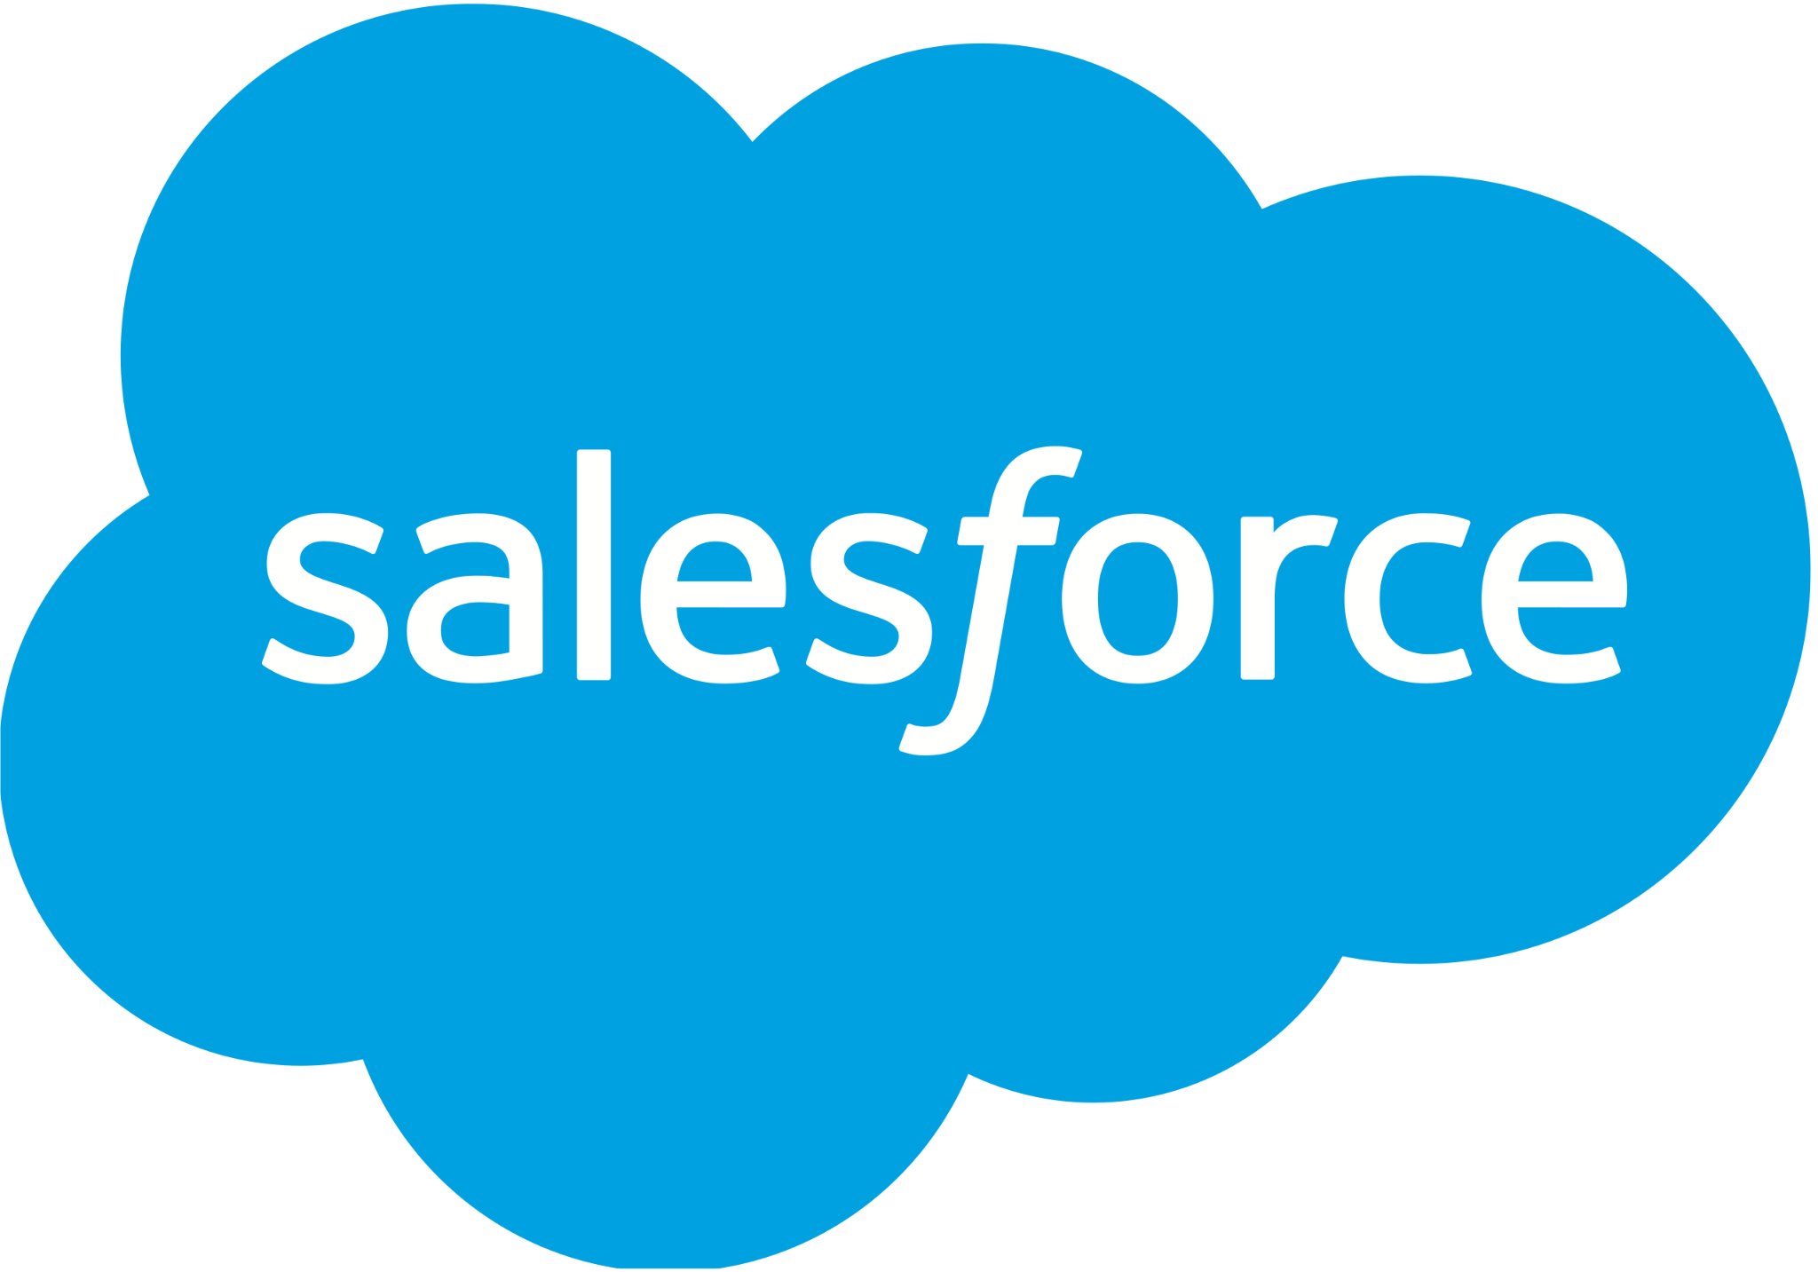
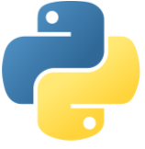





Reading and writing Iceberg and Delta
Using one compute only via UC/Iceberg REST API or Catalog Federation
Compute
DELTA CLIENTS
read
read
read
FOREIGN CATALOGS
Unity Catalog
write
Fabric
Apache Spark
Trino
Flink
EMR
read
Unity REST
Managed
Tables
Foreign Catalog
read
Catalog Federation
Glue
Horizon
Iceberg REST
HMS
data location
ICEBERG CLIENTS
read
Iceberg REST
write
Managed
Tables*
External Location
Kafka
PyIceberg
Starburst
Dremio
Redshift
Athena
Snowflake
3P data platform
Salesforce
Storage
For tables stored in S3
For managed Iceberg tables
Delta
Iceberg
Parquet, CSV, JSON, AVRO

Slide 58
Lakehouse Monitoring and Observability

Slide 59
Lakehouse Observability
System Tables are the observability feature of Unity Catalog
System tables
Lakehouse AI or BI tools
UC Metastore
system
Billing Usage
access
audit
Dashboards
Lineage
Lakehouse Pipeline Infrastructure
(run by Databricks)
billing
Audit Logs
usage
lineage
Exploratory Analysis
Users / Admins
Clusters
column lineage
table lineage
Predictive Optimization
…
information_schema
…
3rd party tools
Delta tables (stored in Databricks account)

Slide 60
Lakehouse Monitoring
Open monitoring for tables and models
Lakehouse AI or BI Tools
DB SQL Alerts
Scheduled Pipeline
Profile metrics Tables
Data Drift Tables
Dashboards
Users / Admins
Databricks Serverless
Lakehouse Monitoring (with AI support)
Monitoring definitions:
monitor
monitor
monitor
monitor
monitor
monitor
Configure in Monitoring UI or via Python API:
Table (data)
Model
Table (inference)
import databricks.data_monitoring as dm dm.create_or_update_monitor( table_name=... ,
analysis_type=dm.analysis.InferenceLog(...),
output_schema_name=... ... ) dm.refresh_metrics(...)
Table (data)
Table (feature)
Representing the model for monitoring
Table (data)

Slide 61
Filesystems in Databricks
Notes:
tag:overview

Slide 62
DBFS (Databricks File System)
Distributed Clients
Abstraction of a distributed file system
File systems
Repos
User access controlled by Workspace object permissions
Unity Catalog Volumes
User access controlled by Unity Catalog
e.g. Spark
dbfs
Root container / bucket
Unsecured !
Do not use for production data!
Mounts: Access control for each user via the IAM policy or Service Principal used for mounting
data container / bucket
Notes:
tag:overview

Slide 63
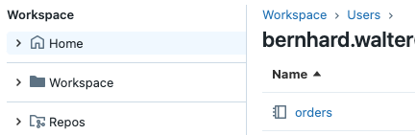



Filesystems in Databricks
Databricks Control Plane
<username>
Databricks Notebooks (%run)
/Shared
/Users /Users/<user_name>/orders
single notebook
%run /Users/<username>/step_1
dbutils.fs.ls("dbfs:/FileStore/…”) dbutils.fs.ls("/databricks-data/…”)
spark.read.csv("dbfs:/FileStore/d.csv”)
Operational DB
%sh cat /dbfs/FileStore/data.csv
<username>
folders
DevOps, GitHub, ...
%sh cat /dbfs/mnt/data/bucket/data.csv
dbutils.fs.ls(“dbfs:/mnt/data/sales-data/…”) dbutils.fs.ls(“/mnt/data/sales-data/…”)
dbutils.fs.ls("abfss://… /mktg-data/…”) dbutils.fs.ls("s3a://… /mktg-data/…”) dbutils.fs.ls("gs://… /mktg-data/…”)
spark.read.csv("/mnt/data/mktg-data/… /d.csv”) spark.read.csv("abfss://… /mktg-data/… /d.csv”)
Driver & worker (POSIX filesystem)
/
Workspace Filesystem
root container / bucket
/ /FileStore /databricks-data
/Workspace/Repos/
/Workspace/Repos/<username>/<path>
dbfs
/
%sh ls /Workspace/Repos/$username/ %sh cat /Workspace/Repos/$username/n.py
from loc_lib import method # loc_lib in repo
config = open(“c.yml”).read()
config = open( “/Workspace/Repos/$username/$path/c.yml” ).read()
dbutils.fs.ls("file:/Workspace/Repos/<username>/")
spark.read.csv(f"file:{os.getcwd()}/data/d.csv")
/dbfs /dbfs/FileStore
/mnt
/mnt/data
/Volumes/<c>/<s>/<v>/<p>
/Volumes/<c>/<s>/<v>/<p>
<c> = catalog
<s> = schema
<v> = volume
<p> = path
container / bucket
/sales-data /mktg-data
Unity Catalog Volumes
Metastore
catalog schema volume
dbutils.fs.ls("dbfs:/Volumes/<c>/<s>/<v>/<p>”) dbutils.fs.ls("/Volumes/<c>/<s>/<v>/<p>”)
%sh ls /Volumes/<c>/<s>/<v>/<p>
%sql LIST ‘/Volumes/<c>/<s>/<v>/<p>’
spark.read.csv(‘/Volumes/<c>/<s>/<v>/’)
container / bucket
/images
Legend
reference
target filesystem
Notes:
tag:overview
Video to explain this slide: https://drive.google.com/drive/folders/1leUtebmO45Ut28nuRoiO-Zj_8O2PAwcB
Note:
With Unity Catalog DBFS mounts will be deprecated
In general, mounts are not recommended, since they have some side effects
Do not store production data in DBFS

Slide 64
Reference Architecture
Notes:
tag: overview,aws,azure,gcp

Slide 65


















Databricks Data Intelligence Platform
Sources
Ingest
Transform
Query / Process
Serve
Analyse
Integrate
Data Intelligence Platform
ID Provider
Files / Logs (semi-structured)
Orchestration, CI/CD, MLOps and DataOps
Lakeflow Jobs
MLFlow
Asset Bundles
SDKs
Terraform Provider
ID Provider
Sensors and IoT
(unstructured)
Batch and Streaming
Data Science, AI / ML and GenAI Apps - Mosaic AI
AI/BI
Governance
AI Gateway
Feature Engineering
Traditional ML
Agent Bricks
Agent Framework
Feature Serving
Vector Search
Model Serving
ETL
RDBMS / DWH (structured)
Lakeflow Connect
Dashboards
Enterprise Catalog
Data Engineering and Processing
Data Warehousing
Auto Loader
Spark
Declarative Pipelines
Spark / Photon
AI Functions
Databricks SQL
Connectors and APIs
Genie
AI Services
Business Apps
(structured)
Batch and Streaming
Data Intelligence
Operational DB
Applications
Assistant
Predictive optimization
Predictive IO
Lakebase
Databricks Apps
Anthropic
Media (unstructured)
Data and AI Governance - Unity Catalog
OpenAI
Ingest tool
Event Streaming
Operat. DB
BI
…
DWH
RDBMS
Federation
Access Control
Catalog and Lineage
Data and AI Assets
Business Semantics
Quality Monitoring
Federation
RDBMs
BI Tool
Orchestration
SaaS
HMS*
Data Management
Collaboration
Applications
Delta Lake
Iceberg
Delta Sharing
Market place
bronze
silver
gold
Clean Rooms
KV store
External Orchestrator
Sharing
Market places
Business/AI App
Data Shares
Sharing Partner
* Hive Metastore
Cloud Storage
Data Consumer
Key:
3rd party
Storage
Databricks
Notes:
The reference architecture is structured along the dimensions “Source”, “Ingest”, “Transform”, “Query and Process”, “Serve”, “Analyse”, “Storage” and “Integration”
It maps capabilities into domains like “Batch & Streaming”, “Processing, ETL, Real-time Analysis”, “Data Warehousing”, “Data Science & Gen AI”, …
(1) Capabilities outside of the Data Intelligence Platform:
Sources:
Source systems that will be integrated via ETL pipelines
We distinguish between semi-structured and unstructured data (Sensors and IoT, Media, Files/Logs), and structured data (RDBMSs, Business Apps).
Additionally, some customer load data from other cloud providers.
No-ETL approach for data integration (federation)
Lakehouse Federation allows to access selected databases directly (without ETL and with query push down). Synapse and SQL Server are supported on Azure, but there are many more systems supported by Lakehouse Federation, e.g. Google BigQuery, Amazon Redshift, Postgres, My SQL, …
Storage:
Data will be stored in the cloud storage, i.e. ADLS on Azure
Ingest:
Streaming events from systems like “IoT Hub” and “Event Hub” can be directly read from Databricks via Structured Streaming.
For batch events “Azure Data Factory” and “Fabric Data Factory” can integrate with Databricks by executing notebooks, Python code or Java jar files as steps of the defined workflow. It is recommended to use Databricks workflows for all steps in the Databricks platform for better monitoring and integrated root cause analysis
Partner ingest tools like Fivetran help to extract data from enterprise source systems and ingest them into the Delta Lake
Serve:
The Databricks Intelligence Platform does not provide capabilities for generic OLTP and key-value databases. If such a capability is needed, transformed data can be pushed as the last step of an ETL pipeline into systems like SQL DB or Cosmos DB
Analysis:
Different business applications leverage the Data Intelligence Platform:
AI Apps and Gen AI Apps using e.g. Model Serving and Vector Search
BI use cases with standard tools like Power BI (but also using Databricks own dashboarding solution Lakeview)
Business Applications that need OLTP DBs or key-value stores, populated by ETL pipelines
3rd party data consumers using Delta Sharing directly or Marketplace or Clean rooms
(2) The Data Intelligence Platform
The Data Intelligence Platform covers all dimensions from Ingest to Serve and offers dashboarding for Analysis:
Storage:
Delta Lake is located on top of ADLS. ETL pipelines will use the so called “medallion architecture” to store data in a curated way as Delta files/tables.
Batch & Streaming
Ingest
Databricks Auto Loader allows to incrementally read files from object storage locations and works well together with Lakeflow Declarative Pipelines
The acquisition of Arcion added Data Replication capabilities which will be integrated into the Data Intelligence Platform in 2024
Processing, ETL, Real-time Analysis
Transform:
Due to its simplicity, a great choice for ETL is LDP with its declarative approach to building pipelines.
LDP integrates nicely with Auto Loader and comes with expectations to check data quality during ETL pipeline execution
Query and Process:
All workloads are covered by the Databricks Intelligence Platform and use the same Spark engine (and its API compatible native counterpart Photon).
They consistently use the same SQL language for all workloads in SQl Warehouses and via notebooks in workspaces
Workspaces additionally support Python, R and Scala
Data pipelines will be monitored via Lakehouse Monitoring
Data Warehousing
Serve
The Databricks Intelligence Platform provides “Databricks SQL” and its serverless version “Serverless SQL” as full Data Warehouse offerings for DWH/BI use cases.
Data Science & Gen AI
Mosaic AI supports end-to-end Machine Learning from data preparation to modeling and model serving for both traditional ML and Gen AI.
Transform
Feature engineering is supported with feature management in UC and “Feature Serving” (not shown in the diagram)
Modeling can be done with the most recent ML and AI Python libraries.
Mosaic AI also provides a low code AutoML capability.
Query and Process
The overall data science life cycle uses the common Lakehouse capabilities like Spark/Photon and Unity Catalog, and is supported by MLflow
Serve
“Model Serving” is a scalable enterprise grade model serving capability hosted in the Databricks Control Plane and supports CPU, GPU and LLM optimized serving. It also provides a unified API to access 3rd party LLMs.
“Feature Serving” (not shown) is also part of the Data Science serving capabilities
For RAG (Retrieval Augmented Generation) use cases, the platform offers “Vector Search”
MLOps (MLflow) is an open source MLOps platform integrated into the Data Intelligence Platform
As with data, ML assets will be monitored via Lakehouse Monitoring
Intelligence Engine:
A core component of the Databricks Data Intelligence Platform is the DatabricksIQ
DatabricksIQ uses generative AI to understand the semantics of your data. This is leveraged for example in the Databricks Assistant (context aware help) and Data Rooms (use of natural language for queries and dashboards)
Data and AI Governance:
Unity Catalog is the central data governance solution of Databricks providing important capabilities like metadata storage, data discovery, lineage tracking and fine grained access control.
Lakehouse Monitoring is the central monitoring capability across the platform. It allows to monitor, tables, features and models (via their inference tables)
Lakehouse Observability is the capability to access Lakehiouse lineage, logs and metrics via system tables.
Orchestration:
Lakeflow Jobs is a flexible workflow management solution running millions of orchestrated pipelines in production of Databricks’ customers. Furthermore, CI/CD support and the MLOps Stacks allow to orchestrate the supporting processes.
Collaboration:
Delta Sharing, the technology agnostic sharing solution provides enterprise grade, secure access to life data for partners
Delta Sharing is also the technical foundation of the Databricks Marketplace and Clean Rooms

Slide 66
1 Built in ingestion from SaaS and databases
Sources
Ingest
Transform
Query / Process
Serve
Analyse
Integrate
Data Intelligence Platform
ID Provider
Files / Logs (semi-structured)
Orchestration, CI/CD, MLOps and DataOps
ID Provider
Sensors and IoT
(unstructured)
Batch and Streaming
Data Science, AI / ML and GenAI Apps - Mosaic AI
AI/BI
Governance
ETL
RDBMS / DWH (structured)
Streaming and batch
Enterprise Catalog
1
Lakeflow Connect
Data Engineering and Processing
Data Warehousing
Spark
Declarative Pipelines
Spark / Photon
AI Services
Business Apps
(structured)
Data Intelligence
Operational DB
Applications
Assistant
Predictive optimization
Predictive IO
Anthropic
Media (unstructured)
Data and AI Governance - Unity Catalog
OpenAI
2
…
DWH
RDBMS
Access Control
Catalog and Lineage
Data and AI Assets
Quality Monitoring
Federation
Orchestration
SaaS
HMS*
Data Management
Collaboration
Delta Lake
Iceberg
bronze
silver
gold
Sharing
External Orchestrator
Market places
Data Shares
* Hive Metastore
Cloud Storage
1
Ingest sources supported by Lakeflow Connect
Check permissions and save data
Key:
3rd party
Storage
2
Databricks
Notes:
Databricks Lakeflow Connect offers built-in connectors for ingestion from enterprise applications and databases. The resulting ingestion pipeline is governed by Unity Catalog and is powered by serverless compute and Lakeflow Declarative Pipelines.
Lakeflow Connect leverages efficient incremental reads and writes to make data ingestion faster, scalable, and more cost-efficient, while your data remains fresh for downstream consumption.

Slide 67
2 Batch ingestion and ETL
Sources
Ingest
Transform
Query / Process
Serve
Analyse
Integrate
1
Data Intelligence Platform
ID Provider
Files / Logs (semi-structured)
Orchestration, CI/CD, MLOps and DataOps
Lakeflow Jobs
Asset Bundles
ID Provider
Sensors and IoT
(unstructured)
Batch and Streaming
Data Science, AI / ML and GenAI Apps - Mosaic AI
AI/BI
Governance
ETL
RDBMS / DWH (structured)
See use case 1
Enterprise Catalog
Lakeflow Connect
Data Engineering and Processing
Data Warehousing
Auto Loader
Spark
Declarative Pipelines
Spark / Photon
4
AI Services
Business Apps
(structured)
Batch and Streaming
Data Intelligence
Operational DB
Applications
Assistant
Predictive optimization
Predictive IO
Lakebase
Anthropic
Media (unstructured)
2
Data and AI Governance - Unity Catalog
OpenAI
Ingest tool
3
Operat. DB
…
DWH
RDBMS
Access Control
Catalog and Lineage
Data and AI Assets
Quality Monitoring
Federation
RDBMs
Orchestration
SaaS
HMS*
Data Management
Collaboration
Delta Lake
Iceberg
bronze
silver
gold
KV store
Sharing
External Orchestrator
Market places
Data Shares
* Hive Metastore
Cloud Storage
1
File ingest
Batch ingest via partner tools
3
Check permissions and save data
Optional: Reverse ETL into operational databases
Key:
3rd party
Storage
2
Databricks
4
Notes:
Ingestion tools use source-specific adapters to read data from the source and then either store it in the cloud storage from where Auto Loader can read it, or call Databricks directly (for example, with partner ingestion tools integrated into the Databricks lakehouse). To load the data, the Databricks ETL and processing engine runs the queries via Lakeflow Declarative Pipelines. Orchestrate single or multitask jobs using Lakeflow Jobs and govern them using Unity Catalog (access control, audit, lineage, and so on). To provide access to specific golden tables for low-latency operational systems, export the tables to an operational database such as an RDBMS or key-value store at the end of the ETL pipeline.

Slide 68
3 Streaming and Change Data Capture
Sources
Ingest
Transform
Query / Process
Serve
Analyse
Integrate
1
Data Intelligence Platform
ID Provider
Files / Logs (semi-structured)
Orchestration, CI/CD, MLOps and DataOps
Lakeflow Jobs
Asset Bundles
ID Provider
Sensors and IoT
(unstructured)
Batch and Streaming
Data Science, AI / ML and GenAI Apps - Mosaic AI
AI/BI
Governance
CDC
ETL
RDBMS / DWH (structured)
See use case 1
Enterprise Catalog
Lakeflow Connect
Data Engineering and Processing
Data Warehousing
Auto Loader
Spark
Declarative Pipelines
Spark / Photon
4
AI Services
Business Apps
(structured)
Batch and Streaming
Data Intelligence
Operational DB
Applications
Assistant
Predictive optimization
Predictive IO
Lakebase
Anthropic
Media (unstructured)
2
SS
Data and AI Governance - Unity Catalog
OpenAI
Event Streaming
3
Operat. DB
…
DWH
RDBMS
Access Control
Catalog and Lineage
Data and AI Assets
Quality Monitoring
Federation
RDBMs
Orchestration
SaaS
HMS*
Data Management
Collaboration
Delta Lake
Iceberg
bronze
silver
gold
KV store
Sharing
External Orchestrator
Market places
Data Shares
* Hive Metastore
SS = Structured Streaming
Cloud Storage
1
File ingest
CDC or streaming ingest via partner tools
3
Check permissions and save data
Optional: Reverse ETL into operational databases
Key:
3rd party
Storage
2
Databricks
4
Notes:
The Databricks ETL engine Spark Structured Streaming to read from event queues such as Apache Kafka or AWS Kinesis. The downstream steps follow the approach of the Batch use case above.
Real-time change data capture (CDC) typically uses an event queue to store the extracted events. From there, the use case follows the streaming use case.
If CDC is done in batch where the extracted records are stored in cloud storage first, then Databricks Autoloader can read them and the use case follows Batch ETL.

Slide 69
4 Machine Learning (traditional)
Sources
Ingest
Transform
Query / Process
Serve
Analyse
Integrate
Data Intelligence Platform
ID Provider
Files / Logs (semi-structured)
Orchestration, CI/CD, MLOps and DataOps
Asset Bundles
MLFlow
4
ID Provider
Sensors and IoT
(unstructured)
Batch and Streaming
Data Science, AI / ML and GenAI Apps - Mosaic AI
AI/BI
Governance
AI Gateway
1
Feature Engineering
2
Traditional ML
Feature Serving
Model Serving
RDBMS / DWH (structured)
6
Enterprise Catalog
ETL
Data Engineering and Processing
Data Warehousing
Spark / Photon
8
AI Services
Business Apps
(structured)
Data Intelligence
Operational DB
5
Applications
Assistant
Predictive optimization
Predictive IO
Lakebase
7
Databricks Apps
Anthropic
Media (unstructured)
for data and AI assets
Data and AI Governance - Unity Catalog
OpenAI
3
…
DWH
RDBMS
Access Control
Catalog and Lineage
Data and AI Assets
Quality Monitoring
Federation
Orchestration
SaaS
HMS*
Data Management
Collaboration
5
Applications
Delta Lake
Iceberg
bronze
silver
gold
Sharing
Business/AI App
External Orchestrator
Market places
Data Shares
* Hive Metastore
1
Create features and register in UC
Create models and register in UC
Check permissions and access data and AI assets
Deploy models and features
5
Inference from clients
Read online features
Read OLTP data (opt.)
Monitoring e.g. model drift (Lakehouse Monitoring)
Key:
3rd party
Cloud Storage
2
6
Databricks
Storage
3
7
8
4
Notes:
For machine learning, the Databricks Data Intelligence Platform provides Mosaic AI, which comes with state-of-the-art machine and deep learning libraries. It provides capabilities such as Feature Store and Model Registry (both integrated into Unity Catalog), low-code features with AutoML, and MLflow integration into the data science lifecycle.
All data science-related assets (tables, features, and models) are governed by Unity Catalog and data scientists can use Lakeflow Jobs to orchestrate their jobs.
For deploying models in a scalable and enterprise-grade way, use the MLOps capabilities to publish the models in model serving.

Slide 70
5 Gen AI: Agents
Sources
Ingest
Transform
Query / Process
Serve
Analyse
Integrate
Data Intelligence Platform
ID Provider
Files / Logs (semi-structured)
Orchestration, CI/CD, MLOps and DataOps
Asset Bundles
MLFlow
4
ID Provider
Sensors and IoT
(unstructured)
Batch and Streaming
Data Science, AI / ML and GenAI Apps - Mosaic AI
AI/BI
Governance
Vector Search
AI Gateway
1
Feature Engineering
Agent
Bricks
Agent Framework
Feature Serving
Model Serving
RDBMS / DWH (structured)
6
Enterprise Catalog
ETL
Data Engineering and Processing
Data Warehousing
Spark / Photon
2
9
8
AI Services
Business Apps
(structured)
Data Intelligence
Operational DB
5
Applications
Assistant
Predictive optimization
Predictive IO
Lakebase
7
Databricks Apps
Anthropic
Media (unstructured)
for data and AI assets
Data and AI Governance - Unity Catalog
OpenAI
3
…
DWH
RDBMS
Access Control
Catalog and Lineage
Data and AI Assets
Quality Monitoring
Federation
Orchestration
SaaS
HMS*
Data Management
Collaboration
5
Applications
Delta Lake
Iceberg
bronze
silver
gold
Sharing
Business/AI App
External Orchestrator
Market places
Data Shares
1
Create features and register in UC
Create an agent using Agent Bricks or manually with the Agent Framework.
Check permissions and load/save data and AI assets
Deploy online features, embeddings
5
Inference from clients
Read features and context
Read OLTP data (opt.)
Call ext LLM service (opt.)
Monitor e.g. model drift (Lakehouse Monitoring)
* Hive Metastore
Cloud Storage
2
6
Key:
3rd party
Storage
7
Databricks
3
8
4
9
Notes:
For machine learning, the Databricks Data Intelligence Platform provides Mosaic AI, which comes with state-of-the-art machine and deep learning libraries. It provides capabilities such as Feature Store and Model Registry (both integrated into Unity Catalog), low-code features with AutoML, and MLflow integration into the data science lifecycle.
All data science-related assets (tables, features, and models) are governed by Unity Catalog and data scientists can use Lakeflow Jobs to orchestrate their jobs.
For deploying models in a scalable and enterprise-grade way, use the MLOps capabilities to publish the models in model serving.

Slide 71
6 Business Intelligence
Sources
Ingest
Transform
Query / Process
Serve
Analyse
Integrate
Data Intelligence Platform
ID Provider
Files / Logs (semi-structured)
Orchestration, CI/CD, MLOps and DataOps
ID Provider
Sensors and IoT
(unstructured)
Batch and Streaming
Data Science, AI / ML and GenAI Apps - Mosaic AI
AI/BI
Governance
3
Model Serving
ETL
RDBMS / DWH (structured)
Dashboards
Enterprise Catalog
Data Engineering and Processing
Data Warehousing
Spark / Photon
AI Functions
Databricks SQL
Connectors and APIs
Genie
AI Services
Business Apps
(structured)
part of
1
Data Intelligence
Operational DB
Applications
Assistant
Predictive optimization
Predictive IO
Databricks Apps
Anthropic
Media (unstructured)
Data and AI Governance - Unity Catalog
OpenAI
2
BI
…
DWH
RDBMS
Access Control
Catalog and Lineage
Data and AI Assets
Federation
BI Tool
Orchestration
SaaS
HMS*
Data Management
Collaboration
Applications
Delta Lake
Iceberg
bronze
silver
gold
Sharing
Business/AI App
External Orchestrator
Market places
Data Shares
* Hive Metastore
Cloud Storage
1
Access DWH from different BI and App clients
Check access permissions and read from object storage
Integrate AI models into SQL
Key:
3rd party
Storage
2
Databricks
3
Notes:
For BI use cases, business analysts can use dashboards, the Databricks SQL editor or BI tools such as Tableau or Amazon QuickSight. In all cases, the engine is Databricks SQL (serverless or non-serverless), and Unity Catalog provides data discovery, exploration, lineage, and access control.

Slide 72
7 Business Apps
Sources
Ingest
Transform
Query / Process
Serve
Analyse
Integrate
Data Intelligence Platform
ID Provider
Files / Logs (semi-structured)
Orchestration, CI/CD, MLOps and DataOps
ID Provider
Sensors and IoT
(unstructured)
Batch and Streaming
Data Science, AI / ML and GenAI Apps - Mosaic AI
AI/BI
Governance
AI Gateway
2
Model Serving
ETL
RDBMS / DWH (structured)
4
Enterprise Catalog
Data Engineering and Processing
Data Warehousing
Spark / Photon
AI Functions
Databricks SQL
Connectors and APIs
2
AI Services
Business Apps
(structured)
part of
Data Intelligence
Operational DB
Applications
Assistant
Predictive optimization
Predictive IO
Lakebase
1
Databricks Apps
Anthropic
Media (unstructured)
Data and AI Governance - Unity Catalog
OpenAI
3
…
DWH
RDBMS
Access Control
Catalog and Lineage
Data and AI Assets
Federation
Orchestration
SaaS
HMS*
Data Management
Collaboration
Delta Lake
Iceberg
bronze
silver
gold
Sharing
External Orchestrator
Market places
Data Shares
* Hive Metastore
Cloud Storage
1
Read data from an OLTP DB
Access data via JDBC from the DWH including AI based results
3
Check permissions and read data
Access models via REST API
Key:
3rd party
Storage
2
Databricks
4

Slide 73
8 Lakehouse Federation
Sources
Ingest
Transform
Query / Process
Serve
Analyse
Integrate
Data Intelligence Platform
ID Provider
Files / Logs (semi-structured)
Orchestration, CI/CD, MLOps and DataOps
ID Provider
Sensors and IoT
(unstructured)
Batch and Streaming
Data Science, AI / ML and GenAI Apps - Mosaic AI
AI/BI
Governance
ETL
RDBMS / DWH (structured)
Enterprise Catalog
Data Engineering and Processing
Data Warehousing
3
Spark / Photon
AI Services
Business Apps
(structured)
Data Intelligence
Operational DB
Applications
2
Anthropic
Media (unstructured)
Data and AI Governance - Unity Catalog
OpenAI
Access Control
…
DWH
RDBMS
1
Lakehouse Federation
Catalog and Lineage
Federation
Orchestration
SaaS
Data Management
Collaboration
Sharing
bronze
silver
gold
External Orchestrator
Market places
Data Shares
* Hive Metastore
1
Integrate external metadata into Unity Catalog
Discover remote data in Unity Catalog
Check access permissions and read from the remote source (JDBC; works for any Databricks service and client , since all use Spark/Photon)
Key:
3rd party
Storage
2
Databricks
3
Notes:
Lakehouse Federation allows external data SQL databases (such as MySQL, Postgres, or Redshift) to be integrated with Databricks.
All workloads (AI, DWH, and BI) can benefit from this without the need to ETL the data into object storage first. The external source catalog is mapped into the Unity catalog and fine-grained access control can be applied to access via the Databricks platform.

Slide 74
9 Catalog Federation
Sources
Ingest
Transform
Query / Process
Serve
Analyse
Integrate
Data Intelligence Platform
ID Provider
Files / Logs (semi-structured)
Orchestration, CI/CD, MLOps and DataOps
ID Provider
Sensors and IoT
(unstructured)
Batch and Streaming
Data Science, AI / ML and GenAI Apps - Mosaic AI
AI/BI
Governance
ETL
RDBMS / DWH (structured)
Enterprise Catalog
Data Engineering and Processing
Data Warehousing
Spark / Photon
AI Services
Business Apps
(structured)
Data Intelligence
Operational DB
Applications
2
3
Anthropic
Media (unstructured)
Data and AI Governance - Unity Catalog
OpenAI
…
1
HMS Federation
Catalog and Lineage
Access Control
Federation
HMS*
Orchestration
Data Management
Collaboration
Sharing
External Orchestrator
Market places
Data Shares
* Hive Metastore
Underlying cloud storage
Cloud Storage
1
Integrate external metadata into Unity Catalog
Discover remote data in Unity Catalog
Check access permissions and read directly from the object storage (for any Databricks service and client , since all use Spark/Photon)
Key:
3rd party
Storage
2
Databricks
3
Notes:
Catalog federation allows external Hive Metastores (such as MySQL, Postgres, or Redshift) or Amazon Glue to be integrated with Databricks.
All workloads (AI, DWH, and BI) can benefit from this without the need to ETL the data into object storage first. The external source catalog is added to Unity Catalog where fine-grained access control is applied via the Databricks platform.

Slide 75
10a Sharing Data
Sources
Ingest
Transform
Query / Process
Serve
Analyse
Integrate
Data Intelligence Platform
ID Provider
Files / Logs (semi-structured)
Orchestration, CI/CD, MLOps and DataOps
ID Provider
Sensors and IoT
(unstructured)
Batch and Streaming
Data Science, AI / ML and GenAI Apps - Mosaic AI
AI/BI
Governance
ETL
RDBMS / DWH (structured)
Enterprise Catalog
Data Engineering and Processing
Data Warehousing
Business Apps
(structured)
AI Services
Data Intelligence
Operational DB
Applications
Anthropic
Media (unstructured)
Data and AI Governance - Unity Catalog
OpenAI
Access Control
…
DWH
RDBMS
Catalog and Lineage
Federation
Orchestration
SaaS
HMS*
Data Management
Collaboration
Sharing Partner
Delta Lake
Iceberg
Market place
Delta Sharing
bronze
silver
gold
Clean Rooms
2
External Orchestrator
Sharing
Data Consumer
Market places
Data Shares
1
3
* Hive Metastore
Cloud Storage
1
Configure sharing
Discover shared data, and check permissions
Direct and secure storage access
Key:
3rd party
Storage
2
Databricks
3
Notes:
Enterprise-grade data sharing with 3rd parties is provided by Delta Sharing. It enables direct access to data in the object store secured by Unity Catalog. This capability is also used in the Databricks Marketplace, an open forum for exchanging data products.

Slide 76

10b Consuming Shared Data
Sources
Ingest
Transform
Query / Process
Serve
Analyse
Integrate
Data Intelligence Platform
ID Provider
Files / Logs (semi-structured)
Orchestration, CI/CD, MLOps and DataOps
ID Provider
Sensors and IoT
(unstructured)
Batch and Streaming
Data Science, AI / ML and GenAI Apps - Mosaic AI
AI/BI
Governance
ETL
RDBMS / DWH (structured)
Enterprise Catalog
Data Engineering and Processing
Data Warehousing
3
Spark / Photon
AI Services
Business Apps
(structured)
Data Intelligence
Operational DB
Applications
2
Anthropic
Media (unstructured)
Data and AI Governance - Unity Catalog
OpenAI
Access Control
…
DWH
RDBMS
1
Catalog and Lineage
Federation
Orchestration
SaaS
HMS*
Data Management
Collaboration
Sharing
bronze
silver
gold
External Orchestrator
Market place
Delta Shares
* Hive Metastore
1
Integrate shared metadata into Unity Catalog
Discover shared data in Unity Catalog
Check access permissions and read from the remote source
Key:
3rd party
Storage
2
Databricks
3
Notes:
The Delta Sharing Databricks-to-Databricks protocol allows to share data securely with any Databricks user, regardless of account or cloud host, as long as that user has access to a workspace enabled for Unity Catalog.

Slide 77
APPENDIX

Slide 78
Communication with DBFS
Note: DBFS is still available in Databricks workspaces, however, it does not support access control. Do not store (production) data on DBFS, use Unity Catalog volumes instead!
Control Plane
(Microsoft VNet)
Managed Identity
Control Plane to DBFS data flow using the MI
(separate from clusters to DBFS flow)
Unity Metastore
Storage Account (DBFS)
DBFS Services
@
1
Clusters/Compute Plane to DBFS data flow using SAS Tokens
1 - Control Plane sends the storage account keys to the Data Daemon during cluster boot
2 - Databricks Runtime calls the Data Daemon to ask for a SAS Token for DBFS
3 - Data Daemon creates a new SAS Token using the storage account key and sends the SAS Token back to the Runtime
4 - Databricks Runtime caches the SAS Token for 1h and uses it to access DBFS
Compute Plane (Customer VNet)
No customer access to the VM and any other Daemons
(Deny Assignments)
Databricks Cluster Node (Ubuntu VM)
Data Daemon
4
Untrusted as user code runs here
(no account keys stored in this container)
2
3
Databricks Runtime Container (User Code)
Notes:
tag:azure

