Slide 1

Capstone 1
Array of Tools
Presented by: Nathan Gatz
3/11/2022

Slide 2
TractorTEK App

Slide 3
TractorTEK App
App Intro
My Thoughts:
I wanted to keep the data entry app as simple as possible, so I took a bare essentials approach.
I used SelectFields to make all current options readily available.
I used an if statement to allow for no sales of a warranty in each week using an if statement, that way there would be no error whilst putting in weekly sales.

Slide 4
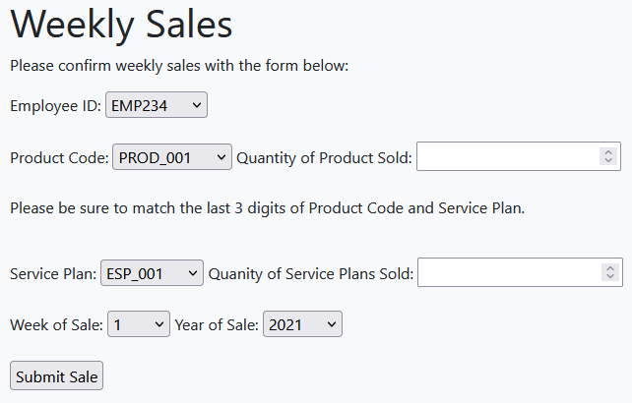
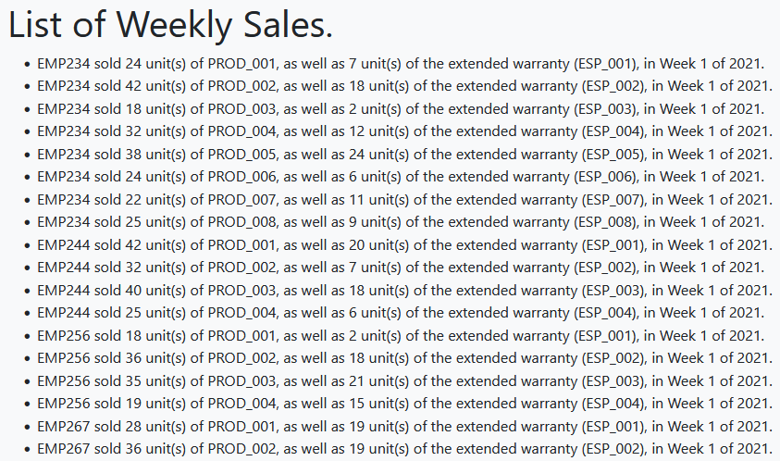
TractorTEK App
Some Examples

Slide 5
TractorTEK Workbook

Slide 6
TractorTEK Workbook
Thought Process
Design Choices:
I think that bar graphs were perfect for digesting this data.
Looking at these graphs can show tons of correlations. Employee Performance, Regional Performance, and Brand Preference can all be gathered throughout.
​Analytic Findings:
I found that EMP256 & EMP 290 struggled to be consistently productive.
Our sales are much stronger from the beginning to the middle of the year as the weather becomes warmer.
There is a strong demand for John Deere products among our customers.

Slide 7
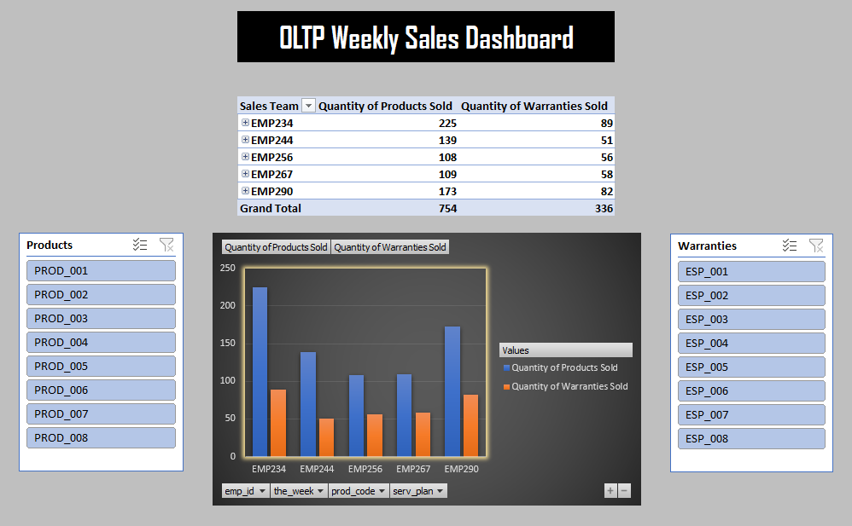
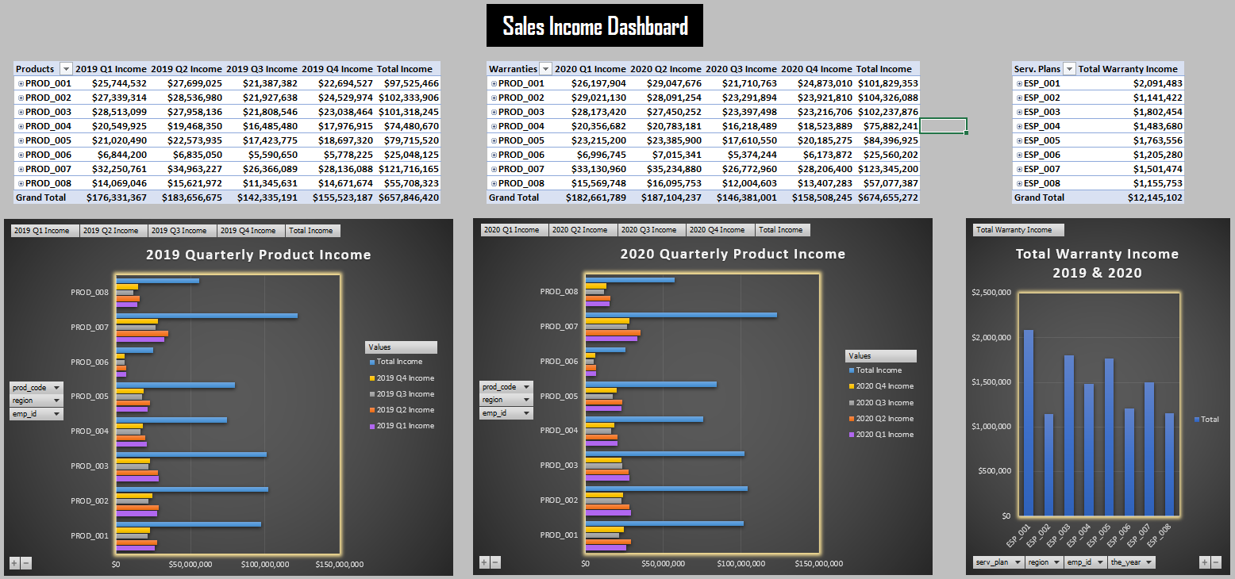
TractorTEK Workbook
Some Examples

Slide 8
TractorTEK Database

Slide 9
TractorTEK Database
The Data Container
Database Layout:
I normalized the backed-up data using Power Query in Excel to create 5 core tables.
Using those 5 tables I created data breakdowns by region, category, employee, product, and warranty. By utilizing some SQL code, I was able to build the database up to 11 tables.
I created a Star Schema (kind of a snowflake) to map out my EER Diagram.
Overall, I restored existing data into an active MySQL Workbench database and then aggregated it to produce analytical insights and visualizations.

Slide 10
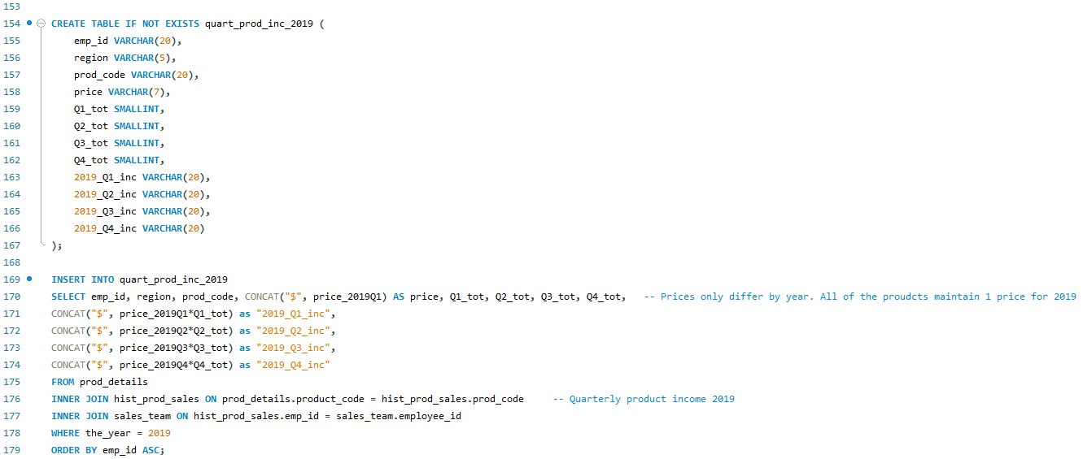
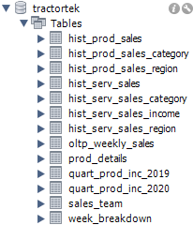
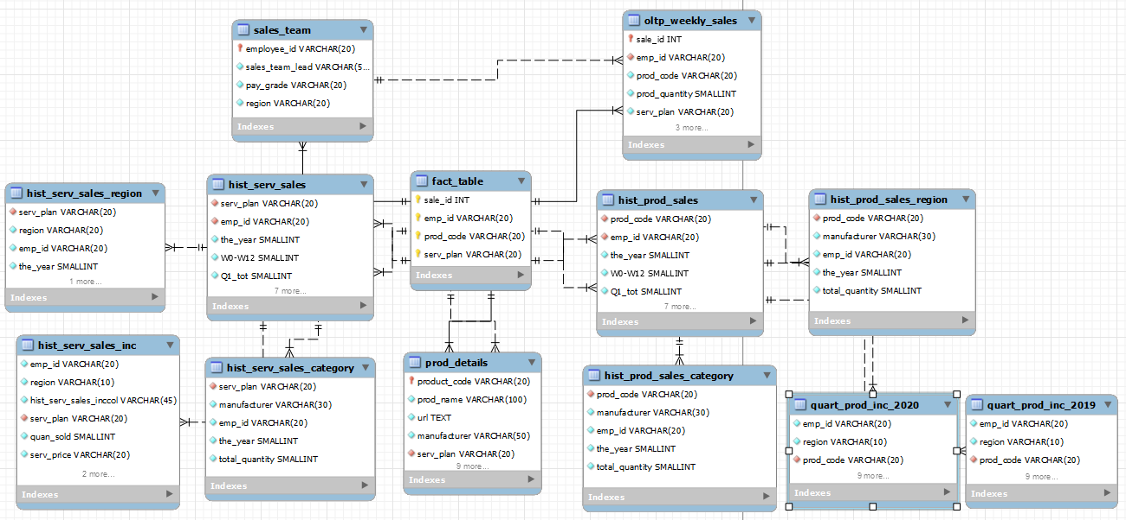
TractorTEK Database
Some Examples

Slide 11
Any Questions?

Slide 12
Thank You!

