Slide 1

Capstone 1
Array of Tools
Presented by: Nathan Gatz
3/11/2022

Slide 2
TractorTEK App

Slide 3
TractorTEK App
App Intro
My Thoughts:
Keep the data entry app as simple as possible, take a bare essentials approach.
Use SelectFields to make all current options readily available.
Use an if statement to allow for zero sales of a warranty during weekly sales input. Make it so the app will not get stuck or throw an error.

Slide 4
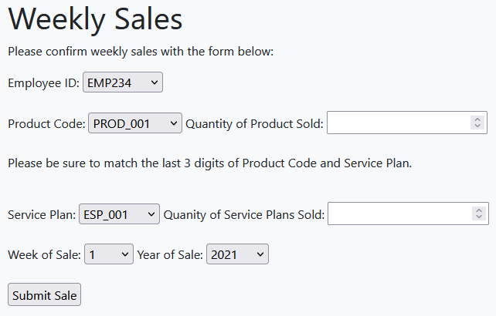
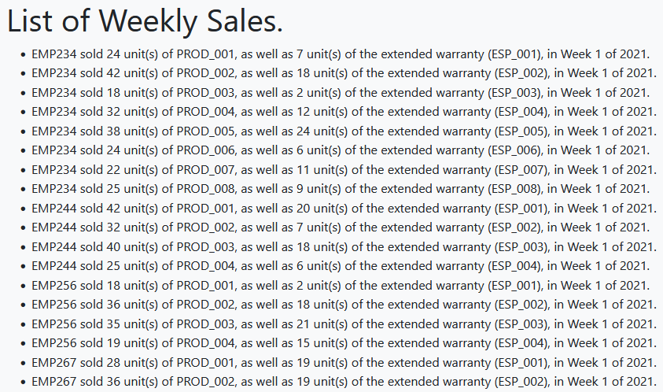
TractorTEK App
Some Examples

Slide 5
TractorTEK Workbook

Slide 6
TractorTEK Workbook
Thought Process
Design Choices:
Bar graphs were perfect for digesting this data.
These graphs show many correlations. Employee Performance, Regional Performance, and Brand Preference can be gathered throughout.
​Analytic Findings:
EMP256 & EMP290 struggled to be consistently productive.
Sales are much stronger from the beginning to the middle of the year as the weather becomes warmer.
There is a strong demand for John Deere products among customers.

Slide 7
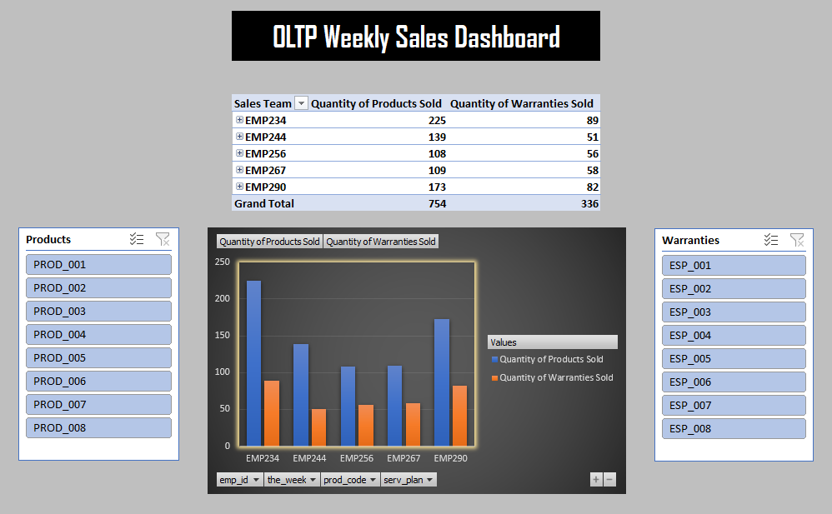
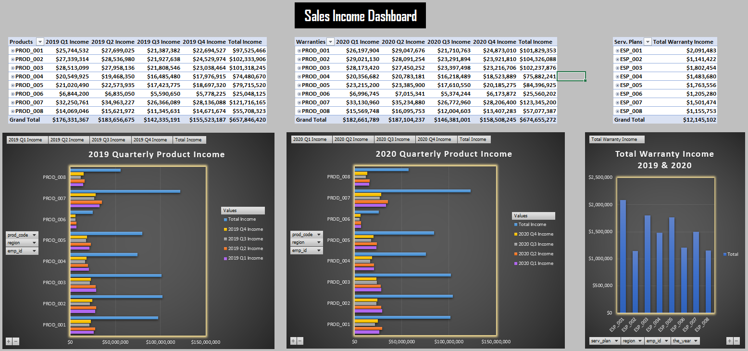
TractorTEK Workbook
Some Examples

Slide 8
TractorTEK Database

Slide 9
TractorTEK Database
The Data Container
Database Layout:
Normalized the backed-up data using Power Query in Excel to create 5 core tables.
Using those 5 tables to create data breakdowns by region, category, employee, product, and warranty. Built an additional 6 tables by utilizing SQL code.
Created a Star Schema to map out EER Diagram.
Overall, restored existing data into an active MySQL Workbench database and then aggregated it to produce analytical insights and visualizations.

Slide 10
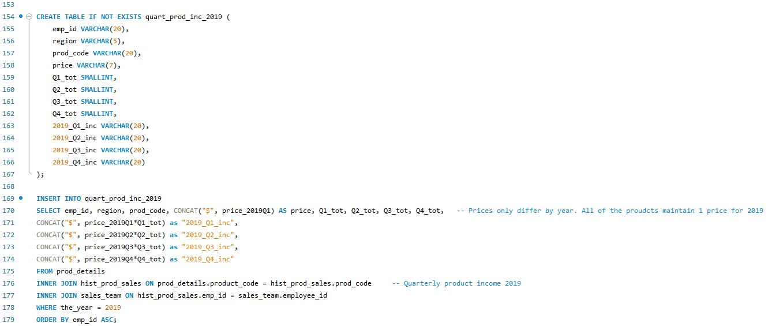
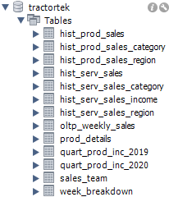
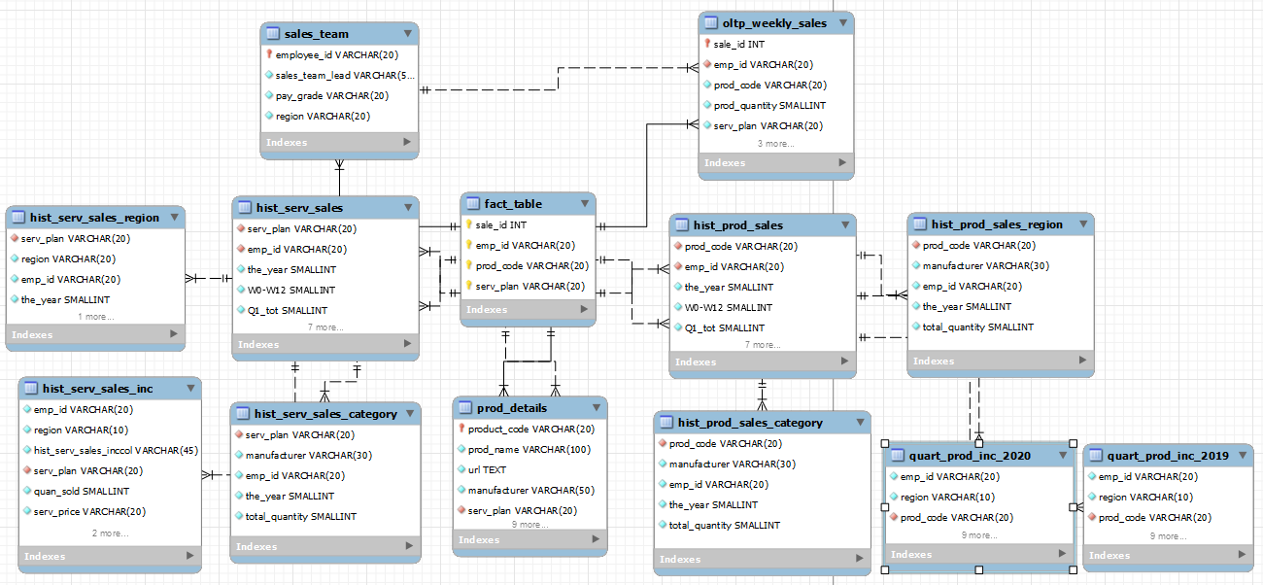
TractorTEK Database
Some Examples

Slide 11
Any Questions?

Slide 12
Thank You!

