Slide 1
Can credit default be predicted?
Erin Boardman | Feifei Chen |
Nate Gentry | Hilary Hall | Rachael Rich
Team 2

Slide 2
Anticipated Results & Implications
Anticipated Results:
Credit Card limit is inversely correlated to likelihood of default
Payment status is correlated with likelihood to default
Managerial Implications:
Limit company spending on risky accounts months earlier in an informed way
and/or do not offer credit to those likely to default
Mitigate consumer default
Notes:
Limiting the company spending on someone’s / allowing someone to spend if they are neglecting their accounts. Proactive response.
Anticipate default

Slide 3
Summarizing Our Challenge
Identify variables that predict default to mitigate consumer default and encourage timely payments.
Overview: Training = 20,000 observations; Validation = 10,000 observations
Limit Balance: The credit limit on the card
Sex: Female = 18,112 ; Male = 11,888
Education: The level of education of each individual
Marriage: Married, single, other
Age: Age of observation ID
Pay: Repayment status, numerical and notes paid full, paid min, or no activity
Bill Amount: Amount charged / spent in the current month
Payment Amount: Current month payment amount
Notes:
Goal to see if we can mitigate default by predicting it before default. If we know all this information, can we predict if the 1 or the zero.
Does the data explain the variation.

Slide 4
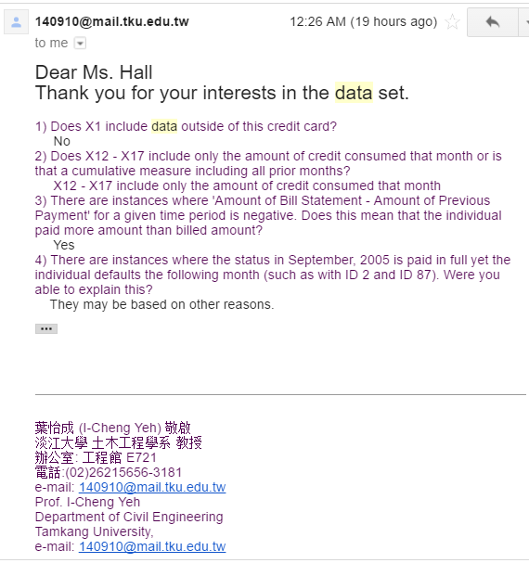
Data: The Good, The Bad & The Ugly
The Good
The Bad
The Ugly
30,000 samples
25 variables
Credit Limit
Monthly Payment Amt
Monthly Amt Charged
Monthly Payment Status
Demographic:
Sex, Education
Age, Marriage
Wanted more variables (e.g. income, credit score, number of credit cards, other debt, minimum payment amount, employment status, credit utilization)
Confusing Dataset
Notes:
Understanding the data set in order to run the regression.
Difficult to interpret variables.

Slide 5
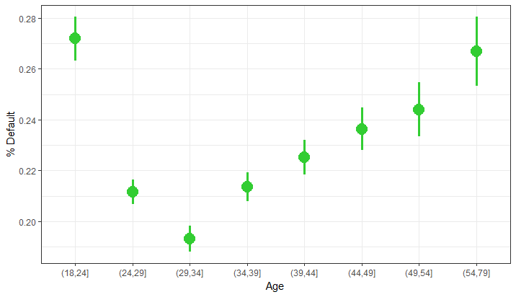
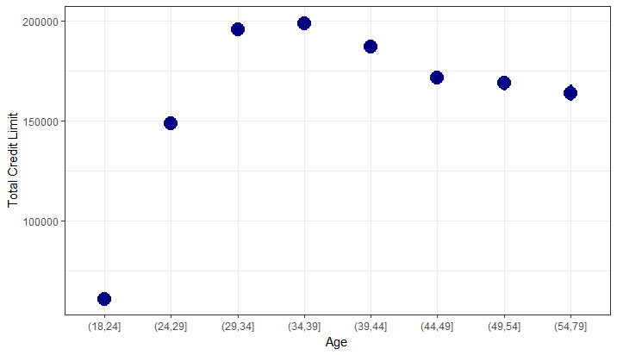
Analysis: Exploratory
Age group (30-39) with highest total credit limit also lowest default rate.
Age group (18-24) with lowest total credit limit also highest default rate.
Notes:
Script:
Summary:
How many people are in each group.
So what?
Factors that likely contribute to the 18 - 24 age group highest default rate:
Education loans, moving out on own, limited income
Factors that likely contribute to 30 - 39 age group low default rate
Factors that contribute to high credit limit
18 - 24:
New credit lines, haven’t had the opportunity to impact credit scores with other debt (mortgage)
Lowest credit limit
30 - 39
More financially stable
Highest credit limit
Target marketing
Non - Risky customers

Slide 6
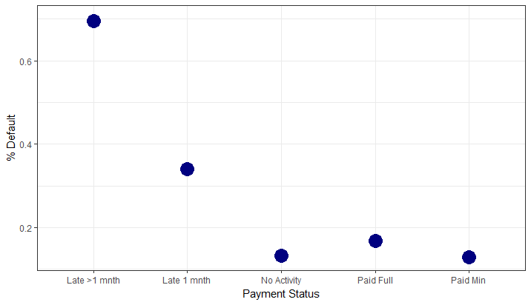
Analysis: Exploratory
Notes:
People who pay in full, had low default percentages
People who had delayed percentages by 1 month,
Late by greater than 1 month had higher default = why Pay 0 is the most important.
These were the most informative, and this is what we decided to help tell our story about

Slide 7
Analysis: Regression Model Testing
 | Training MSE | Validation MSE
Linear Regression | .1496827 | .1536815
Logistic Regression | .1437142 | .1473428
Ridge Regression | .1497315 | .1537065
Lasso Regression | .1497251 | .1536905
Elastic Net | .1497257 | .1536946
Lowest MSE is our logistic regression
Lasso Regression showed that Pay_0 was the most predictive variable

Slide 8
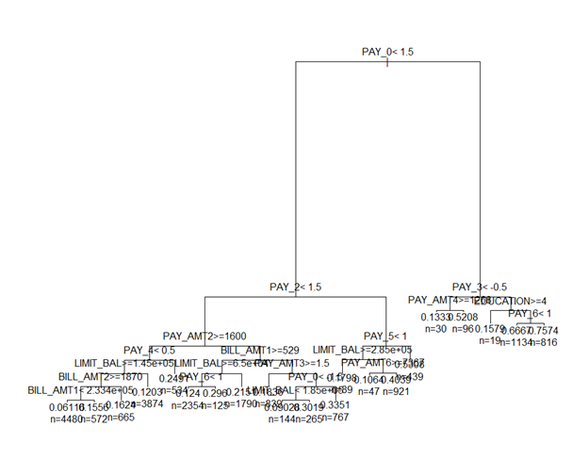
Analysis: Trees & Random Forest
Simple Regression Tree
 | MSE Training | MSE Validation
Regression Tree Cp = .001 | .133078 | .1392094
Random Forest
where ntree=50 | .1432301 | .1409866
where ntree=100 | .1390665 | .1421401

Slide 9
Analysis: Boosted Tree
 | Iteration | Training | Validation
1 | n.trees = 100, interaction.depth = 2, shrinkage = 0.001 | .164472 | .1710079
2 | n.trees = 1000, interaction.depth = 2, shrinkage = 0.001 | .1428102 | .1481024
3 | n.trees = 100, interaction.depth = 4, shrinkage = 0.001 | .1640677 | .1705573
4 | n.trees = 100, interaction.depth = 2, shrinkage = 0.01 | .1428035 | .1481092
5 | n.trees = 100, interaction.depth = 2, shrinkage = 0.1 | .1328526 | .1367258
6 | n.trees = 1000, interaction.depth = 2, shrinkage = 0.1 | .1353588 | .1391581

Slide 10
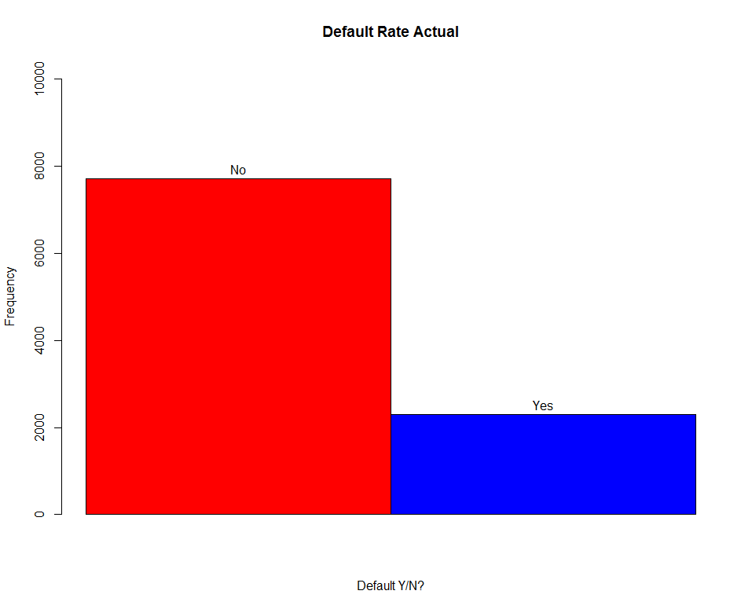
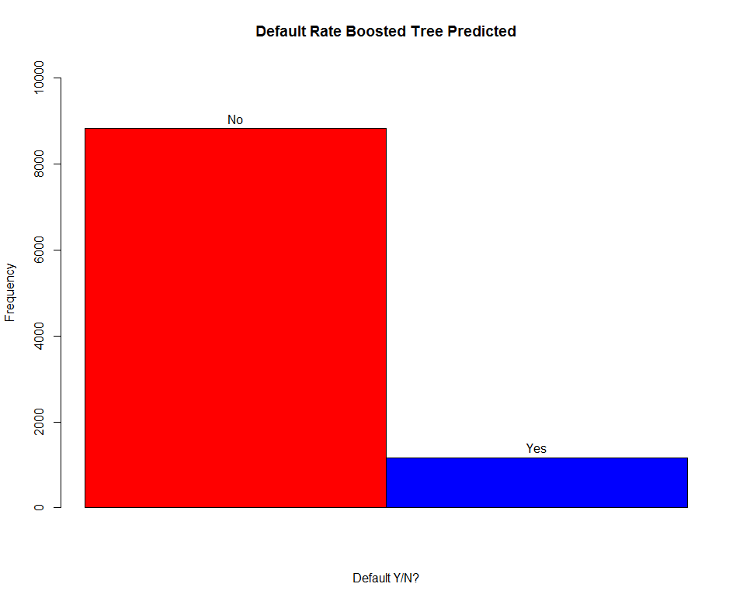
Analysis: Actual vs Predicted Defaults

Slide 11
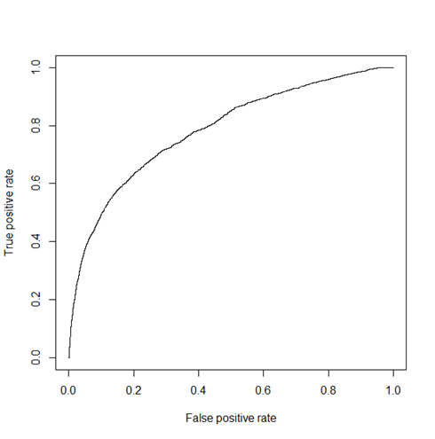
Analysis: Confusion Matrix / Roc Curve
Confusion Matrix at
Cut-Off Probability of 0.5
 | Actual
Predicted | 0 | 1
0 | 7355 | 1477
1 | 354 | 814
Area Under ROC Curve = .7849245
Notes:
How many 1s did we get right / wrong ; How many 0s did we get right / wrong. What are the business implications for this.
Cutoff chosen at point where false positives start out-weighing true positives
Model correctly predicts 1,086 of the 2,278 defaults 48%

Slide 12
Managerial Conclusions
Prediction: Credit card limit is inversely correlated to the likelihood of default
Determined that credit card limit not strongly correlated to default
Payment status is correlated to likelihood to default
Determined that payment status in month 0 is the best predictive variable of default
Given individuals’ age 34 - 39 have the highest credit limit and lowest default, companies should incentivize increased spending on this targeted group.
It appears that individuals are more likely to default if they are late for payments for more than one month; even being late on a payment for one month seems to set individuals on a path more likely to default.
The boosted tree model has predictive ability but the high rate of misclassification of 1’s as 0’s (defaults as not defaults) warrants refining
Notes:
**plot density of yhat or histogram* create new column (yhat), ggplot +stat_density()

Slide 13
Next Steps…
Collection of more data, such as income, credit score, monthly total bill amount (and % of total credit line)
Further refinement of models and cut-off point for classification in order to more effectively predict default
i.e. setting a more precise threshold
Notes:
We only have what they charged in one month, not total bill amount

Slide 14
Questions

