Slide 1
Analysis of Hyatt Hotels Net Promoter Score
Nate Hoffelmeyer, Kirby Hood,
Joshua Shusterman, Monika Taylor
Project completed as a requirement of IST 687-37225: Applied Data Science
School of Information Studies, Syracuse University

Slide 2
Project Scope and Objective
Analyze survey responses for Hyatt hotels in CA, FL, and TX.
Make actionable recommendations from the analysis based on the likelihood to recommend and the satisfaction of the customers who stay at a Hyatt Corporation property.

Slide 3
Business Questions
What is the primary driver of the Net Promoter Score? Over the course of the project a deeper dive will be taken to determine the exact variable that drives the Net Promoter Score.
Is there a correlation between Net Promoter Score and Revenue? Looking at the data set for Hyatt hotels in the United States, revenue needs to be maximized as well as the Net Promoter Score. Running a correlation between the two will determine if there is a relationship between the two variables.
Are we able to predict if a guest would be a promoter based on the amenities of the hotel, customer service, and/or condition of the hotel? Looking at the variables that include all the amenities, we hope to see what would predict if a person was a promoter. There might also be other factors that might indicate if a person is a promoter, such as guest room condition, condition of the overall hotel and the customer service of the hotel staff.

Slide 4
Data Acquisition
Data was provided, pre-filtered
Additional filtering was done to limit variables and top-3 states

Slide 5
Data Processing
Null data was made NA
NA converted to mean of column
Punctuation removed
Binary values numberized: yes = 1, no = 0

Slide 6
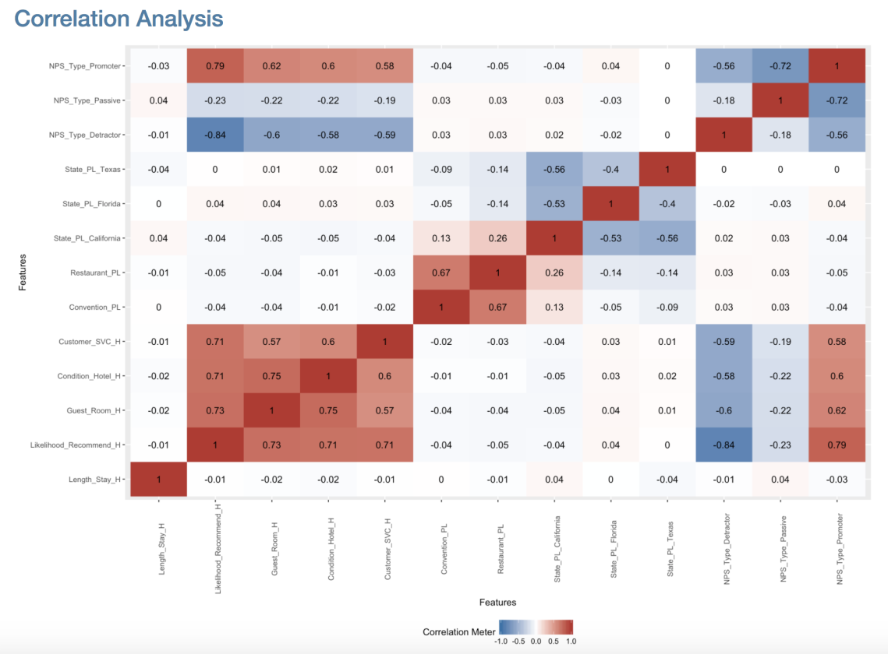
Descriptive Statistics
Correlation analysis

Slide 7
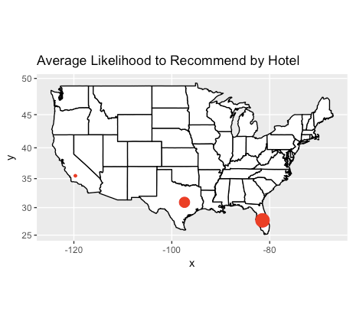
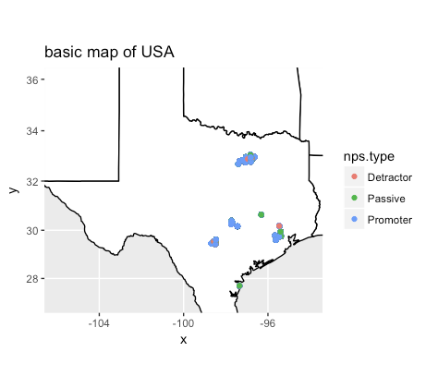
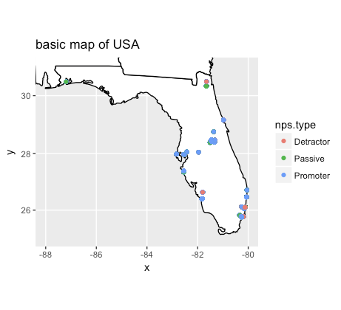
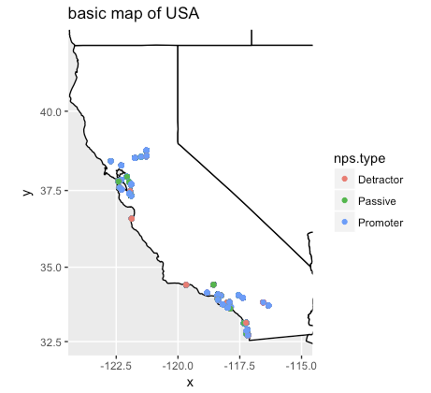
Descriptive Statistics (cont)
State mapping

Slide 8
Modeling
Linear Modeling
Models had high level of error
Amenities seemed to have no impact
Can predict higher scores with higher customer service and/or room condition values

Slide 9
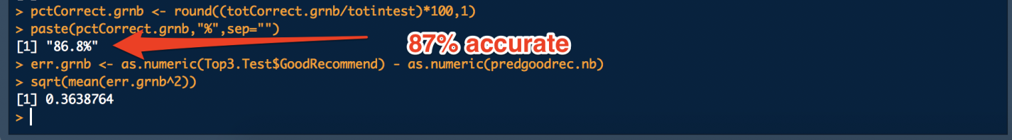
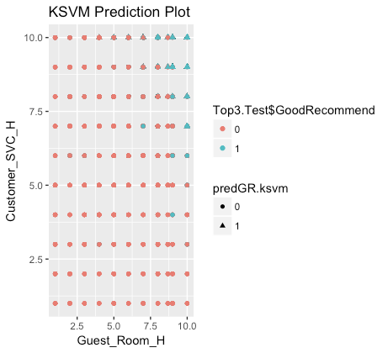
Modeling (cont)
Support Vector
Hotel, customer service, and condition results in 87% accuracy
As customer service and room condition values increase, likelihood to recommend also increases

Slide 10
Recommendations
Train staff to provide better customer service
Hire housekeeping staff to improve condition of rooms.

Slide 11
Business Questions Revisited
What is the primary driver of the Net Promoter Score? The primary driver of the Net Promoter Score of Hyatt Corporation surveys, are customer service and guest room condition. These are both reflected in the recommendations to ensure better customer service training and that each of the hotels can make sure the guest room and overall hotel condition is superb.
Is there a correlation between Net Promoter Score and Revenue? After looking at the data, and doing a correlation analysis, there is a negative correlation and it is not very strong. This indicates that other factors drive the likelihood to recommend and determine the Net Promoter Score.
Are we able to predict if a guest would be a promoter based on the amenities of the hotel, customer service, and/or condition of the hotel? We were able to predict if a guest would be a promoter based on the variables customer service and condition of hotel. We also found that the condition of the guest room also played an important role in indicating if someone would be a promoter. However, we were not able to predict with high accuracy, any amenities that would factor in to indicating if a guest was a promoter.

Slide 12
THANK YOU!

