Slide 1
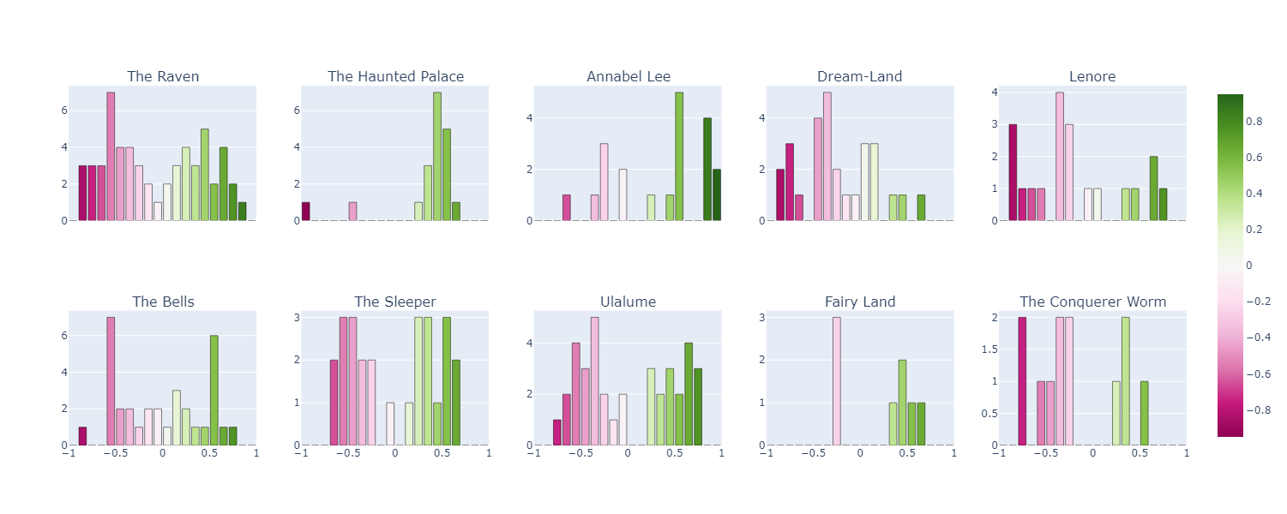
Poextiment: Sentiment Analysis for Multi-stanza Poetry Nathan Parker
Process: After separating each poem into individual lines, VADER Sentiment Analysis was conducted to determine how positive or negative each line was. I chose to focus on the works of Edgar Allan Poe.
Interpretation: In each histogram, the height of a bar represents how many lines in the poem fell in that range of sentiment, with values closer to 1 (green) being more positive and values closer to -1 (pink) being more negative.
Source: https://www.poetryfoundation.org/

