Slide 1
Analyzing Music Listening History to Predict Personality Type
Nate Kelmers DS DC 25

Slide 2
The question…
Can a someone’s music listening history predict their personality?
Wikipedia’s “Psychology of music preferences”: https://en.wikipedia.org/wiki/Psychology_of_music_preference#Big_Five_model
Big Five (OCEAN) model:
Openness > preference for more complex/novel and more intense music
Extraversion > more “happy”, “conventional”, and upbeat/energetic music
More specifically, can song lyrics predict personality?
Can I predict if a person is introverted or extroverted through only text analysis of songs in their listening history?

Slide 3

Curating the dataset
Personality and listening history data collected from Personality Cafe (Myers-Briggs Personality Type discussion board)
User profiles include Myers-Briggs personality type, which includes introversion/extroversion dimension
“What Song Are You Listening To Now?” discussion thread contains roughly 40,000 replies, each with a song or two
Data scraped by crawling through discussion thread with Selenium/BeautifulSoup page-by-page
Personality types of users can only be viewed while logged in

Slide 4
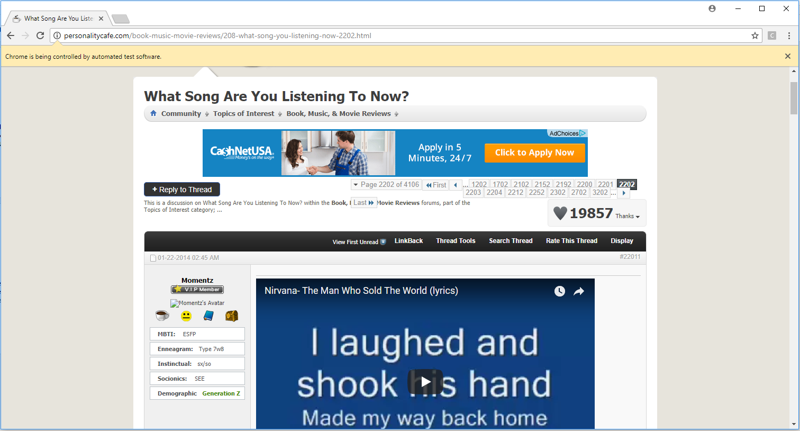

Slide 5
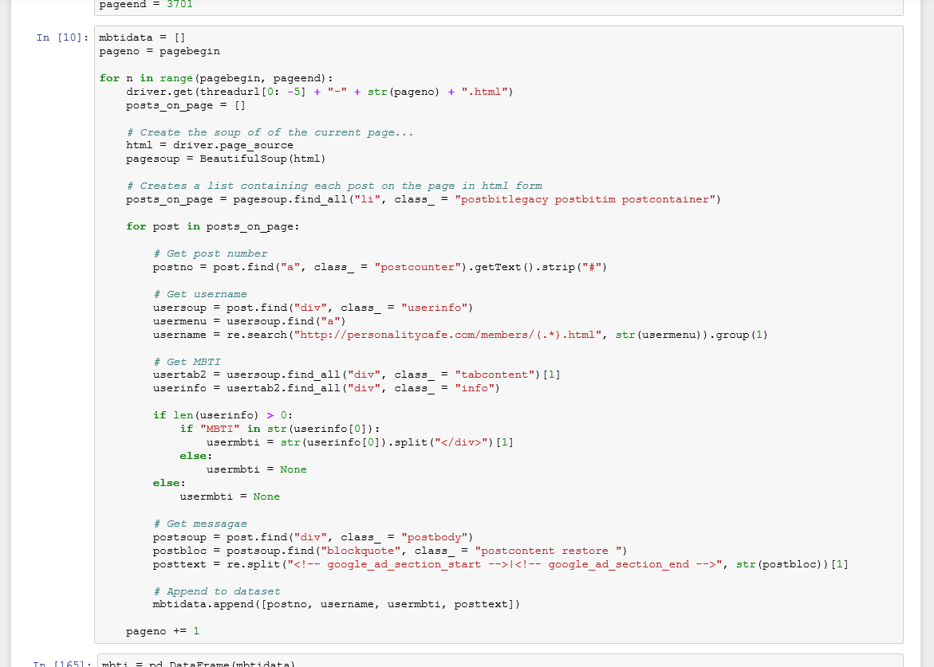

Slide 6
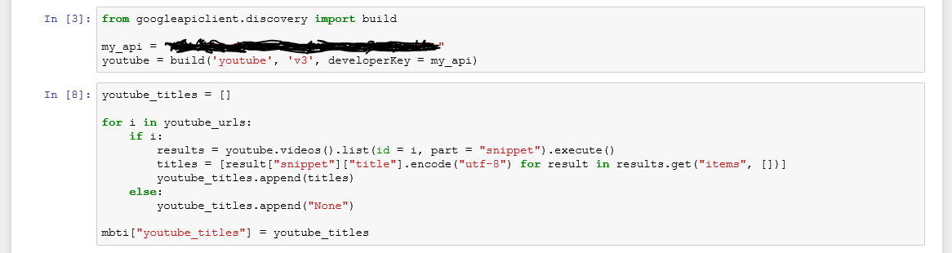
Curating the dataset (con’t)
Data cleaned to return posts consisting of artists and song titles
Returned video titles by:
Lots of regex to extract Youtube IDs from embedded links in messages
Getting titles of the Youtube videos using Youtube Data API
Extracting titles from messages without Youtube links by filtering for those with common song/artist delineators (“-|by”)
Multiple steps of pre-processing to eliminate artifacts from video titles (see next slide)

Slide 7
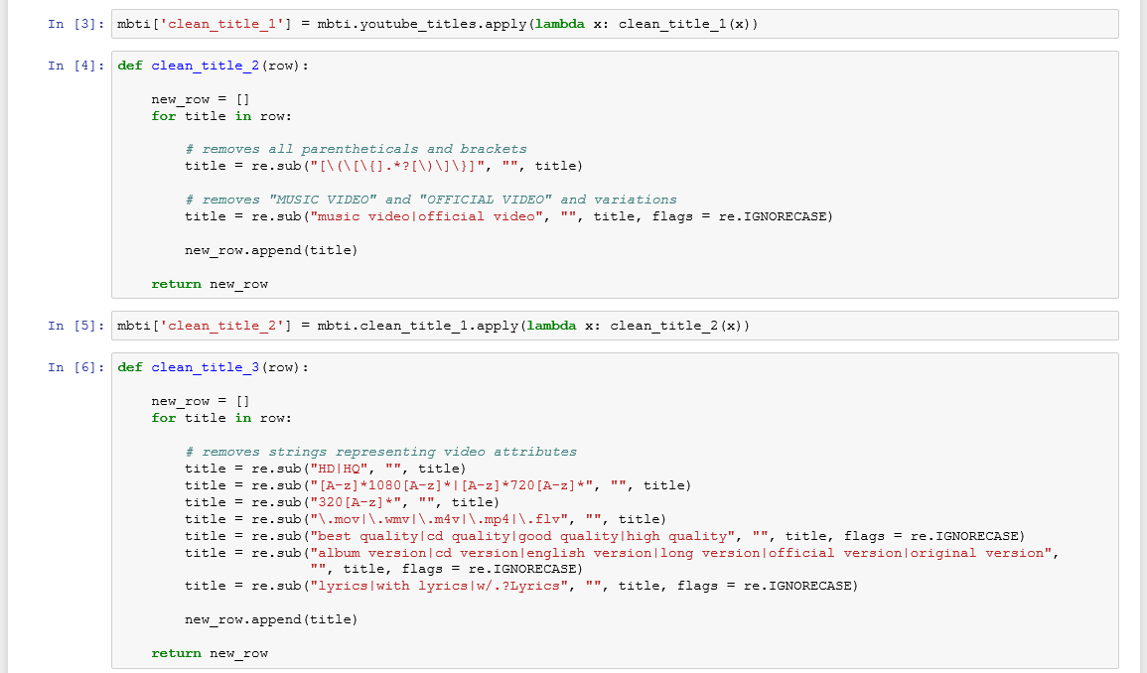

Slide 8
Curating the dataset (con’t)
Gathered lyrics for artists/song title combos using Selenium again
Not ideal
Would rather have used an API or a pre-existing dataset for this to get more/better data (see “next steps” slides)
But, surprisingly good
Ended up with roughly 11,000 rows of data

Slide 9
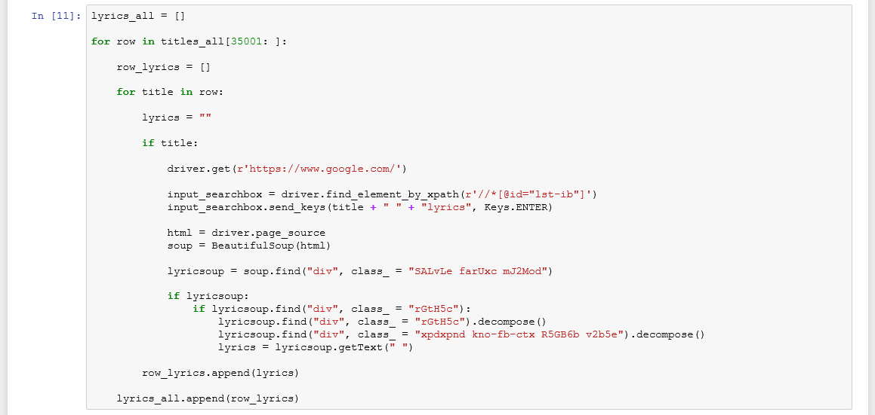

Slide 10
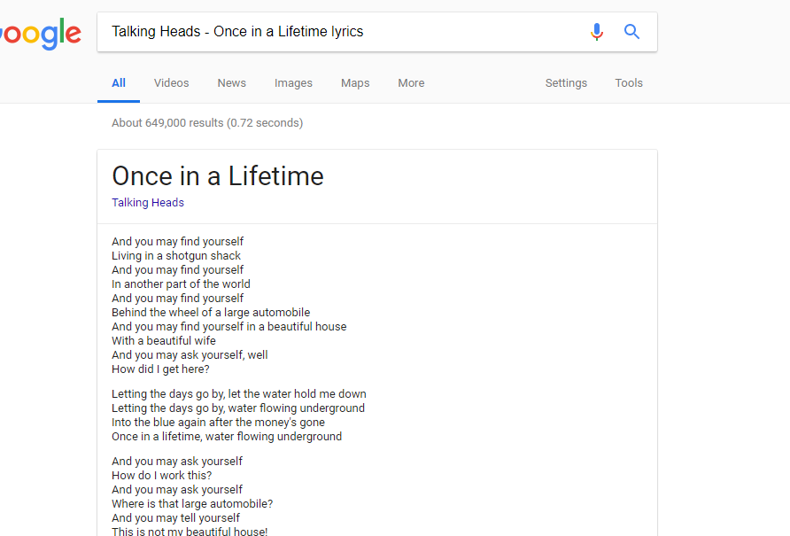

Slide 11
Challenges
Actually gathering the data was difficult!
Computer ran for roughly 1 week to scrape the original thread
Code ran in background…
Modify code and re-run code whenever an error pops up…
Computer ran for roughly 4 days to gather lyrics through Google
Fewer errors, but had to check titles one-by-one instead of page-by-page
Also, extensive manual processing between every step of collecting data
Data returned after one step was not generally useable for next step of collection process
For example:
Youtube IDs had to be extracted manually (regex) from embedded links
Youtube IDs required querying an API to return titles
Titles had to be manually cleaned to be useable for searches

Slide 12
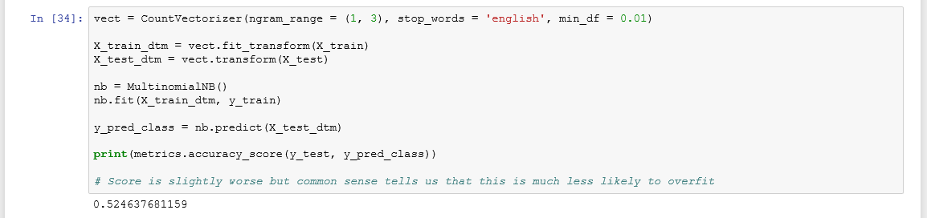
Results
Multinomial Naive Bayes suggests lyrics alone can predict introversion/extroversion slightly > chance
Actually better than I expected given the question
I’m surprised this has any predictive power at all
Not favorite songs, or songs listened to more than once, merely songs people spontaneously chose to listen to at any given moment

Slide 13
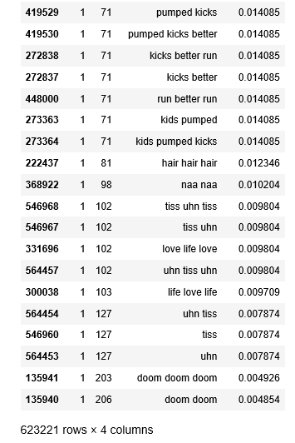

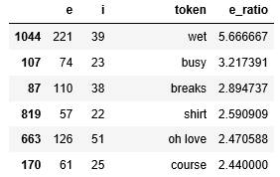
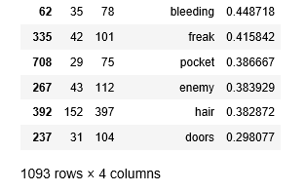
Lyrics that predict introversion and extroversion:
“min_df = 0.01” (roughly 50 songs) was necessary to prevent overfitting
See the most extroverted and most introverted words of the overfit dataset:
Restricted vocabulary:

Slide 14
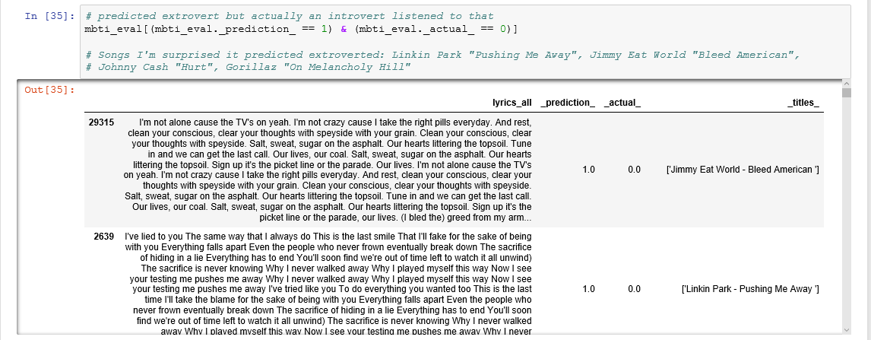
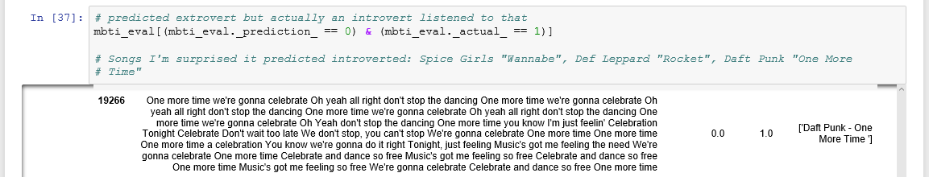
Problems
Multinomial Naive Bayes does not account for sentiment
For example, see some incorrect predictions as a result of using words alone
Model predicted extrovert when actual was introvert
Model predicted introvert when actual was extrovert

Slide 15
Next steps for tuning model:
Sentiment analysis using TextBlob
Build pipeline to tune hyperparameters for Multinomial Naive Bayes

Slide 16
Next steps for the project:
Query an API of a lyrics website (instead of just crawling Google)
What if I had 3x as much data?
Million Song Dataset
https://labrosa.ee.columbia.edu/millionsong/pages/example-track-description
Contains data for:
Genre, beats per minute, danceability, “hotttnesss” (levels of “buzz” online)
Also has audio clips of songs, which may be good for…
Deep-learning neural network with Keras/TensorFlow
Commonly used as an image classifier, but can also analyze audio
What does an “introverted” or “extroverted” song “sound like”?

