Slide 1

Forecasting Player Trends of Top Steam Games
Yuxin Zhang
STAT 418

Slide 2
Scraping the data
The data was scraped from Steam Charts website (an onging analysis of Steam’s concurrent players)
I chose three popular games from steam which are Counter Strike 2, Dota2 and Pubg to capture diverse player behavior across genres (FPS, MOBA, Battle Royale)
Using requests and BeautifulSoup from python to scrap the data with 407 observations
Variables:
Avg.players - Average players counts
Gain - the increasing number of players comparing to last month
%Gain - increasing percentage of number of players comparing to last month
Peak players - the highest number of players during this month

Slide 3
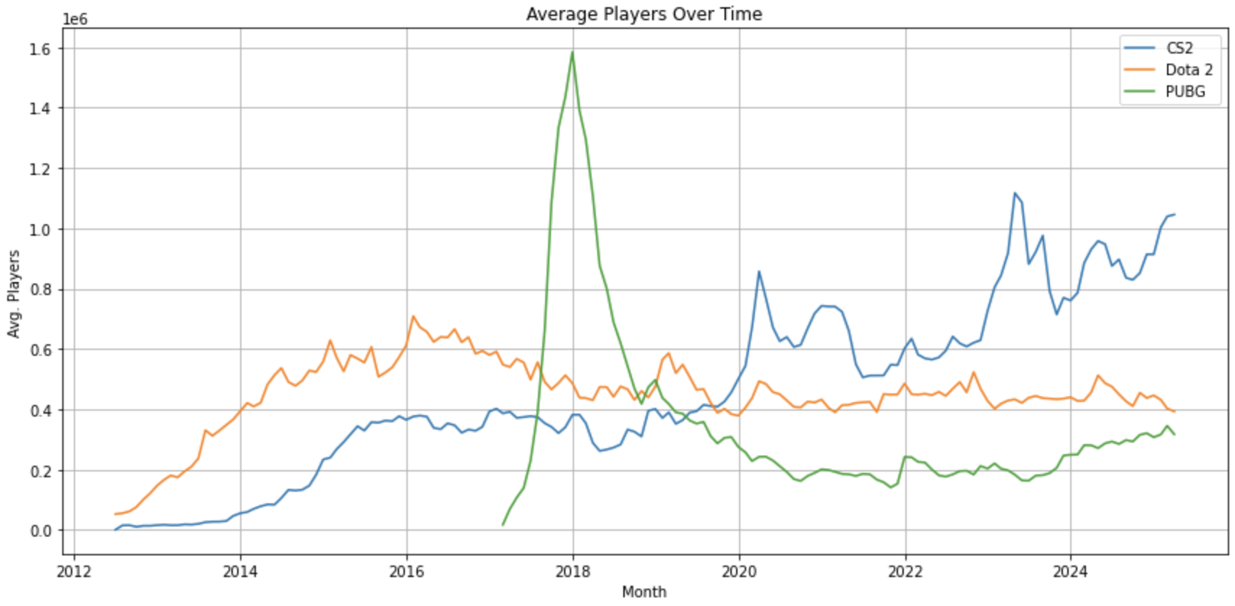
Exploratory Data Anaysis
Check the plot and ADF test: Non stationary series
- Using first order differencing to make it stationary

Slide 4
Proposal and plan
Build separate ARIMA models for CS2, Dota 2, and PUBG to forecast monthly player counts
Compare forecast trends across games to assess future popularity and player retention
Try to add some external variables to improve accuracy

