Slide 1
Sentiment Analysis of Amazon Electronics Reviews
Yifan Yin

Slide 2
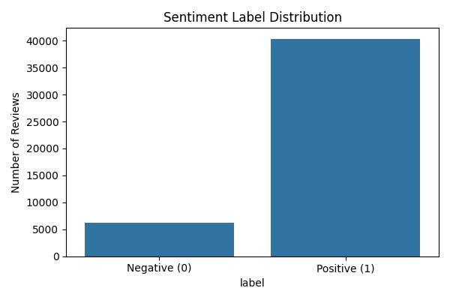
Dataset & Project Goal
Dataset: Amazon electronics reviews
Goal:
Train a model that can automatically judge the sentiment (positive/negative) of comments
Building a user-interactive online sentiment prediction tool

Slide 3
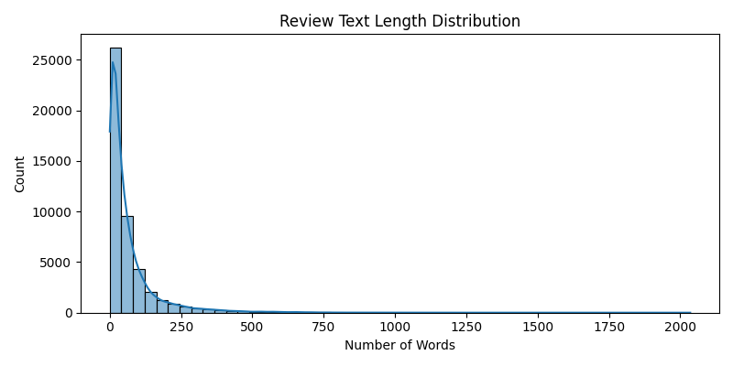
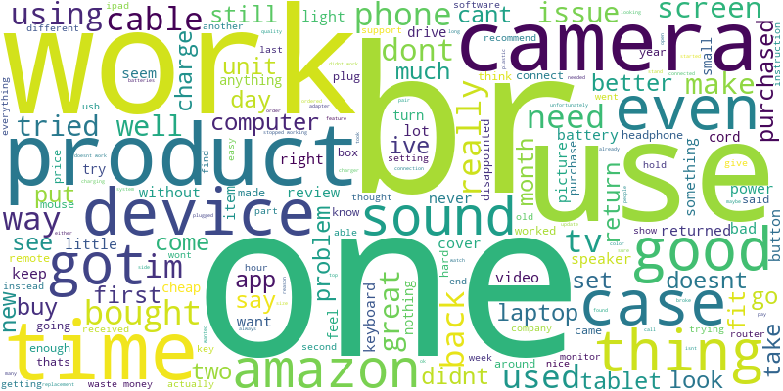
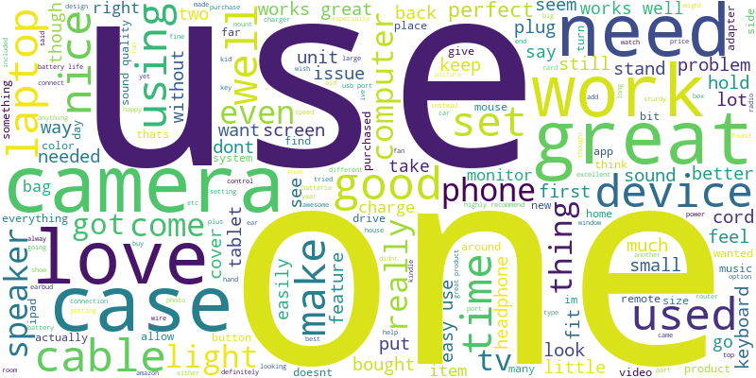
Initial EDA
word cloud positive
word cloud negative

Slide 4
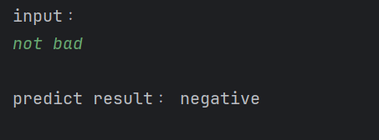
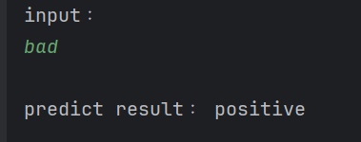
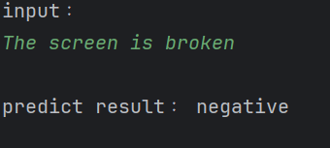
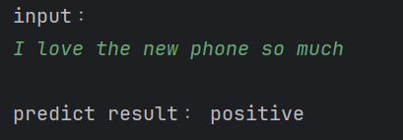
What’s going on now…
A simple model trained via TF-IDF

