Slide 1
Tracking Evolving Skill Demands in Data & AI Jobs with LLMs
Fanchao Lin
STAT418 Final Project Proposal

Slide 2
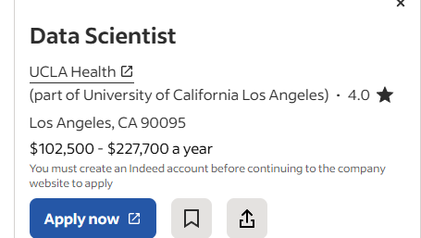
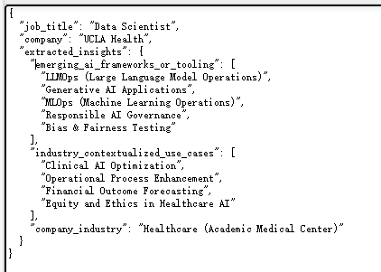
WEBSCRAPE: Extracing Data
· Scraped job postings from Indeed using BeautifulSoup (static HTML):Extracted job title, location, company, posting date, salary, and full description for Data/AI-related roles and saved them to a .csv file.
·Sample GPT-4 API output for keyword summarization of the above job description:

Slide 3
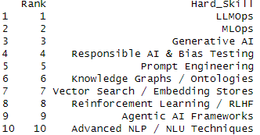
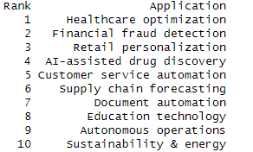
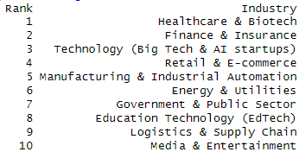
EXPLORATORY ANALYSIS
Top 10 Hard skills:
Top 10 industry applications:
Top 10 hiring industries:

Slide 4
PROJECT PROPOSAL
Expand data collection to include additional sources (e.g., LinkedIn).
Use Shiny to integrate the entire workflow: web scraping, GPT API calls, summarization, and result visualization; deploy the application using Docker.
Answers key questions of job market trends: What advanced skills and experiences are currently in demand? Which industries are actively hiring for these roles? How is the number of job postings evolving over time?

