Slide 1

Forecasting Player Trends of Top Steam Games using Prophet
Yuxin Zhang
STAT 418

Slide 2
Overview
Purpose:
Predict average monthly player counts for CS2, Pubg and Dota2.
Identify genre-level trend over time
Variables:
Avg. Players (target)
Patch_Count and Google_Trends_Index (external regressors)
Tools and methods:
Using request, BeautifulSoup, pytrends to extract data
Using Prophet which is a time series forecasting model developed by Facebook.
The api is created through Flask and hosted in Google Cloud Run

Slide 3
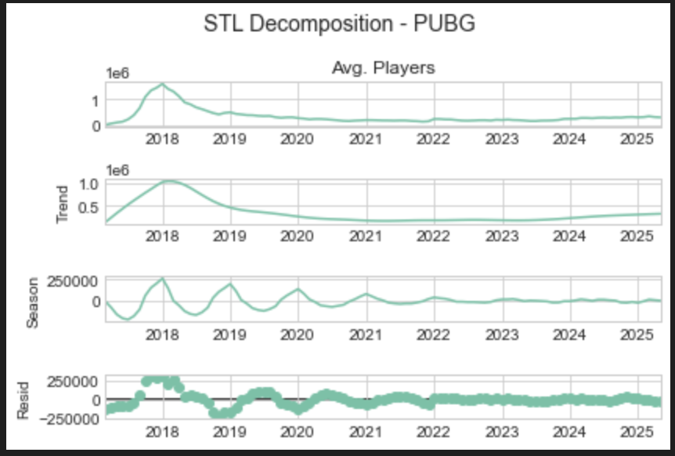
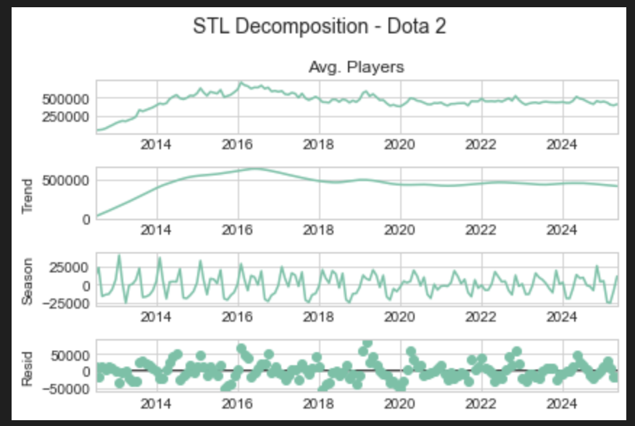
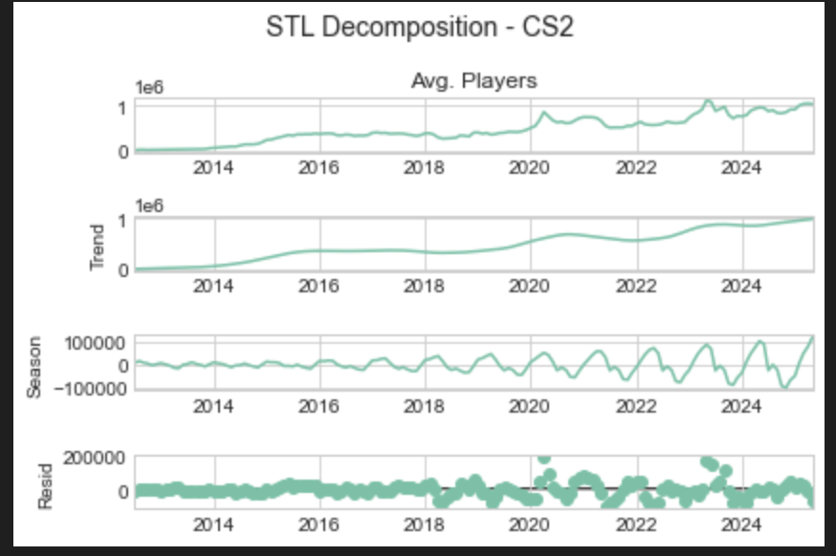
Seasonal and Trend decomposition using Loess

Slide 4
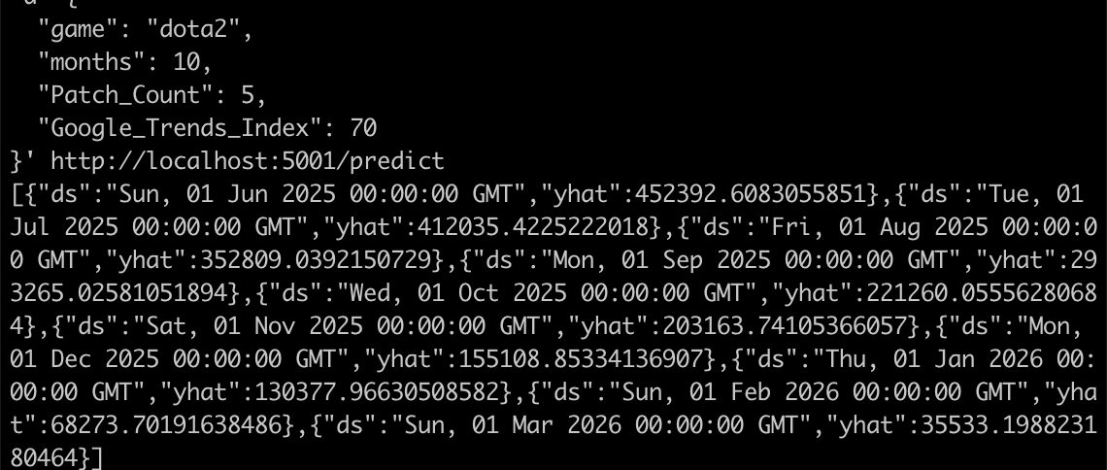
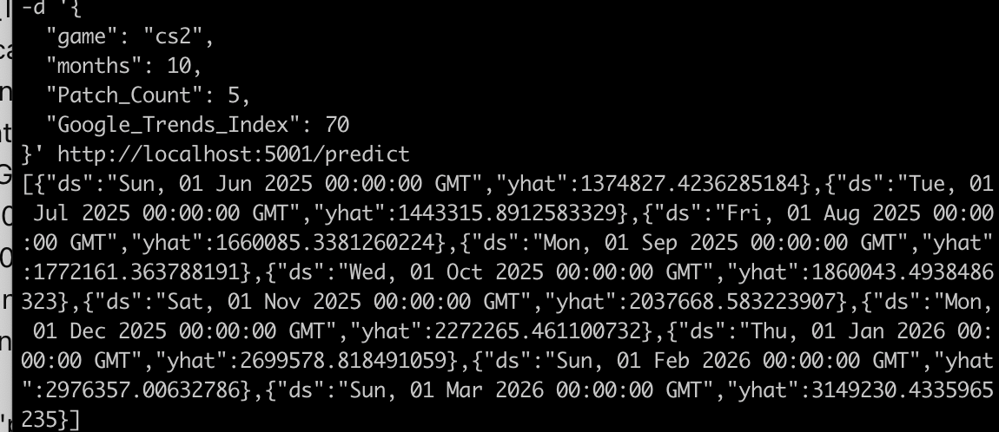
Predicted Result
The average player counts for dota2 is gradually decreasing after ten months starting from June 1st 2025, while CS2 shows a sharp upward trend.
The possible reason for this huge increase is because I set the changepoint scale for Prophet as 1, which increase sensitivity to recent trend shift.

Slide 5
Conclusion
The average player counts for CS2 and Pubg is still increasing in the future, but the number of players of Dota2 is decreasing.
We can imply that in the future, less people will play moba games. And FPS and Battle Royale is still hot genre for games. This might support game developers in content planning.
Future work: Adding more interesting variables like Twitch Viewers to improve the accuracy of the model and tried some other models such as XgBoost to compare.

