Slide 1
Should I Go Out and Eat Friends with Friends Today?
Using Data to Start (or get out of) a Hangout

Slide 2
Project Overview and Motivation
Problem/Motivation
Going out in LA can be a pain
One has to check weather and traffic (and others) to determine whether or not it is worth to go out
Most hangouts center around eating
One has to check review sites (like Yelp) and scroll thru many reviews/ratings to determine whether or not the restaurant is worth going to
Proposed Solution
Create a dashboard that aids in making a decision to go out
Acts as a central location to check weather, air quality, and traffic conditions
Create a model that aids in making a restaurant choice
Use specific features of restaurants and create a classification model that determines if a restaurant is worth going to

Slide 3
Data Collection Approach and Progress
Conditions Data (Dashboard)
Data will be collected with OpenWeatherMap and TomTom
OpenWeatherMap: current and forecast weather and air quality data via a live API
TomTom: live traffic data via a live API
These APIs do not have historical data endpoints
Utilize Supabase and Github Actions to store hourly data thru a SQL server
Restaurant Data (Model)
Data is collected with Google Places API and trained using multiple features

Slide 4
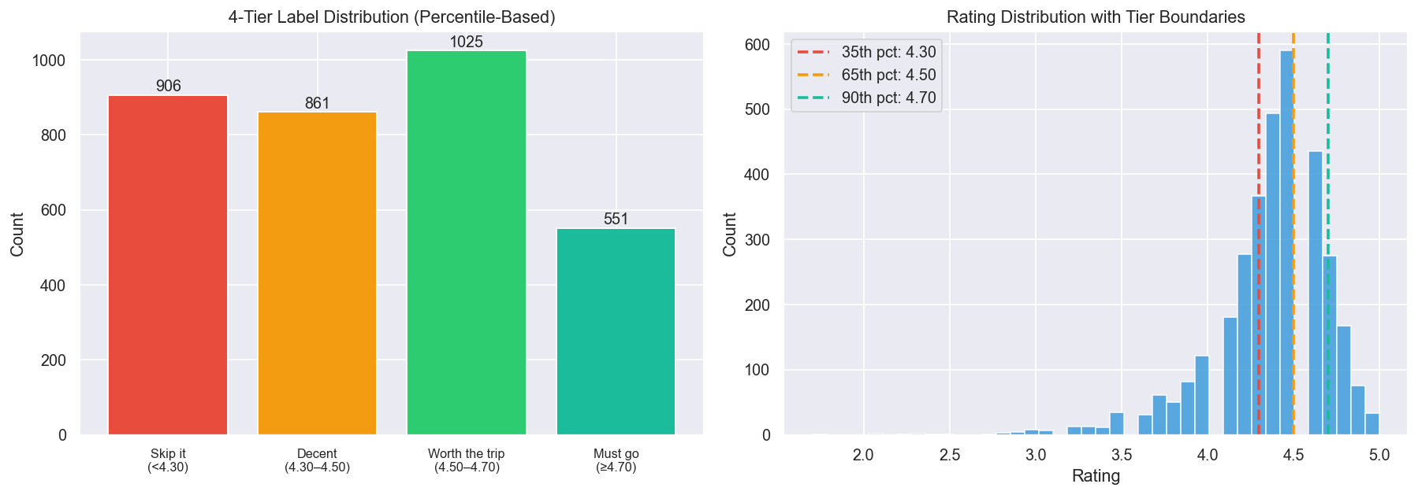
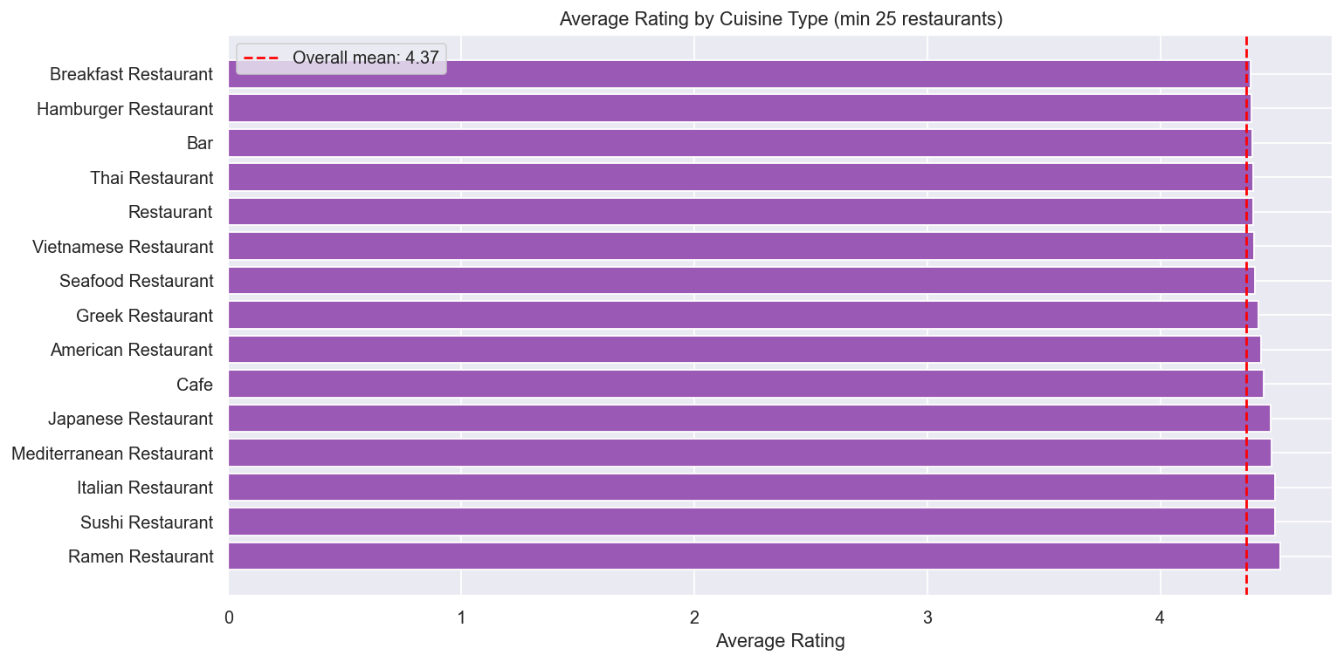
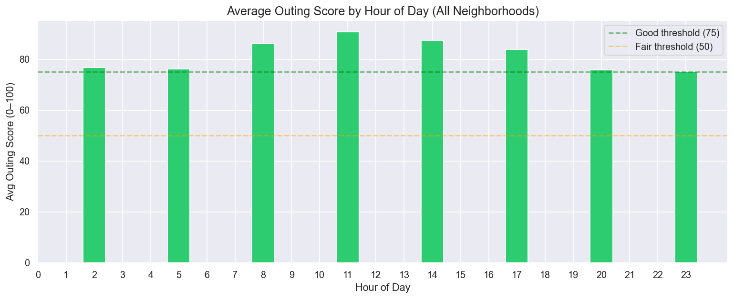
About the Data
(So Far)

Slide 5
Modeling Approach
Target Variable: 4 tier restaurant quality classification based on percentile of ratings
Skip it (0-35 percentile) / Decent (36-65) / Worth the trip (66-90) / Must go (90+)
Features: Review Count, Cuisine Type, Price Level, Reservable, Serves Alcohol, Provides Delivery/Dine In/Takeout, Popularity Flag, etc.
Modeling: XGBoost (Complexity and Performance) or Random Forest (Interpretability)
Targeting a weighted F1 between 0.35 and 0.70, similar/balanced class distributions, and few distant misclassifications
“Skip it” -> “Must Go” vs “Skip It” -> “Decent”

Slide 6
What’s Next?
Data Sources
Google Places API, OpenWeatherMap, TomTom
Week 6/7: Establish Database and Workflow (Supabase + GitHub Actions)
Week 8/9: Build Flask API + Streamlit App, Dockerize, Deploy to Cloud Run
Week 10: Final Testing and Official Deployment
Collection
Python Scripts + GitHub Actions Cron
Data Storage
CSV Storage + Supabase PostgreSQL
Flask API + Streamlit
Establish Connections and Build Dashboard to Reach End User

