Slide 1
What is EarthSafe?
EarthSafe
EarthSafe is a machine learning application that classifies earthquake danger levels using live seismic data from the USGS API.
Earthquake Hazard Classification App
LOW
MODERATE
HIGH
M < 4.0 Rarely felt
M 4.0–6.0 Damage possible
M > 6.0 Serious danger
Predicting earthquake danger levels using USGS real-world data
Yutong Ma
Built with Python · XGBoost · Flask · Streamlit · Docker · Google Cloud Run
STAT 418 | May 2026

Slide 2
What Problem Are We Solving?
500,000+
The Problem
Earthquakes occur worldwide every year
People cannot quickly assess if an earthquake is dangerous
Our Goal
Target Users
Predict hazard level — Low / Moderate / High — using ML
General public, emergency responders, researchers
~20%
of earthquakes are felt by humans
— but ALL are recorded by USGS sensors. That means we have data for every single one.
Personal Motivation
Earthquakes are unpredictable — but data is not. Fast hazard assessment can help emergency teams respond faster and save lives. I chose this project because the data is real, free, and immediately usable.
EarthSafe | Yutong Ma | STAT 418 — Tools in Data Science | May 2026

Slide 3
Data Source & Collection
USGS Earthquake Hazards Program API
Data Source
Dataset Features
USGS Earthquake Hazards Program API
Feature
Example Value
Free — no account or key needed
magnitude
5.2
earthquake.usgs.gov/fdsnws/event/1/
depth (km)
12.4
Real-time global earthquake data
latitude
37.77
longitude
-122.41
Returns clean JSON in seconds
place
10km NE of San Jose, CA
import requests url = 'https://earthquake.usgs.gov/fdsnws/event/1/query' params = {'format':'geojson', 'starttime':'2020-01-01', 'minmagnitude':2.5, 'limit':2000} data = requests.get(url, params=params).json()
gap (degrees)
85.0
rms
0.45
hazard_label
Moderate ← target
⚠ Challenge: 3% of records had missing depth values → Solution: removed null records; final dataset is clean and complete.
2,000+ earthquakes collected from 2023–2024 in under 1 minute using Python
EarthSafe | Yutong Ma | STAT 418 — Tools in Data Science | May 2026

Slide 4
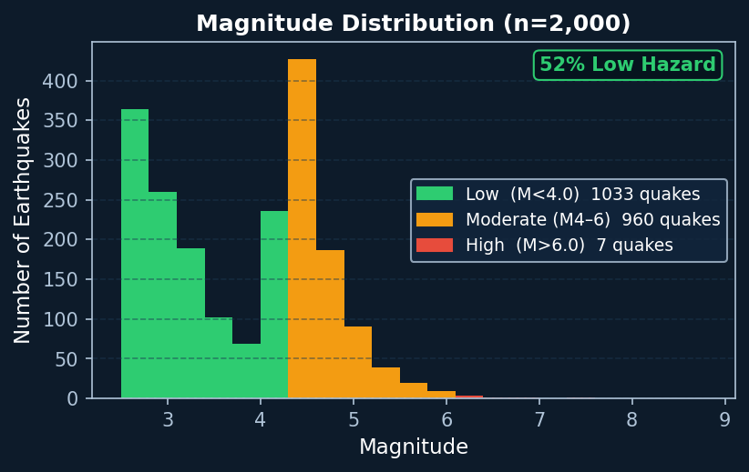
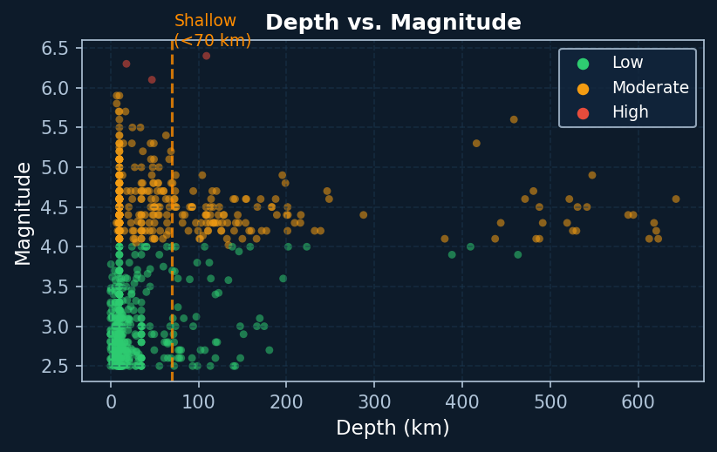
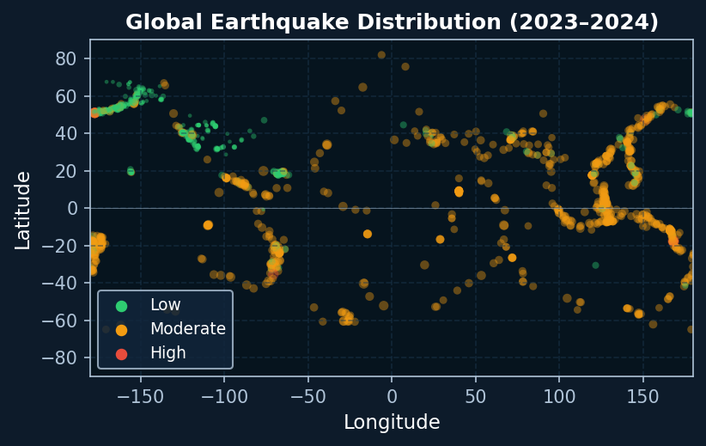
What Does the Data Tell Us?
Real data — 2,000 earthquakes, 2023–2024 (M ≥ 2.5)
Magnitude Distribution
Depth vs. Magnitude
Global Distribution Map
Key Findings
51.6%
of M≥2.5 earthquakes are Low Hazard (includes all magnitudes → even higher)
Depth < 70 km
shallow quakes show the strongest link to surface impact — top predictor
Pacific Rim
California, Alaska, Japan — clear high-density clusters on the global map
Data Quality
Removed 3% null-depth records · No duplicates · Ready to model
Feature Engineering
New feature: shallow_flag (depth < 70 km) · Encode location region
EarthSafe | Yutong Ma | STAT 418 — Tools in Data Science | May 2026

Slide 5
How Will We Build the Model?
3-Class Hazard Classification
Model Plan
Expected Feature Importance
Task
3-class classification: Low / Moderate / High
1. magnitude
92%
Features
magnitude, depth, gap, rms, location type
2. depth
78%
Models
Random Forest · XGBoost · Logistic Regression
3. gap
52%
Evaluation
Macro F1-score · Accuracy · Confusion Matrix
4. rms
35%
Baseline
Majority-class classifier (~52% accuracy)
5. location region
24%
Target
85%+ macro F1-score
Why these models?
* Based on EDA findings. Actual values confirmed after model training in Week 7.
XGBoost
Handles class imbalance well; top performance on tabular data
Random Forest
Robust, easy to interpret; good for feature importance analysis
Logistic Reg.
Fast baseline; helps verify that features are linearly separable
EarthSafe | Yutong Ma | STAT 418 — Tools in Data Science | May 2026

Slide 6
Application & Deployment Plan
Streamlit App Features
Week 6
Week 7
Week 8
Week 9
Week 10
Data collection + EDA
Feature engineering + Training
Model eval + Flask API
Streamlit app + Docker
Deploy Cloud Run + Final test
Interactive world map — color-coded hazard markers
User inputs magnitude + depth → instant prediction
Historical trend charts by region and year
Green = Low
Yellow = Moderate
Red = High
Solution Architecture
USGS API
Python Scraper
Pandas Dataset
XGBoost Model
Flask API Cloud Run
Streamlit Cloud Run
User: Map+Predict
→
→
→
→
→
→
Python
Streamlit
Flask
XGBoost
Docker
Google Cloud Run
Potential Challenges & Backup Plans
Class imbalance
(High-hazard events are rare (<1%))
→ Use class_weight='balanced' in XGBoost; try SMOTE oversampling
Model F1 below 85%
(Complex patterns may reduce accuracy)
→ Add Neural Network (MLP) as 4th model; tune hyperparameters with GridSearch
API downtime
(USGS API may be temporarily unavailable)
→ Cache a local copy of 2,000 records as backup dataset
EarthSafe | Yutong Ma | STAT 418 — Tools in Data Science | May 2026

