Slide 1




Forecasting U.S. Retail
Fuel Prices
Interactive Web App & Deployed Model API
National and regional gasoline price modeling using public energy data
Mike Wu
STAT 418 — Tools in Data Science · May 2026
EIA Open Data API
Flask + Docker
Cloud Run Deploy

Slide 2


Project Overview & Motivation
The Problem
What We Build
Why It Matters
Consumers, small businesses &
logistics planners want to know
where fuel prices are heading.
Raw government data is scattered
across sources, hard to interpret.
• Historical EIA dataset (CSV/Parquet)
• Trained forecasting models
with engineered lag features
• Streamlit app + Flask API
• Fully Dockerized + deployed
on Cloud Run
Fuel costs drive inflation,
transportation & household budgets.
Reproducible API → Model →
Deployed UI pipeline is a
portfolio-ready ML application.

Slide 3


Data Collection Approach
Primary Source
Optional Enrichment
U.S. Energy Information
Administration (EIA) API
FRED API: WTI / Brent crude oil, macro features Static tables: Holiday calendars, region labels
Weekly / monthly U.S. retail gas & diesel prices
National, PADD, or state-level series
Free API key → JSON → pandas → CSV / Parquet
Official, stable schema — satisfies course API requirement
Current Progress
EIA API key obtained
Pilot script pulls gasoline series
Date column standardized
Raw pulls saved to data/raw/
🔗 eia.gov/opendata · fred.stlouisfed.org

Slide 4
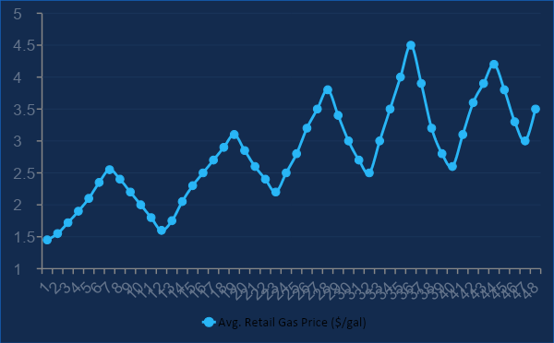


Exploratory Data Analysis
Seasonality
Summer driving & reformulation seasons drive price spikes month-over-month, visible in week-of-year boxplots.
Autocorrelation
Strong lag-1 autocorrelation — yesterday's price is the best single predictor of today's price.
Regime Shifts
U.S. Average Retail Gas Price Over Time ($/gal)
Structural breaks around supply shocks (2005, 2008, 2022). Rolling std reveals volatility clusters.
⚙ Time-based train/test split · forward-fill NaNs · resample weekly→monthly

Slide 5

Proposed Modeling Approach
Target: Predict next-week / next-month average retail price per gallon ($/gal) or week-over-week Δ price.
01 Baseline
02 Machine Learning
03 Optional
Seasonal Naive / SARIMA
Random Forest / XGBoost
Prophet / Expanding CV
Seasonal naive as floor benchmark
ARIMA / SARIMA on national series
ACF / PACF for lag selection
Low complexity, easy to interpret
Lags (1,2,4,8,52 weeks)
Calendar features (month, week-of-year)
Optional WTI crude lags
SHAP for feature importance
Prophet for trend + seasonality
Sklearn pipeline + time-based CV
Expanding validation window
Multi-series / regional extension
▪ MAE($/gal)
▪ RMSE ($/gal)
▪ MAPE (%)
▪ Held-out time window

Slide 6



Application Design
Streamlit UI
Flask API
Deploy
Inputs
/predict endpoint
Accepts JSON feature payload
Loads saved model artifact
Returns price predictions
Optional: prediction intervals
Dockerized for deployment
GCP Cloud Run
Streamlit host
Docker images
Auto-scale
Region / series selector (dropdown)
Forecast horizon (1–4 weeks)
Crude-oil feature toggle (optional)
HTTPS POST
JSON response
Outputs
Forecast table (price + horizon)
History + forecast line chart
Last-updated stamp from EIA pull
Top feature drivers (SHAP panel)
CSV download (stretch goal)

Slide 7

Solution Architecture & Timeline
EIA Open
Data API
collect.py
+ Features
train.py
Model
Flask API
(Docker)
Streamlit
(Docker)
eia.gov/opendata
pandas → Parquet
XGBoost / SARIMA
Cloud Run
Cloud Run
FRED API
(optional)
Milestone
Target
EIA API + EDA notebook committed
Before proposal presentation
Baseline + ML model w/ backtest metrics
Mid-May
Flask API + Dockerfile + local Docker test
Late May
Streamlit app wired to Flask API
Early June
Cloud Run deploy + README links
June 1–2

