Slide 1
PROPOSAL
Soccer Player
Market Value Prediction.
Predicting player market values across the top 5 European leagues from FIFA attributes, performance stats, and league context.
Sungjin Choi · STAT 418 · Final Project Proposal · Spring 2026
5
499
54
€38M
TOP LEAGUES
PLAYERS
FEATURES
AVG. VALUE

Slide 2
01 · OVERVIEW
PROJECT FRAMING
Project Overview & Motivation
A scouting tool that takes a player and returns a predicted market value with the features that drove it. Built for fans, analysts, and clubs.
PROBLEM
WHY IT MATTERS
What drives a player's market value?
€38M average across the top five
Most clubs use basic stats. Real value comes from age, position, league, and performance together.
EPL median is €50M. That is twice the €20-25M of the other four leagues.
GOAL
REAL-WORLD USE
Predict value, find market gaps
A scouting tool you can actually use
Predict log market value. Use SHAP to show why. Flag players the market values wrong.
Pick a player. The app shows a predicted value, the top features, and similar players.

Slide 3
02 · DATA
DATA COLLECTION
Three sources, 499 unique players
Scraped market values, squad lists, and FIFA attributes for the top 100 players in each league.
SOURCE 01
SOURCE 02
TOOLING
Transfermarkt
Sofifa
Python stack
Market values & squad lists
FIFA player attributes
Scrape, parse, join
Top 100 per league with EUR/USD value at scrape time.
28 attributes per player. Reactions, Composure, Vision, and more.
requests, BeautifulSoup, lxml. Rate-limited at 2 to 3 seconds per request.
499
286
5
2-3s
UNIQUE PLAYERS
FULL SOFIFA MATCH
LEAGUES
RATE LIMIT

Slide 4
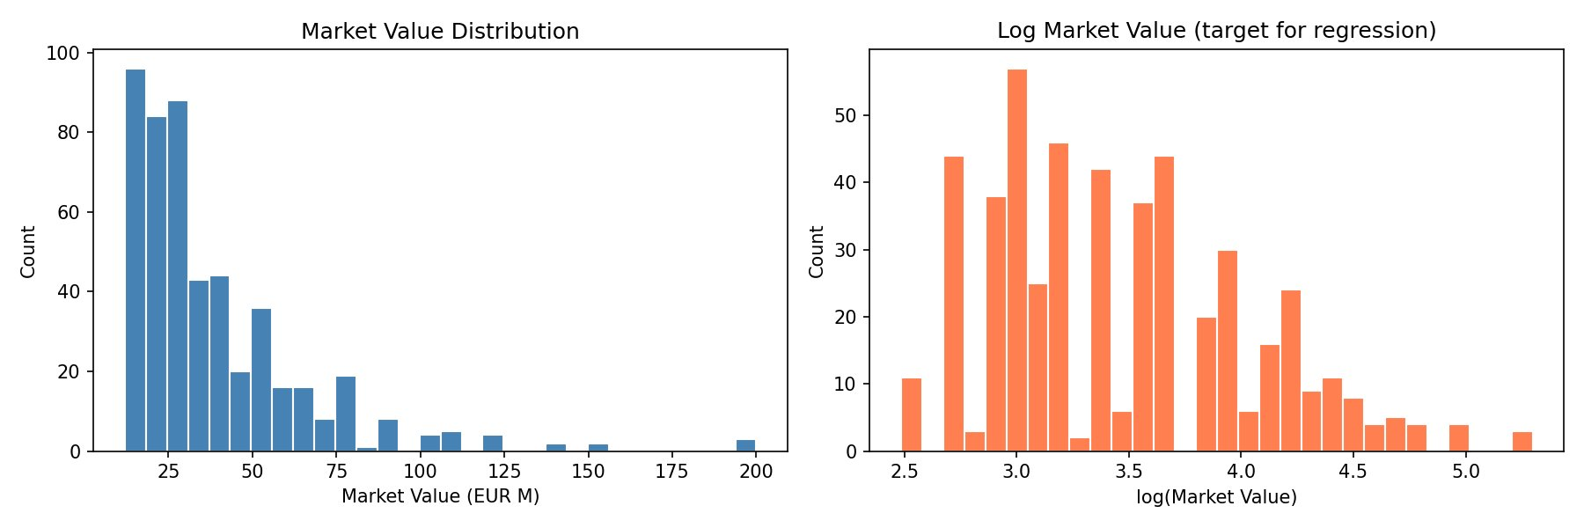
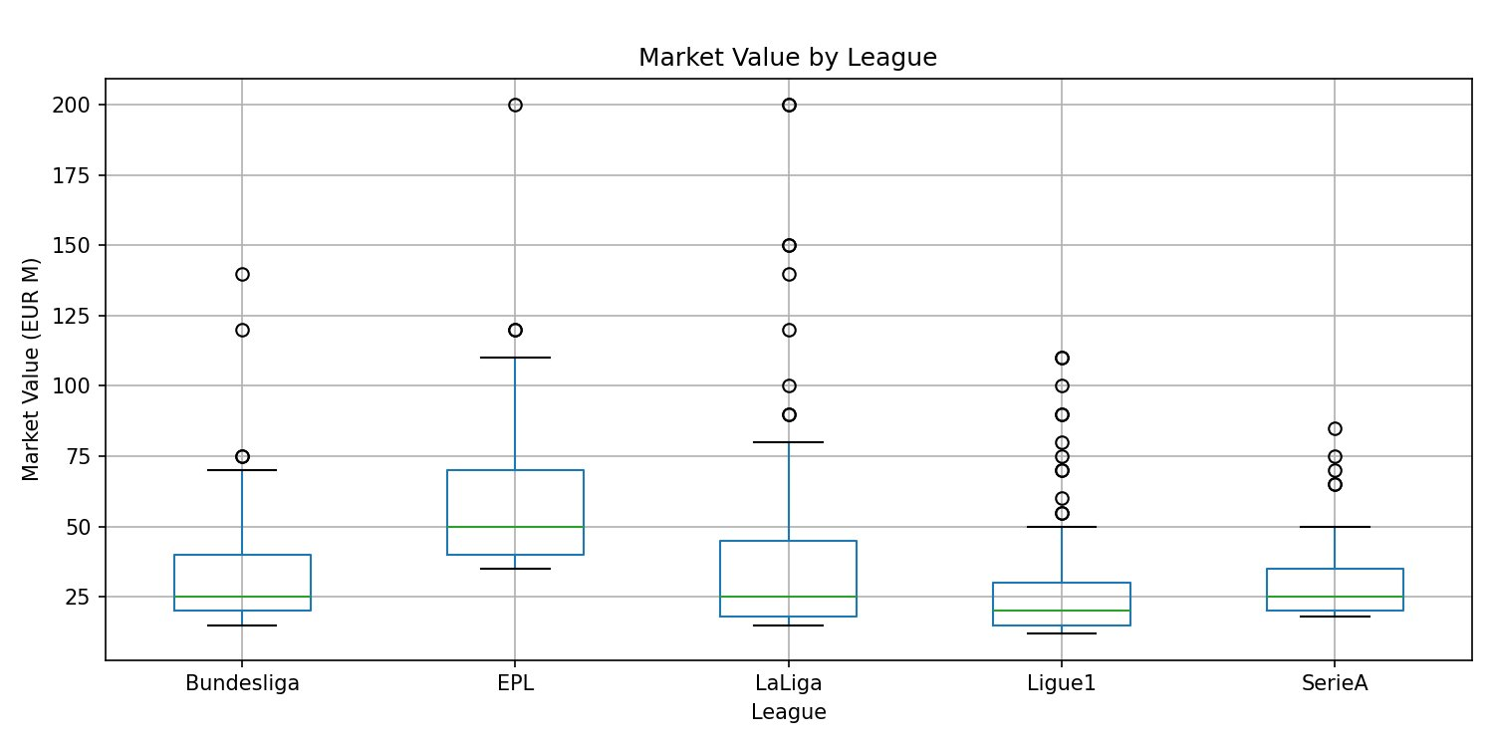
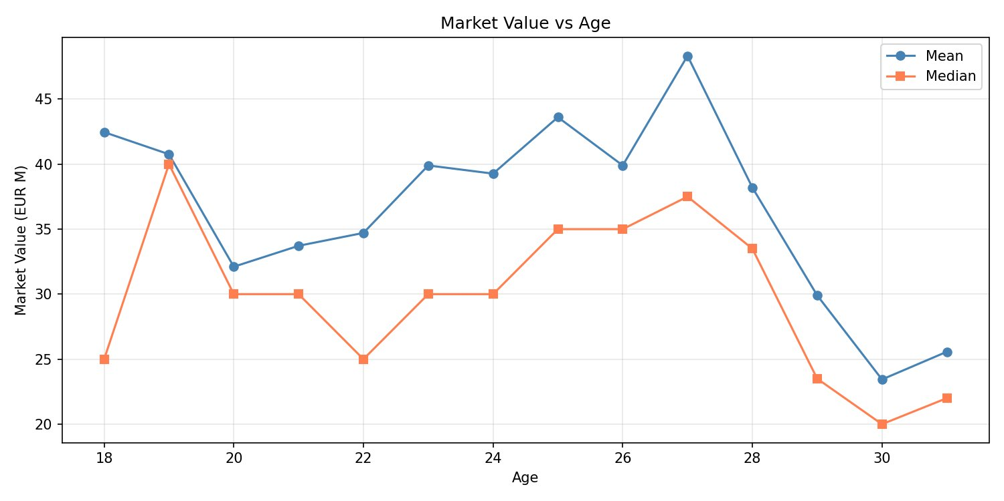
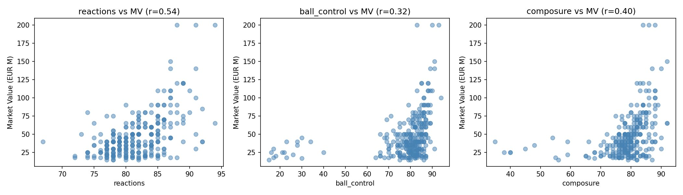
03 · EDA
EDA HIGHLIGHTS
What the data already tells us
Four findings that shape the model: skewed target, EPL premium, age curve, and which FIFA attributes matter.
DISTRIBUTION
Right-skewed → log target
BY LEAGUE
EPL ≈ 2× the other four
AGE CURVE
Peaks at 27, sharp drop after
TOP FIFA FEATURES
Reactions leads at r = 0.54

Slide 5

04 · MODELING
MODELING APPROACH
Build the model, attribute the predictions
Log target with engineered features. Three model families. SHAP attributions on top.
TARGET
FEATURES
log(market_value)
age + age² · position × stats · league dummies · 28 FIFA attrs
Stabilizes the long right tail.
scikit-learn
XGBoost
XGBoost
SHAP
SHAP
ElasticNet · RandomForest
Gradient boosting
Per-prediction
EVAL
FUTURE
RMSE · R² · 5-fold CV · SHAP per prediction
R1 cross-sectional → R2 year-over-year change

Slide 6


05 · APPLICATION
APPLICATION DESIGN
A web app and an API on Cloud Run
Streamlit for the user-facing scouting tool. Flask for a lean prediction API. Both deployed on Cloud Run.
market-value-app · predict
PLAYER
PREDICTED VALUE
TOP DRIVERS
Vinícius Jr. ▾
€142M
Reactions
Age (24)
LEAGUE
EPL/LaLiga
Composure
LaLiga ▾
vs €38M league average
Streamlit web app · the scouting interface above
Flask API · POST /predict returns value + drivers

Slide 7
06 · DELIVERY
ARCHITECTURE & TIMELINE
Pipeline diagram and six-week schedule
From raw scrape to deployed app. Six weeks from baseline to final report.
ARCHITECTURE
SOURCES
SCRAPERS
DATA PIPELINE
ML TRAINING
DEPLOY
Transfermarkt · Sofifa
Python · BeautifulSoup
Clean · join · CSV
scikit-learn · XGBoost
Flask + Streamlit · Cloud Run
TIMELINE
WK 5
WK 6
WK 7
WK 8
WK 9
WK 10
Feature eng.
baseline ElasticNet
Hyperparam
SHAP attribution
Flask API
Streamlit local
Dockerize
Deploy Cloud Run
R2 historical
scraping
Final report
presentation

