Slide 1
STATS418 Proposal Presentation: Portfolio Risk Stress-Tester
Mark Wang
Department of Statistics & Data Science

Slide 2
Motivation
Proposed Application
A large topic of focus in quantitative finance and risk management is the study of options trading. Thus, we are interested in building a system can do the following:
Collect real market data (historical prices, options chains)
Perform EDA to understand market structure
Develop and compare multiple modeling approaches for options pricing
Enable portfolio risk quantification through Value-at-Risk calculations

Slide 3
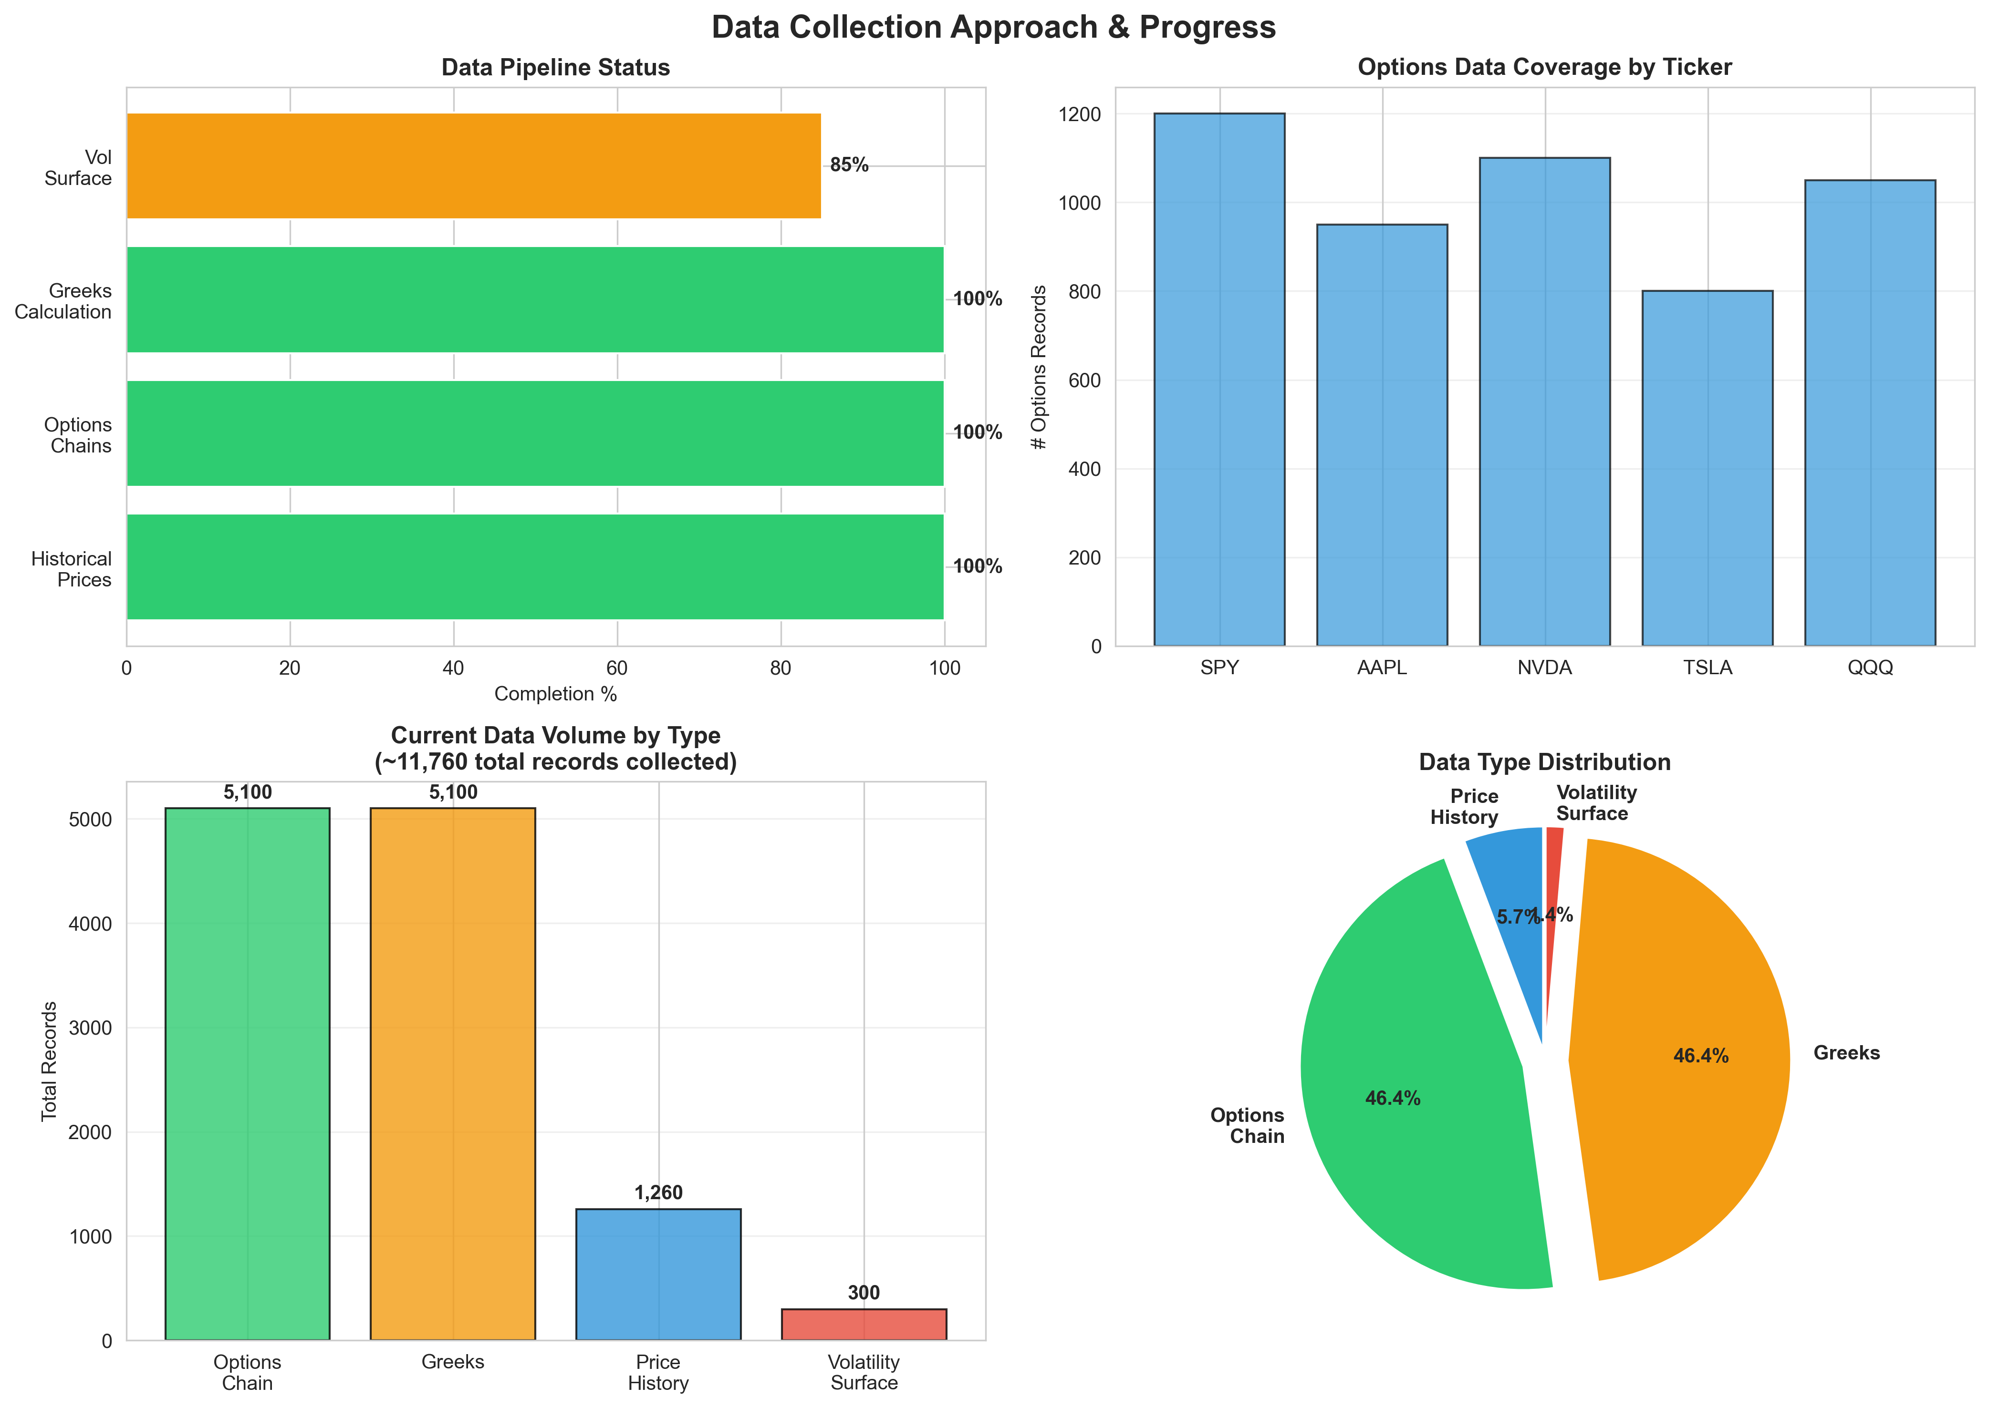
Data Collection Approach & Progress

Slide 4
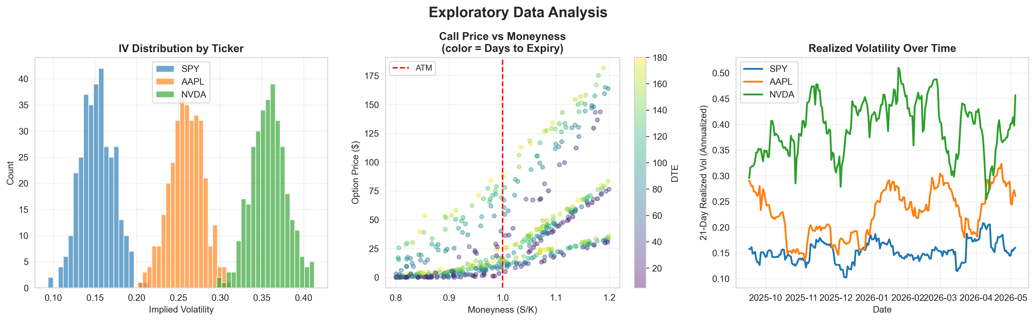
Exploratory Data Analysis

Slide 5
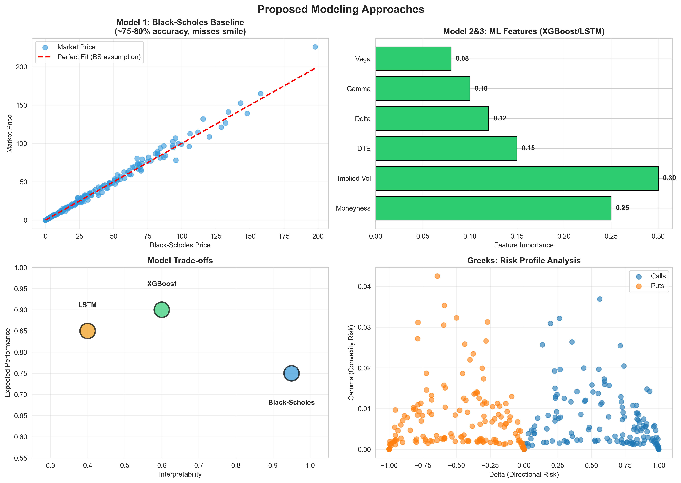
Proposed Modeling Approaches

Slide 6
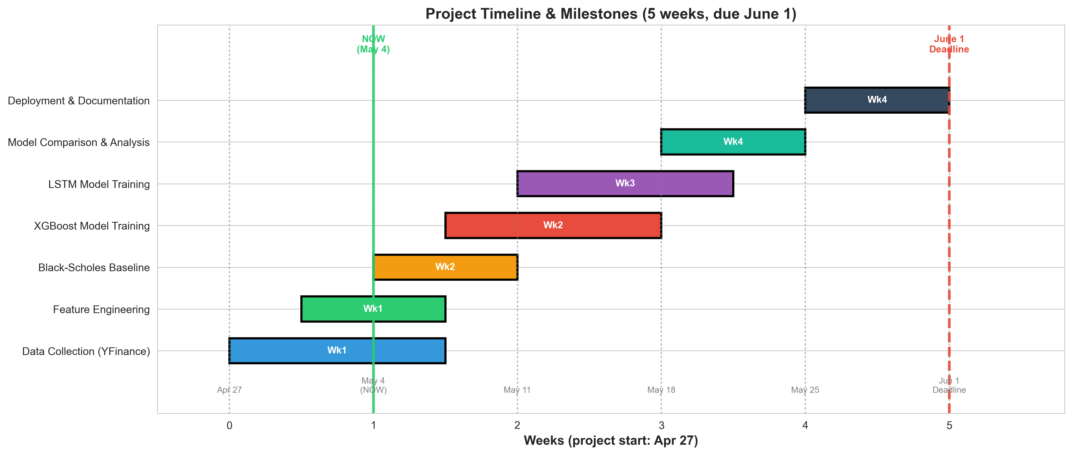
Timeline & Milestones

