Slide 1
Travel Assured Case Study
Nathan Leon Guerrero

Slide 2
Travel Assured Budget Cuts
Due to the COVID-19 pandemic, Travel Assured has had to cut the marketing budget by more than 50%
This presents an issue in being able to produce the previous quality of advertisements Travel Assured created before
Less staff = constrained resources in creating marketing initiatives
It is of the utmost importance that we identify who Travel Assured should target so they can bring profits back to the pre-COVID-19 level

Slide 3
Targeting Potential Customers
To identify the ideal customer, we want to answer the following
What is the typical profile of our customers and non-customers?
Are there differences between customers and non-customers?
How do we approach these questions to identify the right clientele to target?
Target Assured has provided extensive internal data on their clients with multiple attributes
We performed an analysis on these attributes to identify the potential customers based on our business questions

Slide 4
What Is the Profile Of Our Customers?
To analyze this question, we looked at the:
Annual Income
Age of Clients
If they have plans to fly frequently
If they have travelled internationally
Insights gathered:
Many of our customers are between 32 and 35 years old
There is a spike in customers who purchase a travel insurance policy around the $1.2 million or higher income range
Those who plan to fly frequently are more likely to have travel insurance
Those who have travelled abroad before are more likely to have travel insurance

Slide 5
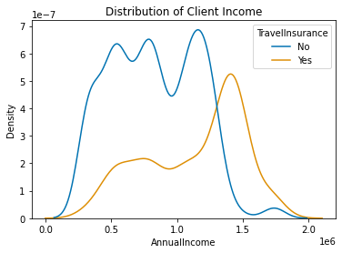
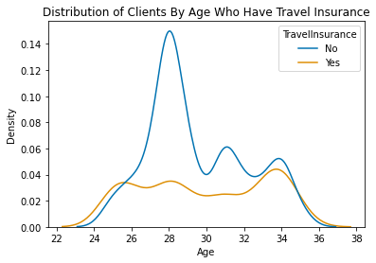
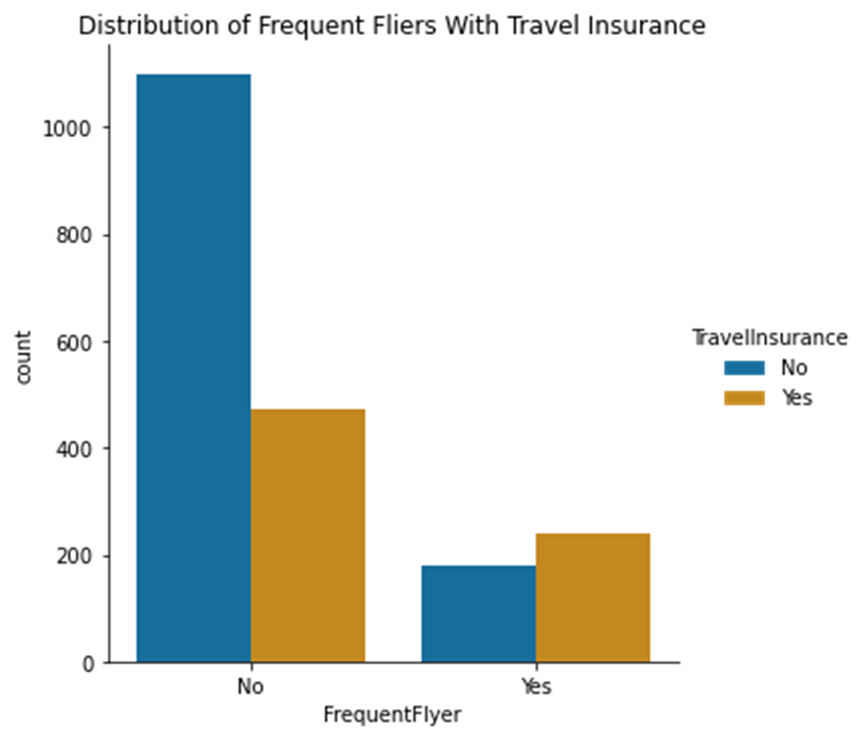
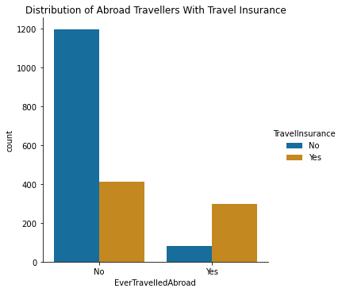

Slide 6
Final Findings
From our analysis, we have been able to identify factors that help us to build a profile of our customers:
Those who have a high income tend to have travel insurance
Many of our customers tend to fall between 32 years of age and 35 years of age
Customers are more likely to fly frequently
Customers are more likely to have travelled abroad before
There is a definitive difference between non-customers and customers
Clients under the age of 30 are less likely to purchase
The lower income clients are less likely to purchase travel insurance
Clients that do not fly frequently are less likely to purchase travel insurance
Clients that have not travelled abroad are less likely to purchase travel insurance

Slide 7
Recommendations
Based on the analysis performed, this is how Target Assured should design their marketing campaign:
Focus more on attracting the clients over 30
Target those who are more affluent/have a high income
Target more to those who fly frequently
Target more to those who have travelled internationally before

