Slide 1
THE ROLE OF LUCK
IN NHL STANDINGS
A Statistical Decomposition of Points Percentage By: Nate Mueller
2025–26 NHL Season
Luck · Expected Goals · Regression Analysis · Outlier Identification

Slide 2
What Is Luck in Hockey
“A puck off a post. A deflection off a skate. A hot goalie for two weeks.”
Hockey Is Compressed
Randomness Is Built In
Luck Is Invisible in Standings
Tiny margins separate playoff teams from the basement. 1-2 points separates playoff and non playoff teams
One lucky bounce can swing a tight game — and tight games decide standings.
The final standings show wins and losses, not whether those wins were earned.

Slide 3
The Question
Are the Standings Telling the Truth?
Bad & Lucky
Good & Lucky
In any sport, results don't always reflect reality. Some teams look great because they're great. Others look good because they've been lucky.
Lucky but fragile
Results exceed process
Bad & Unlucky
Good & Unlucky
Process AND results poor
Process exceeds results
← Bad Quality Good Quality →

Slide 4
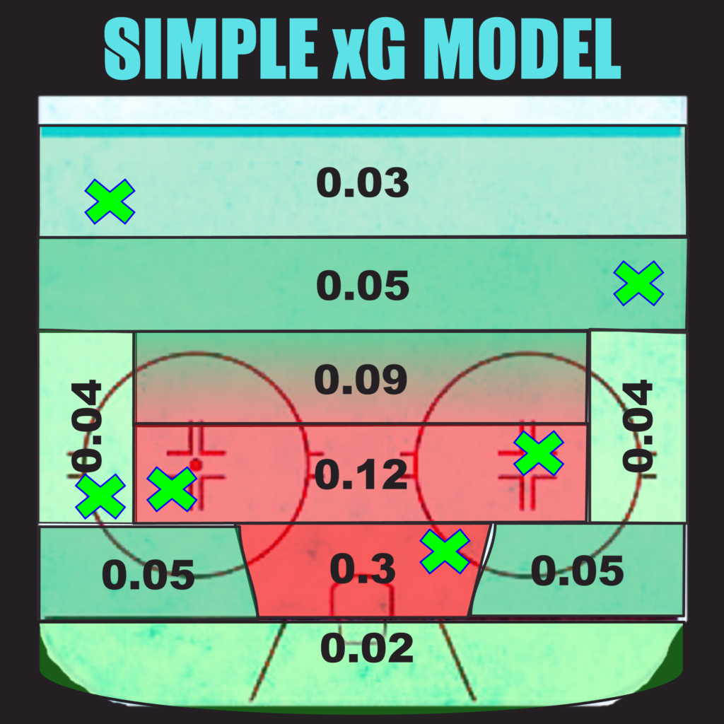
Why Is Luck So Hard to Isolate?
The Challenge
Solution: Expected Goals
PDO (Sh% + Sv%) captures both but cannot differentiate the luck and skill
xG models assign a probability to every unblocked shot based on:
82 games is not enough to fully regress luck away
A team can be genuinely bad AND unlucky or genuinely good AND lucky
Deviation from xG = Luck (+ goaltending + shooting talent)

Slide 5
VARIABLES
The Metrics That Matter
xGF / xGA
Pythagorean Win%
Expected goals for/against — shot quality-based model of goals a team should score or allow.
Expected win rate from actual goal differential — shows if a team over- or underperformed their goal outcomes.
xGDiff
aGF / aGA
xGF minus xGA. The primary quality signal: how dominant is a team at generating and suppressing chances?
Number of goals scored and given up by a team
PDO
Shooting % + save %. Regresses to 100 over time. Sustained outliers = luck signal.
Net Luck
(GF − xGF) − (GA − xGA). Positive = team has benefited from luck. Negative = unlucky.

Slide 6
METHODOLOGY
Four Models
Each model tests a different predictor of standings points (PTS%)
01
02
03
04
Net Luck vs PTS%
xGDiff vs PTS%
PDO vs Net Luck
Pythagorean Pts% -
xGDiff Pythagorean Pts%
R² = 0.23
R² = 0.50
R² = 0.84
Average = 11.1%
Luck alone is real but a weak indicator of wins
Quality of play is a stronger signal
Luck is beyond just better shooters and goalies
Goal outcomes vs Expected
In a different perspective
Key Insight: Luck is real, potentially measurable, and significant in tight playoff races and standings.

Slide 7
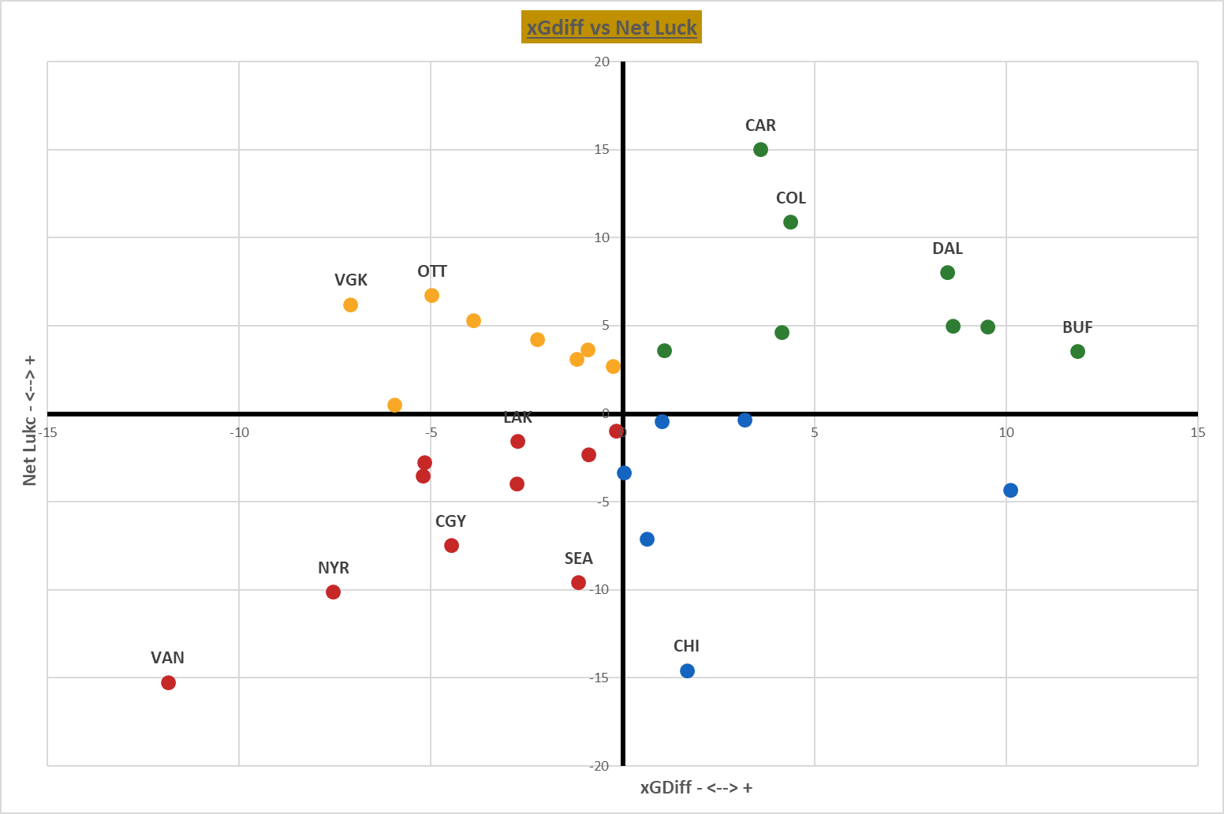
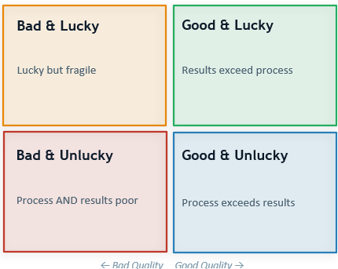
RESULTS
The 2×2 Framework: Quality vs Luck
Every team mapped across both dimensions simultaneously
Horizontal axis = xGDiff (quality) | Vertical axis = Net Luck | Quadrant = team classification

Slide 8
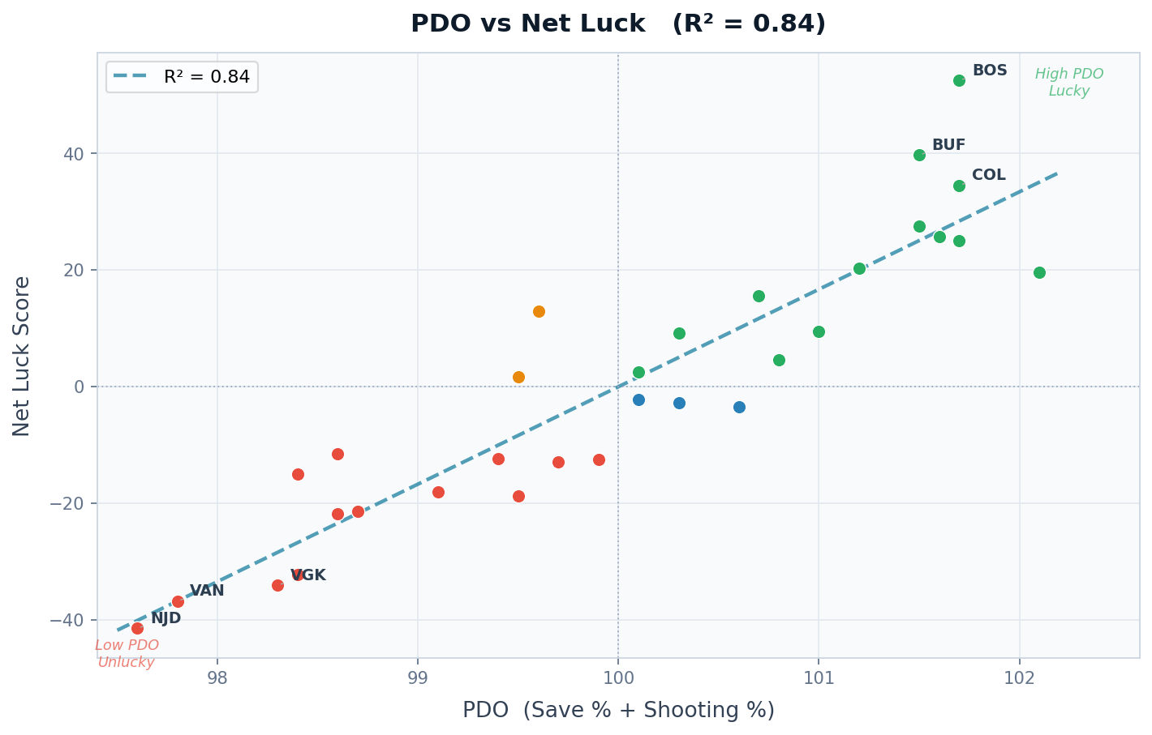
Results
PDO as a Luck Indicator
PDO (save % + shooting %) explains 84% of Net Luck variance — the clearest real-time luck signal
PDO regresses towards net 100
According to Jfresh examination of PDO
Teams closer to the line are truer to their skill
NL > Expected
Teams above average in combined shooting + save % accumulate positive Net Luck
NL < Expected
Teams below average tend to rack up negative luck — goals against expectations
Regression
PDO is the most mean-reverting stat in hockey. High PDO now = lower PDO soon
R² = 0.84 — PDO explains 84% of Net Luck variance | Data: NHL 2024–25

Slide 9
Expected Gdiff Pythagorean Pts%
Pts% = xGF^2 / (xGF^2 + xGA^2) | R^2 = 0.489 | Std Error = 5.74
Pts % = aGF^2 / (aGF^2 + aGA^2) | R^2 = .704 | Std Error = 4.09
What This Tells Us
By using xGDiff Pythag Pts% we account for chances generated.
The difference between the actual and predicted can be attributed to over/under performing or Luck
Using this model from class we have another perspective on how luck and skill have played a factor for these 10 teams.

Slide 10
Identifying Lucky & Unlucky Teams: A 4-Model Composite Framework
Methodology: Combining 4 Models
Results: Top 5 Luckiest vs Top 5 Unluckiest
Why four models?
LUCKIEST
UNLUCKIEST
No single metric captures luck perfectly. Each model isolates a different dimension of over/underperformance, and combining them cancels out noise from any one view.
#
Team
Score
#
Team
Score
1
Buffalo Sabres
+27
1
Vancouver Canucks
−29
PTS% ~ Net Luck
2
Boston Bruins
2
New York Rangers
1
R² = 0.23
+25
−23
How standings points compare to expected-goal luck (shooting + goaltending variance).
3
Colorado Avalanche
3
St. Louis Blues
+22
−13
PTS% ~ xGDiff
4
Carolina Hurricanes
4
Vegas Golden Knights
2
R² = 0.50
+19
−12
How standings points compare to underlying expected-goal differential (play-driving quality).
5
Montreal Canadiens
+17
5
Utah Mammoth
−11
PyThagWin% − XGDiffPythag
3
Direct diff
Scoring
Gap between actual goal-based Pythagorean win% and expected-goal-based Pythagorean win%.
For each model, rank all 32 teams by residual. Top 10 earn 1–10 'Lucky Points' (rank 1 = 10 pts). Bottom 10 earn 1–10 'Unlucky Points'. A team's Grand Total = Σ Lucky − Σ Unlucky across all 4 models. Consistent over/underperformers rise to the top.
Net Luck ~ PDO
4
R² = 0.84
How net luck tracks with PDO (shooting% + save%). Strongest fit — PDO is the purest luck proxy.
Interpretation:
Buffalo and Boston are overperforming their underlying play across every lens — expect regression. Vancouver and NY Rangers are underperforming badly — their records understate their true quality.

Slide 11
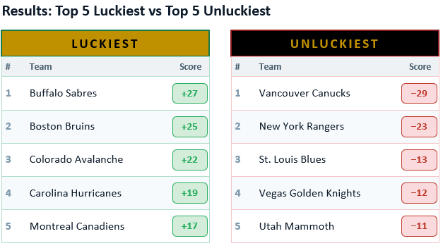

Slide 12
Further Analysis?
Drawbacks
Further Analysis
Goaltending skill and goaltending luck look identical in the standings
Shooting percentage varies with player talent AND with random bounces
To explore further I would first gather and incorporate special-teams statistics
I would also explore strength of schedule
Using player specific data to determine a player's luck
The data does not account for special-teams. (PP and PK)

